Slide 1
Systematic Uncertainties
Vipuli Dharmawardane (NMSU)
CNI meeting
Sep 11th 2008

Slide 2
Uncertainties due to polarization profile
Same approach as run 6
L_{max} determination < 0.2%
Scan is not continuous → We may miss the maximum
Target vibrations (flat profiles) <1%
Simulations done by Sasha → Uncertainty is negligible
Assumption that the profiles are Gaussian < 0.5%
R distributions for vertical/horizontal profile
●Studied the variation in R
●For Blue we have both vertical and horizontal scans
●For Yellow we only have horizontal scans
TOTAL < ≈ 1.1%
RUN 8
SPECIFIC

Slide 3
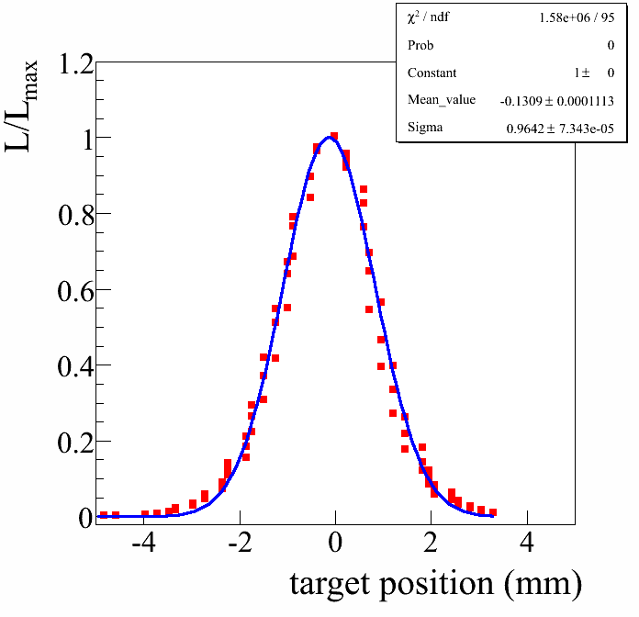
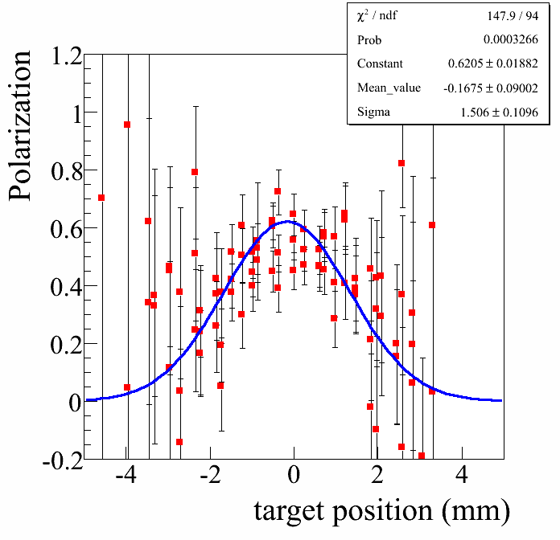
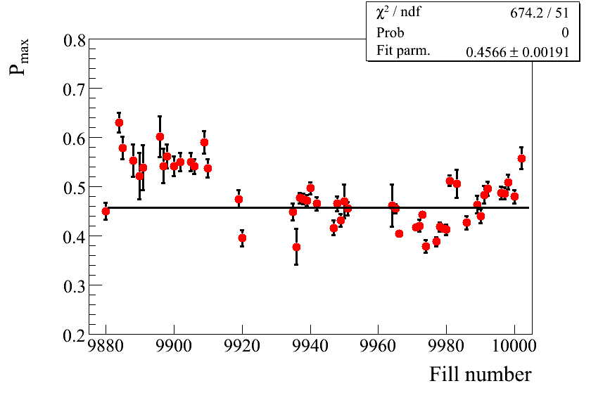
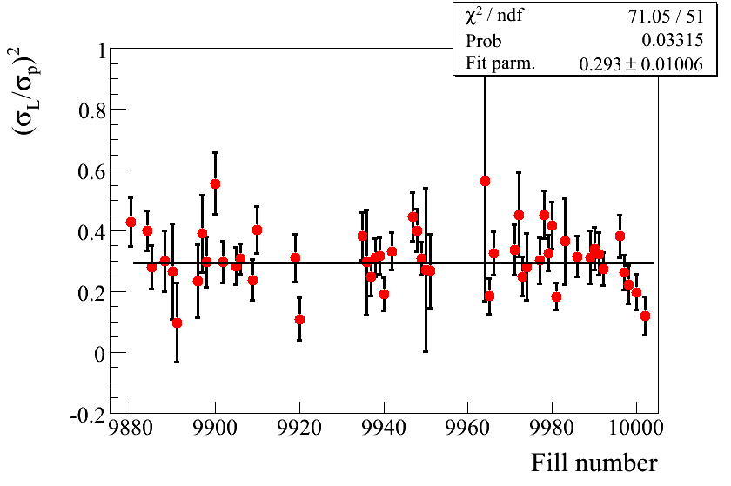
Polarization Profile : YELLOW
HORIZONTAL SCANS

Slide 4
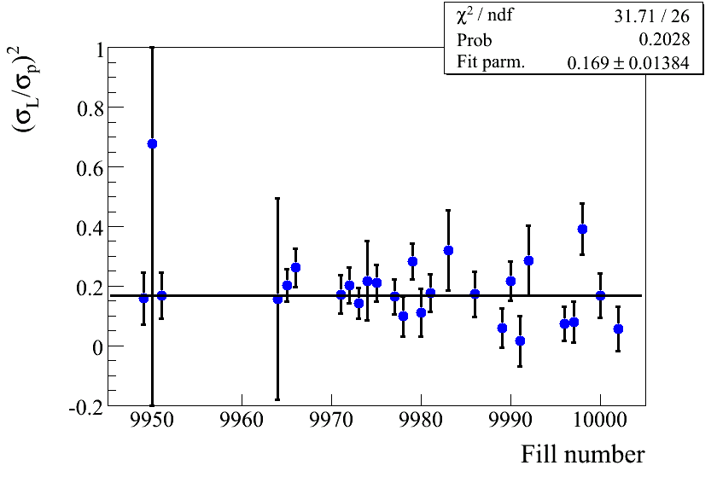
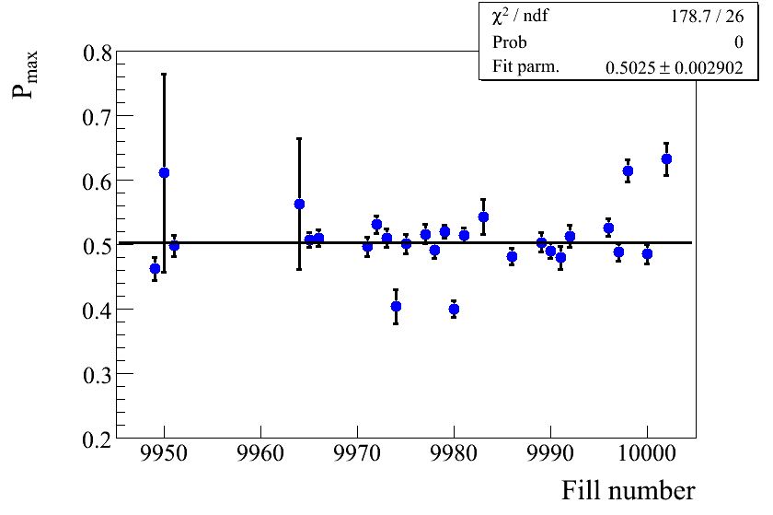
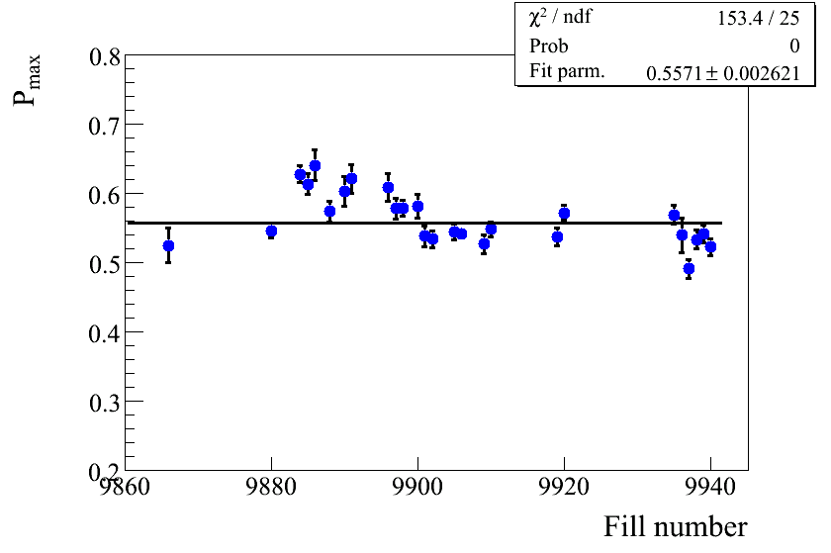
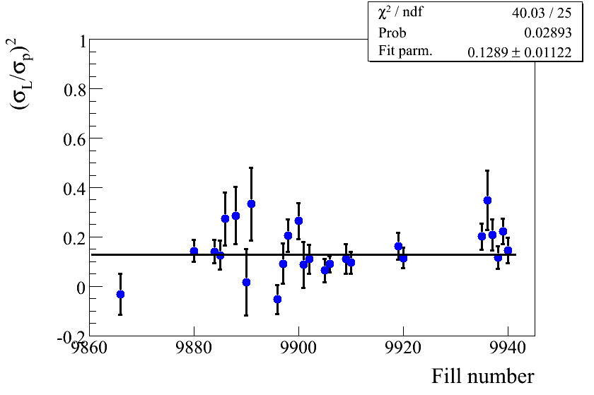
Polarization Profile : BLUE
VERTICAL SCANS
HORIZONTAL SCANS

Slide 5
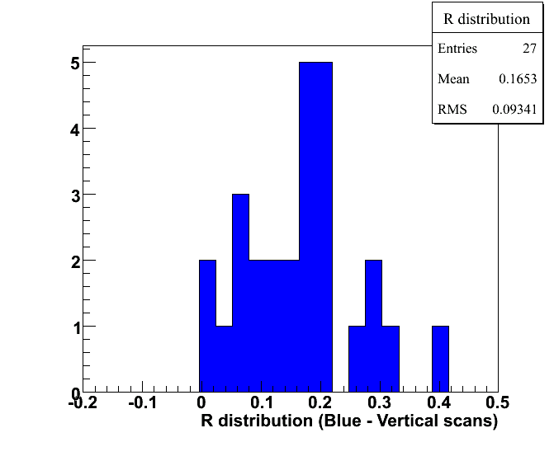
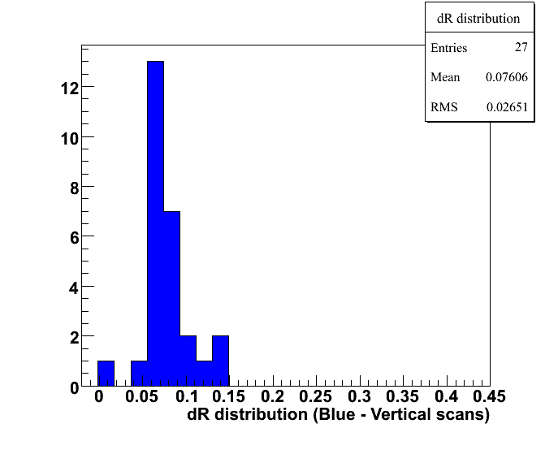
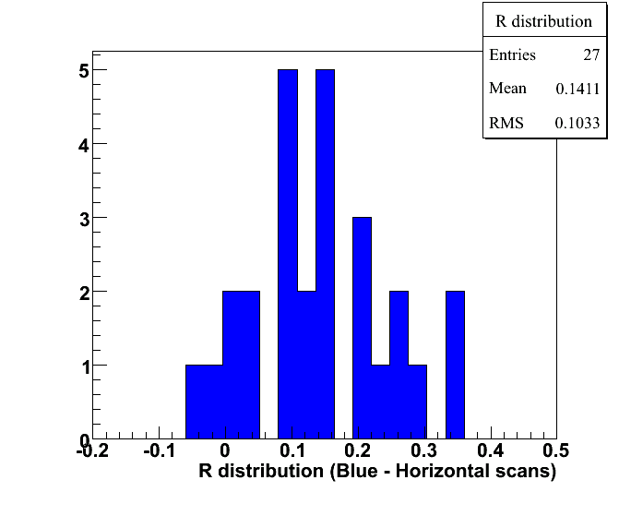
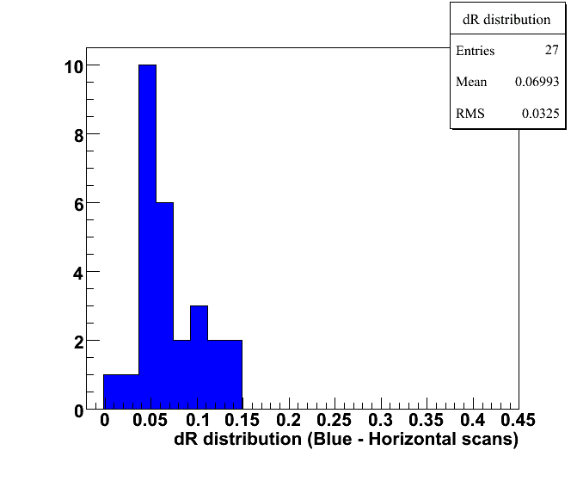
Uncertainties due to polarization profile -Blue
R distribution
δR distribution
Global uncertainty is zero → R is known for both vertical and horizontal scans
Vertical Scans
R →0.07-0.26
Horizontal Scans
R→0.04-0.24
On average
0.15±0.11

Slide 6
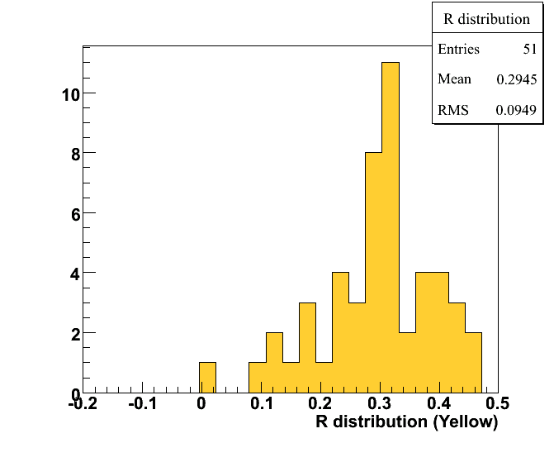
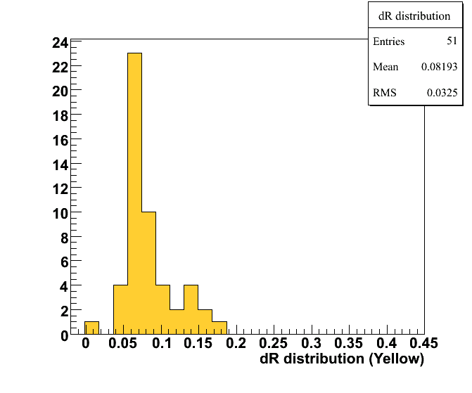
Uncertainties due to polarization profile -Yellow
R distribution
δR distribution
Horizontal Scans
R→0.20-0.39
No vertical scans for Yellow
Assume 0-0.39 variation in R ?
Fill uncertainty R ≈ 0.08

Slide 7
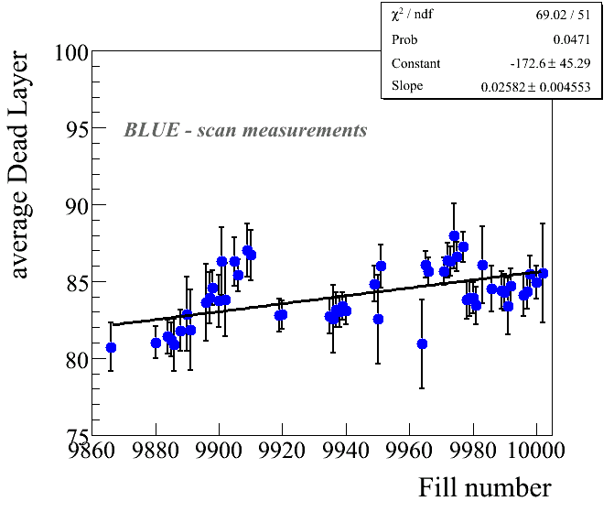
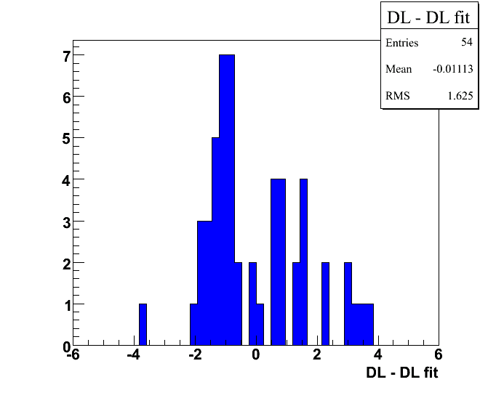
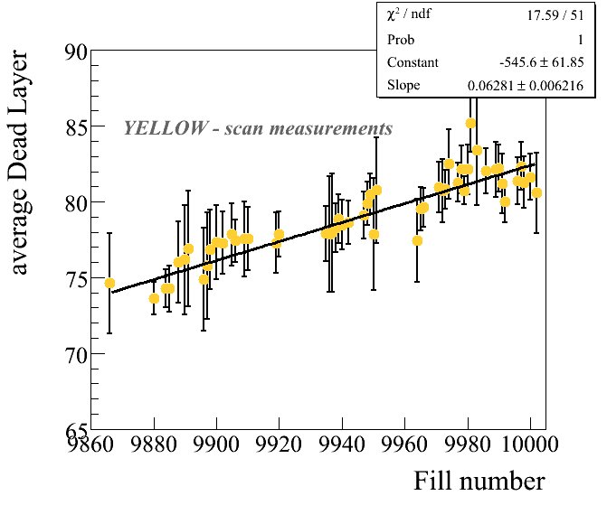
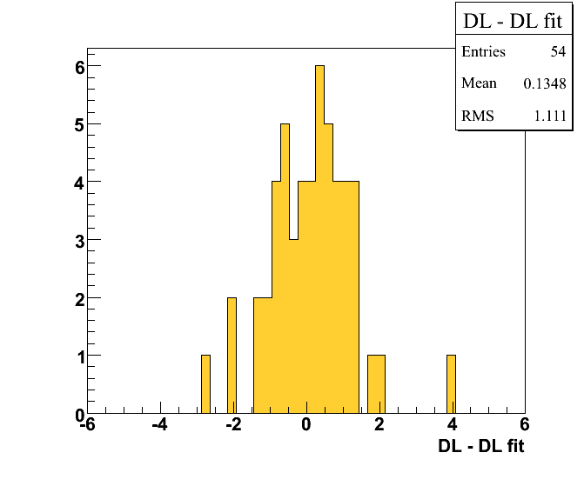
Uncertainty due to Dead Layer
Fill to fill uncertainty
Fill uncertainty
1.6*0.6 ≈ 1%
Dead layer variation
within ±3 μg/cm²
Polarization ±1.8%
Dead layer variation
within ±4 μg/cm²
Polarization ±2.5%
Fill uncertainty
1.1*0.6 ≈ 0.7%

Slide 8
Uncertainties : Summary
Fill to fill uncertainties
Horizontal/Vertical profile 3.0% 4.5%
Energy correction/dead layer 1.0% 0.7%
Global uncertainties
Jet normalization, stat
Jet normalization (profile) 1.1% 1.1%
Jet normalization, systematic uncert.
Pol. Profile (for experiments) 0.0% ??
Energy correction/deal layer 1.8% 2.5%

Slide 9
OTHER PLOTS

Slide 10
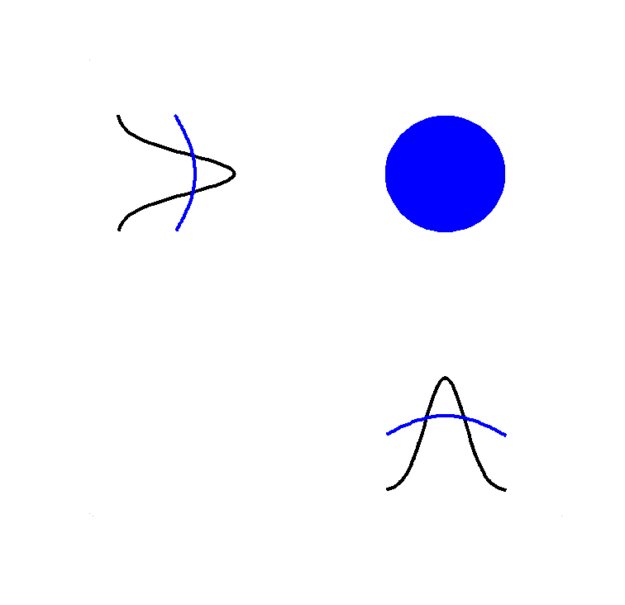
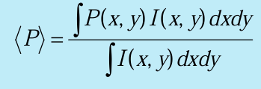
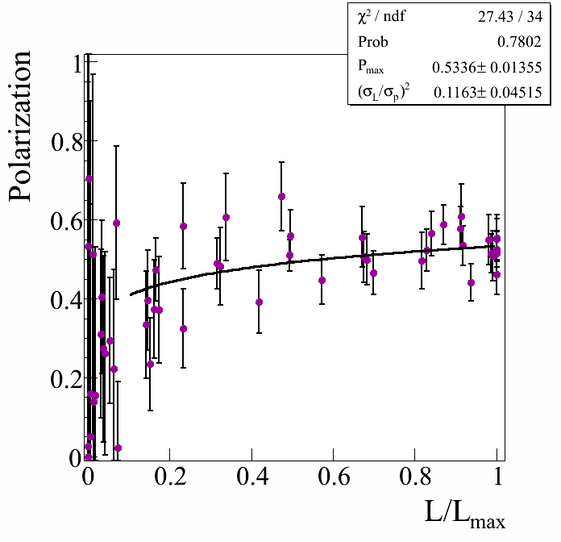
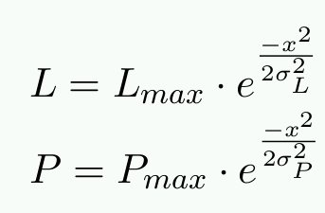
Polarization Profile
VERTICAL / HORIZONTAL
SCANS
A fit to P Vs L/L_{max} to determine P_{max} and σ_{L}/σ_{P}
Intensity/
Polarization
profile
Fixed target measurements
P_{max}

Slide 11
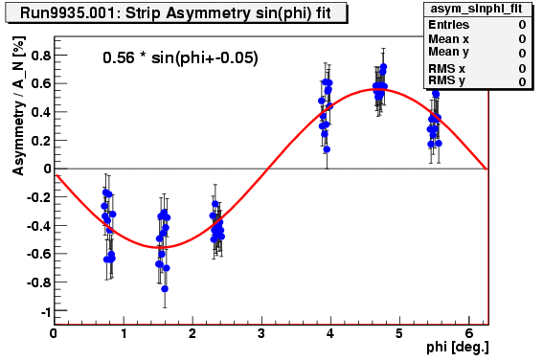
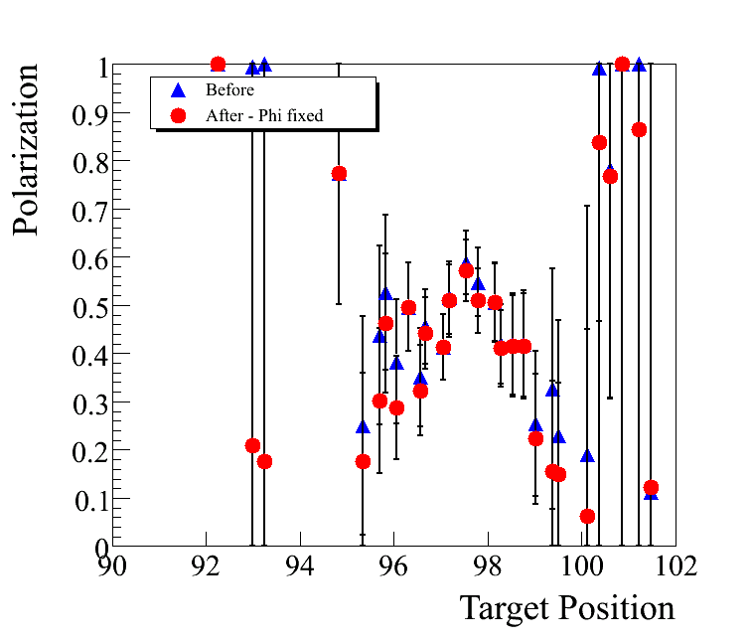
Polarization Profile
RUN08
Φ₀ was kept fixed at average Φ₀
Polarization for each target position is determined by doing a sin phi fit to asymmetry Vs phi measured at each target position

Slide 12
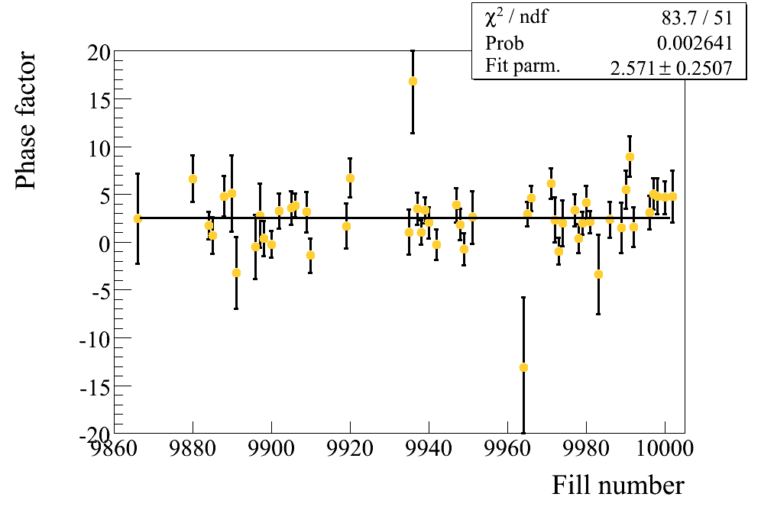
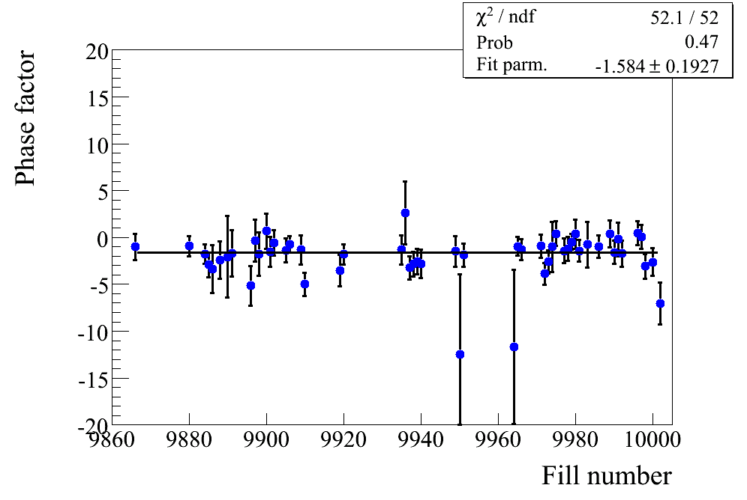
Polarization Profile
RUN08
Φ₀ was kept fixed at average Φ₀
Φ₀ YELLOW
Φ₀ BLUE

Slide 13
NORMALIZATION TO HJET
PERIOD | pC average | pC/HJet
All | 39.59± 0.39 | 1.091± 0.035
1 | 41.00 ±0.61 | 1.045± 0.054
2 | 38.16± 0.73 | 1.124± 0.069
3 | 39.55± 0.69 | 1.110± 0.062
Golden runs
1.101±0.053
OK runs
1.078±0.048
Golden runs
1.086±0.082
OK runs
1.051±0.031
PERIOD | pC average | pC/HJet
ALL | 47.96 ±0.53 | 1.062± 0.029
1 | 52.02± 0.65 | 1.086± 0.055
3 | 47.02± 0.74 | 1.090± 0.044
4 | 47.80± 1.38 | 0.982± 0.057
Run 5 ≈ 1.01 Run 6 ≈ 1.15

Slide 14
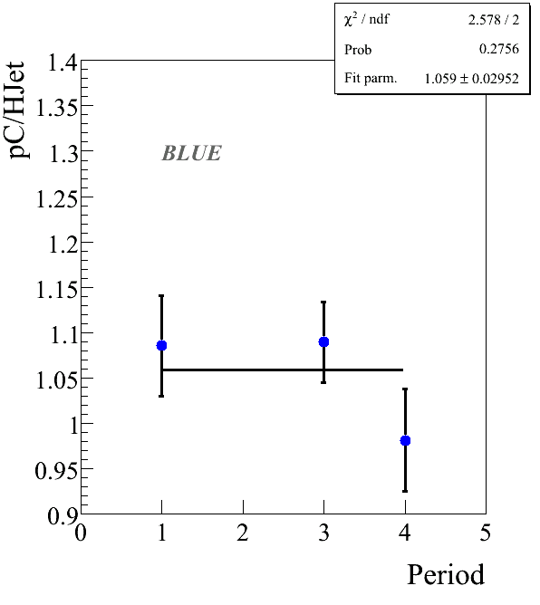
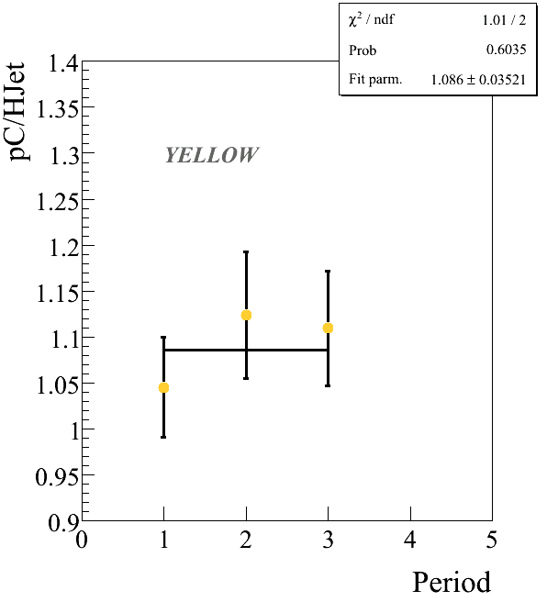
NORMALIZATION TO HJET

Slide 15
BACKUP SLIDES

Slide 16
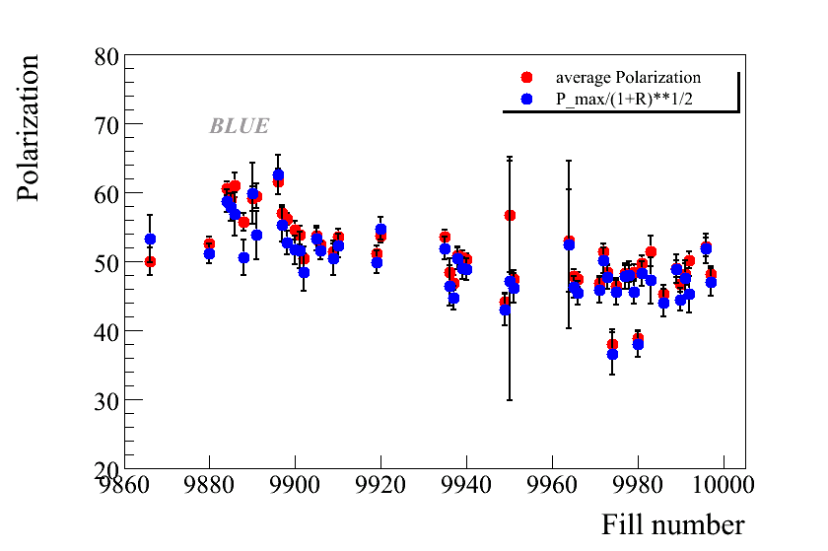
Polarization : BLUE

Slide 17
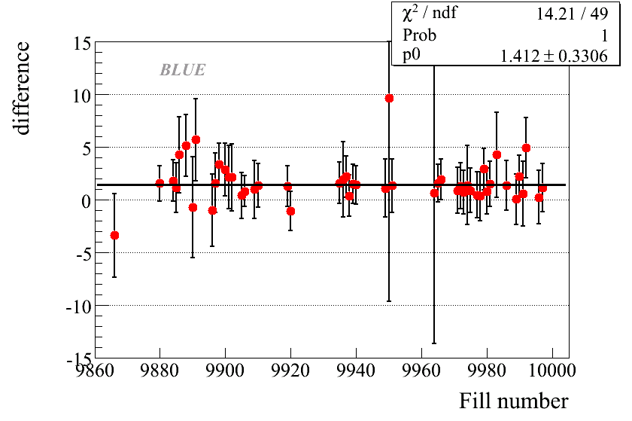
Polarization : BLUE

Slide 18
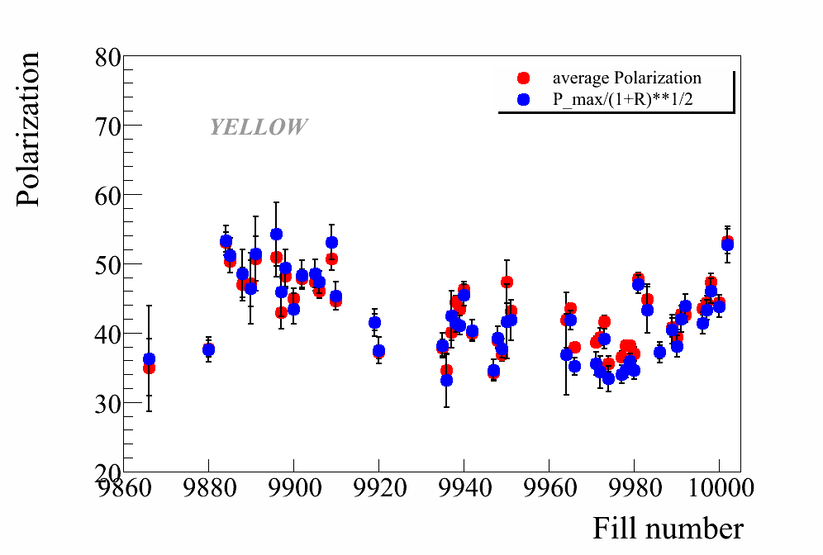
Polarization : YELLOW

Slide 19
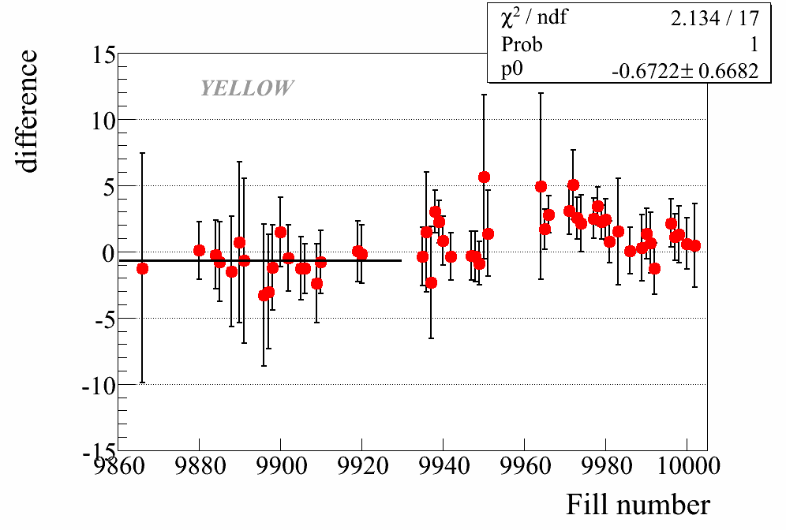
Polarization : YELLOW

Slide 20
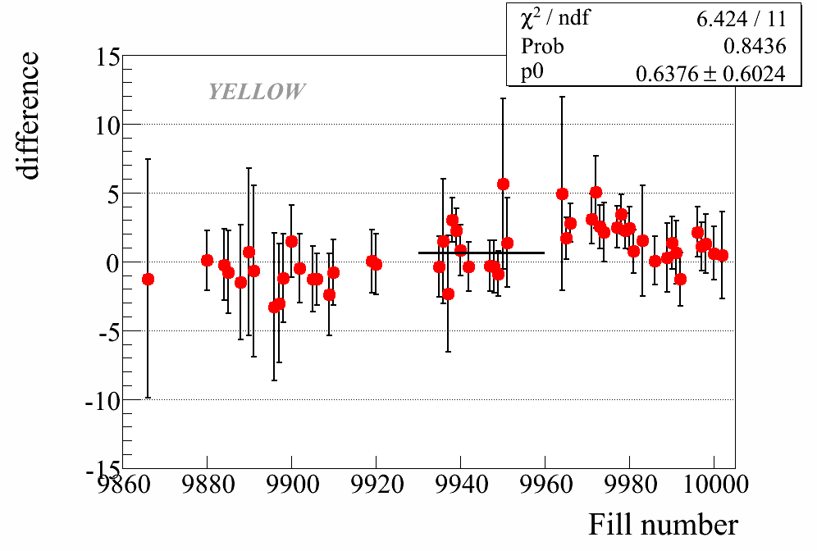
Polarization : YELLOW

Slide 21
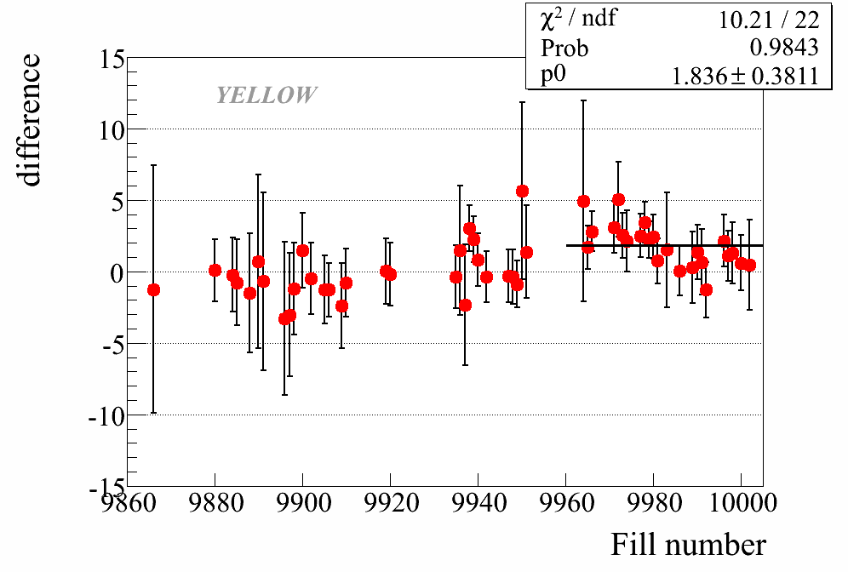
Polarization : YELLOW

