Slide 1

NOAA – National Weather Service
Alaska Region
Shift Leaders Workshop
Aviation Brief
Duane Carpenter
Regional Aviation Meteorologist

Slide 2
Topics
Site Specific TAF Amendment Criteria (SSTAC)
Alaska IC4D Update

Slide 3
Site Specific TAF Amendment Criteria
Three Important Concepts
Ceiling and visibility tailored to meet specific airport requirements
Ceiling and visibility grouped together into categories to match FAA regulatory requirements
TEMPO groups checked immediately against METARs alerting forecasters of resulting customer impacts

Slide 4
SSTAC Requirements
Standard NWSI 10-813 amendment criteria assumes all airports have the same thresholds:
Airfield Mins: 200’ – 1/2SM
Alternate Mins: 600’ – 2SM (precision approach)
SSTAC amendment criteria allows airport specific thresholds to be used, for example:
Airfield Mins: 400’ – 1SM
Alternate Mins: 800’ – 2SM (non-precision approach)
RESULT: Better customer service via meaningful amendments

Slide 5
Categories = Lowest Controlling Element
Using SSTAC, the lowest element is considered “controlling” for amendment purposes.
Example:
Airfield minimums 200’ – 1/2SM
TAF and metar both 100’ – 1/4SM
Special increases ceiling to 300’ visibility remains the same
Current version of AVNFPS – Alert for ceiling amendment. Forecaster prompted to amend.
SSTAC version of AVNFPS – No out of category alert. No forecaster action required because visibility is the lowest “controlling element”
RESULT : Eliminated non-essential amendment, saving valuable forecaster time

Slide 6
Improved TEMPO Monitoring
Immediate notification to non-verify flight planning restriction(s) imposed by the TAF
Better situational awareness alerting
Reduction in the overuse of TEMPO groups
Quicker reaction to customers needs through timely amendments reducing costs and possible flight delays

Slide 7
Total Amendments For All Sites – WFO Fairbanks
Old vs. SSTAC
Average % DECREASE for all Months = 23%
Old averages are from 2003 through April 2006. SSTAC averages are between May 2006 when the program was implemented through May 2008
Notes:
Old averages are from 2003 through April 2006. SSTAC averages are between May 2006 when the program was implemented through May 2008.
Average number per year = 9123, new per year = 7021.
Amendments have been reduced, and more importantly are now being accomplished for elements we know add value to our customers. This is also being accomplished with TEMPO groups alerting forecasters immediately for lowering category conditions which are not verifying. The result here is a more responsive product for all customers.

Slide 8
Customer Feedback
Evert’s Air Cargo – “Terminal forecast amendments are more responsive now than in the past. As a result, flight delays have been reduced.” -- Don Heckert, Director of Operations
Warbelow’s Air Venture – “Our pilots used to complain a lot about the TAFs, this has not been the case over the last year.” “We are impressed that your forecaster are directly notified of the forecast impact to our operations.” -- Mike Morgan, Director of Operations
Alaska Airlines Dispatch - “If we are not calling your office about the TAFs your doing good…..we call other offices on a regular basis”

Slide 9
Alaska Region Schedule
Currently installed and working at WFO Fairbanks
Next at WFOs Juneau and Anchorage
Required to be in place by end of September 2008, according to the regional Annual Operating Plan
ESSD setting the goal for August 15, 2008 for complete implementation

Slide 10
Alaska IC4D Demonstration Update
Background Information
Current Status
Output and Sample Graphics
Integration with WFO Operations

Slide 11
Background
Important past events
Phase I December 2007 (initial deployment)
Phase II May 2008
Forecast Icing Potential (FIP) / Forecast Icing Severity (FIS)
Graphical Turbulence Guidance (GTG)
Who has been involved in the discussion
Alaska and Pacific Regions
Alaska Aviation Weather Unit
OCWWS, Aviation Services Branch
OST, Meteorological Development Laboratory
University Corporation for Atmospheric Research

Slide 12
Current Status at the AAWU
Software and operational evaluation
Spatial and temporal adjustment of derived model fields
Adjusting model parameter weights as input into the Turbulence/Icing algorithms
Evaluation of aviation specific guidance
GTG
FIP/FIS
SREF ceiling and visibility
Freezing levels and cloud tops
PUFF model guidance

Slide 13
Results and Benefits
Leading automated verification
Brings AAWU into gridded digital forecast era
Advances NOAA’s NWS Aviation Program
Addresses JPDO-NextGen 4D Cube goals
Meets aviation users requirements
Allows grid collaboration across NWS

Slide 14
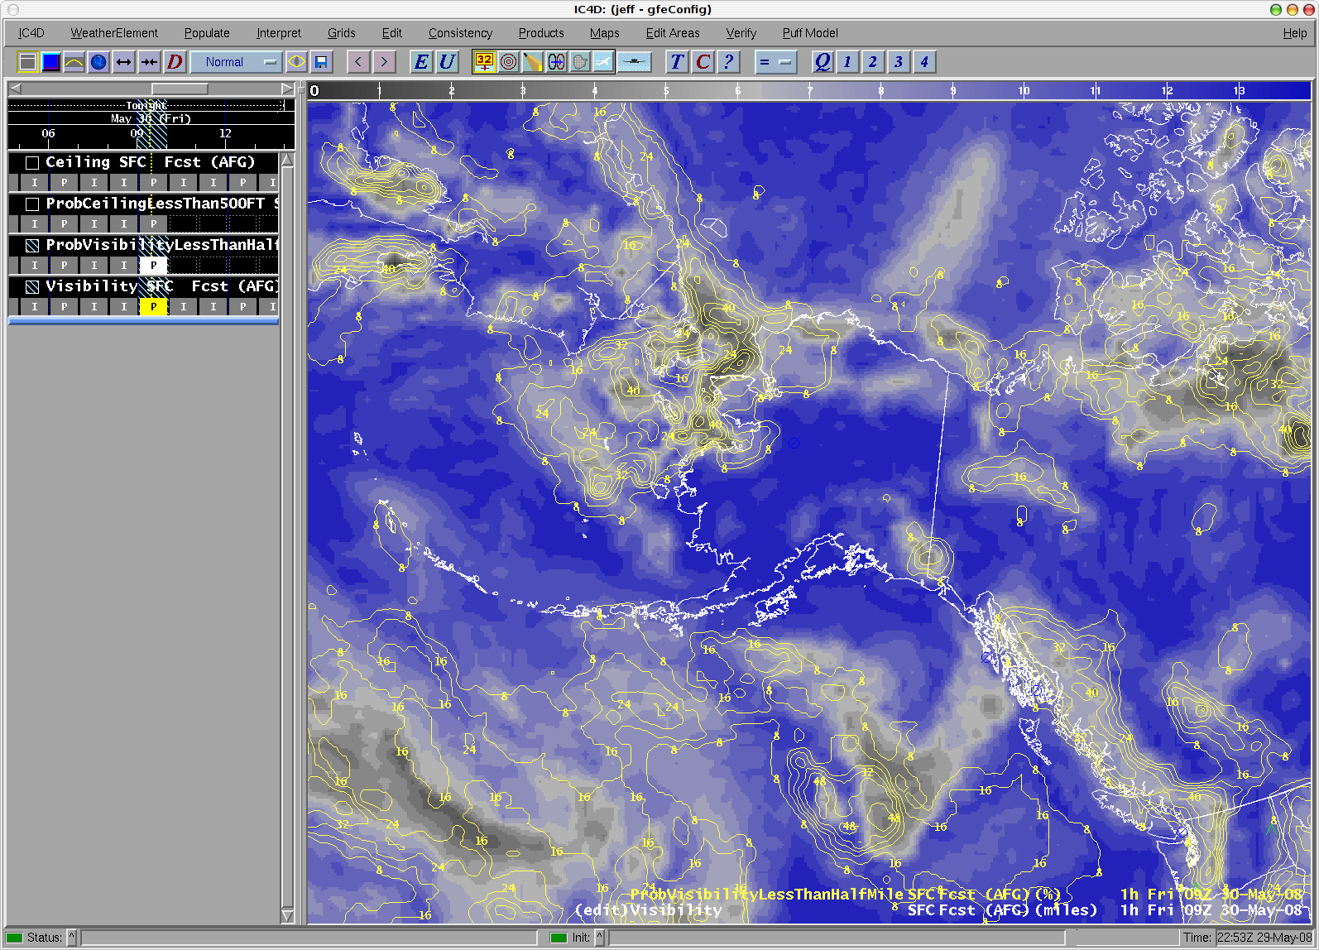
SREF Visibility

Slide 15
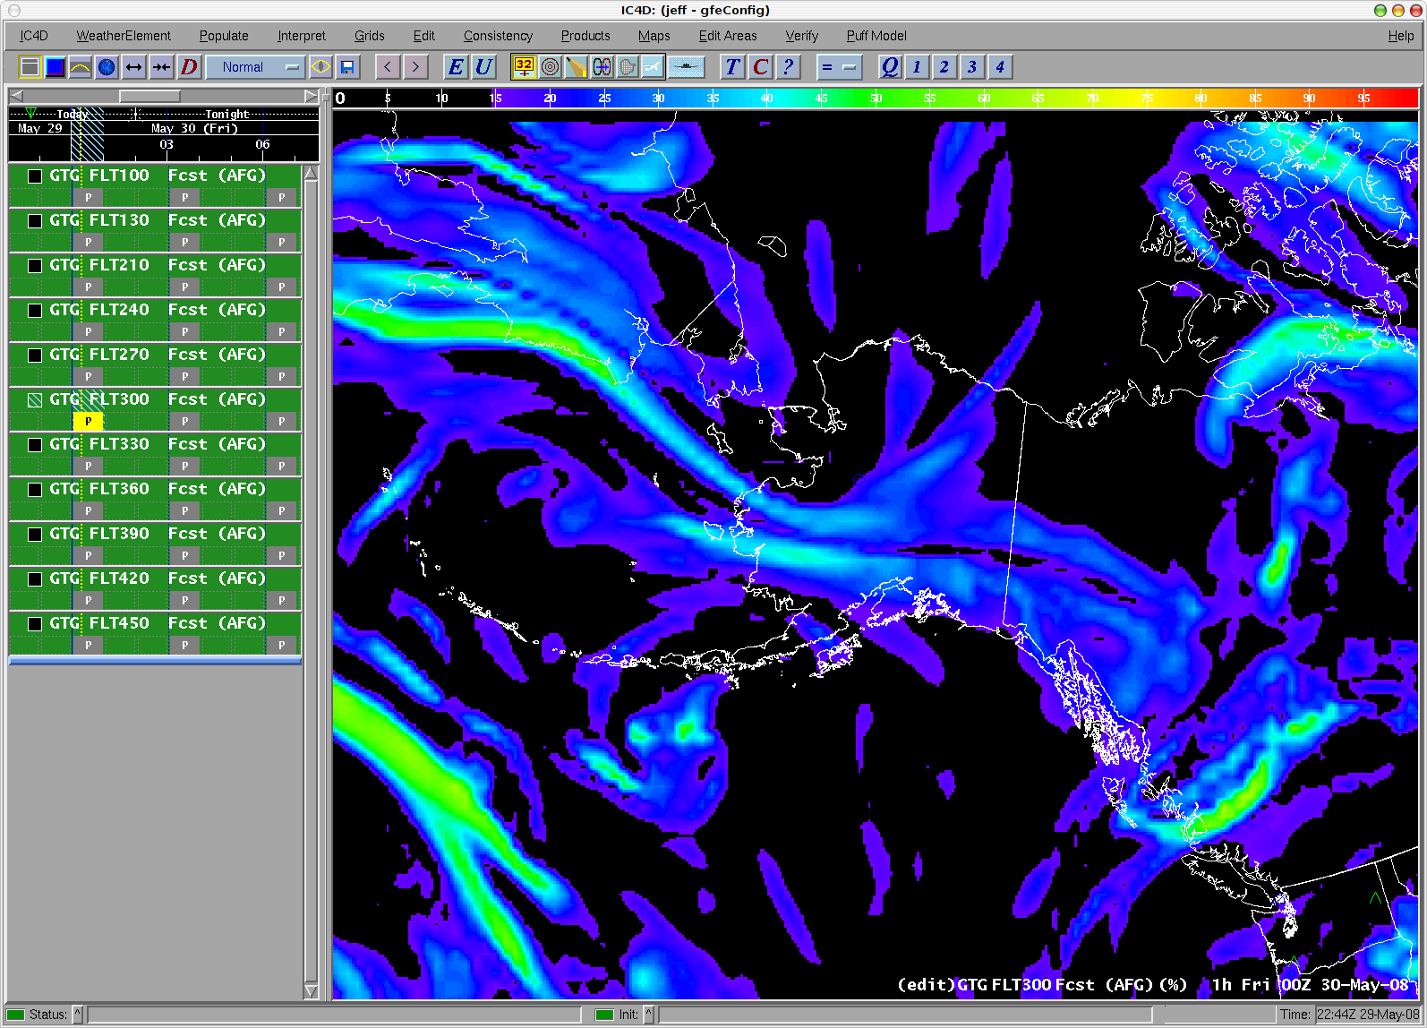
GTG

Slide 16
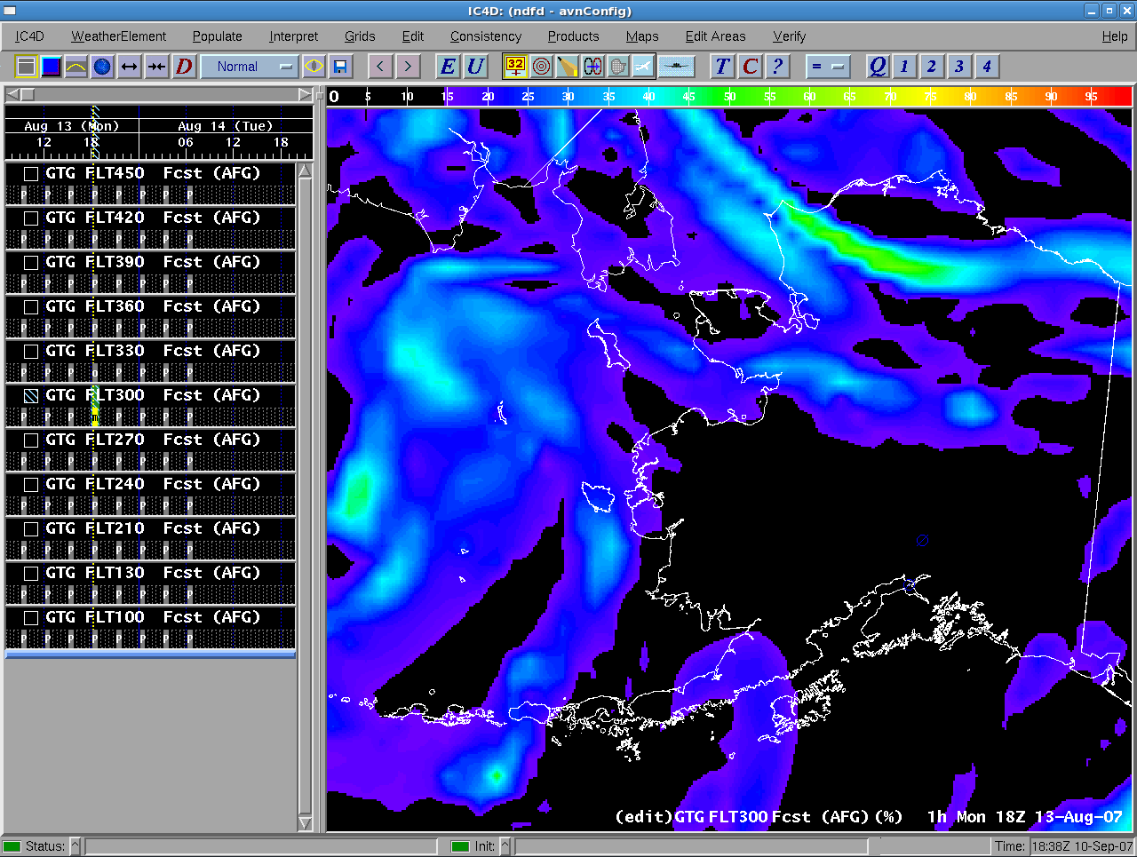
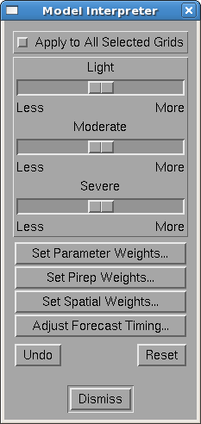
Manipulation of Weights and Parameters for Derived Fields
Interpretation Menu Button
Selected grid to adjust thresholds for
Interpretation Dialog
GTG Slider Bars
Set Pirep Weight

Slide 17
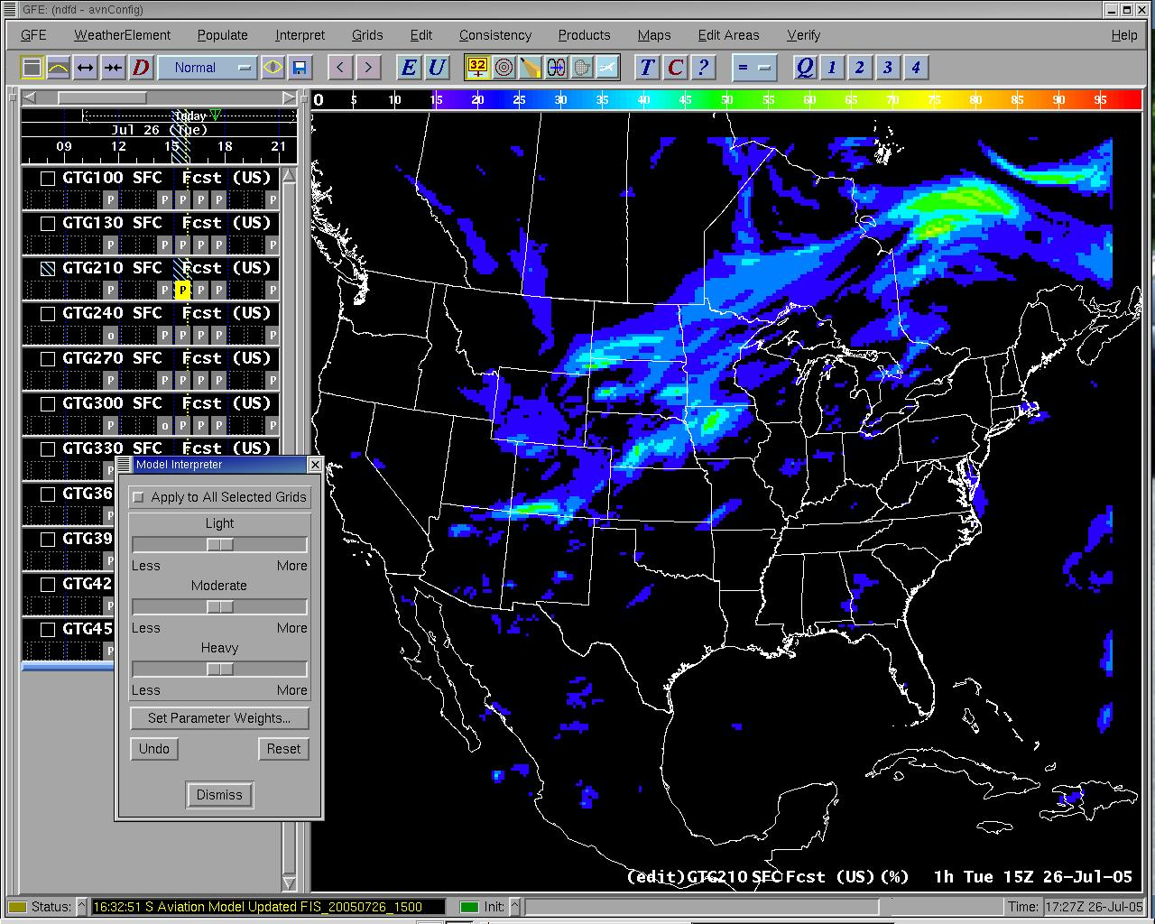
Spatial and Temporal Adjustment of Derived Fields
The timing of the forecast can be made faster or slower
This is done by blending progressive amounts of future or previous hours’ forecast into the selected hour’s forecast
Forecaster selects the amount of temporal shift, and the blending magnitude

Slide 18
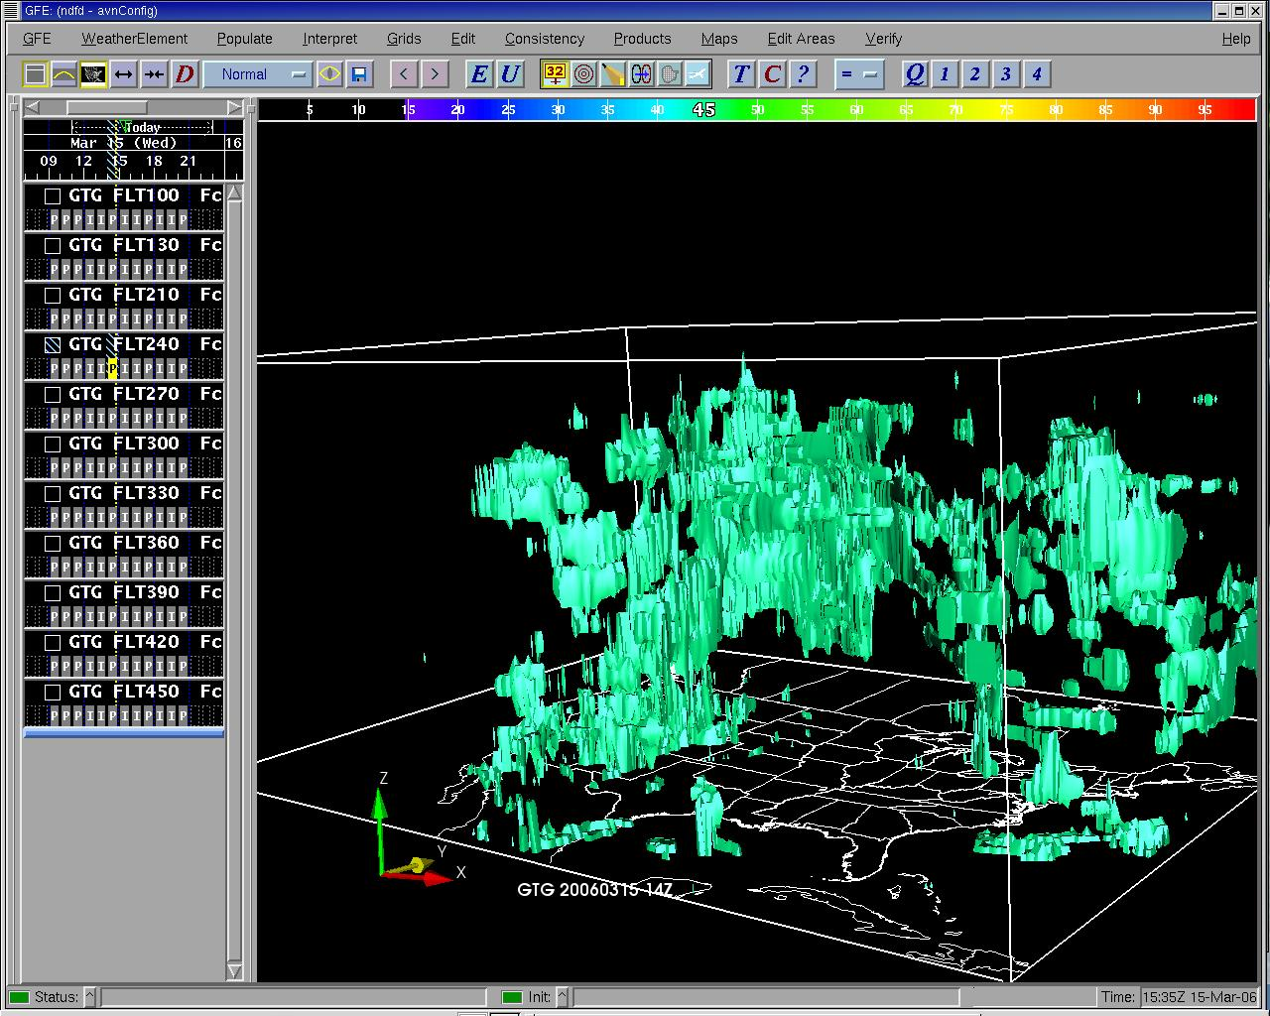
3-Dimensional Displays
IC4D can display forecast data in 3 dimensions
A variety of visualization tools are built into the software
Iso-surfaces are one example

Slide 19
Integration with WFO Operations
AAWU to WFO WFO to AAWU
Freezing level Surface winds (NDFD)
Ceiling Heights Sensible weather
Visibility Graphical Haz. Grids
LLWS/Winds Aloft
MSLP
Sky Cover

Slide 20
Timeline
Initial IC4D software arrived at AAWU Aug 2007
Contract IT position filled in Sept 2007
TDM & IT began software enhancements Sept 2007
Phase I of implementation completed in Dec 2007
Phase II completed May 2008
Fully Operational for AAWU forecasters by Jan 2010?
Begin integration with WFOs
Fully JPDO-4D Cube (Next GEN) status by 2013?

