Slide 1
USGG2009 & GEOID09: New geoid height models for surveying/GIS
ACSM-MARLS-UCLS-WFPS Conference 2009
20 FEB 2009 Salt Lake City, UT

Slide 2
Geoid Research Team
Daniel R. Roman, Ph.D., NGS, GRD
Dan.Roman@noaa.gov, 301-713-3202 x161
Yan Min Wang, Ph.D., NGS, GRD
Jarir Saleh, ERT
Xiaopeng Li, Ph.D., ERT
William Waickman, NGS, SDD
http://www.ngs.noaa.gov/GEOID/

Slide 3
Work Shop Outline
Gravimetric Geoid Development
60 minute presentation
30 minute break and Q&A period
Hybrid Geoid Development
60 minute presentation
30 minute break and Q&A period
Summary and Outlook
30 minute presentation
30 minute break and Q&A period

Slide 4
Gravimetric Geoid Development
Background
Reference Field Models
Digital Elevation Models
Surface Gravity Data
Gravity to Geoid Methodology
The Beta USGG2009 Model
Final USGG2009

Slide 5
Background
United States Gravimetric Geoid (USGG) models are developed from a reference model, surface gravity data, & terrain models
These models provide a ready transformation between easily obtained (GPS) ellipsoidal heights & more practical orthometric heights
Currently, these models are used for scientific studies & as bases for hybrid geoids (GEOIDxx)

Slide 6
Reference Models
Several advances have been made recently
Reference models simplify modeling by removing most of the signal
Processing errors on the residual signal produce proportionally smaller overall errors
GRACE mission provides a global Earth Gravity Model (GGM03S) that uses no surface data
EGM2008 was developed by NGA using GRACE and a robust global gravity database

Slide 7
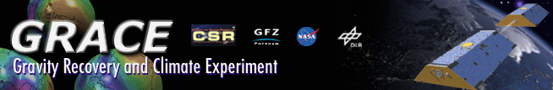
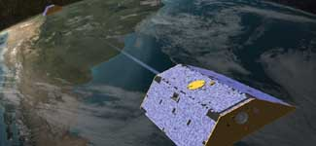
GRACE Satellite Gravity Mission
GRACE, twin satellites launched in March 2002, are making detailed measurements of Earth's gravity field which will lead to discoveries about gravity and Earth's natural systems. These discoveries could have far-reaching benefits to society and the world's population.
http://www.csr.utexas.edu/grace/
GRACE data alone comprise the GGM03S model, which is cm-level accurate - but only at a 300 km scale!
Notes:
GRACE provides an acurate backbone on which to build, but it cannot provide a model by itself.

Slide 8
EGM2008: Earth Gravity Model 2008
Uses GRACE data
Evaluating the extent to which we’ll adopt it
Uses much the same surface data that we hold
Global in coverage but only to 20 km resolution (maybe)
http://earth-info.nga.mil/GandG/wgs84/gravitymod/egm2008/index.html

Slide 9
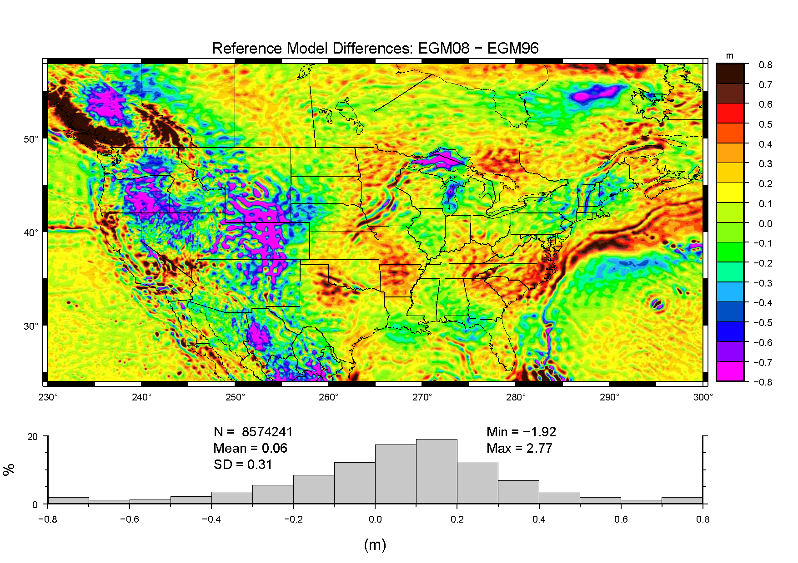
Difference in Reference Models
Notes:
The bubbly features reflect the higher resolution in EGM08 (361-2190)
The larger scale features represent significant changes in the reference earth gravity model
Note that the most extreme features occur in the mountainous regions

Slide 10
Digital Elevation Models
Current geoid height models mainly use 30”
Many denser data sets are available (1” & 3”)
They don’t all necessarily agree though
DEM’s or DTED’s model the high frequency part of the gravity field
Need to be consistent across all boundaries, particularly national boundaries

Slide 11
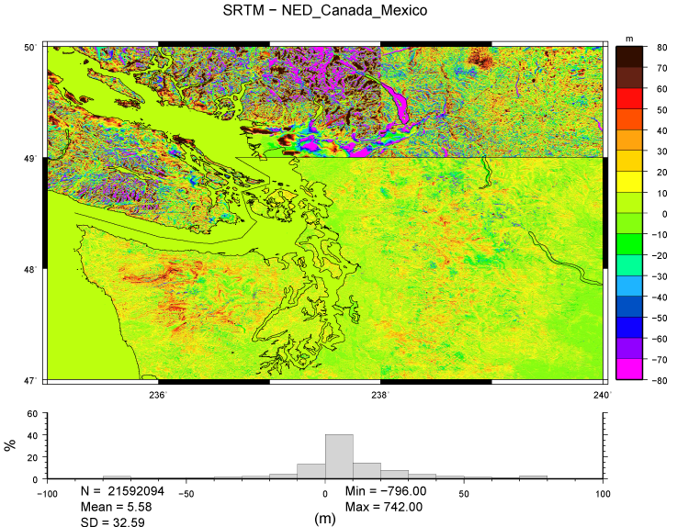
Why not use National DEM’s only?

Slide 12
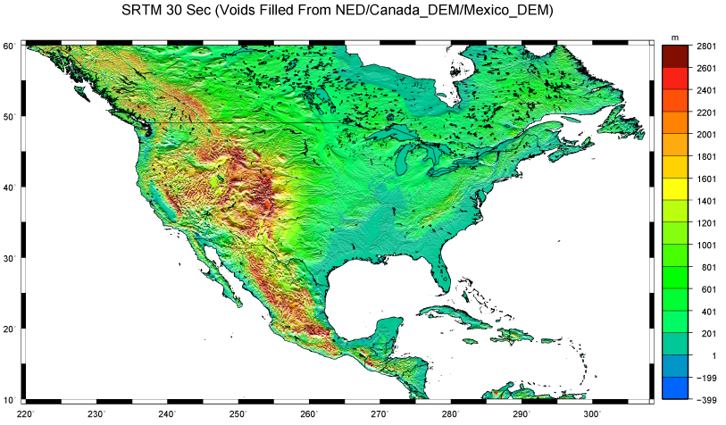
Final terrain model (downsampled) for geoid calculations
Note there are literally billions of points at 3” (90 m) spacing, which must be calculated each iteration

Slide 13
Surface Gravity Observations
Over 1.3 million surface gravity observations!
… collected up to 60 years ago
… by many different personnel
… using various equipment and techniques
… with most of the metadata unknown
This leaves in doubt the overall accuracy of geoid models derived from such data

Slide 14
A Method of Filtering is Needed
Another consistent set of values is desired to check for outliers in the NGSIDB gravity
Ultimately, GRAV-D will serve this function
However, EGM08 can serve in the interim
After some outlier analysis, values in excess of +/-16 mgals will be dropped (3 sigma: 99%)
Using 0.3086 mgal/meter as a metric, this implies elevation errors of +/- 50 meters
Notes:
If you can’t figure out your elevation from the topo map to better than 50 meters, we can’t use that data.

Slide 15
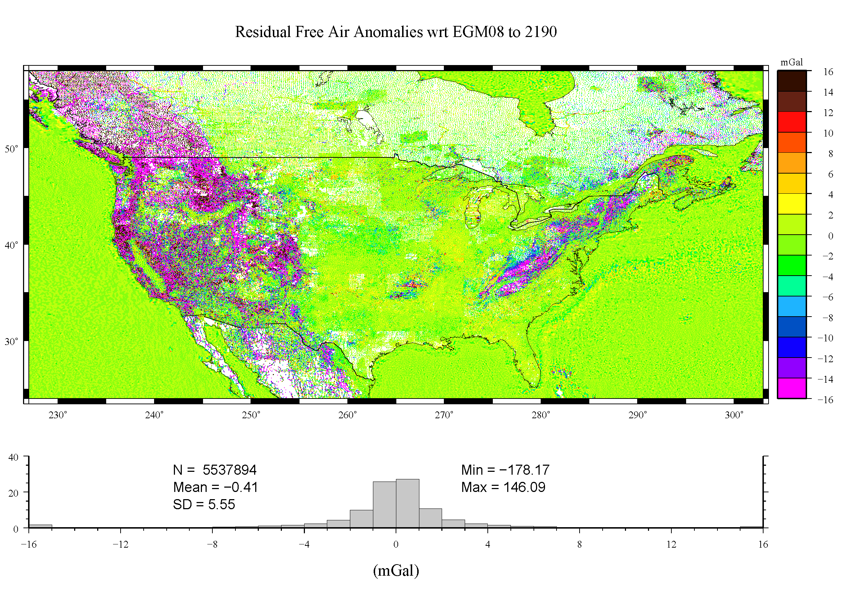
Extent of Gravity Coverage Shown are the differences between NGSIDB value and EGM08 model
Notes:
Note the extreme departures in the mountains

Slide 16
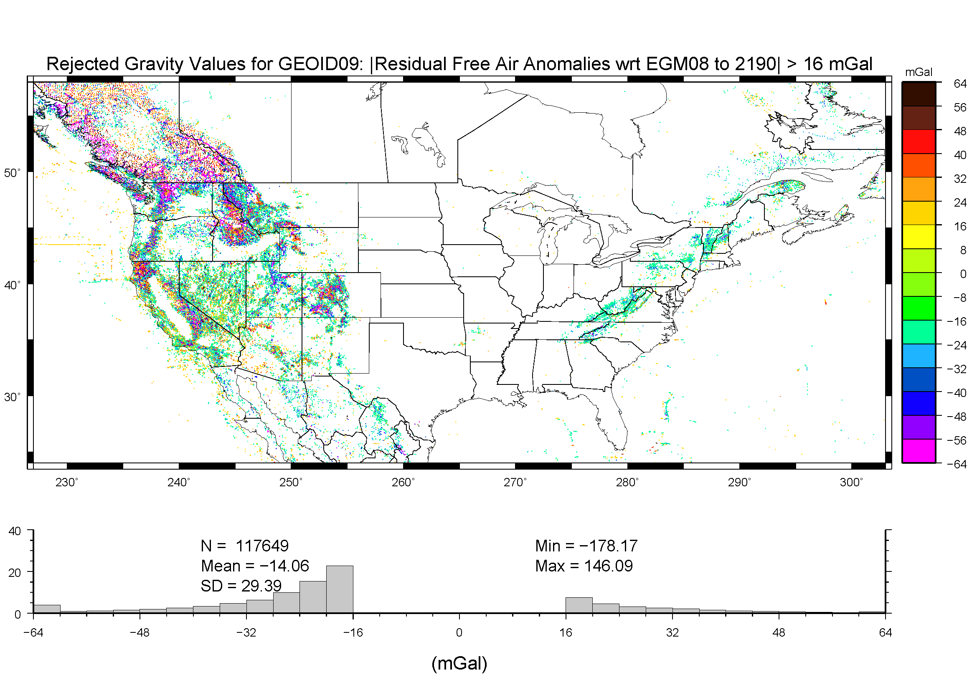
Rejected NGSIDB Data
Notes:
Not a real surprise, most values are in the mountains

Slide 17
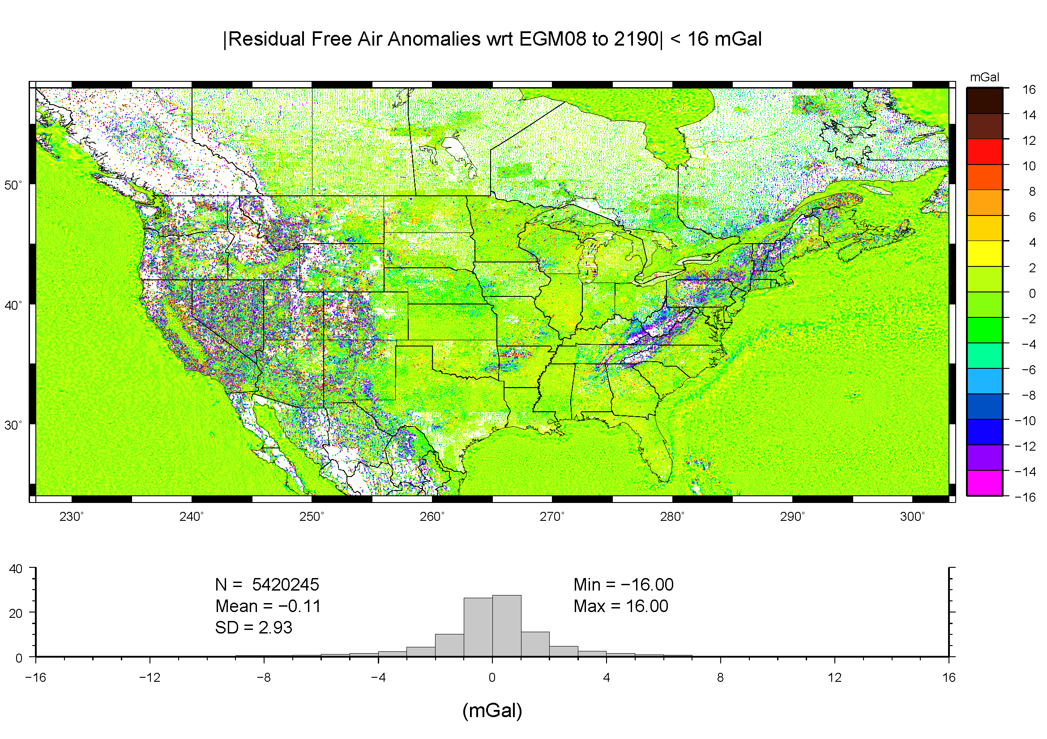
Retained NGSIDB Data
Notes:
Note that there are now significant gaps in the mountains.
This is a trade off between coverage and quality.
Keep in mind that the DEM will also provide short wavelength gravity field information.
Hence, it is better to drop suspect surface gravity to reduce the impact on the final geoid model.

Slide 18
Gravimetric Geoid Modeling
Largely the same techniques as before
Changes in theory primarily relate to a more rigorous downward continuation
Biggest changes result from change in reference model and better screening of surface gravity data

Slide 19
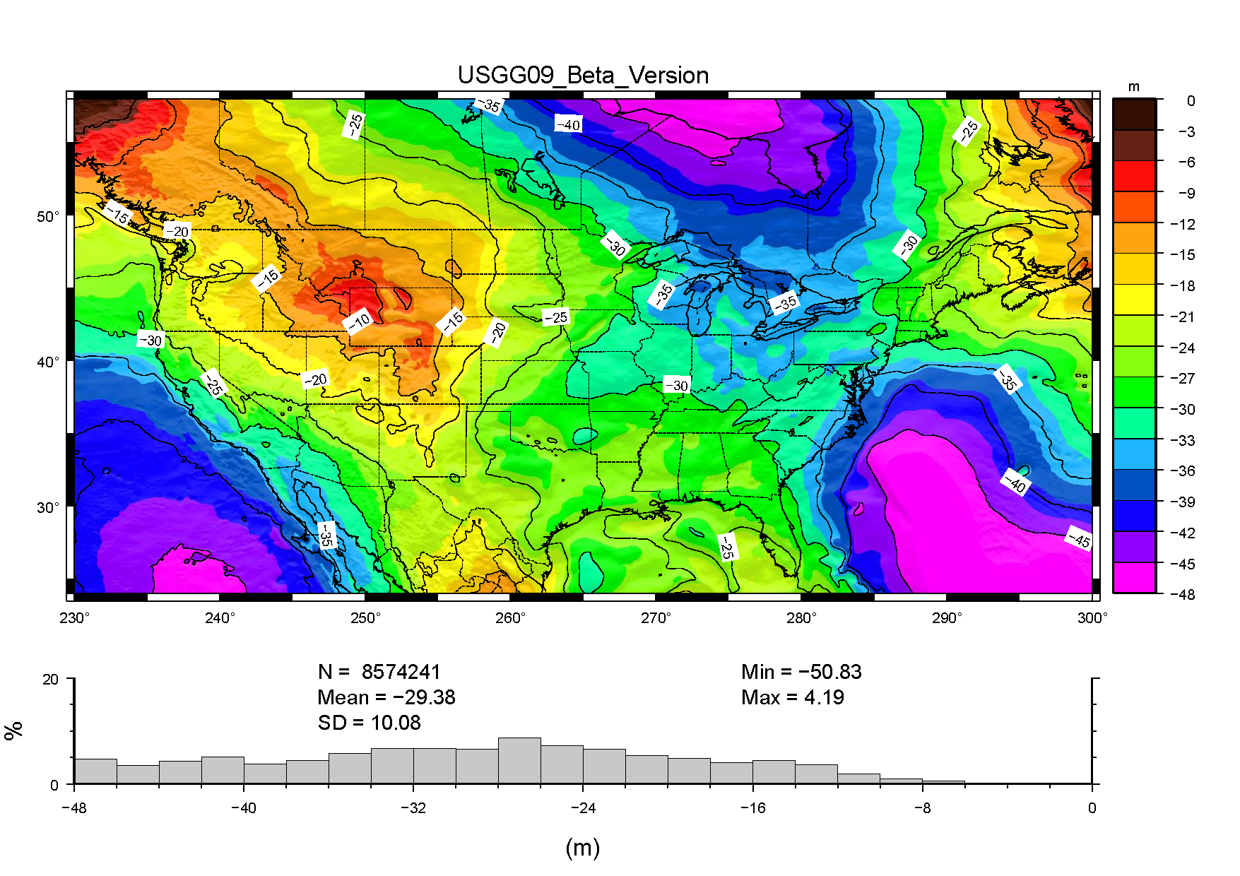
USGG2009 (Beta)

Slide 20
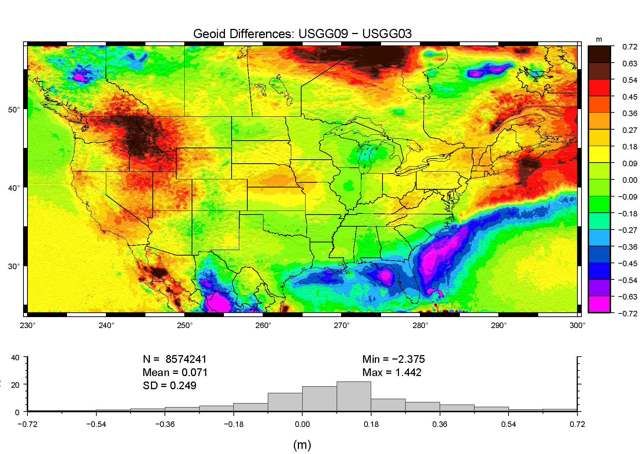
USGG2009 – USGG2003

Slide 21
Summary of the USGG2009
Significant changes due to use of EGM08, improved gravity filtering, consistent DEM’s, and refine modeling techniques
Evaluation continues on the level to which EGM08 will be adopted
Final model will be released next May
Format will be the same as before
Additional coverage for outlying territories

