Slide 1
Office of the Chief Financial Officer (CFO) Providing Essential Financial Management Services

Slide 2


Chief Financial Officer
Provide essential financial management services that enable NOAA to remain a world-class environmental sciences organization.
Responsibilities
Provide guidance and support to the NOAA PPBES Process, specifically as the lead for budget formulation and execution, and financial systems development. The CFO is also responsible for the Commerce Business System (CBS), and OIG Audit.

Slide 3
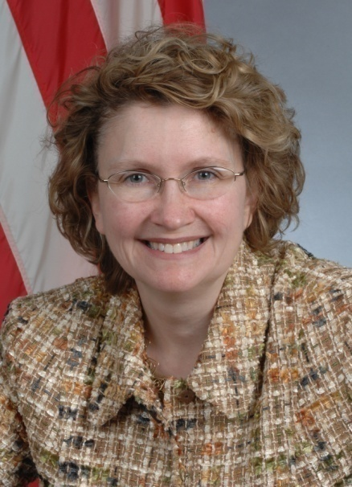
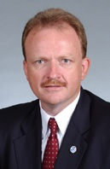

Who We Are: CFO Leadership
Maureen Wylie Chief Financial Officer
Steve Gallagher NOAA Budget Director
Jon Alexander Director, Finance Office/ Comptroller

Slide 4
CFO Organizational Structure
Chief Financial Officer
Maureen E. Wylie
Budget Officer
Steven I. Gallagher
Finance Officer
Jon P. Alexander
Patricia Johnson
Budget Formulation and Analysis
Division
Jon P. Alexander (Acting)
Financial Systems Division
James LeDuc
Budget Execution and Operations
Division
Lois Coleman
Accounting
Operations Division
Julie Hite
Budget Outreach and
Communications Division
Nancy Gates
Financial Policy and
Compliance Division
Sherry Morrissette
Budget Corporate Financial
Management Division
Candace Myers
Financial Reporting
Division
Keith Markva
End-to-End Development
Mathew Grow
Field Financial and Client
Services Division

Slide 5
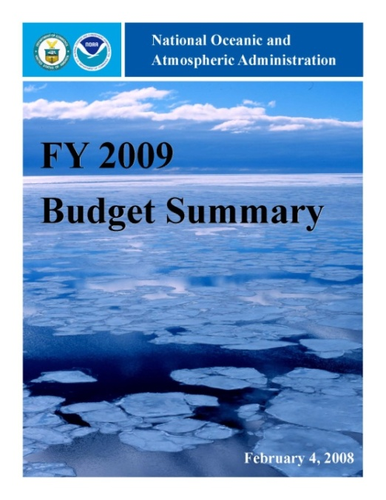
NOAA Budget Office (NBO)
Mission Oversees and manages NOAA's budget process by developing guidance, reviewing proposals, and preparing supporting documentation for the submission of an annual budget. Provides for the proper allocation and execution of all budgetary resources as required under the Congressional Budget and Impoundment Act of 1974 (31 U.S.C. 11). Conducts outreach and communication, particularly with the staff of Congressional Appropriations committees and the Department.
Major Responsibilities
Budget Formulation, Allocation, and Execution
Annual Performance Plan
Congressional Budget
Performance Report
Corporate Financial Management

Slide 6
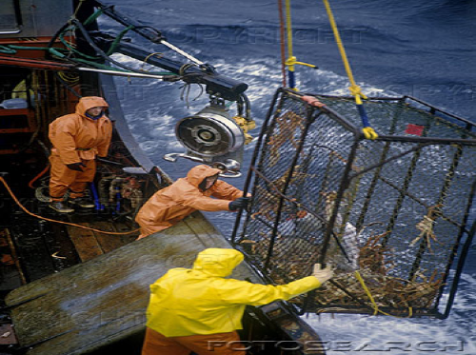
NOAA Finance Office (NFO)
Mission Operates NOAA's financial management system to provide managers with access to timely financial data necessary to make informed programmatic decisions. Advises line/staff offices on financial management policies and procedures and provides special-purpose financial information and analyses on matters of immediate concern.
Major Responsibilities
Financial Reporting
Financial Systems
Travel Policies and Systems
NOAA Data Warehouse
Internal Controls

Slide 7



CFO Contact Information
Maureen E. Wylie Chief Financial Officer (202) 482-0917
Steven I. Gallagher Director of NOAA Budget (202) 482-4977
Jon P. Alexander Director of Finance / Comptroller (301) 444-2102

