Slide 1
End plate analysis, STAR support cylinders
Feb. 2009

Slide 2
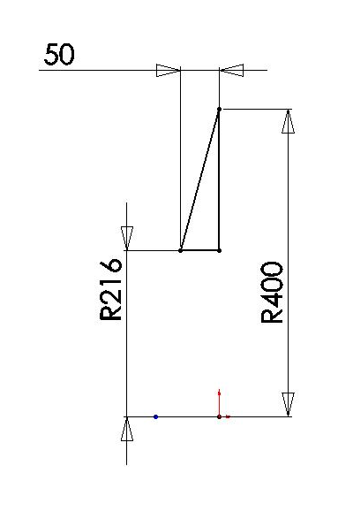
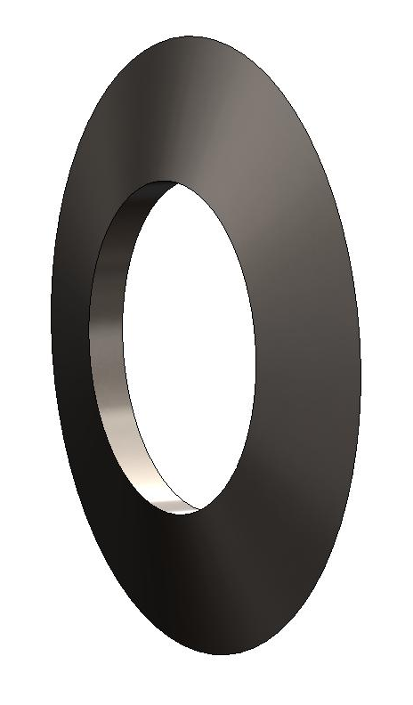
Cone Geometry
rotational sweep
of a triangle
units: mm

Slide 3
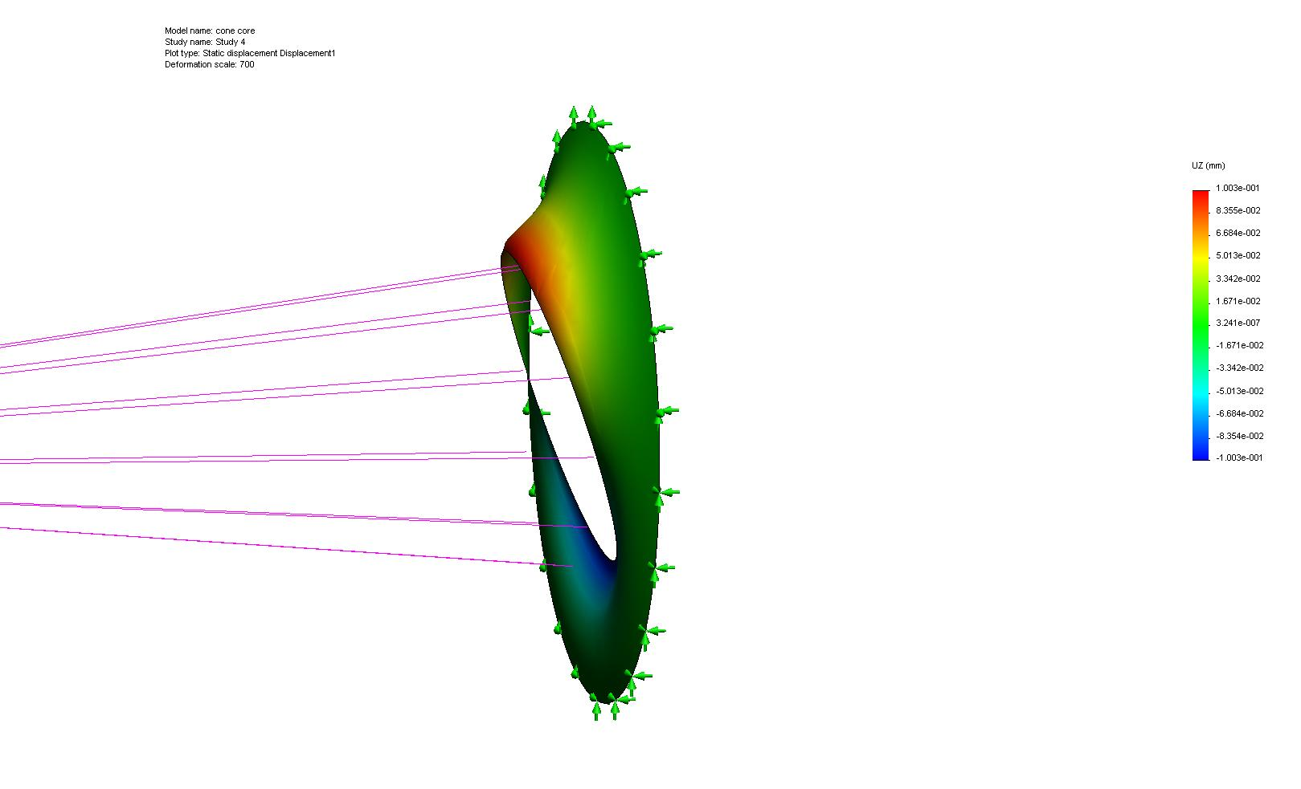
Single wall cone
single cone surface, cone face in slide 2
2 mm thick wall titanium (carbon composite equivalent)
100 lb load displaced by 2m from connection ring
Delta z = 200 microns
cone core-Study 4-1.htm

Slide 4
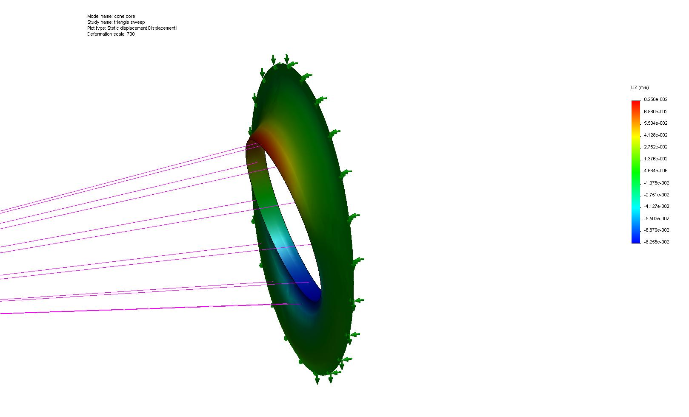
Triangle sweep, shell mesh
Triangle sweep shown in slide 2
1 mm thick walls
Shell analysis
Fixed to edge (not surface). Rigid rod type
cone core-triangle sweep-1.htm

Slide 5
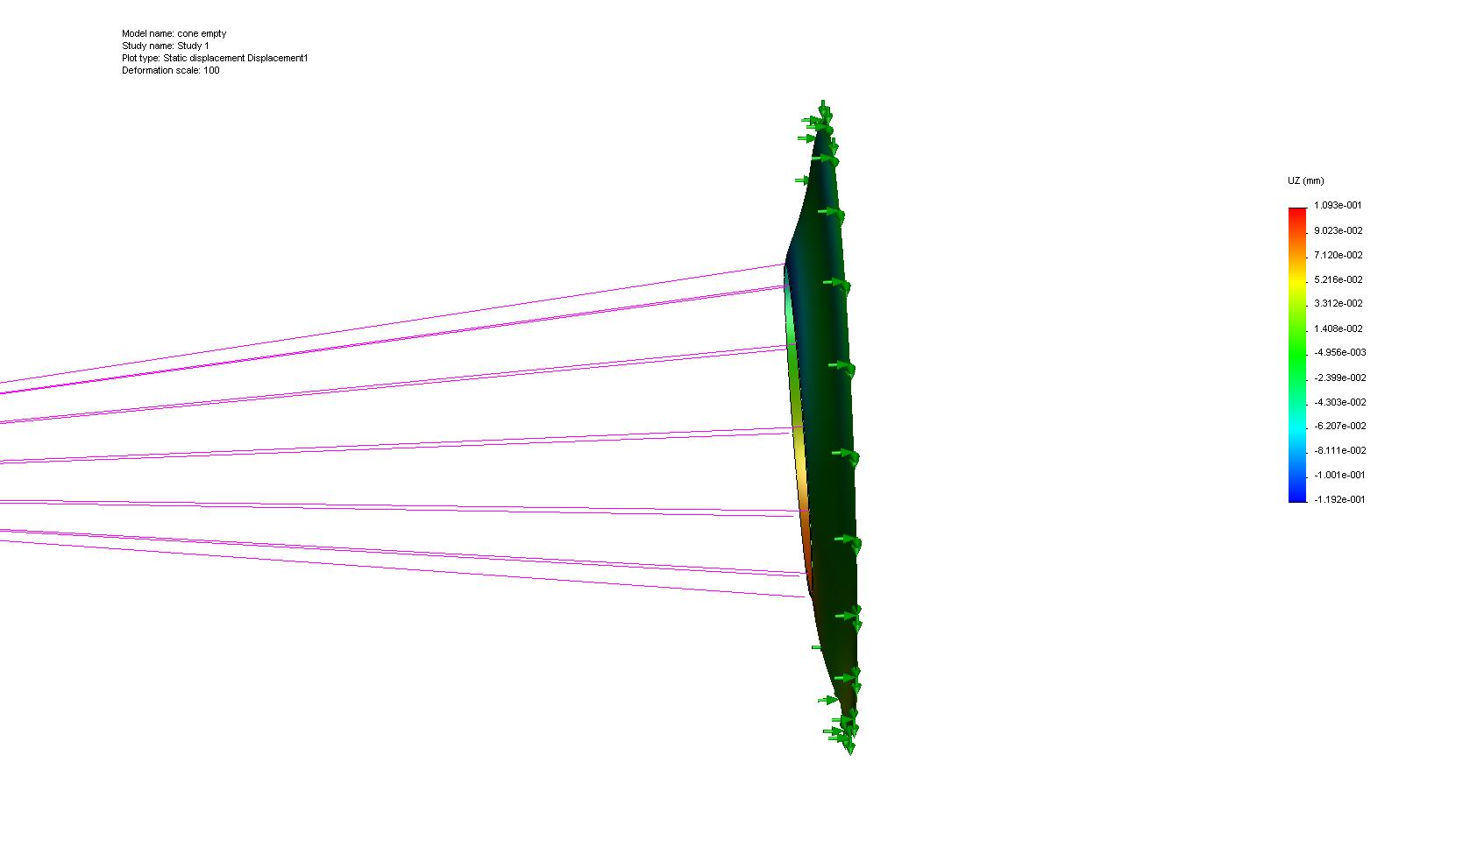
Triangle sweep solid mesh
solid mesh, same geometry as slide4
1 mm hollow
Load 100 lb at 2m
Delta Z = 228 microns
cone empty-Study 1-1.htm

Slide 6

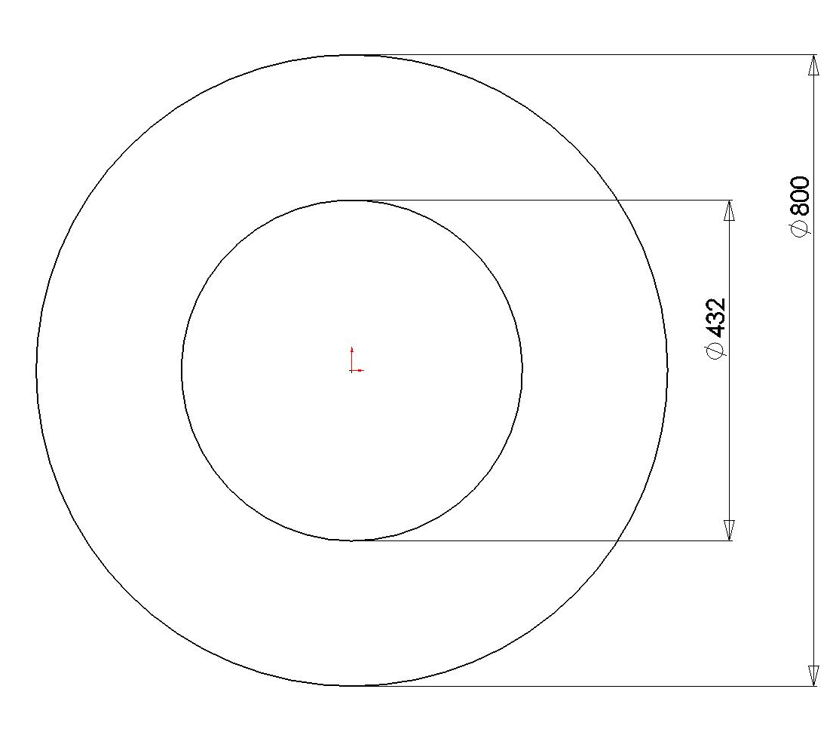
Flat plate geometry
8 mm thick

Slide 7
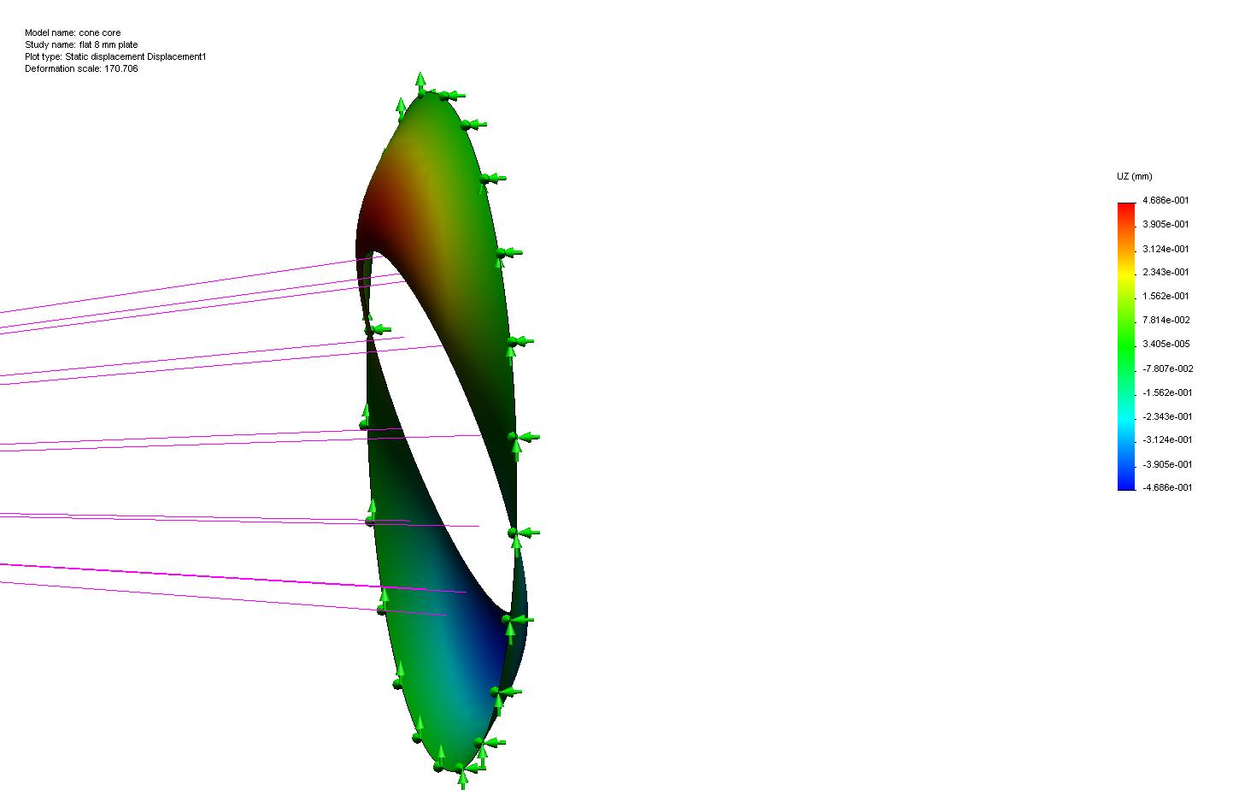
Flat plate, shell mesh, 8mm
flat 8 mm plate
load: 100 lb at 2 m, rigid bars on edge
Delta Z = 937 microns
Shell mesh (thick)
Titanium
cone core-flat 8 mm plate-1.htm

Slide 8
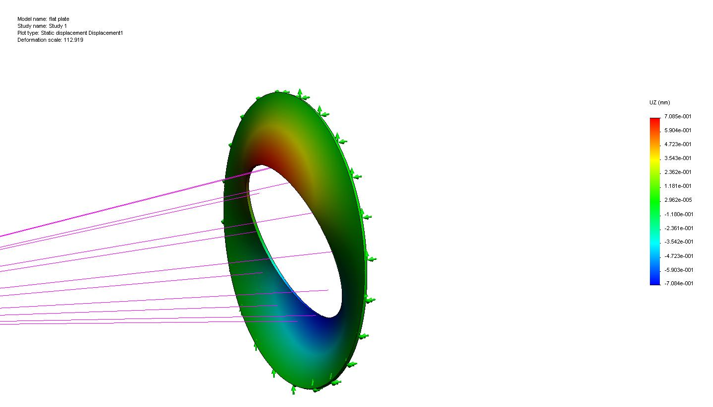
Flat plate, solid mesh, 8 mm
flat plate
solid mesh
8 mm thick
Delta z: 1470 microns
flat plate-Study 1-1.htm

Slide 9
Ribbed geometry

Slide 10
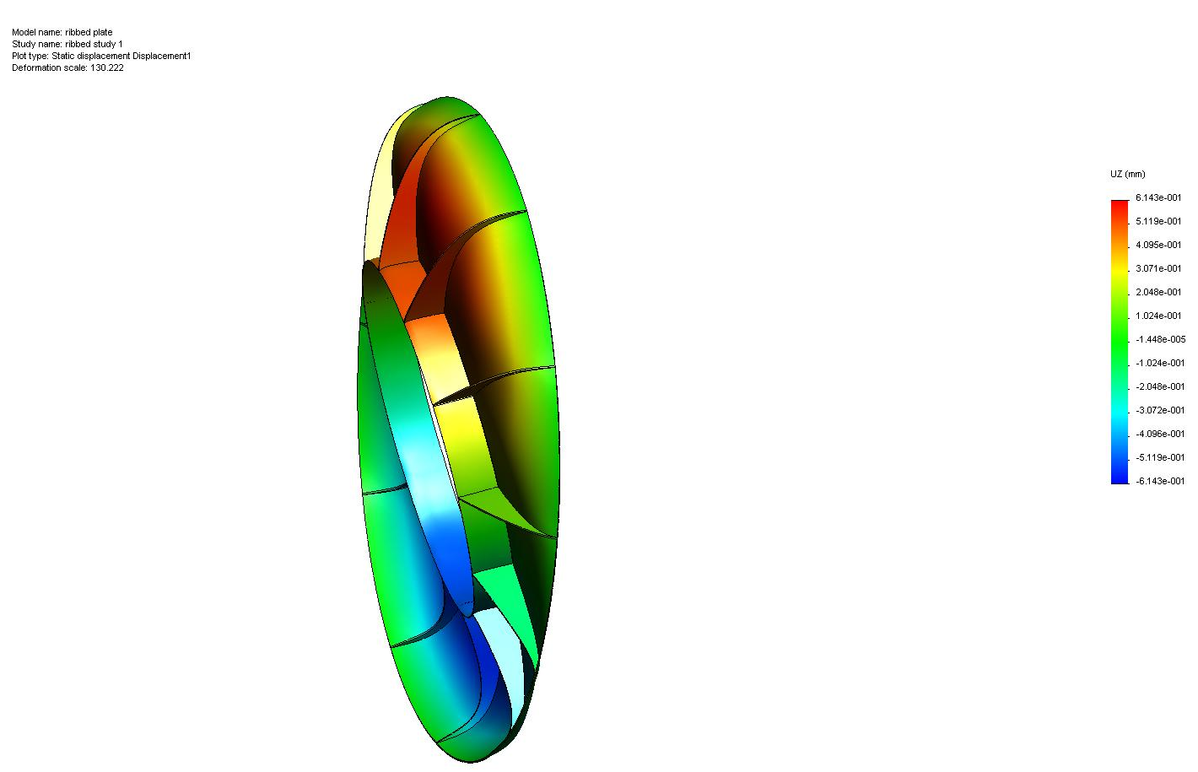
Ribbed, full taper
Ribbed, full taper
solid mesh
1 mm skins
2 mm ribs
full taper
Delta Z: 1230 microns
ribbed plate-ribbed study 1-1.htm

Slide 11
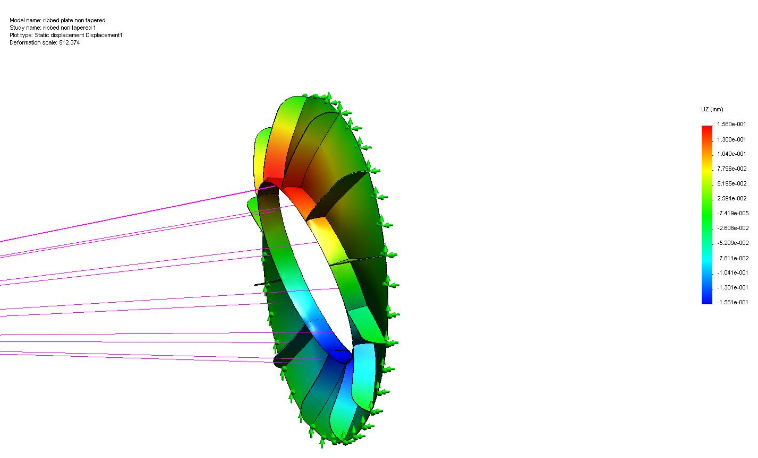
Ribbed, non tapered
full ribs
2 mm ribs
1 mm skins
Solid mesh
Delta z: 312 microns
ribbed plate non tapered 1-1.htm

Slide 12
summary
geometry | Slide # | Mesh type | Dz | Study link
Single wall cone, 2 mm thick wall | 3 | shell | 200 μm | cone core-Study 4-1.htm
Triangle sweep, 1 mm thick wall | 4 | shell | 165 μm | cone core-triangle sweep-1.htm
Triangle sweep, 1 mm thick wall | 5 | solid | 228 μm | cone empty-Study 1-1.htm
Flat plate, 8 mm thick | 7 | shell (thick) | 937 μm | cone core-flat 8 mm plate-1.htm
Flat plate, 8 mm thick | 8 | solid | 1470 μm | flat plate-Study 1-1.htm
Ribbed, full taper | 10 | solid | 1230 μm | ribbed plate-ribbed study 1-1.htm
Ribbed, non tapered | 11 | solid | 312 μm | ribbed plate non tapered 1-1.htm

Slide 13
summary
Triangular swept shell is the stiffest, but only marginally
The simple single layer 2 mm cone is nearly as stiff and much simpler. It presents the same radiation length as the 1 mm triangular sweep. This solution appears to be stiff enough for coupling the STAR cylinders.
The 8 mm disk is clearly inferior for both radiation length and stiffness
The ribbed structure has ribs aligned with the TPC sector boundaries
The results are suspect because the shell mesh solutions do not agree with the solid mesh

