Slide 1
XP900
List of Shots
4 Feb 2009

Slide 2
After bakeout
Magnetics calibrations
Run startup shot from 2008 (Shot List A)
126933
122642
127110 (or equivalent) – Fiducial [900kA, 0.45T, CS @1000, A 40ms, B, 80ms, no C]
Boronize (10g TMB)
Re-run Shot List A

Slide 3
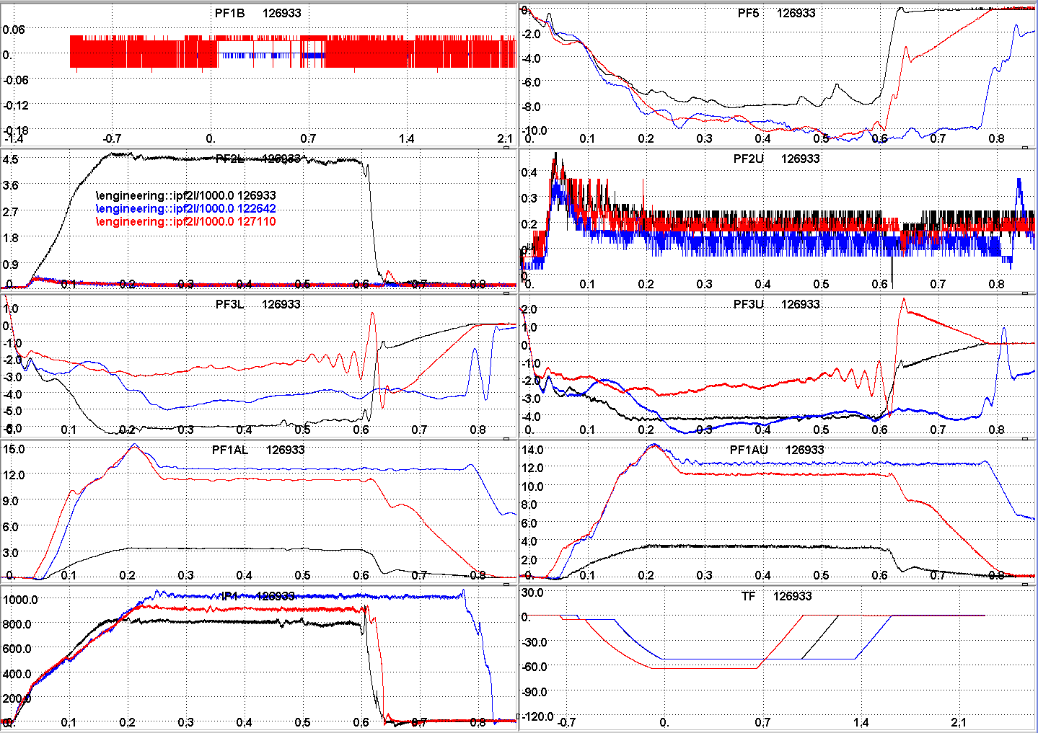

Slide 4
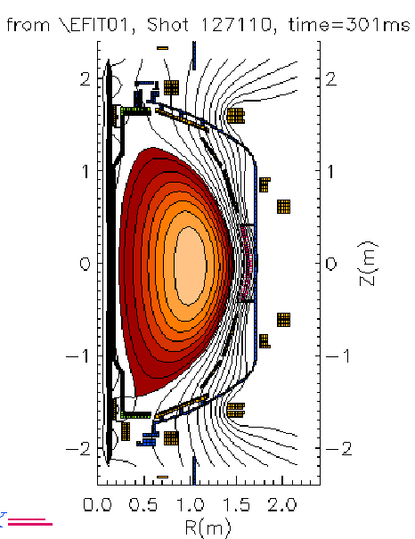
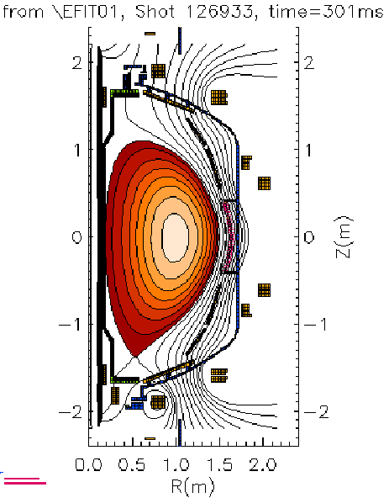
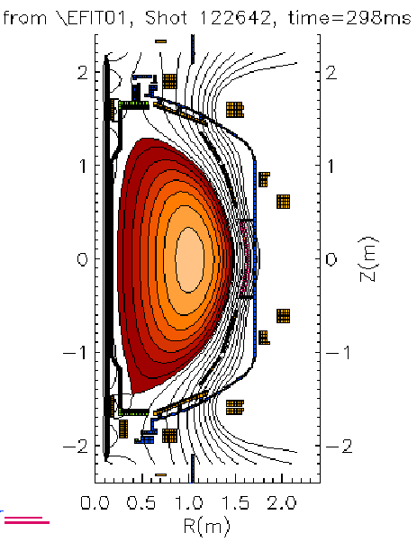
Standard shots after bakeout

Slide 5
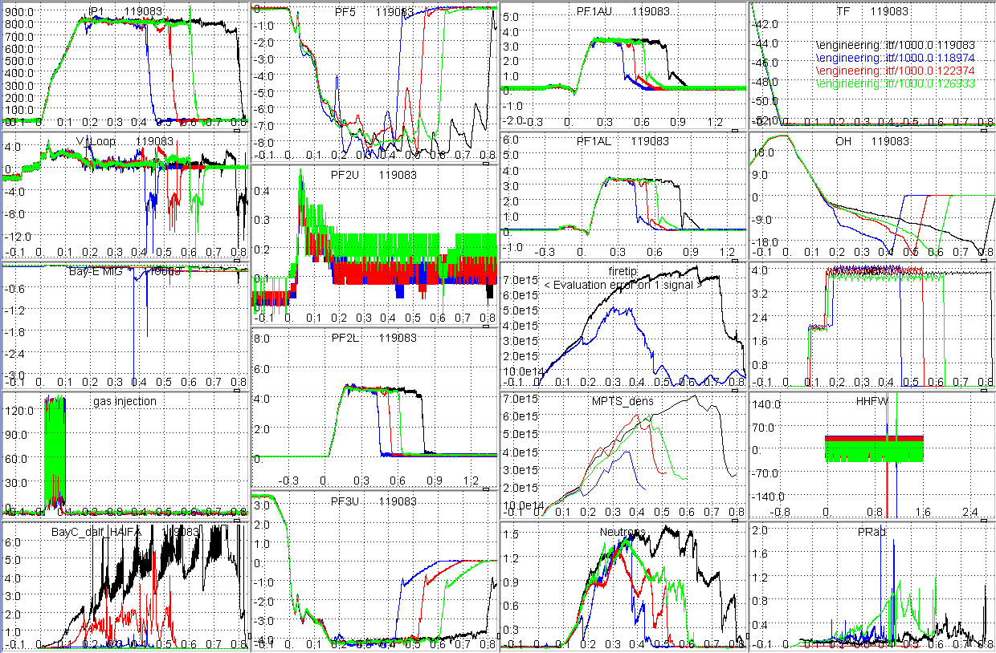
CS @1000

