Slide 1
Internal hydraulic jumps and overturning generated by tidal flow over a tall steep ridge
Sonya Legg
Princeton University, NOAA-GFDL
Jody Klymak
University of Victoria

Slide 2
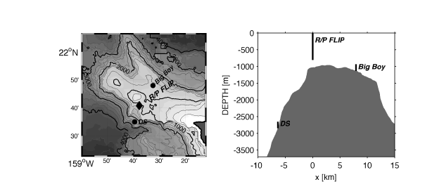
Hawaiian Ocean Mixing Experiment: Observations at Kaena Ridge
Klymak, Pinkel and Rainville, JPO 2007
Strong dissipation observed during transition from offslope to onslope tidal flow at top of ridge
Q: What is the cause of this high dissipation and associated overturning?

Slide 3
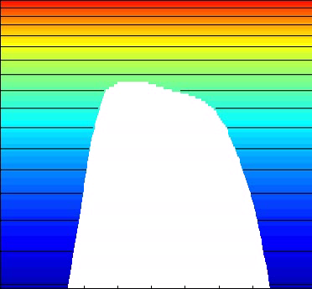
Hawaiian ridge simulations with MITgcm, stratification and topography from Kaena ridge
Buoyancy field for U0=5cm/s, M2 tidal forcing.
-700m
Model details:
2D nonhydrostatic simulations with resolution 115m X 9m near top of slope.
Total domain is 500km X 4300m.
Barotropic tide forced through a body forcing.
Open boundary conditions allow baroclinic tide to radiate away.
-1760m
46km
Hawaiian ridge is tall and steep.
γ> 1, RL < 1, Fr << 1, h/H -> 1.
Hydraulic jumps develop over steep slope during downslope flow: at flow reversal, jumps propagate upslope as internal bores.
Asymmetric response: details of slope are important.

Slide 4
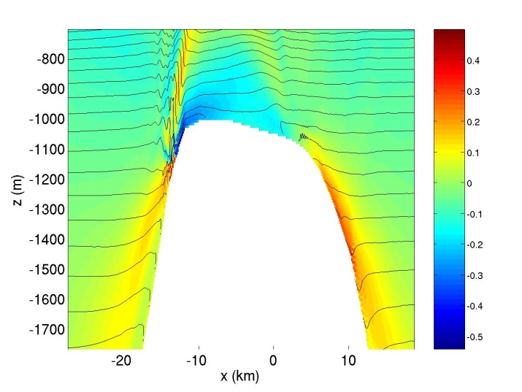
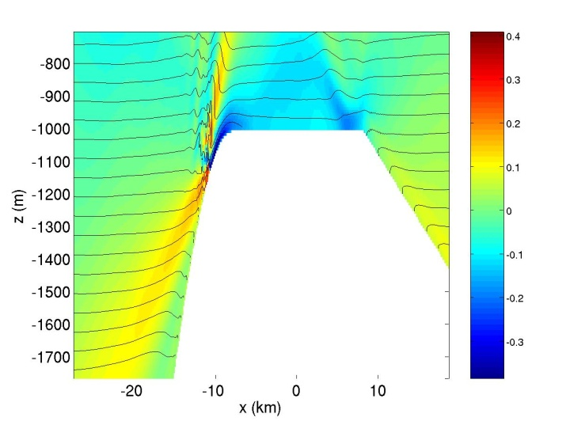
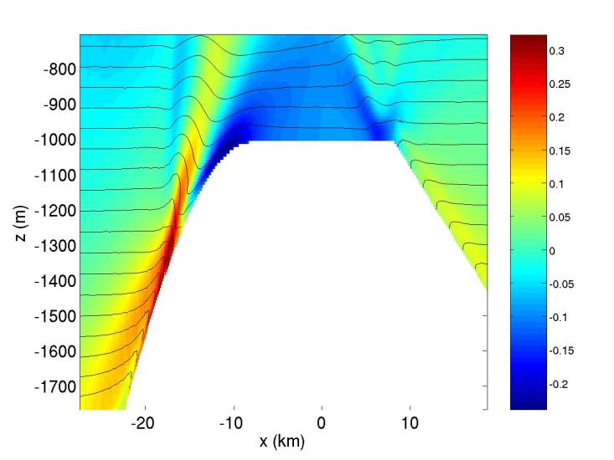
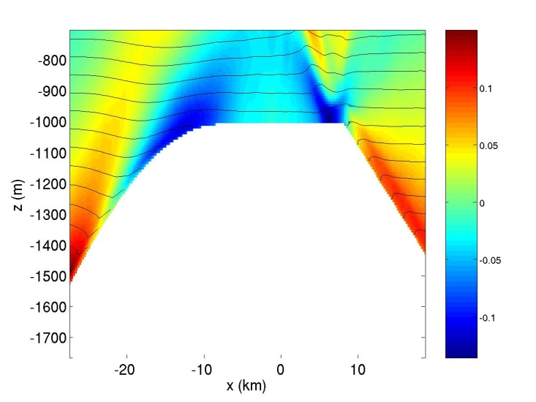
Dependence of overturning on slope
Real topography
dh/dx(max) = 0.2
dh/dx(max) = 0.1
dh/dx(max) = 0.06
Snapshots of U(color) and buoyancy (contours) just after flow reversal, all with U0=5cm/s
Borelike features are found only for steep topography.

Slide 5
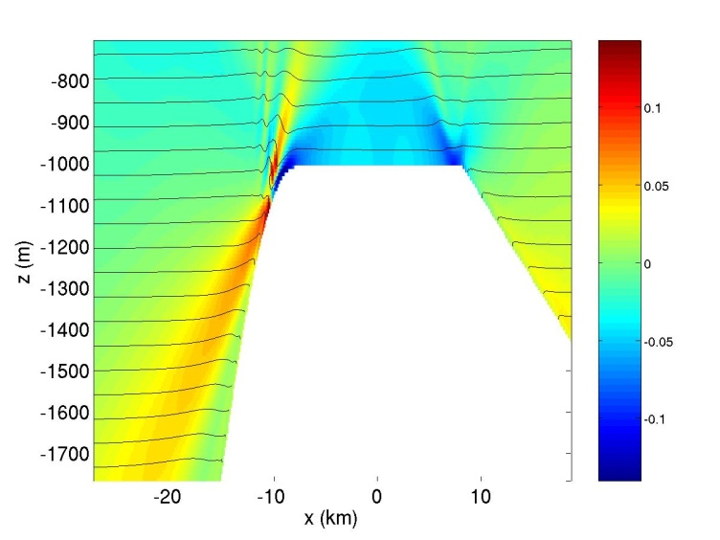
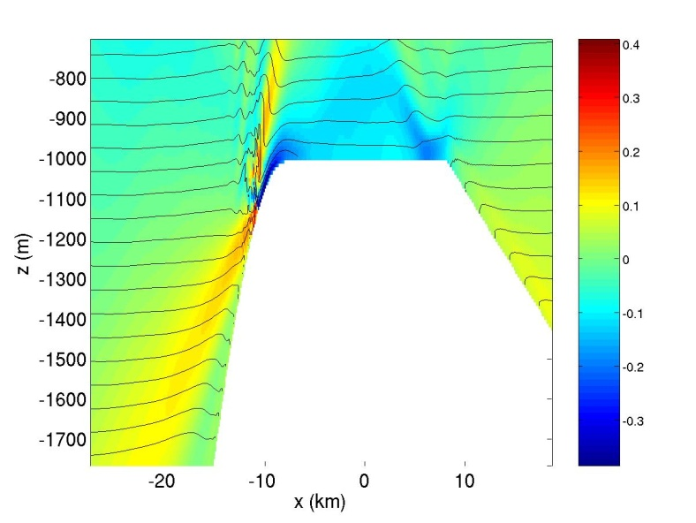
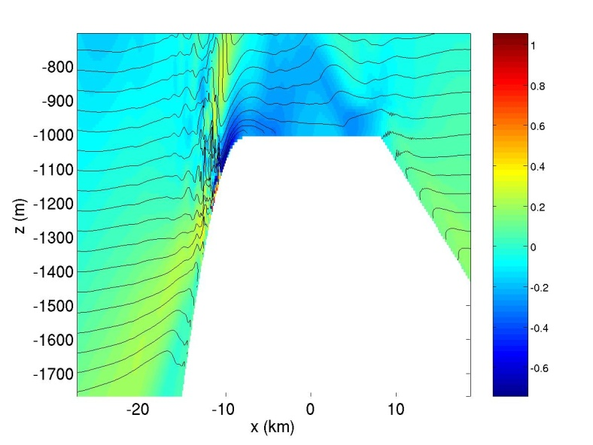
Dependence of overturning on flow amplitude
U0=2cm/s
U0=5cm/s
U0=10cm/s
Snapshots of U (color) and buoyancy (contours) just after flow reversal, for dh/dx(max) = 0.2.
Larger amplitude flow increases vertical extent and vigor of overturning.

Slide 6
Comparison with observations (flip)
For steep slopes and large forcing velocity, simulations generate similar features to observations

Slide 7
Evidence for overturning and internal bores
Height of Ri<1 layer at topographic depth of -1150m
Skewness of dT/dt at top of slope, h=-1028m.
Steeper slopes and stronger flows associated with deeper overturning layer, occurring just after flow reversal.
Negative dT/dt skewness for most runs indicates sudden drops in temperature, associated with upslope propagating internal bores.

Slide 8
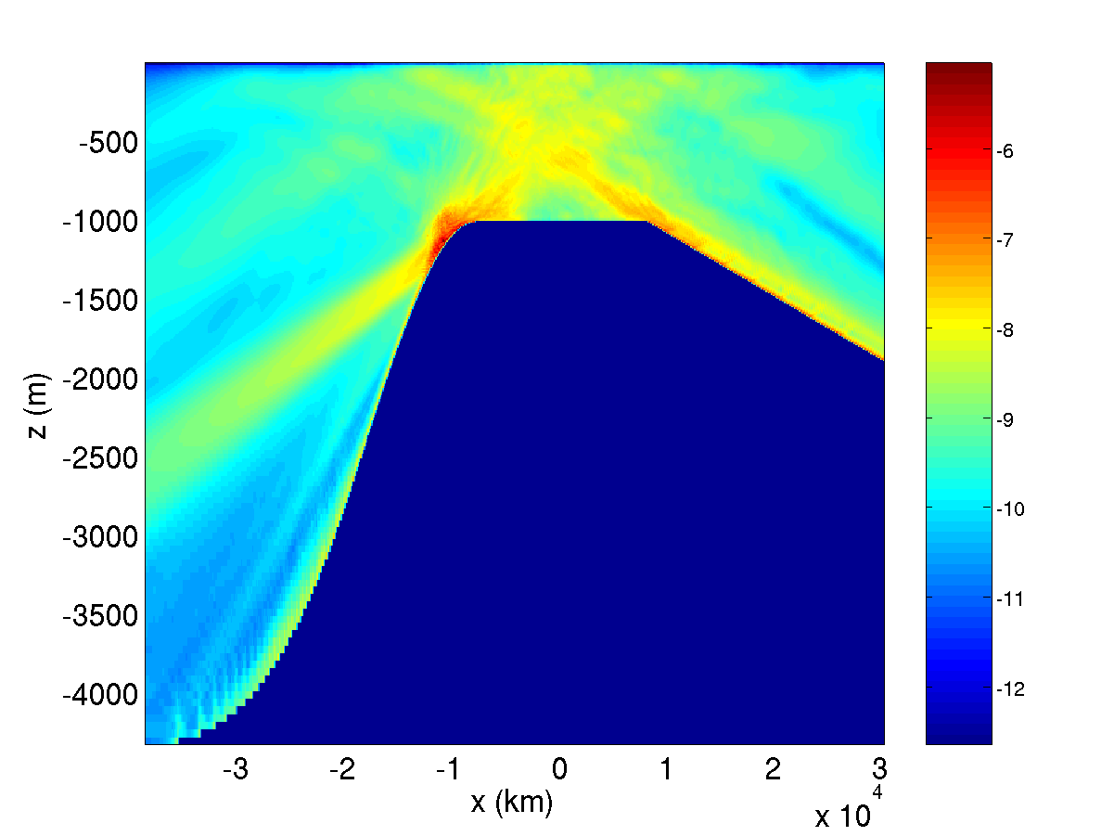
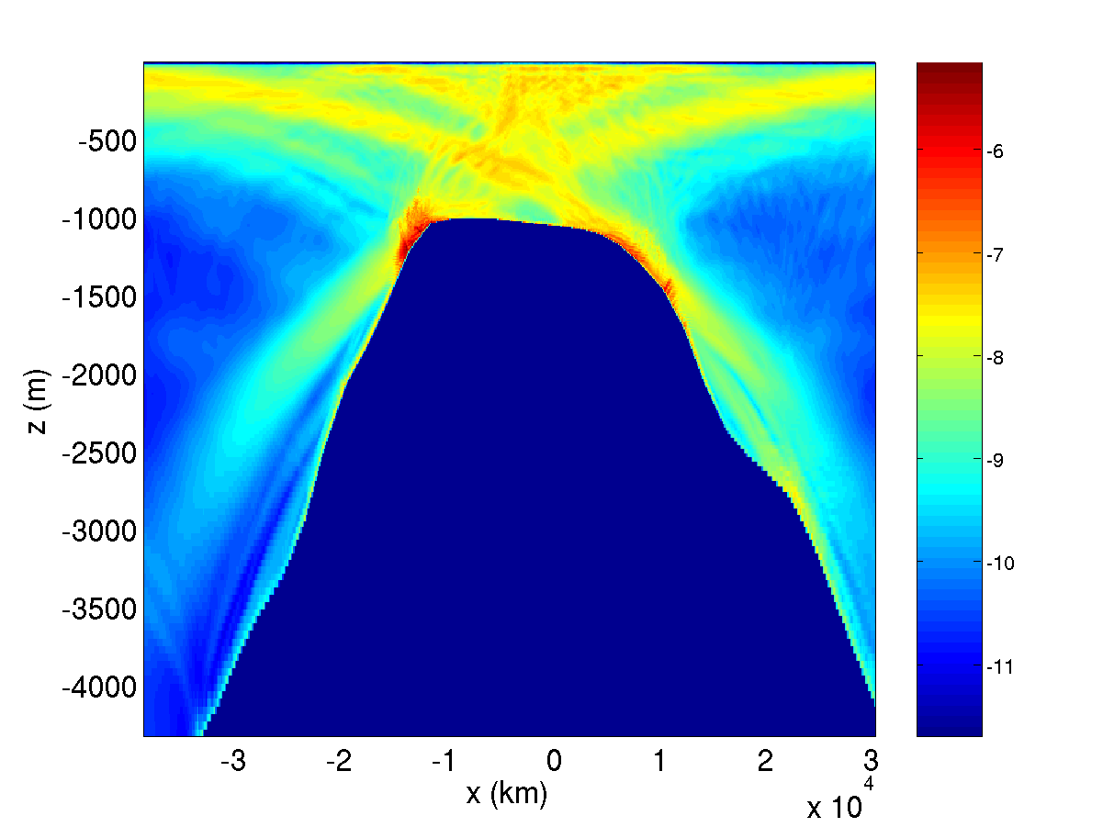
Influence of internal bores on dissipation
Log10 dissipation (time-averaged) for U0=5cm/s, dh/dx=0.2
Log10 dissipation (time-averaged) for U0=5cm/s, realistic topography and stratification
The region affected by internal bores has an order of magnitude higher dissipation than the internal wave beams.

Slide 9
Role of topographic slope in generating transient jumps
In steady state flows, strongly nonlinear leewaves are generated when
Fr << 1: flow is blocked by topography.
Fr >> 1: small amplitude linear leewaves.
In tidally oscillating flow, if RL < 1, fluid does not feel full height of topography within a tidal cycle. Instead the vertical scale of topography experienced by flow is the vertical tidal displacement:
By analogy with steady case, we expect strongly nonlinear waves if hω is large enough that
i.e.
So transient jump-like waves may be possible if slope is sufficiently steep that Frω < 1

Slide 10
Displacement regimes
Nonlinear jump-like waves
Linear waves
Large Fr_{ω}⁻⁻¹ corresponds to steep slopes, lower frequency forcing, higher stratification; the regime of jump-like nonlinear waves.
For small Fr_{ω}⁻⁻¹:
For large Fr_{ω}⁻⁻¹:

Slide 11
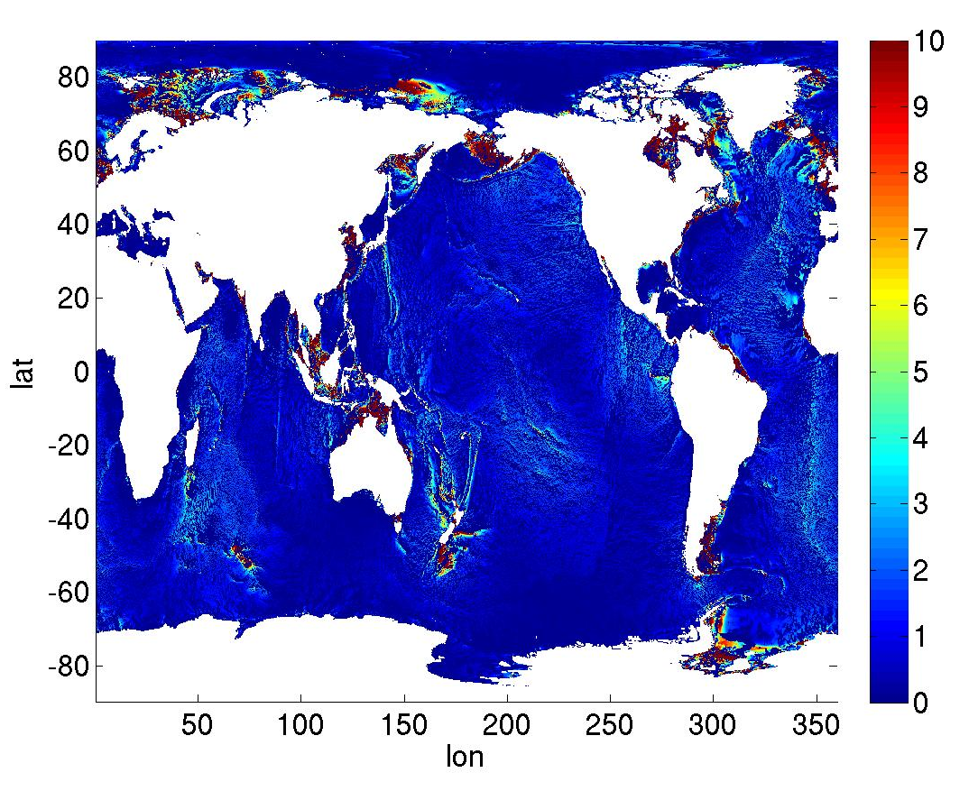
Do tidally driven transient hydraulic jumps matter on a global scale?
Amplitude of tidal velocity projected onto direction of topographic gradient (cm/s)
Frω (N/(ω dh/dx)) calculated on ¼ degree scale
Large velocities combined with Frω < 1 may lead to local overturning in jump-like features: seen in several interesting locations….

Slide 12
Conclusions
For steep slopes and large amplitude flows, overturning internal bores are generated.
The internal bores are locations of enhanced dissipation.
Probable cause: transient jump-like nonlinear lee-waves are generated during off-slope flow, propagate toward slope when flow relaxes, and cause overturning.
Nonlinear jump-like features only appear when Fr based on tidal excursion distance is small, implying steep slopes.
Vertical scale of nonlinear features depends on flow amplitude, stratification.

