Slide 1


Low-Mass Vector Mesons and Continuum at RHIC-PHENIX
Kenta Shigaki (Hiroshima University )
for the X Collaboration
Winter Workshop on Nuclear Dynamics 2009
February 6, 2009
Big Sky, Montana, U.S.A.

Slide 2
Presentation Outline
physics goals in low-mass region
strategy of RHIC-PHENIX
#1: chiral symmetry restoration
low-mass vector mesons at low p_{T}
#2: quark tomography
low-mass vector mesons at high p_{T}
#3: continuum enhancement
low-mass continuum at low p_{T}
summary, remarks and outlook

Slide 3
Four(-or-More)-Fold Low-Mass Physics
probe of (partial) chiral symmetry restoration
mass modification of low-mass vector mesons
mass spectrum shapes
branching ratios
quark tomography
flavor/spin dependence of quark energy loss
(yet-to-be-understood) continuum enhancement
search for thermal radiation
thermal virtual photons

Slide 4
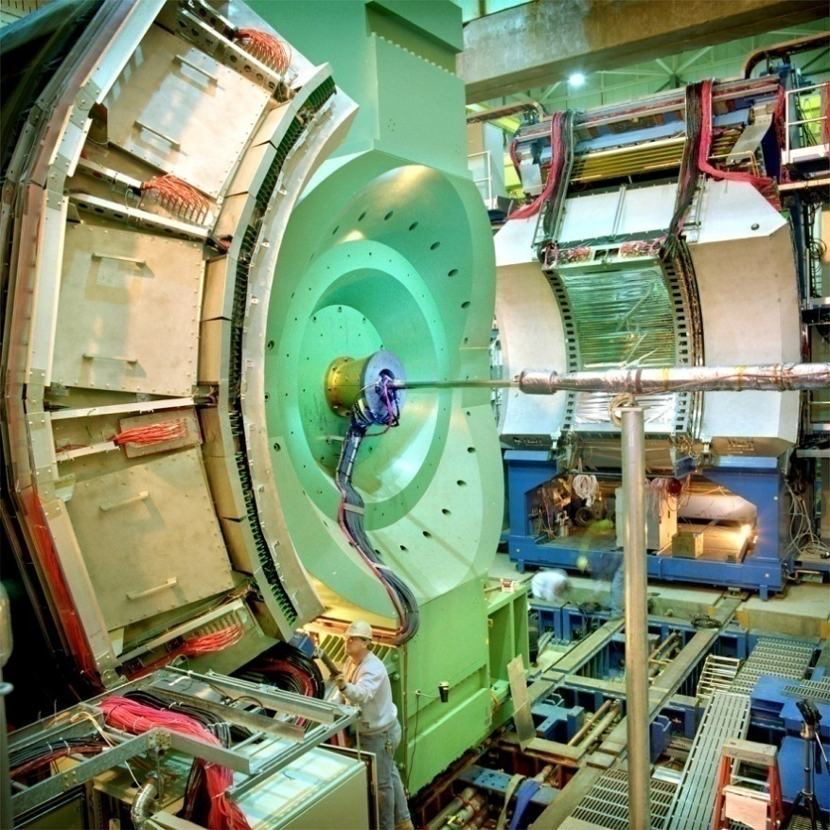
RHIC-PHENIX, Relevant Data Sets
fundamental strategy of PHENIX
multiple probes with emphasis on transparent ones
systematic studies of rare probes
e.g. di-electron
data sets most relevant to this presentation
p+p; run 5; 100 M ( 55 G min. bias equiv.)
d+Au; run 3; 50 M (3.8 G min. bias equiv.)
Au+Au; run 4; 800 M
all data sets at √s_{(NN)} = 200 GeV
more statistics available in later runs

Slide 5
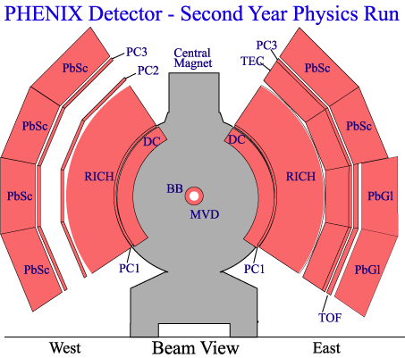
A Key Measurement: Di-Electron
precise tracking and electron identification
challenging background primarily from Dalitz decays
statistical subtraction
γ conversion rejection
correlated background also evaluated
cross pairs
jet components
ref. Wed/PM3, S.Bathe
e⁺
π
e⁻

Slide 6
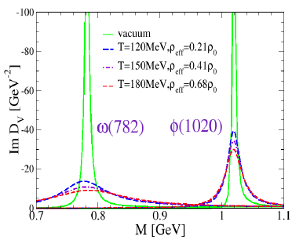
Topic #1a: φ/ω Mass Spectra
naïve method to look at mass modification
changes expected in low p_{T} region
lifetime of LVM in same order as that of partonic phase
R. Rapp, J. Phys G31 (2005) S217

Slide 7
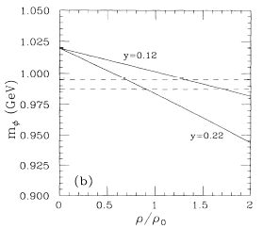
Topic #1b: Decay Modes of φ
possible suppression of φ → K⁺K⁻ decay mode
yield comparison between e⁺e⁻ and K⁺K⁻
ref. Mon/PM2, C.Markert, Mon/PM4 U.Mosel
changes, again, expected in low p_{T} region
T.Hatsuda and S.Lee, Phys.Rev.C46-1 (1992)

Slide 8
Importance of Systematic Studies
p_{T} dependent information, e.g. spectra
τ_{φ} = 46 fm/c, τ_{ω} = 23 fm/c
low p_{T} also essential for yield extraction
multiple decay modes of multiple species
φ → KK, ee (1×10⁻⁴)
ω → πππ, πγ, ee (7×10⁻⁵)
ρ → ππ, ee (5×10⁻⁵)
low p_{T} LVM
high p_{T} LVM

Slide 9
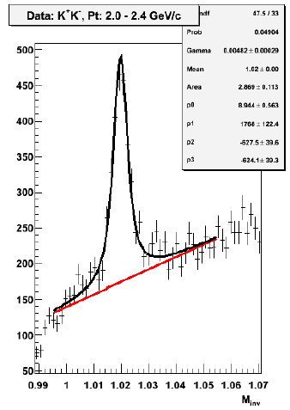
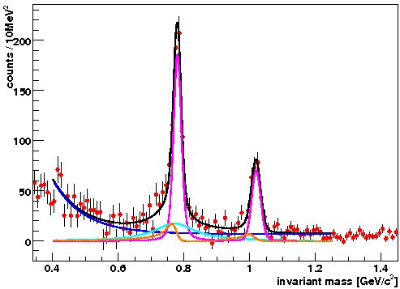
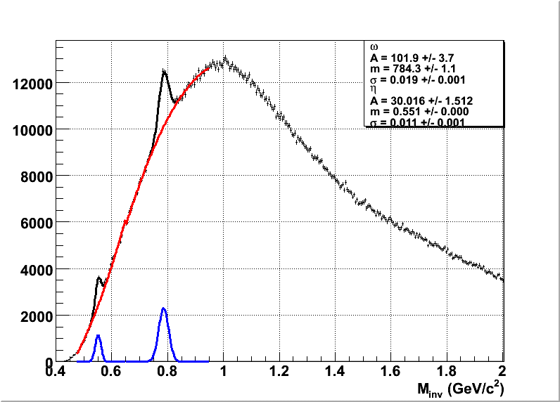
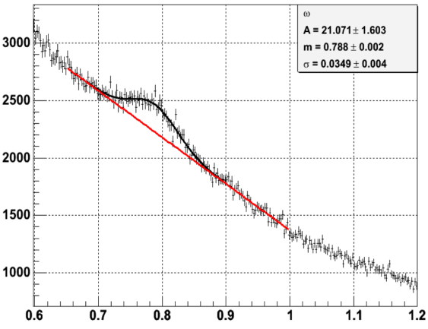
Baselines in p+p
clear peaks in all decay modes
good mass resolution except in radiative mode
p+p; φ → K⁺K⁻
(single K ID)
p+p; ω → π⁰γ
p+p; ω, φ → e⁺e⁻
p+p; ω → π⁰π⁺π⁻

Slide 10
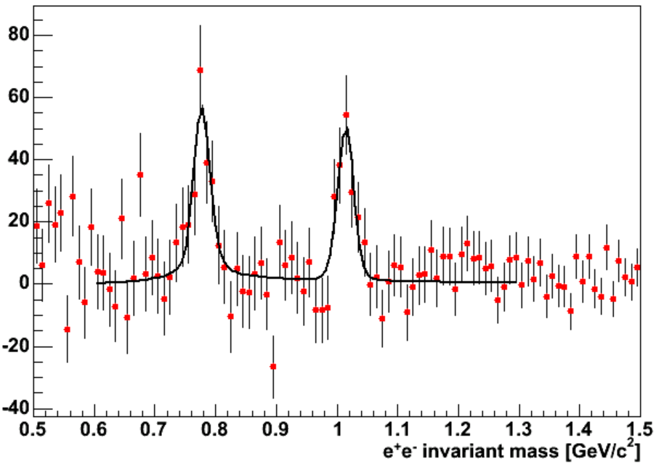
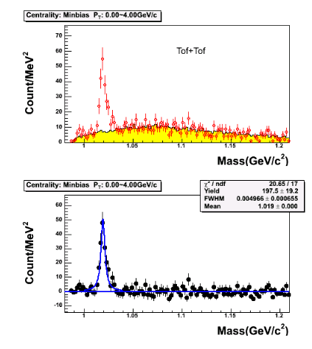
… and in d+Au
nearly as good peaks as in p+p
d+Au; φ → K⁺K⁻ (double K ID)
d+Au; ω, φ → e⁺e⁻

Slide 11
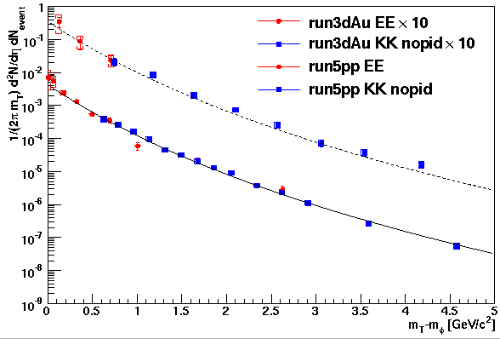
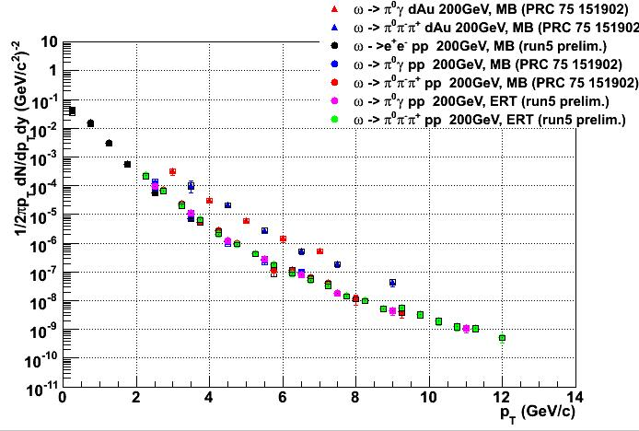
Solid Baselines Established
agreement among all measured decay modes
p+p, d+Au; ω → e⁺e⁻, π⁰π⁺π⁻, π⁰γ
No ID
Single ID
Double ID
PHENIX preliminary
p+p, d+Au; φ → e⁺e⁻, K⁺K⁻
PHENIX preliminary

Slide 12
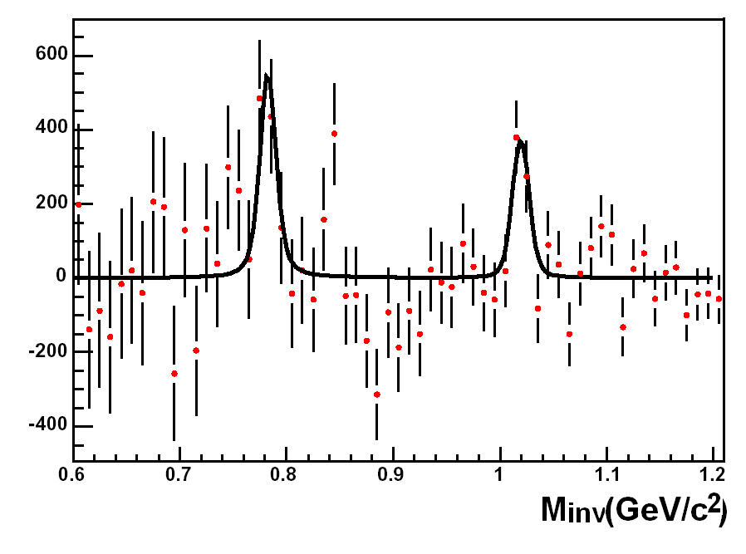
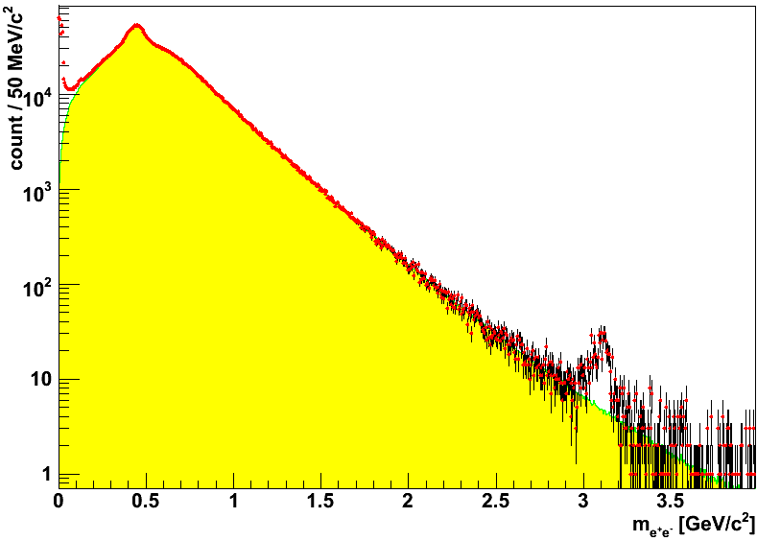
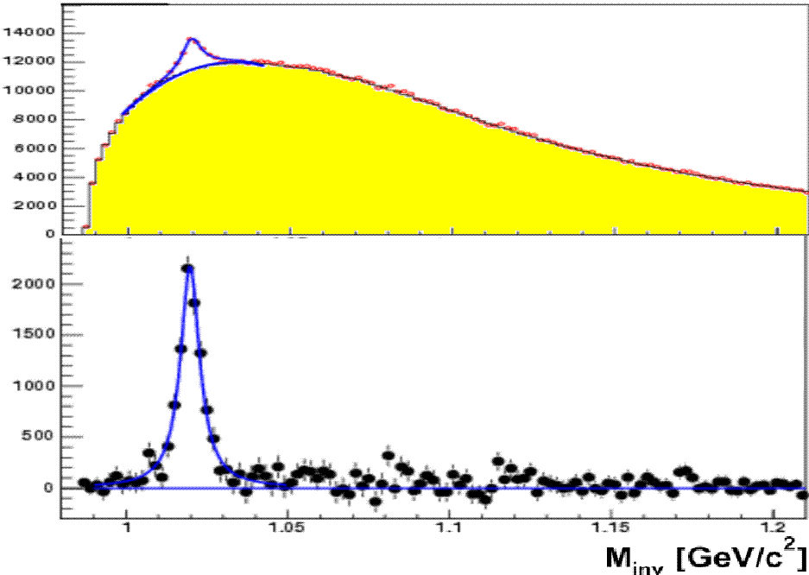
> #1a: φ/ω Mass Spectra in Au+Au
marginal statistics in featured e⁺e⁻ mode
possible mass line shape analysis in later runs
Au+Au; ω, φ → e⁺e⁻
Au+Au; φ → K⁺K⁻ (double K ID)

Slide 13
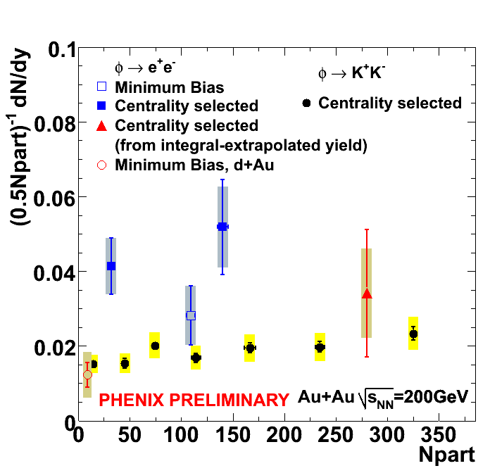
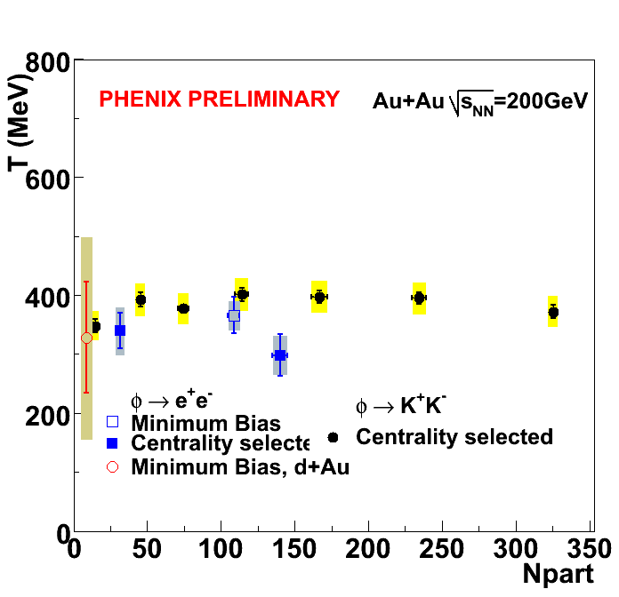
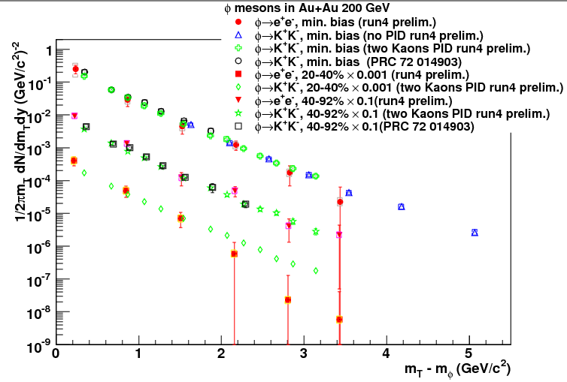
> #1b: Decay Modes of φ in Au+Au
long awaited φ → e⁺e⁻ result (close to final)
no signature of modification beyond errors
centrality dependence of integrated yield, slope, spectra
difference, if any, still to be quantified
MB
20-40%
40-92%
PHENIX preliminary
Au+Au; φ → e⁺e⁻, K⁺K⁻
Au+Au; φ → e⁺e⁻, K⁺K⁻

Slide 14
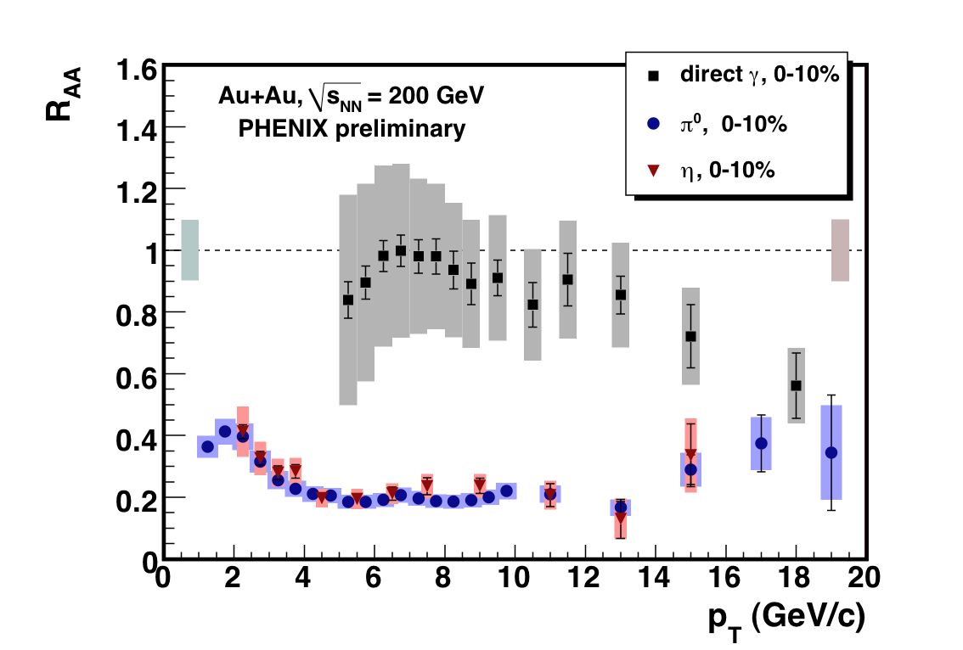
Topic #2: Quark Tomography
energy loss implied in partonic level
same nuclear modifications for π/η (but not for direct γ)
cleaner signal in higher p_{T} region
mesons decaying into multi-photons advantageous
systematic study for real “tomography”
via multiple mesons/baryons/photon
quark flavor dependence?
pseudo-scalar mesons versus vector ones?
photon decay modes of (vector) mesons motivated

Slide 15
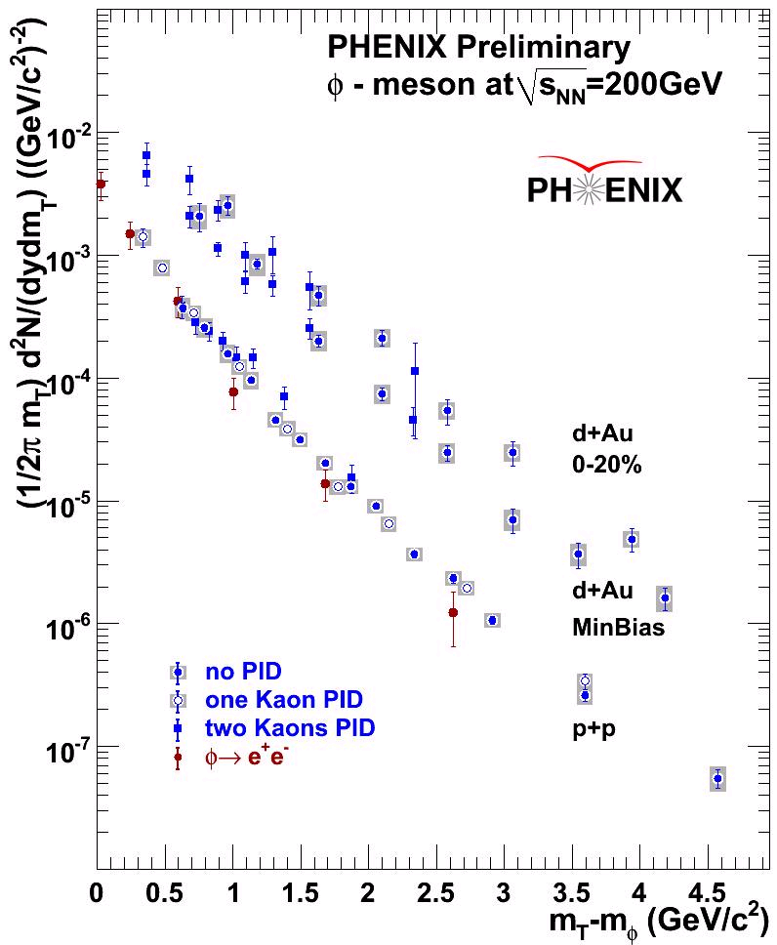
Extended φ Baseline in p+p/d+Au
double/single/no K identification methods
extended p_{T} reach to both low and high sides
different efficiencies and signal/background ratios
consistent results
p+p, d+Au; φ → (e⁺e⁻,) K⁺K⁻

Slide 16
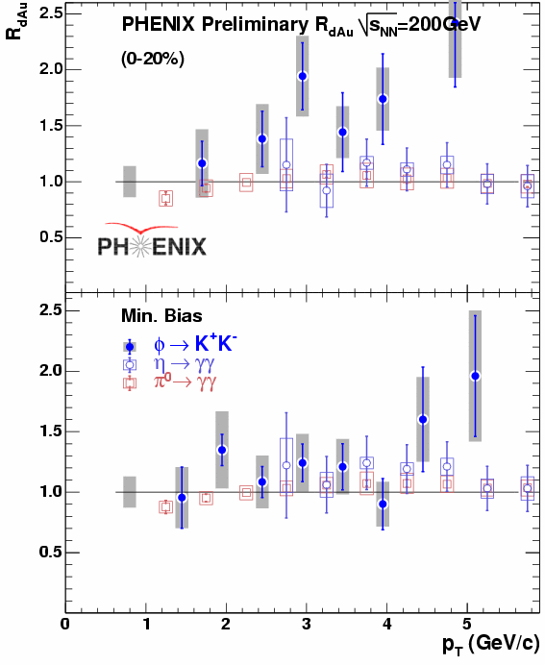
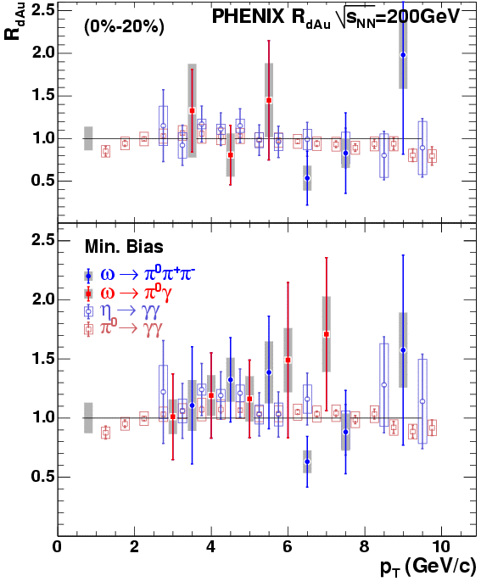
Long Solid Baselines
no suppression in d+Au; consistent with π and η
d+Au 0-20%; φ → K⁺K⁻
d+Au 0-20%; ω → π⁰π⁺π⁻, π⁰γ
d+Au min.bias; φ → K⁺K⁻
d+Au min.bias; ω → π⁰π⁺π⁻, π⁰γ

Slide 17
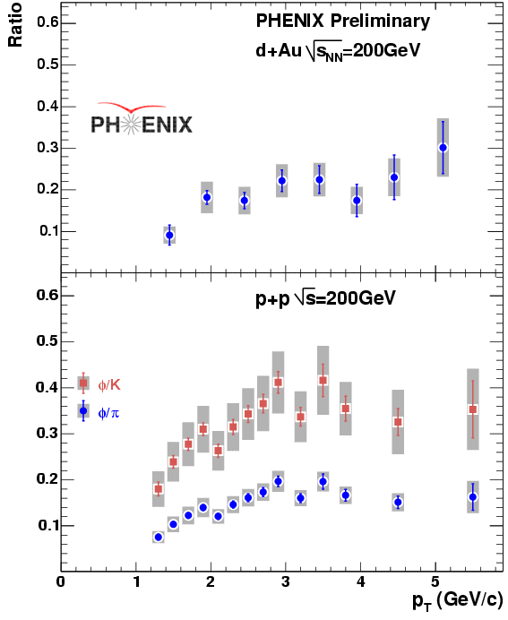
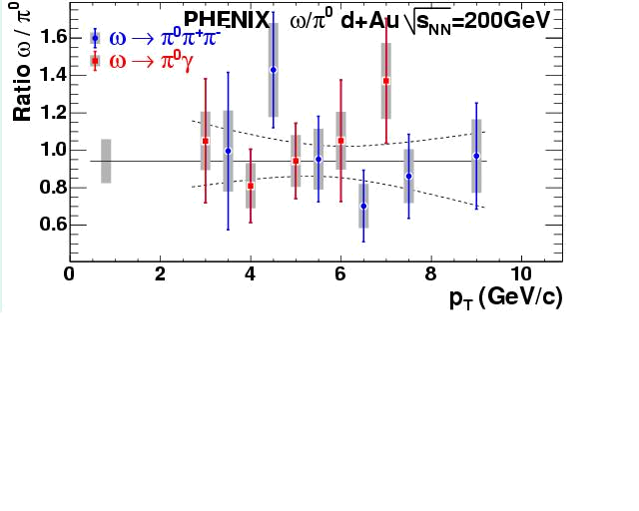
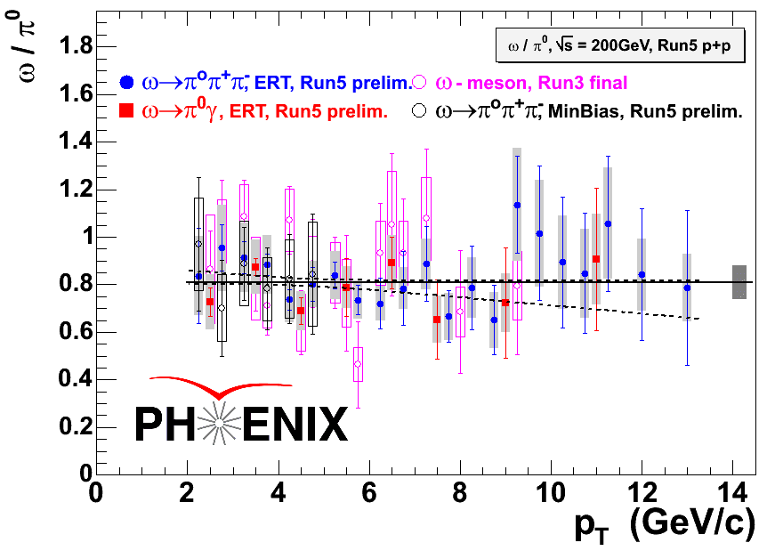
Little p_{T} Dependence in p+p/d+Au
φ, ω/π (K) ratios ~ flat above a few GeV/c
another view of baseline
d+Au; φ/π
d+Au; ω/π
p+p; φ/π (K)
p+p; ω/π

Slide 18
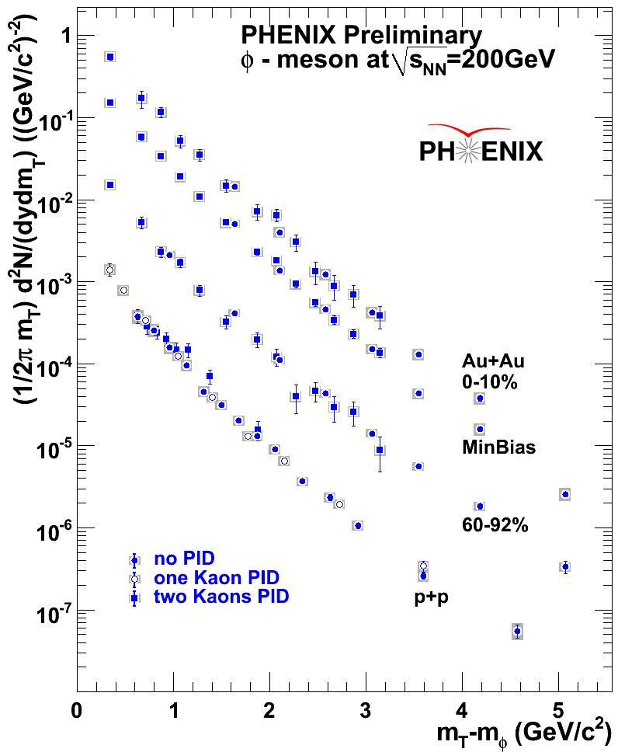
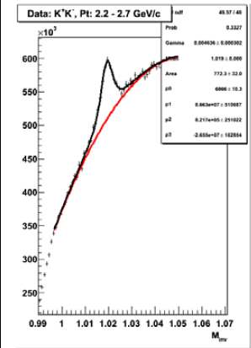
Highlight on High p_{T} Side of Au+Au φ
double/single/no K ID methods as in p+p/d+Au
double K ID
Au+Au; φ → K⁺K⁻
no K ID
p+p, Au+Au; φ → (e⁺e⁻,) K⁺K⁻

Slide 19
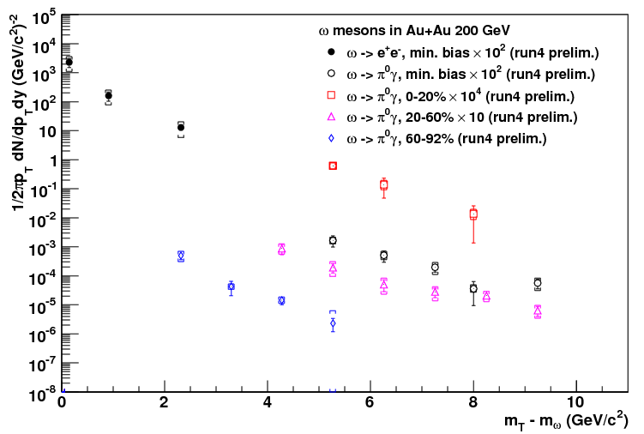
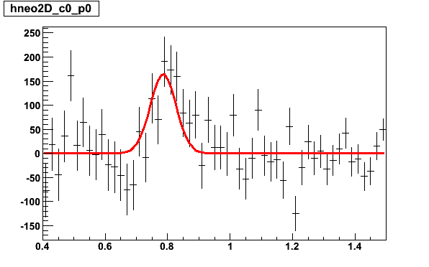
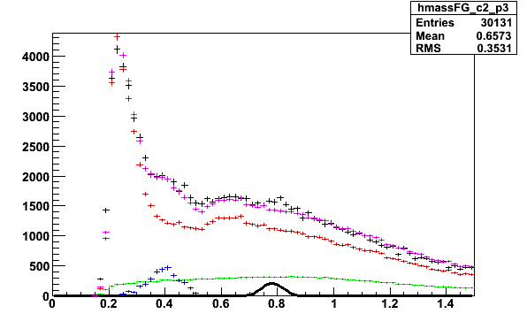
Recent Highlights in Au+Au ω Analysis
ω → π⁰γ on high p_{T} side up to ~ 10 GeV/c
long awaited ω → e⁺e⁻, along with φ → e⁺e⁻
MB
0-20%
60-92%
20-60%
PHENIX preliminary
Au+Au; ω → e⁺e⁻, π⁰γ
Au+Au; ω → π⁰γ

Slide 20
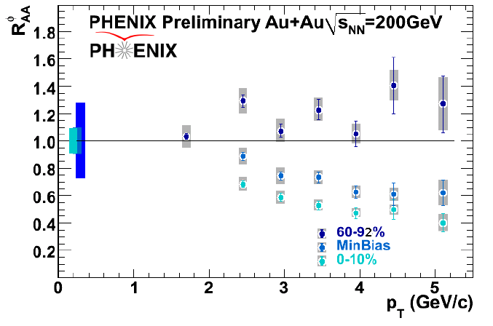
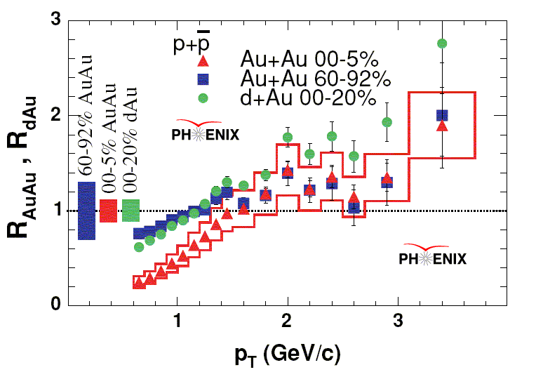
φ (, ω): Meson As Heavy As Proton
different behavior between φ (, ω) and protons
protons not suppressed regardless of centrality
not an mass effect; partonic energy loss implied

Slide 21
> #2: Quark Tomography in Au+Au
quark flavor/spin dependent suppression?
interesting behavior of nuclear modification for φ, ω
K_{s}⁰ at high p_{T} (→ π⁰π⁰) also under study

Slide 22
Topic #3: Low-Mass Continuum
low-mass continuum enhancement at SPS
melting ρ? broadening? thermal virtual photon?
CERES/NA45

Slide 23
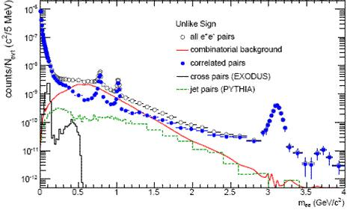
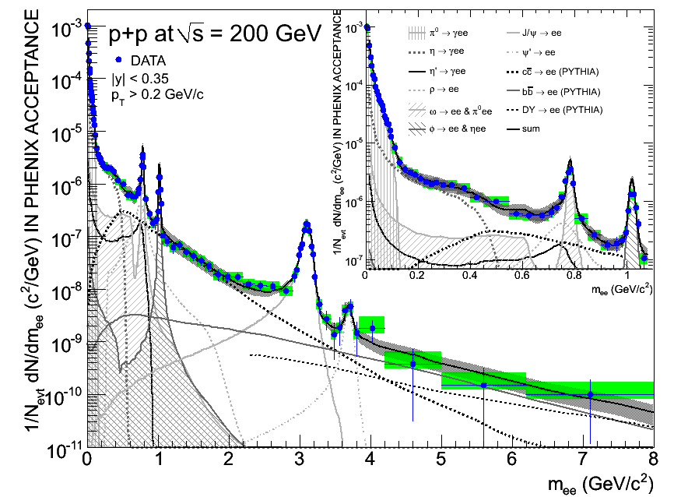
Di-Electron Continuum in p+p
signal/background ~ 1
peaks well separated due to high resolution
agreement with hadron decay contributions
charm consistent with PHENIX single electrons
ref. Fri/AM6 I.Garishvili
Notes:
22

Slide 24
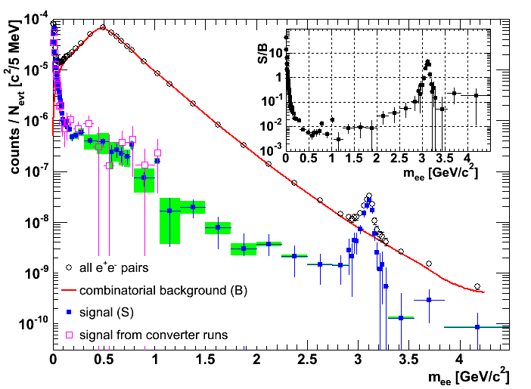
Continuum Extraction in Au+Au
signal/background ~ 1/200
large systematic error from tiny background uncertainty
agreement with extra γ converter runs

Slide 25
Di-Electron Continuum Enhancement
observed in low mass region below ω/ρ
3.4 ± 0.2 (stat) ± 1.3 (sys) ± 0.7 (model) (150–750 MeV)
not in intermediate mass between φ and J/Ψ
agreement with PYTHIA with modified charm
Notes:
24

Slide 26
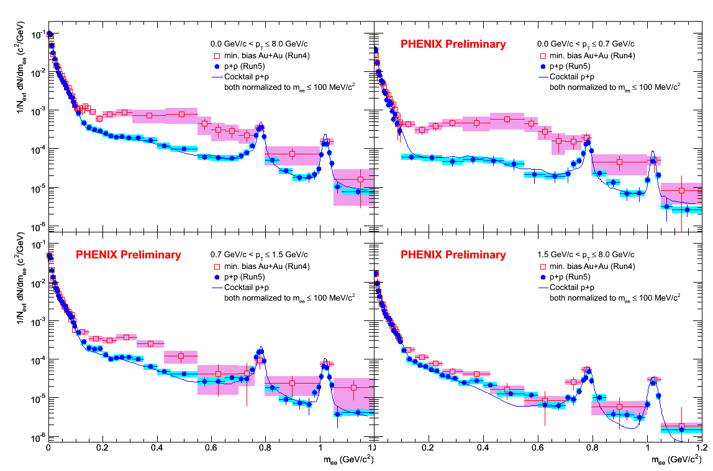
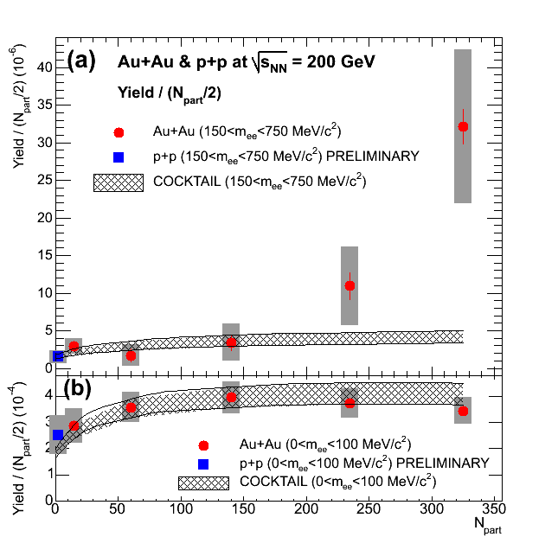
Continuum Enhancement Features
concentrated in low p_{T}
faster increase than number of participants
0 < p_{T} < 8.0 GeV/c
0 < p_{T} < 0.7 GeV/c
0.7 < p_{T} < 1.5 GeV/c
1.5 < p_{T} < 8.0 GeV/c

Slide 27
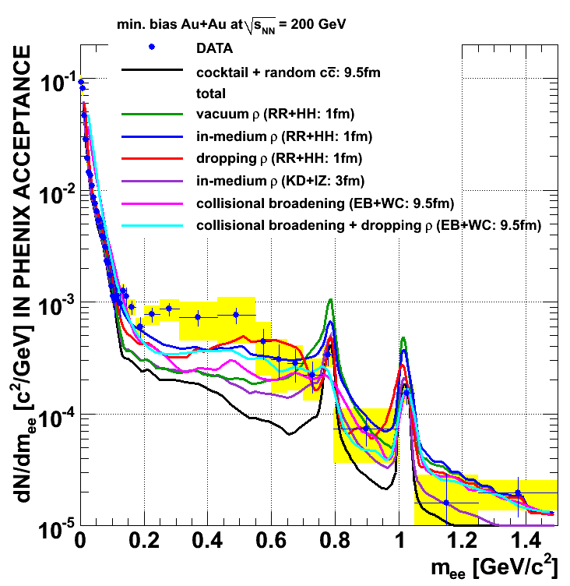
> #3: Low-Mass Continuum in Au+Au
not described by any theoretical model
SPS data (CERES, NA60) described by broadening

Slide 28
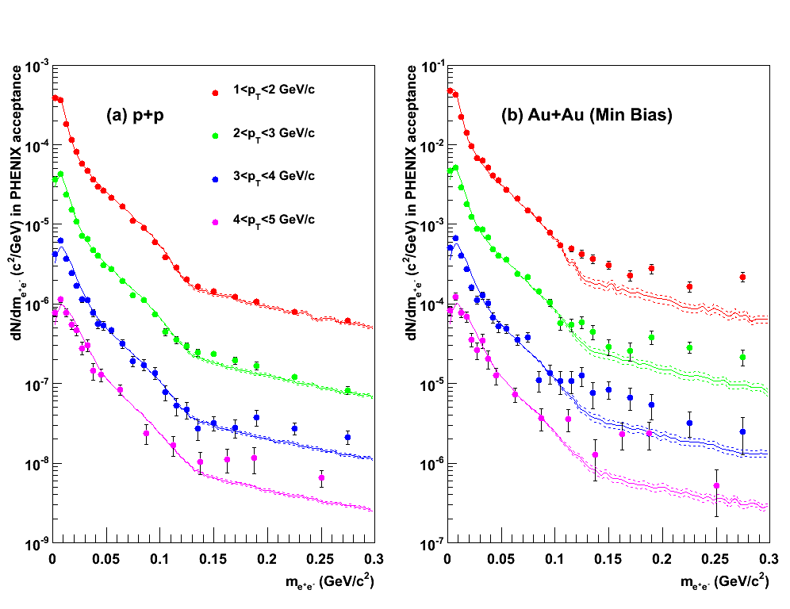
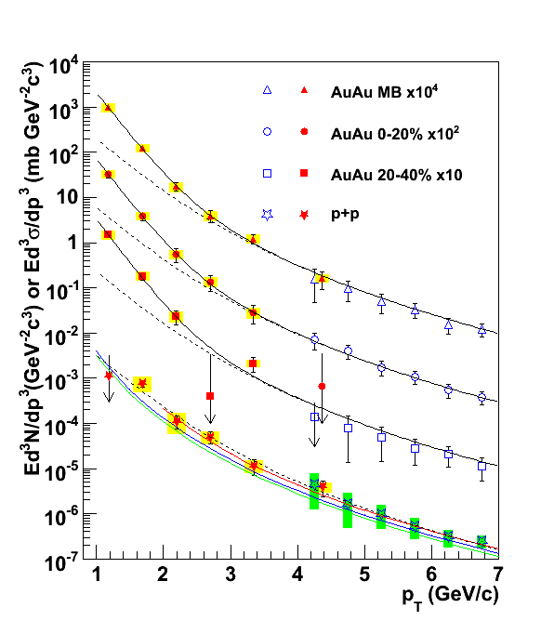
cf. γ* at Low Mass Higher p_{T}
first measurement of thermal radiation at RHIC
ref. Wed/PM3, S.Bathe
p+p: small excess consistent with pQCD
Au+Au: large excess at all p_{T}

Slide 29
Summary, Remarks and Outlook
multi-fold physics in low-mass region addressed
solid systematic baselines established in p+p/d+Au
Au+Au challenges identified, attacked, overcome
electron/photon measurements, as well as hadrons
continuum enhanced in Au+Au; still “mysterious”
paper(s) submitted to PRL
vector mesons in Au+Au elaborated and being finalized
papers in preparation
further systematic studies laid out/underway
HBD to make use of next Au+Au run
ref. Sat/AM1 R.Seto

