Slide 1
Office of Space Commercialization
Overview and Accomplishments

Slide 2
OSC Background/ Mission Areas
Vision: A Robust and Responsive U.S. Industry
Established in 1988
Initially within the Office of the Secretary
Funding transferred to NOAA/NESDIS in 2004
Mission Areas
National Space Policy Stewardship (DOC and Industry)
Commercial Remote Sensing (CRS)
Positioning, Navigation and Timing (PNT)
Space Transportation (w/FAA)
Entrepreneurial “New Space” (Operational U.S. civil requirements)
Export Control Policy Reviews
USG Lead Negotiator for GPS-Galileo Trade Issues
Long-Term Office Sustainability

Slide 3
OSC Staff and Responsibilities
Ed Morris, SES
Office Director
Jason Kim, Senior Policy Analyst
Positioning, Navigation, and Timing (PNT)
PNT EXCOM Staff Member
Eve Douglas, Senior Program Analyst
Commercial Remote Sensing (CRS)
NOAA Resource Allocation Program Manager
Michael Beavin, Senior Program Analyst
Entrepreneurial “New Space”
Space Transportation
Joyce Voyles, Program Support Specialist
Office Manager
OSC Staff Aligned to meet Stakeholder Requirements

Slide 4
PNT EXCOM Support
Assigned to support National Space-Based Positioning, Navigation, and Timing (PNT) Executive Committee (EXCOM) staff in 2005
National GPS management system (2004 PNT National Policy)
OSC provides facilities, IT services, and administrative support
OSC authorities used for EXCOM staff funding transfers and contracts
OSC Office Location (HCHB)
OSC Staff
PNT Staff
OSC provides “Tenant” support to PNT EXCOM Staff

Slide 5
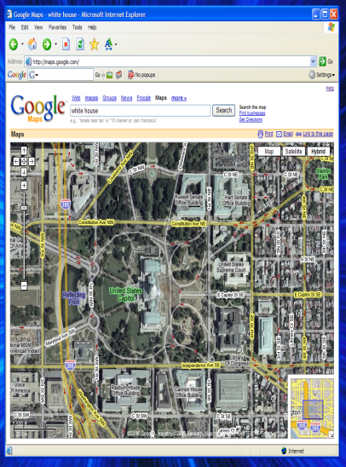



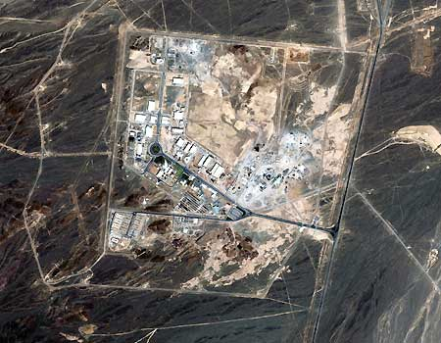

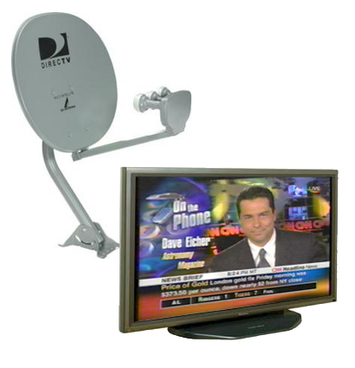

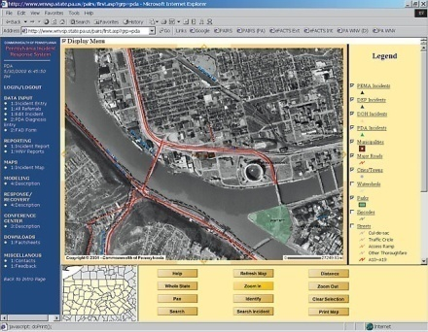
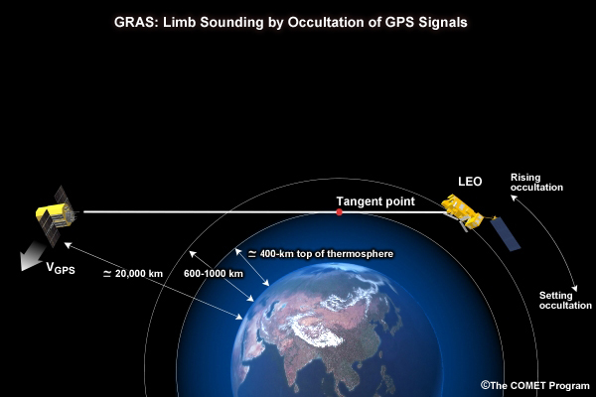

OSC Stakeholders
AP/IKONOS satellite image courtesy of GeoEye
Stakeholders include Commercial and Government Markets

Slide 6
Accomplishments Since FY04
National Space Policy Stewardship (DOC and Industry)
Established PNT National Coordination Office (NCO) (PNT Policy)
DOC lead for BASIC Joint Analysis Team Policy (CRS Policy) Evaluation
Lead advocate (w/DHS) for Distress Alerting Satellite System (DASS)
EOP selected for Senior Management Oversight Committee Vice-Chair (w/NGA)
Established Space Transportation MOU with FAA/AST
Entrepreneurial “New Space”
Issued commercial solution studies (8) for civil agency requirements
Finalized agreement to negotiate NOAA access to personal space flight system
Target Specific Actions for Broad Stakeholder Community

Slide 7
Accomplishments Since FY04 (Cont.)
Export Control Policy Reviews
Partnered with BIS to generate Space Industrial Base Study
USG Lead Negotiator for GPS-Galileo Trade Issues
Secured EU intent to authorize sale of Galileo simulators to US manufacturers
Long-Term Office Sustainability
Published OSC Strategic Plan based on stakeholder requirements
Administration proposed Space Commerce Act of 2007 legislation
Target Specific Actions for Broad Stakeholder Community

Slide 8

Space Commerce Act of 2008
Proposal updates institutional OSC authorities
Serve as principal unit in DOC for space commerce policy activities
Foster conditions for economic growth and technological advancement
Represent space commerce interests within USG and internationally
Promote U.S. geospatial technologies
Support national management of GPS
H.R. 6935 and S.3504 introduced
Growing stakeholder support
Include in transition package
Proposed Legislation Required to Update Authorities

