Slide 1

Uranium Resources in New Mexico

Slide 2
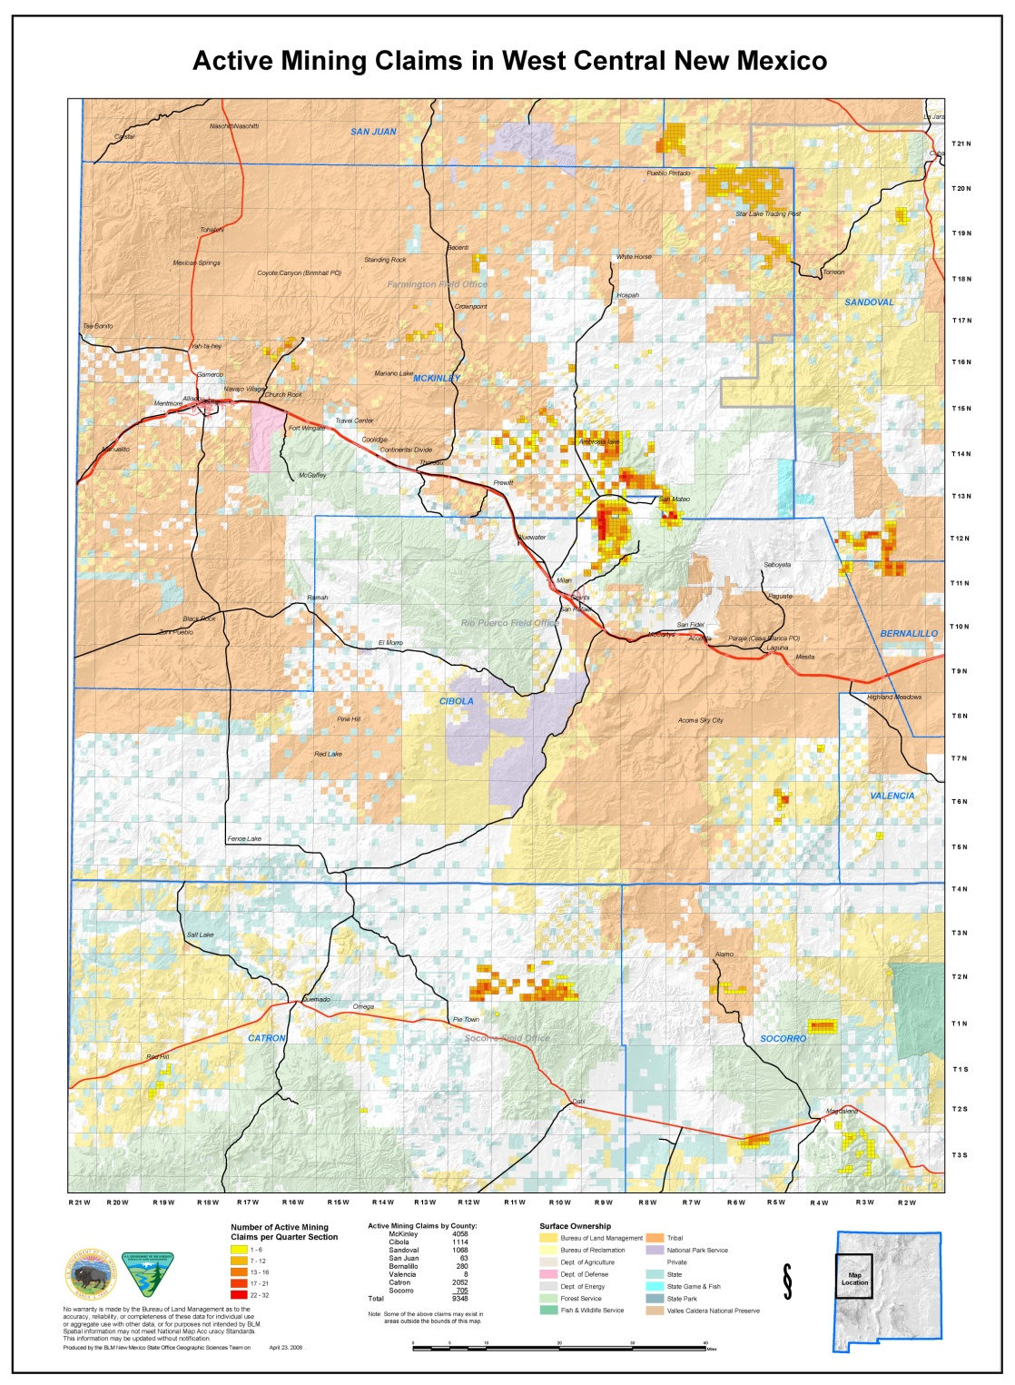

Slide 4
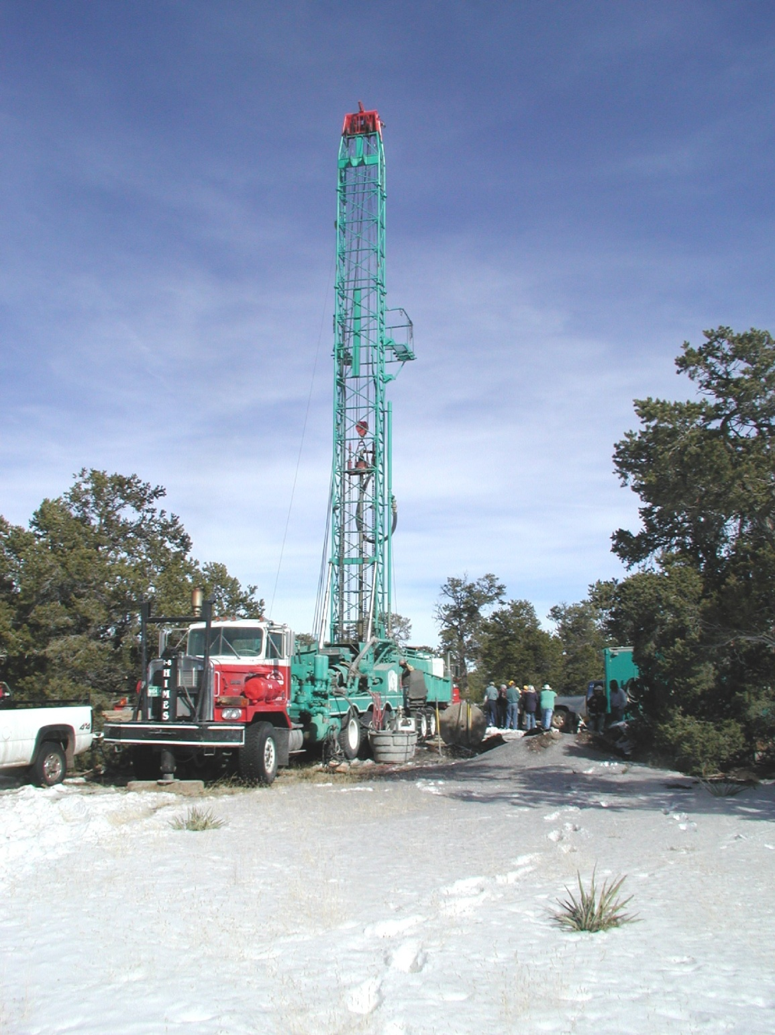

Slide 5
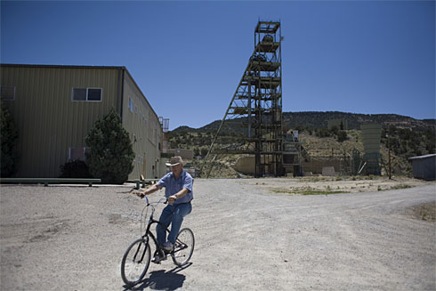

Slide 6
ACQUISITION
Mining Claims on Federal Land
State Lease
Indian Lease
Private Mineral (owned or leased)
OPERATIONS
Federal Surface Management Agencies
NM Mining and Minerals Division
Indian Leases (43 CFR 3590)
Nuclear Regulatory Commission
EPA/ NMED
State Historic Preservation Division

Slide 7
New Claims
 | Increase In New Claims FY 04-07 | Total New Claims FY 04-07
Arizona | 161% | 33,190
Colorado | 1173% | 11,766
New Mexico | 785% | 9,883
Utah | 592% | 29,572
Wyoming | 762% | 35,254

Slide 8
MMD Permits Filed
Approved Pending Denied/Withdrawn
Private 1 2 4
USFS 3 0 5
State 2 0 0
BLM 1 0 1

Slide 9
NM Uranium Facilities (1979)
27 Private
1 State
1 Federal
3 Laguna Tribal
2 Navajo Tribal
1 Navajo Trust
1 Navajo Trust/Private Mineral
ALL MILLS ON PRIVATE LAND

Slide 10
NM State & Federal Permitting
BLM and Forest Service
Casual Use
Notice
Plan of Operations
MMD
Minimal Impact Permit
Non-Minimal Impact Permit

Slide 11
Legal Considerations
Dine Natural Resources Protection Act of 2005 (DNRPA)
Indian Country
Traditional Cultural Property (TCP)

Slide 12
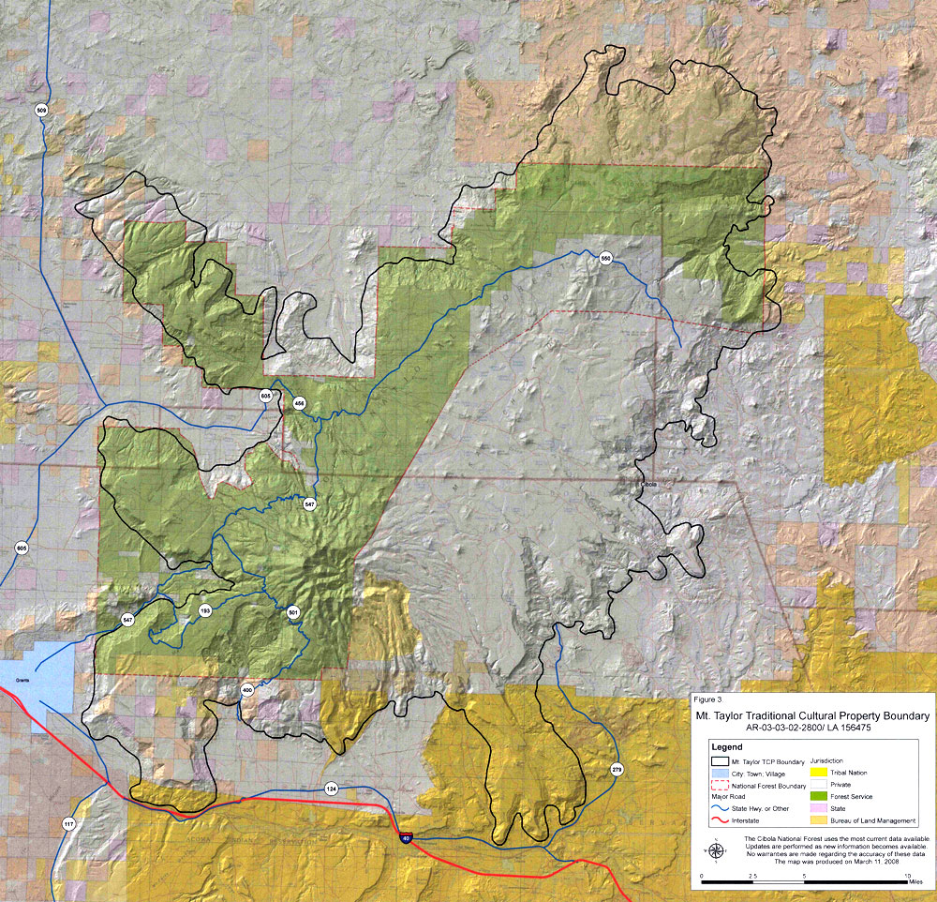

Slide 13
Environmental, Economic and Political Considerations
Navajo Nation
Pueblos
Acoma, Zuni, Laguna
Eastern Navajo Dine Against Uranium Mining (ENDAUM)
Southwest Research and Information Center
NM Environmental Law Center

Slide 14
Environmental, Economic and Political Considerations
Cibola and McKinley County Governments
Grants City Merchants
Eastern Navajo Allottee Association
Governor Bill (?)

Slide 15
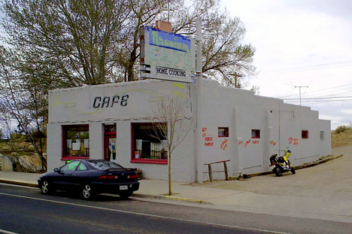

Slide 16
Conclusions
The regulatory processes of the various State and Federal agencies need clarification and coordination.

Slide 17
Conclusions
BLM NM is responsible for the most Indian mineral acreage with uranium reserves.

Slide 18
Conclusions
The majority of future operations in NM can be expected to be on private land.

Slide 19
Conclusions
NM is one of the most politically and environmentally charged states because of the legacy of past uranium mining on Indian lands, especially Navajo lands.

Slide 20
Conclusions
Political & environmental pressures at all governmental levels could result in a moratorium/regional EIS or even a prohibition on uranium development.

Slide 21
