Slide 1
NeuVision Image Encoder

Slide 2
Robotics
Image Sensors
Cambrian Robotics
Omron Automation
AMS OSRAM
Onsemi
NeuVision Image Encoder
AR/VR
eye tracking
AR overlay
Deep Learning Stack
integer quantization
Industrial Measurement
Google TFLite
Cognex
Sensopart
Helmee Imaging
Notes:
The image sensor companies have a problem, which is the high data rate of raw pixels over MIPI. Only a handful of SoC platforms can handle MIPI e.g. NVDA Jetson. The result is that the SoC costs more than the image sensor, limiting adoption of embedded vision. The NV image encoder compresses raw pixels into a 30X smaller feature map + thumbnail, which total 78Mb/s and can be transmitted over USB 2.x. This compressed representation can directly drive downstream tasks such as object recognition and localization, image super resolution, and patch embeddings for a multimodal LLM. Horizon tasks include embodied robotic vision, motor control, and MM-LLM executive functions.

Slide 3
NeuVision Image Encoder Concept
MIPI
[1400,1600,3]
[14,18,512]
microcontroller
USB2
raw pixels
feature map
[140,160,3]
RGB rescale
thumbnail
NV-IE100
scalable foundation vision CNN with 8M parameters
reconfigurable SRAM-based weights
NV-IE100
500MHz clock
3840 integer MAC units
64Mb SRAM (weights)
20Mb SRAM (rowbuf)
CNN RTL available now
MIPI
1600x1400 RGB pixels
12 bits/pixel
30 frames/s
= 2.42 Gb/s
USB
[14,18,512] features
16 bits/feature
30 frames/s
= 62 Mb/s
USB
[140,160,3] thumbnail
8 bits/pixel
30 frames/s
= 16 Mb/s
30X
compression
Notes:
NeuVision Image Encoder performs the initial convolutional pyramid using a VGG-like 18-layer CNN architecture.
The 8M weight VGG18 architecture is a strong foundation vision model with broad applications.
The image encoder also performs a compression function.
Weights are 8 bits, so 64Mb SRAM (weights) + 20Mb SRAM (row buffers) + standard cell logic

Slide 4
Reference Board Concept
real time image encoder
compact form factor, USB powered
supports a broad range of applications
low pin count interfaces
includes USB to I2C for configuration
memory map provides access to weights
lens mount
Mira220
I2C
MIPI CSI-2
DPHY 1.5Ghz
2 data, 1 clock
NV-IE100
NV-IE USB endpoint | M/S
feature pipe | M
thumbnail pipe | M
I2C bridge | S
NV-IE memory map | S
USB2

Slide 5
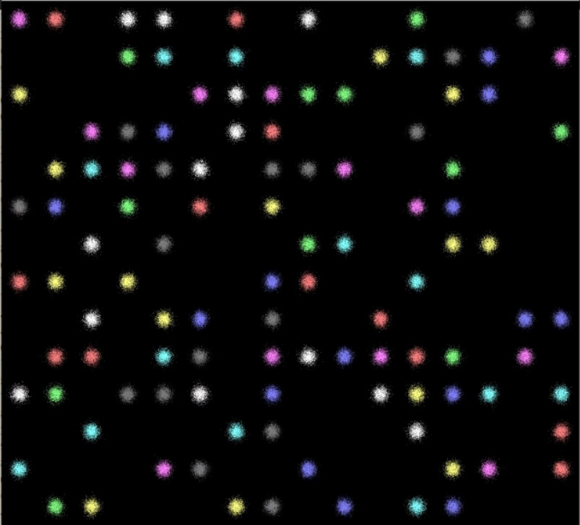
16 columns
Receptive field unit test
randomly populate 16x14 grid locations
label is '0' if empty, '1' if colored ball
224 binary labels
14 rows
1600x1400 RGB images
[1400,1600,3]
[14,18,512]
[224]
pixels
probabilities
NV-IE100 CNN
1x1 conv, 2x1000 dense, 224 dense
binary crossentropy loss

Slide 6
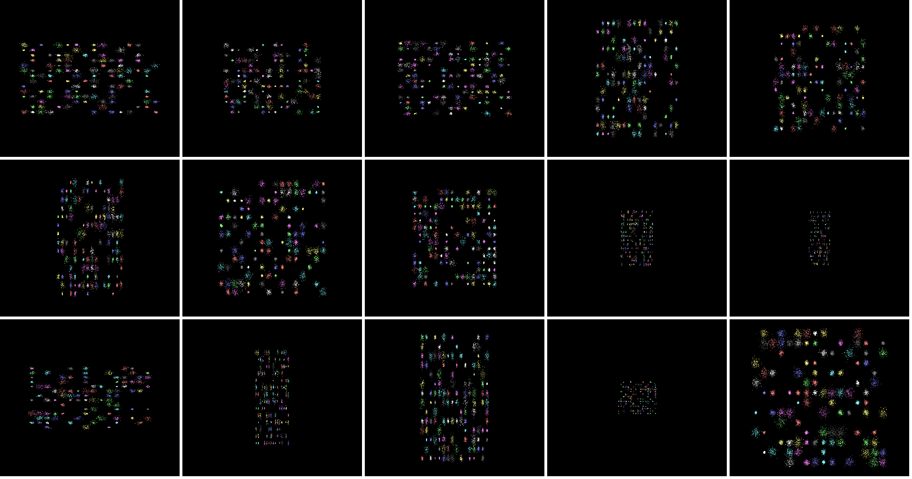
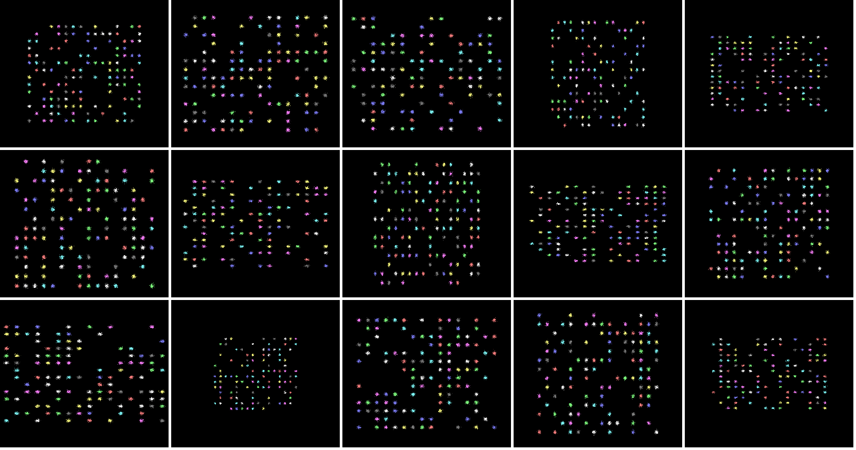
thumbnail gallery of 1600x1400 RGB input images

Slide 7
Product Planning
Milestone | Dependencies | Status
Concept Commit | PRD/datasheet die size/power estimate preliminary budget/schedule | needed for AMS OSRAM joint development proposal
Execution Commit | complete program plan to FCS
FCS | standard SoC development process
PRD Feature | Priority | Schedule
MIPI CSI-2, DPHY RX, 1C 2D, 1.5GHz | P1 | MVP, fastest TTM
[1400,1600,3] input shape (frame) 12 bits/pixel 30 frames/s | P1 | Mira220 RGB
[14,18,512] output shape (feature map) | P1
[140,160,3] output shape (thumbnail) | P1
USB 2.0 PHY, controller | P1

Slide 8
NV-IE100 top level diagram
Block | Owner
MIPI
USB
RGB
CNN
I2C
MIPI
DPHY
CSI-2
AXI-S FIFO
AXI-lite
USB
2.x, 480Mb/s
PHY, controller
AXI-S FIFO
AXI-lite master
clock
data0
data1
AXI-S
AXI-S
CNN top
AXI-lite
rx
tx
AXI-S
RGB rescaler
AXI-lite
PLL
sda
scl
I2C controller
AXI-lite
Notes:
use box filter for rescaler e.g. https://scholarworks.rit.edu/cgi/viewcontent.cgi?article=10864&context=theses

Slide 9
Execution Planning
Function | Tasks | Lead
CNN compiler | add level of hierarchy for inferred SRAM add SRAM option to replace weight ROM (SPI config) enhancements and fixes as needed (DAG,TFLite metadata,quantization) | Rob +Alain, Dana?
RTL design | MIPI CSI-2 RX with DPHY USB PHY and controller CNN top input/output interfaces and FIFO RGB image rescaler and FIFO I2C controller for image sensor configuration | Prakash +Rob
Verification (simulation) | End to end unit tests, pixels to predictions Also correlate predictions with TFLite reference interpreter | Prakash +Rob
Physical implementation | Standard ASIC flow with 500MHz core clock, 16nm libraries Run initial flat P&R experiment on compiled CNN with 18 layers | Liwu
Tools / Automation | Automate SRAM physical memory compiler for arbitrary size CNN instances | Bhavya?
Verification (emulation) | Prototype full chip at 200MHz, partition across multiple FPGAs | Prakash, Rahul
Reference board | Mira220 RGB + NV-IE100, compact fanless form factor, USB powered | Ashraf?
Applications/Models Documentation FAE Support | Mira220+ Opal Kelly Artix US+ data capture and demo Build reference apps/models e.g facial keypoint detection, image super resolution, support HuggingFace model community | Rob +Brian, Bhavya, Rahul?

Slide 10
NeuVision Roadmap
feature map history
image encoder
image fusion
motion encoder
MIPI
Verilog
integrate image fusion and motion encoder into the chip
output feature maps will contain motion information which reduces the frame rate

Slide 11
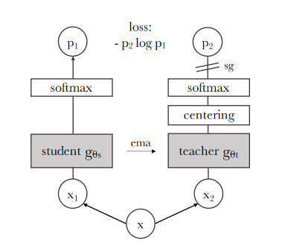
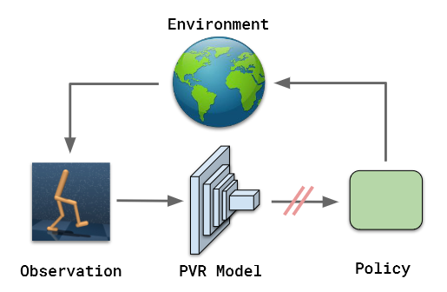
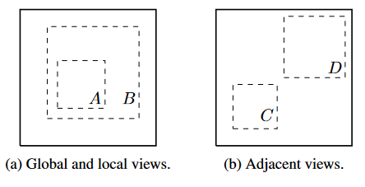
NeuVision Robotics Demo Application
Paper | Year
A Simple Framework for Contrastive Learning of Visual Representations | 2020 | random crop and rescale
Bootstrap Your Own Latent A New Approach to Self-Supervised Learning | 2020 | positive pairs only
Emerging Properties in Self-Supervised Vision Transformers | 2021 | our baseline method (DINO)
The (Un)Surprising Effectiveness of Pre-Trained Vision Models for Control | 2022 | robot demo
Notes:
SimCLR introduced the effectiveness of using random crops from an image for self-supervised representation learning.
BYOL introduced self-supervised learning with positive examples only.
DINO refines BYOL and will serve as our baseline algorithm for self-supervised feature learning for images
For video, transformers may be preferable as sequence processors.
Our initial objective is to demo a real time, pretrained vision model in a robot control setting.

Slide 12
APPENDIX

Slide 13
Risks
Risk | Sev | Mitigation
negative effects of integer quantization |  | POR use TFLite signed integer 8b weights, 16b activations Straightforward to switch to 8b/16b floating point as a fallback
no batch normalization or skip connections |  | POR use RELU activations with small learning rate Straightforward to support SELU using 64Kx16 SRAM LUT as a fallback
MIPI burstiness due to vertical blanking |  | CNN throughput is specified as a row time, not frame time

Slide 14
NeuVision Strategy
chip company vs. IP, vs. FPGA only
use existing team as it rolls off the Virgo tapeout
straightforward execution and go to market -> fast TTM
image sensor companies are natural partners

Slide 15
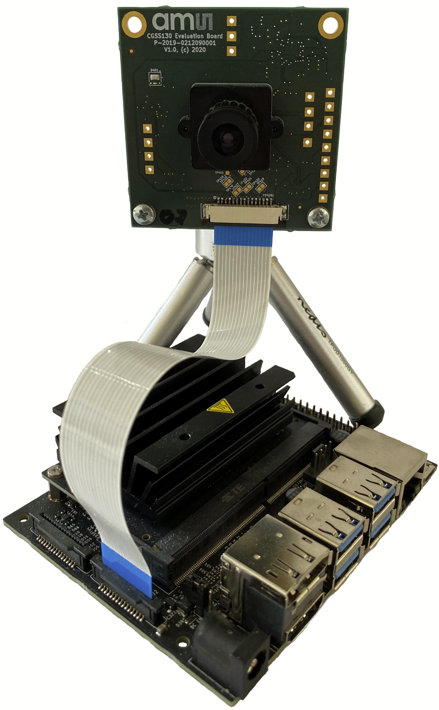
MIPI SoC platforms exceed the cost of the image sensor

Slide 16
Image Encoder Product Options
NeuVision Product | Model Architecture | Model Weights | Scalability
NV-IE-FPGA | reconfigurable | reconfigurable | <1M weights, <1 TOP, chiplets?
NV-IE-100-RAM | fixed VGG18 | reconfigurable (RAM) | 8M weights, 2 TOP
NV-IE-100-ROM | fixed VGG18 | fixed (ROM) | 8M weights, 2 TOP
NeuVision Image Encoder performs the initial convolutional pyramid using a VGG-like architecture.
The proposed 8M weight VGG18 architecture is a strong foundation vision model with broad application.
The image encoder also performs a valuable compression function.
Weights are 8 bits, so 64Mb SRAM (weights) + 20Mb SRAM (row buffers) + standard cell logic

Slide 17
_________________________________________________________________
Layer (type) Output Shape Param #
=================================================================
input_1 (InputLayer) [(None, 1400, 1600, 3)] 0
conv2d (Conv2D) (None, 1398, 1598, 16) 448
conv2d_1 (Conv2D) (None, 698, 798, 16) 2320
conv2d_2 (Conv2D) (None, 696, 796, 16) 2320
conv2d_3 (Conv2D) (None, 694, 794, 32) 4640
conv2d_4 (Conv2D) (None, 346, 396, 32) 9248
conv2d_5 (Conv2D) (None, 344, 394, 32) 9248
conv2d_6 (Conv2D) (None, 342, 392, 64) 18496
conv2d_7 (Conv2D) (None, 170, 195, 64) 36928
conv2d_8 (Conv2D) (None, 168, 193, 64) 36928
conv2d_9 (Conv2D) (None, 166, 191, 128) 73856
conv2d_10 (Conv2D) (None, 82, 95, 128) 147584
conv2d_11 (Conv2D) (None, 80, 93, 128) 147584
conv2d_12 (Conv2D) (None, 78, 91, 256) 295168
conv2d_13 (Conv2D) (None, 38, 45, 256) 590080
conv2d_14 (Conv2D) (None, 36, 43, 256) 590080
conv2d_15 (Conv2D) (None, 34, 41, 512) 1180160
conv2d_16 (Conv2D) (None, 16, 20, 512) 2359808
conv2d_17 (Conv2D) (None, 14, 18, 512) 2359808
=================================================================
Total params: 7,864,704
Trainable params: 7,864,704
Non-trainable params: 0
_________________________________________________________________
proposed VGG-like CNN
uses conv2d layer only
downsample using stride=2
padding=valid
activation nonlinearity=RELU, last layer=None
8 bit integer weights, 16 bit integer activations

Slide 18
Proposed NeuVision Image Encoder
NV-IE-MIRA220
500MHz clock
7500 integer MAC units
64Mb SRAM (weights)
20Mb SRAM (rowbuf)
Verilog RTL available now
NV-IE-MIRA220
MIPI
USB
microcontroller
[1400,1600,3]
[14,18,512]
scalable foundation vision CNN with 8M parameters
reconfigurable SRAM-based weights
MIPI
1600x1400 RGB pixels
12 bits/pixel
110 frames/s
= 8.87 Gb/s
USB
[14,18,512] features
16 bits/feature
110 frames/s
= 0.227 Gb/s
39X compression
Notes:
NeuVision Image Encoder performs the initial convolutional pyramid using a VGG-like 18-layer CNN architecture.
The 8M weight VGG18 architecture is a strong foundation vision model with broad applications.
The image encoder also performs a compression function.
Weights are 8 bits, so 64Mb SRAM (weights) + 20Mb SRAM (row buffers) + standard cell logic

Slide 19
Smart Sensor Silicon Segmentation
NeuVision
- model size versions
e.g. 1M,5M,10M ROM weights
- image fusion versions
e.g. 1,2,3 MIPI inputs
- image resolution versions
e.g. [3840,2160,3], [1600,1400,1]
NeuVision Image Encoder
MIPI
USB
NeuSense
- RISC-V SoC
- Vector ISA
- general purpose connectivity
performance
products
Notes:
low end can be addressed using RISC-V SoC with vector instructions
high end can be addressed using NeuVision ROM-programmable product line

Slide 20
collect unlabeled dataset
synchronized frame capture from multiple image sensors
synchronized metadata e.g. robot servo angles
self supervised pretraining using unlabeled dataset
BYOL, DINO
few shot learning using pretrained vision model
imitation learning for robotics
classifier for object detection
image decoder for object segmentation
patch embeddings for multimodal LLM
data sheet for {100K,1M,5M,20M parameter VGG-like CNN}, {FPGA, ASIC}
area, ROM area, clock frequency
Notes:
Masked Autoencoders As Spatiotemporal Learners
DINOv2: Learning Robust Visual Features without Supervision
Emerging Properties in Self-Supervised Vision Transformers
A Simple Framework for Contrastive Learning of Visual Representations
Bootstrap Your Own Latent A New Approach to Self-Supervised Learning

Slide 21
Paper | Year
A Simple Framework for Contrastive Learning of Visual Representations | 2020 | random crop and rescale
Bootstrap Your Own Latent A New Approach to Self-Supervised Learning | 2020 | positive pairs only
Emerging Properties in Self-Supervised Vision Transformers | 2021 | our baseline method (DINO)
DINOv2: Learning Robust Visual Features without Supervision | 2023
Masked Autoencoders As Spatiotemporal Learners | 2022
The (Un)Surprising Effectiveness of Pre-Trained Vision Models for Control | 2022 | robot demo
Notes:
SimCLR introduced the effectiveness of using random crops from an image for self-supervised representation learning.
BYOL introduced self-supervised learning with positive examples only.
DINO refines BYOL and will serve as our baseline algorithm for self-supervised feature learning for images
For video, transformers may be preferable as sequence processors.
Our initial objective is to demo a real time, pretrained vision model in a robot control setting.

Slide 22
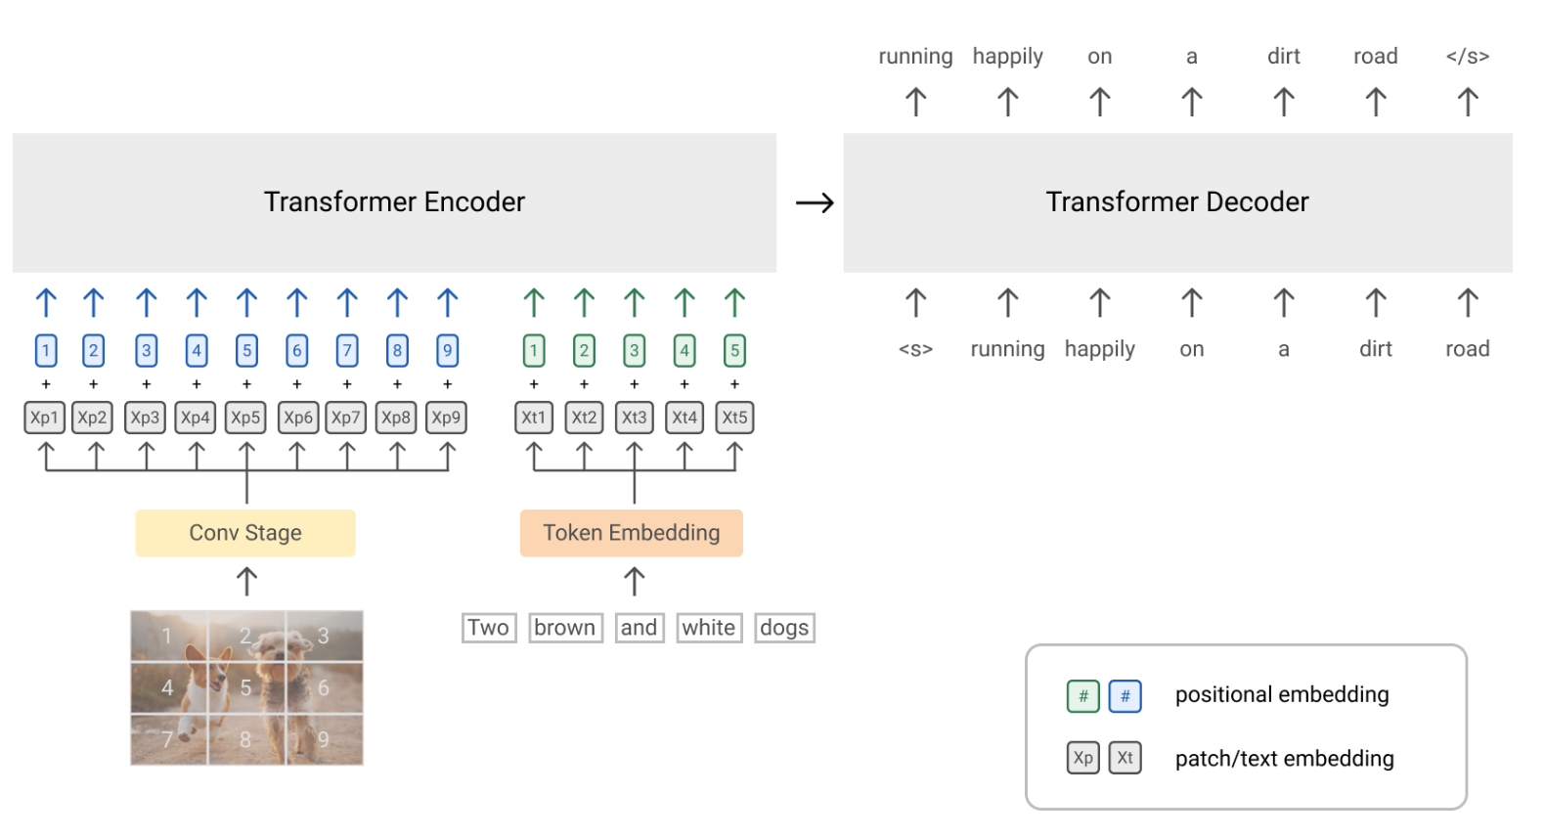
[1120,1280,3]
@110 FPS
1000X compression
[16,19,256]
@10 FPS
feature map history
image fusion
image encoder
motion encoder
MIPI
Verilog
motion decoder
depth map
object detection
semantic heatmap
optical flow
patch embeddings for multimodal LLM, e.g. SIMVLM

Slide 23
image decoder
image fusion
image sensors
depth map
object detection
semantic heatmap
image encoder
MIPI
[16,19,256]
@110 FPS
multimodal LLM, e.g. SIMVLM
Verilog
CNN
[1120,1280,3]
@110 FPS
100X compression
patch embeddings

Slide 24

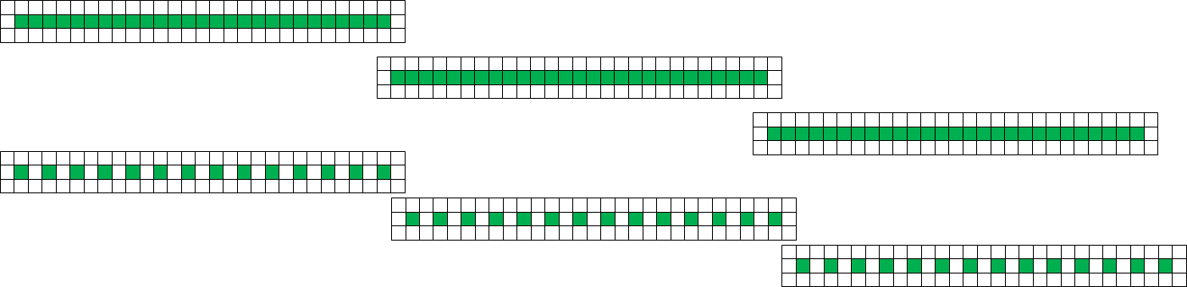
B) parallel output channels
A) parallel vertical stripes
C) parallel layers

Slide 25
TDP RAM
MAC
ALU
TDP RAM
MAC
ALU
TDP RAM
MAC
ALU
MAC
ALU
MAC
ALU
MAC
ALU
MAC
ALU
MAC
ALU
MAC
ALU
MAC
ALU
MAC
ALU
MAC
ALU
MAC
ALU
MAC
ALU
MAC
ALU
MAC
ALU
ROM
MAC
ALU
ROM
MAC
ALU
ROM
MAC
ALU
ROM
MAC
ALU
ROM
MAC
ALU
ROM
MAC
ALU
ROM
MAC
ALU
ROM
MAC
ALU

Slide 26
Andromeda CNN compiler
iverilog
VCS
model.v
model.tflite
FlatBuffers
--model model.tflite
--clk 200e6
--fps 100
model_rom.v
Vivado
Quartus
Raptor
dc_shell
conv2d.v
concatenate.v
replicate.v
…
Notes:
inference only, supports small but useful subset of TFLite (conv2d only, padding='valid', stride={1,2}, activation=RELU)
no external memory required
real time data stream -> real time prediction stream (or feature map)
tool to compile TFLite model into synthesizable Verilog
generated Verilog code is self contained, includes streaming inference and weights
compiler generates parallel code for OCHAN*NSTRIPE MAC operations
compiler generates ROM file with the weights

Slide 27

CLOUD
EDGE
AI
Training Model
Datasets
Custom FPGA
Data Capture
Sensor Input
Raptor
Inference
to
FPGA HW
Translator
Inference
Output Controller
Inference
Model (TFLite)
Custom FPGA Architecture
IP Library

Slide 28
Real time vision IP flow
data collection
"frame burst"
capture to DDR
supervised training
"imitation learning"
use OpenCV brute force algorithms to produce labels
e.g. stereo disparity, optical flow, frequency domain, segmentation
deployment
andromeda.py
conv2d.v
concatenate.v
replicate.v
model.v
model_rom.v
model.tflite
egocentric
data
IP
ongoing data sampling for continuous learning
self-supervised pre-training
+ feature alignment
+ downstream task
collect large, unlabeled, egocentric data set
pretrain using pretext augmentation, contrastive learning e.g. CLIP
align output feature map to downstream task using e.g. linear SVM
IP characterization
converts pixels to feature map
"image encoder"
"foundation vision model"
high speed vision tasks
spatial and temporal fusion
A ConvNet for the 2020s, SIMVLM
can drive multi-model LLM
- using reference datasets and models
- characterize max clock freq, DSP, BRAM, area
- over {input shapes, frame rates, model sizes}

Slide 29
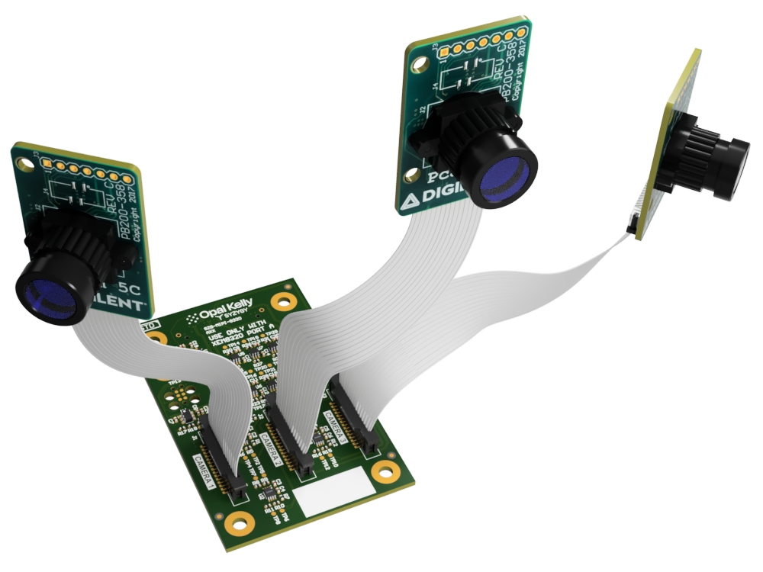
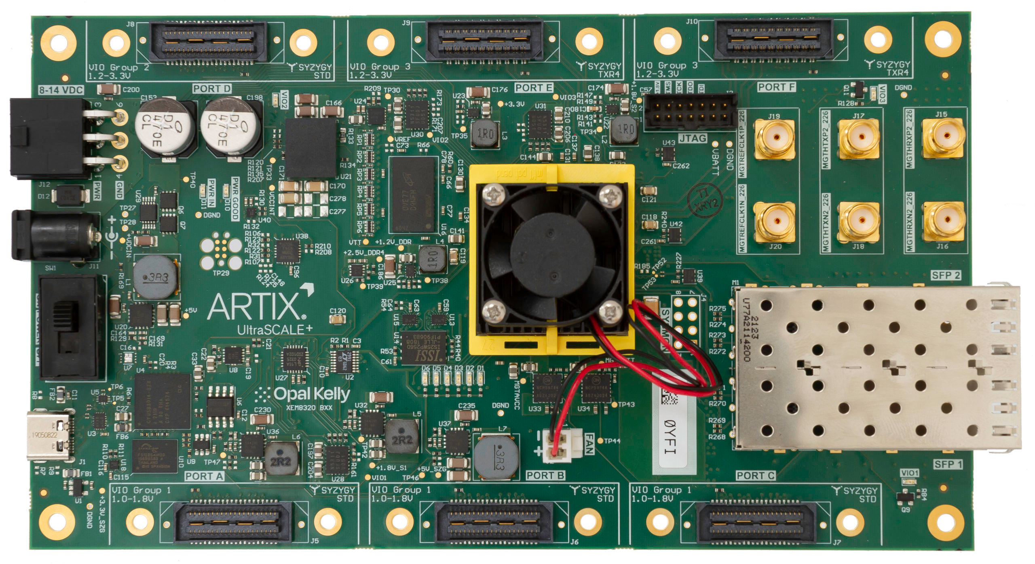
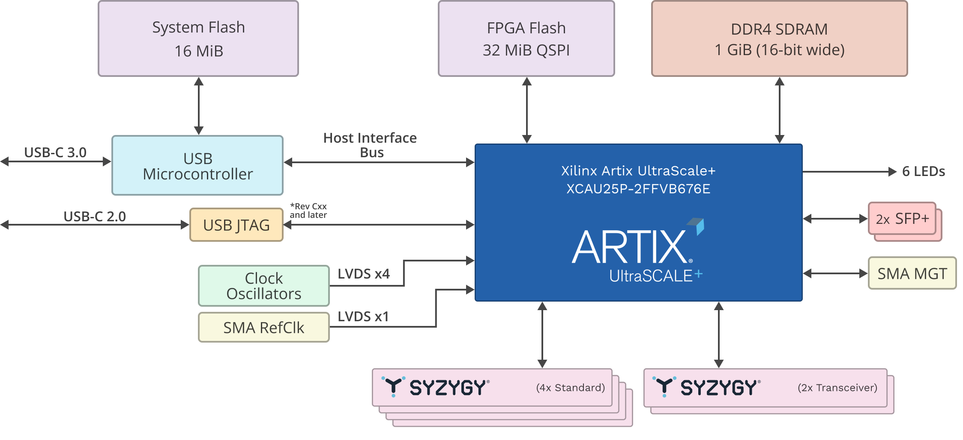
$1400
$100
Notes:
https://www.amazon.com/Yahboom-Raspberry-Omnidirectional-Autopilot-Recognition/dp/B088PRGQJ1/ref=sr_1_24
https://www.amazon.com/Yahboom-Robotic-Raspberry-%EF%BC%88DOFBOT-Without/dp/B08T8XG2J6/ref=sr_1_2
https://www.amazon.com/LewanSoul-Programmable-Feedback-Parameter-Programming/dp/B0793PFGCY

Slide 30
streaming frame capture
JTAG
KINTEX US XCKU040-2FFVA1156I
ARTIX US+ XCAU25P-2FFVB676E
JTAG to AXI Master
AXI Interconnect
AXILite
AXILite
AXILite
AXILite
AXILite
I2C Master
control
status
interrupt
DDR Memory Controller
SCL
SDA
AXI-S DMA
ready
DDR
DRAM
[1120,1280,3]
@110fps
MM2S AXI
AXI-S
2b@1500MHz
MIPI PHY
10b@158MHz
format
32b@158MHz
2b@1500MHz
10b@158MHz
AXI-S
S2MM AXI
2b@1500MHz
10b@158MHz
MIPI CSI-2
https://www.xilinx.com/products/intellectual-property/jtag_to_axi_master.html
https://docs.xilinx.com/r/en-US/pg232-mipi-csi2-rx/MIPI-CSI-2-Receiver-Subsystem-Product-Guide
https://docs.xilinx.com/v/u/en-US/pg150-ultrascale-memory-ip
https://docs.xilinx.com/r/en-US/pg021_axi_dma/AXI-DMA-Register-Address-Map?section=XREF_38966_AXI_DMA_Simple_DMA
https://docs.xilinx.com/v/u/en-US/ds768_axi_interconnect

Slide 31
EP address | Type | Bits | Description
0x00 | wire_in | 31:0 | AWADDR
0x01 |  | 31:0 | WDATA
0x02 |  | 31:0 | ARADDR
0x03 |  | 7:0 | AWLEN
0x03 |  | 10:8 | AWSIZE
0x03 |  | 12:11 | AWBURST
0x03 |  | 13 | AWLOCK
0x03 |  | 17:14 | AWCACHE
0x03 |  | 20:18 | AWPROT
0x03 |  | 24:21 | AWQOS
0x04 |  | 3:0 | WSTRB
0x04 |  | 4 | WLAST
0x05 |  | 7:0 | ARLEN
0x05 |  | 10:8 | ARSIZE
0x05 |  | 12:11 | ARBURST
0x05 |  | 13 | ARLOCK
0x05 |  | 17:14 | ARCACHE
0x05 |  | 20:18 | ARPROT
0x05 |  | 24:21 | ARQOS
EP address | Type | Bits | Description
0x40 | trigger_in | 0 | AWVALID
0x40 |  | 1 | WVALID
0x40 |  | 2 | BREADY
0x40 |  | 3 | ARVALID
0x40 |  | 4 | RREADY
0x40 |  | 5 | global_resetn
EP address | Type | Bits | Description
0x20 | wire_out | 0 | AWVALID
0x20 |  | 1 | WVALID
0x20 |  | 2 | BVALID
0x20 |  | 3 | ARVALID
0x20 |  | 4 | RVALID
0x21 |  | 31:0 | RDATA
0x22 |  | 1:0 | BRESP
0x23 |  | 1:0 | RRESP
0x23 |  | 2 | RLAST

Slide 32
demo
AXI-S
[1120,1280,3]
110fps
AXI-S
[480,640,1]
110fps
2b@1500MHz
MIPI PHY
10b@158MHz
format
10b@158MHz
convnet model
output buffer
MIPI CSI-2
2b@1500MHz
10b@158MHz
10b@158MHz
8b@38MHz
MIPI CSI-2
USB3
MIPI CSI-2
2b@1500MHz
10b@158MHz
10b@158MHz

Slide 33
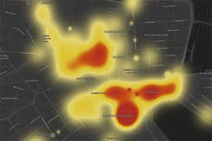
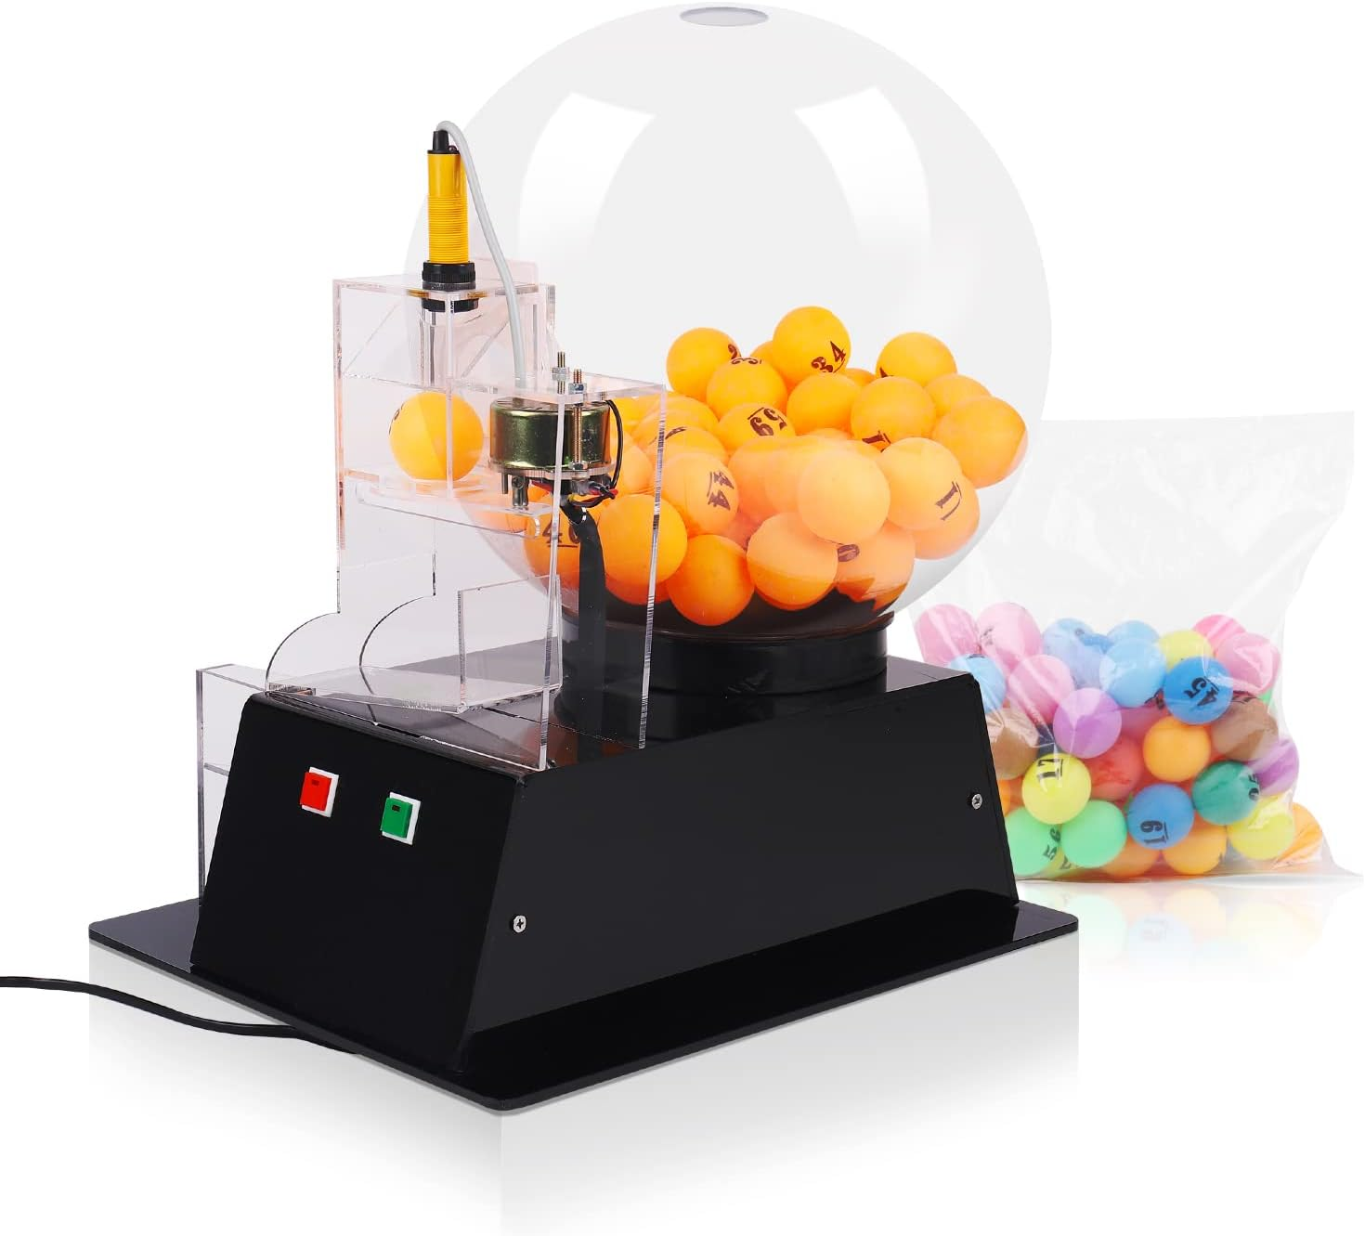
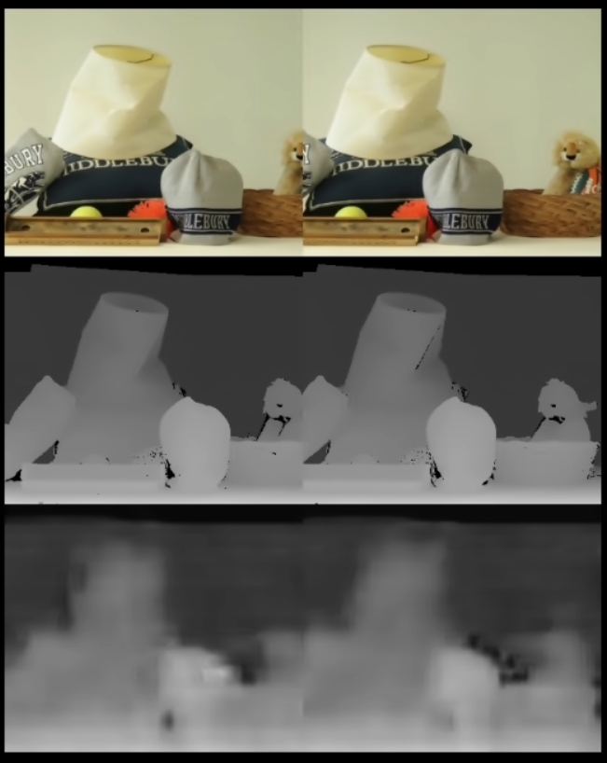
demo concept
Mira220, IMG.2/SPEED.1/ADC.2
1280x1120/110fps/10b
MIPI CSI-2
stereo disparity
640x480/110fps/8b
USB3
R
M
FPGA
L
https://www.amazon.com/Lottery-Machine-Automatic-Electric-Colorful/dp/B0C1XGSZKQ/ref=sr_1_9?crid=1C4OQX8RFH0P4&keywords=lottery+ping+pong+ball+machine

Slide 34
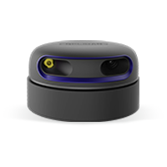
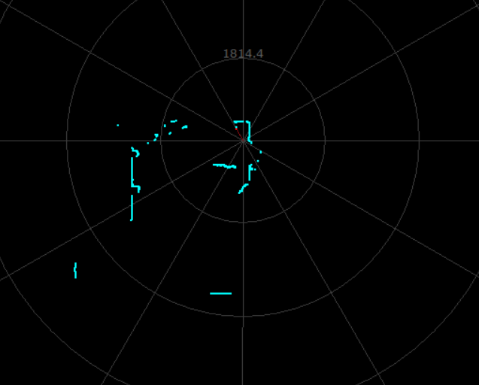
predict RPLidar 2-D LIDAR map from 3X Mira220 in 360 deg configuration (e.g. Roomba view)
demo concept
1280x1120/110fps/10b
Mira220, IMG.2/SPEED.1/ADC.2
FPGA
USB3
640x480/110fps/8b
MIPI CSI-2
https://www.amazon.com/Lottery-Machine-Automatic-Electric-Colorful/dp/B0C1XGSZKQ/ref=sr_1_9?crid=1C4OQX8RFH0P4&keywords=lottery+ping+pong+ball+machine

Slide 35
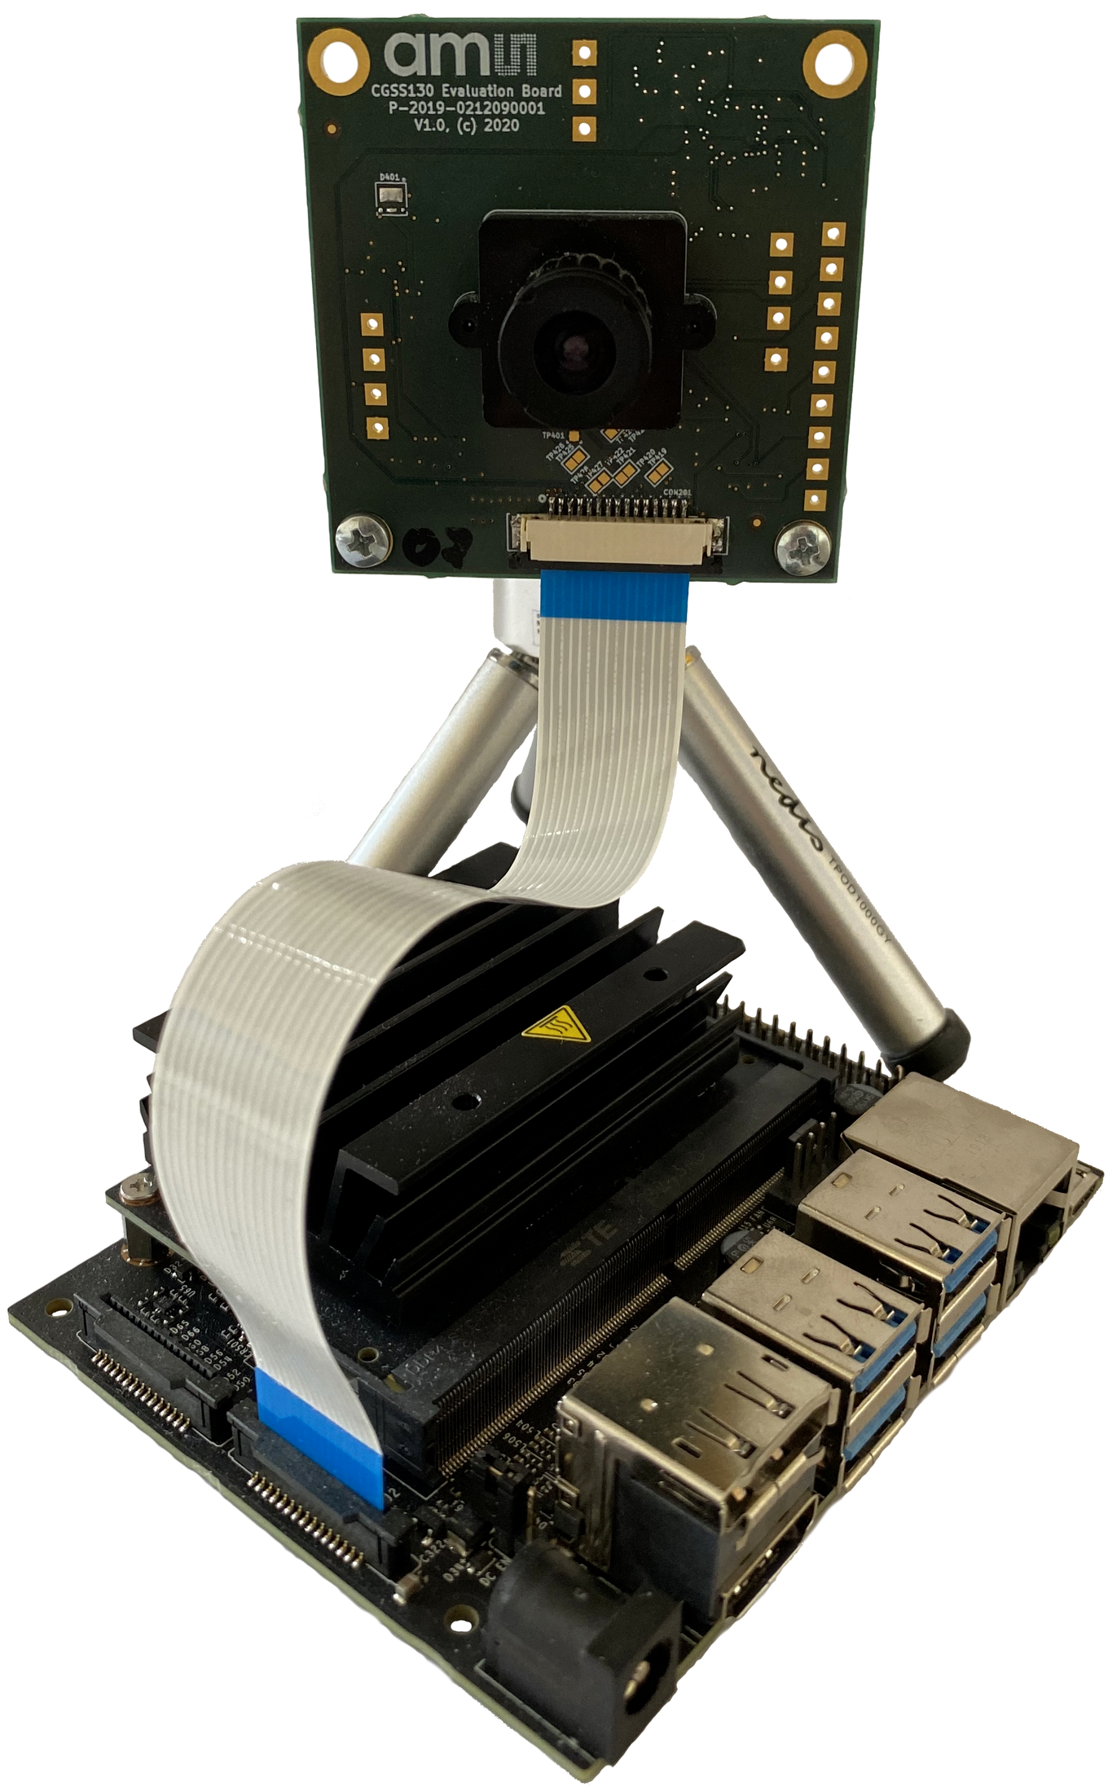
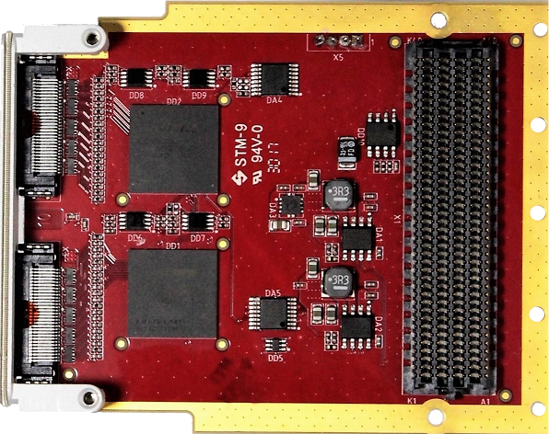
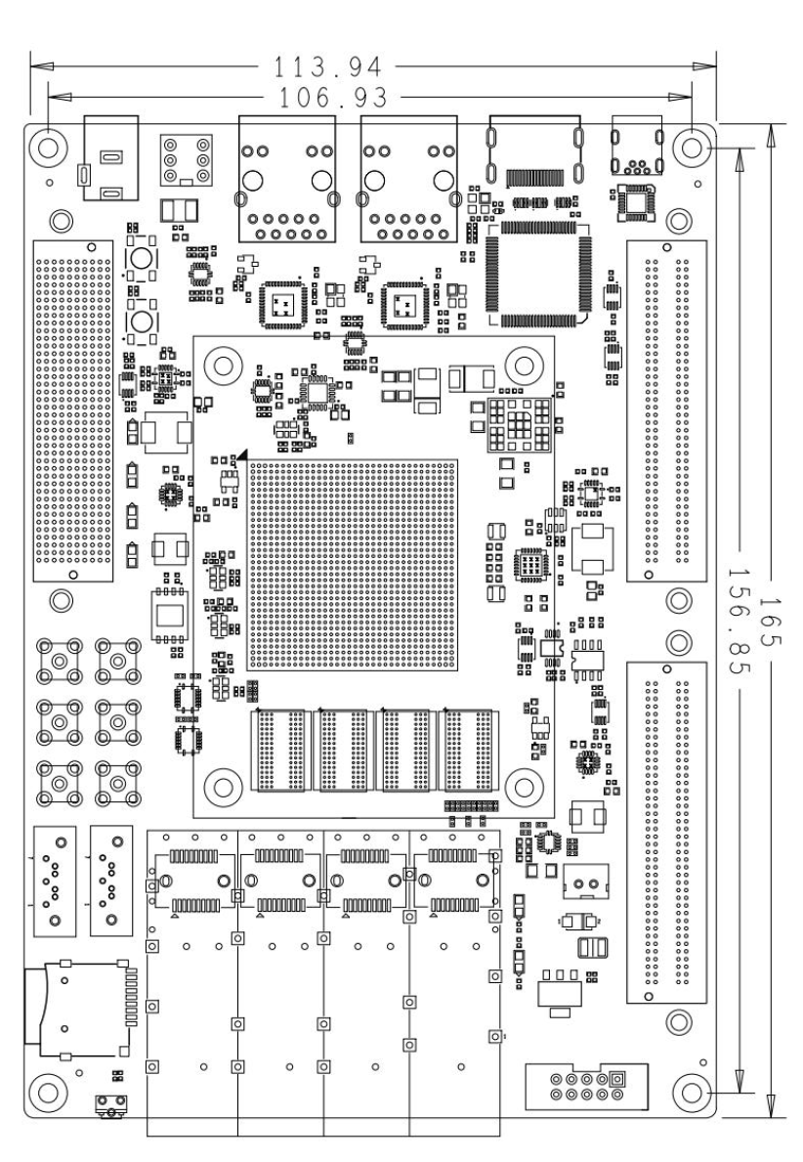
phase 1
Mira-220
FMC-MIPI
LVDS C+2D@1.5GHz
LVDS C+2D@1.5GHz
https://docs.arducam.com/Nvidia-Jetson-Camera/type-and-pinout-mipi-csi-2/

Slide 36
phase 1
KINTEX UltraScale XCKU040-2FFVA1156I
Mira220
MIPI synchronize deserialize
udp/eth/mii
channel interleave
AXI-S
capture buffer
UDP
MII
Mira220
[1400,1600,2]
@90 FPS

Slide 37
phase 2
self supervised pretrained image encoder
Mira220
channel interleave
AXI-S
heat map
Mira220
[1400,1600,2]
@90 FPS
[82,95,64]
@90 FPS
[82,95,1]
@90 FPS
pretrain using self-supervised pretext tasks on unlabeled data
LR eye swap, predict LR vs RL
LR time shift, predict L[t]R[t] vs L[t-1]R[t] vs L[t]R[t-1]

Slide 38
RapidSense
Silicon vision and sensing platform for next generation robotics
target next generation robotics based on multimodal LLM technology
the image encoder socket is the first stage in a multimodal LLM e.g. CLIP
foundation/backbone vision models encode raw pixels into a compressed feature map
domain specific FPGA enables low latency "pixels to features" at sensor speed
extends to 360-degree vision, hyperspectral, video, tactile sensors, audio, RF
Strategy
Open software
Optimized FPGA silicon initially targeting the emerging image encoder socket
Scale using chiplets
Partner with image sensor, robotics ecosystems
Execution
TF to Verilog demo, real time CNN inference at high resolution and frame rate
demonstrate vision model using self supervised pretraining on egocentric image data

Slide 39
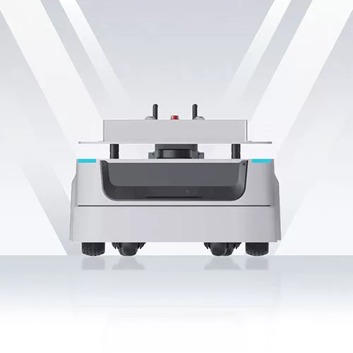
https://www.slamtec.ai/#
Mira220
RPLidar
supervised training
predict overhead Lidar view from 4xMira220
Mira220
channel interleave
AXI-S
[1400,1600,4]
@90 FPS
[170,195,1]
@90 FPS
CNN

Slide 40
phase 1
uart
i2c
ethernet
KINTEX UltraScale XCKU040-2FFVA1156I
LiteX SoC
Mira220
MIPI synchronize deserialize
wb
channel interleave
AXI-S
capture buffer
Mira220
[1400,1600,2]
@90 FPS

Slide 42
https://www.terasic.com.tw/cgi-bin/page/archive.pl?Language=English&CategoryNo=142&No=1295#contents
https://www.xilinx.com/products/boards-and-kits/1-so55i9.html

Slide 43
RapidCompute
Vision
FPGA as a flexible compute platform
embedded AI, edge and cloud applications, GPU alternative
Strategy
GPT-friendly open IP library
GPT-automated development flow
Raptor, HW/SW co-design (CUDA, RTOS)
GPT-assisted dataflow algorithm implementation
graph based computation for deep models (CNN, Transformer)
TF to Verilog
traditional DSP pipelines (vision, RF)
MATLAB to Verilog
multiple architectures (training accelerators, embedded streaming inference)
Compute-optimized FPGA silicon product line
Execution
"hello world" TF to Verilog demo (embedded real time edge inference)

Slide 44
move parameters on-chip, remove IO bottleneck, large aggregate bandwidth with many small RAMs
conv2d can be streamed using a row buffer, i.e. 'C' order input tensors (framed by TLAST) can be evaluated in order to produce an output feature map also in 'C' order -> reduced data storage, e.g. able to process 3840x2160 frames in raster order
conv2d can be pipelined layer by layer

Slide 45
Parallel computation of CNN dot products
weights
[ochan,3,3,ichan]
parallel ochan
input feature patch
[3,3,ichan]
output feature vector
[1,1,ochan]
parallel nstripe
same shape
tensor dot product

