Slide 1
TFLite to Verilog streaming CNN compiler for embedded AI applications andromeda.py + conv2d.v + concatenate.v + replicate.v

Slide 2
Replicate(), Concatenate(), Add()
https://vision.middlebury.edu/stereo/data/scenes2006/

Slide 3
Applications
LAD-RCNN:A Powerful Tool for Livestock Face Detection and Normalization
EvConv: Fast CNN Inference on Event Camera Inputs For High-Speed Robot Perception
Sony Event-based Vision Sensor
CNN-based Methods for Object Recognition with High-Resolution Tactile Sensors
FusionRCNN: LiDAR-Camera Fusion for Two-stage 3D Object Detection
Low-complexity CNNs for Acoustic Scene Classification
Counting Varying Density Crowds Through Density Guided Adaptive Selection CNN and Transformer Estimation
Agricultural Plantation Classification using Transfer Learning Approach based on CNN
Predictive Modeling of Charge Levels for Battery Electric Vehicles using CNN EfficientNet and IGTD Algorithm
A CNN Approach for 5G mmWave Positioning Using Beamformed CSI Measurements

Slide 4
Target applications
Prediction / parameter estimation from joint sensor data at ~100K samples/sec
e.g. MLX90640 thermal array, piezo, Hall effect
app: thermal screening , motor control, equipment monitoring
AI audio processing using multiple microphones/speakers
Advanced multi-camera vision tasks at 100M+ pixels/s
300+ FPS, 20M+ uncompressed pixel resolution, 10+ cameras, hyperspectral
AI radio using RF baseband IQ samples, MIMO antennas
Replace traditional DSP algorithms with trained deep models
- Performance improvement from using deep model instead of heuristics
- Can learn over time and adapt
- Can automate the implementation of e.g. MATLAB model using imitation learning

Slide 5
Streaming CNN compiler
andromeda.py
iverilog
VCS
model.v
model.tflite
FlatBuffers
--model model.tflite
--clk 100e6
--fps 30
model_rom.v
Vivado
Quartus
Raptor
dc_shell
conv2d.v
conv2d_data.v
conv2d_ctrl.v
automated tool to compile TFLite model into synthesizable Verilog, using conv2d.v parameterized module
compiler generates parallel code for OCHAN*NSTRIPE MAC operations per layer
Notes:
inference only, supports small but useful subset of TFLite (conv2d only, padding='valid', stride={1,2}, activation=RELU)
no external memory required
real time data stream -> real time prediction stream (or feature map)
tool to compile TFLite model into synthesizable Verilog
generated Verilog code is self contained, includes streaming inference and weights
compiler generates parallel code for OCHAN*NSTRIPE MAC operations
compiler generates ROM file with the weights

Slide 6
Generated Verilog
model.v
conv2d.v
conv2d.v
conv2d.v
S_VALID
M_VALID
conv2d_ctrl.v
#(KHEIGHT,KWIDTH,…)
conv2d_ctrl.v
#(KHEIGHT,KWIDTH,…)
conv2d_ctrl.v
#(KHEIGHT,KWIDTH,…)
M_ROW, M_COL
S_ROW, S_COL
S_DATA[ICHAN]
M_DATA[OCHAN]
conv2d_data.v
#(ICHAN,OCHAN,NSTRIPE)
conv2d_data.v
#(ICHAN,OCHAN,NSTRIPE)
conv2d_data.v
#(ICHAN,OCHAN,NSTRIPE)
RESET
model_rom.v
model_rom.v
model_rom.v
CLK

Slide 7

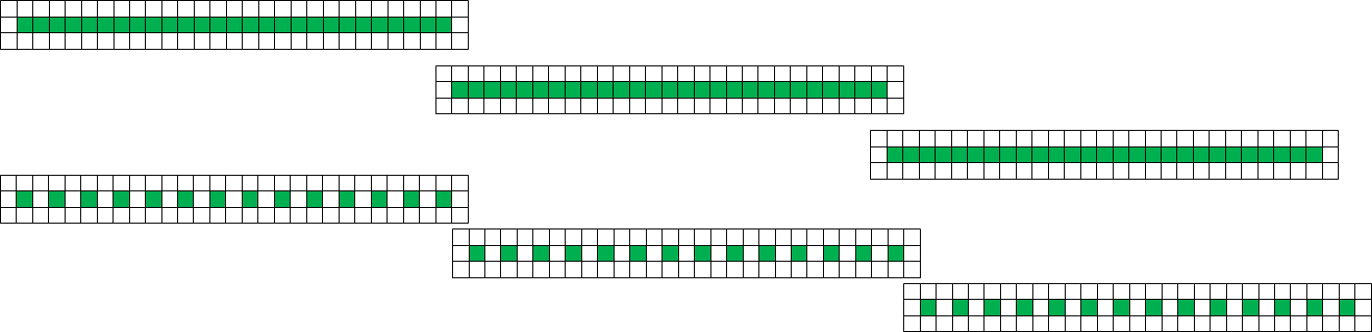
Parallel computation of CNN dot products
weights
[ochan,3,3,ichan]
parallel ochan
input feature patch
[3,3,ichan]
output feature vector
[1,1,ochan]
parallel nstripe
same shape
tensor dot product

Slide 8
wa,wen
ra
ichan sel
reg_a
reg_b
clr
op
stripe_sel
DTYPE*ICHAN
patch
acc
reg_z
TDP RAM
MAC
ALU
DTYPE*OCHAN
TDP RAM
MAC
ALU
TDP RAM
MAC
ALU
padded stripes [NSTRIPE]
MAC
ALU
MAC
ALU
MAC
ALU
MAC
ALU
MAC
ALU
MAC
ALU
MAC
ALU
MAC
ALU
MAC
ALU
MAC
ALU
MAC
ALU
MAC
ALU
ra
MAC
ALU
ROM
MAC
ALU
ROM
MAC
ALU
ROM
MAC
ALU
ROM
MAC
ALU
ROM
MAC
ALU
ROM
MAC
ALU
ROM
MAC
ALU
ROM
MAC
ALU
conv2d_data.v : NSTRIPE=3, OCHAN=8
weight [OCHAN]
TDATA

Slide 9
TFLite 16x8 quantization
1: compute dot product
2: add bias
3. multiply by scale
4. shift right with rounding
5. clamp and RELU
s16
input data
s64
s8
*
+
rounding right shift
weight
acc
+
s16
s64
s96
*
>>
CLAMP RELU
output data
bias
u31
scale
u6
shift

Slide 10
CNN striped parallel execution
ncol
owidth=27*3
stride=1
ncol
owidth=14*3
stride=2

Slide 11
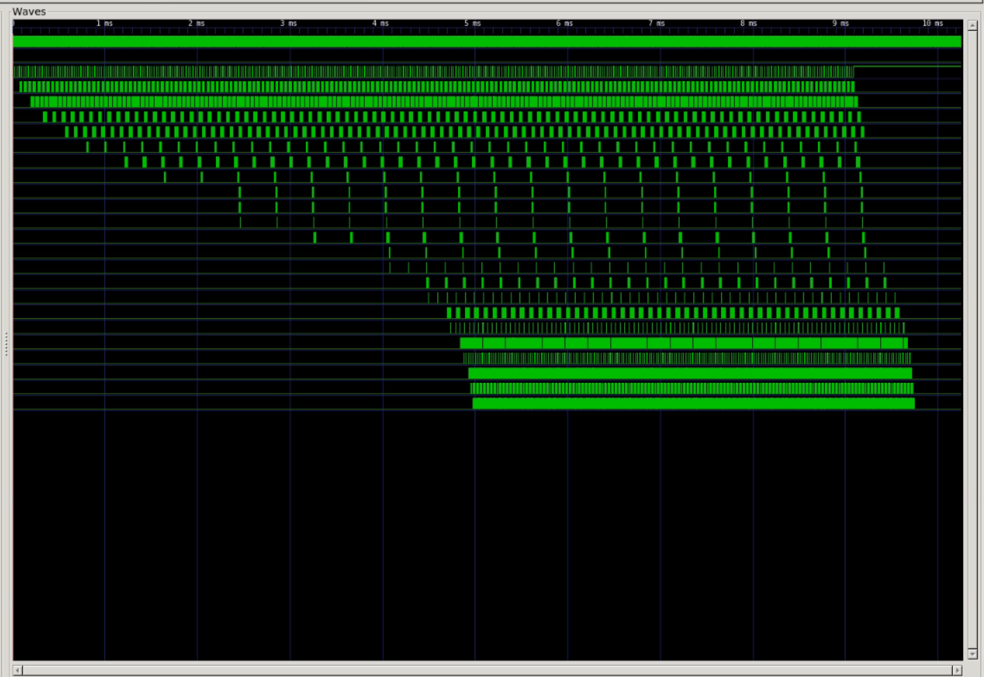

Slide 12
Demo
barrel shifter
16:1
reg [7:0] fb[15:0][767:0]
768x8
CNN
WB WR
16
128
WB RD
768x8
MLX90640
I2C
LiteX SOC
UDP/Ethernet
read MLX90640 frame using I2C
read previous prediction and assert seq++
assert reset
copy frame to next fb[15:0]
increment and write chan[3:0]
deassert reset
goto 1
WB
FPGA
streaming CNN

Slide 13
Demo
15
2
1
0
FB addr
16'h8001
fb[3:0]
pix[9:0]
2'b00
15
8
0
FB data
data[8:0]
CSR 0x80000000
CSR data
15
3
0
chan0[3:0] selects which physical fb is fed to the CNN input as channel 0
16'h8000
0
seq_reset
cnn_reset
brl_reset
brl_shift
1
2
3
15
4
2
1
0
PRED addr
2'b00
16'h8002
pred[2:0]
pred seq[5:0] increments every m_tdata_valid
15
7
0
PRED data
seq[5:0]
data[8:0]

Slide 14
NanEye
binocular
feature map
multiframe
feature map
action heatmap
interleave
concat
NanEye
[16,16,1]
[320,320,6]
@120 FPS
[64,64,16]
[64,64,64]
@30 FPS
Mira220
binocular
feature map
multiframe
feature map
action heatmap
interleave
concat
Mira220
[70,80,1]
[1400,1600,6]
@90 FPS
[350,400,16]
@90 FPS
[350,400,64]
@30 FPS

Slide 15
Mira220
binocular
feature map
multiframe
feature map
action heatmap
interleave
concat
Mira220
[70,80,1]
[1400,1600,6]
@90 FPS
[350,400,16]
@90 FPS
[350,400,64]
@30 FPS
Mira220
binocular
feature map
multiframe
feature map
P
interleave
concat
pan,tilt,zoom
control
T
Mira220
Z
[1400,1600,6]
@90 FPS
[350,400,16]
@90 FPS
[350,400,64]
@30 FPS

Slide 16
High performance demo
MIRA220
MIPI CSI-2
DPHY 1.5Gb/s
XC7VX1140T
feature map
classifier heat map
multiframe classifier
USB or Ethernet
1600x1400 RGB @60fps
89x76 mono@60fps
classifier heat map (auto PTZ)
multiframe classifier (action recognition)
stereo vision (RGBD)
hyperspectral imaging, feature map based on sensor fusion
line scan image sensor with infinite scrolling
audio analysis using spectrograms https://en.wikipedia.org/wiki/Spectrogram
self supervised visual feature learning https://arxiv.org/pdf/1902.06162.pdf

Slide 17
binocular vision demo - self supervised binocular feature map training
https://en.wikipedia.org/wiki/Binocular_vision
A
B
~10 deg vergence angle
~10 cm distance between cameras
predict A given B, B given A, sharing weights
self supervised "pixels to feature map" learning with binocular inputs, multi-frame features

Slide 18
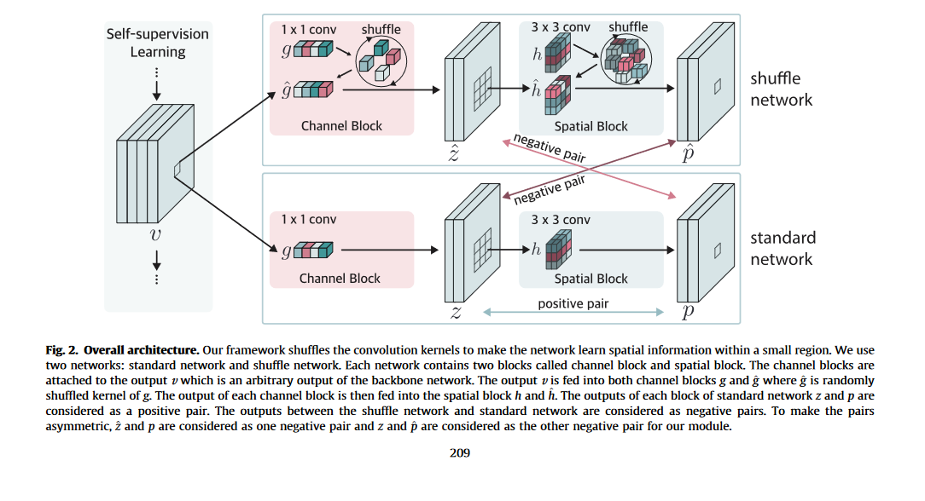
https://www.sciencedirect.com/science/article/pii/S0020025522013032
https://www.robots.ox.ac.uk/~vgg/publications/2021/Ge21/ge21.pdf
self supervised egocentric multicamera representations
predict camera A feature map given camera B feature map
predict camera B given camera A, share weights
can extend to more cameras, multiframe feature maps at high frame rate

Slide 19
References
Research
AoCStream: All-on-Chip CNN Accelerator With Stream-Based Line-Buffer Architecture
https://github.com/Xilinx/finn
A Study on the Intersection of GPU Utilization and CNN Inference
Commercial Edge AI
https://www.nvidia.com/en-us/autonomous-machines/embedded-systems/
https://perceive.io/
TFLite
https://www.tensorflow.org/lite/api_docs
https://arxiv.org/pdf/1712.05877.pdf
https://www.tensorflow.org/lite/performance/quantization_spec
https://www.tensorflow.org/lite/performance/post_training_quantization
https://github.com/tensorflow/tensorflow/blob/92f84571edb98bdb31f1e7b1e23f17bf2c1438e9/tensorflow/lite/kernels/internal/reference/conv.h#L101
https://pypi.org/project/tflite/

Slide 20
Image Encoder Concept

Slide 21
arbitrary model architecture
arbitrarily large model size
DRAM based model parameters
parameters
(DRAM)
accelerator
SOC
streaming data
streaming predictions
general purpose inference architecture ("compute platform")
image
encoder
(SRAM/ROM)
fixed model architecture
fixed model size
SRAM/ROM based parameters
streaming pixels
streaming feature maps
MIMO OFDM
SDR receiver
(SRAM/ROM)
streaming IQ samples
streaming demapped QAM bits
data/task specific inference architectures ("perception components")
Notes:
wireless MIMO OFDM receiver, replace 50K lines of MATLAB code with 500 lines of Verilog plus a deep model
trend away from general purpose compute platform toward data/task specific component model implementations
image encoder chip can perform different tasks depending on the weights, very flexible for different mass markets
image encoder only performs the front end CNN pyramid, a downstream task will consume feature maps instead of pixels

Slide 22
image
encoder
(SRAM/ROM)
multimodal LLM
(DRAM)
streaming pixels
feature
map
accelerator
text
MIMO OFDM
wireless
(SRAM/ROM)
QAM
soft bits
streaming IQ samples
FEC DSP
payload
Notes:
wireless MIMO OFDM receiver, replace 50K lines of MATLAB code with 500 lines of Verilog plus a deep model
trend away from general purpose compute platform toward data/task specific component model implementations
image encoder chip can perform different tasks depending on the weights, very flexible for different mass markets
image encoder only performs the front end CNN pyramid, a downstream task will consume feature maps instead of pixels

Slide 23
Technology Strategy
Powerful on-chip models can perform multiple tasks
for a vision convnet feature map pyramid, 8M weights ~ foundation vision model
it is feasible to use fixed model arch w/ params on-chip (SRAM or ROM)
supports image, video, RF and encoder/decoder tasks
Use existing algorithms, implemented in Verilog
high throughput (>100M samples/s), low latency (<10µs), zero jitter, low power (<2W)
no new algorithms, leverage TFLite framework, correlated with TFLite reference
parameterized Verilog code with Python compiler
Notes:
minimize layer variants, "conv2d only", RELU w/o batch norm, skip connections
params off-chip to on-chip, distributed, aggregate bandwidth
off-chip weights -> 8 MB * 100 fps = 800 MB/s memory bandwidth
SRAM/MAC ratio per VGG18 layer, fine grain parallel compute and memory
avoids access pattern bottlenecks
CNN have highly parallel and local structure -> pipelined, high MAC utilization
implement model using dataflow architecture, similar to gnuradio.org
output channels X number of stripes X pipelined layers -> unexploited parallelism

Slide 24
Robotics
Image Sensors
Cambrian Robotics
Omron Automation
AMS OSRAM
Onsemi
Image Encoder
AR/VR
eye tracking
AR overlay
Deep Learning Stack
integer quantization
Industrial Measurement
Google TFLite
Cognex
Sensopart
Helmee Imaging
Notes:
The image sensor companies have a problem, which is the high data rate of raw pixels over MIPI. Only a handful of SoC platforms can handle MIPI e.g. NVDA Jetson. The result is that the SoC costs more than the image sensor, limiting adoption of embedded vision. The NV image encoder compresses raw pixels into a 30X smaller feature map + thumbnail, which total 78Mb/s and can be transmitted over USB 2.x. This compressed representation can directly drive downstream tasks such as object recognition and localization, image super resolution, and patch embeddings for a multimodal LLM. Horizon tasks include embodied robotic vision, motor control, and MM-LLM executive functions.

Slide 25
Image Encoder Concept
MIPI
[1400,1600,3]
[14,18,512]
microcontroller
USB2
raw pixels
feature map
[140,160,3]
RGB rescale
thumbnail
NV-IE100
scalable foundation vision CNN with 8M parameters
reconfigurable SRAM-based weights
NV-IE100
500MHz clock
3840 integer MAC units
64Mb SRAM (weights)
20Mb SRAM (rowbuf)
MIPI
1600x1400 RGB pixels
12 bits/pixel
30 frames/s
= 2.42 Gb/s
USB
[14,18,512] features
16 bits/feature
30 frames/s
= 62 Mb/s
USB
[140,160,3] thumbnail
8 bits/pixel
30 frames/s
= 16 Mb/s
30X
compression
Notes:
Image Encoder performs the initial convolutional pyramid using a VGG-like 18-layer CNN architecture.
The 8M weight VGG18 architecture is a strong foundation vision model with broad applications.
The image encoder also performs a compression function.
Weights are 8 bits, so 64Mb SRAM (weights) + 20Mb SRAM (row buffers) + standard cell logic

Slide 26
Reference Board Concept
real time image encoder
compact form factor, USB powered
supports a broad range of applications
low pin count interfaces
includes USB to I2C for configuration
memory map provides access to weights
lens mount
Mira220
I2C
MIPI CSI-2
DPHY 1.5Ghz
2 data, 1 clock
IE100
NV-IE USB endpoint | M/S
feature pipe | M
thumbnail pipe | M
I2C bridge | S
NV-IE memory map | S
USB2

Slide 27
Execution Plan
applications
chip
reference board
image capture
simulated
demo
real time
demo
model training
synthetic images
spec
design
DV
PD
tapeout
spec
schematic
layout
build
bringup

Slide 28
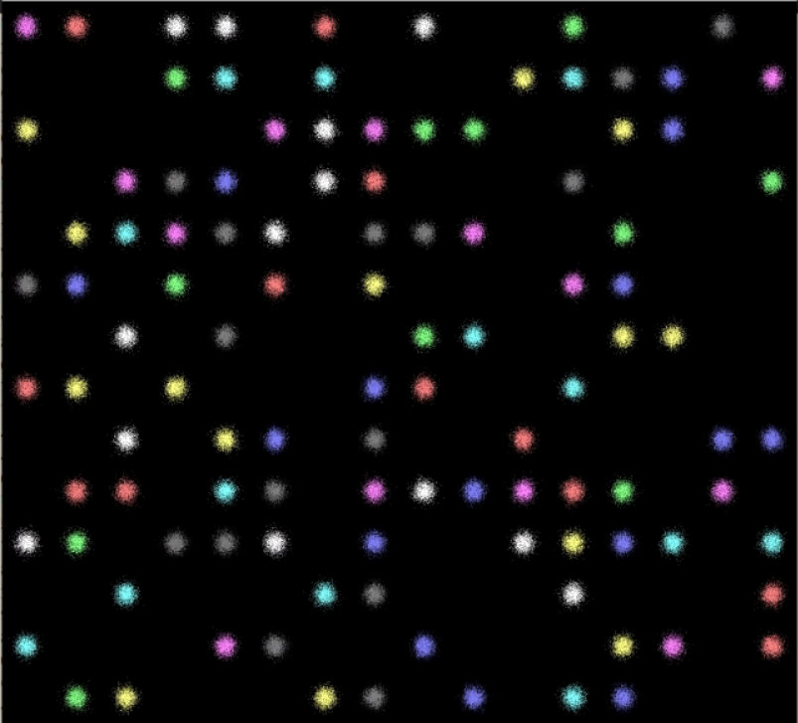
16 columns
Receptive field unit test
randomly populate 16x14 grid locations
label is '0' if empty, '1' if colored ball
224 binary labels
14 rows
1600x1400 RGB images
[1400,1600,3]
[14,18,512]
[224]
pixels
probabilities
IE100 CNN
1x1 conv, 2x1000 dense, 224 dense
binary crossentropy loss

Slide 29
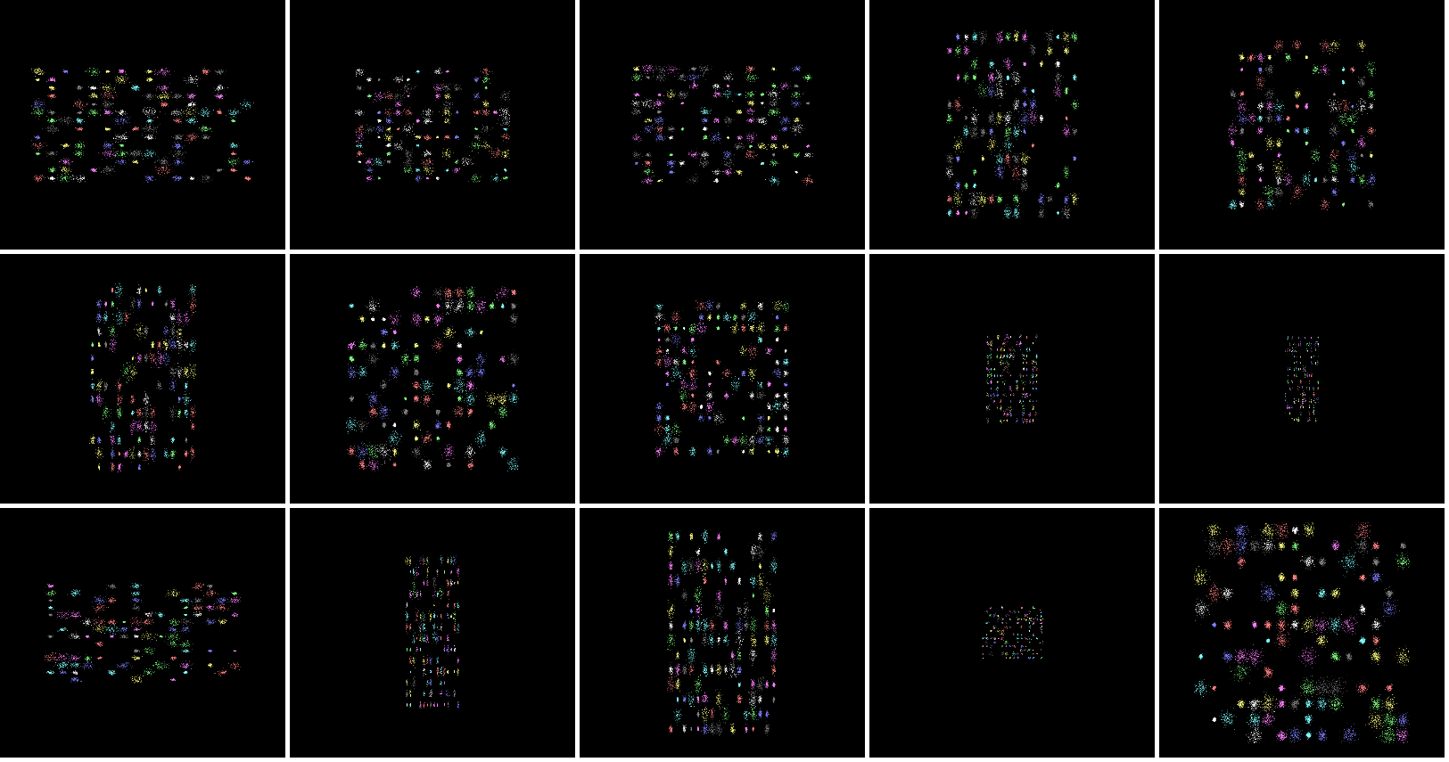
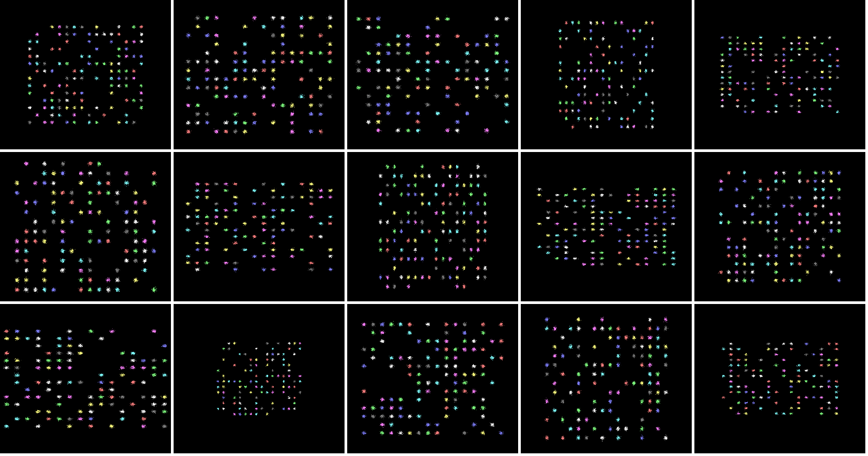
thumbnail gallery of 1600x1400 RGB input images

Slide 30
Product Planning
Milestone | Dependencies | Status
Concept Commit | PRD/datasheet die size/power estimate preliminary budget/schedule | needed for joint development proposal
Execution Commit | complete program plan to FCS
FCS | standard SoC development process
PRD Feature | Priority | Schedule
MIPI CSI-2, DPHY RX, 1C 2D, 1.5GHz | P1 | MVP, fastest TTM
[1400,1600,3] input shape (frame) 12 bits/pixel 30 frames/s | P1 | Mira220 RGB
[14,18,512] output shape (feature map) | P1
[140,160,3] output shape (thumbnail) | P1
USB 2.0 PHY, controller | P1

Slide 31
NV-IE100 top level diagram
Block | Owner
MIPI
USB
RGB
CNN
I2C
MIPI
DPHY
CSI-2
AXI-S FIFO
AXI-lite
USB
2.x, 480Mb/s
PHY, controller
AXI-S FIFO
AXI-lite master
clock
data0
data1
AXI-S
AXI-S
CNN top
AXI-lite
rx
tx
AXI-S
RGB rescaler
AXI-lite
PLL
sda
scl
I2C controller
AXI-lite
Notes:
use box filter for rescaler e.g. https://scholarworks.rit.edu/cgi/viewcontent.cgi?article=10864&context=theses

Slide 32
Execution Planning
Function | Tasks | Lead
CNN compiler | add level of hierarchy for inferred SRAM add SRAM option to replace weight ROM (SPI config) enhancements and fixes as needed (DAG,TFLite metadata,quantization)
RTL design | MIPI CSI-2 RX with DPHY USB PHY and controller CNN top input/output interfaces and FIFO RGB image rescaler and FIFO I2C controller for image sensor configuration
Verification (simulation) | End to end unit tests, pixels to predictions Also correlate predictions with TFLite reference interpreter
Physical implementation | Standard ASIC flow with 500MHz core clock, 16nm libraries Run initial flat P&R experiment on compiled CNN with 18 layers
Tools / Automation | Automate SRAM physical memory compiler for arbitrary size CNN instances
Verification (emulation) | Prototype full chip at 200MHz, partition across multiple FPGAs
Reference board | Mira220 RGB + NV-IE100, compact fanless form factor, USB powered
Applications/Models Documentation FAE Support | Mira220+ Opal Kelly Artix US+ data capture and demo Build reference apps/models e.g facial keypoint detection, image super resolution, support HuggingFace model community

Slide 33
Roadmap
feature map history
image encoder
image fusion
motion encoder
MIPI
Verilog
integrate image fusion and motion encoder into the chip
output feature maps will contain motion information which reduces the frame rate
100M IQ baseband samples/s for wireless sensing and communication e.g. MIMO OFDMA

Slide 34
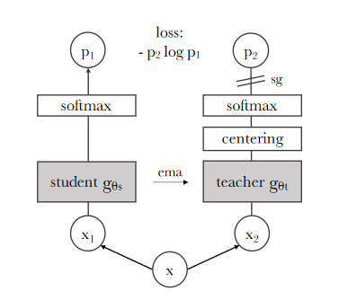
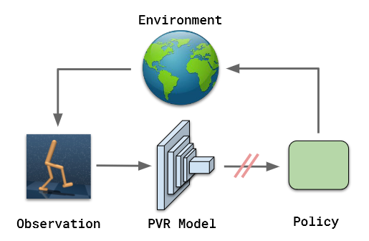
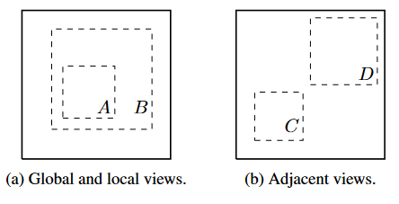
NeuVision Robotics Demo Application
Paper | Year
A Simple Framework for Contrastive Learning of Visual Representations | 2020 | random crop and rescale
Bootstrap Your Own Latent A New Approach to Self-Supervised Learning | 2020 | positive pairs only
Emerging Properties in Self-Supervised Vision Transformers | 2021 | our baseline method (DINO)
The (Un)Surprising Effectiveness of Pre-Trained Vision Models for Control | 2022 | robot demo
Notes:
SimCLR introduced the effectiveness of using random crops from an image for self-supervised representation learning.
BYOL introduced self-supervised learning with positive examples only.
DINO refines BYOL and will serve as our baseline algorithm for self-supervised feature learning for images
For video, transformers may be preferable as sequence processors.
Our initial objective is to demo a real time, pretrained vision model in a robot control setting.

Slide 35
APPENDIX

Slide 36
Risks
Risk | Sev | Mitigation
negative effects of integer quantization |  | POR use TFLite signed integer 8b weights, 16b activations Straightforward to switch to 8b/16b floating point as a fallback
no batch normalization or skip connections |  | POR use RELU activations with reduced learning rate Straightforward to support SELU using 64Kx16 SRAM LUT as a fallback
MIPI burstiness due to vertical blanking |  | CNN throughput is specified as a row time, not frame time

Slide 37
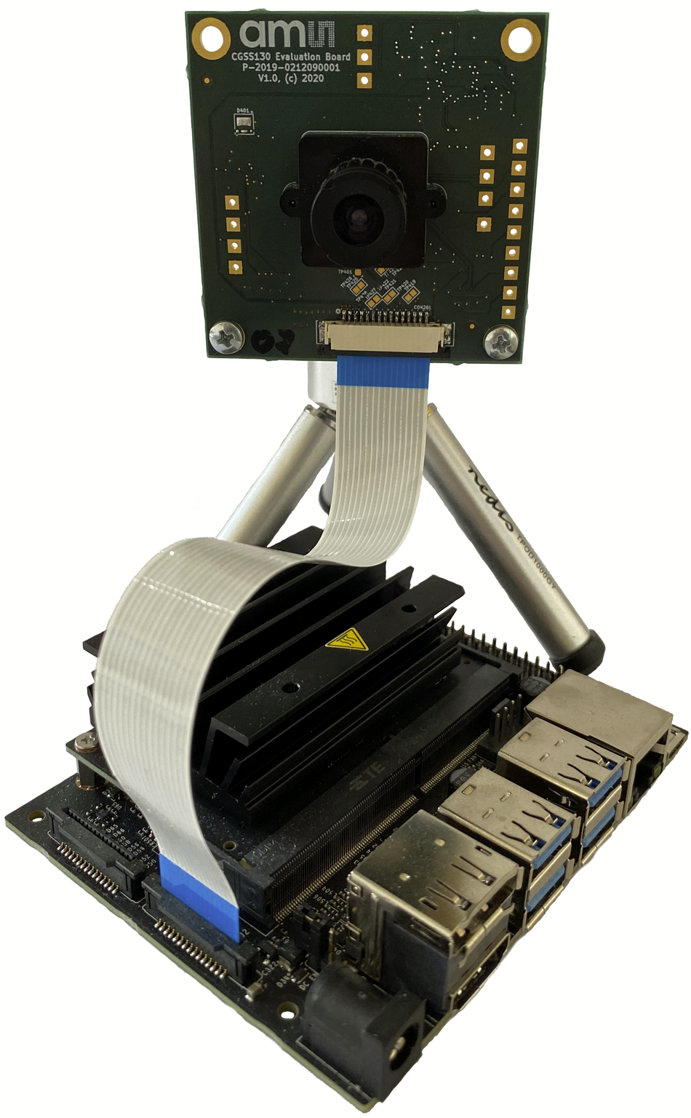
MIPI SoC platforms exceed the cost of the image sensor

Slide 38
Image Encoder Product Options
NeuVision Product | Model Architecture | Model Weights | Scalability
IE-FPGA | reconfigurable | reconfigurable | <1M weights, <1 TOP, chiplets?
IE-100-RAM | fixed VGG18 | reconfigurable (RAM) | 8M weights, 2 TOP
IE-100-ROM | fixed VGG18 | fixed (ROM) | 8M weights, 2 TOP
Image Encoder performs the initial convolutional pyramid using a VGG-like architecture.
The proposed 8M weight VGG18 architecture is a strong foundation vision model with broad application.
The image encoder also performs a valuable compression function.
Weights are 8 bits, so 64Mb SRAM (weights) + 20Mb SRAM (row buffers) + standard cell logic

Slide 39
_________________________________________________________________
Layer (type) Output Shape Param #
=================================================================
input_1 (InputLayer) [(None, 1400, 1600, 3)] 0
conv2d (Conv2D) (None, 1398, 1598, 16) 448
conv2d_1 (Conv2D) (None, 698, 798, 16) 2320
conv2d_2 (Conv2D) (None, 696, 796, 16) 2320
conv2d_3 (Conv2D) (None, 694, 794, 32) 4640
conv2d_4 (Conv2D) (None, 346, 396, 32) 9248
conv2d_5 (Conv2D) (None, 344, 394, 32) 9248
conv2d_6 (Conv2D) (None, 342, 392, 64) 18496
conv2d_7 (Conv2D) (None, 170, 195, 64) 36928
conv2d_8 (Conv2D) (None, 168, 193, 64) 36928
conv2d_9 (Conv2D) (None, 166, 191, 128) 73856
conv2d_10 (Conv2D) (None, 82, 95, 128) 147584
conv2d_11 (Conv2D) (None, 80, 93, 128) 147584
conv2d_12 (Conv2D) (None, 78, 91, 256) 295168
conv2d_13 (Conv2D) (None, 38, 45, 256) 590080
conv2d_14 (Conv2D) (None, 36, 43, 256) 590080
conv2d_15 (Conv2D) (None, 34, 41, 512) 1180160
conv2d_16 (Conv2D) (None, 16, 20, 512) 2359808
conv2d_17 (Conv2D) (None, 14, 18, 512) 2359808
=================================================================
Total params: 7,864,704
Trainable params: 7,864,704
Non-trainable params: 0
_________________________________________________________________
proposed VGG-like CNN
uses conv2d layer only
downsample using stride=2
padding=valid
activation nonlinearity=RELU, last layer=None
8 bit integer weights, 16 bit integer activations

Slide 40
Proposed Image Encoder
NV-IE-MIRA220
500MHz clock
7500 integer MAC units
64Mb SRAM (weights)
20Mb SRAM (rowbuf)
NV-IE-MIRA220
MIPI
USB
microcontroller
[1400,1600,3]
[14,18,512]
scalable foundation vision CNN with 8M parameters
reconfigurable SRAM-based weights
MIPI
1600x1400 RGB pixels
12 bits/pixel
110 frames/s
= 8.87 Gb/s
USB
[14,18,512] features
16 bits/feature
110 frames/s
= 0.227 Gb/s
39X compression
Notes:
Image Encoder performs the initial convolutional pyramid using a VGG-like 18-layer CNN architecture.
The 8M weight VGG18 architecture is a strong foundation vision model with broad applications.
The image encoder also performs a compression function.
Weights are 8 bits, so 64Mb SRAM (weights) + 20Mb SRAM (row buffers) + standard cell logic

Slide 41
Smart Sensor Silicon Segmentation
Vision
- model size versions
e.g. 1M,5M,10M ROM weights
- image fusion versions
e.g. 1,2,3 MIPI inputs
- image resolution versions
e.g. [3840,2160,3], [1600,1400,1]
NeuVision Image Encoder
MIPI
USB
Sensing
- RISC-V SoC
- Vector ISA
- general purpose connectivity
performance
products
Notes:
low end can be addressed using RISC-V SoC with vector instructions
high end can be addressed using NeuVision ROM-programmable product line

Slide 42
collect unlabeled dataset
synchronized frame capture from multiple image sensors
synchronized metadata e.g. robot servo angles
self supervised pretraining using unlabeled dataset
BYOL, DINO
few shot learning using pretrained vision model
imitation learning for robotics
classifier for object detection
image decoder for object segmentation
patch embeddings for multimodal LLM
data sheet for {100K,1M,5M,20M parameter VGG-like CNN}, {FPGA, ASIC}
area, ROM area, clock frequency
Notes:
Masked Autoencoders As Spatiotemporal Learners
DINOv2: Learning Robust Visual Features without Supervision
Emerging Properties in Self-Supervised Vision Transformers
A Simple Framework for Contrastive Learning of Visual Representations
Bootstrap Your Own Latent A New Approach to Self-Supervised Learning

Slide 43
Paper | Year
A Simple Framework for Contrastive Learning of Visual Representations | 2020 | random crop and rescale
Bootstrap Your Own Latent A New Approach to Self-Supervised Learning | 2020 | positive pairs only
Emerging Properties in Self-Supervised Vision Transformers | 2021 | our baseline method (DINO)
DINOv2: Learning Robust Visual Features without Supervision | 2023
Masked Autoencoders As Spatiotemporal Learners | 2022
The (Un)Surprising Effectiveness of Pre-Trained Vision Models for Control | 2022 | robot demo
Notes:
SimCLR introduced the effectiveness of using random crops from an image for self-supervised representation learning.
BYOL introduced self-supervised learning with positive examples only.
DINO refines BYOL and will serve as our baseline algorithm for self-supervised feature learning for images
For video, transformers may be preferable as sequence processors.
Our initial objective is to demo a real time, pretrained vision model in a robot control setting.

Slide 44
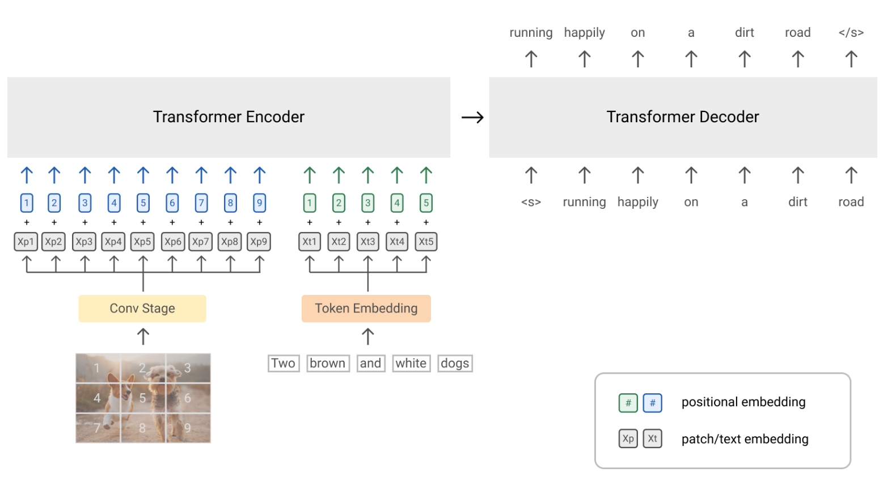
[1120,1280,3]
@110 FPS
1000X compression
[16,19,256]
@10 FPS
feature map history
image fusion
image encoder
motion encoder
MIPI
Verilog
motion decoder
depth map
object detection
semantic heatmap
optical flow
patch embeddings for multimodal LLM, e.g. SIMVLM

Slide 45
image decoder
image fusion
image sensors
depth map
object detection
semantic heatmap
image encoder
MIPI
[16,19,256]
@110 FPS
multimodal LLM, e.g. SIMVLM
Verilog
CNN
[1120,1280,3]
@110 FPS
100X compression
patch embeddings

Slide 46
B) parallel output channels
A) parallel vertical stripes
C) parallel layers

Slide 47
TDP RAM
MAC
ALU
TDP RAM
MAC
ALU
TDP RAM
MAC
ALU
MAC
ALU
MAC
ALU
MAC
ALU
MAC
ALU
MAC
ALU
MAC
ALU
MAC
ALU
MAC
ALU
MAC
ALU
MAC
ALU
MAC
ALU
MAC
ALU
MAC
ALU
ROM
MAC
ALU
ROM
MAC
ALU
ROM
MAC
ALU
ROM
MAC
ALU
ROM
MAC
ALU
ROM
MAC
ALU
ROM
MAC
ALU
ROM
MAC
ALU

Slide 48
Andromeda CNN compiler
iverilog
VCS
model.v
model.tflite
FlatBuffers
--model model.tflite
--clk 200e6
--fps 100
model_rom.v
Vivado
Quartus
Raptor
dc_shell
conv2d.v
concatenate.v
replicate.v
…
Notes:
inference only, supports small but useful subset of TFLite (conv2d only, padding='valid', stride={1,2}, activation=RELU)
no external memory required
real time data stream -> real time prediction stream (or feature map)
tool to compile TFLite model into synthesizable Verilog
generated Verilog code is self contained, includes streaming inference and weights
compiler generates parallel code for OCHAN*NSTRIPE MAC operations
compiler generates ROM file with the weights

Slide 49
Real time vision IP flow
data collection
"frame burst"
capture to DDR
supervised training
"imitation learning"
use OpenCV brute force algorithms to produce labels
e.g. stereo disparity, optical flow, frequency domain, segmentation
deployment
andromeda.py
conv2d.v
concatenate.v
replicate.v
model.v
model_rom.v
model.tflite
egocentric
data
IP
ongoing data sampling for continuous learning
self-supervised pre-training
+ feature alignment
+ downstream task
collect large, unlabeled, egocentric data set
pretrain using pretext augmentation, contrastive learning e.g. CLIP
align output feature map to downstream task using e.g. linear SVM
IP characterization
converts pixels to feature map
"image encoder"
"foundation vision model"
high speed vision tasks
spatial and temporal fusion
A ConvNet for the 2020s, SIMVLM
can drive multi-model LLM
- using reference datasets and models
- characterize max clock freq, DSP, BRAM, area
- over {input shapes, frame rates, model sizes}

Slide 50
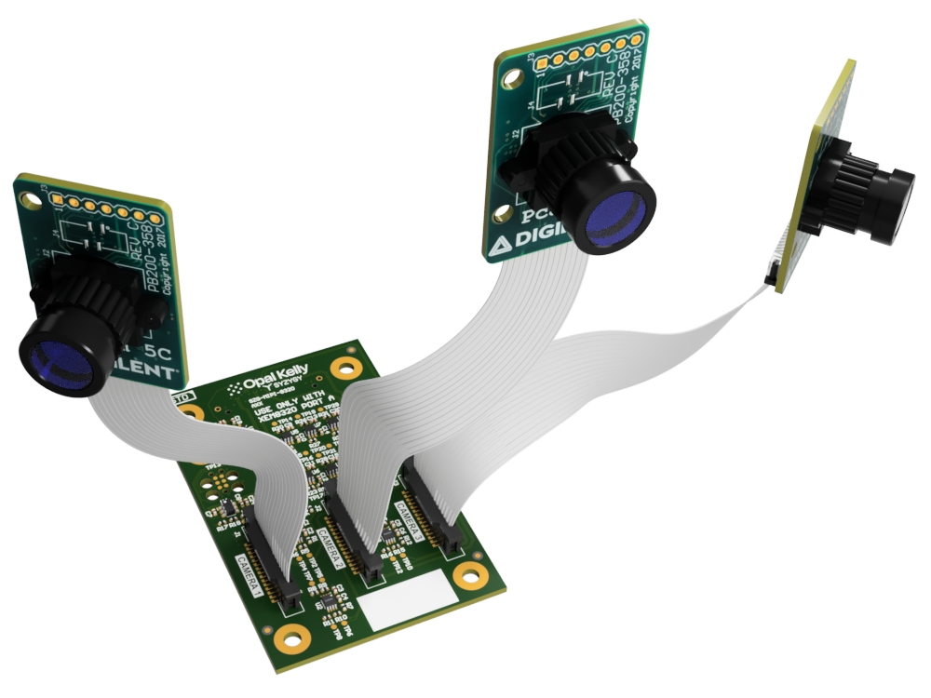
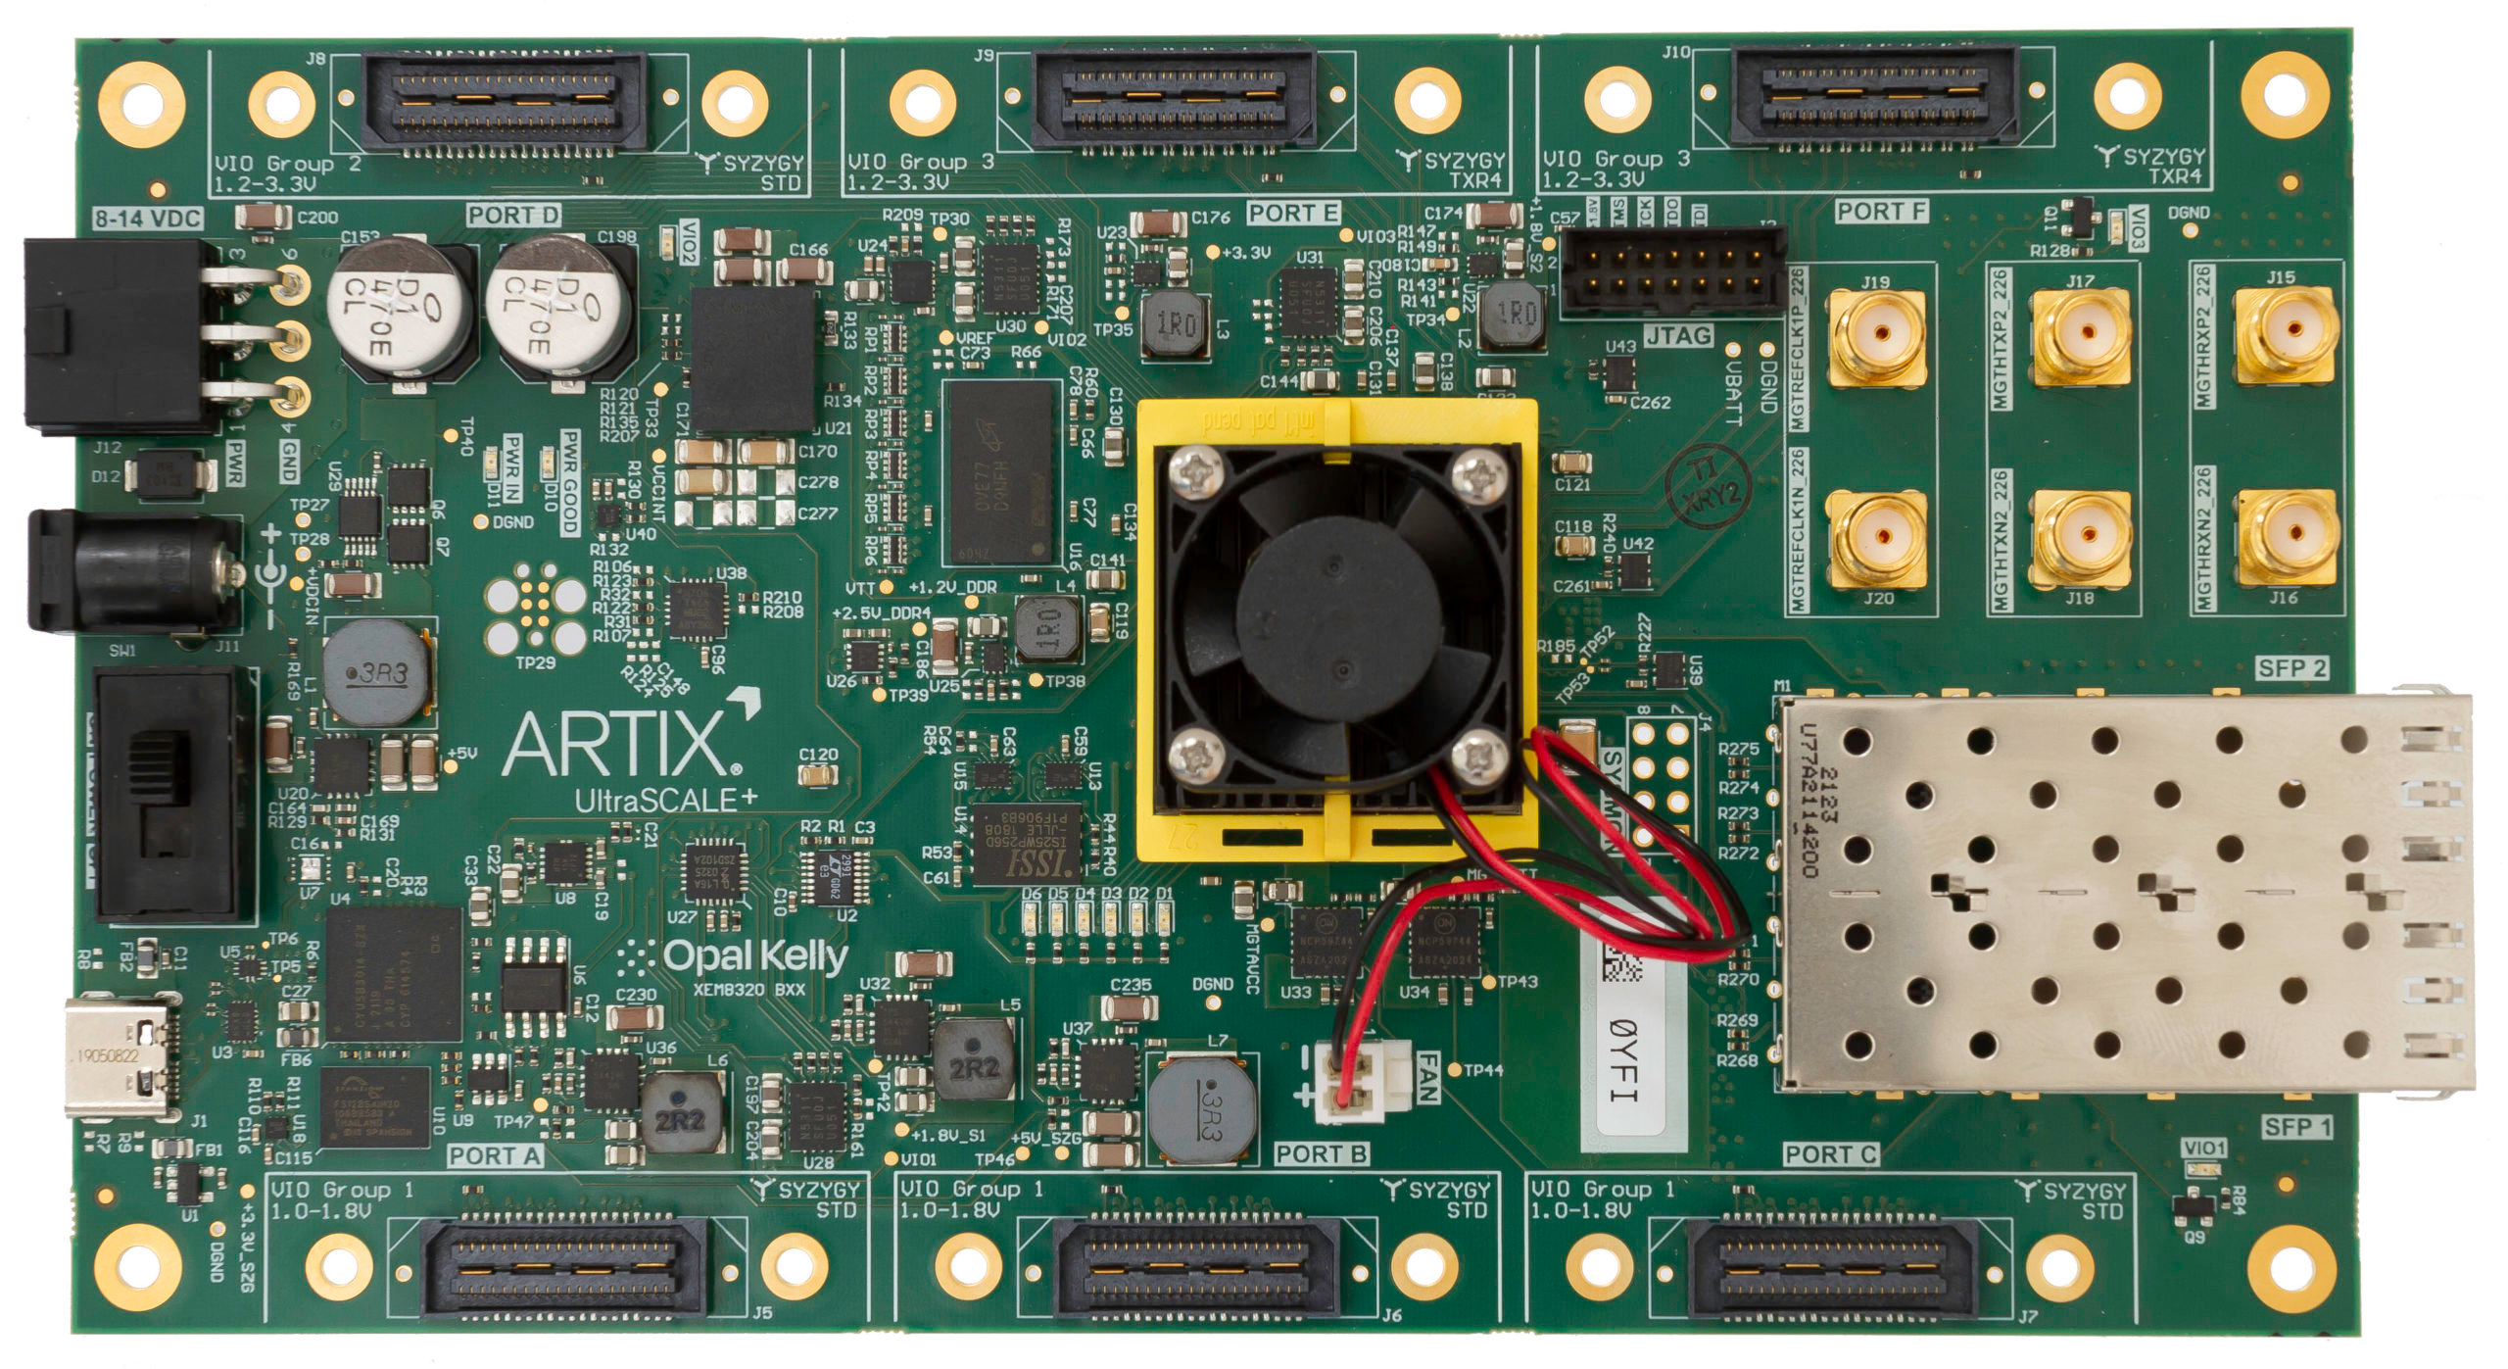
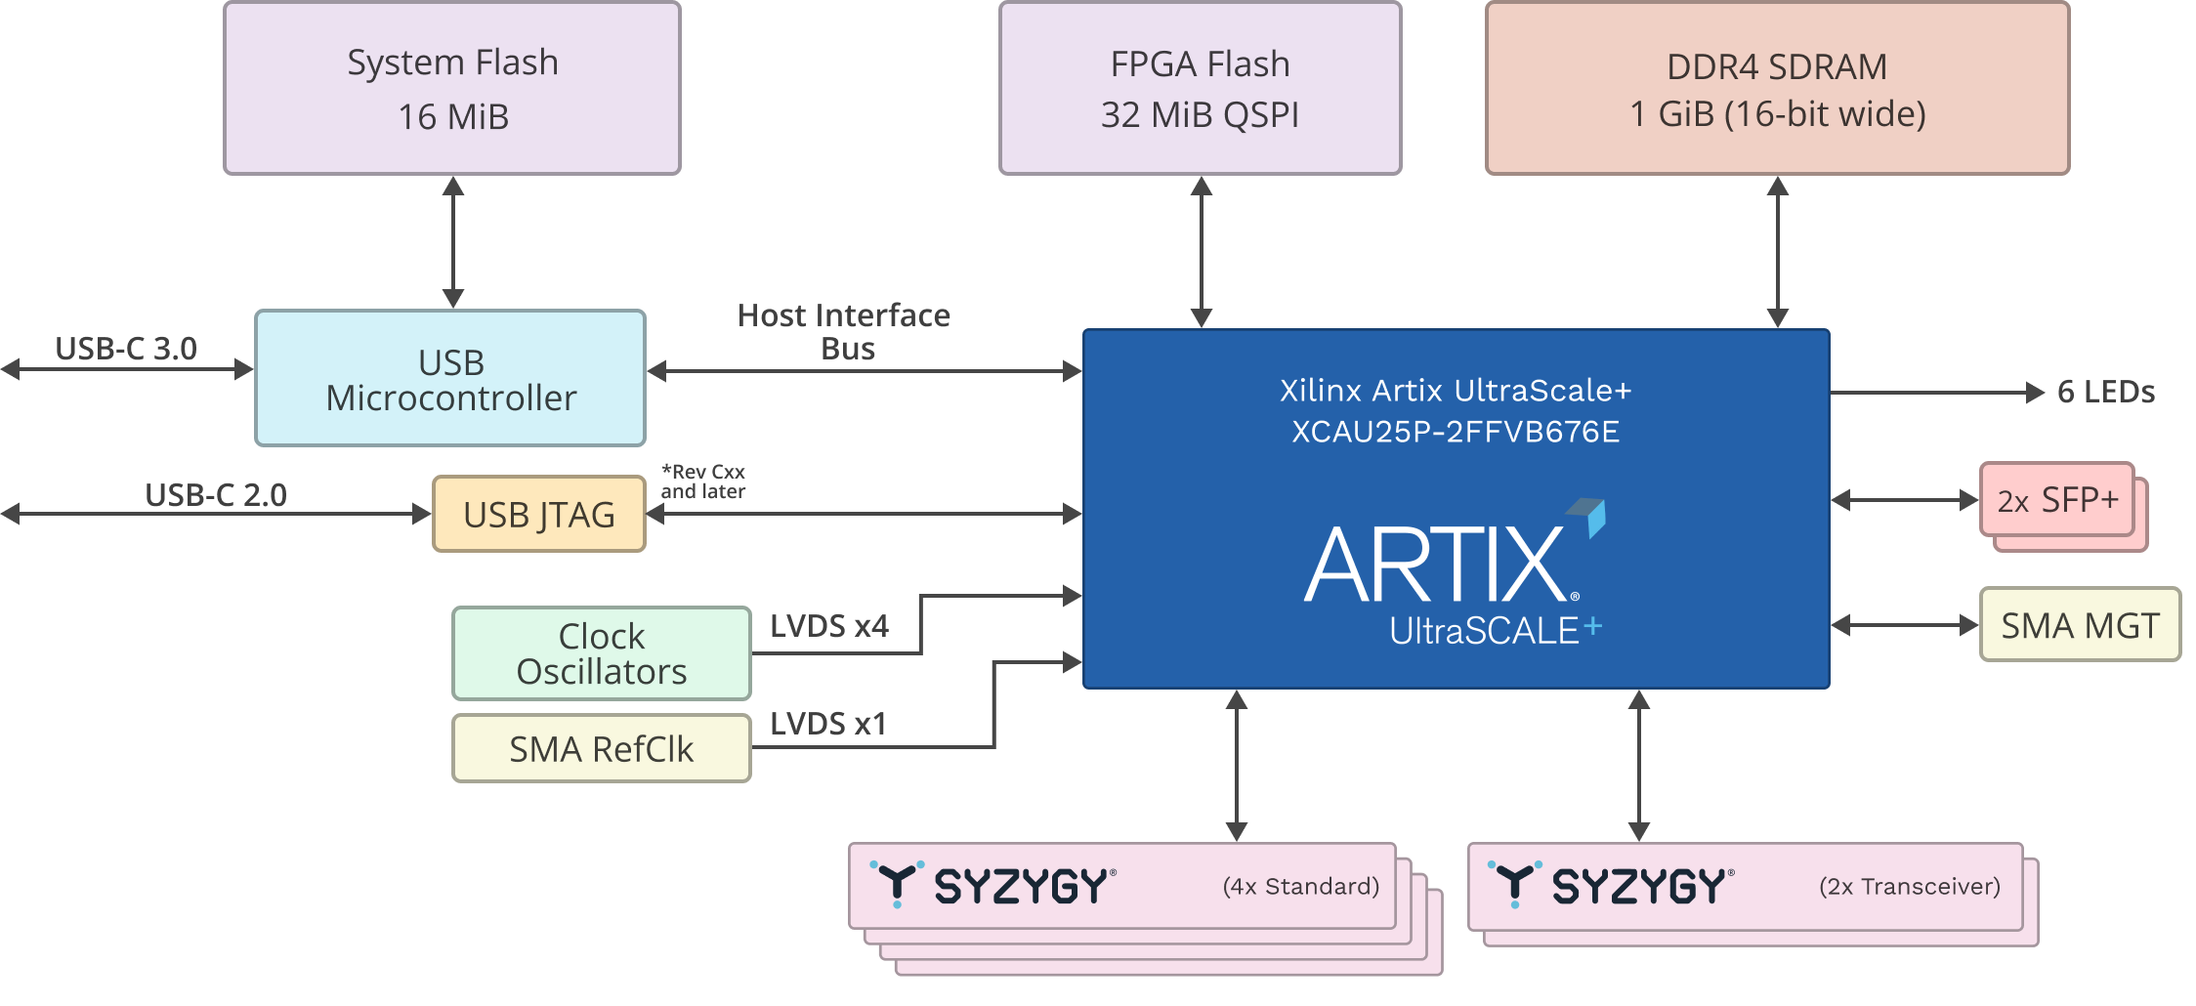
$1400
$100
Notes:
https://www.amazon.com/Yahboom-Raspberry-Omnidirectional-Autopilot-Recognition/dp/B088PRGQJ1/ref=sr_1_24
https://www.amazon.com/Yahboom-Robotic-Raspberry-%EF%BC%88DOFBOT-Without/dp/B08T8XG2J6/ref=sr_1_2
https://www.amazon.com/LewanSoul-Programmable-Feedback-Parameter-Programming/dp/B0793PFGCY

Slide 51
streaming frame capture
JTAG
KINTEX US XCKU040-2FFVA1156I
ARTIX US+ XCAU25P-2FFVB676E
JTAG to AXI Master
AXI Interconnect
AXILite
AXILite
AXILite
AXILite
AXILite
I2C Master
control
status
interrupt
DDR Memory Controller
SCL
SDA
AXI-S DMA
ready
DDR
DRAM
[1120,1280,3]
@110fps
MM2S AXI
AXI-S
2b@1500MHz
MIPI PHY
10b@158MHz
format
32b@158MHz
2b@1500MHz
10b@158MHz
AXI-S
S2MM AXI
2b@1500MHz
10b@158MHz
MIPI CSI-2
https://www.xilinx.com/products/intellectual-property/jtag_to_axi_master.html
https://docs.xilinx.com/r/en-US/pg232-mipi-csi2-rx/MIPI-CSI-2-Receiver-Subsystem-Product-Guide
https://docs.xilinx.com/v/u/en-US/pg150-ultrascale-memory-ip
https://docs.xilinx.com/r/en-US/pg021_axi_dma/AXI-DMA-Register-Address-Map?section=XREF_38966_AXI_DMA_Simple_DMA
https://docs.xilinx.com/v/u/en-US/ds768_axi_interconnect

Slide 52
EP address | Type | Bits | Description
0x00 | wire_in | 31:0 | AWADDR
0x01 |  | 31:0 | WDATA
0x02 |  | 31:0 | ARADDR
0x03 |  | 7:0 | AWLEN
0x03 |  | 10:8 | AWSIZE
0x03 |  | 12:11 | AWBURST
0x03 |  | 13 | AWLOCK
0x03 |  | 17:14 | AWCACHE
0x03 |  | 20:18 | AWPROT
0x03 |  | 24:21 | AWQOS
0x04 |  | 3:0 | WSTRB
0x04 |  | 4 | WLAST
0x05 |  | 7:0 | ARLEN
0x05 |  | 10:8 | ARSIZE
0x05 |  | 12:11 | ARBURST
0x05 |  | 13 | ARLOCK
0x05 |  | 17:14 | ARCACHE
0x05 |  | 20:18 | ARPROT
0x05 |  | 24:21 | ARQOS
EP address | Type | Bits | Description
0x40 | trigger_in | 0 | AWVALID
0x40 |  | 1 | WVALID
0x40 |  | 2 | BREADY
0x40 |  | 3 | ARVALID
0x40 |  | 4 | RREADY
0x40 |  | 5 | global_resetn
EP address | Type | Bits | Description
0x20 | wire_out | 0 | AWVALID
0x20 |  | 1 | WVALID
0x20 |  | 2 | BVALID
0x20 |  | 3 | ARVALID
0x20 |  | 4 | RVALID
0x21 |  | 31:0 | RDATA
0x22 |  | 1:0 | BRESP
0x23 |  | 1:0 | RRESP
0x23 |  | 2 | RLAST

Slide 53
demo
AXI-S
[1120,1280,3]
110fps
AXI-S
[480,640,1]
110fps
2b@1500MHz
MIPI PHY
10b@158MHz
format
10b@158MHz
convnet model
output buffer
MIPI CSI-2
2b@1500MHz
10b@158MHz
10b@158MHz
8b@38MHz
MIPI CSI-2
USB3
MIPI CSI-2
2b@1500MHz
10b@158MHz
10b@158MHz

Slide 54
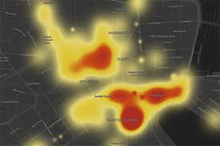
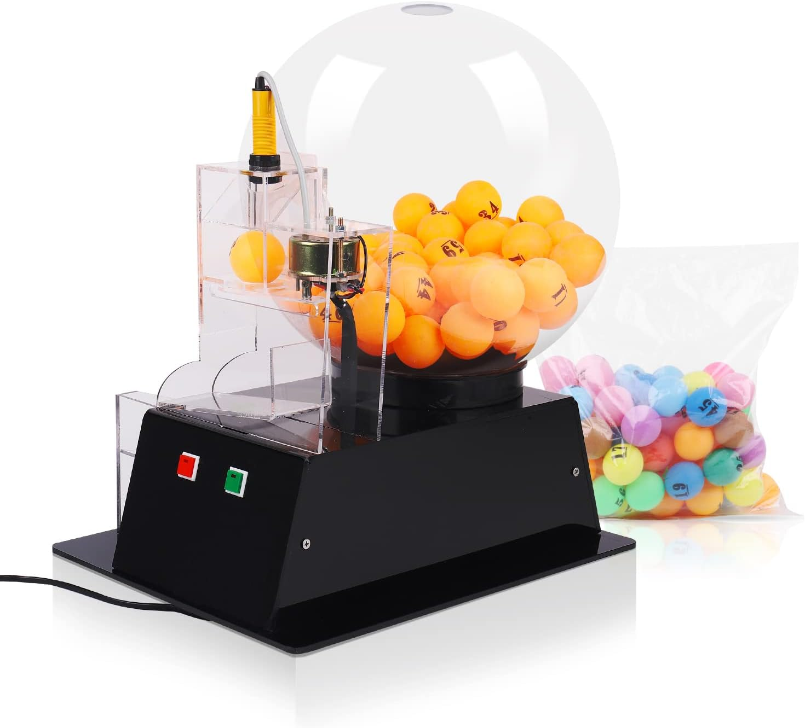
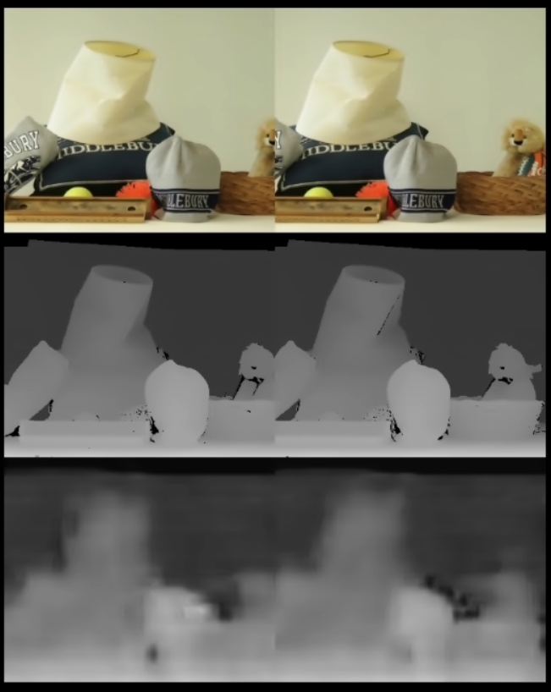
demo concept
Mira220, IMG.2/SPEED.1/ADC.2
1280x1120/110fps/10b
MIPI CSI-2
stereo disparity
640x480/110fps/8b
USB3
R
M
FPGA
L
https://www.amazon.com/Lottery-Machine-Automatic-Electric-Colorful/dp/B0C1XGSZKQ/ref=sr_1_9?crid=1C4OQX8RFH0P4&keywords=lottery+ping+pong+ball+machine

Slide 55
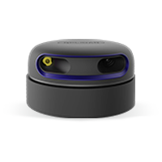
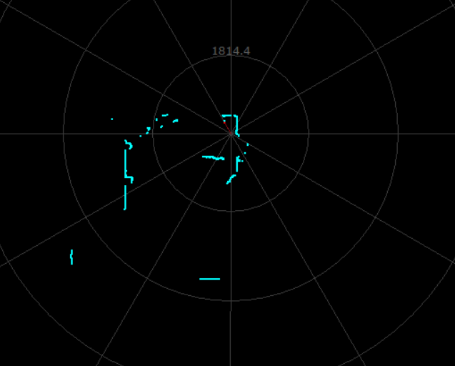
predict RPLidar 2-D LIDAR map from 3X Mira220 in 360 deg configuration (e.g. Roomba view)
demo concept
1280x1120/110fps/10b
Mira220, IMG.2/SPEED.1/ADC.2
FPGA
USB3
640x480/110fps/8b
MIPI CSI-2
https://www.amazon.com/Lottery-Machine-Automatic-Electric-Colorful/dp/B0C1XGSZKQ/ref=sr_1_9?crid=1C4OQX8RFH0P4&keywords=lottery+ping+pong+ball+machine

Slide 56
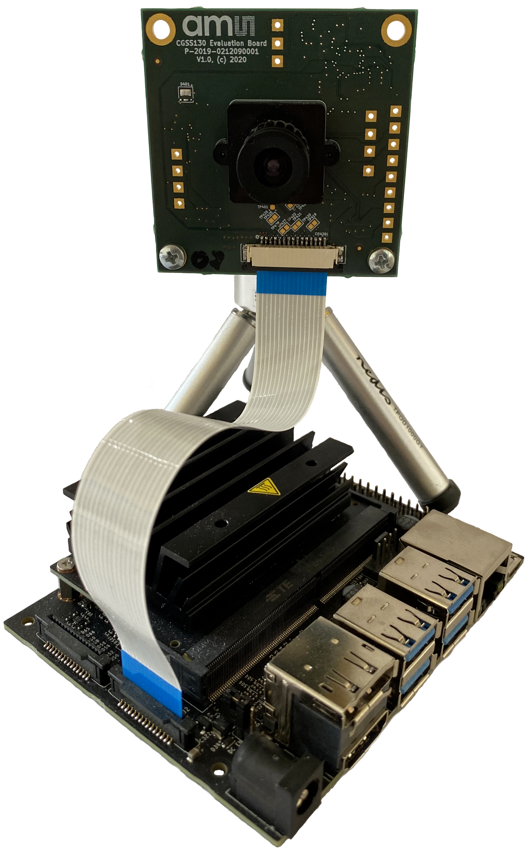
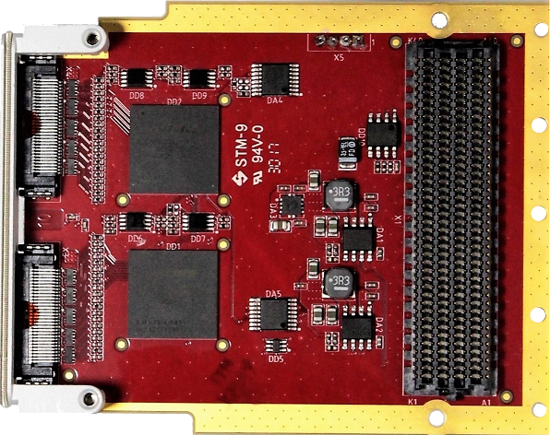
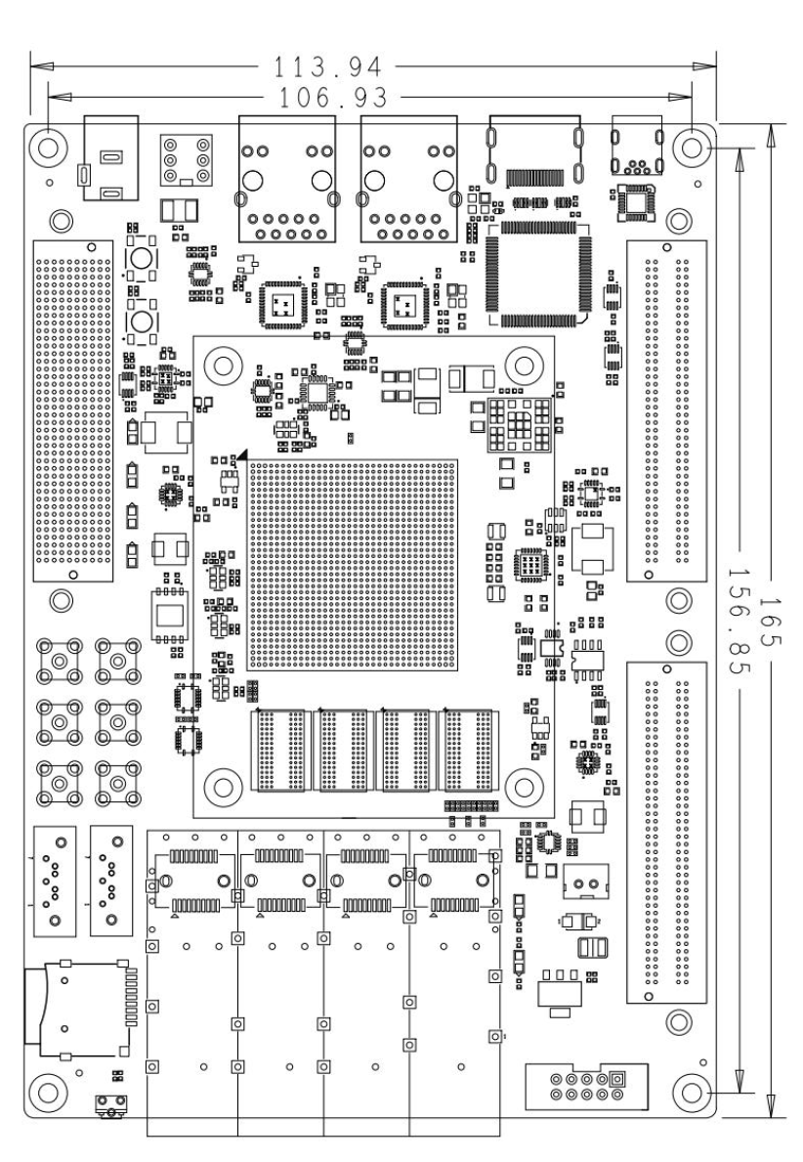
phase 1
Mira-220
FMC-MIPI
LVDS C+2D@1.5GHz
LVDS C+2D@1.5GHz
https://docs.arducam.com/Nvidia-Jetson-Camera/type-and-pinout-mipi-csi-2/

Slide 57
phase 1
KINTEX UltraScale XCKU040-2FFVA1156I
Mira220
MIPI synchronize deserialize
udp/eth/mii
channel interleave
AXI-S
capture buffer
UDP
MII
Mira220
[1400,1600,2]
@90 FPS

Slide 58
phase 2
self supervised pretrained image encoder
Mira220
channel interleave
AXI-S
heat map
Mira220
[1400,1600,2]
@90 FPS
[82,95,64]
@90 FPS
[82,95,1]
@90 FPS
pretrain using self-supervised pretext tasks on unlabeled data
LR eye swap, predict LR vs RL
LR time shift, predict L[t]R[t] vs L[t-1]R[t] vs L[t]R[t-1]

Slide 59
Sensing platform
Silicon vision and sensing platform for next generation robotics
target next generation robotics based on multimodal LLM technology
the image encoder socket is the first stage in a multimodal LLM e.g. CLIP
foundation/backbone vision models encode raw pixels into a compressed feature map
domain specific FPGA enables low latency "pixels to features" at sensor speed
extends to 360-degree vision, hyperspectral, video, tactile sensors, audio, RF
Strategy
Open software
Optimized FPGA silicon initially targeting the emerging image encoder socket
Scale using chiplets
Partner with image sensor, robotics ecosystems
Execution
TF to Verilog demo, real time CNN inference at high resolution and frame rate
demonstrate vision model using self supervised pretraining on egocentric image data

Slide 60
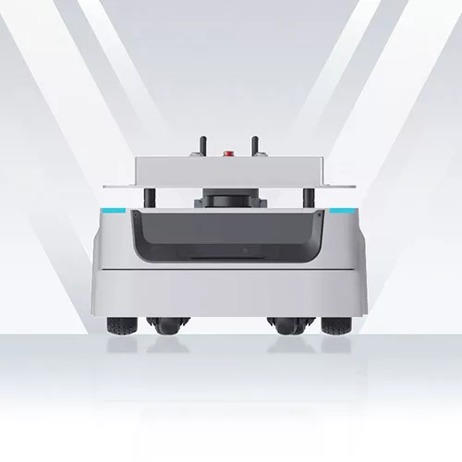
https://www.slamtec.ai/#
Mira220
RPLidar
supervised training
predict overhead Lidar view from 4xMira220
Mira220
channel interleave
AXI-S
[1400,1600,4]
@90 FPS
[170,195,1]
@90 FPS
CNN

Slide 61
phase 1
uart
i2c
ethernet
KINTEX UltraScale XCKU040-2FFVA1156I
LiteX SoC
Mira220
MIPI synchronize deserialize
wb
channel interleave
AXI-S
capture buffer
Mira220
[1400,1600,2]
@90 FPS

Slide 63
https://www.terasic.com.tw/cgi-bin/page/archive.pl?Language=English&CategoryNo=142&No=1295#contents
https://www.xilinx.com/products/boards-and-kits/1-so55i9.html

Slide 64
FPGA Compute Platform
Vision
FPGA as a flexible compute platform
embedded AI, edge and cloud applications, GPU alternative
Strategy
GPT-friendly open IP library
GPT-automated development flow
Raptor, HW/SW co-design (CUDA, RTOS)
GPT-assisted dataflow algorithm implementation
graph based computation for deep models (CNN, Transformer)
TF to Verilog
traditional DSP pipelines (vision, RF)
MATLAB to Verilog
multiple architectures (training accelerators, embedded streaming inference)
Compute-optimized FPGA silicon product line
Execution
"hello world" TF to Verilog demo (embedded real time edge inference)

Slide 65
Parallel computation of CNN dot products
weights
[ochan,3,3,ichan]
parallel ochan
input feature patch
[3,3,ichan]
output feature vector
[1,1,ochan]
parallel nstripe
same shape
tensor dot product

Slide 66
Backup

Slide 67
TFLite int8 quantization
s9
input data
s32
s8
*
+
weight
acc
+
s9
s32
s64
*
>>31
CLAMP RELU
output data
bias
s32
scale M
1: compute dot product (s9*s9+s32)
2: add bias (s32+s32)
3. multiply by scale (s32*s32)
4. shift right >>31
5. clamp to s9 bits and RELU

Slide 68
wa,wen
ra
ichan sel
reg_a
reg_b
clr
op
stripe_sel
DTYPE*ICHAN
patch
acc
reg_z
TDP RAM
MAC
ALU
DTYPE*OCHAN
MAC
ALU
MAC
ALU
MAC
ALU
MAC
ALU
MAC
ALU
MAC
ALU
MAC
ALU
ra
ROM
ROM
ROM
ROM
ROM
ROM
ROM
ROM
conv2d_data.v : NSTRIPE=3, OCHAN=8
weight [OCHAN]

Slide 69
wa,wen
ra
ichan sel
reg_a
reg_b
clr
op
stripe_sel
DTYPE*ICHAN
patch
acc
reg_z
TDP RAM
MAC
ALU
DTYPE*OCHAN
ra
ROM
ROM
ROM
ROM
ROM
ROM
ROM
ROM
weight [OCHAN]
conv2d_data.v : NSTRIPE=3, OCHAN=8

Slide 70
fill row of
padded stripes
from previous
layer
t_{row}
compute NSTRIPE*OCHAN parallel
dot products, quant scale, RELU
stride through input row data
t_{dot}
(owidth/nstripe)∙t_{dot} < t_{row}
serialize nstripe features over
output TDATA*OCHAN
nstripe ∙ t_{clk} < t_{dot}
ndata = # of input features since TLAST (for current layer)
stripe = ndata % istripe

Slide 71
ncol
owidth=27*3
stride=1
ncol
owidth=14*3
stride=2
col
row

Slide 72
t3.py (4K video @30fps)
_________________________________________________________________
Layer (type) Output Shape Param #
=================================================================
conv2d (Conv2D) (None, 2158, 3838, 8) 224
conv2d_1 (Conv2D) (None, 1078, 1918, 8) 584
conv2d_2 (Conv2D) (None, 1076, 1916, 16) 1168
conv2d_3 (Conv2D) (None, 537, 957, 16) 2320
conv2d_4 (Conv2D) (None, 535, 955, 32) 4640
conv2d_5 (Conv2D) (None, 267, 477, 32) 9248
conv2d_6 (Conv2D) (None, 265, 475, 32) 9248
conv2d_7 (Conv2D) (None, 132, 237, 32) 9248
conv2d_8 (Conv2D) (None, 130, 235, 32) 9248
conv2d_9 (Conv2D) (None, 64, 117, 32) 9248
conv2d_10 (Conv2D) (None, 62, 115, 32) 9248
conv2d_11 (Conv2D) (None, 30, 57, 32) 9248
conv2d_12 (Conv2D) (None, 28, 55, 32) 9248
conv2d_13 (Conv2D) (None, 13, 27, 32) 9248
conv2d_14 (Conv2D) (None, 11, 25, 16) 4624
conv2d_15 (Conv2D) (None, 5, 12, 16) 2320
conv2d_16 (Conv2D) (None, 3, 10, 8) 1160
conv2d_17 (Conv2D) (None, 1, 4, 8) 584
flatten (Flatten) (None, 32) 0
=================================================================
Total params: 100,856
Trainable params: 100,856
Non-trainable params: 0
_________________________________________________________________
+----------+-------+---------------------+
| Ref Name | Used | Functional Category |
+----------+-------+---------------------+
| LUT6 | 18400 | LUT |
| FDRE | 12853 | Flop & Latch |
| MUXF7 | 5218 | MuxFx |
| RAMD64E | 2112 | Distributed Memory |
| RAMB36E1 | 1851 | Block Memory |
| CARRY4 | 1568 | CarryLogic |
| LUT4 | 1517 | LUT |
| DSP48E1 | 1032 | Block Arithmetic |
| LUT5 | 807 | LUT |
| LUT2 | 249 | LUT |
| FDSE | 146 | Flop & Latch |
| LUT1 | 131 | LUT |
| LUT3 | 117 | LUT |
| OBUF | 66 | IO |
| IBUF | 26 | IO |
| MUXF8 | 15 | MuxFx |
| OBUFT | 1 | IO |
| BUFG | 1 | Clock |
+----------+-------+---------------------+

Slide 73
andromeda.py log file
rliston@uscomputefe1:~/andromeda$ python3 andromeda.py --model t3 --fps 30
numpy 1.23.5
Namespace(model='t3', clk=500000000.0, fps=30.0, tdata=8)
layer 0 nstripe 14 stride 1 sdepth 3291 wdepth 31 rate 5.375e+10 nmac 108 shapes [ 1 2160 3840 3] [ 1 2158 3838 8] [8 3 3 3] [8]
layer 1 nstripe 9 stride 2 sdepth 17057 wdepth 76 rate 3.578e+10 nmac 72 shapes [ 1 2158 3838 8] [ 1 1078 1918 8] [8 3 3 8] [8]
layer 2 nstripe 9 stride 1 sdepth 6819 wdepth 76 rate 7.146e+10 nmac 143 shapes [ 1 1078 1918 8] [ 1 1076 1916 16] [16 3 3 8] [16]
layer 3 nstripe 5 stride 2 sdepth 30656 wdepth 148 rate 3.562e+10 nmac 72 shapes [ 1 1076 1916 16] [ 1 537 957 16] [16 3 3 16] [16]
layer 4 nstripe 5 stride 1 sdepth 12249 wdepth 148 rate 7.104e+10 nmac 143 shapes [ 1 537 957 16] [ 1 535 955 32] [32 3 3 16] [32]
layer 5 nstripe 3 stride 2 sdepth 50933 wdepth 292 rate 3.532e+10 nmac 71 shapes [ 1 535 955 32] [ 1 267 477 32] [32 3 3 32] [32]
layer 6 nstripe 3 stride 1 sdepth 20352 wdepth 292 rate 3.521e+10 nmac 71 shapes [ 1 267 477 32] [ 1 265 475 32] [32 3 3 32] [32]
layer 7 nstripe 1 stride 2 sdepth 76000 wdepth 292 rate 8.700e+09 nmac 18 shapes [ 1 265 475 32] [ 1 132 237 32] [32 3 3 32] [32]
layer 8 nstripe 1 stride 1 sdepth 30336 wdepth 292 rate 8.649e+09 nmac 18 shapes [ 1 132 237 32] [ 1 130 235 32] [32 3 3 32] [32]
layer 9 nstripe 1 stride 2 sdepth 37600 wdepth 292 rate 2.112e+09 nmac 5 shapes [ 1 130 235 32] [ 1 64 117 32] [32 3 3 32] [32]
layer 10 nstripe 1 stride 1 sdepth 14976 wdepth 292 rate 2.070e+09 nmac 5 shapes [ 1 64 117 32] [ 1 62 115 32] [32 3 3 32] [32]
layer 11 nstripe 1 stride 2 sdepth 18400 wdepth 292 rate 4.928e+08 nmac 1 shapes [ 1 62 115 32] [ 1 30 57 32] [32 3 3 32] [32]
layer 12 nstripe 1 stride 1 sdepth 7296 wdepth 292 rate 4.728e+08 nmac 1 shapes [ 1 30 57 32] [ 1 28 55 32] [32 3 3 32] [32]
layer 13 nstripe 1 stride 2 sdepth 8800 wdepth 292 rate 1.064e+08 nmac 1 shapes [ 1 28 55 32] [ 1 13 27 32] [32 3 3 32] [32]
layer 14 nstripe 1 stride 1 sdepth 3456 wdepth 292 rate 4.852e+07 nmac 1 shapes [ 1 13 27 32] [ 1 11 25 16] [16 3 3 32] [16]
layer 15 nstripe 1 stride 2 sdepth 2000 wdepth 148 rate 4.752e+06 nmac 1 shapes [ 1 11 25 16] [ 1 5 12 16] [16 3 3 16] [16]
layer 16 nstripe 1 stride 1 sdepth 768 wdepth 148 rate 2.074e+06 nmac 1 shapes [ 1 5 12 16] [ 1 3 10 8] [ 8 3 3 16] [8]
layer 17 nstripe 1 stride 2 sdepth 400 wdepth 76 rate 1.296e+05 nmac 1 shapes [ 1 3 10 8] [1 1 4 8] [8 3 3 8] [8]
total stripe RAM bits 147841520
total weight RAM bits 816832
total required MAC units 733
total used MAC units 1032
rliston@uscomputefe1:~/andromeda$

Slide 74
t3.py (4K video @30fps)
3. Memory
---------
+-------------------+------+-------+------------+-----------+-------+
| Site Type | Used | Fixed | Prohibited | Available | Util% |
+-------------------+------+-------+------------+-----------+-------+
| Block RAM Tile | 1851 | 0 | 0 | 1880 | 98.46 |
| RAMB36/FIFO* | 1851 | 0 | 0 | 1880 | 98.46 |
| RAMB36E1 only | 1851 | | | | |
| RAMB18 | 0 | 0 | 0 | 3760 | 0.00 |
+-------------------+------+-------+------------+-----------+-------+
* Note: Each Block RAM Tile only has one FIFO logic available and therefore can accommodate only one FIFO36E1 or one FIFO18E1. However, if a FIFO18E1 occupies a Block RAM Tile, that tile can still accommodate a RAMB18E1
4. DSP
------
+----------------+------+-------+------------+-----------+-------+
| Site Type | Used | Fixed | Prohibited | Available | Util% |
+----------------+------+-------+------------+-----------+-------+
| DSPs | 1032 | 0 | 0 | 3360 | 30.71 |
| DSP48E1 only | 1032 | | | | |
+----------------+------+-------+------------+-----------+-------+

Slide 75
Target applications
high speed, low latency inference at the edge
ex: 3840x2160 @100 fps image classification for industrial applications
process raw uncompressed pixels directly from sensor (e.g. HDMI,MIPI)
hyperspectral image sensors, RF IQ baseband, 300+ frames/s
inference only, supports small but useful subset of TFLite (conv2d only, padding='valid', stride={1,2}, activation=RELU)
no external memory required
real time data stream -> real time prediction stream (or feature map)
tool to compile TFLite model into synthesizable Verilog
generated Verilog code is self contained, includes streaming inference and weights
compiler generates parallel code for OCHAN*NSTRIPE MAC operations
compiler generates ROM file with the weights

Slide 76
wa,we
ra
ichan sel
reg_a
reg_b
clr
stripe_sel
patch
TDATA
acc
reg_x
TDATA*OCHAN
TDATA*ICHAN
TDP RAM
MAC
TDP RAM
MAC
TDP RAM
MAC
padded stripes [NSTRIPE]
MAC
ra
reg_c
reg_d
MAC
acc
MAC
ROM
MAC
MAC
ROM
MAC
MAC
ROM
MAC
MAC
ROM
MAC
MAC
ROM
MAC
MAC
ROM
MAC
MAC
ROM
MAC
MAC
ROM
MAC
MAC
bias [OCHAN]
scale M0 [OCHAN]
MAC
ra
MAC
ROM
MAC
ROM
MAC
ROM
MAC
ROM
MAC
ROM
MAC
ROM
MAC
ROM
MAC
conv2d_data.v
NSTRIPE=3, OCHAN=8
ROM
TDATA
MAC
TDATA
weight [OCHAN]

Slide 77
u8
input data
u8
-
s8
input zeropoint
s32
s8
*
+
weight
acc
+
s32
*
>> 31
bias
8
+
CLAMP
output data
u32
scale M0
u8
output zeropoint
1: compute dot product (8*8+32)
2: add bias (32+32)
3. multiply by M0 scale (32*32)
4. shift right 31 bits with round
5. clamp to 8 bits + RELU

Slide 80
wa,we
ra
ichan sel
reg_a
reg_b
opcode, args
stripe_sel
TDATA*ICHAN
patch
TDATA
reg_z
TDP RAM
DSP
TDATA*OCHAN
TDP RAM
DSP
TDP RAM
DSP
padded stripes [NSTRIPE]
DSP
DSP
DSP
DSP
DSP
DSP
DSP
DSP
DSP
DSP
DSP
DSP
ra
DSP
ROM
DSP
ROM
DSP
ROM
DSP
ROM
DSP
ROM
DSP
ROM
DSP
ROM
DSP
ROM
DSP
conv2d_data.v : NSTRIPE=3, OCHAN=8
weights [OCHAN]
TDATA
TDATA

Slide 81
wa,we
ra
ichan sel
reg_a
reg_b
opcode, args
stripe_sel
TDATA*ICHAN
patch
TDATA
reg_z
TDP RAM
DSP
TDATA*OCHAN
TDP RAM
DSP
TDP RAM
DSP
padded stripes [NSTRIPE]
DSP
DSP
+----------+------+---------------------+
| FDRE | 3735 | Flop & Latch |
| LUT6 | 1634 | LUT |
| LUT4 | 695 | LUT |
| CARRY4 | 586 | CarryLogic |
| DSP48E1 | 510 | Block Arithmetic |
| RAMB18E1 | 181 | Block Memory |
| LUT2 | 177 | LUT |
| RAMB36E1 | 105 | Block Memory |
| OBUF | 82 | IO |
| LUT1 | 64 | LUT |
| LUT3 | 54 | LUT |
| FDSE | 39 | Flop & Latch |
| LUT5 | 24 | LUT |
| IBUF | 10 | IO |
| FDCE | 6 | Flop & Latch |
| OBUFT | 1 | IO |
| BUFG | 1 | Clock |
+----------+------+---------------------+
DSP
DSP
DSP
DSP
DSP
DSP
DSP
DSP
DSP
DSP
ra
DSP
ROM
DSP
ROM
DSP
ROM
DSP
TDATA = {int8, bfloat16}
ICHAN = {1..256}
OCHAN = {1..256}
NSTRIPE = {1..64}
ROM
DSP
ROM
DSP
ROM
DSP
ROM
DSP
ROM
DSP
conv2d_dp.v : NSTRIPE=3, OCHAN=8
weights [OCHAN]
TDATA
TDATA

Slide 82
andromeda.py streaming CNN compiler
iverilog
VCS
model.v
andromeda.py
conv2d.v
conv2d_dp.v
conv2d_ctrl.v
model.tflite
FlatBuffers
--model model
--clk 500e6
--fps 30
Vivado
Quartus
Raptor
dc_shell
model_weights.v
automated tool to compile TFLite model into synthesizable Verilog
compiler generates parallel code for OCHAN*NSTRIDE MAC operations per layer

Slide 83
Streaming CNN Verilog Hierarchy
(AXI-S)
model.v
(AXI-S)
conv2d.v
conv2d.v
conv2d.v
conv2d_dp.v
#(ICHAN,OCHAN,NSTRIPE)
TDATA
conv2d_dp.v
#(ICHAN,OCHAN,NSTRIPE)
conv2d_dp.v
#(ICHAN,OCHAN,NSTRIPE)
TDATA
TDATA
weight_rom.v
weight_rom.v
weight_rom.v
TVALID,TLAST
TREADY
TVALID,TLAST
TREADY
conv2d_ctrl.v
conv2d_ctrl.v
conv2d_ctrl.v
TVALID,TLAST
TREADY
CLK

Slide 84
Streaming CNN Verilog Hierarchy
model.v
conv2d.v
conv2d.v
conv2d.v
TDATA
conv2d_dp.v
#(ICHAN,OCHAN,NSTRIPE)
conv2d_dp.v
#(ICHAN,OCHAN,NSTRIPE)
conv2d_dp.v
#(ICHAN,OCHAN,NSTRIPE)
TDATA
weight_rom.v
weight_rom.v
weight_rom.v
conv2d_ctrl.v
conv2d_ctrl.v
conv2d_ctrl.v
TVALID
TLAST
TVALID
TLAST
CLK

Slide 85
https://arxiv.org/pdf/1712.05877.pdf
https://www.tensorflow.org/lite/performance/quantization_spec#int8_quantized_operator_specifications
requirements for TFLite quant:
saturating 8*8+32 bit MAC
rounding-to-nearest right-shift
https://en.wikipedia.org/wiki/Wafer-scale_integration
https://en.wikipedia.org/wiki/Cerebras
https://arxiv.org/pdf/2112.07571.pdf

Slide 86
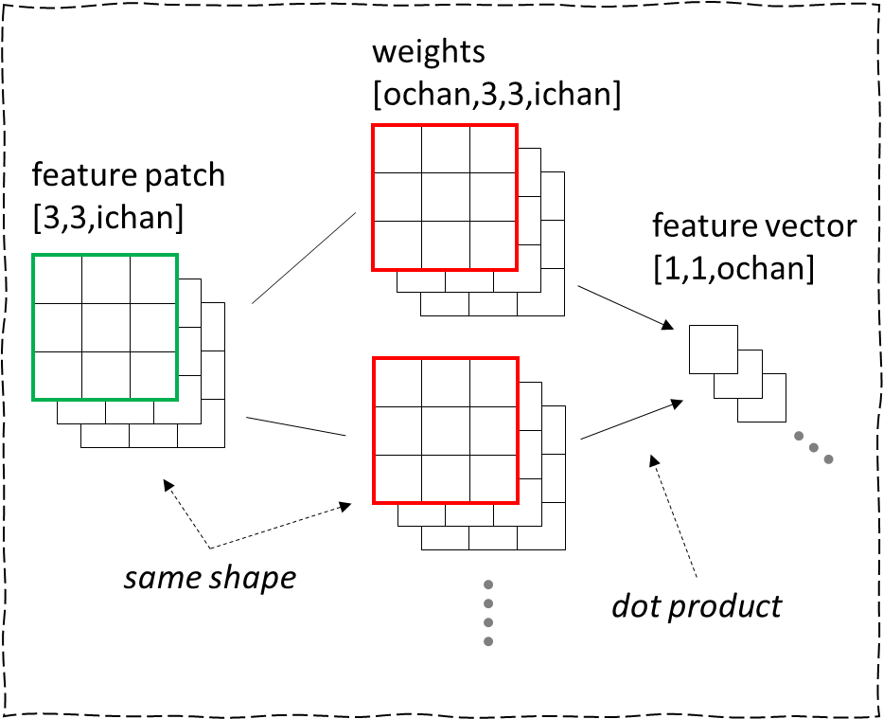
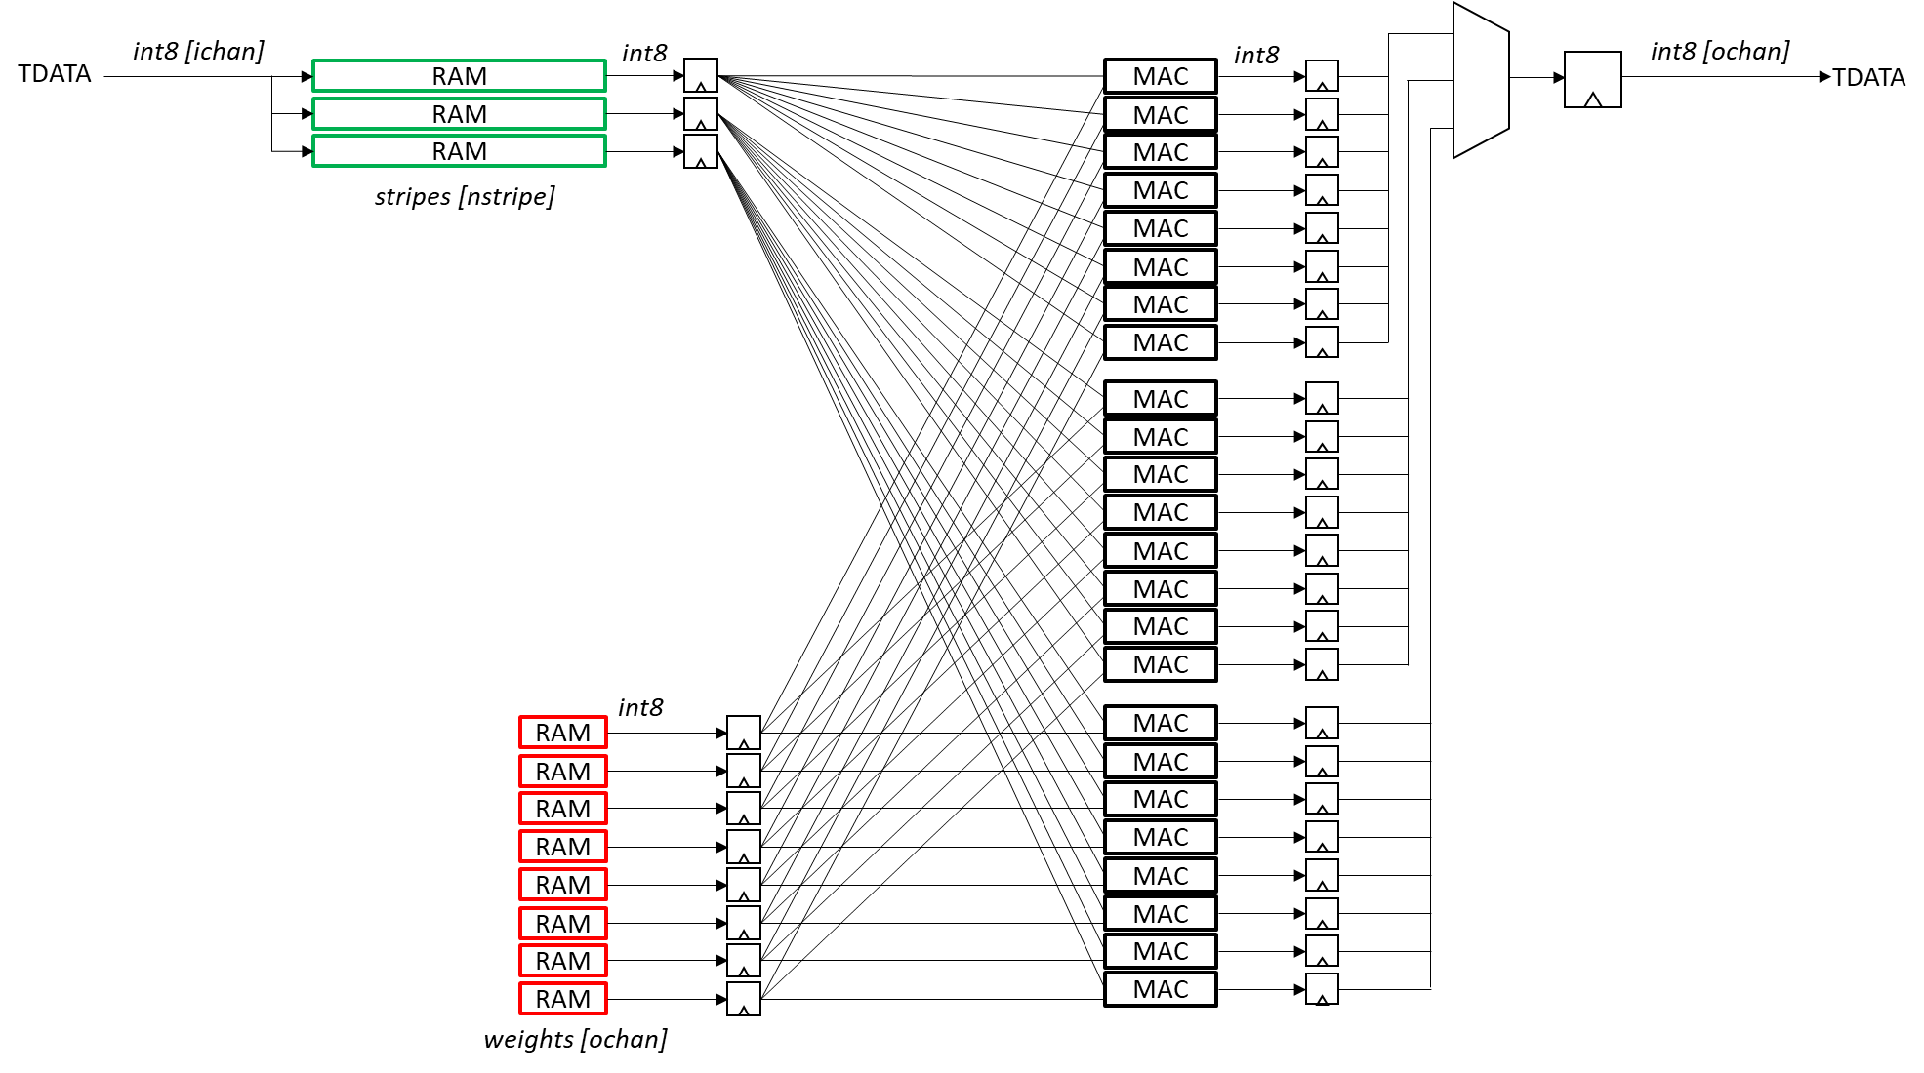


CNN dot product using FPGA
BRAM
stripes
BRAM
weights

Slide 87
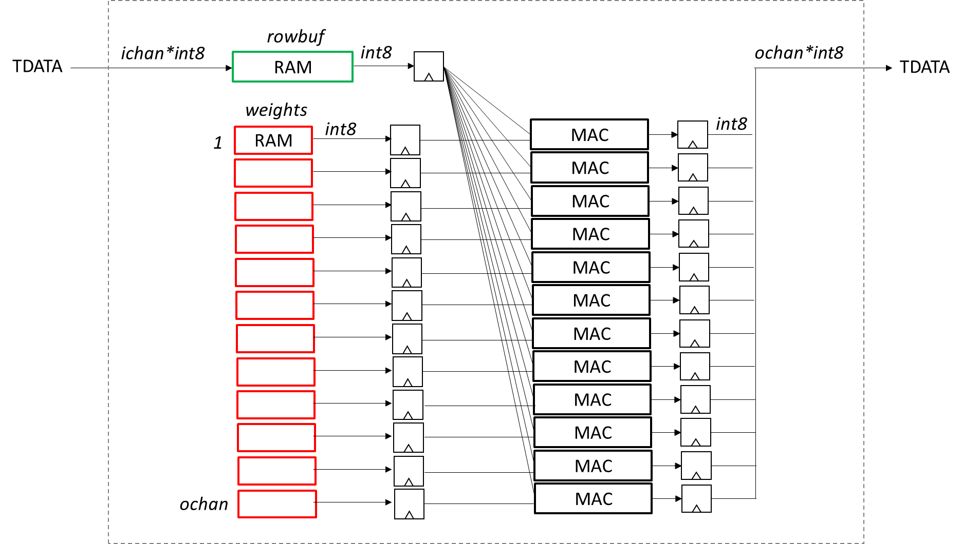
CNN dot product using FPGA
BRAM
row buffer
BRAM
weights

Slide 88
rowbuf
ichan*int8
int8
ochan*int8
TDATA
RAM
TDATA
weights
int8
int8
1
RAM
MAC
MAC
MAC
MAC
MAC
MAC
MAC
MAC
MAC
MAC
MAC
ochan
MAC
Notes:
stripe input activations across input buffer BRAMs
compute n*m dot products in parallel
each RAM stores complete input patches (input activations in the rowbuf and per-output channel weights)
always use m=ochan as a simplification
m <= output channels
each MAC computes a complete dot product to produce an output feature
parallelism comes from 1) row buffer stripes are computed in parallel, patch by patch and 2) output feature vector channels are computed in parallel
circular row buffer
each BRAM contains an overlapped vertical slice of the row buffer, contains complete patches, stripmining, striping
TDATA is int8 or float16
compute dot products of each input rowbuf stripe in parallel

Slide 89
rowbuf
ichan*int8
int8
ochan*int8
TDATA
RAM
TDATA
RAM
RAM
weights
int8
int8
1
RAM
MAC
MAC
MAC
MAC
MAC
MAC
MAC
MAC
ochan
MAC
Notes:
stripe input activations across input buffer BRAMs
compute n*m dot products in parallel
each RAM stores complete input patches (input activations in the rowbuf and per-output channel weights)
always use m=ochan as a simplification
m <= output channels
each MAC computes a complete dot product to produce an output feature
parallelism comes from 1) row buffer stripes are computed in parallel, patch by patch and 2) output feature vector channels are computed in parallel
circular row buffer
each BRAM contains an overlapped vertical slice of the row buffer, contains complete patches, stripmining, striping
TDATA is int8 or float16
compute dot products of each input rowbuf stripe in parallel

Slide 90
int8
rowbuf
RAM
MAC*ochan
RAM
int8
MAC*ochan
ichan*int8
int8
ochan*int8
TDATA
RAM
TDATA
weights
int8
int8
1
RAM
MAC
MAC
MAC
MAC
MAC
MAC
MAC
MAC
MAC
MAC
MAC
ochan
MAC
Notes:
stripe input activations across input buffer BRAMs
compute n*m dot products in parallel
each RAM stores complete input patches (input activations in the rowbuf and per-output channel weights)
always use m=ochan as a simplification
m <= output channels
each MAC computes a complete dot product to produce an output feature
parallelism comes from 1) row buffer stripes are computed in parallel, patch by patch and 2) output feature vector channels are computed in parallel
circular row buffer
each BRAM contains an overlapped vertical slice of the row buffer, contains complete patches, stripmining, striping
TDATA is int8 or float16
compute dot products of each input rowbuf stripe in parallel

Slide 91
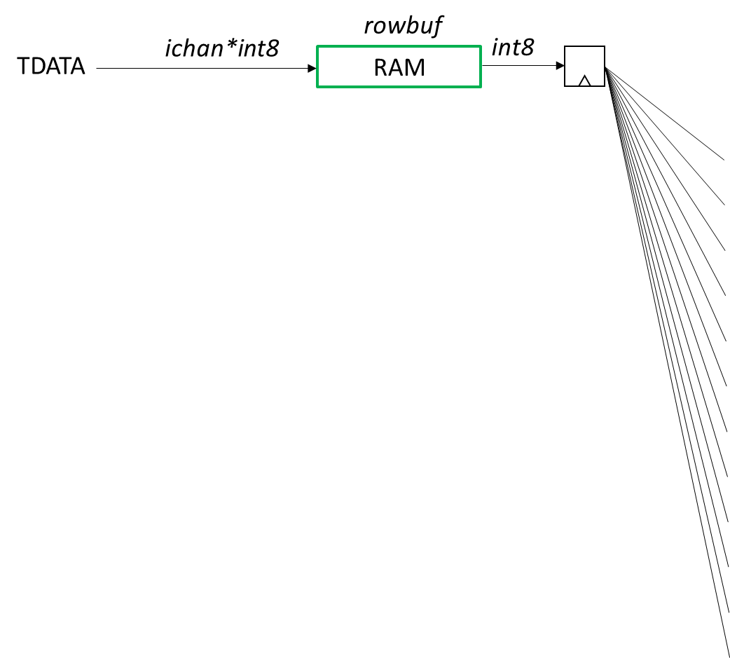
ochan*int8
TDATA

Slide 92
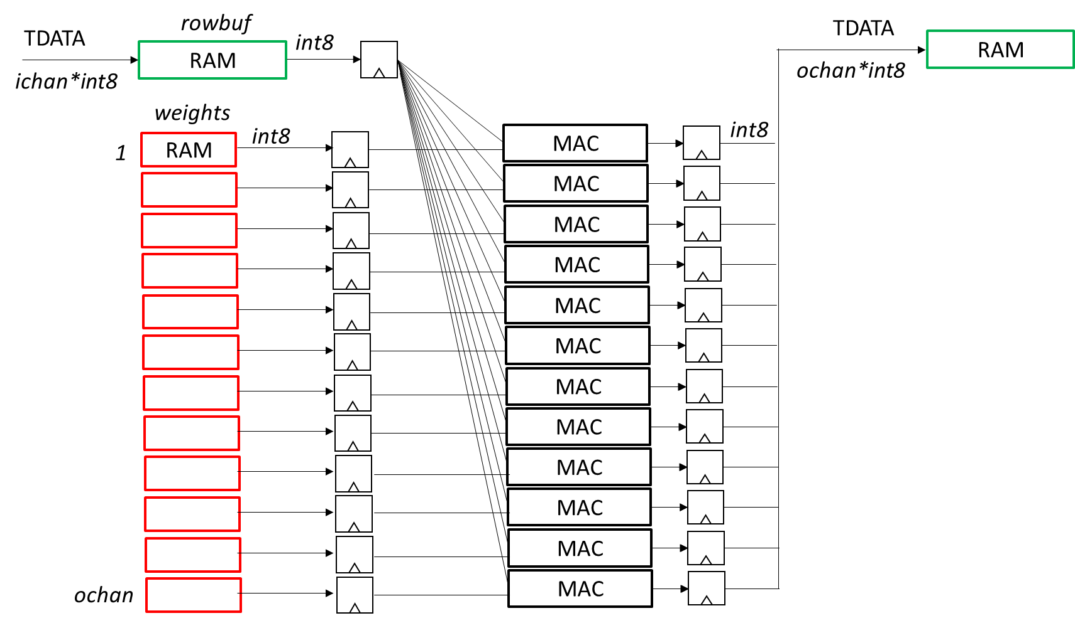
CNN dot product using FPGA
weights
[ochan,3,3,ichan]
feature patch
[3,3,ichan]
feature vector
[1,1,ochan]
same shape
dot product
BRAM
row buffer
BRAM
weights

Slide 93
rowbuf
RELU
TDATA
RAM
MAC
TDATA
RAM
MAC
RAM
MAC
RAM
MAC
RAM n
MAC
MAC
MAC
MAC
MAC
MAC
weights
MAC
RAM
MAC
data path interface
n * rowbuf.wa, we
n * rowbuf.ra
n * rowbuf.ra_adjacent
n * rowbuf.muxsel
m * weights.ra
mac_clear, mac_load
RAM
MAC
RAM m
MAC
MAC n*m
(m=ochan)
Notes:
stripe input activations across input buffer BRAMs
compute n*m dot products in parallel
each RAM stores complete input patches (input activations in the rowbuf and per-output channel weights)
always use m=ochan as a simplification
m <= output channels
each MAC computes a complete dot product to produce an output feature
parallelism comes from 1) row buffer stripes are computed in parallel, patch by patch and 2) output feature vector channels are computed in parallel
circular row buffer
each BRAM contains an overlapped vertical slice of the row buffer, contains complete patches, stripmining, striping
TDATA is int8 or float16
compute dot products of each input rowbuf stripe in parallel

Slide 94
rowbuf
TDATA
shape=[chunk]
dtype=int8
BRAM
ichan MAC
MAC
MAC
weights
RAM
RAM
RAM m
(m=ochan)
serialize flattened tensor
send tensor over TDATA in S*dtype size chunks
write and read BRAM in S*dtype size chunks
data path interface
n * rowbuf.wa, we
n * rowbuf.ra
n * rowbuf.ra_adjacent
n * rowbuf.muxsel
m * weights.ra
mac_clear, mac_load
Notes:
stripe input activations across input buffer BRAMs
compute n*m dot products in parallel
each RAM stores complete input patches (input activations in the rowbuf and per-output channel weights)
always use m=ochan as a simplification
m <= output channels
each MAC computes a complete dot product to produce an output feature
parallelism comes from 1) row buffer stripes are computed in parallel, patch by patch and 2) output feature vector channels are computed in parallel
circular row buffer
each BRAM contains an overlapped vertical slice of the row buffer, contains complete patches, stripmining, striping
TDATA is int8 or float16
compute dot products of each input rowbuf stripe in parallel

Slide 95
fps | 289
width | 728
height | 544
channels | 3
clk | 500,000,000
layer | iwidth | iheight | ichan | stride | kheight | kwidth | owidth | oheight | ochan | patches/s | MAC/patch | MAC/s | required MAC | row buffer words | weight words | n | n*m | rowbuf depth
1 | 728 | 544 | 3 | 1 | 3 | 3 | 726 | 542 | 32 | 114,453,248 | 864 | 98,887,606,272 | 198 | 6,552 | 864 | 7 | 224 | 936
2 | 726 | 542 | 32 | 2 | 3 | 3 | 362 | 270 | 32 | 28,246,860 | 9,216 | 260,323,061,760 | 521 | 69,696 | 9,216 | 17 | 544 | 4,100
3 | 362 | 270 | 32 | 1 | 3 | 3 | 360 | 268 | 32 | 27,882,720 | 9,216 | 256,967,147,520 | 514 | 34,752 | 9,216 | 17 | 544 | 2,044
4 | 360 | 268 | 32 | 2 | 3 | 3 | 179 | 133 | 32 | 6,880,223 | 9,216 | 63,408,135,168 | 127 | 34,560 | 9,216 | 4 | 128 | 8,640
5 | 179 | 133 | 32 | 1 | 3 | 3 | 177 | 131 | 32 | 6,701,043 | 9,216 | 61,756,812,288 | 124 | 17,184 | 9,216 | 4 | 128 | 4,296
6 | 177 | 131 | 32 | 2 | 3 | 3 | 88 | 65 | 32 | 1,653,080 | 9,216 | 15,234,785,280 | 31 | 16,992 | 9,216 | 1 | 32 | 16,992
7 | 88 | 65 | 32 | 1 | 3 | 3 | 86 | 63 | 32 | 1,565,802 | 9,216 | 14,430,431,232 | 29 | 8,448 | 9,216 | 1 | 32 | 8,448
8 | 86 | 63 | 32 | 2 | 3 | 3 | 42 | 31 | 32 | 376,278 | 9,216 | 3,467,778,048 | 7 | 8,256 | 9,216 | 1 | 32 | 8,256
9 | 42 | 31 | 32 | 1 | 3 | 3 | 40 | 29 | 32 | 335,240 | 9,216 | 3,089,571,840 | 7 | 4,032 | 9,216 | 1 | 32 | 4,032
10 | 40 | 29 | 32 | 2 | 3 | 3 | 19 | 14 | 32 | 76,874 | 9,216 | 708,470,784 | 2 | 3,840 | 9,216 | 1 | 32 | 3,840
11 | 19 | 14 | 32 | 1 | 3 | 3 | 17 | 12 | 32 | 58,956 | 9,216 | 543,338,496 | 2 | 1,824 | 9,216 | 1 | 32 | 1,824
12 | 17 | 12 | 32 | 2 | 3 | 3 | 8 | 5 | 32 | 11,560 | 9,216 | 106,536,960 | 1 | 1,632 | 9,216 | 1 | 32 | 1,632
13 | 8 | 5 | 32 | 1 | 3 | 3 | 6 | 3 | 32 | 5,202 | 9,216 | 47,941,632 | 1 | 768 | 9,216 | 1 | 32 | 768
14 | 6 | 3 | 32 | 2 | 3 | 3 | 2 | 1 | 32 | 578 | 9,216 | 5,326,848 | 1 | 576 | 9,216 | 1 | 32 | 576
15 | 2 | 1 | 32 | 1 | 3 | 3 | 0 | -1 | 32 | - | 9,216 | - | - | 192 | 9,216 | - | - | #DIV/0!
 |  |  |  |  |  |  |  |  |  |  |  | 778,976,944,128 | 1,565 | 209,304 | 129,888 | 58 | 1,856
write incoming features from AXI-S to rowbuf[]
when a compete row of patches has arrived, begin computing dot products per-inputslice per-chanout
n*m features will complete simultaneously, write them sequentially into the reorder buffer

Slide 96
RELU
rowbuf
o:1
TDATA
MAC
RAM
RAM
MAC
RAM
MAC
RAM
MAC
n:1
RAM n
MAC
RAM
MAC
RAM
MAC
RAM
MAC
RAM m
MAC
MAC
weights
MAC
RAM
MAC
data path interface
n * rowbuf.wa, we
n * rowbuf.ra
n * rowbuf.ra_adjacent
n * rowbuf.muxsel
m * weights.ra
mac_clear, mac_load
RAM
MAC
RAM o
MAC
MAC n*o
(o=ochan)
Notes:
stripe input activations across input buffer BRAMs
compute n*m dot products in parallel
each RAM stores complete input patches (input activations in the rowbuf and per-output channel weights)
always use m=ochan as a simplification
m <= output channels
each MAC computes a complete dot product to produce an output feature
parallelism comes from 1) row buffer stripes are computed in parallel, patch by patch and 2) output feature vector channels are computed in parallel
circular row buffer
each BRAM contains an overlapped vertical slice of the row buffer, contains complete patches, stripmining, striping
TDATA is int8 or float16
compute dot products of each input rowbuf stripe in parallel

Slide 97
rowbuf
RELU
TDATA
RAM
MAC
TDATA
RAM
MAC
RAM
MAC
RAM
MAC
RAM n
MAC
MAC
MAC
MAC
MAC
MAC
weights
MAC
RAM
MAC
data path interface
n * rowbuf.wa
n * rowbuf.ra
n * rowbuf.ra_adjacent
n * rowbuf.muxsel
m * weights.ra
mac_clear, mac_load
RAM
MAC
RAM m
MAC
MAC n*m
(m=ochan)
Notes:
stripe input activations across input buffer BRAMs
compute n*m dot products in parallel
each RAM stores complete input patches (input activations in the rowbuf and per-output channel weights)
always use m=ochan as a simplification
m <= output channels
each MAC computes a complete dot product to produce an output feature
parallelism comes from 1) row buffer stripes are computed in parallel, patch by patch and 2) output feature vector channels are computed in parallel
circular row buffer
each BRAM contains an overlapped vertical slice of the row buffer, contains complete patches, stripmining, striping
TDATA is int8 or float16
compute dot products of each input rowbuf stripe in parallel

Slide 98
CNN dot product using FPGA
conv2d.v
AXI-S
AXI-S
weights
[ochan,3,3,ichan]
RAM
MAC
RAM
MAC
RAM
MAC
RAM
MAC
feature patch
[3,3,ichan]
RAM n
MAC
MAC
feature vector
[1,1,ochan]
MAC
MAC
MAC
MAC
RAM
MAC
MAC
RAM
MAC
RAM m
MAC
MAC n*m
same shape
dot product
BRAM
row buffer
BRAM
weights

Slide 99
rowbuf
RELU
TDATA
reorder
RAM
MAC
TDATA
TVALID
TLAST
TREADY
RAM
MAC
RAM
TVALID
TLAST
TREADY
RAM
MAC
RAM
MAC
RAM n
MAC
MAC
MAC
MAC
MAC
data path interface
n * rowbuf.wa
n * rowbuf.ra
m * weights.ra
mac_clear, mac_load
MAC
weights
MAC
RAM
MAC
RAM
MAC
RAM m
MAC
MAC n*m
Notes:
stripe input activations across input buffer BRAMs
compute n*m dot products in parallel
each RAM stores complete input patches (input activations in the rowbuf and per-output channel weights)
always use m=ochan as a simplification
m <= output channels
each MAC computes a complete dot product to produce an output feature
parallelism comes from 1) row buffer stripes are computed in parallel, patch by patch and 2) output feature vector channels are computed in parallel
circular row buffer
each BRAM contains an overlapped vertical slice of the row buffer, contains complete patches, stripmining, striping
TDATA is int8 or float16
compute dot products of each input rowbuf stripe in parallel

Slide 100
rowbuf
RELU
TDATA
reorder
RAM
MAC
TDATA
RAM
MAC
RAM
TVALID
TLAST
TREADY
RAM
MAC
RAM
MAC
RAM n
MAC
MAC
MAC
1-32 chunk of int8
MAC
MAC
data path interface
n * rowbuf.wa
n * rowbuf.ra
m * weights.ra
mac_clear, mac_load
MAC
weights
MAC
RAM
MAC
RAM
MAC
RAM m
MAC
MAC n*m
Notes:
stripe input activations across input buffer BRAMs
compute n*m dot products in parallel
each RAM stores complete input patches (input activations in the rowbuf and per-output channel weights)
always use m=ochan as a simplification
m <= output channels
each MAC computes a complete dot product to produce an output feature
parallelism comes from 1) row buffer stripes are computed in parallel, patch by patch and 2) output feature vector channels are computed in parallel
circular row buffer
each BRAM contains an overlapped vertical slice of the row buffer, contains complete patches, stripmining, striping
TDATA is int8 or float16
compute dot products of each input rowbuf stripe in parallel

Slide 101
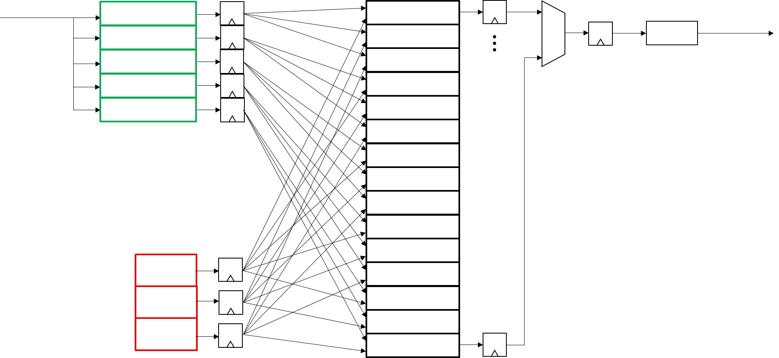
CNN dot product using FPGA
AXI-S
AXI-S
weights
[ochan,3,3,ichan]
RAM
MAC
RAM
RAM
MAC
RAM
MAC
RAM
MAC
RAM n
MAC
MAC
feature patch
[3,3,ichan]
MAC
MAC
feature vector
[1,1,ochan]
MAC
MAC
RAM
MAC
MAC
RAM
MAC
RAM m
MAC
conv2d.v
MAC n*m
BRAM
row buffer
BRAM
weights
same shape
dot product
layer 1
layer 2
layer n

Slide 102
Notes:
stripe input activations across input buffer BRAMs
compute n*m dot products in parallel
each RAM stores complete input patches (input activations in the rowbuf and per-output channel weights)
m <= output channels
each MAC computes a complete dot product to produce an output feature
parallelism comes from 1) row buffer stripes are computed in parallel, patch by patch and 2) output feature vector channels are computed in parallel
circular row buffer
each BRAM contains an overlapped vertical slice of the row buffer, contains complete patches, stripmining, striping
TDATA is int8 or float16
compute dot products of each input rowbuf stripe in parallel

Slide 104
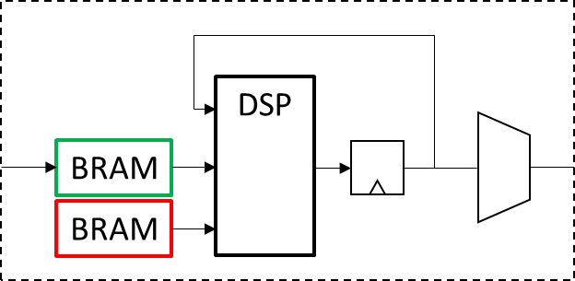
CNN dot product using FPGA
weights
[ochan,3,3,ichan]
DSP
18
18
feature patch
[3,3,ichan]
BRAM
feature vector
[1,1,ochan]
AXI-S
AXI-S
BRAM
conv2d.v
BRAM
row buffer
BRAM
weights
layer 1
layer 2
layer n
same shape
dot product

Slide 105
rowbuf
RELU
TDATA
reorder
RAM
MAC
TDATA
TVALID
TLAST
TREADY
RAM
MAC
RAM
TVALID
TLAST
TREADY
RAM
MAC
RAM
MAC
RAM n
MAC
MAC
MAC
MAC
MAC
MAC
weights
MAC
RAM
MAC
RAM
MAC
RAM m
MAC
MAC n*m
Notes:
stripe input activations across input buffer BRAMs
compute n*m dot products in parallel
each RAM stores complete input patches (input activations in the rowbuf and per-output channel weights)
m <= output channels
each MAC computes a complete dot product to produce an output feature
parallelism comes from 1) row buffer stripes are computed in parallel, patch by patch and 2) output feature vector channels are computed in parallel
circular row buffer
each BRAM contains an overlapped vertical slice of the row buffer, contains complete patches, stripmining, striping
TDATA is int8 or float16
compute dot products of each input rowbuf stripe in parallel

Slide 106
row buffer
TDATA
reorder buffer
4Kx8 RAM
8*8+32 MAC
TDATA
TVALID
TLAST
TREADY
RAM
MAC
RAM
TVALID
TLAST
TREADY
RAM
MAC
RAM
MAC
RAM n
MAC
MAC
MAC
MAC
MAC
MAC
weights
MAC
4Kx8 RAM
MAC
RAM
MAC
RAM m
MAC
MAC n*m
BRAM
Notes:
stripe input activations across input buffer BRAMs
compute n*m dot products in parallel
each BRAM stores complete patches (input activations and weights)
circular row buffer
each BRAM contains an overlapped vertical slice of the row buffer, contains complete patches, stripmining

Slide 107
input buffer
TDATA
reorder buffer
4Kx8 RAM 1
8*8+32 MAC
TDATA
TVALID
TLAST
TREADY
RAM
MAC
RAM
TVALID
TLAST
TREADY
RAM
MAC
RAM
MAC
RAM n
MAC
MAC
MAC
MAC
input buffer
each BRAM contains an overlapped
vertical slice of the row buffer,
contains complete patches
stripmining
MAC
MAC
weights
MAC
4Kx8 RAM 1
MAC
RAM
MAC
RAM m
MAC
MAC n*m
stripe input activations across input buffer BRAMs
compute n*m dot products in parallel
each BRAM stores complete patches (input activations and weights)
BRAM

Slide 108
input buffer
TDATA
RAM 1
MAC
RAM 2
MAC
RAM 3
MAC
BRAM
RAM 4
MAC
RAM n
MAC
input buffer
each BRAM contains an overlapped
vertical slice of the row buffer,
contains complete patches
MAC
MAC
MAC
MAC
MAC
model parameters
MAC
RAM 1
MAC
MAC
RAM 2
MAC
RAM m
MAC
MAC n*m
compute n*m dot products in parallel

Slide 109
input buffer
TDATA
BRAM 1
BRAM 2
BRAM 3
BRAM 4
MAC
BRAM n
model parameters
MAC
URAM 1
MAC
FPU
URAM 2
URAM m
TDATA
URAM 1
URAM 2
FPU
URAM m

Slide 110
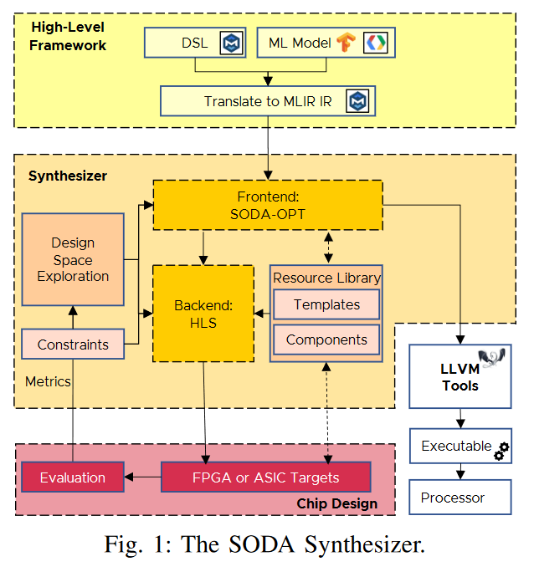
TFLite to MLIR, starting with Conv2D

Slide 111
flowgraph tile
URAM
32
shape @rate
32
model
AXI-S
FPU
32
[24,32,1]
[2160,3840,64]
32
32
AXI-S
AXI-S
@30Hz
dot product
32
AXI-S
circular buffer

Slide 112
flowgraph tile
URAM
32
shape @rate
32
model
AXI-S
FPU
32
[24,32,1] @30Hz
[24,32,1] @30Hz
32
32
AXI-S
AXI-S
dot product
32
AXI-S
circular buffer

Slide 113
flowgraph tile
URAM
32
shape @rate
32
model
AXI-S
32
FPU
AXI-S
32
32
[24,32,1] @30Hz
32
32
AXI-S
AXI-S
32
AXI-S
dot product
32
AXI-S
fifo

Slide 114
flowgraph tile
URAM
32
AXI-S
32
model
AXI-S
CLB
FPU
32
AXI-S
32
32
dot product
AXI-S
32
fifo

Slide 115
AI tile
URAM
32
AXI-S0
32
model
FPU
32
AXI-S
CLB
AXI-SI
32
32
dot product
AXI-S2
32
deinterleave
fifo

Slide 116
input buffer
TDATA
BRAM 1
BRAM 2
BRAM 3
BRAM 4
BRAM n
model parameters
URAM 2
FPU
URAM m
TDATA
URAM 1
URAM 2
FPU
URAM m

Slide 117
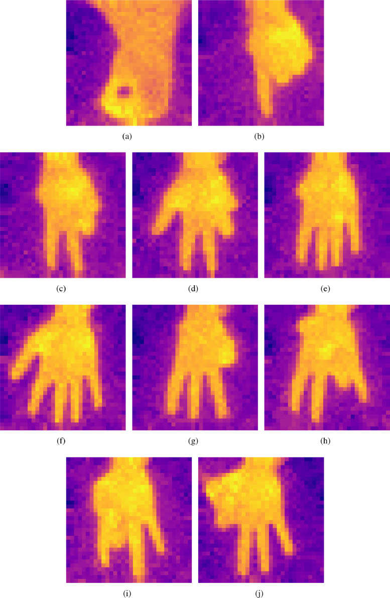
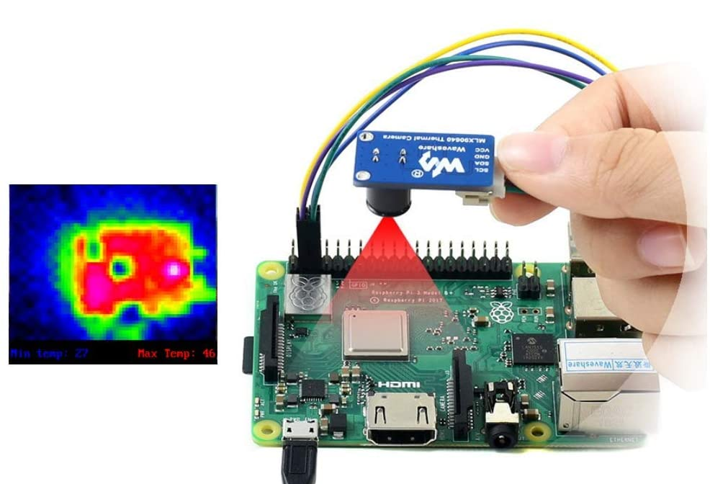
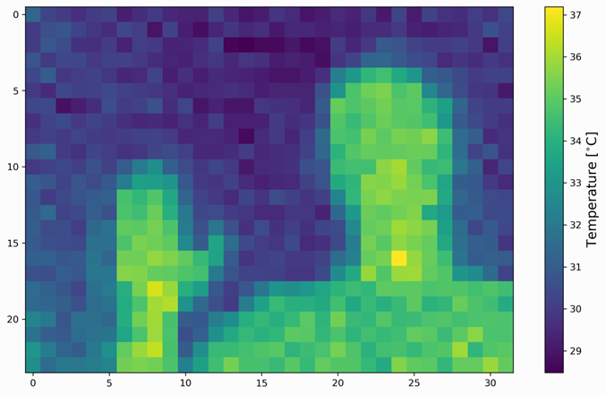
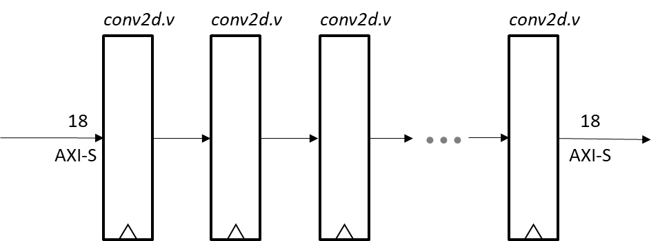
conv2d.v is a Tensorflow compatible CNN layer implementation
Each layer in the model is evaluated in parallel using pipelining
Weights are stored in on-chip BRAM for high performance
Can be used stand alone or as a front end to a larger model
Real time classification demo for Gemini
- Code complete, runs at 200MHz using Artix-7/Vivado
- Next step is functional verification using MNIST

Slide 118
conv2d.v

Slide 119
Objectives
initially target Gemini fabric
high throughput, low latency deep model evaluation
efficiently utilize FPGA BRAM and DSP resources
package as a parameterized, reusable IP
conv2d.v
conv2d.v
conv2d.v
conv2d.v
18
18
AXI-S
AXI-S

Slide 120
CNN primitive operation
weights
[ochan,3,3,ichan]
feature patch
[3,3,ichan]
feature vector
[1,1,ochan]
same shape
tensor dot product

Slide 121
CNN primitive operation
weights
[ochan,3,3,ichan]
feature patch
[3,3,ichan]
feature vector
[1,1,ochan]
same shape
tensor dot product

Slide 122
CNN dot product using FPGA
BRAM
stripes
BRAM
weights

Slide 123
Sequential implementation
BRAM
DSP
RELU
TDATA
acc
TDATA
18
18
row buffer
BRAM
weights

Slide 124
row buffer
Parallel implementation
TDATA
18x1K BRAM 1
18x1K BRAM 2
18x1K BRAM 3
n=(iwidth*3*ichan)/1K
m=(3*3*ichan)/1K
ndsp=ochan
ex: ichan=3,ochan=16,iwidth=768
ex: ichan=256,ochan=256,iwidth=192
18x1K BRAM 4
18x1K BRAM n
weights
18x1K BRAM 1
18x1K BRAM 2
DSP
18x1K BRAM m
TDATA
ochan
18x1K BRAM 1
18x1K BRAM 2
DSP
18x1K BRAM m

Slide 125
input buffer
TDATA
BRAM 1
BRAM 2
BRAM 3
BRAM 4
BRAM n
model parameters
URAM 1
URAM 2
FPU
URAM m
TDATA
URAM 1
URAM 2
FPU
URAM m

Slide 126
row buffer
Parallel implementation
TDATA
18x1K BRAM 1
p=3
18x1K BRAM 2
18x1K BRAM 3
n=(iwidth*3*ichan)/1K
m=(3*3*ichan)/1K
p=min(n,m)
ndsp=p*ochan
ex: ichan=3,ochan=16,iwidth=768
ex: ichan=256,ochan=256,iwidth=192
18x1K BRAM 4
18x1K BRAM n
chained
accumulator
weights
18x1K BRAM 1
DSP 1
18x1K BRAM 2
DSP 2
18x1K BRAM m
DSP p
TDATA
ochan
18x1K BRAM 1
DSP 1
18x1K BRAM 2
DSP 2
18x1K BRAM m
DSP p

Slide 127
striped row buffer
Parallel implementation
TDATA
18x1K BRAM 1
p=3
18x1K BRAM 2
18x1K BRAM 3
n=(iwidth*3*ichan)/1K
m=(3*3*ichan)/1K
p=min(n,m)
ndsp=p*ochan
ex: ichan=3,ochan=16,iwidth=768
ex: ichan=256,ochan=256,iwidth=192
18x1K BRAM 4
18x1K BRAM n
chained
accumulator
weights
18x1K BRAM 1
DSP 1
18x1K BRAM 2
DSP 2
18x1K BRAM m
DSP p
TDATA
ochan
18x1K BRAM 1
DSP 1
18x1K BRAM 2
DSP 2
18x1K BRAM m
DSP p

Slide 128
input buffer
TDATA
18x1K BRAM 1
18x1K BRAM 2
18x1K BRAM n
weights
18x1K BRAM 1
DSP
18x1K BRAM 2
DSP
18x1K BRAM n
DSP
TDATA
18x1K BRAM 1
DSP
18x1K BRAM 2
DSP
18x1K BRAM n
DSP

Slide 129
input buffer
TDATA
18x1K BRAM 0
18x1K BRAM 1
18x1K BRAM m
weights
18x1K BRAM 0
DSP
18x1K BRAM 1
DSP
18x1K BRAM n
DSP
TDATA
18x1K BRAM 0
DSP
18x1K BRAM 1
DSP
18x1K BRAM n
DSP

Slide 130
weights
18x1K BRAM 0
DSP
18x1K BRAM 1
DSP
18x1K BRAM n
DSP
TDATA
18x1K BRAM 0
DSP
18x1K BRAM 1
DSP
18x1K BRAM n
DSP
input buffer
TDATA
18x1K BRAM 0
18x1K BRAM 1
18x1K BRAM m

Slide 131
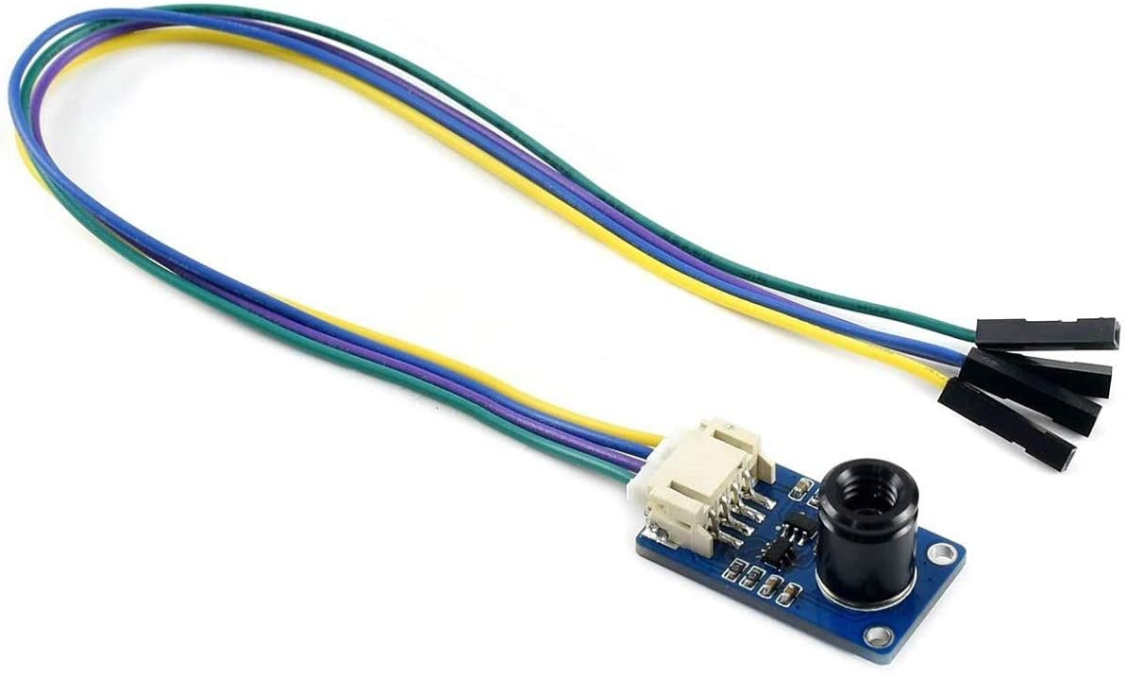

AI application concept – thermal imaging CNN
MLX90640 IR Array Thermal Imaging Camera Module 32×24 Pixels 55° Field of View Camera with I2C Interface for Raspberry Pi/Arduino
32x24 calibrated FIR pixels, 14 bit precision, 32 fps
High precision non-contact temperature measurements
Intrusion / Movement detection
Presence detection / Person localization
Temperature sensing element for intelligent HVAC
Thermal Comfort sensor in automotive air conditioning control systems
Microwave ovens
Industrial temperature control of moving parts
Visual IR thermometers

Slide 132
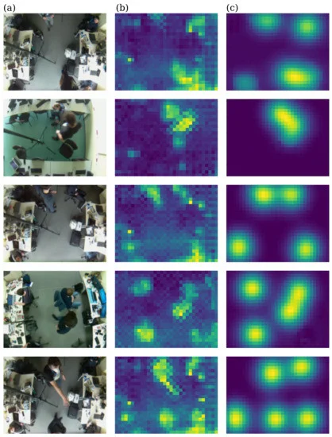
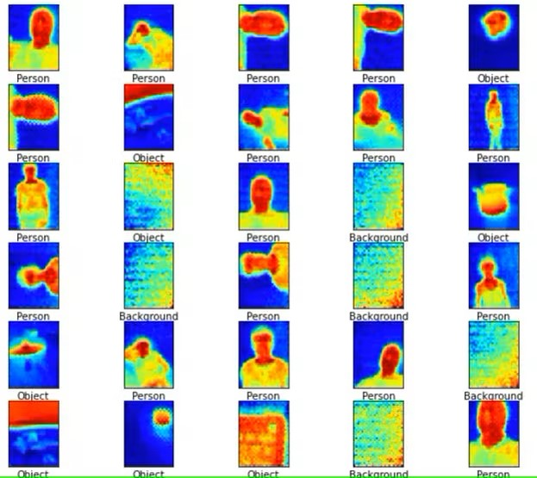
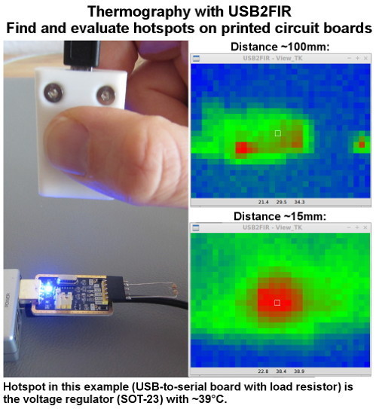
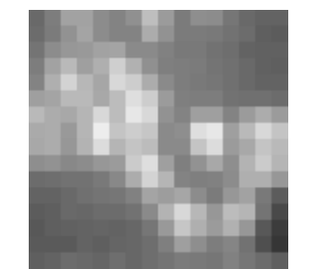
Example CNN tasks and training data
Industrial Inspection
Anomaly Detection
PCB hot spot analysis
Animal health screening
Occupancy Counting
Privacy preserving
Pose detection
Gesture Recognition
Sign language
Action Recognition
Human fall detection

Slide 133
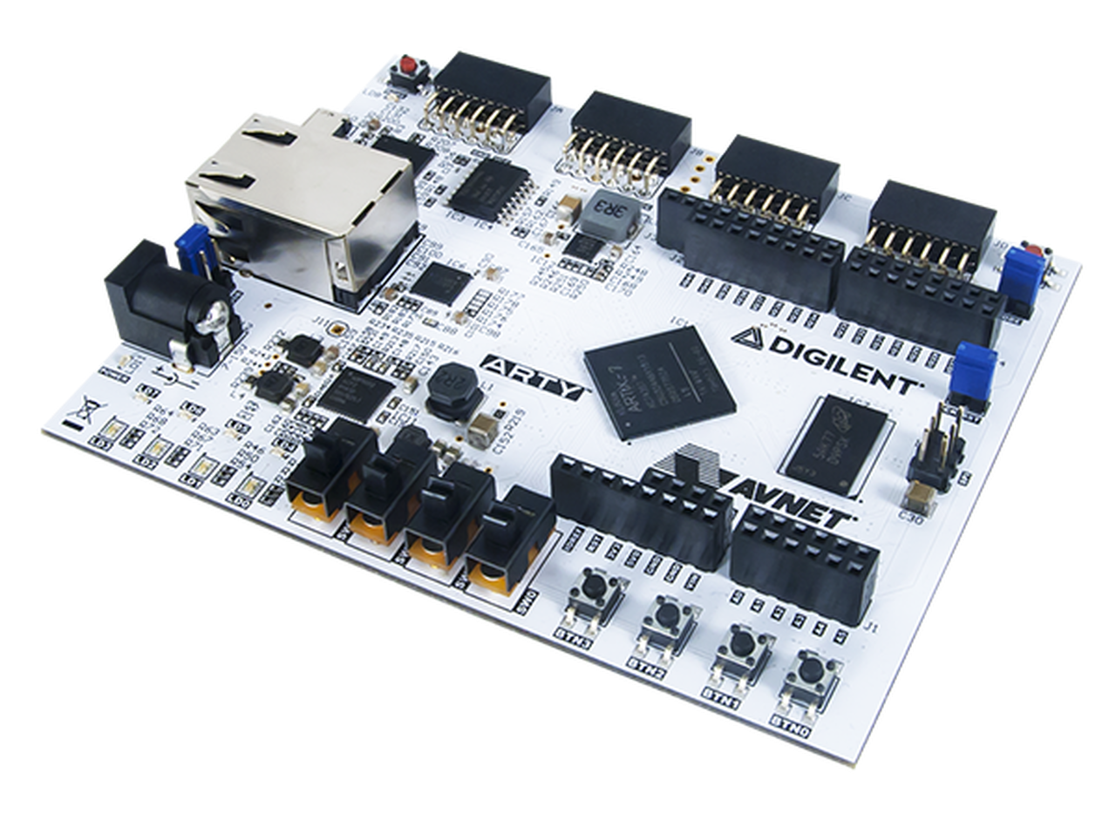
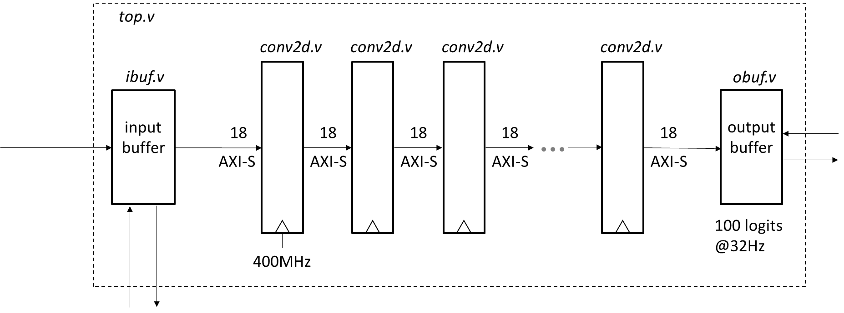
AI application prototype
server
MLX90640
32x24 IR
Arty A7-100T
Artix-7
32 fps
prediction stream
32 pkt/s
I2C @1MHz
10/100/1000 ethernet
MQTT
"accelerator" vs. hard real time
All parameters on chip using BRAM
Model evaluated entirely in FPGA fabric
Real time streaming pipeline

Slide 134
9'
110 deg : 24' diameter
55 deg : 10' diameter

