Slide 1
SPI flash
MLX90640
32x24 IR
Gemini
FPGA SoC
MQTT broker
32 fps
eth
phy
32 msg/s
I2C @1MHz
MII
MQTT
DDR
Notes:
figure1

Slide 2
andromeda.v
conv2d.v
conv2d.v
conv2d.v
conv2d.v
ibuf.v
obuf.v
input buffer
output buffer
I2C @1MHz
GPIO
18
18
18
18
18
32x24x16b
32 fps
chess board
AXI-S
AXI-S
AXI-S
AXI-S
AXI-S
axi
lite
axi
lite
intr
intr
axi lite
soc_if.v
100 logits
@32Hz
SoC i/f
Notes:
figure2

Slide 3
ibuf.v
AXI-S
FSM
TVALID
TLAST
18x1K BRAM 2
RA
RA
RD
WD
RD
18x1K BRAM 0
sdc_i
I2C
FSM
18
18
sdc_o
DSP
TDATA
sda_i
16
18x1K BRAM 1
sda_o
AXI-Stream
rate limit TVALID
25KHz
WA,WE
BRAM0,1,2 R/W
CSR
AXI lite memory mapped slave
CPU interrupt
AXI lite
Notes:
figure3

Slide 4
weights
[ochan,3,3,ichan]
feature patch
[3,3,ichan]
feature vector
[1,1,ochan]
same shape
dot product
Notes:
figure4

Slide 5
BRAM
DSP
RELU
TDATA
acc
TDATA
18
18
row buffer
BRAM
weights
Notes:
figure5

Slide 6
row buffer
TDATA
18x1K BRAM 1
18x1K BRAM 2
m
18x1K BRAM n
weights
18x1K BRAM 1
DSP
18x1K BRAM 2
DSP
18x1K BRAM m
DSP
TDATA
ochan
ochan*m
18x1K BRAM 1
DSP
18x1K BRAM 2
DSP
18x1K BRAM m
DSP
Notes:
figure6

Slide 7
~25K pix/s
‘C’ order
TDATA,TVALID,TLAST
[24,32,1]
tensorflow 2.7.0
Model: "model"
_________________________________________________________________
Layer (type) Output Shape Param #
=================================================================
input_1 (InputLayer) [(None, 24, 32, 1)] 0
conv2d (Conv2D) (None, 22, 30, 32) 288
conv2d_1 (Conv2D) (None, 20, 28, 32) 9216
conv2d_2 (Conv2D) (None, 18, 26, 32) 9216
conv2d_3 (Conv2D) (None, 16, 24, 32) 9216
conv2d_4 (Conv2D) (None, 14, 22, 32) 9216
conv2d_5 (Conv2D) (None, 12, 20, 32) 9216
conv2d_6 (Conv2D) (None, 10, 18, 32) 9216
conv2d_7 (Conv2D) (None, 8, 16, 32) 9216
conv2d_8 (Conv2D) (None, 6, 14, 33) 9216
conv2d_9 (Conv2D) (None, 4, 12, 32) 9216
conv2d_10 (Conv2D) (None, 2, 10, 32) 9216
conv2d_11 (Conv2D) (None, 1, 1, 100) 64000
conv2d_12 (Conv2D) (None, 1, 1, 100) 10000
conv2d_13 (Conv2D) (None, 1, 1, 100) 10000
=================================================================
Total params: 176,448
Trainable params: 176,448
Non-trainable params: 0
_________________________________________________________________
FPGA Verilog
32 fps
[1,1,100]
Notes:
figure7

Slide 8
Project Andromeda
Gemini FPGA Reference Application

Slide 9
Application engineering objectives
Develop two initial FPGA SoC reference applications
Target Gemini device
4096 CLB tiles, 720KB BRAM, 336 DSP, ~300MHz, ~1W
Equivalent to Zynq 7000, Cyclone 10, Spartan 6
proposal
App #1: Connectivity application - 32 port serial to telnet
App #2: AI application - thermal imaging with 14 layer CNN

Slide 10
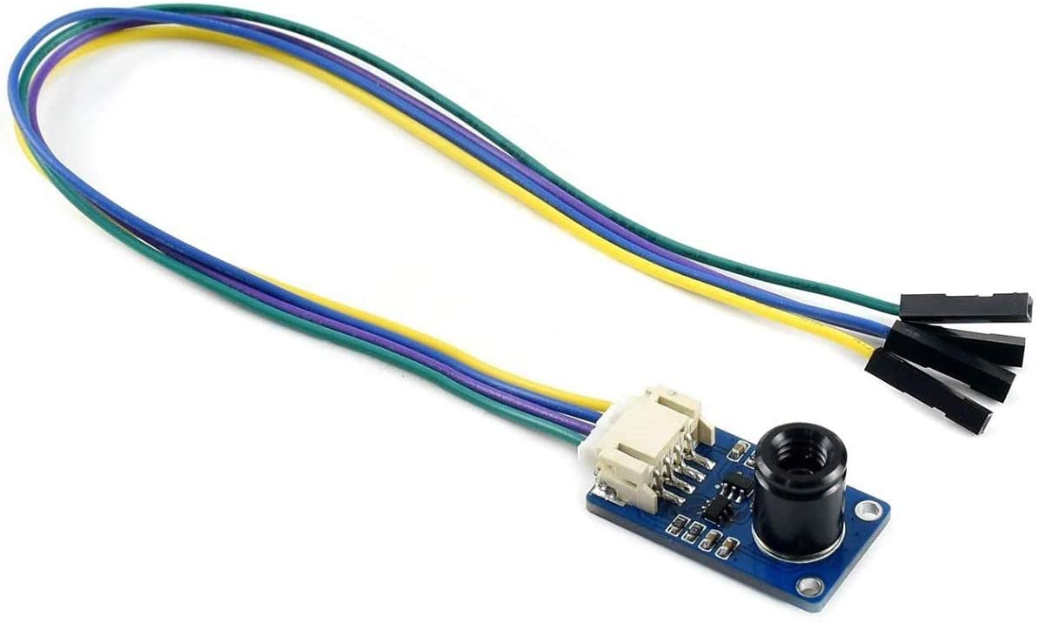
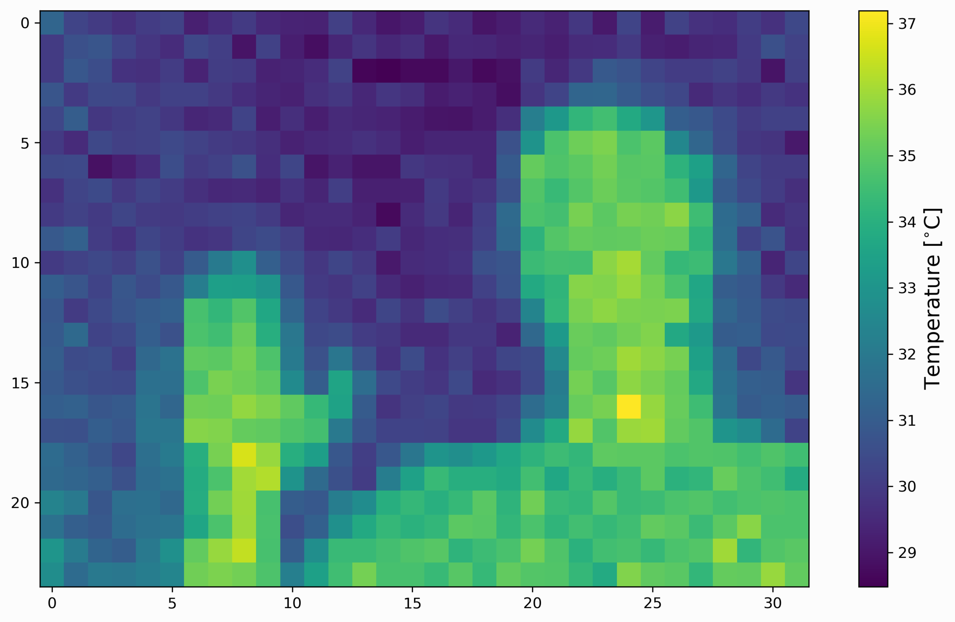
AI application concept – thermal imaging CNN
MLX90640 IR Array Thermal Imaging Camera Module 32×24 Pixels 55° Field of View Camera with I2C Interface for Raspberry Pi/Arduino
32x24 calibrated FIR pixels, 14 bit precision, 32 fps
High precision non-contact temperature measurements
Intrusion / Movement detection
Presence detection / Person localization
Temperature sensing element for intelligent HVAC
Thermal Comfort sensor in automotive air conditioning control systems
Microwave ovens
Industrial temperature control of moving parts
Visual IR thermometers

Slide 11
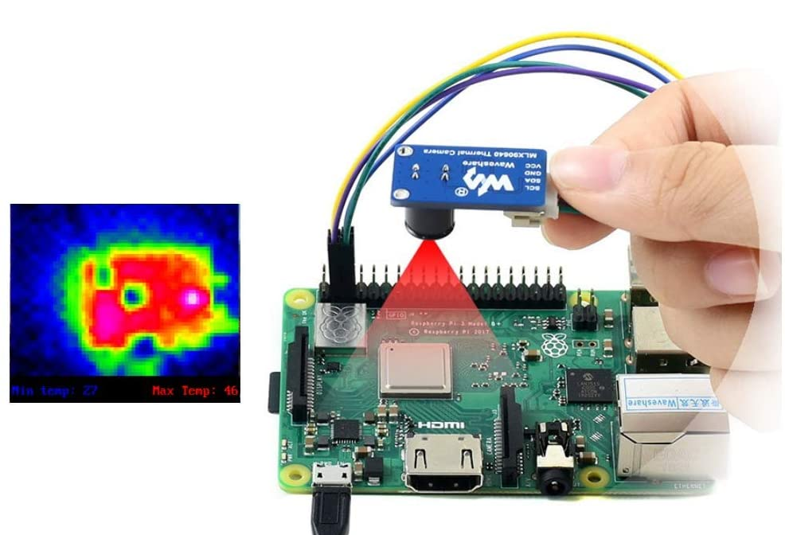
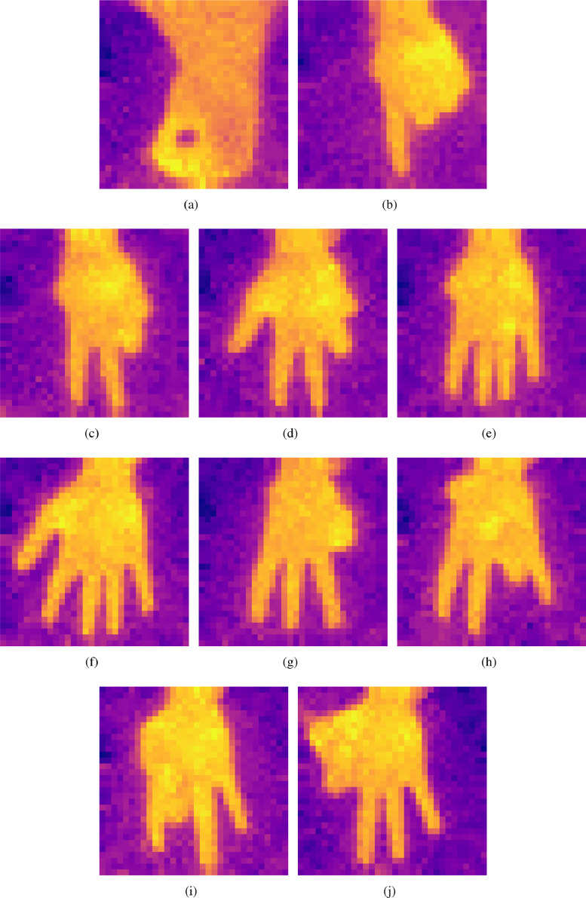
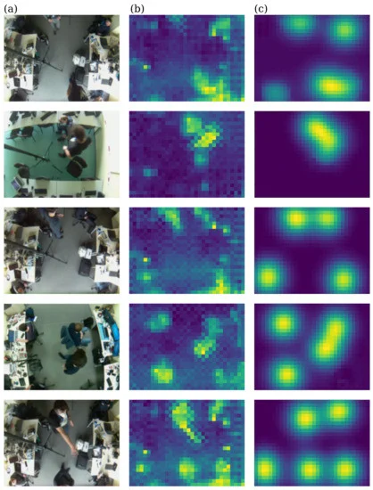
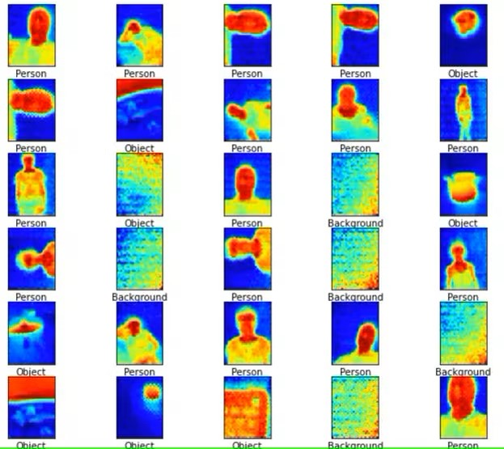
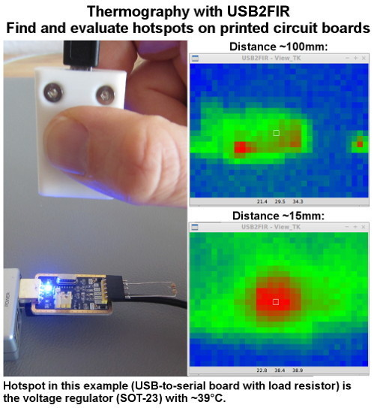
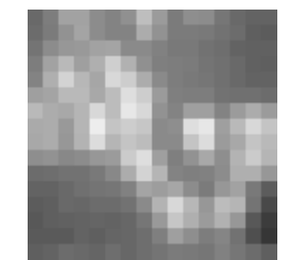
Example CNN tasks and training data
Industrial Inspection
Anomaly Detection
PCB hot spot analysis
Animal health screening
Occupancy Counting
Privacy preserving
Pose detection
Gesture Recognition
Sign language
Action Recognition
Human fall detection

Slide 12
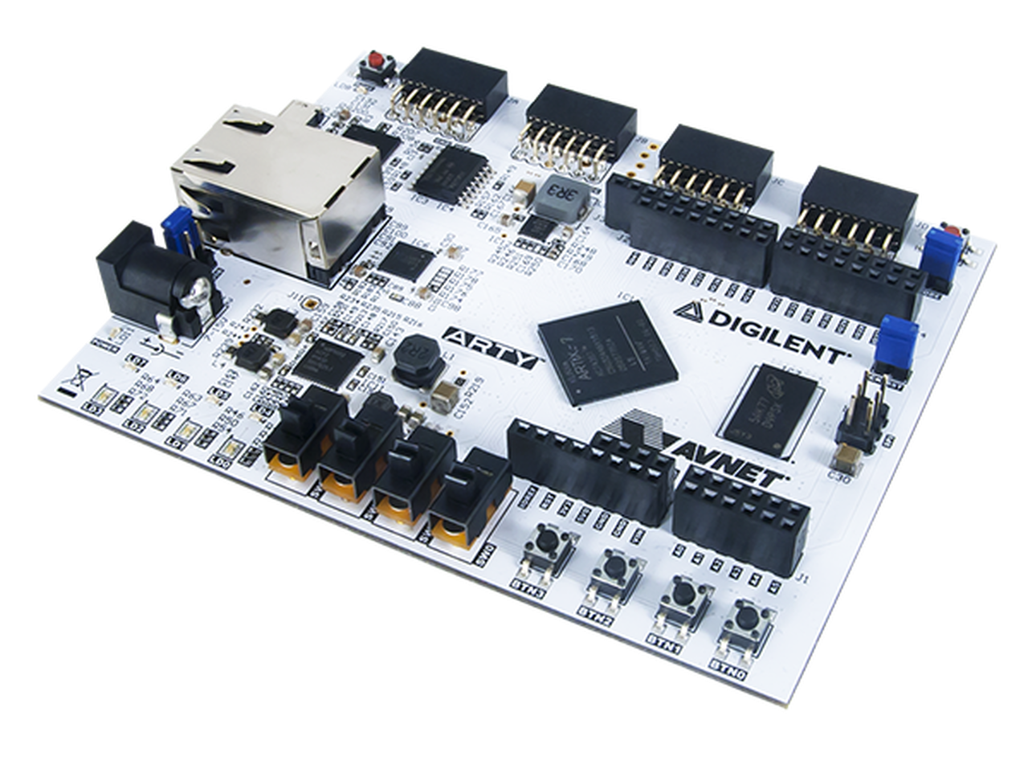
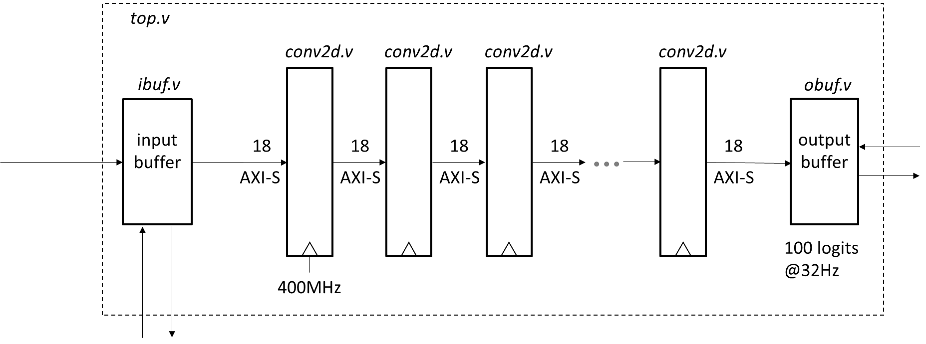
AI application prototype
server
MLX90640
32x24 IR
Arty A7-100T
Artix-7
(Gemini/Orion)
32 fps
prediction stream
32 pkt/s
I2C @1MHz
10/100/1000 ethernet
MQTT
Not an accelerator
All parameters on chip using BRAM
Model evaluated entirely in FPGA fabric
Real time streaming pipeline

Slide 13
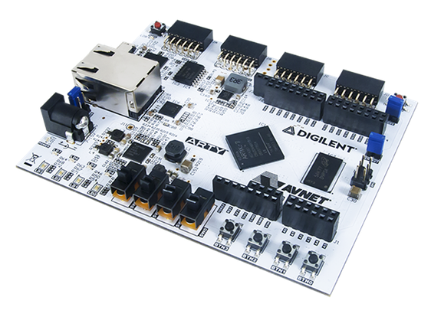
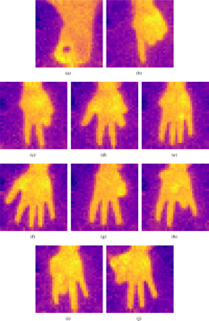

AI application milestones
Milestone | Target Date | Status
Concept review | 4/1/22
Lab ready with Arty A7-100T, MLX90640, remote test bed (SJ+Lahore) | 4/15/22
Boot petalinux on minimal MicroBlaze design with ethernet and uart (top.v) | 5/1/22
Live frame capture demo using MLX90640, I2C, MicroBlaze, UDP server (ibuf.v) | 6/1/22
Hand gesture classifier dataset acquisition, model training, weight extraction | 7/1/22
Verilog code complete with basic DV testbench (top.v,ibuf.v,conv2d.v,obuf.v) | 7/1/22
Hand gesture classifier demo complete, Artix-7 | 9/1/22
Port to Gemini evaluation board | 11/15/22
complete
in progress
not started

Slide 14
Roadmap – Intelligent IoT
Spoken keyword detection
Slow moving license plate reader camera
Machine acoustic vibration monitoring
Short range FMCW radar applications
6-axis IMU inertial sensor applications

Slide 15
Figures

Slide 16
Software Architecture
Embedded Application
interrupt driven
MQTT pub
MQTT broker
mosquitto
Visualization Application
localhost
MQTT sub
Zephyr
LiteX/Vexriscv SoC
Windows/Ubuntu
192.168.1.50
192.168.1.51
Arty A7-100T FPGA board
Laptop
eth
eth

Slide 17
VEXRISCV
ROM
SRAM
DDR
TIMER
UART
LEDS
WishBone
interrupt
interrupt
wb_decoder.v
SDA
SCL
ibuf.v
conv2d.v
conv2d.v
obuf.v
MLX90640
andromeda.v

Slide 18
weights
18x1K BRAM 0
DSP
18x1K BRAM 1
DSP
18x1K BRAM n
DSP
TDATA
18x1K BRAM 0
DSP
18x1K BRAM 1
DSP
18x1K BRAM n
DSP
input buffer
TDATA
18x1K BRAM 0
18x1K BRAM 1
18x1K BRAM m

Slide 19
conv2d.v
CLB
BRAM
CLB
DSP
CLB
TDATA
WD
RDA,RDB
#(iwidth,ichan,stride,ochan)
18
WA
18x1K BRAM 0
RA,RB
WE
18x1K BRAM 1
DSP
RDA
acc
TDATA
RDB
18
RELU
18x1K BRAM n
RA
RB
WA,WE[n:0]
TVALID
TLAST
TVALID
TLAST
BRAM iterator
Arrays are delimited by TLAST
AXI-S never stalls (no TREADY)

Slide 20
conv2d.v
CLB
BRAM
CLB
DSP
CLB
TDATA
WD
RDA,RDB
#(iwidth,ichan,stride,ochan)
18
WA
18x1K BRAM 0
RA,RB
WE
18x1K BRAM 1
DSP
RDA
acc
TDATA
RDB
18
RELU
18x1K BRAM n
RA
RB
WA,WE[n:0]
TVALID
TLAST
TVALID
TLAST
BRAM iterator
Arrays are delimited by TLAST
AXI-S never stalls (no TREADY)

Slide 21
Figure 1 : Application system diagram
SPI flash
MLX90640
32x24 IR
sensor array
Gemini
I2C
MII
eth phy
DDR (tbd)

Slide 22
Figure 2 : FPGA top level
top.v
conv2d.v
conv2d.v
conv2d.v
conv2d.v
ibuf.v
obuf.v
input buffer
output buffer
SoC i/f
I2C @1MHz
GPIO
18
18
18
18
18
axi
32x24x16b
32 fps
chess board
AXI-S
AXI-S
AXI-S
AXI-S
AXI-S
intr
100 logits
@32Hz
400MHz
axi
intr
SoC i/f

Slide 23
ibuf.v memory map
Address (32 bit aligned) | Bits | Description
0x00000-0x3fffc | 15:0 | MLX90640 I2C registers, 64K words
0x40000-0x40ffc | 17:0 | BRAM0, 1K words
0x50000-0x50ffc | 17:0 | BRAM1, 1K words
0x60000 | 0 | FSM reset, enable CPU access to MLX90640

Slide 24
ibuf.v block diagram
wb_interface
select
reset
interrupt
addr
data
i2c_if
SA=0x33
i2c_addr
i2c_mux
mlx_addr
mlx_fsm
i2c_wdata
mlx_wdata
RA
RD
WE0
o_sdc
i2c_rdata
mlx_rdata
18x1K BRAM 0
i_sdc
WA,WD
i2c_stb
mlx_stb
o_sda
i2c_ack
mlx_ack
WE1
18x1K BRAM 1
i_sda
i2c_we
mlx_we
clk
clk

Slide 25
Figure 3 : ibuf.v block diagram
ibuf.v
AXI-S
FSM
TVALID
TLAST
18x1K BRAM 2
RA
RA
RD
WD
RDA
18x1K BRAM 0
sdc_i
I2C
FSM
18
18
sdc_o
DSP
TDATA
sda_i
16
18x1K BRAM 1
sda_o
AXI-Stream
rate limit TVALID
25KHz
WA,WE
BRAM 0,1
RB
RDB
AXI
memory mapped slave
BRAM 2
I2C FSM reg
CPU interrupt 0,1
NoC AXI

Slide 26
VEXRISCV
ROM
SRAM
DDR
TIMER
UART
LEDS
WishBone or AXI
CSRStorage()
CSRStatus()
EventManager()
SDA
SCL
ibuf.v
TDATA
TVALID
TLAST
class ibuf(Module,AutoCSR):

Slide 27
i2c_if
SA=0x33
16
i2c_addr
16
i2c_wdata
o_sdc
16
PADS
open drain
1MHz
i2c_rdata
i_sdc
CSR
o_sda
i2c_req
i_sda
i2c_ack
i2c_wr_n
reset
clk

Slide 28
CNN architecture - classification task
Tiny models that fit in FPGA BRAM
Train and test model using tensorflow/pytorch
Extract weights and write to FPGA BRAM
~25K pix/s
‘C’ order
TDATA,TVALID,TLAST
[24,32,1]
tensorflow 2.7.0
Model: "model"
_________________________________________________________________
Layer (type) Output Shape Param #
=================================================================
input_1 (InputLayer) [(None, 24, 32, 1)] 0
conv2d (Conv2D) (None, 22, 30, 32) 288
conv2d_1 (Conv2D) (None, 20, 28, 32) 9216
conv2d_2 (Conv2D) (None, 18, 26, 32) 9216
conv2d_3 (Conv2D) (None, 16, 24, 32) 9216
conv2d_4 (Conv2D) (None, 14, 22, 32) 9216
conv2d_5 (Conv2D) (None, 12, 20, 32) 9216
conv2d_6 (Conv2D) (None, 10, 18, 32) 9216
conv2d_7 (Conv2D) (None, 8, 16, 32) 9216
conv2d_8 (Conv2D) (None, 6, 14, 33) 9216
conv2d_9 (Conv2D) (None, 4, 12, 32) 9216
conv2d_10 (Conv2D) (None, 2, 10, 32) 9216
conv2d_11 (Conv2D) (None, 1, 1, 100) 64000
conv2d_12 (Conv2D) (None, 1, 1, 100) 10000
conv2d_13 (Conv2D) (None, 1, 1, 100) 10000
=================================================================
Total params: 176,448
Trainable params: 176,448
Non-trainable params: 0
_________________________________________________________________
FPGA Verilog
32 fps
[1,1,100]

Slide 29
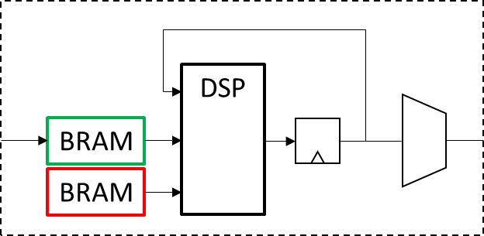
CNN dot product using FPGA
weights
[ochan,3,3,ichan]
DSP
18
18
feature patch
[3,3,ichan]
BRAM
feature vector
[1,1,ochan]
AXI-S
AXI-S
BRAM
conv2d.v
BRAM
row buffer
BRAM
weights
layer 1
layer 2
layer n
same shape
dot product

Slide 30
conv2d.v
TDATA
WD
RDA,RDB
#(iwidth,ichan,stride,ochan)
18
WA
18x1K BRAM 0
RA,RB
WE
18x1K BRAM 1
DSP
RDA
acc
TDATA
RDB
18
RELU
18x1K BRAM n
RA
RB
WA,WE[n:0]
TVALID
TLAST
BRAM iterator
Arrays are delimited by TLAST
TVALID
TLAST
AXI-S never stalls (no TREADY)

Slide 31
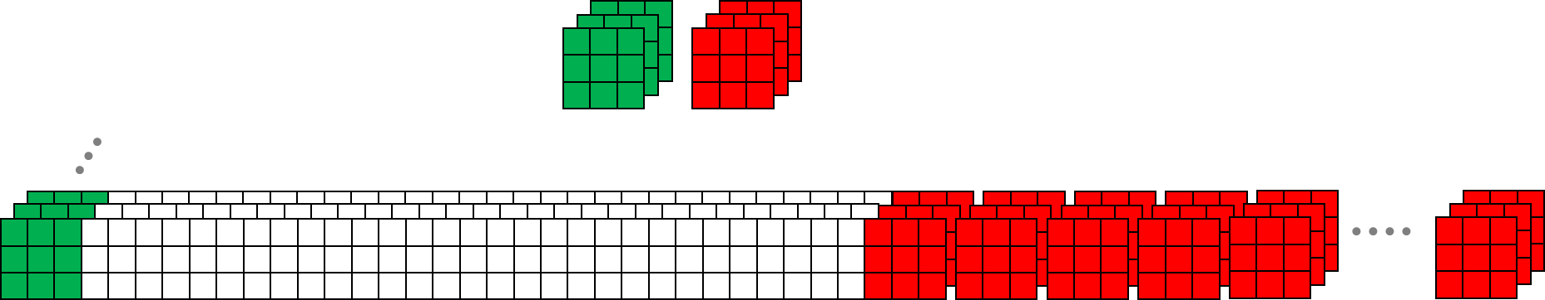
BRAM 0..n
TDATA
WD
18
ichan
row buffer
DSP
RDA
acc
TDATA
RDB
18
RELU
weights
ochan

Slide 32
Backup

Slide 33
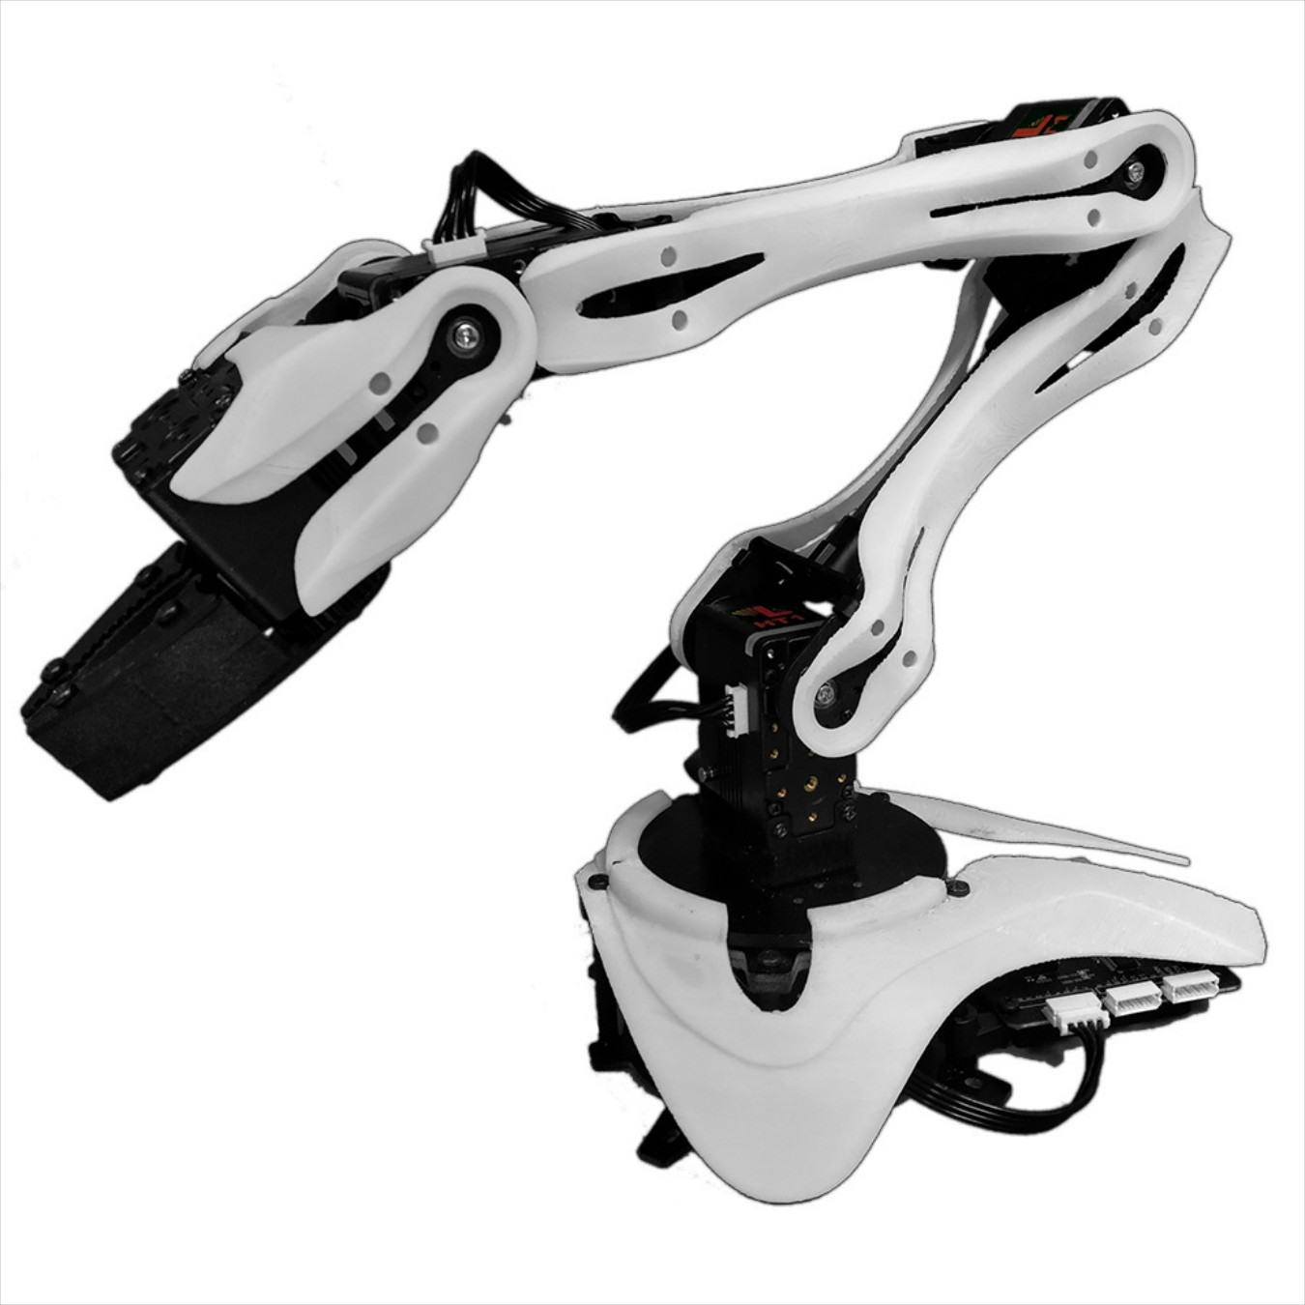
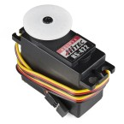
Control application concept
Remote PWM servo control over UDP
Industrial ethernet
PWM
server
servo
Arty A7-100T
Artix-7
(Gemini/Orion)
up to
32
GPIO
UDP
UDP
servo
10/100/1000 ethernet

Slide 34
Low latency control concept
Remote PWM servo control over UDP
MIPI over UDP
MIPI
camera
Arty A7-100T
Artix-7
(Gemini/Orion)
server
PWM
UDP
UDP
servo
up to
32
GPIO
10/100/1000 ethernet
servo

Slide 35
Edge AI application landscape
weights: on or off chip
FPGA vs. GPU vs. multicore
data rate
industrial imaging 728x544@289fps
5G/802.11 baseband IQ processing
100M
samples/s
10M
samples/s
consumer imaging 2MP@5fps
IoT wireless
100K
samples/s
Thermal sensor
Audio
Fingerprint reader
model size

Slide 36
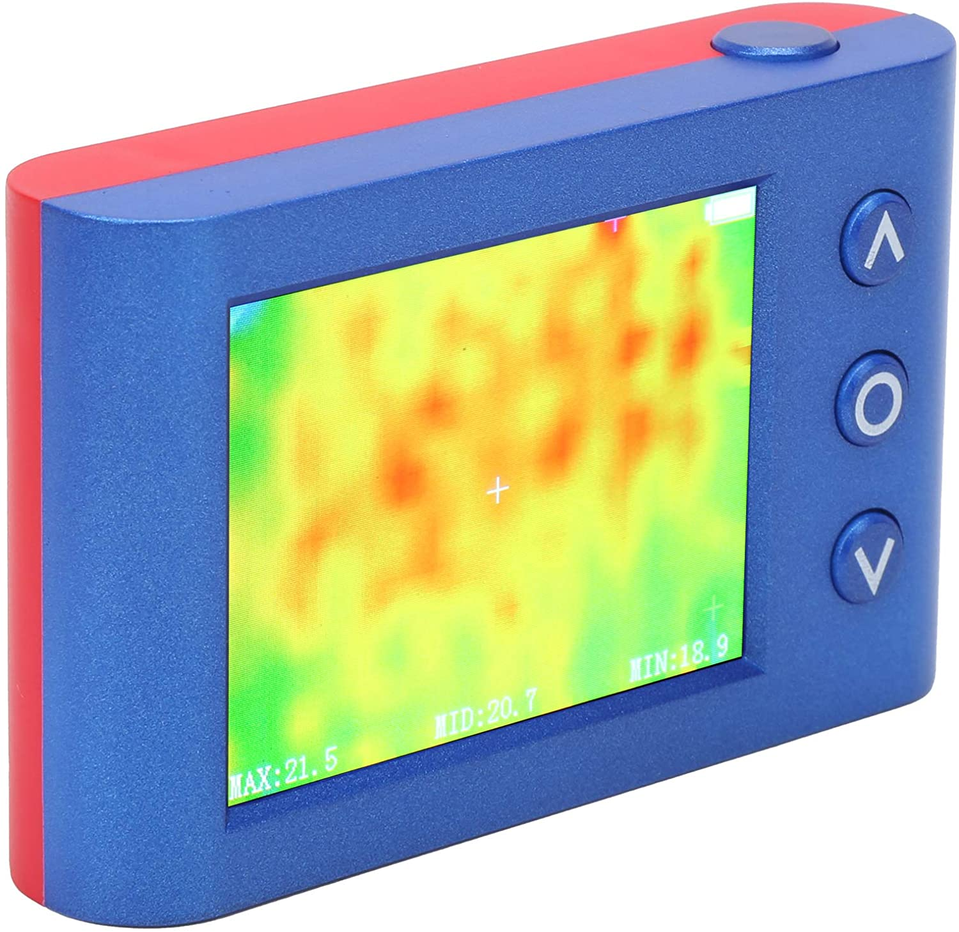
Budget
Thermal Imager Camera Handheld, MLX90640 Portable Temperature Tester Meter Sensor 2.4in LCD Display Screen
$170 through Amazon
MLX90640 IR Array Thermal Imaging Camera Module 32×24 Pixels 55° Field of View Camera with I2C Interface for Raspberry Pi/Arduino
$83 through Amazon
Arty A7
$249 through Digilent
PR: need someone to chase lead times on several items

Slide 37
FPGA resource analysis spreadsheet

Slide 38
Model training
Initial dataset will be manually labeled with ~1000 examples
Future: large unlabeled dataset + few shot learning for classification tasks
Future: multimodal training data https://github.com/openai/CLIP

Slide 39
Figure 5 : row buffer
ichan
ichan*iwidth*3
[3,iwidth,ichan]

Slide 41
BRAM 0..n
TDATA
WD
18
ichan
row buffer
DSP
RDA
acc
TDATA
RDB
18
RELU
weights
ochan

Slide 42
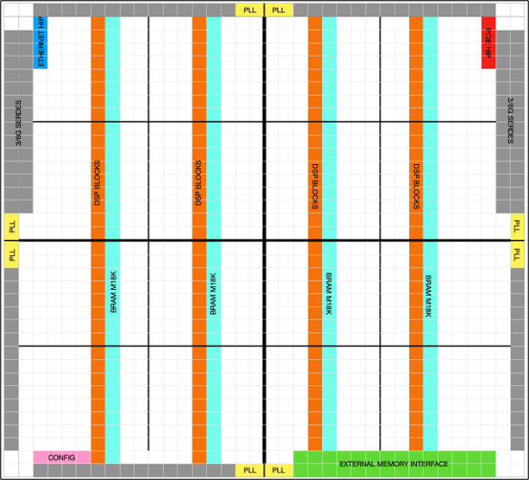

Slide 43
Parallel CNN dot product using FPGA
conv2d.v
weights
[ochan,3,3,ichan]
BRAM
DSP
feature patch
[3,3,ichan]
BRAM
feature
[1,1,ochan]
BRAM
DSP
16
AXI-S
16
AXI-S
BRAM
CLB
‘C’ order
‘C’ order
BRAM
DSP
BRAM
same shape
dot product
dot.v
reorder mux
dot.v

Slide 44
Streaming CNN Data Path
DSP
16
16
BRAM
AXI-S
AXI-S
BRAM
conv2d.v
BRAM
patch buffer
BRAM
weights

Slide 45
Model training
For supervised classification tasks, start with 10K labeled examples
For unlabeled data, investigate training using clustering, GAN, sparse labels, digital twin
https://github.com/openai/CLIP
Semi-supervised GAN
unlabeled raw data
{data}
{data,label}
supervised training dataset
sparse labels

Slide 46
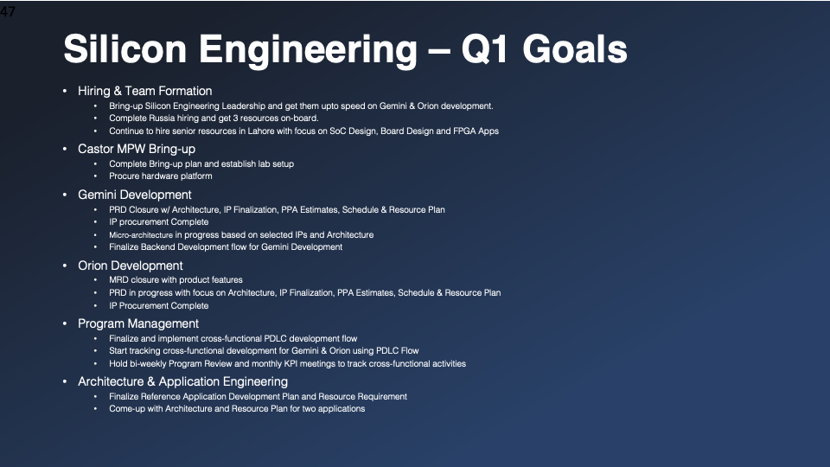
Finalize Reference Application Development Plan
Develop Architecture and Resources Plan (2 apps)

Slide 47
EDA Flow
Train and test model using tensorflow/pytorch
Extract and quantize weights from trained model
Program weights into conv2d.v BRAM per layer

Slide 48
Proposed Project Milestones
Assemble hardware prototype using Xilinx MPSoC eval + camera
Hello world and frame grab to FPGA SRAM
Develop streaming CNN verilog (dot.v, conv2d.v, top.v)
Generate training data, train and test CNN using GPU/python/tensorflow
Weight quantization
Live demo
Port to Gemini / LiteX

Slide 49
Budget - $10K
GPU workstation, $6K
ZCU102, $3K
Alvium 1800 U-040c, $400

Slide 50
Reference Application Concept
Target Gemini device
4096 CLB, 720KB BRAM, 336 DSP, 400MHz, <1W
Streaming CNN classifier for industrial imaging
Pipelined, parallel FPGA implementation → 100M+ pix/s, <100µs latency
728x544 RGB pixels @289 fps
10 layers, 100 classifier outputs, ~30K parameters on chip, ~80 GMAC DSP
Scalable up or down using parameterized IP
Streaming CNN
FPGA verilog
pixel stream
prediction stream
MIPI CSI-2
SoC
3*16b@115MHz
100*16b@289Hz

Slide 51
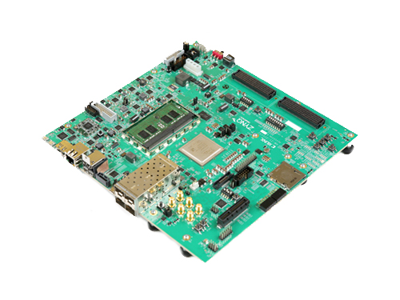
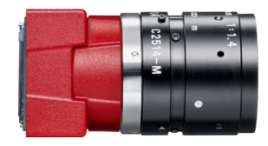
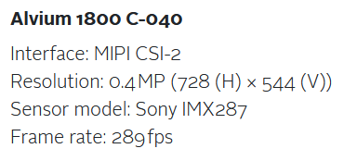
Streaming CNN Prototype Concept
MIPI CSI-2 or USB-3
Allied Vision industrial camera
Zynq UltraScale+ MPSoC ZCU102 Evaluation Kit
* Port to Gemini in phase 2

Slide 52
conv2d.v

Slide 53
Objectives
target Gemini fabric, no new algorithms, implementation only
on chip model parameters, high aggregate bandwidth
efficiently utilize FPGA BRAM and DSP resources
package as a parameterized, reusable IP
conv2d.v
conv2d.v
conv2d.v
conv2d.v
18
18
AXI-S
AXI-S

Slide 54
CNN primitive operation
weights
[ochan,3,3,ichan]
feature patch
[3,3,ichan]
feature vector
[1,1,ochan]
same shape
dot product

Slide 55
Sequential implementation
BRAM
DSP
RELU
TDATA
acc
TDATA
18
18
row buffer
BRAM
weights

Slide 56
row buffer
Parallel implementation
TDATA
18x1K BRAM 1
18x1K BRAM 2
m
n=(iwidth*3*ichan)/1K
m=(3*3*ichan)/1K
speedup=m*ochan
ex: ichan=3,ochan=16,iwidth=768
ex: ichan=256,ochan=256,iwidth=192
18x1K BRAM n
weights
18x1K BRAM 1
DSP
18x1K BRAM 2
DSP
18x1K BRAM m
DSP
TDATA
ochan
ochan*m
18x1K BRAM 1
DSP
18x1K BRAM 2
DSP
18x1K BRAM m
DSP

Slide 57
Backup

Slide 59
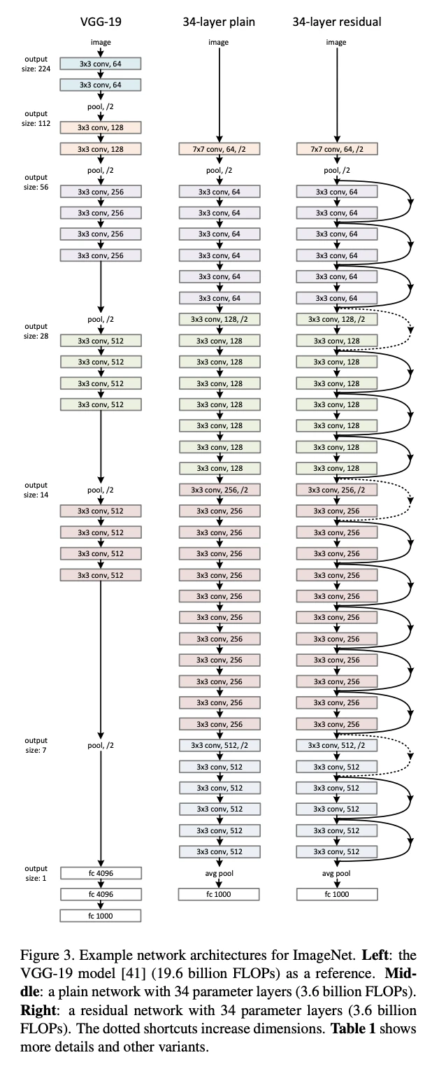

Slide 60
input buffer
TDATA
18x1K BRAM 1
18x1K BRAM 2
18x1K BRAM n
weights
18x1K BRAM 1
DSP
18x1K BRAM 2
DSP
18x1K BRAM n
DSP
TDATA
18x1K BRAM 1
DSP
18x1K BRAM 2
DSP
18x1K BRAM n
DSP

Slide 61
input buffer
TDATA
18x1K BRAM 0
18x1K BRAM 1
18x1K BRAM m
weights
18x1K BRAM 0
DSP
18x1K BRAM 1
DSP
18x1K BRAM n
DSP
TDATA
18x1K BRAM 0
DSP
18x1K BRAM 1
DSP
18x1K BRAM n
DSP

Slide 62
CNN dot product using FPGA
weights
[ochan,3,3,ichan]
DSP
18
18
feature patch
[3,3,ichan]
BRAM
feature vector
[1,1,ochan]
AXI-S
AXI-S
BRAM
conv2d.v
BRAM
row buffer
BRAM
weights
layer 1
layer 2
layer n
same shape
dot product

Slide 63
weights
18x1K BRAM 0
DSP
18x1K BRAM 1
DSP
18x1K BRAM n
DSP
TDATA
18x1K BRAM 0
DSP
18x1K BRAM 1
DSP
18x1K BRAM n
DSP
input buffer
TDATA
18x1K BRAM 0
18x1K BRAM 1
18x1K BRAM m

Slide 64
DSP
18
18
BRAM
AXI-S
AXI-S
BRAM
conv2d.v
BRAM
row buffer
BRAM
weights
layer 1
layer 2
layer n
Notes:
figure5

