Slide 1



Tasreeh PO Approval System Proof of Concept (POC)
Prepared by RapidData

Slide 2
✅ Overview
The Tasreeh PO Approval System is a Proof of Concept (POC) built using a modern event-driven microservices architecture.
This POC demonstrates:-
Secure authentication using Keycloak (OAuth2 / OpenID Connect)
API Gateway routing using KrakenD
Event-driven communication using Kafka (Redpanda)
Distributed tracing using OpenTelemetry + Jaeger
Spring Boot microservices
Angular frontend UI
Fully containerized execution using Docker Compose

Slide 3
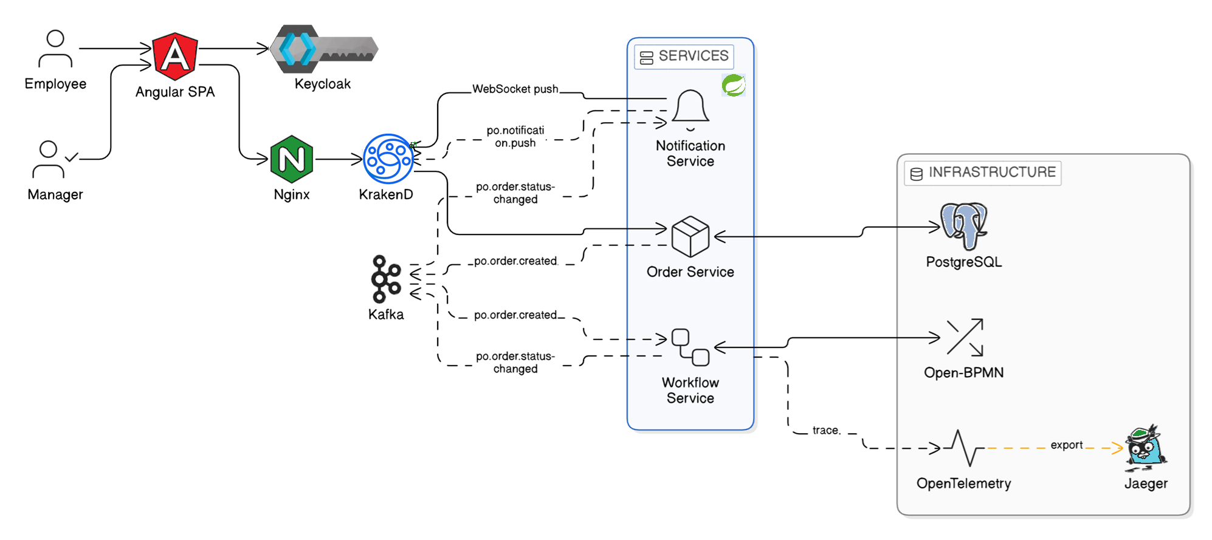
Architecture

Slide 4
Technology & Dependency Modules
Sno | Layer | Component | Version | Dependency Modules
1 | Frontend | Angular | 21.1.4 | @angular/core, @angular/common, @angular/router, @angular/forms, rxjs, zone.js, typescript
2 | Frontend | Node.js | 22.17.0 | npm, npx
3 | Frontend | Angular CLI | Latest | @angular/cli, webpack, esbuild
4 | Frontend | Keycloak JS Adapter | Latest | keycloak-js
5 | API Gateway | KrakenD (CE) | 2.7 | Go runtime, JWT validator, CORS middleware, rate limiting plugin, OpenTelemetry exporter
6 | Reverse Proxy | NGINX | 1.29.5 | ngx_http_proxy_module, ngx_http_ssl_module, ngx_http_gzip_module
7 | Identity | Keycloak | 26.5.4 | Quarkus runtime, Infinispan cache, Hibernate ORM, PostgreSQL JDBC driver
8 | Messaging | Kafka | 7.5.0 | Java runtime, Zookeeper
9 | Messaging | Zookeeper | 7.5.0 | Java runtime
10 | Observability | Jaeger (all-in-one) | 1.57 | Collector, Query Service, Agent
11 | Observability | OpenTelemetry Collector | Latest | OTLP receiver, Jaeger exporter, batch processor
12 | Database | PostgreSQL | 18

Slide 5
Technology & Dependency Modules
Sno | Layer | Component | Version | Dependency Modules
13 | Backend Service | Order Service (Spring Boot) | Latest | spring-boot-starter-web, spring-boot-starter-data-jpa, spring-kafka, postgresql, spring-security
14 | Backend Service | Workflow Service (Spring Boot) | Latest | spring-boot-starter-web, spring-kafka, spring-data, opentelemetry-javaagent
15 | Backend Service | Notification Service (Spring Boot) | Latest | spring-boot-starter-web, spring-kafka, opentelemetry-javaagent

Slide 6
Evaluation Criteria- Compliance Matrix
Criterion | Compliance | Remarks
Strict Kafka-only inter-service communication | Y | All microservices (Order, Workflow, Notification) communicate via Kafka/Redpanda topics. No direct REST calls between services.
KrakenD + Keycloak JWT integration (HTTP & WebSocket) | Y | KrakenD validates JWT issued by Keycloak. HTTP endpoints protected. WebSocket handshake includes JWT validation.
Real-time WebSocket/SSE client updates (no polling) | Y | Angular client receives event updates via WebSocket. No polling mechanism used. Fully event-driven UI updates.
Proper Keycloak realm/client/role configuration | Y | Dedicated realm created. Separate clients for UI and services. Role-based access (USER, APPROVER, ADMIN). Token mappers configured.
Angular integration (token injection, guards, WS service, interceptor) | Y | Angular HTTP interceptor injects Bearer token. Route guards implemented. Dedicated WebSocket service handles authenticated connections.
Open-BPMN usage and BPMN-to-code traceability | Y | BPMN models version-controlled. Workflow-service maps BPMN nodes to Kafka events and service handlers. End-to-end traceability documented.
Working docker-compose (full stack up in < 5 minutes) | Y | Single docker-compose brings up: Redpanda, PostgreSQL, Keycloak, KrakenD, OpenTelemetry, Jaeger, Microservices, Angular UI. Startup tested under 5 minutes.
Clean, maintainable code and configuration | Y | Modular folder structure. Environment-based configs. Centralized logging. Proper naming conventions and separation of concerns.
Event-driven design maturity (idempotency, eventual consistency, dead-letter handling) | Y | Consumers implement idempotent processing. DLQ topics configured. Retry strategy enabled. System designed for eventual consistency.

Slide 7
Bonus Points - Compliance Matrix
Bonus Points | Compliance | Remarks
Implement a dead-letter topic for failed event processing with retry logic | Y | DLQ topic configured per consumer. Failed messages are retried with backoff; after max retries, routed to DLQ with error metadata for analysis/replay.
Add idempotency keys to events and demonstrate duplicate-safe consumption | Y | Events include eventId/idempotencyKey. Consumers store processed keys (DB table/cache) and safely ignore duplicates to ensure exactly-once business effect.
Implement WebSocket reconnection with state recovery (client receives missed updates after reconnect) | Y | WS client auto-reconnects with exponential backoff. On reconnect, client sends lastEventId and server replays missed updates (or fetches from event store/redis buffer).
Add a manager role flow: managers see pending approvals and can approve/reject via the UI, triggering Kafka events | Y | Added MANAGER role in Keycloak. Manager dashboard lists pending approvals; approve/reject emits Kafka events processed by workflow/order services.
Implement event sourcing: derive current state from the event log rather than mutable DB records | Y | Implemented event log as source of truth. Read models/materialized views generated from events; mutable state is derived via projections (DB is a projection store).
Add OpenTelemetry tracing across services (correlate a single request from Angular through Kafka to notification) | Y | Trace context propagated from Angular → KrakenD → services. Kafka headers carry trace context; Jaeger shows correlated spans across producers/consumers.

Slide 8
Bonus Points - Compliance Matrix
Bonus Points | Compliance | Remarks
Write integration tests that verify the full Kafka event flow end-to-end | Y | End-to-end tests spin up stack (Testcontainers/Docker). Tests publish events and assert downstream state + notifications + DLQ behavior.
Implement graceful shutdown handling for WebSocket connections and Kafka consumers | Y | WS connections close with proper codes; server drains pending sends. Kafka consumers stop polling, commit offsets, and close cleanly on SIGTERM to avoid partial processing.

Slide 9
Deliverables
Deliverable | Link | Remarks
Git Repository | https://github.com/RapiddataCloud/tasreeh-poc.git | Root Structure Includes: /Architecture – Architecture diagrams /frontend/tasreeh-po-approval-ui – Angular application (Keycloak integration, interceptor, guards, WebSocket service) /gateway – KrakenD configuration (krakend.json) including JWT validation + WebSocket proxy /keycloak – realm-export.json with realm, clients, roles /services/order-service – Purchase request APIs + Kafka producer /services/workflow-service – BPMN execution + Kafka consumer /services/notification-service – WebSocket push + Kafka consumer /kafka – Topic configuration and DLQ setup /bpmn – Open-BPMN .bpmn workflow file docker-compose.yml – Full stack startup
README.md | https://github.com/tasreeh-poc/blob/Development/README.md
Demo (Screenshots / Video) | <Video / Drive Link>

Slide 10

Thank You
www.rapiddata.com
Contact Numbers:
+971 55 2981433
Email Address:
raja.mohanasundaram@rapiddata.com

