Slide 1
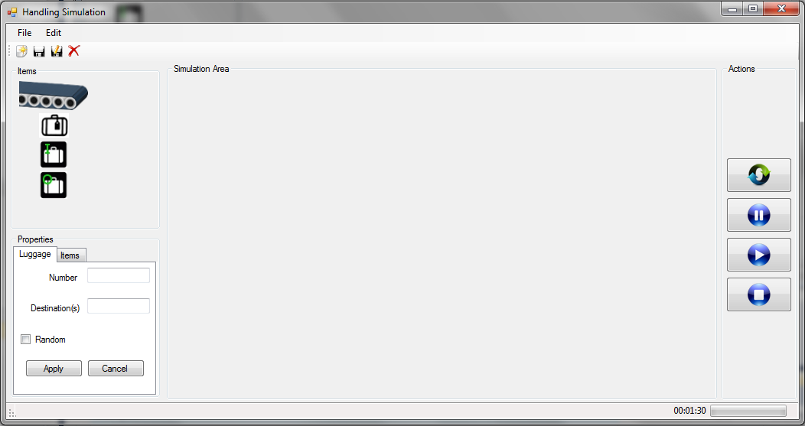




1
2
1
3
1
2
3
S

Slide 2
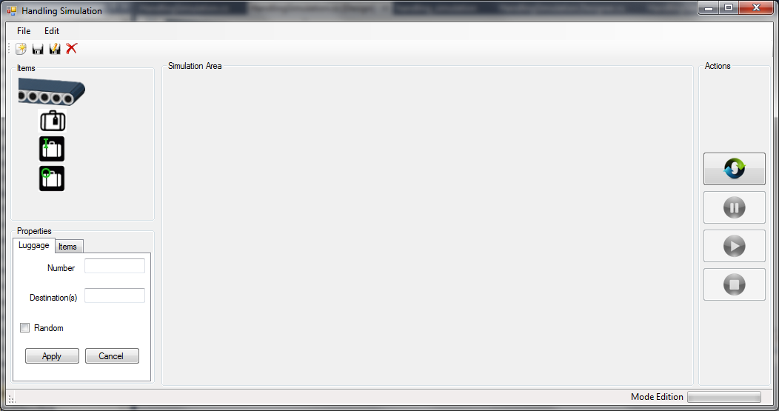
1
2
3

