Slide 1

Credit Scoring
GitHub Repository
2025/01/17
Ovidiu PASCAL

Slide 2
Context & Mission
→ "Prêt à Dépenser" is a financial company offering consumer credit to individuals with minimal or no loan history. The company aims to broaden the financial inclusion for the unbanked population.
With this intent in mind, financial, statutory & behavioral data were acquired to bridge the lack of loan history to:
Build a classifier model which accepts or reject a credit application
Make the model inference available through an API
(Future Work) provide a Dashboard which:
Display the model decision
Assist customer relation managers in transparency by explaining the main factors that influenced the model decision
Facilitates navigation through customers's data

Slide 3
Constraints
Embrace a MLOps approach
ML Flow → Track experiments, store models in a registry, and test ML serving.
Git & Github → Manage and share code, integrate continuously.
CI/CD with GitHub Actions → Automate API deployment in the cloud.
Testing → Design and automate unit tests using PyTest
Logging → Through the Loguru library
Deploy the API
Test evidently → As a tool to detect datadrift when the model is in production
Document the steps explored to build the classifier

Slide 4
Plan

Slide 5
Modeling Approach & Results

Slide 6
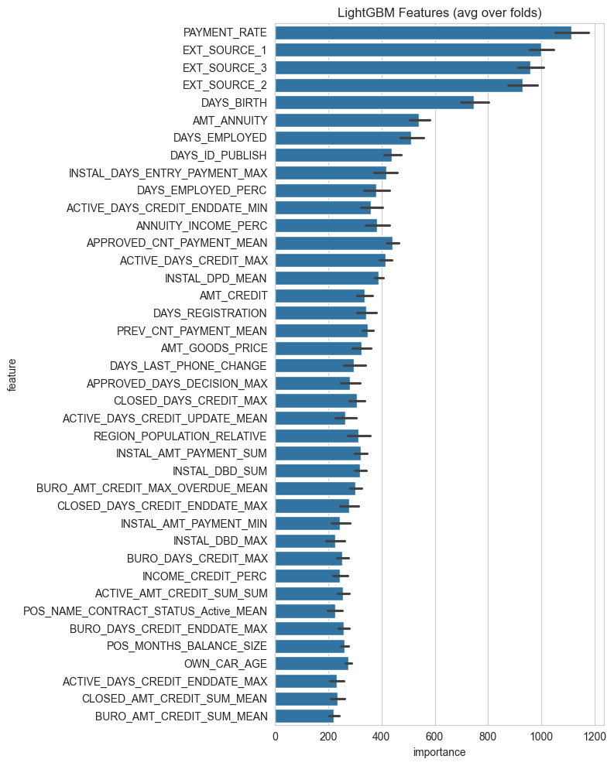
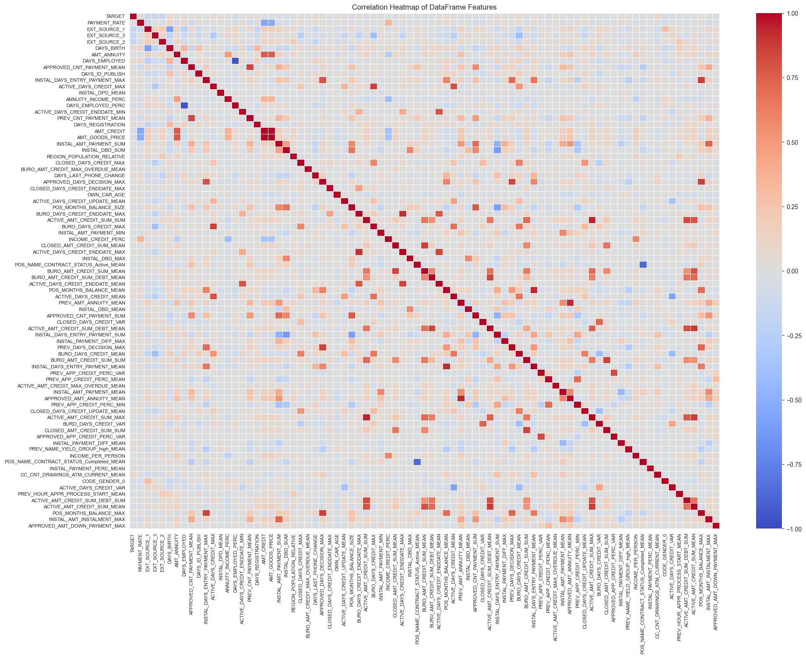
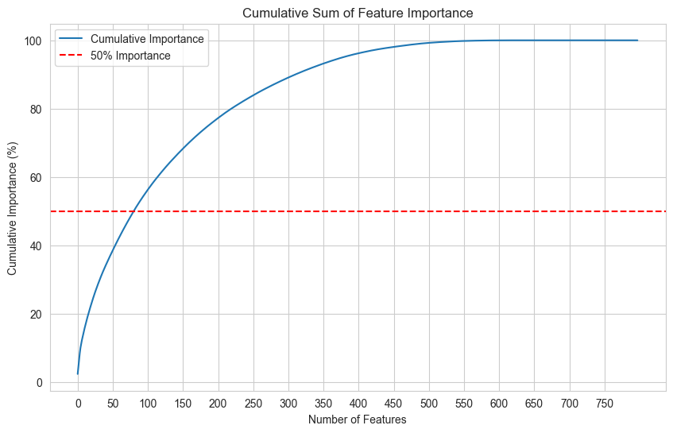
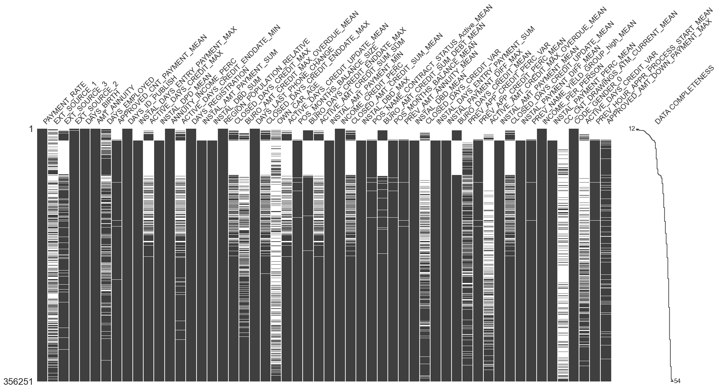
Feature engineering + Data Preparation
Feature Engineering → LightGBM with Simple Features (Kaggle)
One hot categorical, Numerical Aggregation/Group By
(356 000 individuals, 800 features)
Retained the 80 most important features
Highly correlated pairs deleted through lowest importance
Missing Values Imputation → Facebook AI Similarity Search (FAISS) KNN + median because of outliers
( 356 000 individuals, 50 features)
Only numerical variables, no categorical ones
Skewed Distributions
High Range between Min/Max values
High count of outliers

Slide 7
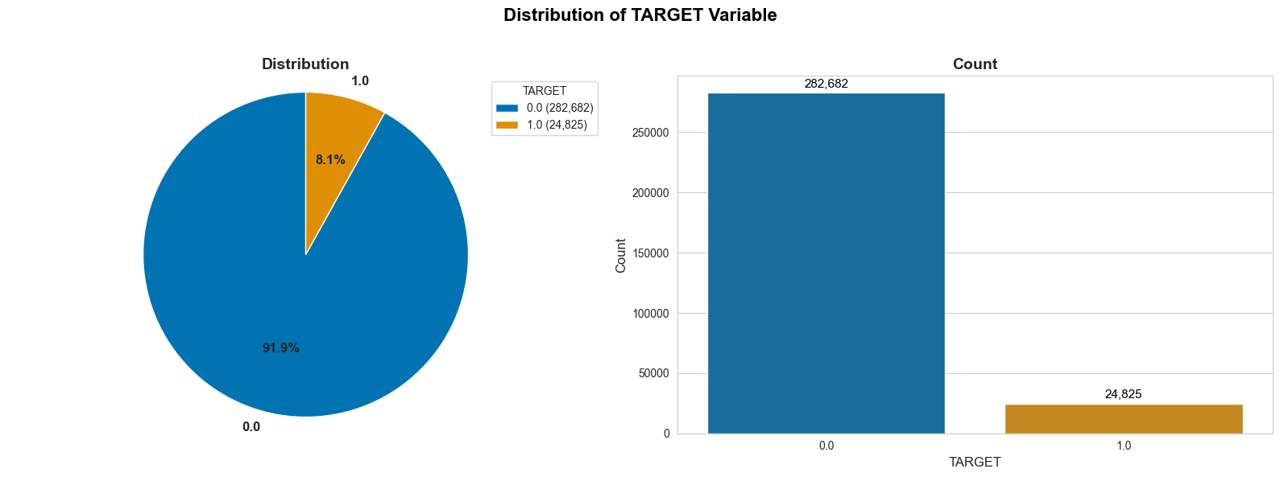
Target Distribution
Imbalance ratio → 11.38
Problem → Classifiers tend to predict the dominant class
3 Techniques used to address this issue
Weight Class Errors → Increase the impact of errors made on the minority class when evaluating & decrease the ones made on the majority class
Ressampling through SMOTETomek → Combine over-sampling on the minority class using SMOTE & under-sampling on the majority class using Tomek links to get closer to class balance
Threshold optimization → Finding the best threshold value to decide the cutoff class from probability prediction which default to 0,5.

Slide 8

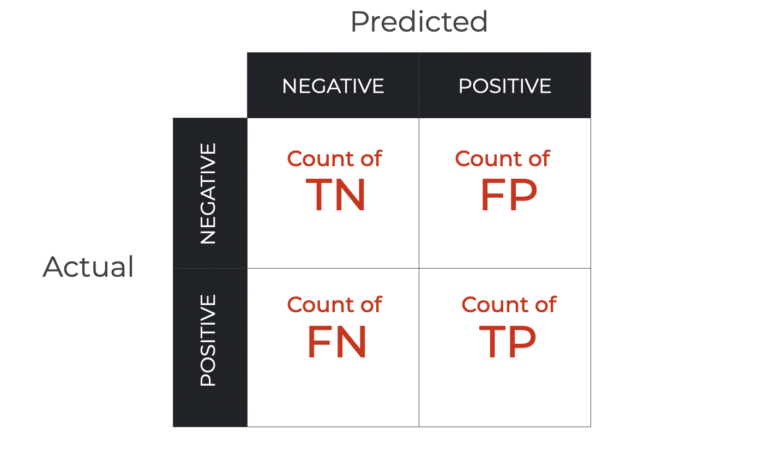

Model Evaluation & Business Considerations
False Negative (FN) → Real loss of money, a client wrongly seen as capable of paying
False Positive (FP) → Hypothetical loss of money, a client capable of paying but seen as not capable
Assumption → "The cost incurred by a FN is ten times that of the cost incurred by a FP"
For the finetuning → We adjusted the cost function to dynamically increase false negative penalties when recall is low, ensuring accurate identification of default risks

Slide 9
Finding the Best Model
Tested Models
Dummy Classifier (Baseline)
Logistic Regression (solver: saga/sag & Penalty :Lasso, Ridge, ElacticNet)
RandomForest Classifier
XGBoost Classifier
LightGBM Classifier
Best Hyperparameters Search with Optuna
→ Sampled 20% of the original dataset = 61 501 individuals
Preprocessing Pipeline : RobustScaler + SMOTETomek ("Sampling Strategy" : [0.15, 0.25, 0.30, 0.35])
Evaluation: StratifiedKFold (5 splits) + Cross Validation Score
Scorer: Maximized (ROC AUC; - Business Cost)
Sampler: TPE (Tree-structured Parzen Estimator) algorithm
Trials: 15 & 45 for the Best Model
ML Flow → Recorded each run, save plots as artifacts and register the fitted model inside the Model Registry
Metrics → Precision/Recall, FNR, F2 Beta Score (Beta =2), ROC AUC, FN, FP, Business Cost, Profit, Business Cost Std

Slide 10
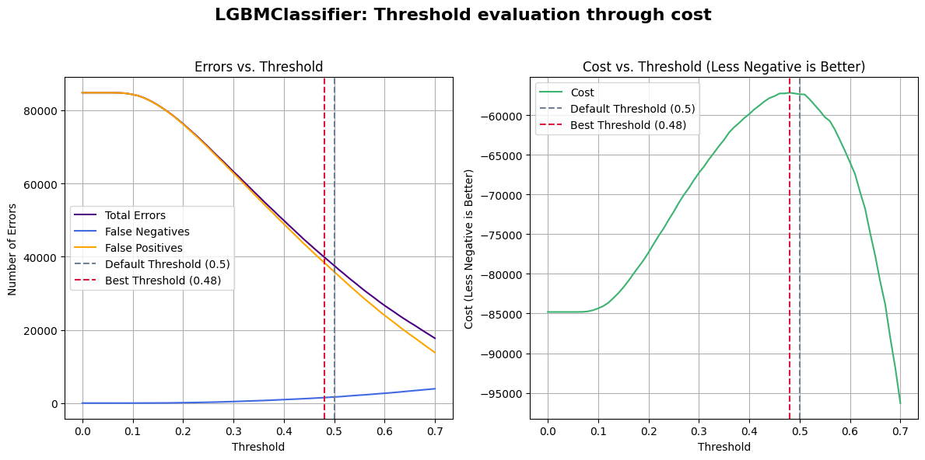
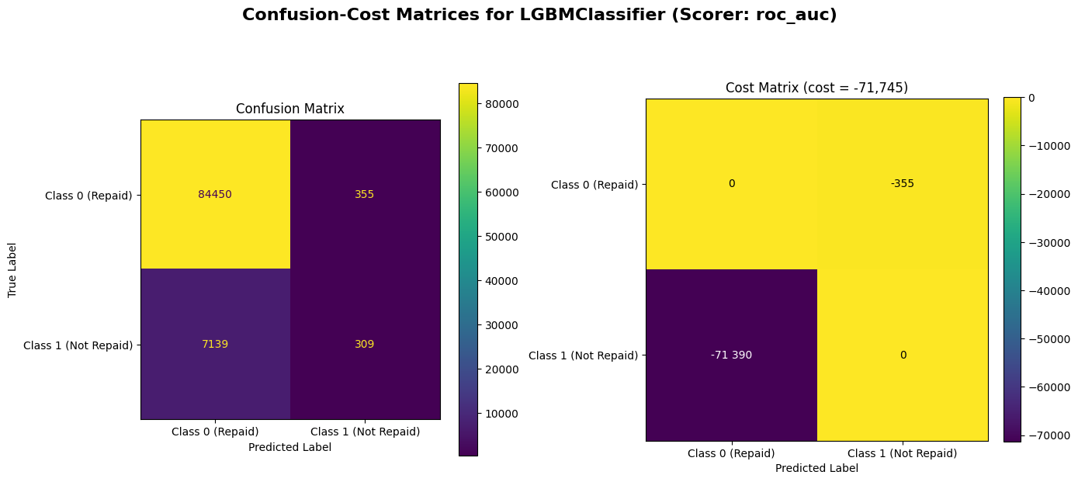
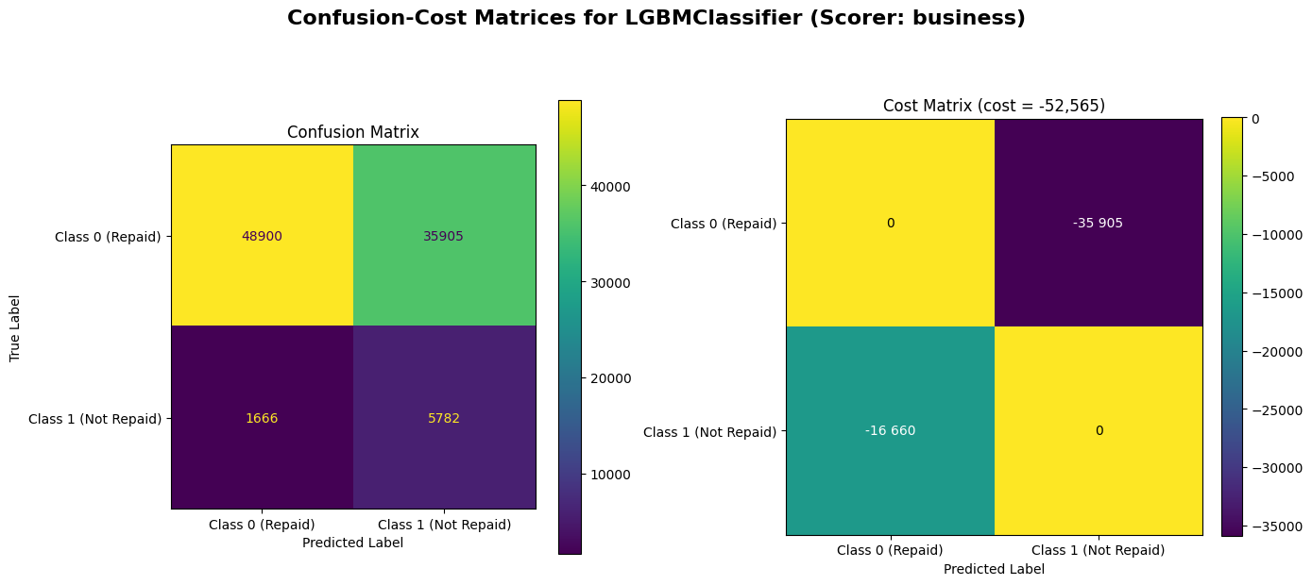
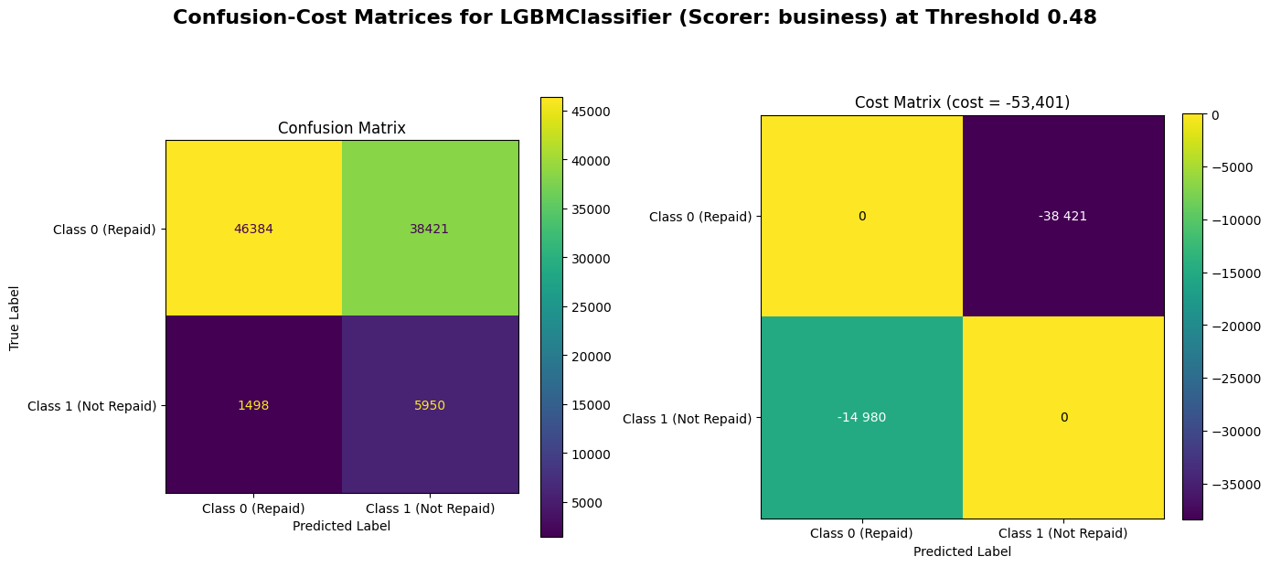
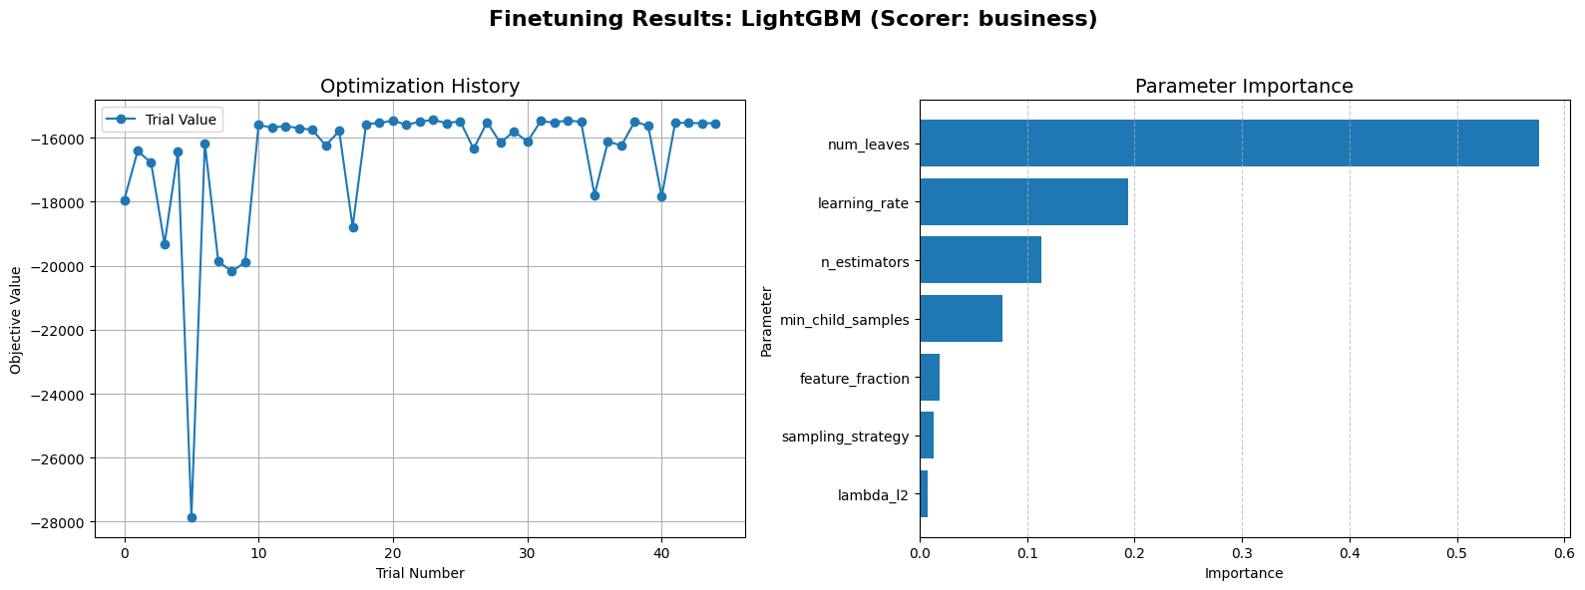
LightGBM

Slide 11
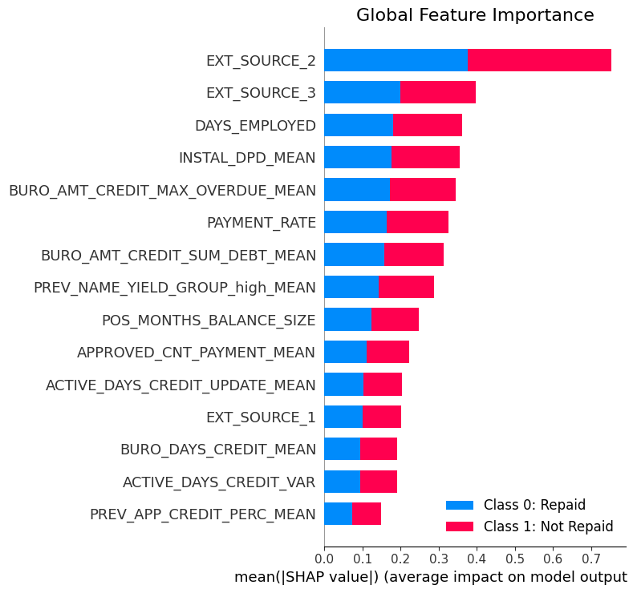
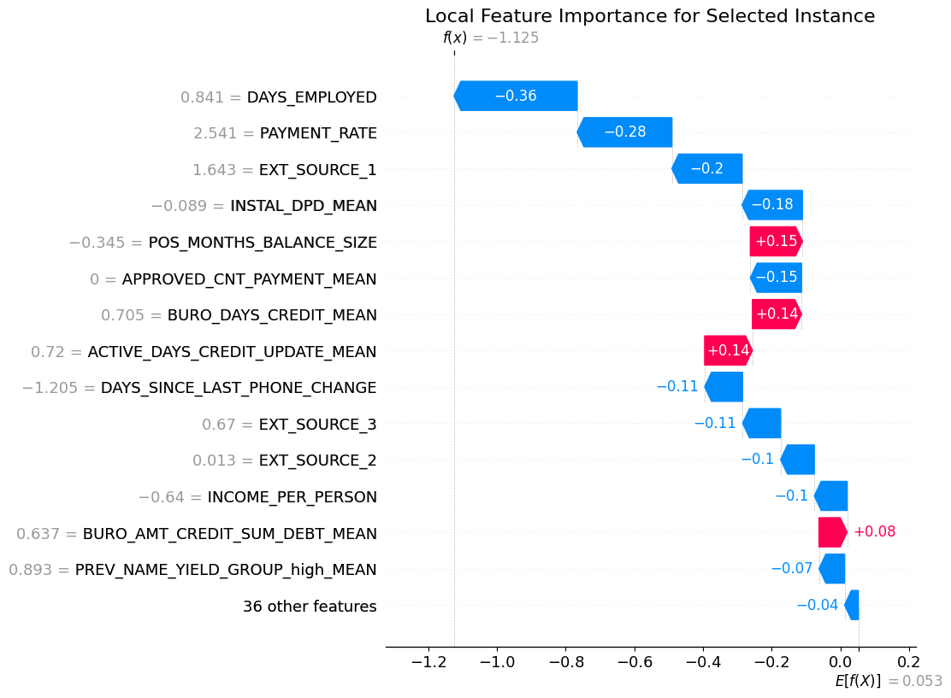
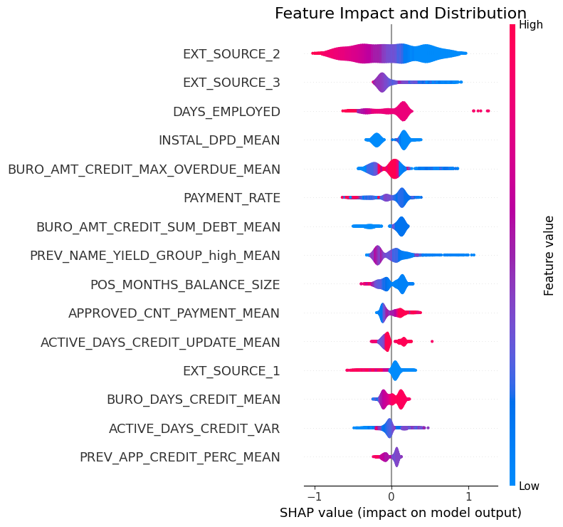
Feature Importance

Slide 12
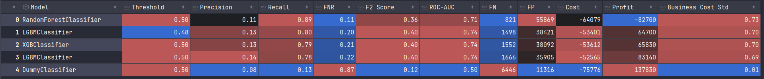
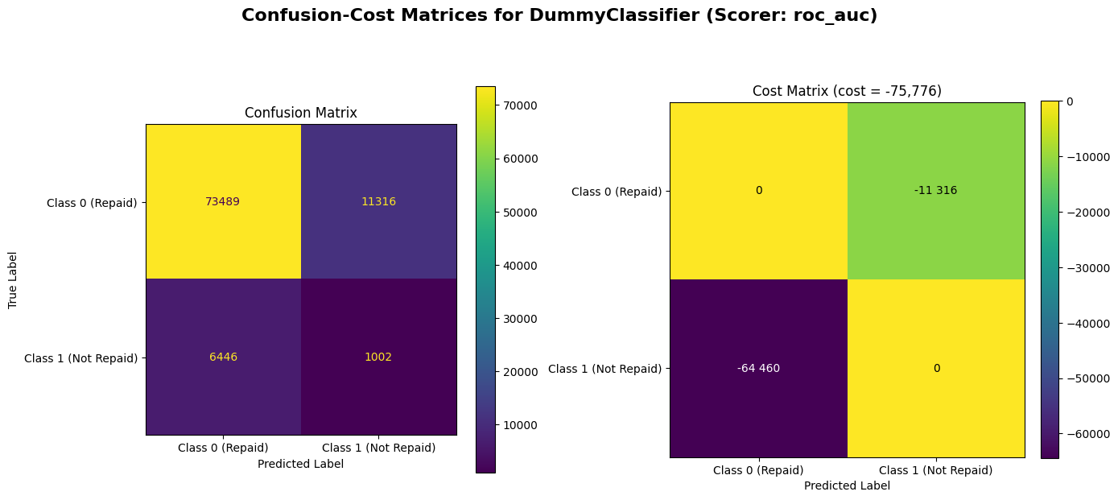
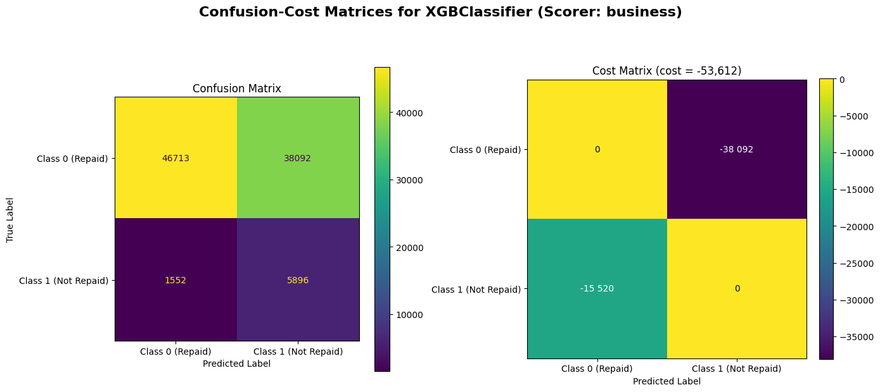
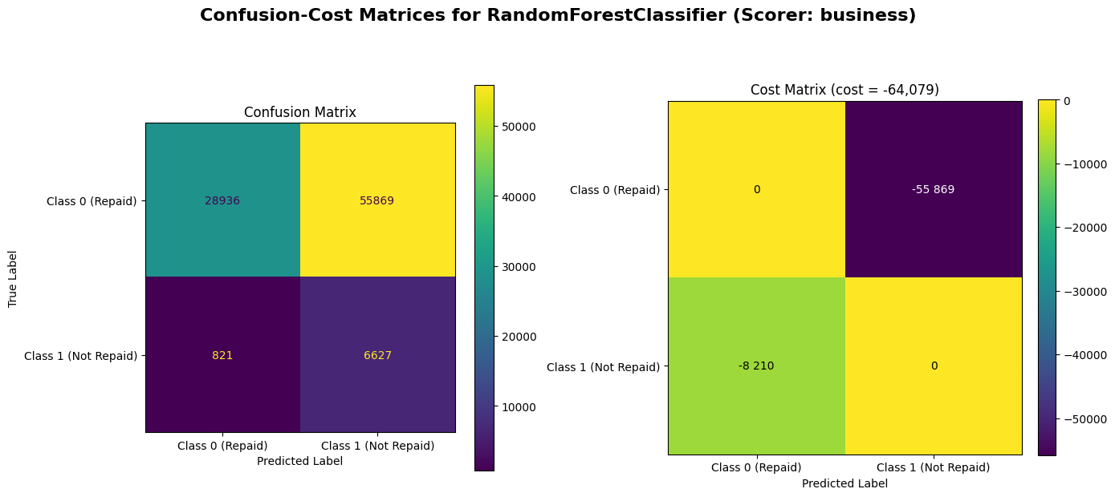
Summary
Logistic Regression → faces convergence issues & cannot be fitted
RandomForest → is the best in terms of pure FN reduction but negative profits
LightGBM & XGBoost →Decent balance between FN reduction & High TN
Our choice → LightGBM

Slide 13
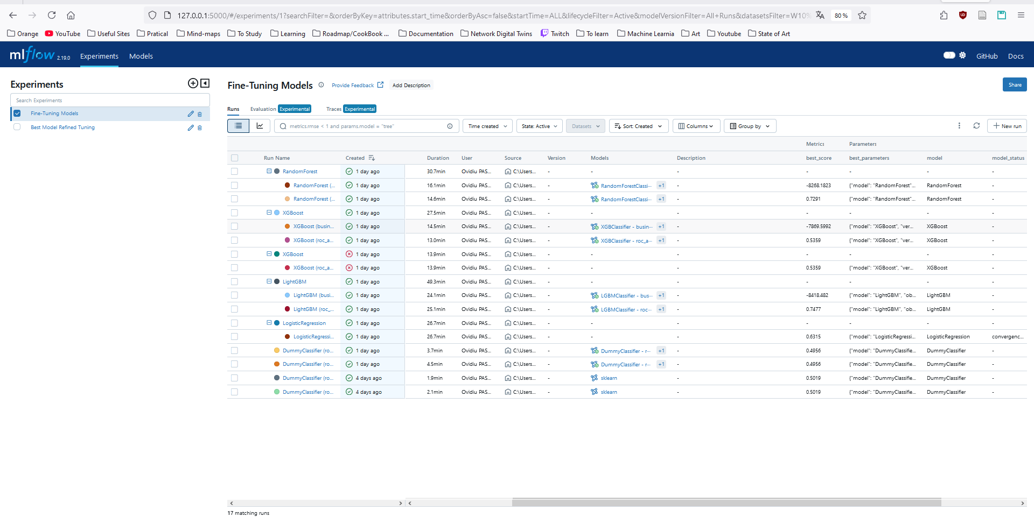
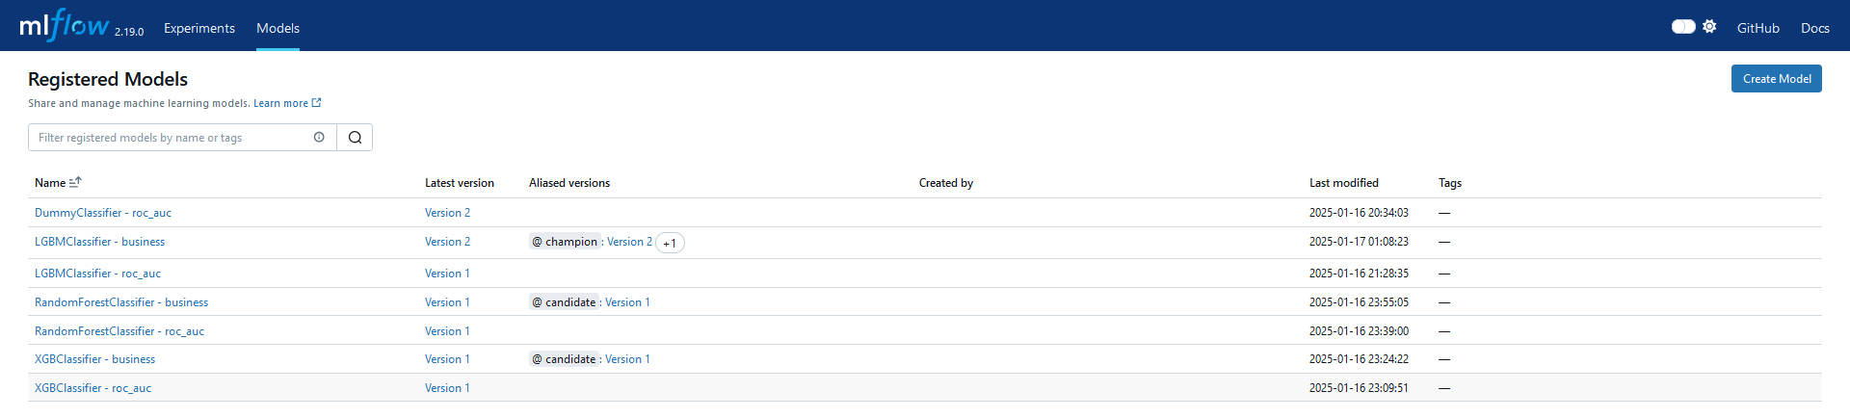
ML Flow

Slide 14
CI/CD Pipeline

Slide 15
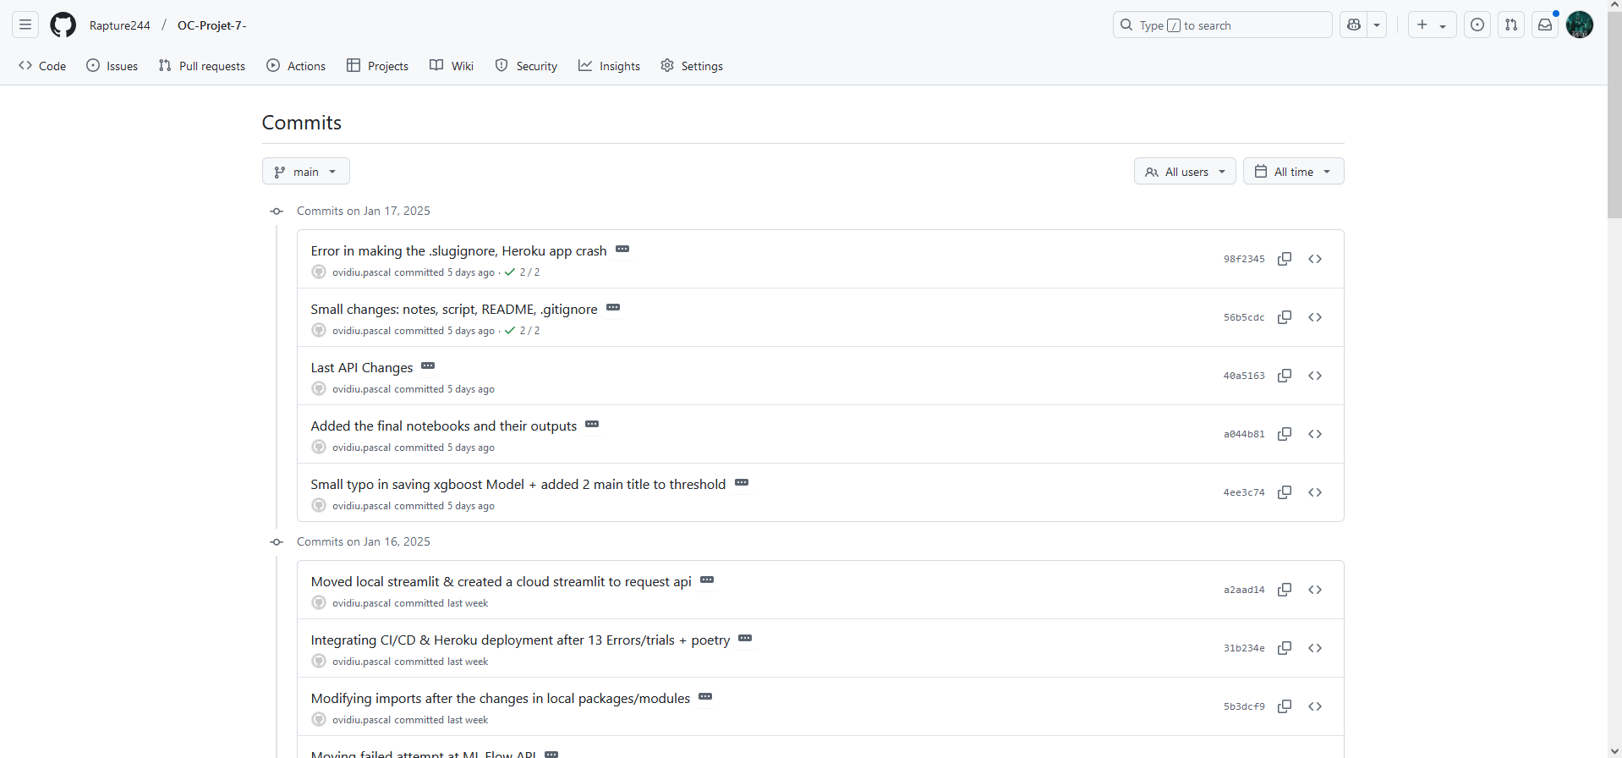
Code Versionning

Slide 16
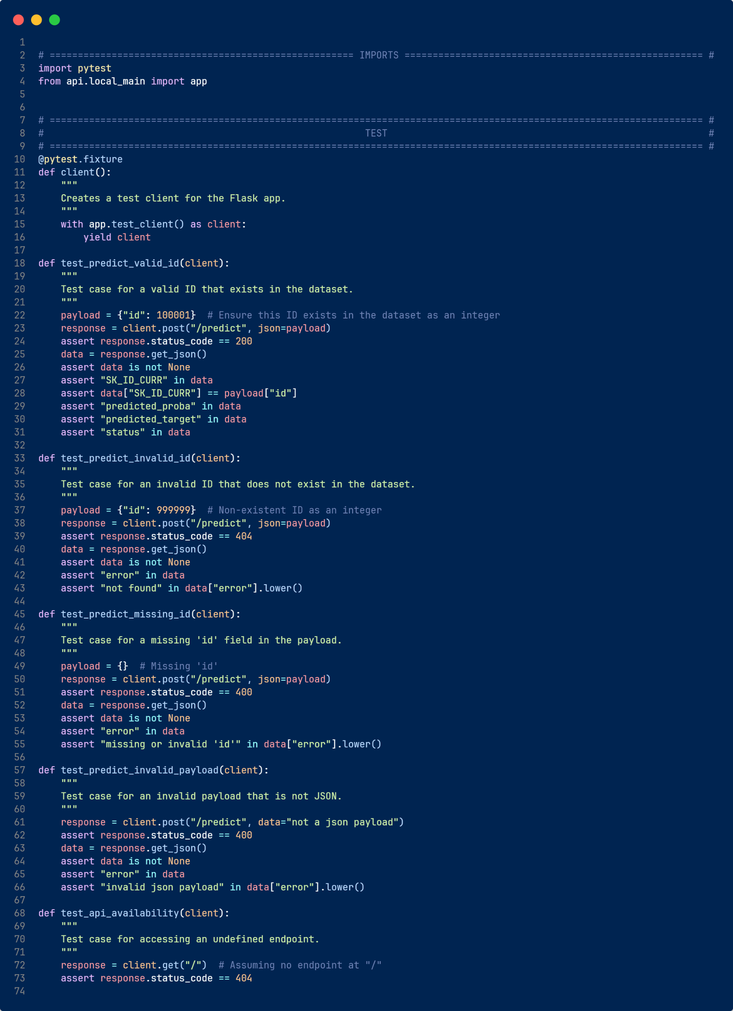
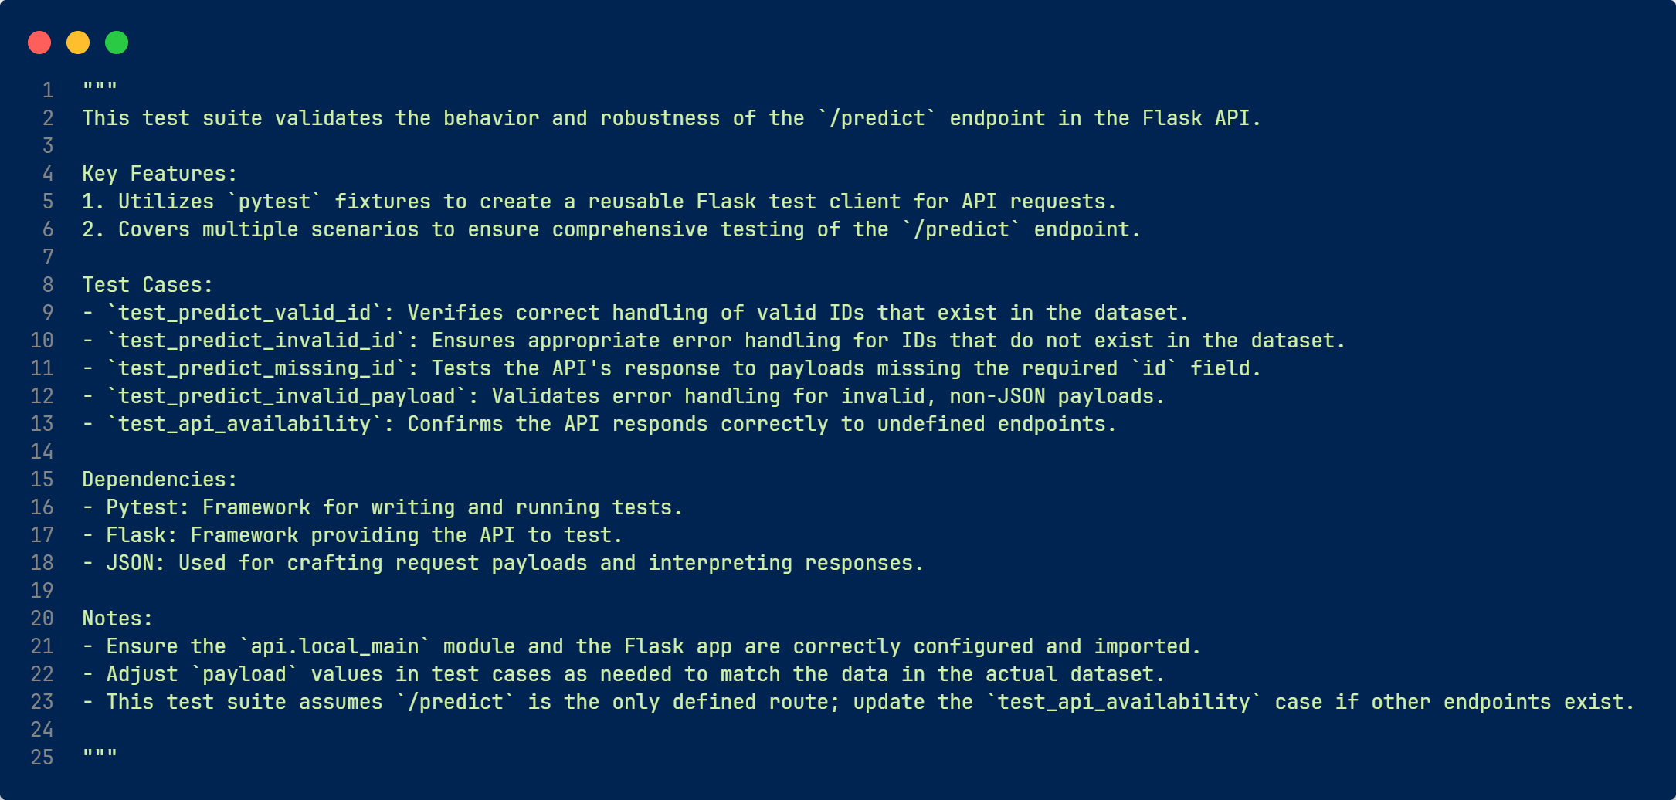
Tests made with PyTest

Slide 17
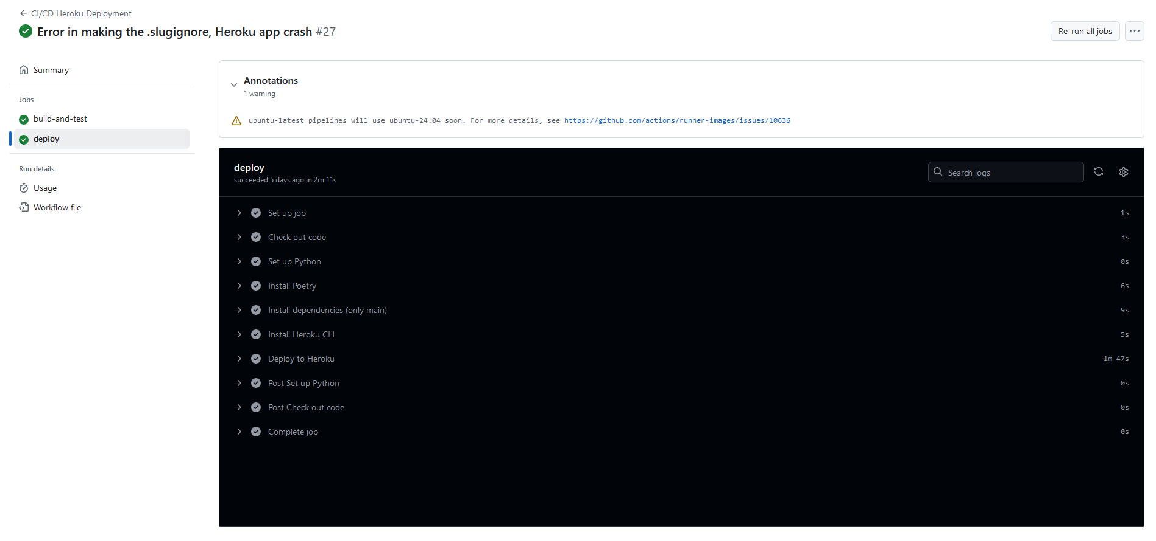
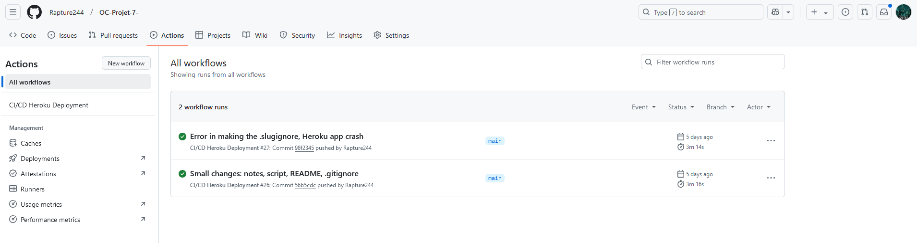
GitHub Actions to build, test & deploy the API

Slide 18
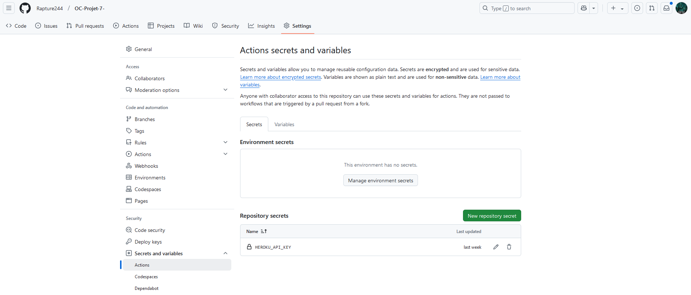
Used GitHub Secrets To Secure the Connection to Heroku

Slide 19
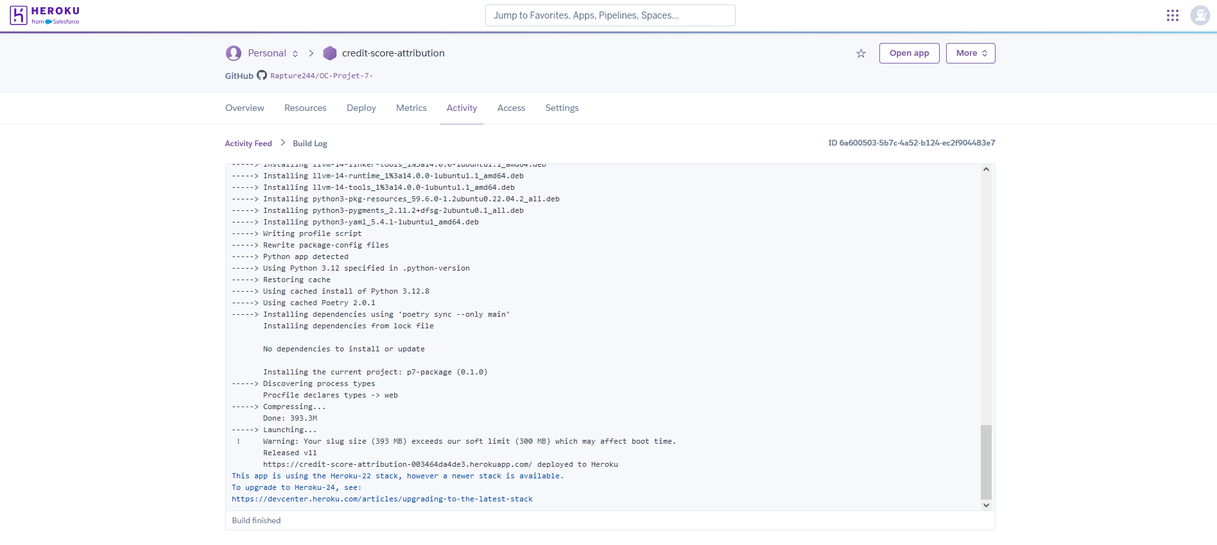
API Deployment on Heroku

Slide 20
Data Drift

Slide 21
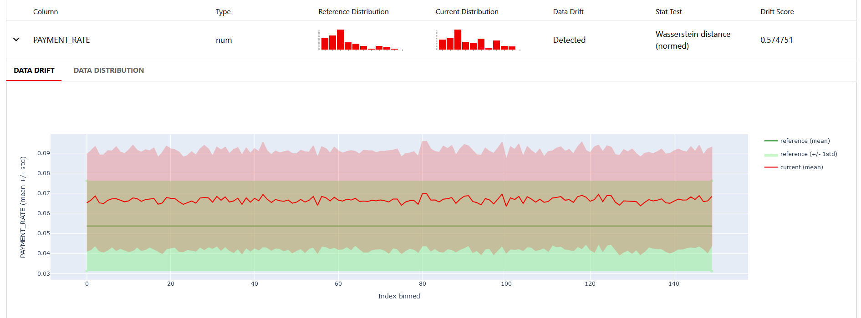
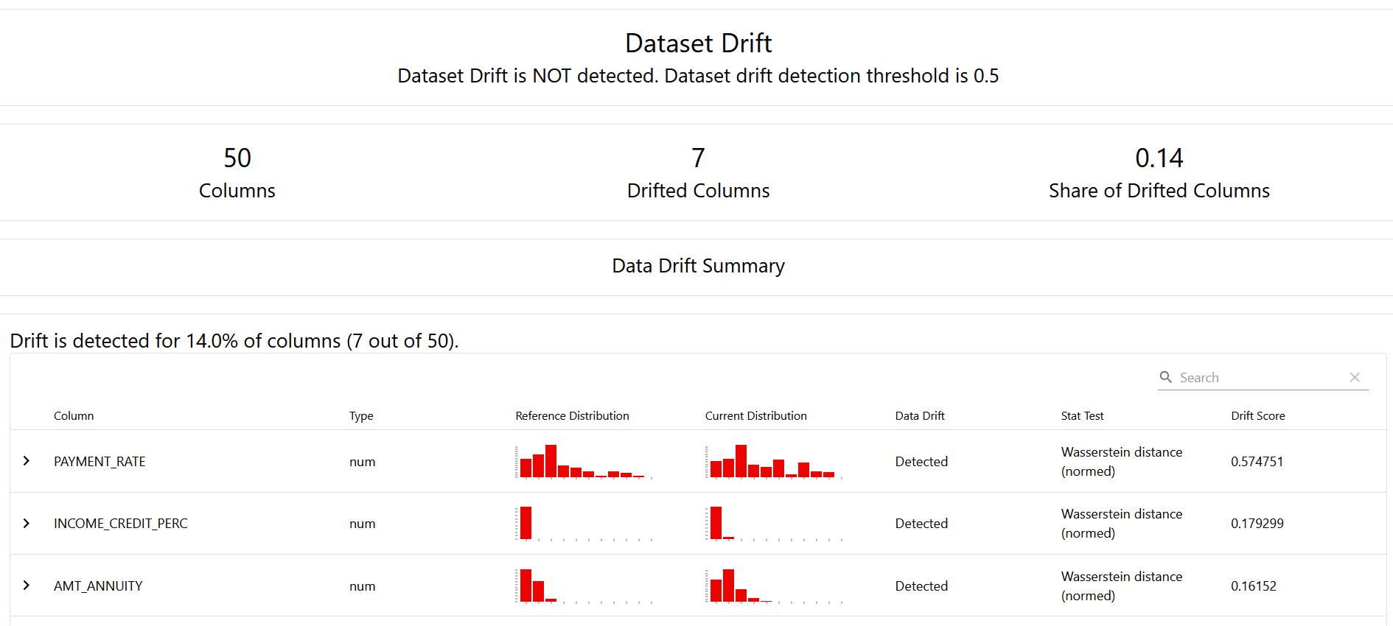
Data Drift

Slide 22
Live Demonstration
ML Flow UI
Streamlit test of the API + Heroku Log of the app

Slide 23
Q&A

