Slide 1
CREDIT RISK PREDICTION SYSTEM USING MACHINE LEARNING
KL University logo
Final Project Review | Department of CSE | KL University, Hyderabad
TEAM MEMBERS
2420030535 – Jagu Madhura
2420030534 – Rapuru Lokesh Reddy
2420030610 – Ch Srikar
Guide: To be added | Academic Year: To be added
Notes:
Title slide. Replace all bracketed text. Use the full project title, list every team member with registration number, and name your guide. Insert the institution logo in the dashed box.

Slide 2



Introduction & Problem Statement
CREDIT RISK ASSESSMENT FLOW
Background
Credit risk is the possibility that a borrower may fail to repay a loan. Reliable risk assessment helps financial institutions make informed lending decisions and reduce potential losses.
APPLICANT PROFILE
Age • Credit history • Loan details
Problem Statement
MACHINE-LEARNING ASSESSMENT
Preprocess → Classify → Explain
Manual, criteria-based assessment can be time-consuming and inconsistent. The project aims to use applicant and financial attributes to estimate whether an applicant belongs to a lower-risk or higher-risk class.
DECISION SUPPORT OUTPUT
Default probability • Risk tier • Key factors
Motivation / Need
Benefits: lenders and loan applicants. Faster, consistent preliminary assessment can support decision-making; inaccurate assessment may lead to financial losses or poor lending decisions.
Notes:
State the domain, the exact problem and why it matters. Keep it to about 2 minutes. Add one real-world statistic if you can, with a citation.

Slide 3


Objectives & Scope
Objectives
1
Design a machine-learning workflow for preliminary credit-risk assessment.
2
Prepare applicant data through cleaning, missing-value treatment and categorical encoding.
3
Train classification models using applicant and financial attributes.
4
Evaluate model performance using accuracy, precision, recall, F1-score and a confusion matrix.
Notes:
Objectives should be measurable and start with action verbs. The scope slide tells the panel what you did and did not attempt.

Slide 4

Literature Survey
S.No | Author(s) & Year | Method / Technique | Key Findings | Limitation / Gap
1 | Hastie et al. (2009) | Statistical learning methods | Foundational reference for supervised learning and model evaluation | General ML text; not a credit-risk-specific study
2 | Bishop (2006) | Pattern recognition and classification | Explains statistical pattern-recognition foundations | Not an evaluation of this proposed system
3 | Pedregosa et al. (2011) | Scikit-learn library | Presents a Python ML toolkit for model development | Software/library paper; no credit-risk results
4 | Chen & Guestrin (2016) | XGBoost | Introduces scalable tree boosting | Algorithm reference; project-specific comparison not reported
Research Gap
Research gap (as framed by this project): a consistent end-to-end workflow is needed to transform applicant information, train classification models and evaluate risk predictions with multiple metrics. This project brings these stages together for preliminary credit assessment. The paper does not provide a dedicated review of prior credit-risk studies.
Notes:
Summarise four to six relevant papers or existing systems. End with the research gap, because that gap justifies your project.

Slide 5





Proposed System & Methodology
STEP 1
STEP 2
STEP 3
STEP 4
STEP 5
Define Problem
Collect Data
Design
Implement
Test & Evaluate
Define applicant risk prediction as a binary classification task.
Applicant attributes: income, loan amount, credit history, employment and related financial features. Dataset source and size: to be confirmed.
Plan preprocessing, EDA, classification and evaluation. LR, DT and RF are listed in the paper's abbreviations.
Prepare data, transform features, train the selected classifier and connect prediction output.
Evaluate using accuracy, precision, recall, F1-score and confusion matrix.
Key Novelty / Contribution
Contribution: an end-to-end, consistent preprocessing-to-prediction workflow intended to provide faster and more consistent preliminary credit assessment. No novel algorithm is claimed in the paper.
Notes:
Walk through the five steps left to right. Rename the steps to match your project (for example, Requirement Analysis, Design, Coding, Testing, Deployment). End with your novelty.

Slide 6
System Architecture
Components
1. DATA INPUT
Streamlit applicant form
2. PREPROCESSING
ColumnTransformer
1
Applicant Data Input
Captures the 20 German Credit attributes through the Streamlit form.
4. MODEL EVALUATION
Accuracy • F1 • ROC-AUC
3. ML CLASSIFIERS
LR • Decision Tree • RF • SVM
2
Preprocessing
StandardScaler for numeric fields; OneHotEncoder for categorical fields.
5. EXPLAINABILITY & FAIRNESS
SHAP • LIME • Group audit
6. OUTPUT & AUDIT
Risk tier • Similar cases • History
3
ML Classifiers
Compares Logistic Regression, Decision Tree, Random Forest and SVM.
USER DASHBOARD | Streamlit
4
Decision Support Output
Risk probability and tier, SHAP/LIME explanations, fairness and similar-case insights.
Notes:
Insert a clear block diagram: input, processing, storage, output. Number each block and explain them on the right. Redraw the figure yourself rather than copying it.

Slide 7


Hardware & Software Requirements
Hardware
Software & Tools
Libraries / Frameworks
Software-only application; no sensors or embedded boards.
Hardware: standard Python-capable computer; exact CPU/RAM not specified.
Storage: dataset CSV + serialized model artifacts.
Operating system: Not stated in paper
Programming language: Not stated in paper
IDE / notebook: Not stated in paper
Version control: Not stated in paper
Machine-learning library: Scikit-learn (referenced)
Other libraries and versions: Confirm from implementation
Framework / API: [Not specified]
Database / cloud: [Not specified]
Deployment: Streamlit web application; local execution on port 8501 (README).
Notes:
List only what you actually used, with versions. For a pure software project, shorten the hardware list and add cloud or deployment resources.

Slide 8
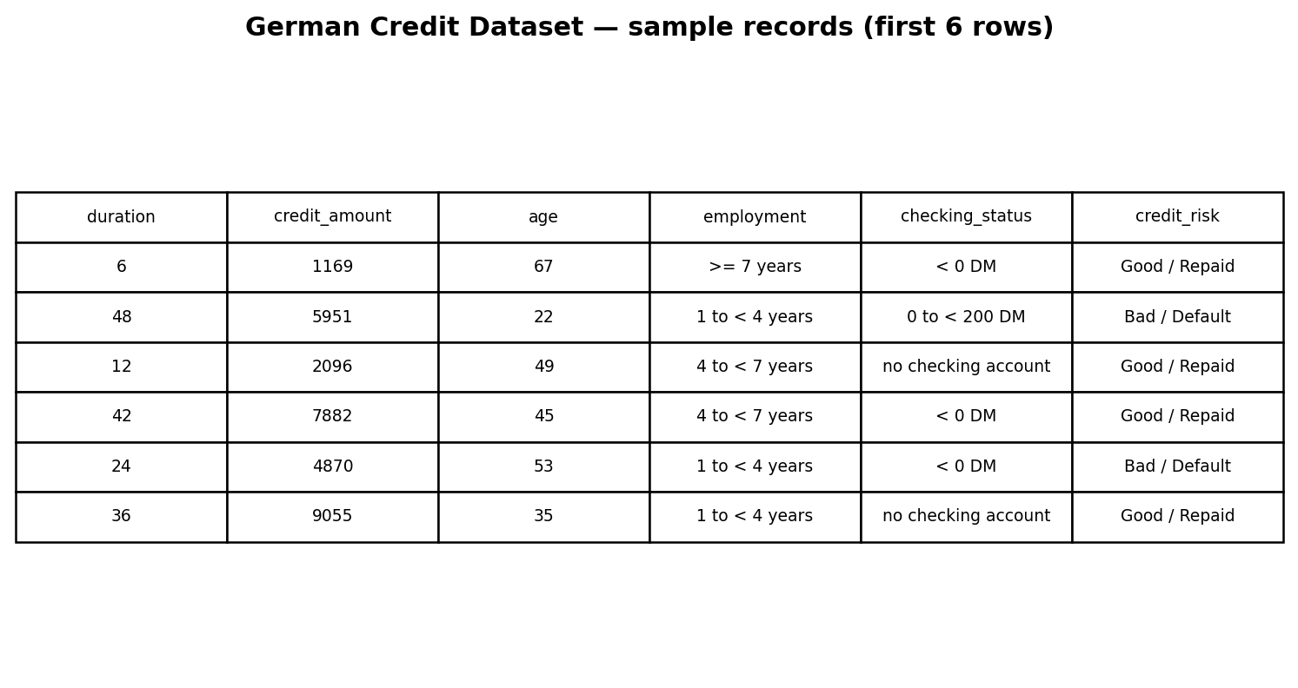
Dataset / Data Understanding
Dataset preview: actual first six records
1,000
20
Records (rows)
Features (columns)
0
2
Missing values
Target classes
Source: Statlog German Credit dataset (UCI).
Target: 700 Good/Repaid (70%); 300 Bad/Default (30%).
Quality: 0 missing values; 0 duplicate rows. 7 numeric + 13 categorical inputs.
Notes:
Explain where the data came from and what it contains. Show a screenshot of the first rows or the info summary. For non-data projects, replace this slide with “Requirement Analysis” or “Input Specification”.

Slide 9
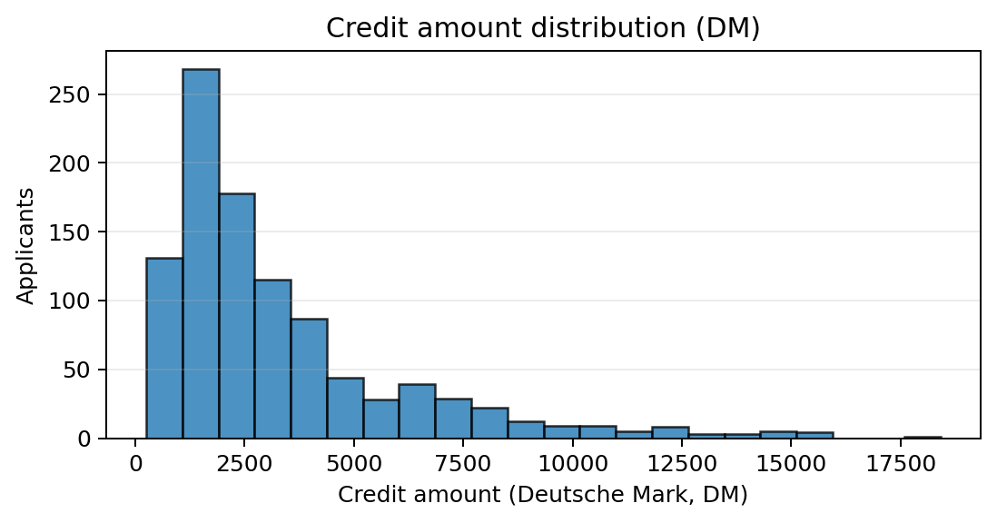
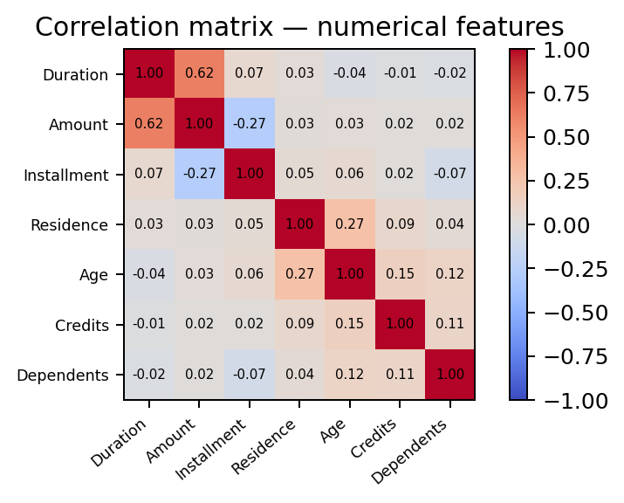



Data Preprocessing & Exploratory Analysis
Cleaning
Transformation
Feature Selection
Cleaning: dataset contains 0 missing values and 0 duplicates. No separate outlier-removal step is documented.
Transformation: StandardScaler for 7 numeric fields; OneHotEncoder for 13 categorical fields (unknown categories ignored).
Feature selection: no separate selection stage; all 20 input features are used.
Notes:
Show two or three plots that tell a story: distributions, correlations, outliers. Explain what each plot told you and what you did about it.

Slide 10
Module-wise Description
1
Data Input & Understanding
2
Data Preprocessing & EDA
Purpose: Collects applicant attributes and inspects the dataset.
Input → Output: Applicant records → structured feature set.
Developed by: To be assigned by team
Purpose: Cleans and transforms data; explores feature patterns.
Input → Output: Raw data → prepared features.
Developed by: To be assigned by team
3
Model Training
4
Prediction & Evaluation
Purpose: Trains classification algorithms on prepared applicant data.
Input → Output: Training features and labels → trained classifier.
Developed by: To be assigned by team
Purpose: Produces a risk class and evaluates model performance.
Input → Output: Applicant features → risk class and evaluation metrics.
Developed by: To be assigned by team
Notes:
Divide the project into three to five modules. For each, state its purpose, inputs, outputs and who built it. Duplicate a card if you have more modules.

Slide 11

Algorithms & Technologies Used
Logistic Regression
Random Forest
SVM + Decision Tree
Why chosen
Interpretable linear baseline; strongest default recall (80.0%) and F1 (65.75%).
Key parameters
max_iter=1000; class_weight=balanced; C=1.0; liblinear.
Why chosen
Project's selected primary model; supports tree-based SHAP explanations.
Key parameters
150 trees; max_depth=8; class_weight=balanced; min_samples_leaf=3.
Why chosen
SVM gives highest accuracy (78.0%) and ROC-AUC (0.8107); Decision Tree is a baseline.
Key parameters
SVC with balanced weights + sigmoid calibration; DT max_depth=5.
All four models were compared on the same stratified 200-record test set. RF retained as primary for SHAP explainability; SVM leads accuracy/AUC; LR leads recall/F1.
Notes:
Name each model, algorithm or technology, say why you chose it, and list the key settings. Then explain how you picked the final one.

Slide 12
Implementation / Model Building
Feature Selection
CODE: PREPROCESSING + RANDOM FOREST
20 German Credit attributes: 7 numerical and 13 categorical features.
# 1) Split data without target leakage
X_train, X_test, y_train, y_test = train_test_split(
X, y, test_size=0.20, stratify=y, random_state=42)
# 2) Fit preprocessing on training data only
preprocessor = ColumnTransformer([
("num", StandardScaler(), NUMERICAL_COLS),
("cat", OneHotEncoder(handle_unknown="ignore"),
CATEGORICAL_COLS)
])
X_train_p = preprocessor.fit_transform(X_train)
X_test_p = preprocessor.transform(X_test)
# 3) Train and evaluate a classifier
model = RandomForestClassifier(
n_estimators=150, max_depth=8,
min_samples_split=6, min_samples_leaf=3,
class_weight='balanced', random_state=42)
model.fit(X_train_p, y_train)
prob = model.predict_proba(X_test_p)[:, 1]
Preprocessing Pipeline
StandardScaler + OneHotEncoder(handle_unknown='ignore') in a ColumnTransformer.
Data Splitting
Stratified 80:20 split (random_state=42): 800 training rows and 200 test rows.
Configuration
Balanced class weights; RF uses 150 trees, max_depth=8, min_split=6 and min_leaf=3.
Notes:
Describe the build in the order you did it. Paste only the most important code or pseudocode, not entire files. For hardware projects, show the circuit or wiring summary instead.

Slide 13
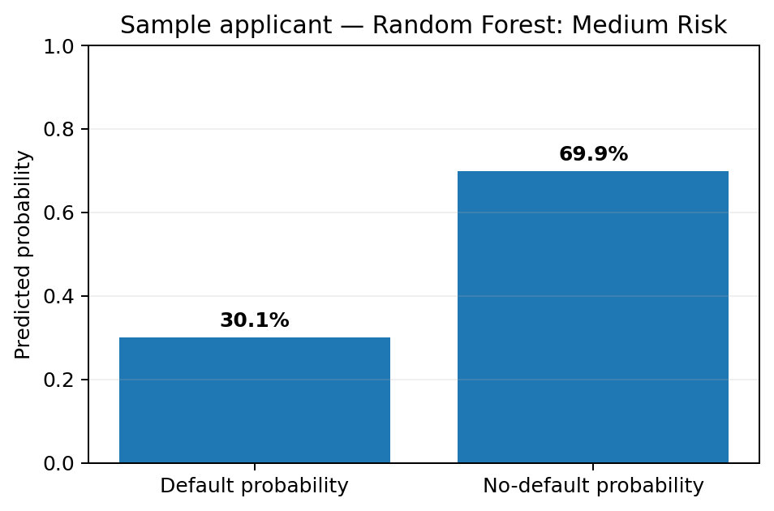
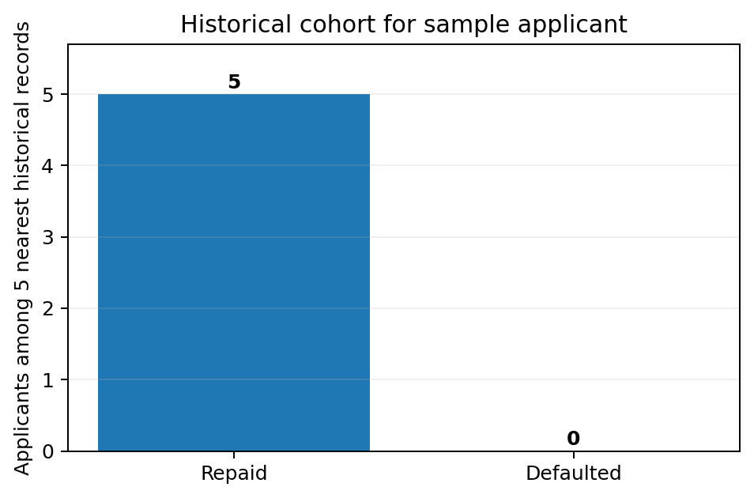
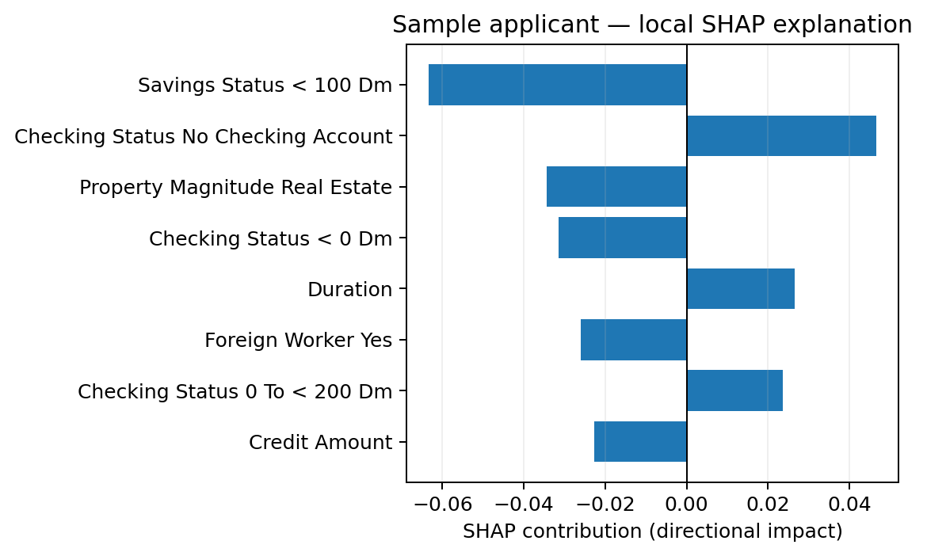
Working Prototype / Output Screens
Insert real screenshot
Insert real screenshot
Sample applicant prediction
RF predicts 30.1% default probability → Medium Risk.
Historical cohort matching
5 nearest training applicants: 5 repaid, 0 defaulted.
Local SHAP explanation
Applicant-specific risk drivers from the trained RF model.
Notes:
Show real screenshots, photos of the hardware or a short demo video link. Caption each one with what the viewer should notice.

Slide 14
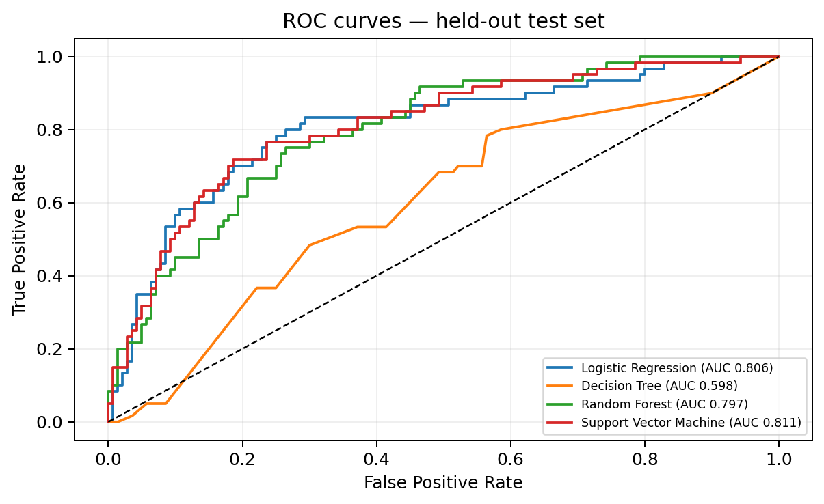
Results & Performance Comparison
Model | Accuracy | Recall | ROC-AUC
Logistic Reg. | 0.750 | 0.800 | 0.806
Decision Tree | 0.560 | 0.683 | 0.598
Random Forest | 0.745 | 0.617 | 0.797
SVM | 0.780 | 0.483 | 0.811
Top accuracy/AUC: SVM (78.0% / 0.811). Top recall/F1: Logistic Regression (80.0% / 0.658).
Notes:
Right-click the chart and choose Edit Data to enter your real numbers. Replace the metrics with the ones that fit your project (accuracy, latency, power, throughput, user rating). State clearly which option performed best.

Slide 15
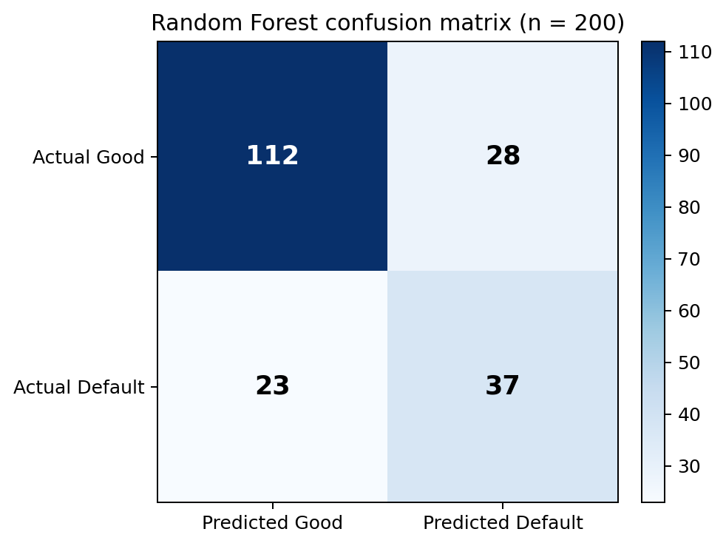
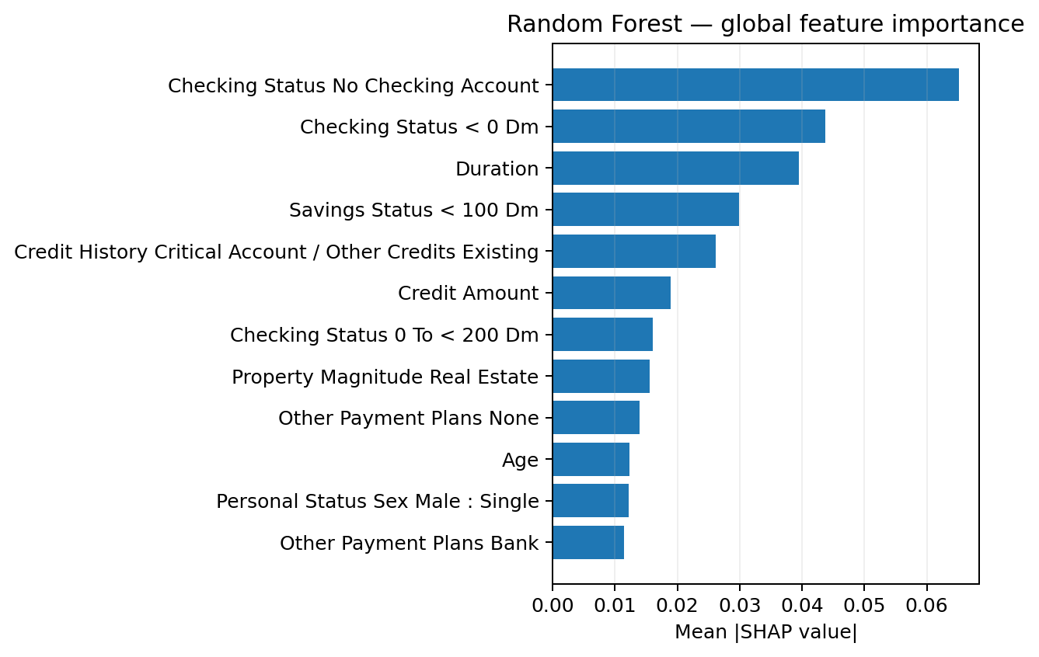
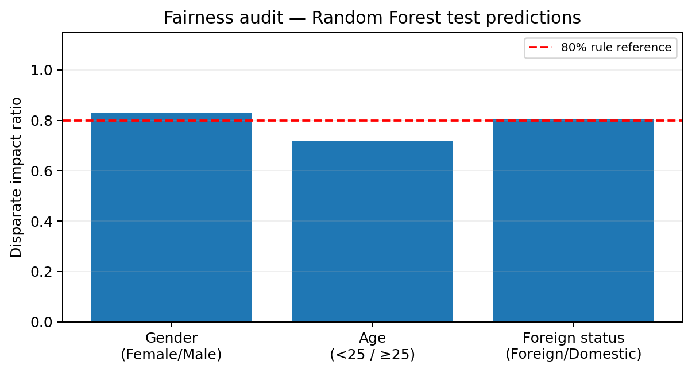
Analysis & Key Findings
74.5%
Random Forest accuracy (primary model)
RF confusion matrix: TN=112, FP=28, FN=23, TP=37 (default class=1).
SHAP ranks the strongest global input drivers.
Fairness: age-group DI=0.718 (<0.80), requiring review. Gender DI=0.829. Foreign-worker DI=0.804, but only 6 domestic test cases; interpret cautiously.
Notes:
Explain what the numbers mean. Use a confusion matrix, ROC curve, feature-importance chart or output comparison. Be honest about weak results; panels value that.

Slide 16

Testing & Validation
Test ID | Test Description | Expected Result | Observed Result | Status
TC-01 | Dataset + preprocessing | 1,000 rows; 20 features transformed | Verified; no missing/duplicate rows | PASS
TC-02 | Four models + risk tiers | All models predict; tiers map correctly | All four classifiers and thresholds verified | PASS
TC-03 | SHAP + historical matching | Explanation and 5-neighbour cohort returned | Both checks verified on sample input | PASS
TC-04 | Fairness + audit history | Parity metrics and history log returned | Both checks verified; LIME separate test blocked | PASS*
Functional Testing
Validation Method
Performance Testing
8 of 9 individual checks passed. The LIME test was blocked by a missing package and is not counted as passed.
Stratified hold-out: 80% train / 20% test, random_state=42. Test set: 200 records (60 defaults, 140 good cases).
Metrics calculated on the held-out test set. *Grouped row excludes LIME; install lime and rerun test_system.py to complete validation.
Notes:
List representative test cases with expected and actual outcomes. Name the validation methods you used. Delete rows you do not need.

Slide 17


Challenges & Limitations
Challenges Faced
Limitations
Challenges to address:
Missing/incomplete records → apply a documented imputation strategy.
Mixed categorical/numerical data → encode categories and scale numerical data where required.
Class imbalance → evaluate precision, recall and F1-score, not accuracy alone.
Dataset source, size and class balance are not stated in the paper.
No measured model performance or best classifier is reported.
The system is described as preliminary decision support, not a replacement for full credit underwriting.
Notes:
Be candid. Pair every challenge with how you solved it, and list limitations that the panel would otherwise spot themselves.

Slide 18

Conclusion
Implemented a Streamlit credit-risk decision-support system using 1,000 Statlog German Credit records and 20 applicant features.
1
Final Outcome
SVM achieved the best accuracy (78.0%) and ROC-AUC (0.811); Logistic Regression achieved the best default recall (80.0%) and F1-score (0.658).
78%
2
Headline: highest test accuracy (SVM) = 78.0%.
Primary configured model: Random Forest (74.5% accuracy). 8/9 checks passed; LIME dependency pending.
The system adds SHAP explanations, historical cohort matching, what-if simulation, prediction history and fairness checks. Human review remains essential.
3
Notes:
Revisit each objective and say whether you met it. Quote your headline result with numbers. Do not introduce new material here.

Slide 19



Future Scope & Applications
Improve Performance
Tune hyperparameters and compare additional classifiers using consistent test data.
Applications
Preliminary loan-application screening
Credit-risk analysis support
Financial institution decision-support workflows
Potential users: banks, lenders and financial institutions.
Expand Data / Features
Use larger, more representative datasets with documented features and class balance.
Deploy & Build an Interface
Build a web interface or API for applicant input and risk prediction.
Scale & Secure
Add access control, privacy safeguards, monitoring and reliability checks.
Notes:
Give concrete next steps, ideally tied to the limitations. Then name two or three real-world uses.

Slide 20
Team Contribution
Reg. No. | Name | Contribution / Modules Handled
2420030535 | Jagu Madhura | [Add verified contribution / modules]
2420030534 | Rapuru Lokesh Reddy | [Add verified contribution / modules]
2420030610 | Ch Srikar | [Add verified contribution / modules]
— | — | Remove unused row if only three members
Notes:
Show that work was planned and shared. Every member should be able to explain their own module.

Slide 21

References
[1] T. Hastie, R. Tibshirani, and J. Friedman, The Elements of Statistical Learning, 2nd ed. Springer, 2009.
[2] C. M. Bishop, Pattern Recognition and Machine Learning. Springer, 2006.
[3] F. Pedregosa et al., “Scikit-learn: Machine learning in Python,” Journal of Machine Learning Research, vol. 12, pp. 2825–2830, 2011.
[4] W. McKinney, Python for Data Analysis, 3rd ed. O’Reilly Media, 2022.
[5] T. Chen and C. Guestrin, “XGBoost: A scalable tree boosting system,” Proc. ACM SIGKDD, 2016, pp. 785–794.
Project Links
GitHub: [Add project repository URL]
Dataset: [Add dataset name and URL]
Demo video: [Add link if available]
Notes:
Use IEEE style, numbered in order of first citation in the deck. Include datasets, documentation and code repositories.

Slide 22
THANK YOU
Questions & Discussion
Team: Jagu Madhura | Rapuru Lokesh Reddy | Ch Srikar
Guide: Guide name and department: To be added
Notes:
Leave this slide up during questions. Make sure every team member can answer questions about their own module.

