Slide 1
A Project Review-1 Project title: Retail Sales Analytics and Customer Intelligence Framework Using Machine Learning and Business Intelligence
Submitted by
Batch No:9
Sri Hansika-2420030556 J. Madhura-2420030535 R. Lokesh-2420030534 G. Charan-2420080042
Under the Esteemed guidance of
Mrs. Dr.Swapnika
Assistant Professor
Department of Computer Science and Engineering

Slide 2

Outline of the presentation
Problem Statement
Abstract
Project flow diagram
Literature Survey
Objectives with justification
Research gaps
Novelty/Innovation/Feseability
Tools
Project plan

Slide 3
Problem Statement
Retail organizations generate large volumes of sales data, but traditional reporting provides limited actionable insights. Existing approaches mainly focus on sales prediction and customer segmentation. There is a need for an integrated framework combining ML-based sales prediction, CLV analysis, and What-If Business Analysis to support better retail decision-making.

Slide 4
Abstract
The project proposes a Retail Sales Analytics and Customer Intelligence Framework that transforms retail sales data into actionable business insights.
The Superstore Sales Dataset is preprocessed using Python, NumPy, and Pandas, followed by EDA and statistical analysis using Matplotlib and Seaborn to identify sales, customer, product, and regional patterns.
Machine learning models including Linear Regression, Decision Tree, Random Forest, XGBoost, and K-Means are applied for sales prediction and customer segmentation, with XGBoost used as the primary model for sales prediction.
The framework incorporates Customer Lifetime Value (CLV) Prediction to estimate future customer value using purchasing behavior and RFM-based features.
What-If Business Analysis is integrated with Power BI to analyze how changes in variables such as discount and quantity can affect predicted sales, supporting scenario-based decision-making.

Slide 5
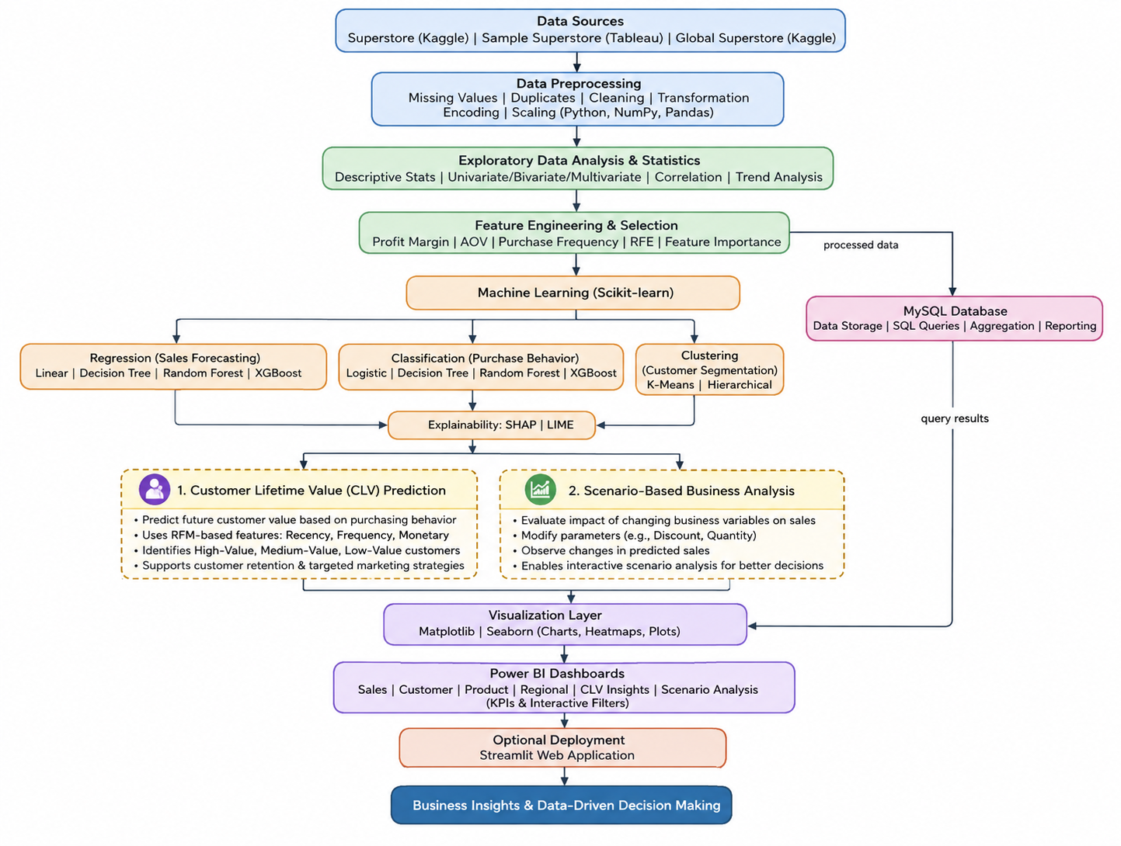
Project flow diagram

Slide 6
Literature Survey
S.No | Paper Title | Year | Key Focus | Limitations
1. | Unlocking Retail Insights: Predictive Modeling and Customer Segmentation Through Data Analytics | 2025 | Predictive modeling and customer segmentation using ML | Focuses mainly on prediction and segmentation; limited integration with BI dashboards, SQL, and actionable business recommendations.
2. | Predictive modeling and customer segmentation using ML | 2025 | Comparison and evaluation of ML models for sales forecasting | Focuses primarily on ML model comparison; limited customer intelligence, visualization, and recommendation capabilities.
3. | Customer Profiling, Segmentation, and Sales Prediction Using AI in Direct Marketing | 2025 | AI-based customer profiling, segmentation and sales prediction | Focuses on direct marketing; limited emphasis on product performance, regional analysis, inventory optimization, and BI integration.
4. | A Dynamic Customer Segmentation Approach by Combining LRFMS and Multivariate Time Series Clustering | 2024 | Dynamic customer segmentation using LRFMS and time-series clustering | Mainly focuses on customer segmentation; does not extensively address sales prediction, product analysis, or end-to-end business intelligence.
5. | A Comprehensive Framework for Customer Segmentation and Predictive Analytics | 2025 | Integrated customer segmentation and predictive analytics framework | Integrates segmentation and prediction but has limited emphasis on SQL, Power BI, explainability, and automated business recommendations.

Slide 7
Literature Survey
S.No | Paper Title | Year | Key Focus | Limitations
6. | Revolutionizing Retail Analytics: Advancing Inventory and Customer Insights with AI | 2024 | AI-based inventory management, customer insights and demand forecasting | Focuses mainly on inventory and demand forecasting; limited integration of comprehensive sales analytics, model comparison, and business recommendations.
7. | Understanding Consumer Behavior in the Retail Sector Using RFM Segmentation and Machine Learning | 2024 | RFM-based customer behavior analysis and ML | Primarily focuses on customer behavior and RFM segmentation; limited product, regional, sales forecasting, and dashboard integration.
8. | An Exploration of Clustering Algorithms for Customer Segmentation in the UK Retail Market | 2024 | Comparison of clustering algorithms for customer segmentation | Focuses mainly on clustering and customer segmentation; limited predictive sales analysis and integration with broader retail analytics.
9. | Customer Segmentation with Clustering Methods in the Retail Industry | 2024 | Clustering techniques and customer-based marketing strategies | Concentrates on segmentation and marketing; limited sales prediction, product analysis, SQL integration, and BI dashboards.
10. | Omni-channel Customer Segmentation: A Personalized Customer Journey Perspective | 2024 | Omni-channel customer behavior and personalized segmentation | Focuses mainly on customer segmentation and personalization; limited inventory, regional performance, sales forecasting, and recommendation analysis.

Slide 8
Objectives with justification
To develop an End-to-End Analytics Framework Integrating Python, Preprocessing, EDA, ML, SQL & Power BI To analyze Customer & Product Behavior.
To build and enhance Interactive Dashboards for Sales, Customer, Product & Regional Insights
To predict Customer Lifetime Value (CLV), by Estimate future customer value using historical purchasing behavior and RFM-based features.
To Analyze the impact of changes in business variables such as discount and quantity on predicted sales using interactive Power BI scenarios.
To develop and evaluate the proposed Retail Sales and Customer Intelligence Model (RSCIM) using XGBoost as the primary machine-learning algorithm for Sales Prediction.

Slide 9
Research gaps
Lack of comprehensive integration of Data Analytics, ML, SQL & BI.
Insufficient customer and product intelligence alongside sales prediction.
Inadequate comparative evaluation of multiple ML models.
Limited focus on future customer value prediction, such as CLV.
Insufficient interactive scenario-based analysis for business decision-making.

Slide 10
Novelty
Customer Lifetime Value (CLV) Prediction to estimate the future value of customers based on their purchasing behavior.
Uses RFM-based features such as Recency, Frequency, and Monetary value for customer value estimation.
Identifies high-value, medium-value, and low-value customers based on predicted CLV.
Supports improved customer retention and targeted marketing strategies.
Scenario-Based Business Analysis to evaluate the impact of changing business variables on predicted sales.
Allows users to modify parameters such as discount and quantity and observe changes in predicted sales.
Provides interactive scenario analysis through Power BI.
Integrates predictive customer intelligence with interactive business decision-making.

Slide 11
Feasibility of the Project
1. Technical Feasibility - The project can be developed using Python, Pandas, NumPy, Matplotlib, Seaborn, Scikit-learn, MySQL, and Power BI. - The Superstore dataset provides sufficient sales, customer, product, profit, and regional data. - The required tools are accessible and suitable for the proposed analytics and ML tasks.
2. Economic Feasibility - Most tools used are free or have accessible academic/free versions. - The dataset is publicly available. - No specialized hardware is required. - Development can be performed using existing computers.
3. Operational Feasibility - The system provides easy-to-understand Power BI dashboards and business insights. - It can help retailers analyze sales, customers, products, and regions. - The recommendation module can support data-driven decision-making.
4. Schedule Feasibility - The project can be completed in phases: Data Collection → Preprocessing → EDA → ML → SQL → Recommendation Module → Power BI → Testing & Documentation. - Each phase can be developed and integrated progressively.

Slide 12
Project Plan
Phase | Activity | Description
Phase-1 | Data Collection & Preprocessing | Collect and clean the Superstore dataset by handling missing values, duplicates, outliers, and transforming data.
Phase-2 | EDA & Statistical Analysis | Analyze sales, customers, products, and regions using statistical methods and visualizations.
Phase-3 | Machine Learning & Evaluation | Build ML models for sales prediction and customer segmentation, then evaluate and compare their performance.
Phase-4 | SQL & Business Intelligence | Store data in MySQL, perform queries and analysis, and create Power BI dashboards for business insights.
Phase-5 | CLV, Scenario Analysis & Finalization | • Develop Customer Lifetime Value (CLV) Prediction • Perform RFM-based customer value analysis • Identify High/Medium/Low-value customers • Implement Scenario-Based Business Analysis • Analyze impact of discount and quantity on predicted sales • Integrate all modules • Validate results • Final report & presentation

Slide 13
Thank you

