Slide 1


S h a d o w C r y p t
P r o a c t i v e R a n s o m w a r e P r o t e c t i o n :
E m p l o y i n g C a m o u f l a g e a n d C o n c e a l m e n t
Under the Guidance of
Ms. Sariya Jabeen Duriya
Assistant Professor, CSE - ( IoT )
*****
Abdul Samad - 161021749020
Mohammed Abdul Raqeeb - 161021749035
Mohammed FasiUddin Arsalaan - 161021749041

Slide 2

Ransomware Description
Malware encrypts files and demands ransom for decryption.
Advanced variants of Ransomware evade traditional detection.
Example:
LockBit operates as a “Ransomware-as-a-Service”
“Double Extortion” - Encrypt data and also threaten to publish confidential information on DarkWeb

Slide 3
Objective
“Ransomware Protection
through File Concealment”

Slide 4
Existing Systems (Active)
Firewalls
Intrusion Detection/Prevention Systems
Endpoint Security solutions
Backup and Recovery
Proposed System (Proactive)
Minimize ransomware impact by hiding critical files.
Ensure usability while preventing unauthorized encryption.

Slide 5

Key Concept
✔Ransomware targets the user data (i.e. “C:\Users\”)
✘Doesn’t target the system files with extensions “.dll” or “.exe”

Slide 6
Proposed Method
This project presents a proactive defense strategy that minimizes damage even after ransomware attack.
To protect user data from ransomware attack, we can -
User data ----> Rename & Move ----> System Directories
{ .docx, .xlsx, .pptx, .pdf ....} ----> { .dll or .exe }
{ .docx, .xlsx, .pptx, .pdf ....} <---- { .lnk }

Slide 7
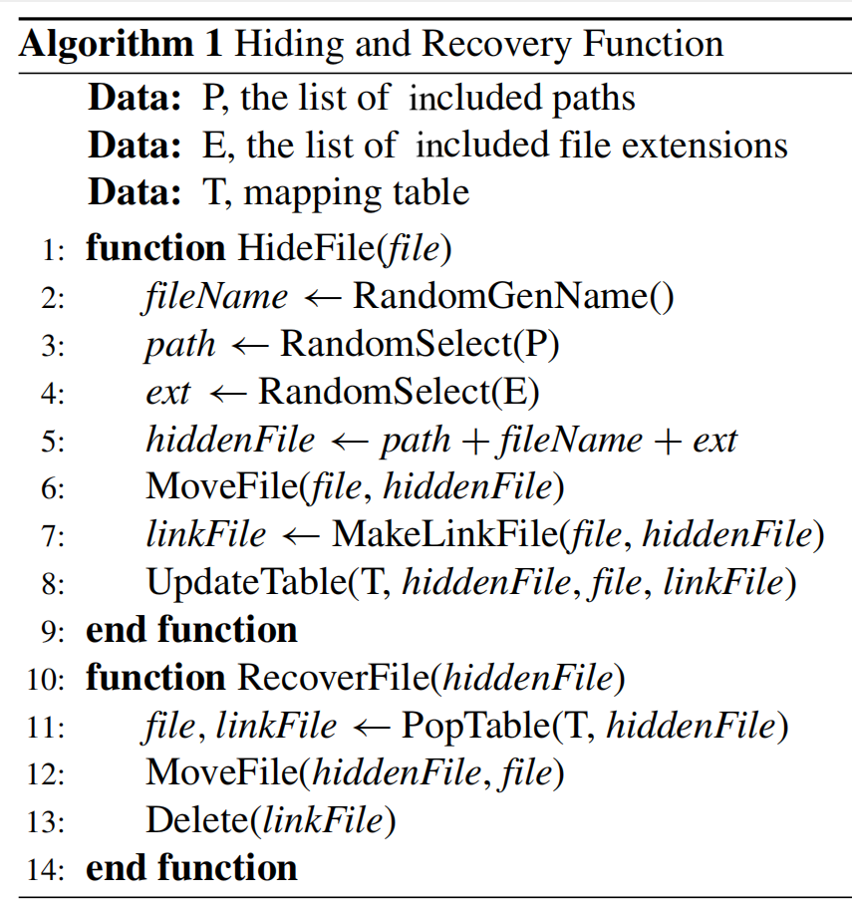
Algorithm

Slide 8
Project Overview
File Concealment: Hide User files in System directories.
Encrypted Database: Secures data for safe file tracking (Confidentiality)
Store Hashes of Filepaths (Integrity)
Linker Mechanism: Allows access to hidden files securely (Availability)
File Recovery: Recover the hidden files back.

Slide 9
Tools and Technologies Used
Target OS : Windows
Languages : Python, Powershell, Batch scripting
Python package manager : UV
Encryption : AES
Version Control : Git, GitHub
Virtualization : VirtualBox
Windows Installation builder software : InstallForge

Slide 10


ARCHITECTURE
Database Initialization Process
Input
Password
Sanitize Input &
Check password requirements
Initialization Code
Initialize
Encrypted Database
Password
AES Encryption
Hidden Paths & Extensions
Mapping Table
Hash Table
enc_database.dll
Database

Slide 11

User Layer
Hiding Process
Hidden Path
Hash(mar27q35.dll)
Hiding
Code
privacy.docx.lnk
Hide
mar27q35.dll
privacy.docx
privacy.docx
mar27q35.dll
privacy.docx
Hidden Path\
mar27q35.docx
mar27q35.dll
Hash(mar27q35.dll)
Hidden Paths & Extensions
Mapping Table
mar27q35.dll
--> privacy.docx
Hash Table
H(mar27q35.dll) --> mar27q35.dll
Encrypted Database

Slide 12

Linking Process
User Layer
Hidden Layer
Linker Code
[WINWORD.EXE]
Open
Hash(mar27q35.dll)
mar27q35.dll
privacy.docx.lnk
mar27q35.dll
mar27q35.dll
Hash(mar27q35.dll)
[type: docx]
Hidden Paths & Extensions
Mapping Table
mar27q35.dll
--> privacy.docx
Hash Table
H(mar27q35.dll) --> mar27q35.dll
Encrypted Database

Slide 13
User Layer
Recovery Process
Hidden Path
Recovery
Code
privacy.docx
Recover
mar27q35.dll
Hash(mar27q35.dll)
privacy.docx.lnk
mar27q35.dll
mar27q35.dll
Hash(mar27q35.dll)
privacy.docx
Hidden Paths & Extensions
Mapping Table
mar27q35.dll
--> privacy.docx
Hash Table
H(mar27q35.dll) --> mar27q35.dll
Encrypted Database

Slide 14

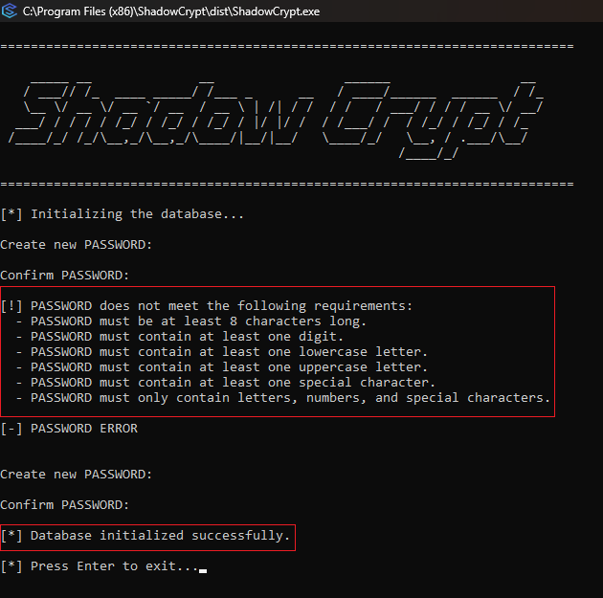
Project
Implementation
*Initializing
Database

Slide 15
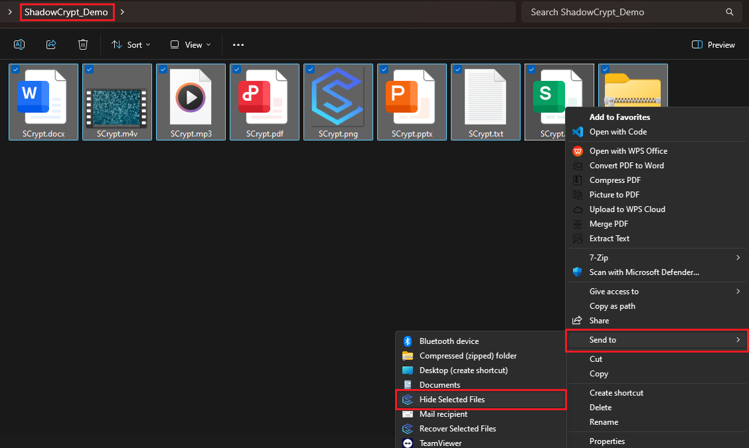
*Hide Multiple Files
‘RightClick’
> ‘Send to’
> ‘Hide Selected Files’

Slide 16
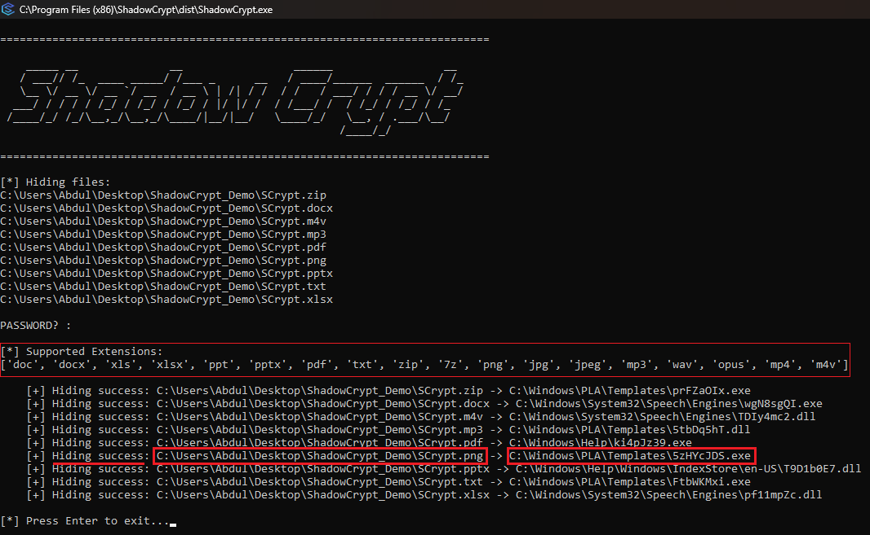
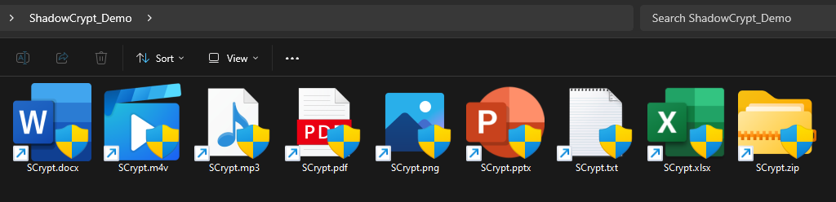
*Hiding
Files

Slide 17
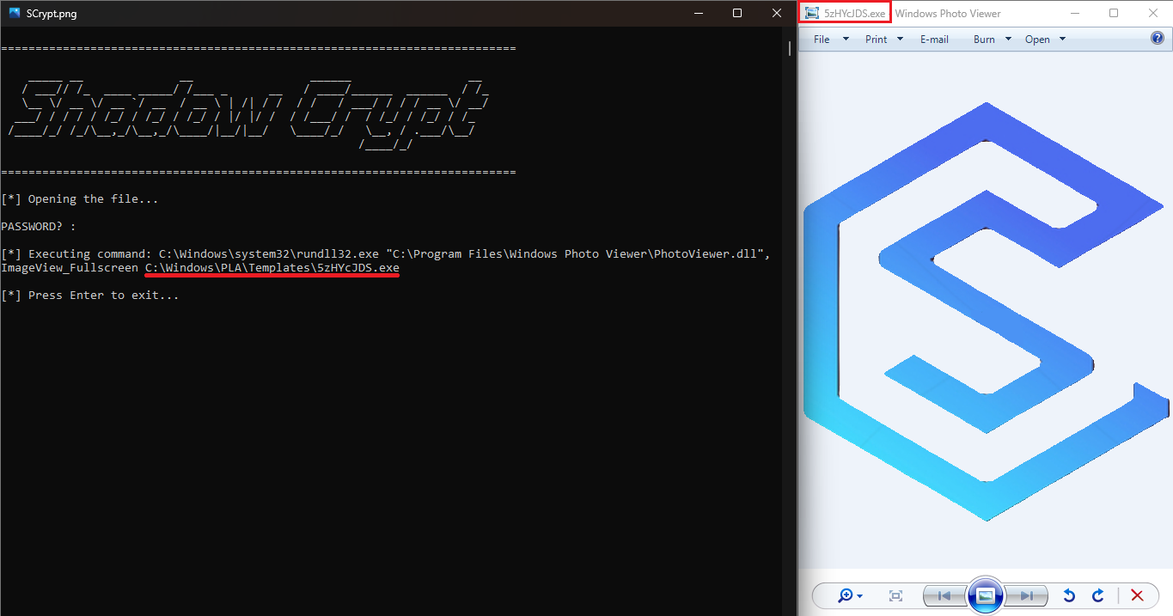
*Linking
File

Slide 18
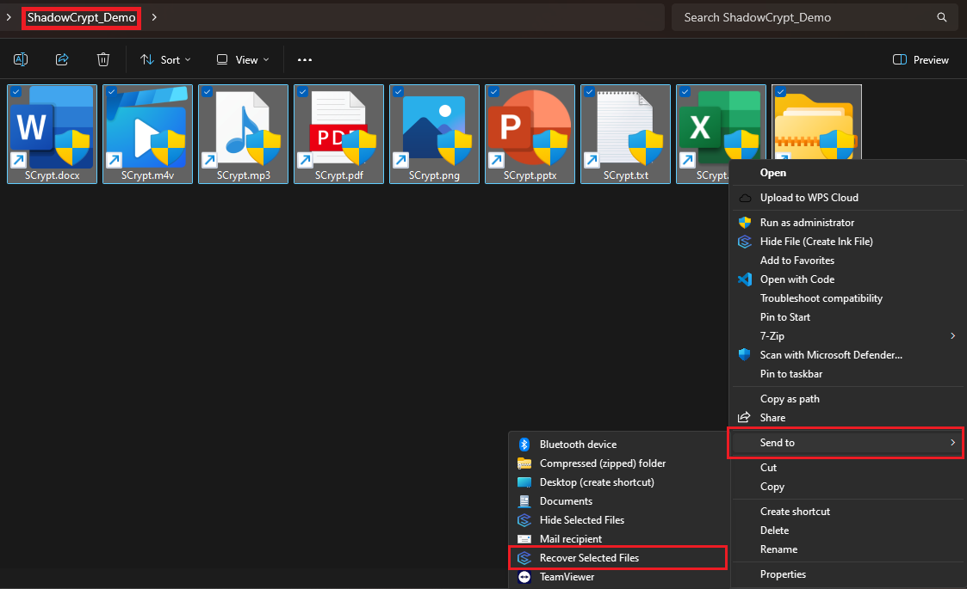
*Recover Multiple Files
‘RightClick’
> ‘Send to’
> ‘Recover Selected Files’

Slide 19
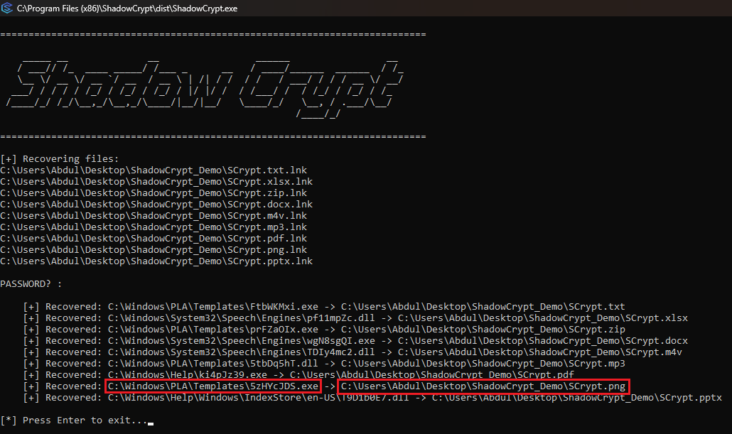
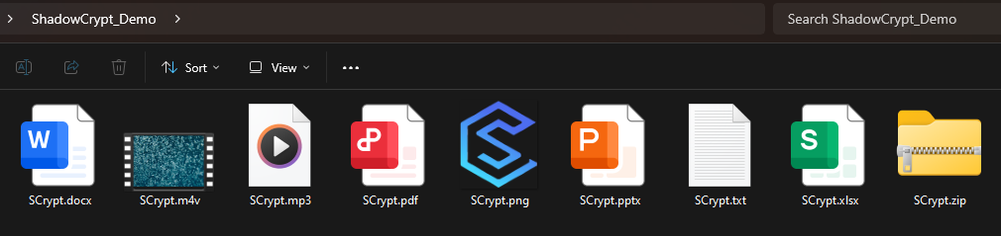
*Recovering
Files

Slide 20
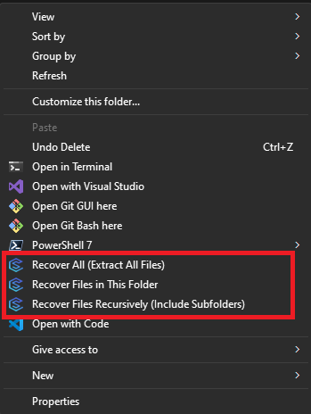
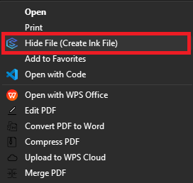
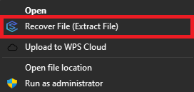
Other Features
*Recovery Features
*Single File Operations

Slide 21
FEATURES
Proactive Defense
Strong Password Policy
Secure File Hiding
Encrypted Mappings (Confidentiality)
Identify files without exposing their contents (by Hashing --> Integrity)
Access via Smart Shortcuts (Availability)
Ease of access:
Rightclick Menu options
Installation with `.exe`

Slide 22
REFERENCES
Research Paper
S. Lee, S. Lee, J. Park, K. Kim and K. Lee, "Hiding in the Crowd: Ransomware Protection by Adopting Camouflage and Hiding Strategy With the Link File,"
IEEE Access, vol. 11, pp. 92693-92704, 2023,
doi: 10.1109/ACCESS.2023.3309879

Slide 23
Thank You !

