Slide 1

16-bit Parallel Communication Link Between FPGAs
A Robust Asynchronous CDC Bridge
RAQEEB | SAKSHAM | AAKARSH | SOHAIL

Slide 2

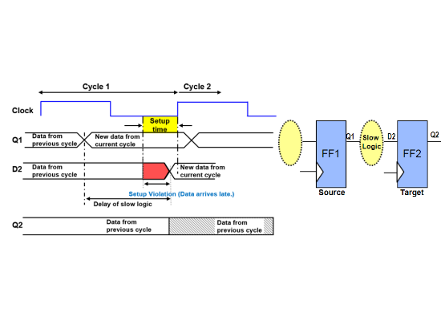
The Core Problem: Metastability
►
When data crosses asynchronous clock domains (like `clk_A` to `clk_B`), the receiving flip-flop can violate its setup/hold times.
►
This can cause the flop's output to enter a "metastable" state—an unknown voltage level that is neither 0 nor 1.
►
This state eventually resolves, but it takes an unknown amount of time, leading to unpredictable behavior, data corruption, and system failure.
►
Our project connects two FPGAs, each with its *own* clock. This is a classic Clock Domain Crossing (CDC) problem.

Slide 3


Project Goal & Our Solution
Project Goal
Our Solution
To design a **lossless** 16-bit parallel link that *guarantees* safe data transfer between two asynchronous clock domains.
A **4-Phase `VALID/READY` Handshake Protocol**.
This provides "backpressure." The Transmitter (master) *asks* to send data (`VALID`). The Receiver (slave) *agrees* when it's ready (`READY`). This is the core optimization for **reliability**.
The system must be robust, reliable, and prevent any data corruption from metastability.

Slide 4

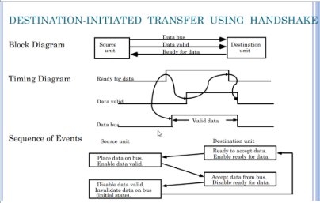
System Architecture
The system is split into two independent domains, isolated from each other:
►
Transmitter (TX) Domain
Operates on `clk_tx`. It contains a `FIFO` to buffer outgoing data and an FSM to manage the handshake.
►
Receiver (RX) Domain
Operates on `clk_rx`. It contains a `FIFO` to buffer incoming data and an FSM to acknowledge it.
The domains are only linked by the asynchronous data bus and the two 1-bit handshake signals.

Slide 5
The Building Blocks
(The Core Verilog Modules)

Slide 6

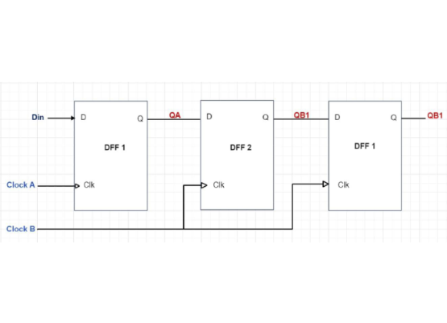
Module 1: The 2-FF Synchronizer (`cdc_sync`)
Purpose: The Stabilizer
To safely pass a 1-bit signal (`valid`, `ready`) from one clock domain to another.
►
**How it works:** A 2-Flip-Flop pipeline.
►
The 1st flop (`s1_sync_reg`) samples the async signal. It is allowed to go metastable.
►
The 2nd flop (`s2_sync_reg`) samples the 1st flop one cycle later. This gives the 1st flop time to resolve to a stable 0 or 1.
►
This makes the Mean Time Between Failure (MTBF) astronomically high.

Slide 7

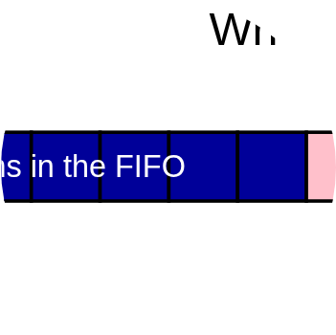
Module 2: The Synchronous FIFO (`FIFO`)
Purpose: The Buffer
Provides "elastic" buffering *within* each clock domain.
►
Transmitter FIFO: Allows the user to "burst" data in. The FSM then sends it safely, one-by-one.
►
Receiver FIFO: Stores the received data, allowing the user to read it out at their own pace.
►
Uses 5-bit pointers for reliable `full` and `empty` detection.

Slide 8





Module 3: `transmitter` FSM (The Master)
State: IDLE
State: WAIT_ACK
State: WAIT_READY_LOW
Waits for data to appear in its local FIFO (`!fifo_empty`). When data is present, it reads one word and moves to the next state.
Places the data on `parallel_data_out`. Asserts `parallel_valid_out` HIGH, signaling to the receiver. Waits for `ready_sync` to go HIGH.
The receiver has acknowledged. De-asserts `parallel_valid_out` LOW. Waits for `ready_sync` to go LOW to complete the handshake.

Slide 9



Module 4: `Receiver` FSM (The Slave)
State: IDLE
Action: Acknowledge
State: WAIT_VALID_LOW
Waits for `valid_sync` to go HIGH. Critically, it also checks if its own local FIFO is *not* full (`!fifo_full`).
If `valid_sync` is HIGH and it has space, it latches the data from `parallel_data_in` and asserts `parallel_ready_out` HIGH.
Waits for `valid_sync` to go LOW. This confirms the transmitter saw the acknowledgment. It then writes the latched data to its FIFO and de-asserts `ready`.

Slide 10

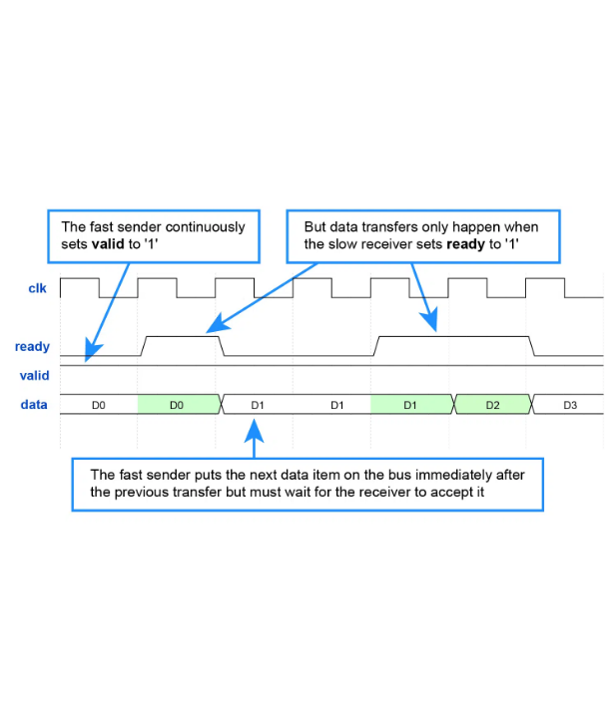
The 4-Phase Handshake in Action
This timing diagram shows the complete, lossless transfer of one word.
►
1. TX Asserts VALID: Transmitter puts data on the bus and raises `valid`.
►
2. RX Asserts READY: Receiver sees `valid`, latches the data, and raises `ready`.
►
3. TX De-asserts VALID: Transmitter sees `ready`, knows the data was taken, and drops `valid`.
►
4. RX De-asserts READY: Receiver sees `valid` is low, drops `ready`, and writes to its FIFO.
The cycle is now complete and ready for the next transfer.

Slide 11
Analysis: The Core Trade-Off
Pro: Reliability (Lossless)
Con: Latency (Slow)
Our design is **robust and guaranteed lossless**. The `READY` signal provides essential "backpressure."
The 4-phase handshake is **slow on a per-word basis**. We must pay a multi-cycle latency penalty for the *entire round-trip* acknowledgment.
Data is *never* lost if the receiver is busy or its FIFO is full. This is the correct, safe, professional solution for critical data.
This includes propagation delay and 2-3 cycles of synchronization on *both* sides of the bridge.

Slide 12
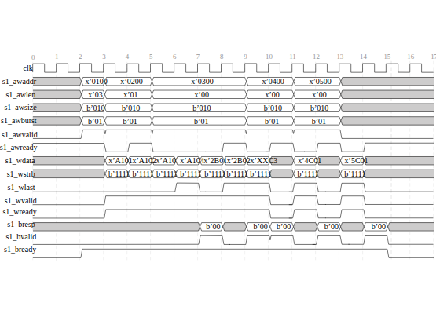
Future Optimization: Burst Transfers
How to Increase Throughput?
Modify the protocol to be burst-oriented, similar to AXI-Stream.
►
`VALID` stays HIGH for an entire *burst* of data (e.g., 64 words).
►
`READY` stays HIGH as long as the Receiver's FIFO has space.
►
Data is transferred on **every single clock cycle** as long as both signals are HIGH.
Result: We pay the latency penalty **once per burst**, not once per word, dramatically increasing the data rate.

Slide 13
Conclusion
We successfully designed a **robust, lossless** 16-bit CDC bridge.
Solved the critical problem of metastability using **2-FF synchronizers**.
Guaranteed data integrity with a **4-phase `VALID/READY` handshake**.
Identified a clear path to high-throughput via **burst transfers**.

Slide 14
Thank You
RAQEEB | SAKSHAM | AAKARSH | SOHAIL

