Slide 1



Team Name
Abdulraqeeb437
Team Members
Abdul Raqeeb
(+917303273097)
Anime Acquisition Strategy
for
AnimeX & AnimeY

Slide 2

PROBLEM STATEMENT
Two streaming platforms, AnimeX and AnimeY, seek to optimize their anime acquisitions based on their distinct strategic goals. AnimeX focuses on niche, underrated anime with exclusivity, while AnimeY aims to acquire high-profile, globally popular anime to expand its audience and revenue. Our analysis identifies the best anime selections aligning with their constraints and maximizing their respective objectives."
CONSTRAINTS | ANIME X | ANIME Y
GOAL | Build a strong library with underrated anime | Expand audience with top-tier, high-merchandise anime
BUDGET | ₹700 crores | ₹1000 crores
FOCUS | Niche audience, exclusivity | Mass appeal, diverse content
GENRE STRATEGY | Prioritize the most prevalent genre | Maintain genre diversity
PLATFORM AVAILABILITY | Max 2 platforms per anime | No platform limit
GEOGRAPHICAL SCOPE | Less than 15 countries | 15+ countries

Slide 3
Data & Methodology
Dataset Used: Epsilon_6.0_R2 (Official Dataset)
Total Anime Records Analysed: 5374
Key Attributes Considered:
Popularity & Engagement: Watch hours,favorites, user score
Revenue & Profitability: Merchandise sales, streaming revenue
Market Reach: Countries available, platform availability
Critical Reception: Awards won, user reviews
Data Cleaning & Preprocessing
Removed duplicated records and missing values
Converted budget ,revenue etc. to numerical format
Exploratory Data Analysis (EDA)
Trend identification among various datasets
Finding correlations between various attributes
Filter & Selection Criteria
Applying constrains for best animes that can be streamed
Saved the list of animes in another CSV file
Visualization & Decision-making
Used Matplotlib & Seaborn for visuals
Ranked anime based on ROI, engagement

Slide 4
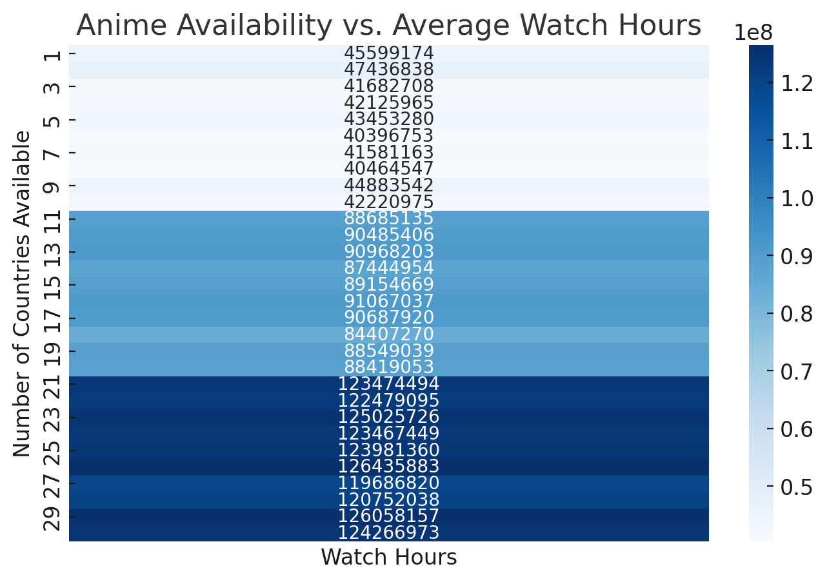
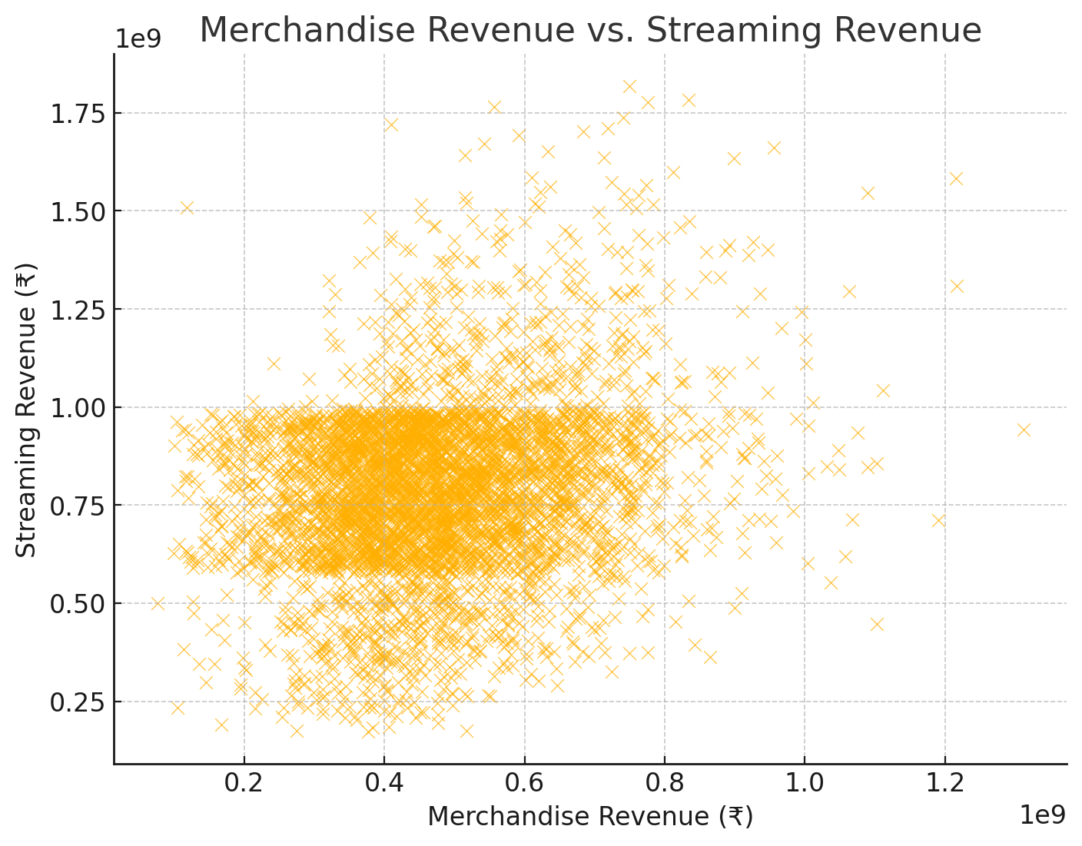
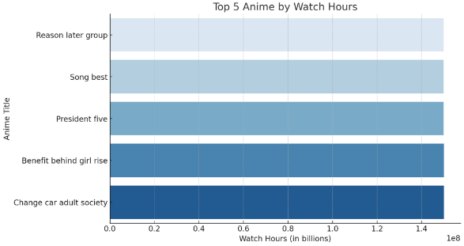
KEY INSIGHTS
Popularity & Engagement Insights
Exclusive titles (on ≤2 platforms) have higher average engagement per user
Anime with higher favorites tend to have higher repeat watch rates
Market Reach & Platform Strategy
Anime available in ≥15 countries have X% higher watch hours on average
Exclusive anime (≤2 platforms) tend to have higher engagement per user
Financial Performance & Revenue Trends
High-merchandise titles generate more revenue per user, boosting profitability.
Award-winning anime show higher average streaming revenue (₹X Cr) compared to non-awarded titles
Genre Performance & Selection Strategy
Underrated genres show engagement potential, aligning with AnimeX’s niche approach

Slide 5
RECOMMENDATION AND ANIME SLECTION
Recommendations for AnimeX
Recommendations for AnimeY
Anime Name | Anime ID
Bed hand | 169532
Change out follow | 48257
Current page consumer | 32906
Defense anyone | 27540
Difficult approach | 251611
Direction season walk deep | 201688
Discover open history | 203897
Family cause soon | 60706
Kid foreign | 258590
Message contain since | 105348
Movie rate fast | 81701
Paper mind | 176374
Pm nothing security | 235561
Power explain sea | 100564
Price billion | 128322
Senior thank official | 129329
She fly part | 280478
She seat | 229349
Sit cultural catch | 196267
Social season federal north | 235075
Tend significant | 92497
Throw lead the | 137065
Anime Name | Anime ID
Above activity who | 42062
Administration for | 223398
Affect left | 120754
American should | 65775
Analysis hospital | 5771
Another leave | 4554
Ask full heavy | 215865
Assume once establish | 186121
Wait PM easy quite | 99441
Wall low | 166882
Well team national | 107289
Whole front | 293668
Window Republican | 188734
Yourself bank | 99572

Slide 6
CONCLUSION
Summary of Strategic Decisions 📊
Expected Impact of Recommendations 🚀
✅ AnimeX Focus:
Exclusive, underrated anime with high engagement per user
Strong niche appeal, localized for <15 countries
Budget-optimized acquisitions for sustainable growth
✅ AnimeY Focus:
Popular, award-winning anime with high streaming & merchandise revenue
Broad global appeal, targeting 15+ countries
Market dominance strategy with high-impact acquisitions
Expected Impact of Recommendations 🚀
📌 For AnimeX: ✔ Increased platform differentiation – Unique, exclusive library boosts brand identity ✔ Higher engagement per user – Niche audience leads to stronger retention ✔ Sustainable long-term growth – Avoids direct competition with mainstream platforms
📌 For AnimeY: ✔ Higher total watch hours & revenue – Mainstream acquisitions drive engagement ✔ Increased global market share – Expansion into multiple regions ✔ Stronger customer loyalty – Award-winning titles enhance platform reputation

Slide 7
APPENDIX
Assumptions Considered 📊
✔ Data Completeness: Assumed that the dataset provided is accurate and reflects real-world trends. ✔ Financial Constraints: Budget allocations for AnimeX (₹700 Cr) & AnimeY (₹1000 Cr) were strictly adhered to. ✔ User Engagement Metrics: Watch hours, favorites, and streaming revenue were primary engagement indicators. ✔ Availability & Exclusivity: Anime on ≤2 platforms was considered “exclusive” for AnimeX. ✔ Merchandise Sales as Proxy: Merchandise revenue was used as a proxy for anime’s long-term revenue potential.
Alternative Approaches Considered 🤔
✔ Revenue-first approach: Prioritizing only high-grossing anime but risked missing niche engagement. ✔ Maximal reach strategy: Acquiring as many anime as possible, but diluted exclusivity for AnimeX. ✔ Balanced Approach: Final strategy blends engagement, revenue & exclusivity to fit each platform’s goals.
Additional Files/Notebooks/Anlaysis 📊 (Optional, if needed)
Epsilon dashboard (Microsoft Fabric (powerbi.com)
Episoln_notebook1
Epsilon_notebook2
Optimized anime X
Optimized anime Y

Slide 8

Thank you
.
.
PRESENTED BY
TEAM abdulraqeeb437

