Slide 1
Group 03
Acrylic Painting Problem

Slide 2
Team Members
Name: Md. Romjan Ali
Id:2022-3-60-247
Name: Shakhaoat Hossain
Id:2022-3-60-259
Name: Raqibul Hasan
Id:2022-3-60-261
Name: Jobeir Ahamed Dip
Id:2022-3-60-307
Name: Md Moon Rhaman Nayem
Id:2022-3-60-210

Slide 3
Introduction
Main Stages:
1. Preparation stage - Where everything is made ready
2. Painting Stage – Where artists paint step by step
3. Finishing Stage – Where final work is done
Important system programming tools:
i) Threads to run each artist
ii) Semaphores and mutex to control timing
iii) Shared memory to save the progress
iv) Fork to create processes for each stage

Slide 4
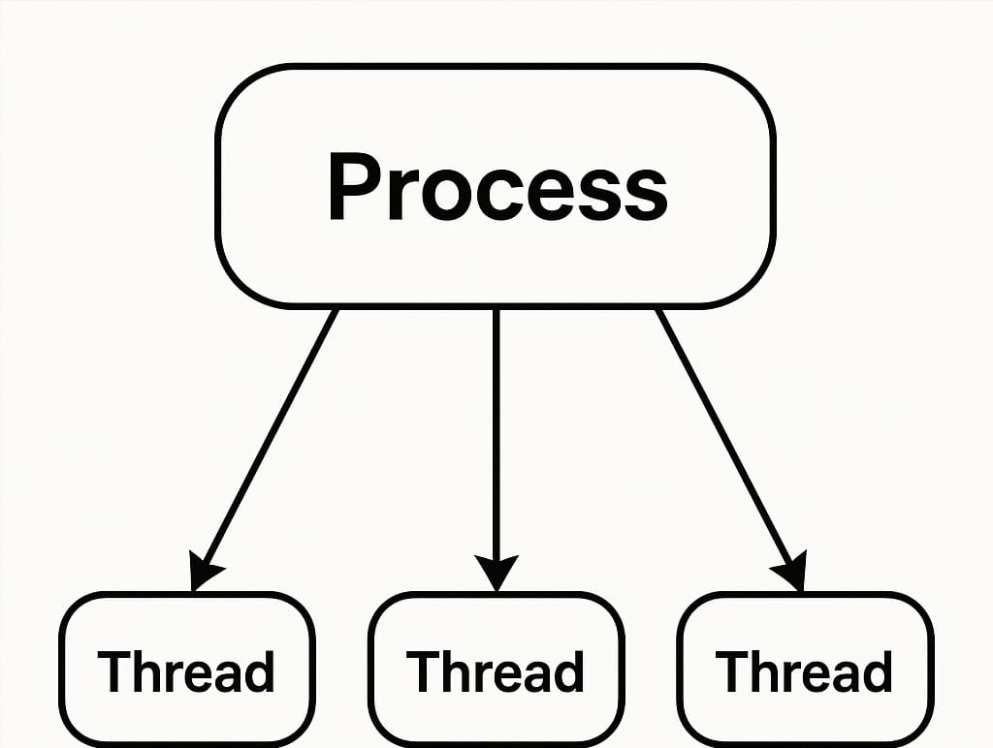
Core Concept of this project
1) Multithreading :

Slide 5
2) Shared Memory :
A way for separate processes to share a section of memory
3) Synchronization with Semaphore :
A counter-based locking mechanism used to control sequence amon threads.
4) Mutual Exclusion with Pthread_mutex:
A mutex lock is used to ensure only one thread accesses shared resources at a time .

Slide 6
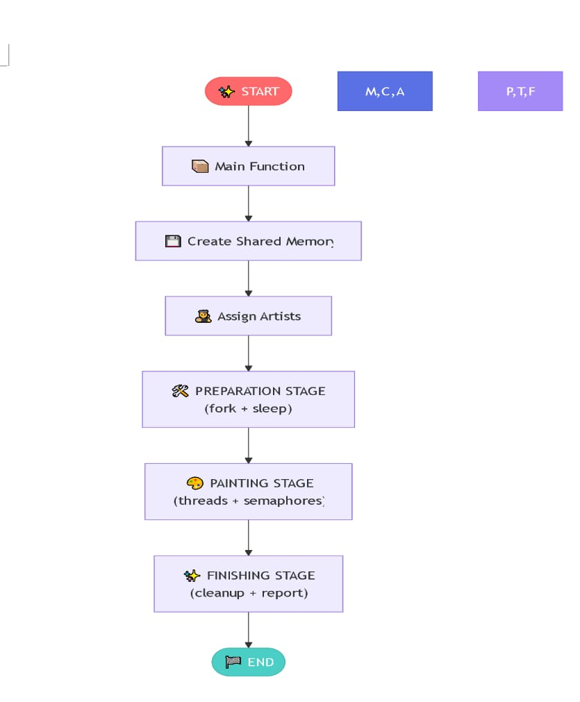
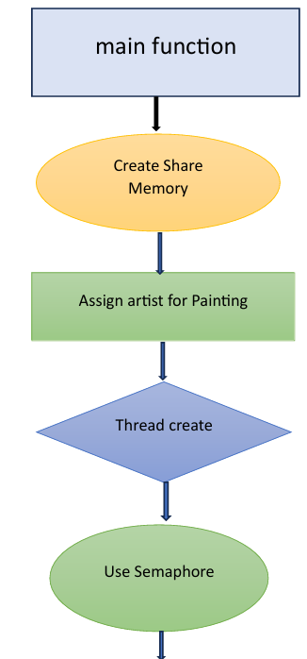
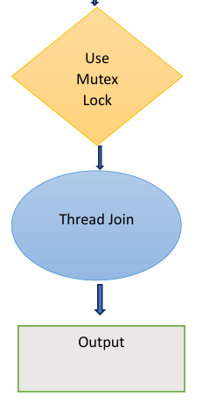
The Diagram of project representation

Slide 7
Where We Can Use This Project
1. In online drawing apps where many people work together.
2. In factories where parts are made one by one.
3. In software development where steps must run in order.
4. In science labs where tests are done step-by-step.
5. In universities to teach students how threads work together.

Slide 8
Limitations of This Project
1. Tasks must follow a fixed order.
2. Not good for big projects with many workers.
3. Only uses a simple number to show progress.
4. Waiting time is not real – just using sleep.
5. No way to go back or fix a part after it is done.

Slide 9
Future Work
Dynamic Number of Artists (User Input)
Custom Painting and Drying Time Per Artist
Robust Error Handling for System Call
Logging Process to a File
Graphical or Real Time Process Visualization

Slide 10
Conclusion
The project showcased effective process and thread synchronization in C. It ensured safe coordination using semaphores, mutexes, and shared memory.

Slide 11

Thank You

