Slide 1
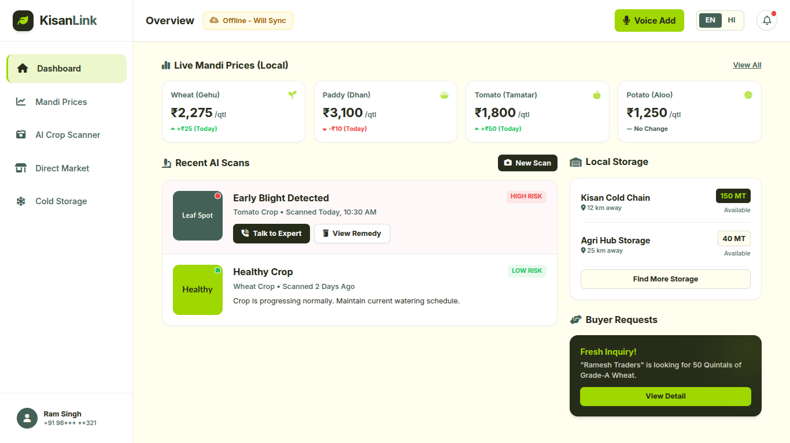
KisanLink
FARMER-FIRST AGRITECH PLATFORM
Works offline.
No typing.
No passwords.
A farmer-owned platform for fair trading and crop management.
Dashboard wireframe
TEAM
Raqin Al-Asraar
Ali Abbas Haidar | Sourabh Jala

Slide 2
Where farmers lose money and crops
THE PROBLEM
ROOT CAUSE
01
Price exploitation
No real-time mandi prices, so farmers depend on middlemen.
02
Post-harvest spoilage
Not enough cold storage or processing capacity nearby.
03
Delayed disease detection
Limited access to local agronomists and timely advice.

Slide 3
One platform, three answers
PRICE EXPLOITATION
POST-HARVEST SPOILAGE
DELAYED DISEASE DETECTION
Know the price
Find a place to store it
Catch disease early
Direct buyer-seller listings, plus a live mandi price dashboard.
Local storage space discovery and rental listings.
Instant AI vision diagnosis with one-tap expert escalation.
CORE USP
A farmer-owned platform that works offline without signal, typing or passwords, creating records signed at creation for fair trading and crop management.

Slide 4
How a farmer moves through the website
1
2
3
4
5
Sign in
Dashboard
AI Crop Scanner
Market & Storage
Expert help
Phone number and OTP. No password to remember.
Live prices, recent scans, storage and buyer requests on one screen.
Upload a photo or use Voice Add. Get the disease, severity and action steps.
List crops for buyers on Direct Market, or find a cold room on Cold Storage.
High-risk result? One tap to Talk to Local Expert.
AT EVERY STEP
Works offline: actions save locally and sync automatically when the network returns.

Slide 5
The dashboard at a glance
1
1
Top bar
Offline status, Voice Add and an EN / HI toggle.
2
2
Live mandi prices
Large rates with daily ▲ / ▼ change.
3
4
3
Recent AI scans
Color-coded risk with a Talk to Expert button.
4
Storage & buyers
Nearby cold storage and buyer inquiries.

Slide 6
What farmers get
A | CORE
B
Market & Direct Trading
AI Crop Disease Diagnosis
Visual scan: one-tap photo with automatic compression.
Instant diagnosis: disease name, severity and 2–3 action steps in plain language.
Price Dashboard
Daily local mandi rates with ▲ / ▼ change indicators, from public APIs such as data.gov.in or sample sets.
Low
Medium
High
High severity unlocks “Talk to Local Expert”.
Direct Selling
Farmers list crop, quantity and asking price using visual dropdowns.
C
Buyer Connect
Buyers view local listings and tap to contact farmers directly.
Post-Harvest Storage Sharing
Storage owners list available cold or dry room capacity for temporary rental.

Slide 7
Built for how farmers actually work
LOW-LITERACY BY DESIGN
NO SIGNAL
Saved Offline – Will Sync when back in network
Voice-first Magic Add
Speak in regional dialects or Hinglish. AI turns it into a structured listing.
Photos, audio logs and listings save instantly on the device.
Zero passwords
Sign in with a phone number and OTP.
Icons over text
Minimal typing and visual dropdowns.
BACK IN NETWORK
Big numbers, clear trends
Large prices with ▲ / ▼ arrows.
Diagnosed & Synced
The site detects connectivity and syncs queued data in the background.
Hear it, switch it
Text-to-speech and a Hindi / English toggle.

Slide 8
Records you can verify
STEP 1
STEP 2
STEP 3
Saved on the device
Signed at creation
Verified on sync
Works with no signal. Offline-first caching (Service Worker + IndexedDB) keeps everything on the device until it syncs.
Every action and claim is signed in the browser (Web Crypto API) and verified by the Flask server, so tampering is detectable.
When the network returns, the Flask server checks each signature and the app shows a Verified badge.
WHY IT MATTERS
Signed records make tampering detectable, which keeps trading and crop history fair.
Prototype scope: the live demo runs offline-first on React + Flask + SQLite, with a mock OTP login.

Slide 9
Tech stack
Frontend
React
Backend
Flask
Database
SQLite
Voice
Web Speech API
AI vision
Gemini Vision
Offline
Service Worker
IndexedDB
localStorage
Data
data.gov.in
Trust
Web Crypto API

