Slide 1
Network Automation Final project presentation
Name of the project: Monitoring
Team: Spanish Team
Presenters: Raquel Vila, Jorge Olivera
E-mails: raquel.vila@mail.polimi.it ,jorgeluis.olivera@mail.polimi.it
Academic Year: 2022/2023

Slide 2
Agenda
Introduction
Project objectives
Implementation
Flow charts of the project with and without the testbed (if they differ)
Experiments
Description of the experiments (included the testbed setup)
Results and demo
Description of the results.
Lessons learned
Problems solved, configurations.

Slide 3
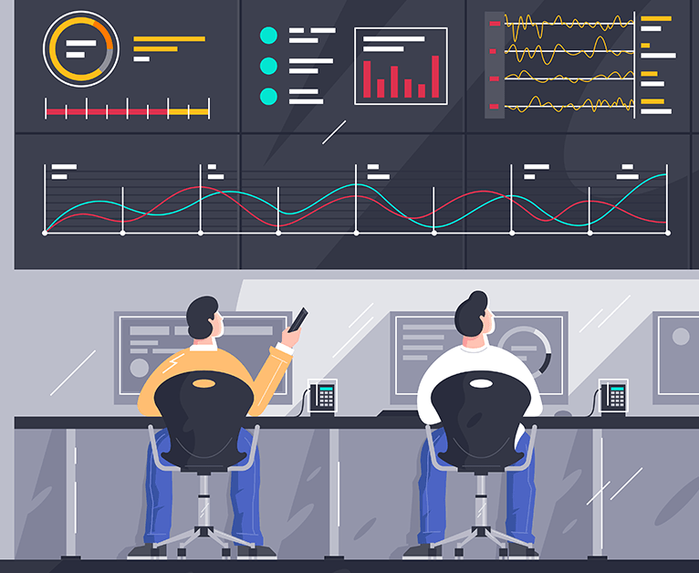
Introduction
The main objective of this work is to monitor a network, in order to obtain flow statistics of the different switches that form the topology.
The specific objectives for this project are:
Design a multipath network where there are different paths from one switch to another.
Implement a monitoring algorithm to collect periodic information on the switch flow statistics.
Test them with traffic generation tools such as Iperf.
Display these data obtained in different graphs that show the behavior of the network.
Finally, the BONSAI SDN testbed will be implemented.

Slide 4

Implementation
This code implements a basic Ryu controller application that monitors and collects flow and port statistics from switches in an SDN network.
It also generates graphs to visualize the collected statistics.
RYU Controller
Class SimpleSwitch13
Libraries and Tools
The monitoring algorithm is implemented using the Ryu controller.
Responsible for communicating with the switches, sending statistics requests, and receiving responses.
The main libraries that we have used are for example:
This class is one of the predefined components of Ryu. It implements the switching logic so that the switches can dynamically forward packets. The controller will dynamically install the necessary rules through Openflow messages to provide this functionality. We extended the functionalities of this simple class to include loop prevention, monitoring and statistical graph creation.
Pandas: Provides data structures and functions for data analysis and data manipulation in Python.
Matplotlib: Python data visualization library that allows you to create high quality graphs, plots and figures.
Hub (from ryu.lib) : allows to parallelize workflows within the Ryu controller
Stplib (from ryu.lib): provides the components to implement the STP algorithm for loop prevention.

Slide 5
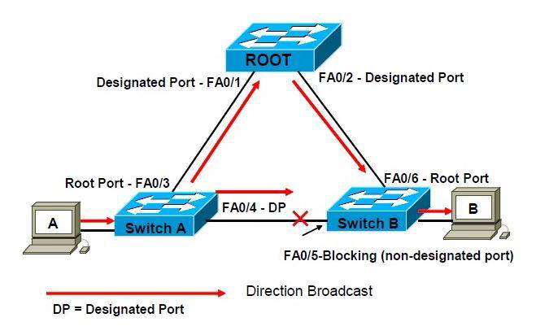
Execution flow
STP configuration: Spanning Tree Protocol (STP) is used to configure the switches to avoid loops in the network,
stplib.Stp library is used to perform the configuration.
Switch Monitoring: Uses a separate thread to periodically monitor the switches in the network. After waiting for some time for the STP configuration to complete, statistics requests are sent to the switches and data is collected on packets received and transmitted on each port.
STP algorithm behaviour
Graph Generation: : The collected data is used to generate graphs showing the evolution of packets over time and the number of packets received and transmitted on each port.

Slide 6
OBJECTIVE 1: DESIGNING A MULTIPATH NETWORK

Slide 7
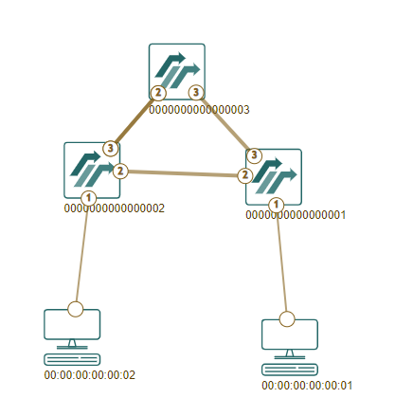
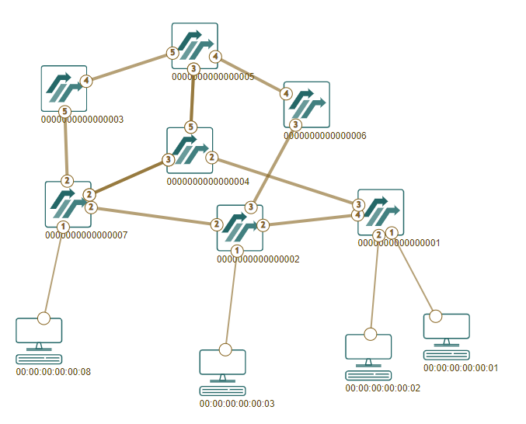
Multipath Network
Different topologies to perform the monitoring tests.
Ring topology to visualize several paths through the same switch.
More complex topology to verify the performance.

Slide 8
OBJECTIVE 2: MONITORING ALGORITHM

Slide 9
Monitoring process
In order to perform the monitoring, the controller requests two types of statistics:
Flow Statistics: information about the different flows being processed by the Openflow switch.
Port Statistics: information about the traffic and behavior of a certain port of the Openflow switch.
These statistics are retrieved every 10 seconds thanks to specific Openflow messages sent by the controller. The monitoring hub is responsible of requesting said statistics in a parallel process.
The responses are then processed through specific methods, in which the controller will build the corresponding Panda data frames. These data will be saved to different csv files:
flowStatsX: flow statistics of switch X.
portStatsX: port statistics of switch X.
timeStatsX: accumulated port statistics of switch X, with an additional time field to provide the evolution of certain fields over time.

Slide 10
OBJECTIVE 3: TESTS WITH TRAFFIC GENERATION TOOLS

Slide 11
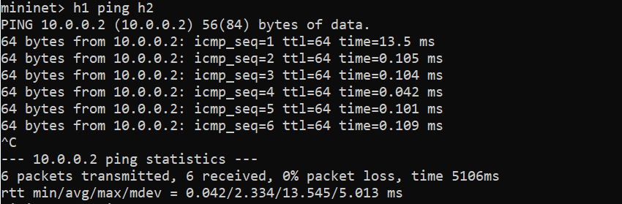
Experiments
The different experiments and tests we have done have been with the ping tool sending traffic from one host to another to monitor the traffic and with the Iperf tool.
PING EXPERIMENT:

Slide 12
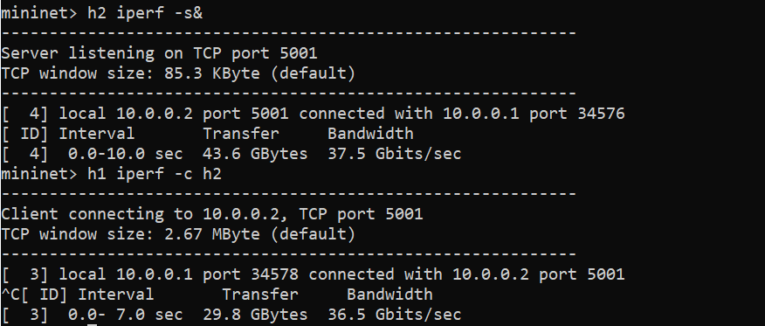
Experiments
The different experiments and tests we have done have been with the ping tool sending traffic from one host to another to monitor the traffic and with the Iperf tool.
IPERF EXPERIMENT:

Slide 13
OBJECTIVE 4: DISPLAY DATA IN GRAPHS

Slide 14
Resulting graphs
After retrieving the necessary statistics for the switches and creating the csv files, the controller will produce the following graphs:
Port_rx_pktsX
Port_tx_pktsX
Switch_X
These graphs are produced by plotting with matplotlib the information collected in the csv files.
The results of the monitoring algorithm can be very helpful for network administrators to better understand and solve issues within the network.

Slide 15
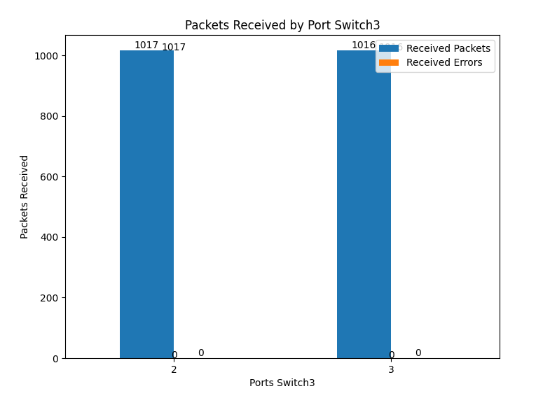
Port_rx_pktsX
Shows the packets received until that moment by each port of switch X using a bar graph.

Slide 16
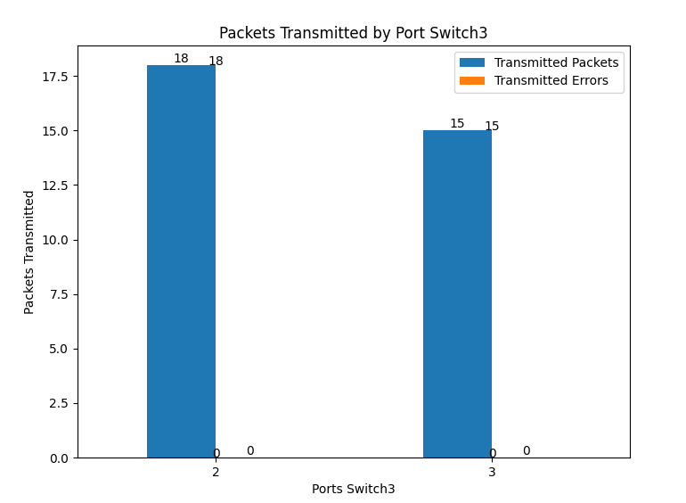
Port_tx_pktsX
Shows the packets transmitted until that moment by each port of switch X using a bar graph.

Slide 17
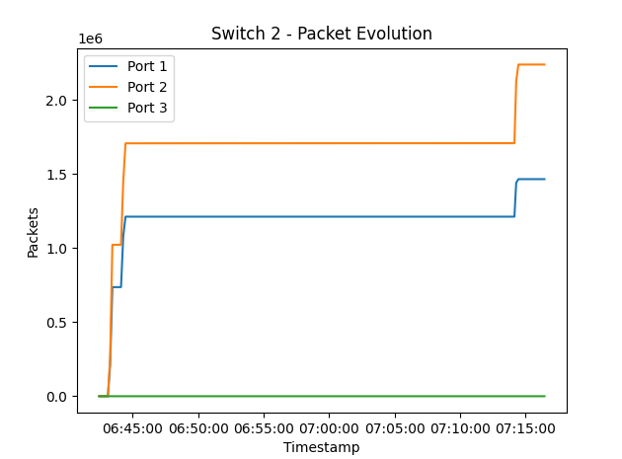
SwitchX:
Shows the evolution of the received packets over time by each port of switch X.

Slide 18
OBJECTIVE 5: IMPLEMENT IN BONSAI SDN TESTBED

Slide 19
Conclusions: Lessons learned
One of the problems we faced when developing this program was finding a way to cope with the routing loops that were appearing in our network. We found out that some packets were not reaching the hosts correctly, so we implemented the STP algorithm to prevent this issues. We also discovered that we needed to stablish a waiting time before starting the monitoring process so that the STP algorithm had converged.
We noticed this issue with the routing loops among others when launching our application in the Bonsai SDN testbed, so we had to perform some modifications to our code.

Slide 20
THANK YOU

