Slide 1

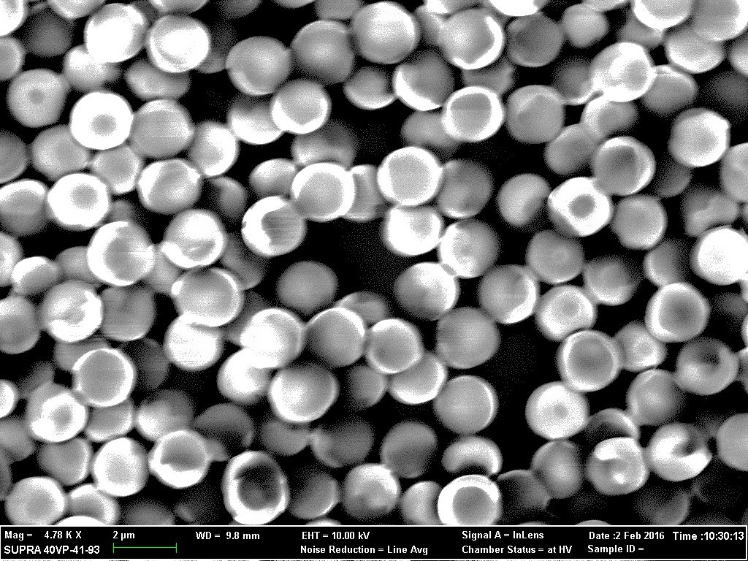
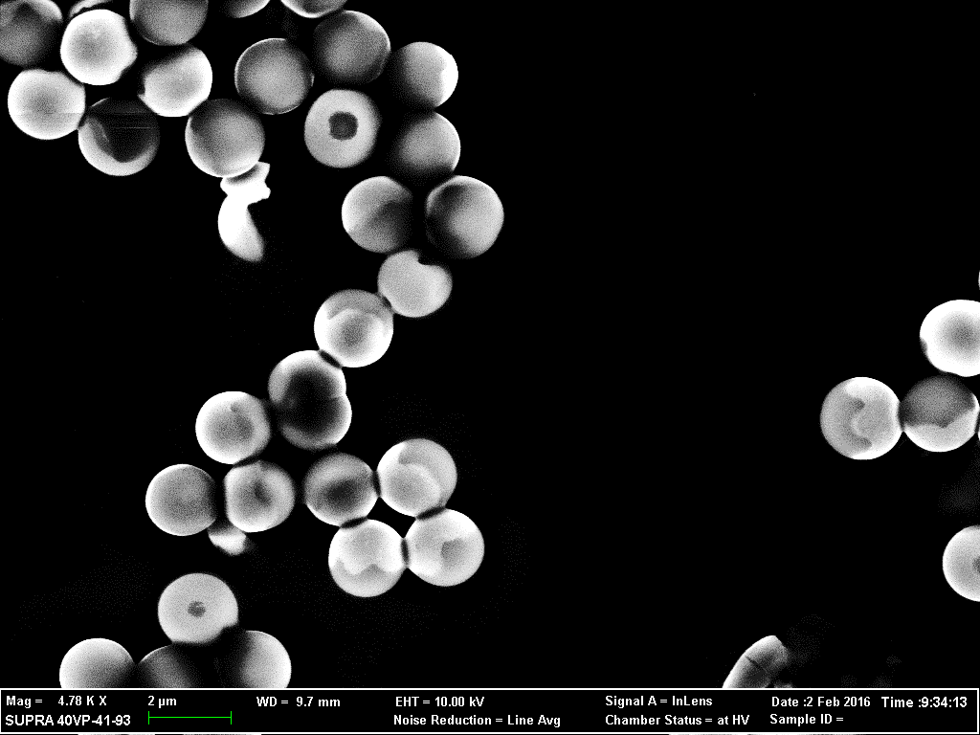
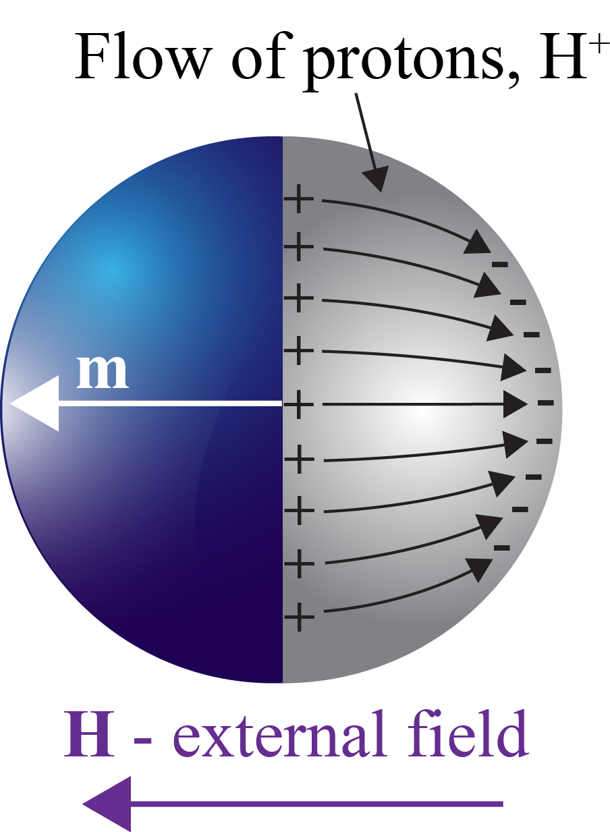
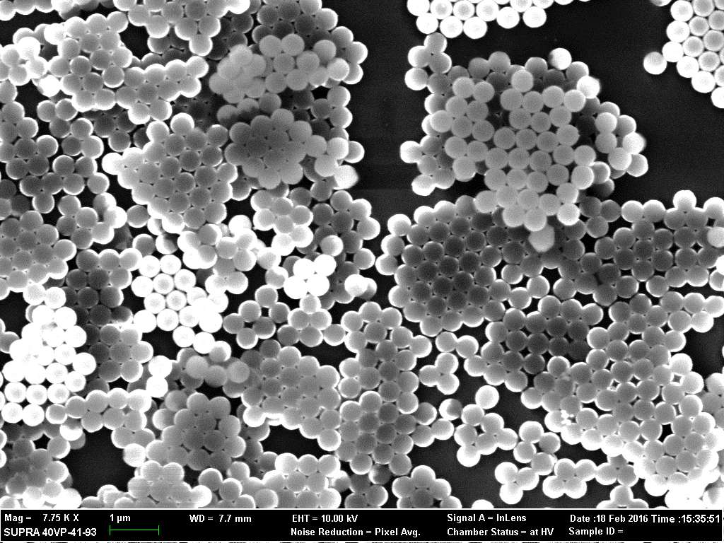
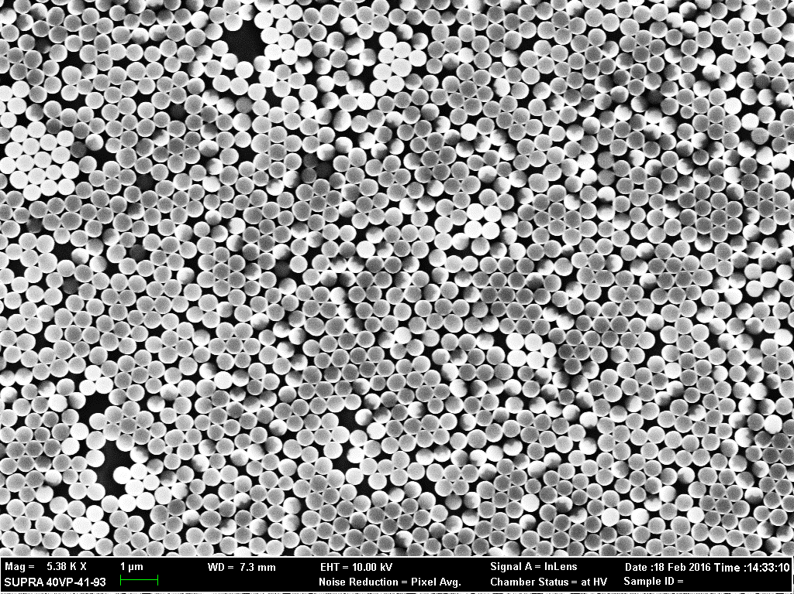
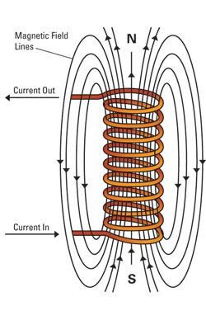
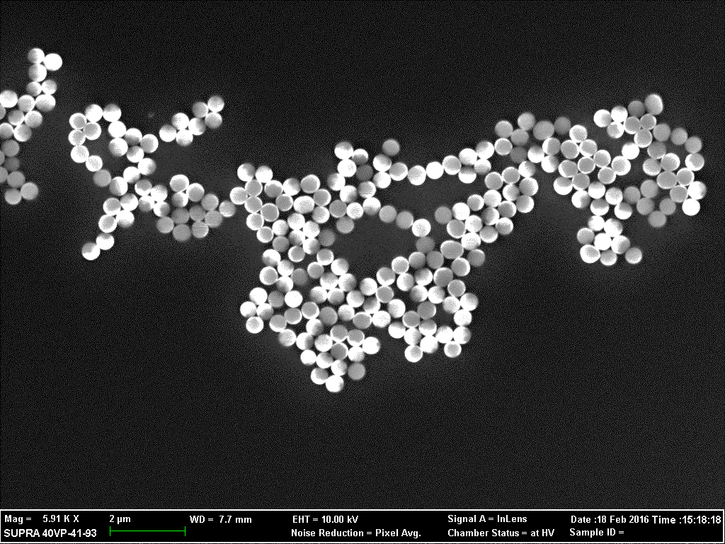
The Fabrication of Propelling Magnetic Nanomotors
Program: HURA Author: Ra’Shae Esplin Mentor: Dr. John Gibbs
Department of Physics/Astronomy, Northern Arizona University
Abstract
The overall goal of this project is to understand how small moving particles interact with each other on the microscopic scale. In particular, this project involves the motion of Janus particles (spherical silicon dioxide beads with a metal coating) in a liquid solution. The purpose is to observe the motional behavior of these particles using several experimental procedures; concentrated hydrogen peroxide, H₂O₂, is used as a chemical fuel due to the presence of a catalyst on the particle. The particles are then subjected to a controlled magnetic field that causes the particles to move in the same direction with respect to the magnetic field. The speed of the particles is a function of the magnetic field strength. This experimental observation holds clues to the underlying mechanism involved in motion at this scale and will help us understand why they self-assemble. The Janus particles were also subjected in a scanning electron microscope (SEM) to observe aggregation patterns.
Experiment 1: Procedure
Putting Janus spheres inside water with 30% concentrated hydrogen peroxide-While the reaction occurred the particles were exposed to a magnetic field and then their motion was recorded through an AmScope camera. Video data was collected for electromagnetic currents (1 amp to 6 amps) and then the velocity was measured and averaged.
Hypothesis:
The particles were expected to change speed due to the interaction of the magnetic field and the bi-produces of the chemical reaction.
SEM IMAGES
Experiment 2:
SEM: Scanning Electron Microscope; provided by the NAU Imaging and Histology Core Facility.
(1) Image of magnetic material (Ni) in water and with H₂O₂ (hydrogen peroxide).
(2) Image of magnetized particle aggregation after being exposed to a 0.5 T magnet before being dried.
(3) Non-magnetic (Pt) particle aggregation in water and with H₂O₂.
Lorentz Force Law
The above equation defines the force that is being applied to the charged fluid layer on the particles, where θ is the angle between the field and the particle’s motion direction.
(a) Silicon dioxide and nickel; showing deformation.
(b) Silicon dioxide with nickel and H₂O₂.
H is the external field that is being applied to the system. The flow of protons will naturally respond the this force.
Experiment 2: Results
Images were taken to show the particles’ aggregation behavior. Some looked to be deformed in (a) and (b), which may have been due to them sitting too long in pure water. To fix this, the samples had to be prepared on the day of imaging.
In images (f) and (b), the separation of the particles can clearly be seen. There is a metal cap (the lighter area), usually Ni, that encompasses half of the glass bead SiO₂ (darker area).
Images (c) and (d) show the particles aggregated, but this could be due from the manufacturing process.
(c) Magnetized magnetic material (Ni) with H₂O₂
(d) Non-magnetic material (platinum) with H₂O₂.
Experiment 1: Results
From the velocities calculated from the collected videos it at first looked like the particles were speeding up, but with more data collected they were in fact slowing down. The hypothesis was correct in this regard, even though there were discrepancies (wide range of velocities that could have altered the final calculated average velocity).
Conclusions:
The reason why these particles are slowing down could be from the Lorentz force acting on the charged fluid layer moving over the surface of the particles.
An example of what the magnetic fields look like when current is running through the coils.
SiO₂
Ni
(e) Non-magnetic material (platinum).
(f) The separate parts of the particles can be resolved here Ni & SiO₂ .
Current (amps) | Average Velocities (m/s)
1 amps | 4.53
2 amps | 5.11
3 amps | 7.95
4 amps | 8.47
5 amps | 6.79
6 amps | 6.35
Table 1:
At first the velocities looked to be slowing down then there was a “jump”. This discrepancy may be due to the particles being too close to the bubbles, which can speed them up. After that though, the particles were slowing down again.
Discussion:
Magnetic fields cannot change a charge’s speed (either slowing down or speeding up), it can only change its direction. At first it appeared that the magnetic force did have an effect on the speed when the current increased, but it could be just the Lorentz Force Law being in effect. The magnetic force can, however, change the speed of the particle as the charged fluid flow moving over the surface changes direction, causing the propulsion speed of the particle to change.
References
Larysa Baraban, “Control over Janus micromotors by the strength of a magnetic field”, Nanoscale 2013, RSCpublishing.
Acknowledgments
HURA: Hooper Undergraduate Research Award, NAU, and Dr. John Gibbs.

