Slide 1
CLARA (Clustering Large Applications)
Author: Buzatu Rares Tudor
Artificial Intelligence

Slide 2

Topics
What is CLARA?
PAM (Partitioning around medoids)
Algorithm Description
Applications of CLARA

Slide 3
What is clara?
Clustering Algorithm
Kaufman and Rousseeuw (1990) : tackling large applications
Used on big Applications
Uses k-medoids / pam

Slide 4
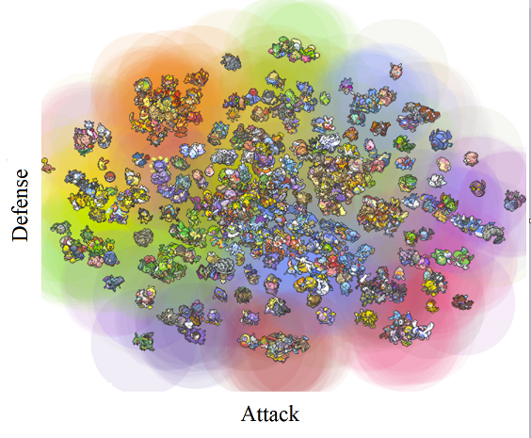
clustering
Grouping a set of objects
Similar objects => together
Big applications: >5000 entries (> 5 features)
Common technique : statistical data analysis
Fields:
pattern recognition
image analysis
information retrieval
bioinformatics
data compression
computer graphics
machine learning.

Slide 5
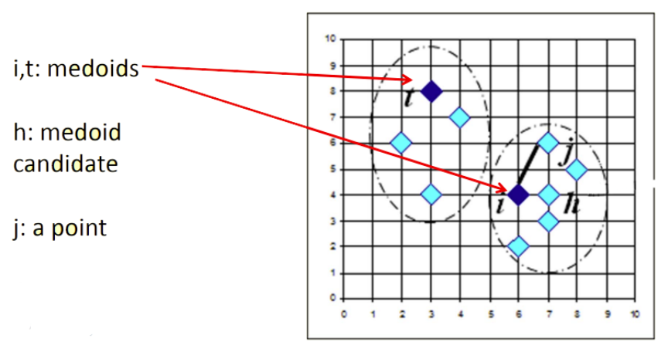
K-medoids / pam (Partitioning around medoids)
Clustering algorithm – similar to k-means
Group similar objects
Uses median, not mean
Algorithm
Select k random data points as initial medoids
Associate each point to the closest medoid
Compute distance cost medoids – points
Try another points as medoids
Compare costs
Keep combination of lowest cost
Repeat for all combinations of medoids
Complexity: O(k(n-k)^2) / iteration
2D data

Slide 6
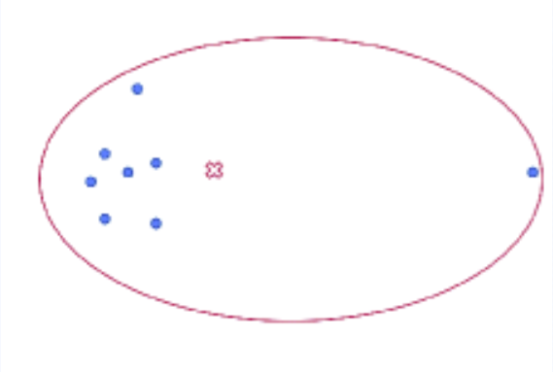
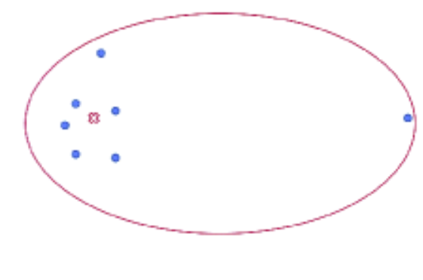
K-medoids / pam (Partitioning around medoids)
Advantage: protection against outliers
K - means
K- medoids

Slide 7

CLARA: Algorithm description
Pseudocode:
Create subsets randomly
Compute PAM for each subset
Compute dissimilarities of all obs
Retain subset with min dissimilarities
Complexity: O(k(M-k)^2) / iteration
$$Cost\left(M,D\right)= \frac{\sum_{i=1}^{n}{dissimilarity(O_{i}, rep(M,O_{i}))}}{n}$$

Slide 8
Applications of clara
Multivariate surveys
Recognizing communities: social media
Image segmentation
Anomaly detection
Crime analysis
Identifying fake news
Large datasets

Slide 9
Improvements (Clara vs k-means)
Reduced complexity from O(k(n-k)^2) to O(k(M-k)^2)
Improved immunity to outliers
PAM => CLARA => CLARANS
CLARANS

Slide 10
Datasets
Wholesale customers data (400 entries, 6 features)
https://archive.ics.uci.edu/ml/datasets/wholesale+customers
Obesity analysis (2100 entries, 5 features)
https://archive.ics.uci.edu/ml/datasets/Estimation+of+obesity+levels+based+on+eating+habits+and+physical+condition+
Bitdefender client purchases Analysis (10.000 entries, 20 features)

Slide 11
Thank you!

