Slide 1
Bus Schedule Optimization
Genetic Algorithm and Hybrid GA + Simulated Annealing
Metaheuristics — Final Project (Week 11 + Week 12)
Cotfas Rares
Cozma Dacian
Topic: Public Transport Timetabling

Slide 2
Problem Definition
When should each bus depart? — 06:00 to 22:00, line 429A, real data
Goal
Constants used in the model
Optimize departure times of 200 buses across a 16-hour day so that:
Operating day: 06:00 – 22:00 (960 minutes)
Fleet size: N_BUSES = 200
Bus capacity: 55 seats
Min. safety gap: 2 minutes
Soft max gap: 45 minutes
Dataset: hourly_transportation_202001.csv
Filter: 01.01.2020 + line 429A
passengers wait less
buses are not overcrowded
headways stay regular
the day is fully covered (06:00 → 22:00)
Encoding
x = [d1, d2, ..., d200] — minutes after 06:00
A repair operator sorts and enforces a 2-minute minimum gap so every candidate is feasible.
Cotfas Rares & Cozma Dacian — Metaheuristics Final Project

Slide 3
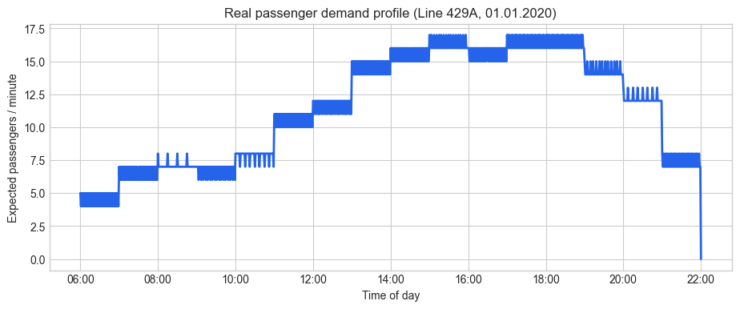
Dataset — Real Passenger Demand
Hourly tap-in counts spread evenly across 60 minutes per hour
Source
Real city transport CSV
(line 429A, 01.01.2020).
Pre-processing
Group by transition_hour, distribute each hourly total uniformly over 60 minutes → minute-level demand vector of length 961.
~11 000
16 h
200
55
passengers (line 429A)
06:00 – 22:00
fleet vehicles
seats per bus
Cotfas Rares & Cozma Dacian — Metaheuristics Final Project

Slide 4
Objective Function
Five practical costs combined into one scalar to minimize
F(x) = waiting + crowding + regularity + coverage + max_gap
Waiting
Crowding
D · h / 2
20 · max(0, D − 55)²
Mean wait approximation per interval (h = headway, D = demand integrated over the interval).
Quadratic penalty when passenger demand between two buses exceeds capacity.
Regularity
Coverage + max gap
4 · Var(headways)
25·(s₀^1.35 + ...) + 80·max(0, h−45)²
Variance of operational headways; punishes uneven spacing.
Penalises uncovered start/end of day and any gap > 45 min.
Cotfas Rares & Cozma Dacian — Metaheuristics Final Project

Slide 5
The Five Metaheuristics
Two required methods (GA, Hybrid GA + SA) and three comparators (PSO, WOA, POA)
Simple GA
Hybrid GA + SA
PSO
WOA
POA
Required
Required
Comparator
Comparator
Comparator
Tournament select (k=3)
Arithmetic + single-point crossover
Gaussian mutation σ=16
Elitism (top 4)
Run GA to completion
Take best schedule
Refine with Metropolis SA
Cooling T = 220 · 0.99^t
Particles with velocity
Personal + global best
w=0.72, c1=c2=1.45
42 particles × 90 iters
Encircle / spiral around best
Coefficient a: 2 → 0
Bubble-net hunting analogy
42 whales × 90 iters
Exploration vs. exploitation
Blended by progress
Roam + stalk + jump
42 pumas × 90 iters
Cotfas Rares & Cozma Dacian — Metaheuristics Final Project

Slide 6
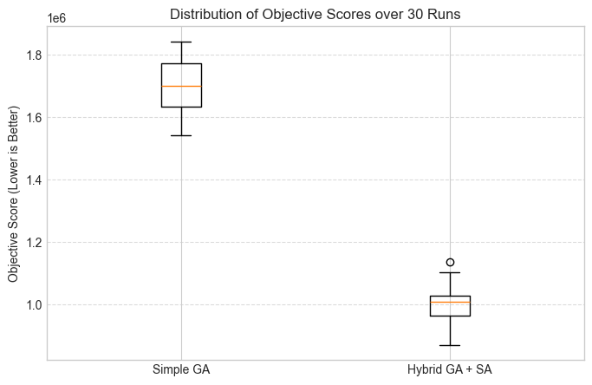
Parameter Validation by Grid Search
54 GA combinations + 27 SA combinations, then 30 independent runs
GA grid search winner
SA grid search winner
population = 50
generations = 100
mutation_rate = 0.1
crossover_rate = 0.9
mean score: 1 627 861
runtime: ~11.3 s
steps = 1000
t0 = 200.0
cooling = 0.99
mean score: 913 543
min score: 854 426
added runtime: ~2.2 s
30-run statistical comparison
Simple GA: mean 1.70M (min 1.54M)
Hybrid: mean 1.00M (min 0.87M)
The two distributions do not overlap.
Hybrid's worst run beats Simple GA's best run.
Cotfas Rares & Cozma Dacian — Metaheuristics Final Project

Slide 7
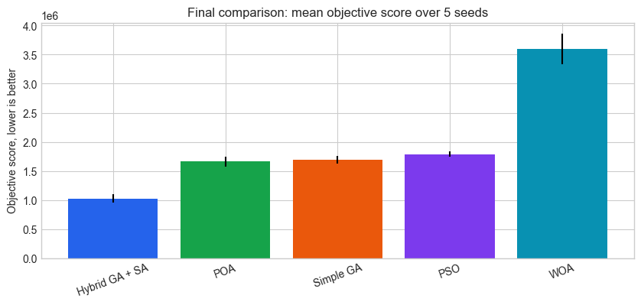
Final Results — 5-seed Benchmark
All five algorithms with the same 5 seeds [101, 202, 303, 404, 505]
Rank | Method | Best score | Mean score | Std | Mean runtime (s) | Mean max headway (min)
1 | Hybrid GA + SA | 941 403 | 1 022 518 | 72 806 | 13.92 | 8.99
2 | POA | 1 536 486 | 1 659 049 | 87 284 | 8.52 | 12.29
3 | Simple GA | 1 603 798 | 1 690 278 | 67 633 | 11.60 | 14.76
4 | PSO | 1 743 476 | 1 788 697 | 48 323 | 8.35 | 15.45
5 | WOA | 3 231 642 | 3 596 147 | 261 872 | 8.62 | 17.71
Hybrid GA + SA wins on every metric
~41% better mean score than Simple GA, lowest max headway, lowest variance.
Cotfas Rares & Cozma Dacian — Metaheuristics Final Project

Slide 8
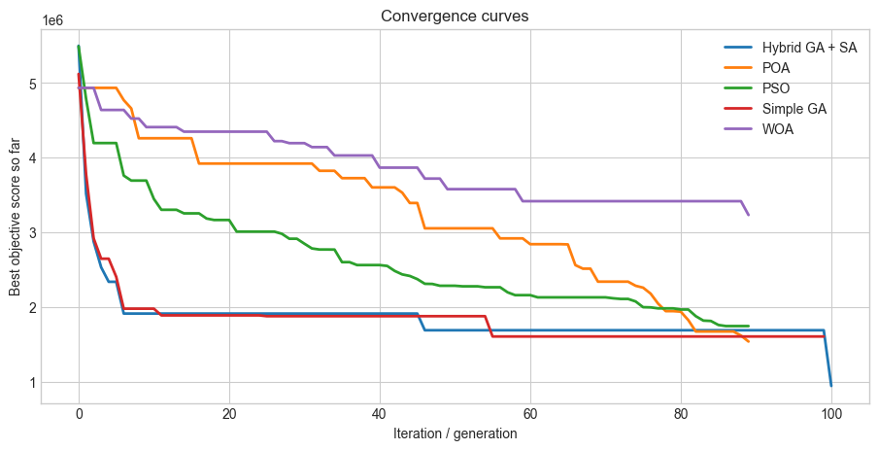
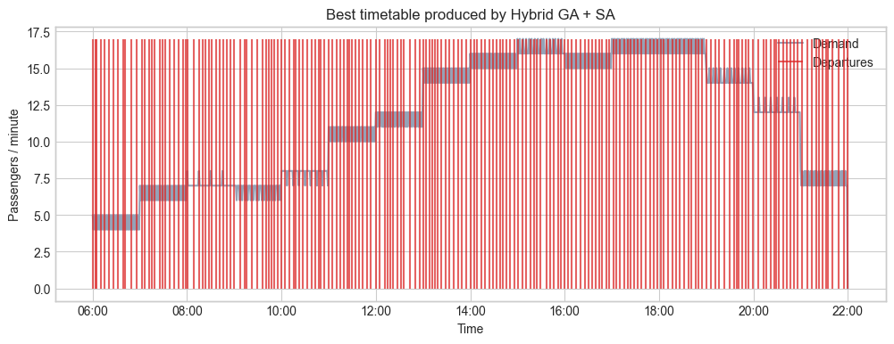
Convergence & Best Timetable
Hybrid GA + SA — best schedule produced
Convergence — Hybrid drops sharply at the last point (SA refinement).
Departures align with the real demand peaks.
941 403
4.82
7.68
06:00 → 22:00
Best objective (Hybrid GA + SA)
Mean headway (min)
Max headway (min)
First → last departure
Cotfas Rares & Cozma Dacian — Metaheuristics Final Project

Slide 9
Discussion & Conclusions
Why the Hybrid wins
Future improvements
GA does the global search — strong recombination across a 200-D space.
SA polishes the best schedule by shifting single departures by a few minutes.
Result is guaranteed ≤ the GA score and in practice ~40% better on the mean.
PSO / WOA / POA: continuous-swarm — less suited to a sorted, discrete-feeling search space.
Dynamic fleet size based on daily demand.
Multiple intersecting routes simultaneously.
Driver shifts, depot capacity, vehicle circulation.
Passenger transfer synchronization (bus ↔ metro ↔ tram).
Final answer
Hybrid GA + SA produces a timetable with mean headway 4.82 min, max headway 7.68 min, full 06:00 → 22:00 coverage, 200 buses, on real demand data.
Cotfas Rares & Cozma Dacian — Metaheuristics Final Project

Slide 10
Thank you!
Questions?
References
Suanpang, P. et al. (2022). Tourism Service Scheduling in Smart City Based on Hybrid GA+SA. Sustainability, 14(23), 16293.
Fatyanosa, T. N. & Mahmudy, W. F. (2018). Hybrid GA and SA for multi-trip vehicle routing problem with time windows. IAES.
Dataset: hourly_transportation_202001.csv — line 429A, 01.01.2020.
Cotfas Rares & Cozma Dacian — Metaheuristics, Final Project

