Slide 1
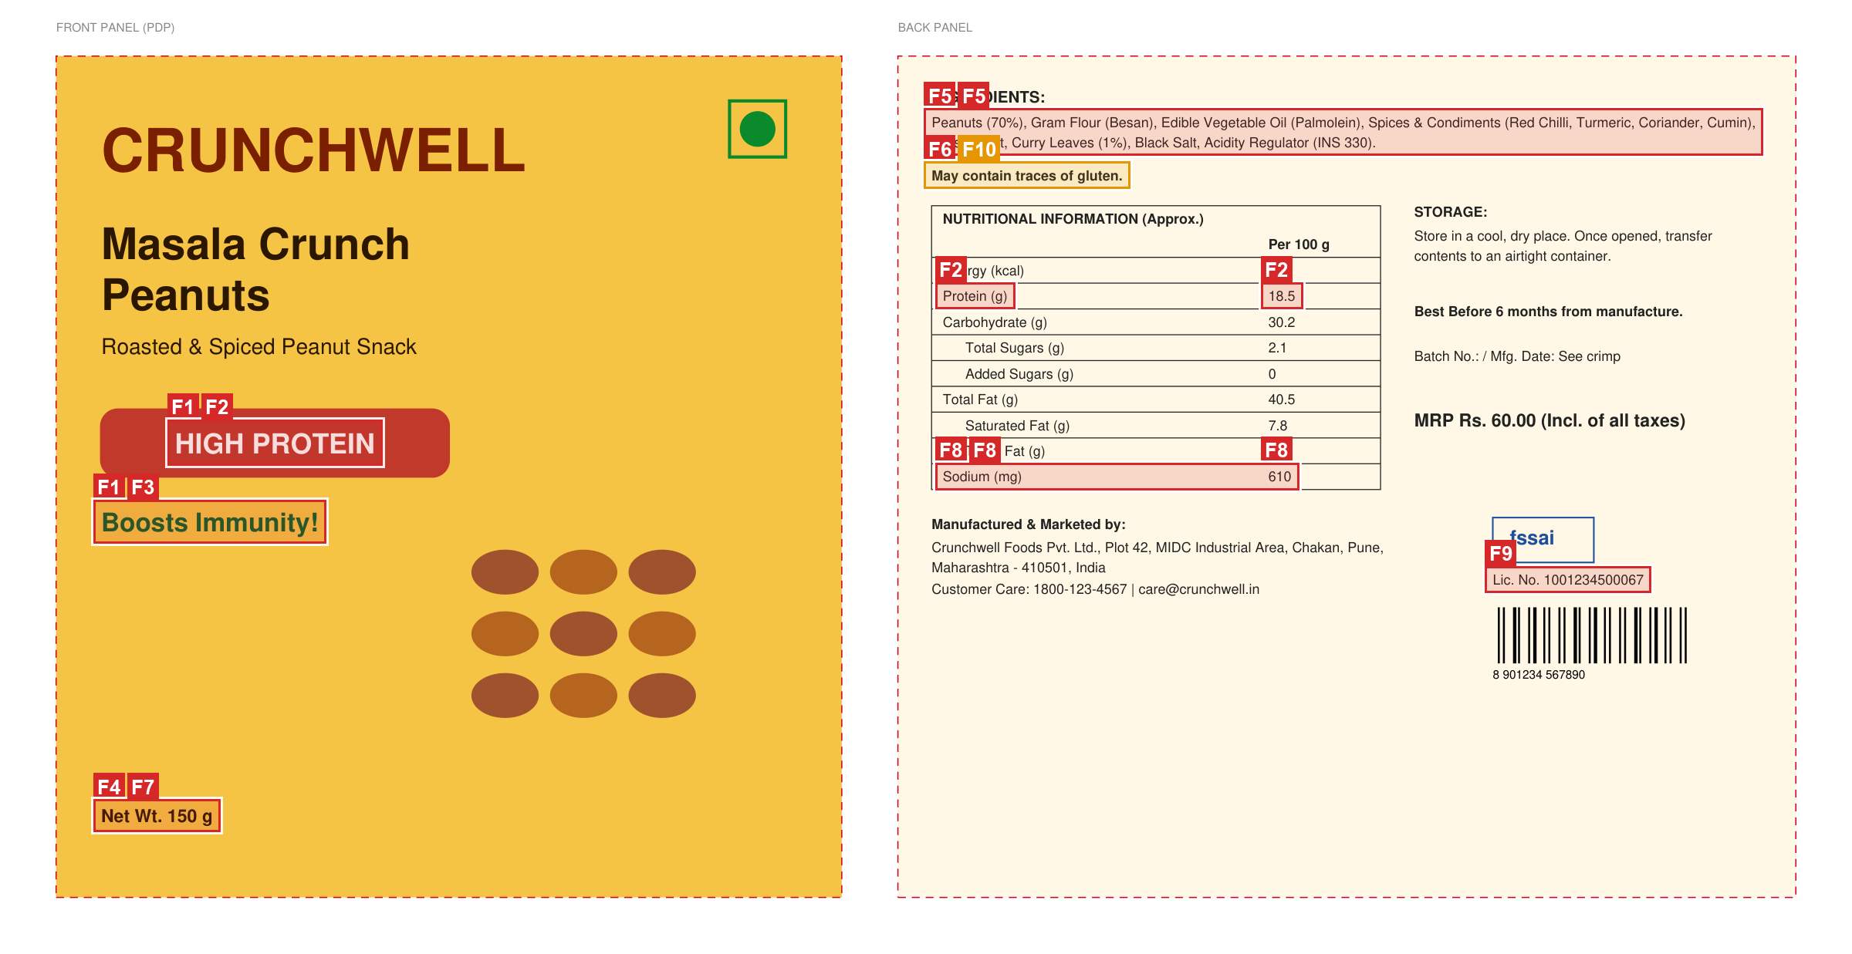
LabelGuard
Is this packaging artwork ready to launch?
AI pre-flight check for packaging artwork
Esko AIForge 2026 · Theme 2
A real check: every problem is boxed on the artwork
Live app: labelguard-re4hy3d9hvwj6rffs4fdcn.streamlit.app
Code: github.com/Rarxx4/LabelGuard
Notes:
LabelGuard answers one question for a packaging team: is this artwork ready to print? It is live at the link on the slide, and the code is on GitHub.

Slide 2
The problem
Before packaging goes to print, someone checks every word on the artwork against the regulations, the company rulebook and the approved product data. Today this is done by hand.
Slow
Reviewers read artwork, spec sheets and rulebooks side by side, line by line.
Costly when missed
A wrong net quantity or a missing allergen declaration means a reprint, or a recall.
AI alone isn't trusted
AI can misread a number, invent a quote or raise false alarms. Reviewers need proof.
We want AI that shows its evidence, and says so when it isn't sure.
Notes:
Three pains: it is slow, mistakes are expensive, and plain AI is not trustworthy enough for a compliance decision. So our goal was AI that proves every claim.

Slide 3
Our idea: split the work, then verify the AI
AI
reads and reasons
Turns the rulebook into testable rules, reads the spec and the artwork, and judges each rule with quoted evidence.
CODE
measures and compares
Exact text, positions and sizes from the PDF (OCR for images). Compares quantities, ingredients, nutrition and licence numbers.
TRUST LAYER
checks the AI
Every AI claim is checked against the artwork and the code. Anything unproven becomes "needs review", with the reason.
Result: a launch verdict (NOT READY / NEEDS REVIEW / READY TO PRINT) and every finding with its evidence highlighted on the artwork.
Notes:
The key design choice: each part does what it is best at. AI understands language and images, code does exact comparisons and measurements, and the trust layer decides what can be believed.

Slide 4
How it works
INPUT
CODE
AI
CODE
AI
TRUST
OUTPUT
Inputs
Artwork (PDF or image)
Rulebook
Approved spec
Read files
PDF text with exact positions and sizes
OCR for images
Understand
Rules to checklist
Spec to facts
Artwork to elements
(in parallel)
Cross-check
Compare with the spec
Measure text in mm
Judge each rule
PASS, FAIL or REVIEW
Confidence
Quoted evidence
Verify the AI
Find quotes on the artwork
Re-check "missing"
Code wins on values
Reviewer
Launch verdict
Evidence on artwork
Confirm or dismiss
Report
AI = Gemini 3.8 Flash (Claude Opus 5.5 optional) CODE = plain Python, no AI TRUST = checks every AI answer
Every AI answer must match a fixed JSON schema (structured outputs), so each claim can be checked by code.
Notes:
Walk left to right. Code reads the files exactly; the AI understands rules, spec and artwork in parallel; code cross-checks values and measures sizes; the AI judges every rule; the trust layer verifies the AI; the reviewer gets a verdict with evidence.

Slide 5
When the AI is wrong, LabelGuard catches it
If the AI... | LabelGuard...
misreads or invents text | searches every quote in the PDF text or OCR. Numbers must match exactly: "200 g" never matches "150 g".
says something is missing | searches the artwork again. If it is there, the finding becomes "possible false alarm".
disagrees with arithmetic | lets the code win on value checks, e.g. sodium printed 610 mg vs 560 mg approved.
is unsure | sends low-confidence verdicts to NEEDS REVIEW instead of guessing.
can't measure something | measures text size exactly from PDFs; from a photo (no scale) it sends the rule to a human.
Every change is written into the finding's trust notes, so the reviewer always sees why.
Notes:
This is how we handle uncertainty and wrong AI output. In our tests we deliberately feed the system an AI that makes these mistakes, and the trust layer catches each one.

Slide 6
Results on our test artwork
7 / 7
planted errors caught: net quantity, allergen statement, peanut %, sodium, licence number, claims, text size
0
false alarms on the corrected artwork: READY TO PRINT, 25 rules pass
PDF + photo
Real run with Gemini 3.8 Flash on our sample pouch (fictitious product). Red boxes = failing findings.
the same errors are found from a photo via OCR; size rules go to a human
Notes:
We built a realistic pouch with seven planted errors. LabelGuard caught all seven with real Gemini, gave zero false alarms on the corrected version, and found the same errors from a photo.

Slide 7
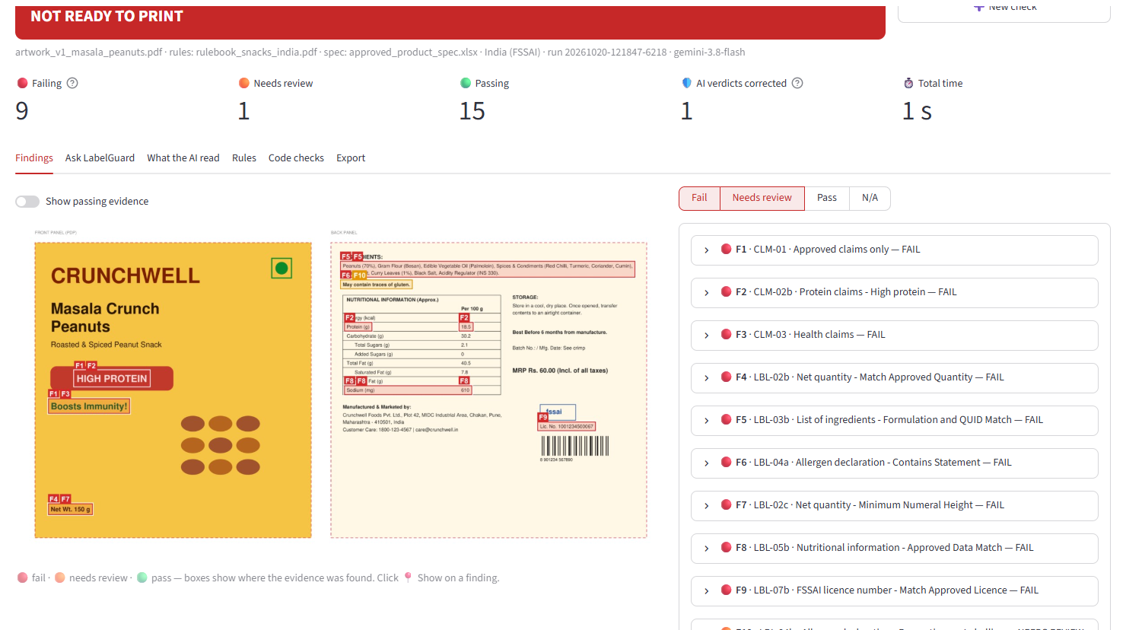
The reviewer workspace
Launch verdict at a glance
Click a finding to see its evidence on the artwork
Rule text quoted from the source document
Confirm, or dismiss as a false alarm
Ask follow-up questions in a chat
Export an HTML report for the design agency
Try it live: labelguard-re4hy3d9hvwj6rffs4fdcn.streamlit.app
Notes:
This is the real app on the recorded Gemini run. The banner gives the verdict, each finding links to its evidence on the artwork, and the reviewer stays in control.

Slide 8
Built with
AI
Google Gemini 3.8 Flash (free tier), Claude Opus 5.5 as an option. Structured outputs: every answer must match a schema.
Reading files
PyMuPDF for PDF text, positions and font sizes. RapidOCR for images. python-docx and openpyxl for documents.
Checking
RapidFuzz matching that is strict on numbers, plus plain Python comparisons and measurements.
App
Streamlit, deployed on Streamlit Community Cloud. HTML and JSON report export.
Quality
27 automated tests, including a fake AI that makes deliberate mistakes the trust layer must catch.
Notes:
Technology choice earns no points by itself: AI is used only where it adds value, and everything that can be verified is done by code.

Slide 9
Try it
Live app
labelguard-re4hy3d9hvwj6rffs4fdcn.streamlit.app
Code
github.com/Rarxx4/LabelGuard
Next steps
Detect panels and dielines for placement rules
Multilingual packs
Turn reviewer dismissals into rulebook clarifications
Connect to an approval workflow such as Esko WebCenter
How to try it
Open "Previous runs" in the sidebar and pick a recorded example: real results, no key needed. To check new artwork, enter the access code we share or paste your own free Gemini key.
Notes:
Invite the judges to try it. Recorded examples work instantly; new artwork needs the access code or their own free Gemini key. Thank you.

