Slide 1
Osteoporosis:
From the Economic Lens
1

Slide 2
Direct costs for osteoporosis medication vary, depending on insurance and type of medication
Commonly prescribed medications for osteoporosis are typically bisphosphonates (ex. alendronates and risedronates) and hormones (ex. teriparatide).
Generic Medication Costs:
Typically about $10 USD/month; covered under most insurance plans.
Name-brand Medication Costs:
Fosamax/Acetonel are about $80 USD/mo, and also typically covered.
Forteo is used for severe cases, with a cost of $900+ USD/mo, and often not covered.
Osteoporosis is non-reversible, so patients take generic medication typically for the rest of their lives*.
Information adapted from CostHelper Health (n.d.) and Mayo Clinic (2014)
Notes:
Osteoporosis medications are typically taken orally or injected [1].
Fosamax and acetonel are bisphosphonates; forteo is a teriparitide hormone [1].
Covered medication has an insurance co-pay of $5-$150 [2].
Osteoporosis medication is taken regularly after diagnosis, so costs can be significant over many years [2].
Extremely expensive medication is not taken indefinitely, only to treat extremely weakened bones [1].

Slide 3
Osteoporosis-related fractures significantly increase the direct cost of care for over a year post-fracture
Post-Fracture vs Non-Fracture Medical Costs Over 1 Year
Category | Fracture Cohort | Non-Fracture Cohort
Mean all-cause | $47,163 | $16,034
Hip fracture | $71,057 | $16,807
Spine fracture | $37,543 | $16,860
Radius/Ulna fracture | $24,505 | $14,673
Total medical + pharmacy (second fracture) | $78,137 | $44,467
Having osteoporosis greatly increases the chance of fractures, leading to greater costs for patients.
Beyond the one-time fracture cost, subsequent healthcare expenses are also much higher.
Table 1: Medical costs over 1 year compared for a post-fracture and non-fracture cohort (U.S)
Information and table 1 adapted
from Williams et al. (2020)
Notes:
Osteoporosis places patients at a higher risk for various kinds of fractures (seen in table 1) [3].
This data is from a study conducted on senior adults in the US, comparing a osteoporotic fracture cohort to a non-fracture cohort.
For all fracture types, patients spend more over the course of the year following the fracture than they would if there was no fracture [3].
These costs come in the form of skilled nursing, inpatient costs, and hospice care [3].
Mortality rates in general are also about twice as high [3].

Slide 4
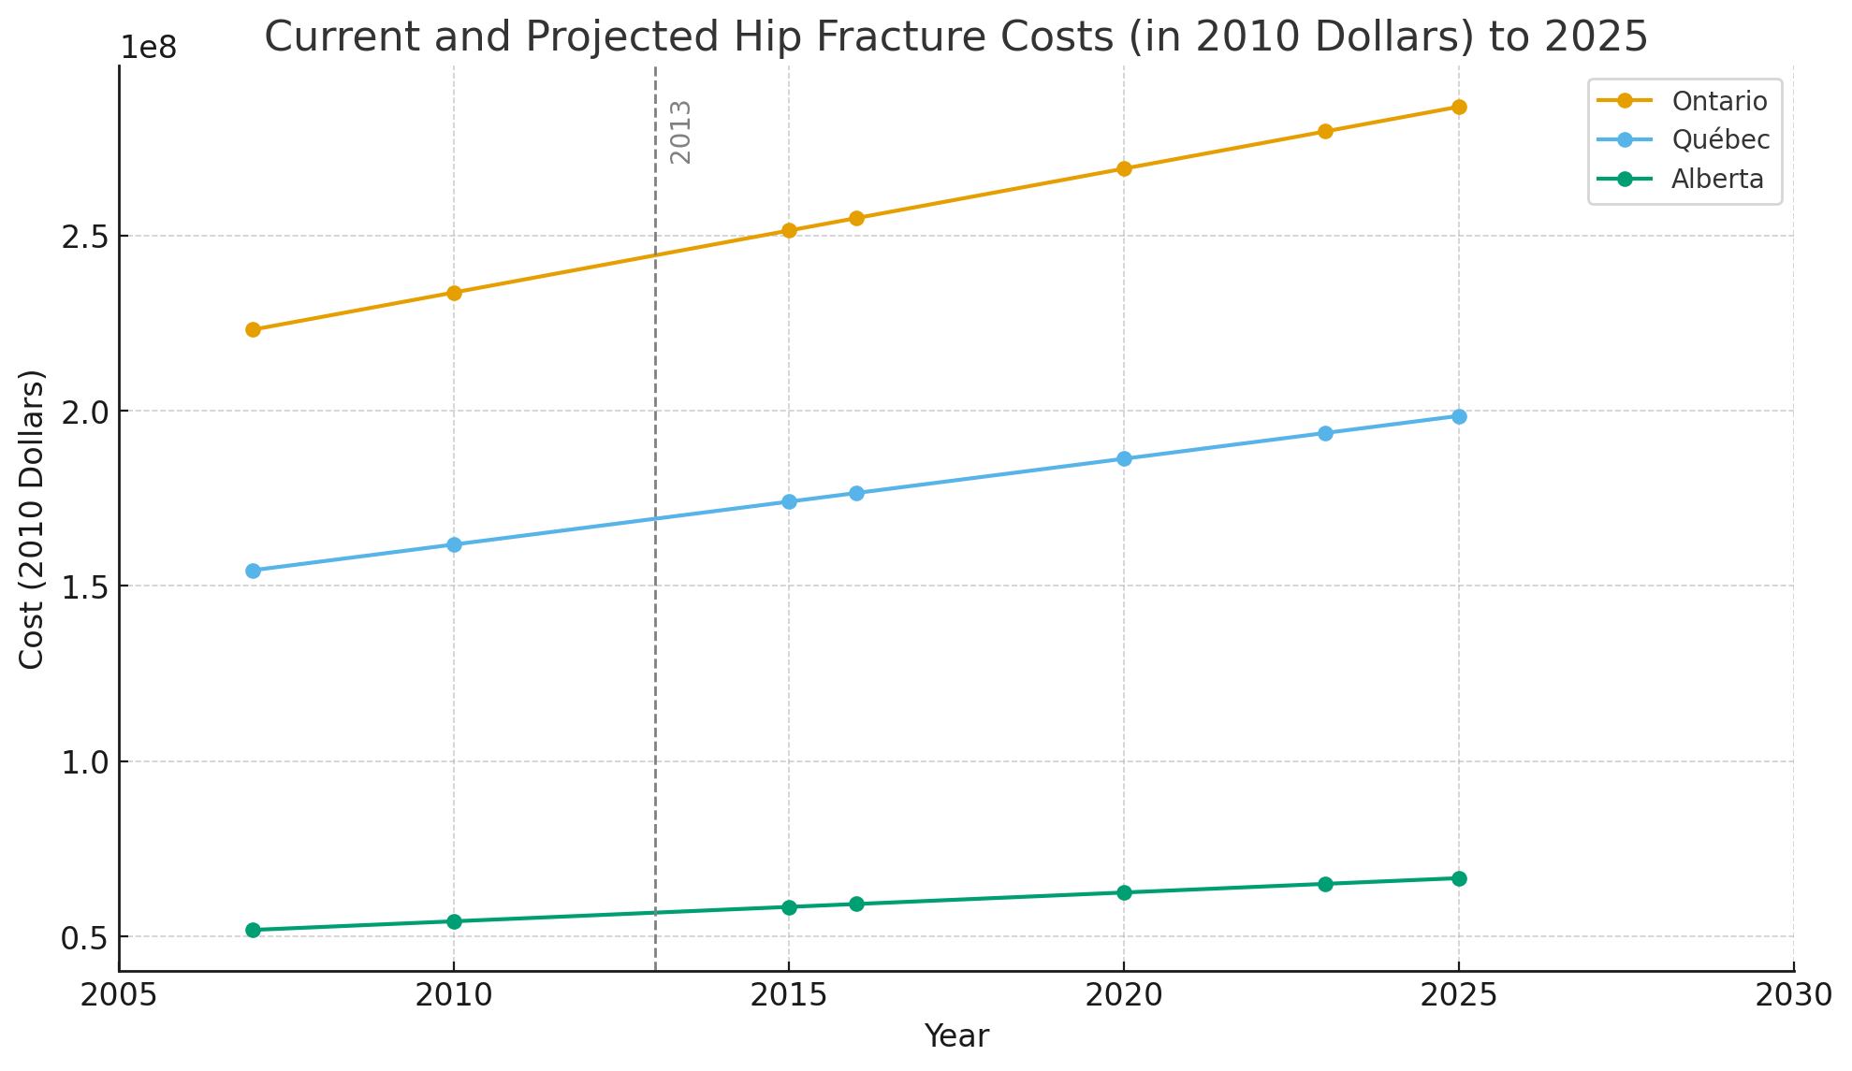
Direct acute costs for fracture treatments are are rising yearly across provinces, and projected to rise faster
In Ontario, hip fracture associated costs are projected to be around $280 million in 2025.
A general increase year-to-year is projected for all major provinces.
Figure 1: Current and projected hip fracture costs in hundreds of millions for Ontario, Quebec, and Alberta
Information and Figure 1 Adapted from Osteoporosis Canada (2013)
Notes:
Provinces spend significant and increasing amounts of money each year on treating fractures.
Other fractures are not as expensive as hip fractures, but they are much more common, so they are still significant costs [4].
Mention that the study itself calls these estimations conservative [4].
This data does not account for the fact that most of Canada’s population will be in the senior bracket around ~2035 [4].

Slide 5
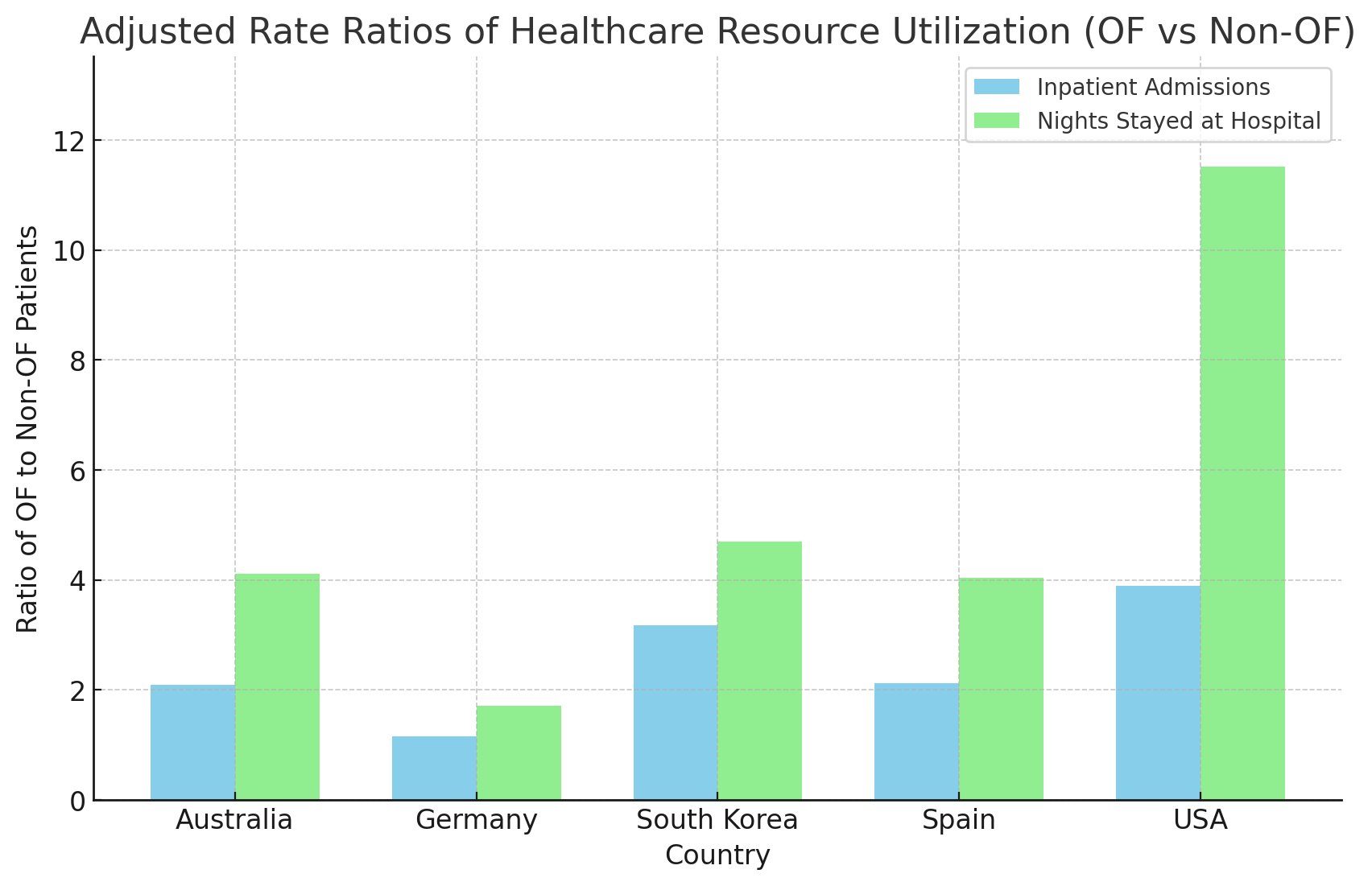
Indirect Costs: Osteoporotic Fracture (OF) patients consistently utilize more healthcare resources
OF fracture patients use more healthcare services, regardless of country.
These services also include ER visits, home visits, prescriptions, and outpatient visits.
Figure 2: Ratios of OF to non-OF patients in terms of healthcare resource utilization in various countries
Information and Figure 2 adapted from Moayyeri et al. (2023)
Notes:
Healthcare resources used for osteoporosis-related incidents can be thought of as an indirect cost.
The bar graph shows the ratios of OF to non-OF patients in terms of their hospital admissions and nights stayed across countries; all ratios are greater than 1, so OF patients use more resources in all conditions [5].
Building off the 2nd bullet point, even for those services not included in figure 1, the OF to non-OF ratio is consistently over 1 [5].
General conclusion: osteoporosis patients require a disproportionately large amount of healthcare services, regardless of location or the type of healthcare system [5].

Slide 6
References:
Mayo Clinic. What medications help treat osteoporosis? [Internet]. Mayo Clinic. 2024. Available from: https://www.mayoclinic.org/diseases-conditions/osteoporosis/in-depth/osteoporosis-treatment/art-20046869
CostHelper Health. How Much Do Osteoporosis Treatments Cost? [Internet]. CostHelper. Available from: https://health.costhelper.com/osteoporosis-treatments.html
Williams SA, Daigle SG, Weiss R, Wang Y, Arora T, Curtis JR. Economic Burden of Osteoporosis-Related Fractures in the US Medicare Population. Annals of Pharmacotherapy. 2020 Nov 4;55(7):821–9.
Osteoporosis Canada. Stop the unnecessary suffering -implement FLS [Internet]. Osteoporosis Canada. 2013. Available from: https://osteoporosis.ca/fls/wp-content/uploads/FLS-TOOLKIT-App-B.pdf
A. Moayyeri, Warden J, Han S, Suh HS, R. Pinedo-Villanueva, Harvey NC, et al. Estimating the economic burden of osteoporotic fractures in a multinational study: a real-world data perspective. Osteoporosis International. 2023 Aug 31;34(12):2121–32.

