Slide 1

Silex et Backbone - 20 mars 2014

Slide 2


Silex et Backbone - 20 mars 2014

Slide 3

Qui suis-je ?
Développeur Sf1 et Sf2
Novice JS
@jonathanj33

Slide 4

Sommaire
Silex, qu’est-ce que
c’est?
Qui est Backbone ?
Du code !!!
Et on déploie

Slide 5

Silex qu’est-ce que c’est?
Le petit frère de Symfony
Plus flexible, plus simple
Du PHP et des Services

Slide 6

Qui est backbone ?
Un nouveau framework JS
Du client-serveur ?
La puissance du JS

Slide 7

Du code !!!
- L’application Silex
- L’application
- Les providers
- Les controllers
- Les tests

Slide 8
L’application
public function __construct(array $config)
{
…………………… etc …………………………...
// register twig
$this->register(new Provider\TwigServiceProvider());
$this->register(new Silex\Provider\ServiceControllerServiceProvider());
$this->register(new MongoDBServiceProvider('mongo'));
$this->register(new ScrumMastorProvider());
$this->loadConfig();
$this->loadRoute();
…………………… etc …………………………...
}

Slide 9
L’application
protected function loadConfig() {
$config = array_replace_recursive(
require $this['path.config'] . '/default.php',
require $this['path.config'] . '/' . $this['env'] . '.php'
);
foreach ($config as $key => $value) {
$this[$key] = $value;
}
}
protected function loadRoute() {
// Url for save the task
$this->post('/task', 'task.controller:saveAction');
// Url for update task
$this->put('/task/{id}', 'task.controller:updateAction');
// Url for see one task
$this->get('/task/{id}', 'task.controller:getAction');
// Url for delete task
$this->delete('/task/{id}', 'task.controller:deleteAction');
// Url for list of tasks
$this->get('/tasks', 'task.controller:listAction');
}

Slide 10
Les providers
class ScrumMastorProvider implements ServiceProviderInterface
{
public function register(Application $app)
{
$app['task.controller'] = $app->share(function ($app) {
return new TaskController($app['mongo'], $app['request']);
});
$app['tag.controller'] = $app->share(function ($app) {
return new TagController($app['mongo'], $app['request']);
});
}
public function boot(Application $app)
{
// Nothin todo
}
}

Slide 11
Les controllers
class TaskController
{
protected $mongo;
protected $request;
public function __construct($mongo, Request $request)
{
$this->mongo = $mongo;
$this->request = $request;
}
}
public function saveAction()
{
$title = $this->request->get('title');
if (!isset($title)){
return new JsonResponse('false', 500);
}
$this->mongo->tasks->insert(array('title' => $title, 'description' => $this->request->get('description', '')));
return new JsonResponse('true', 200);
}

Slide 12
Les tests
class ScrumMastorTestCase extends WebTestCase
{
public function createApplication()
{
$app = new ScrumMastorApplication(array('env' => 'test'));
$app['debug'] = true;
$app['exception_handler']->disable();
// mock
$app[mailling] = $this->getMockBuilder('ScrumMastor\Service\MaillingService')
->disableOriginalConstructor()
->getMock();
return $app;
}
}

Slide 13
Les tests
class TaskTest extends ScrumMastorTestCase
{
public function dataGetTasks()
{
return array(
array('/task/1'),
array('/task/2'),
);
}
/**
* @dataProvider dataGetHomes
*/
public function testGetHomes($url)
{
$client = $this->createClient();
$crawler = $client->request('GET', $url);
$response = $client->getResponse();
$this->assertEquals(200, $response->getStatusCode());
}

Slide 14

Du code !!!
- L’application Backbone
- Les libs
- L’application
- Le router
- Le src

Slide 15

Les libs
- Backbone http://backbonejs.org/
- Underscore http://underscorejs.org/
- Jquery http://jquery.com/
- Require http://requirejs.org/
- Text http://requirejs.org/docs/download.html

Slide 16
Main.js
requirejs.config({
paths: {
jquery: '../lib/jquery/jquery.min',
underscore: '../lib/underscore/underscore.min',
backbone: '../lib/backbone/backbone.min',
localstore: '../lib/backbone/backbone.localStorage',
templates: '../templates',
taskModel: '../src/models/tasks/index',
taskCollection: '../src/collections/tasks/index',
config: '../config/config_dev'
}
});
requirejs([
// Load our app module and pass it to our definition function
'app',
], function(App){
// The "app" dependency is passed in as "App"
// Again, the other dependencies passed in are not "AMD" therefore don't pass a parameter to this function
App.initialize();
});

Slide 17
App.js
define([
'jquery',
'underscore',
'backbone',
'router', // Request router.js
], function($, _, Backbone, Router) {
var initialize = function() {
// Pass in our Router module and call it's initialize function
Router.initialize();
};
return {
initialize: initialize
};
});

Slide 18
Router.js
define([
'jquery',
'underscore',
'backbone',
'routes/userroutes',
'routes/taskroutes'
], function($, _, Backbone, UserRoutes, TaskRoutes) {
var AppRouter = Backbone.Router.extend({
routes: {
// '' : 'home' => TODO
}
});
});
var initialize = function() {
this._subRouters = {
'users': new UserRoutes(),
'tasks': new TaskRoutes()
};
Backbone.history.start();
};
return {
initialize: initialize
};

Slide 19
Le router
define(['backbone'], function(Backbone) {
var TaskRoutes = Backbone.Router.extend({
routes: {
'': 'listTasks',
'addTask': 'addTask',
},
listTasks: function() {
requirejs(['views/tasks/index'], function(TasksView) {
if (this.currentView) {
this.currentView.close();
}
var tasksView = new TasksView();
this.currentView = tasksView;
this.currentView.render();
});
},
addTask: function() {
requirejs(['views/tasks/form'], function(TasksFormView) {
if (this.currentView) {
this.currentView.close();
}
var tasksFormView = new TasksFormView({el : '#content'});
this.currentView = tasksFormView;
this.currentView.render();
});
}
});
return TaskRoutes;
});

Slide 20
MVC
Collection
define([
'jquery',
'underscore',
'backbone',
'localstore',
'taskModel',
'config'
], function($, _, Backbone, localstore, TaskModel, config){
var TasksCollection = Backbone.Collection.extend({
model: TaskModel,
initialize: function()
{
if (config.store == 'local') {
this.localStorage = new Store("tasks");
} else {
this.url = config.store_url;
}
console.log('Tasks collection Constructor');
}
});
return TasksCollection;
});

Slide 21
MVC
Model
define([
'underscore',
'backbone'
], function(_, Backbone) {
var TaskModel = Backbone.Model.extend({
defaults: {
title: "Nouvelle tache",
description: "Ce que j'ai a faire",
},
initialize: function Doc() {
console.log('Task Constructor');
this.bind("invalid", function(model, error) {
console.log(error);
});
},
validate: function(attributes) {
if (attributes.title === '') {
return "Le titre du document ne peut pas être vide !!!";
}
},
getId: function() {
return this.get('id');
},
setId: function(value) {
this.set({id: value});
},
});
return TaskModel;
});

Slide 22
MVC
View
define([
'jquery',
'underscore',
'backbone',
'taskModel',
'taskCollection',
'text!templates/tasks/form.html'
], function($, _, Backbone, TaskModel, TasksCollection, TasksFormTemplate){
var TasksFormView = Backbone.View.extend({
events: {
'submit form': 'addPost'
},
addPost: function(e) {
e.preventDefault();
var tasksCollection = new TasksCollection();
tasksCollection.fetch();
console.log(tasksCollection);
var taskModel = new TaskModel();
taskModel.setTitle(this.$('#title').val());
taskModel.setDescription(this.$('#description').val());
tasksCollection.add(taskModel, {error: _.bind(this.error, this)});
this.$('input[type="text"]').val(''); //on vide le form
taskModel.save();
},

Slide 23
MVC
View
error: function(model, error) {
console.log(model, error);
return this;
},
render: function() {
this.$el.html(TasksFormTemplate);
},
close: function() {
this.undelegateEvents();
}
});
return TasksFormView;
});

Slide 24

Les tests
Les tests en Backbone
- Karma
- Jasmine

Slide 25
Karma.conf.js
module.exports = function(config) {
config.set({
// base path, that will be used to resolve files and exclude
basePath: '',
frameworks: ['jasmine', 'requirejs'],
// list of files / patterns to load in the browser
files: [
'test/test-main.js',
'lib/mock-ajax.js',
'lib/jquery-min.js',
'lib/jasmine-jquery.js',
// all the sources, tests
{pattern: 'src/**/*.js', included: false},
{pattern: 'test/**/*.js', included: false},
{pattern: 'config/**/*.js', included: false},
{pattern: 'lib/**/*.js', included: false},
{pattern: 'templates/**/*.html', included: false}
],

Slide 26
Karma.conf.js
// test results reporter to use
// possible values: dots || progress
reporters: ['dots', 'coverage'],
// web server port
port: 9876,
// enable / disable colors in the output (reporters and logs)
colors: true,
// level of logging
// possible values: LOG_DISABLE || LOG_ERROR || LOG_WARN || LOG_INFO || LOG_DEBUG
logLevel: config.LOG_INFO,
// enable / disable watching file and executing tests whenever any file changes
autoWatch: true,
// Start these browsers, currently available:
// - Chrome
// - ChromeCanary
// - Firefox
// - Opera
// - Safari
// - PhantomJS
browsers: ['PhantomJS'],

Slide 27
Karma.conf.js
preprocessors: {
"templates/**/*.html": [],
'src/models/*.js': ['coverage'],
'src/views/*.js': ['coverage'] },
// Continuous Integration mode
// if true, it capture browsers, run tests and exit
singleRun: false,
coverageReporter: {
type : 'html',
dir : 'coverage/'
},
plugins: [
'karma-requirejs',
'karma-jasmine',
'karma-phantomjs-launcher',
'karma-html2js-preprocessor',
'karma-coverage'
],
});
};

Slide 28
test-main.js
var tests = [];
for (var file in window.__karma__.files) {
if (window.__karma__.files.hasOwnProperty(file)) {
if (/Spec\.js$/.test(file)) {
tests.push(file);
}
}
}
requirejs.config({
baseUrl: '/base',
paths: {
text: 'src/text',
config: 'config/config_dev',
jquery: 'lib/jquery/jquery.min',
underscore: 'lib/underscore/underscore.min',
backbone: 'lib/backbone/backbone.min',
localstore: 'lib/backbone/backbone.localStorage',
taskModel: 'src/models/tasks/index',
tasksFormView: 'src/views/tasks/form',
taskCollection: 'src/collections/tasks/index'
},

Slide 29
test-main.js
shim: {
'underscore': {
exports: '_'
},
'jquery': {
exports: '$'
},
'backbone': {
deps: ['underscore', 'jquery'],
exports: 'Backbone'
},
'text' : {
exports : 'text'
}
},
// ask Require.js to load these files (all our tests)
deps: tests,
// start test run, once Require.js is done
callback: window.__karma__.start
});

Slide 30
ViewSpec.js
define(['tasksFormView'], function(TasksFormView) {
describe('Tasks Form View', function() {
beforeEach(function() {
el = $('<div></div>');
tasksFormView = new TasksFormView(el);
tasksFormView.render();
});
it('Initiate view', function() {
expect(tasksFormView.$('#title').attr('type')).toBe('text');
expect(tasksFormView.$('#description').attr('type')).toBe('text');
});
it('Add post', function() {
tasksFormView.$('#title').val('Nouveau post');
tasksFormView.$("#addTaskForm").trigger('submit');
expect(tasksFormView.$('#title').val()).toBe('');
expect(tasksFormView.$('#description').val()).toBe('');
});
});
});

Slide 31
Mockup
it('When not connect facebook datawall', function() {
spyOn(memberFormView.router, 'navigate');
spyOn(memberFormView, 'redirect');
memberFormView.state = Constants.DATAWALL;
var response = new Array();
response['authResponse'] = new Array();
response['authResponse']['accessToken'] = 'test';
memberFormView.callbackFacebooLogin(memberFormView, response);
expect(doneFn).not.toHaveBeenCalled();
expect(jasmine.Ajax.requests.mostRecent().url).toBe(Config.url_api + '/api/auth/facebook');
jasmine.Ajax.requests.mostRecent().response(
{
'status': 404,
'responseText': '{"meta":{"status":200,"msg":"Ok"}}'
});
expect(memberFormView.redirect).toHaveBeenCalled();
expect(memberFormView.router.navigate).not.toHaveBeenCalled();
});

Slide 32
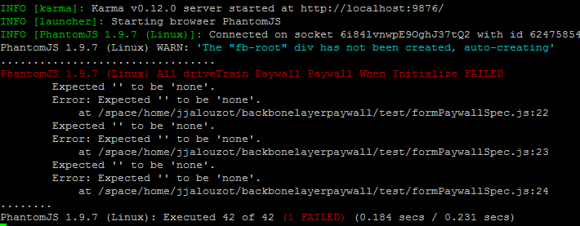

Karma start

Slide 33
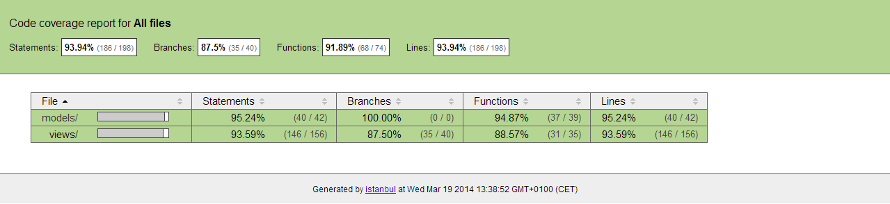
Code-Coverage

Slide 34
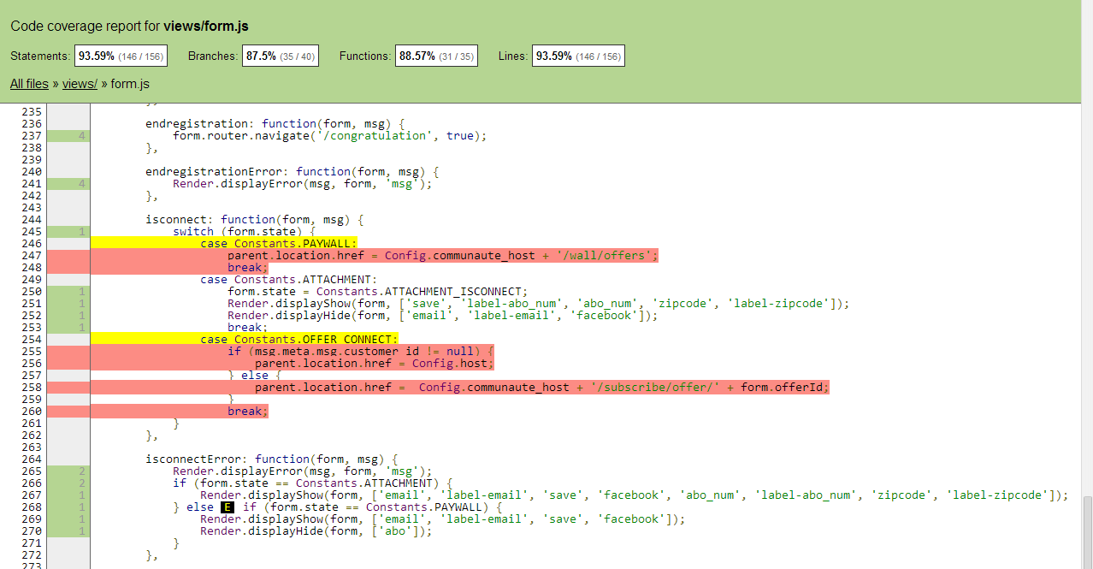
Code-Coverage

Slide 35


Slide 36


Déploie

Slide 37
gulpFile.js
var gulp = require('gulp');
var jshint = require('gulp-jshint');
var uglify = require('gulp-uglify');
var concat = require('gulp-concat');
var minifyHTML = require('gulp-minify-html');
var rjs = require('gulp-requirejs');
var jscs = require('gulp-jscs');
gulp.task('html-prod', function() {
gulp.src('./templates/**/*.html')
.pipe(minifyHTML())
.pipe(gulp.dest('./build/templates'));
});
gulp.task('js-prod', function() {
gulp.src('./src/**/*.js')
.pipe(uglify())
.pipe(jshint())
.pipe(gulp.dest('./build/src'));
gulp.src('./lib/**/*.js')
.pipe(uglify())
.pipe(gulp.dest('./build/lib'));
gulp.src('./config/**/*.js')
.pipe(uglify())
.pipe(gulp.dest('./build/config'));
});

Slide 38
gulp.task('requirejs-prod', function() {
rjs({
baseUrl: './build/src',
out: 'deploy.js',
name: "main",
paths: {
jquery: './../lib/jquery-min',
backbone: './../lib/backbone-min',
underscore: '../lib/underscore-min',
text: './../lib/text',
utils: './../src/utils/utils',
config: './../config/config',
constants: './../src/utils/constants',
templates: './../templates',
member: './../src/models/member',
templating: './../src/utils/templating',
facebook: './../lib/facebook',
},
})
.pipe(uglify())
.pipe(gulp.dest('./deploy/')); // pipe it to the output DIR
gulp.src('./build/lib/require.js')
.pipe(gulp.dest('./deploy'));
});

Slide 39
gulpFile.js
gulp.task('js-cs-fixer', function () {
gulp.src('./src/**/*.js')
.pipe(jscs());
gulp.src('./config/**/*.js')
.pipe(jscs());
gulp.src('./test/**/*.js')
.pipe(jscs());
});
gulp.task('default', ['js-prod', 'html-prod']);

Slide 40
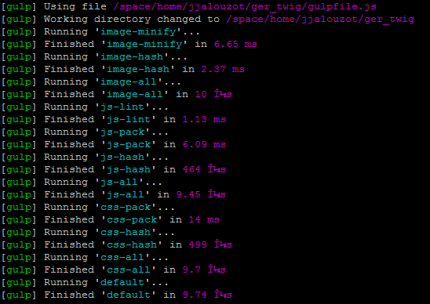
Console

Slide 41

Questions

Slide 42








