Slide 1
JPMC - EIS
Code Academy
JPMC Code Academy
Class 1
Class 1

Slide 2
COURSE INTRO
JPMC Code Academy
Let’s introduce ourselves and the structure of the course
Class 1

Slide 3
/TABLE OF CONTENTS
/01
/Course Objective
/02
/Introduce Mentors
/03
/Mentor Assignments
/04
/Content Repository
JPMC Code Academy
Explain course objective and its structure
Introduce the mentors and explain their roles
Show the mentor’s participant assignments
Show the Github repository with the classes content
Class 1

Slide 4
/COURSE OBJECTIVE
JPMC Code Academy
/Mentorship
Someone to clear doubts and guide you
/Basic Concepts
Explain basic development concepts
/Peer Coding
Shadow your mentor during development
/Practice
Complete an individual E2E project
Class 1

Slide 5

/MENTORS
JPMC Code Academy
Who are they?
What are their roles?
Who is assigned to each mentor?
Class 1

Slide 6
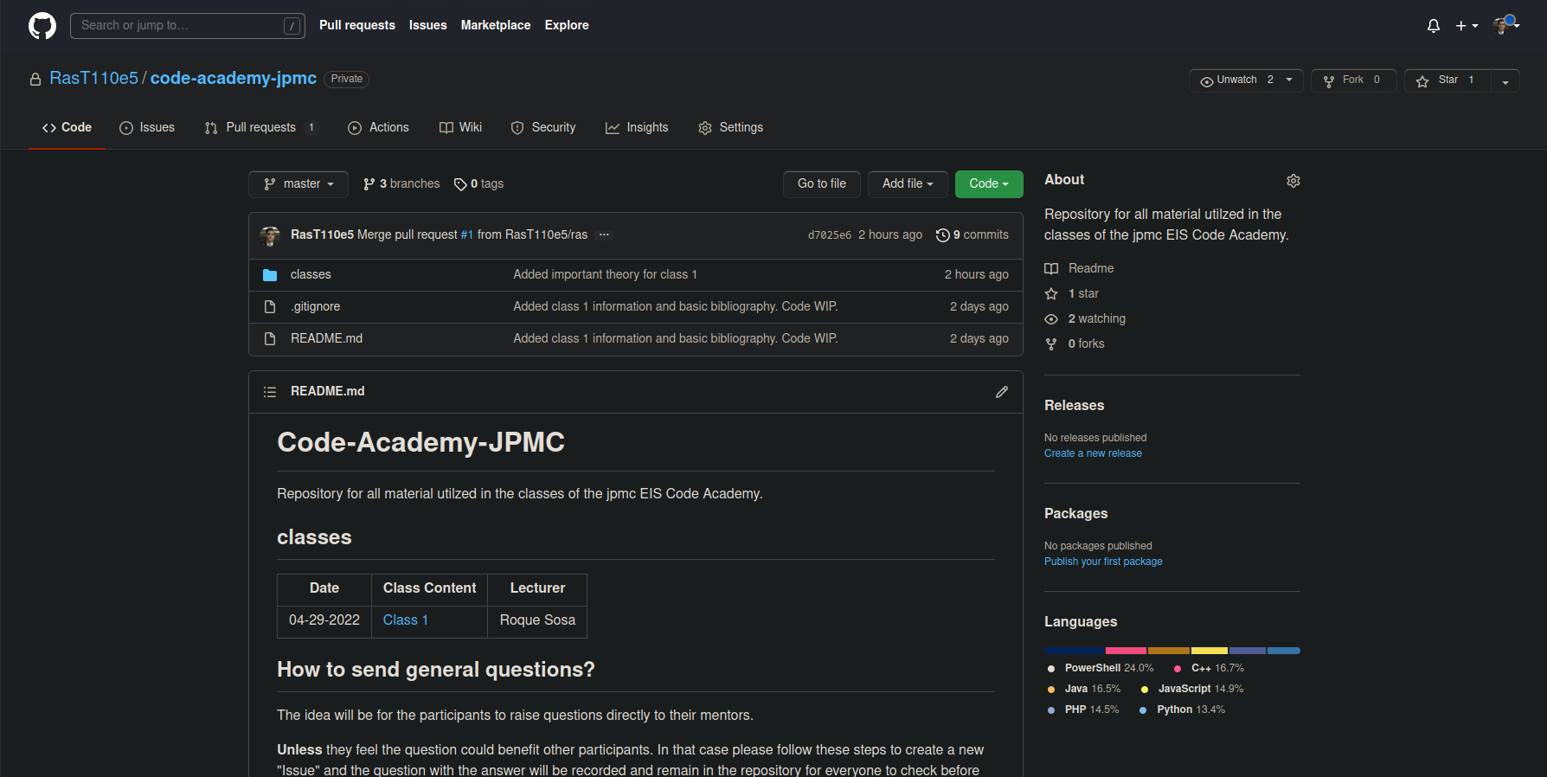
/Content Repository
JPMC Code Academy
github.com
This repository will be used to store any material we use during our classes
Class 1

Slide 7
WHAT IS CODING
JPMC Code Academy
Let’s start with defining some key terms and tools
Class 1

Slide 8
/TABLE OF CONTENTS
/01
/”Coding”
/02
/Basics
/03
/Languages to learn
/04
/Tips
JPMC Code Academy
Where does the term coding comes from?
Basics of most programming languages
What languages should you learn?
Tips on how to learn coding and the learning curve
Class 1

Slide 9
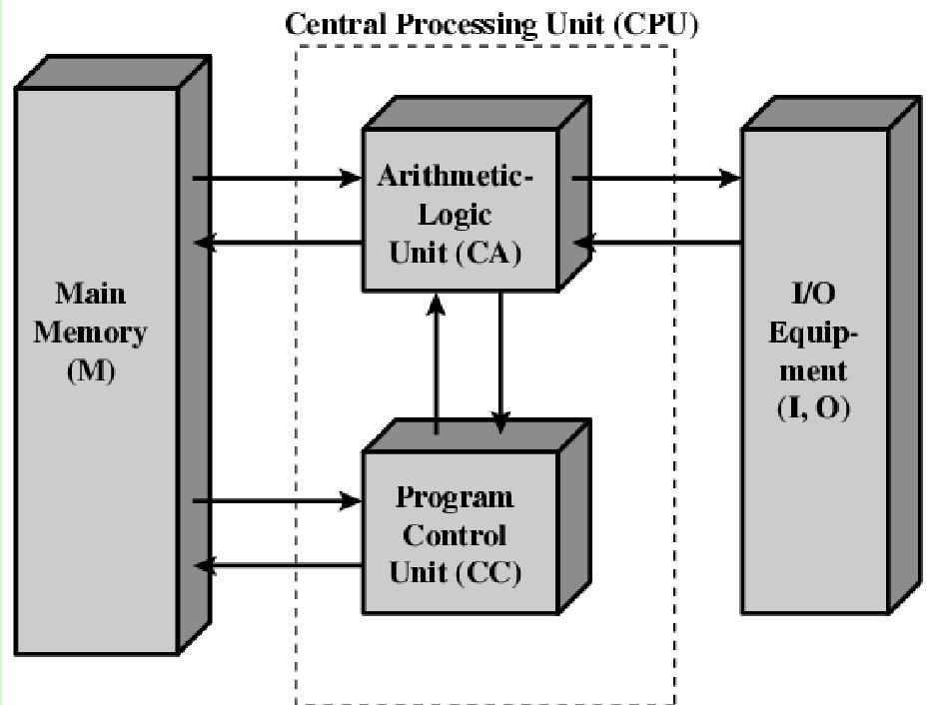
—WILLIAM STALLINGS
JPMC Code Academy
“An electronic digital programmable machine made to automatically process
information. Capable of receiving, operating over and providing the results of such operations”
Class 1

Slide 10
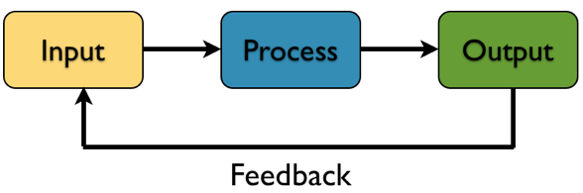
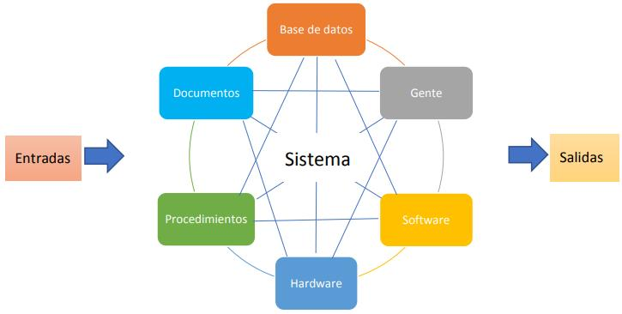
/System and Software
—IEEE 610.12-1990
JPMC Code Academy
“Organized Components to fulfill a function or set of functions”
Class 1

Slide 11
/CODING VS PROGRAMMING
JPMC Code Academy
/Coding
/Programming
Coding is the ability to write instructions from one language to another
Programming is the ability to process, interpret and assemble a set of instructions to machine executable instructions
Class 1

Slide 12
“The ability to give instructions to a computer”
JPMC Code Academy
Class 1

Slide 13

/Basics
JPMC Code Academy
Computers are dumb
Programming Languages are dumb
“Go into the shed, grab the shovel and come back”
Class 1

Slide 14
“A Programming Language is a language that is used to write instructions for a computer in a way that it can still be shared and understood by a human.”
JPMC Code Academy
Class 1

Slide 15
/BASICS OF MOST PROGRAMMING LANGUAGES
/Sequence
/Selection
/Iteration
JPMC Code Academy
Arrangement of 2 blocks in time, the exit of the first block feeds the entry of the second.
Boolean expression statements to select the continuation of the flow.
Repeated execution of a set of statements until boolean expression is no longer true.
Class 1

Slide 16
/PRACTICAL EXAMPLE
Sam is a professor at the university and likes to round each student's according to these rules:
If the difference between the grade and the next multiple of 5 is less than 3, round up to the next multiple of 5.
If the value of grade is less than 38, no rounding occurs as the result will still be a failing grade.
JPMC Code Academy
Class 1

Slide 17
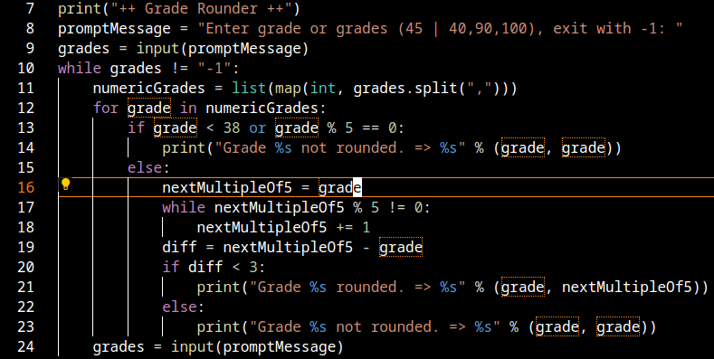
/Possible Solution
JPMC Code Academy
Class 1

Slide 18
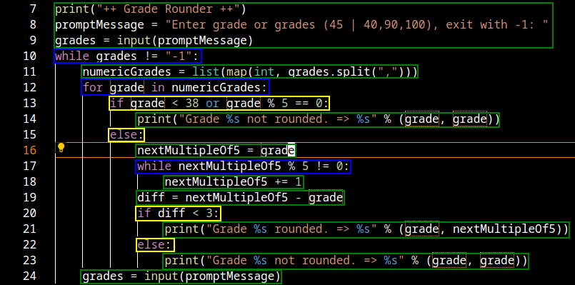
/Possible Solution
JPMC Code Academy
Class 1

Slide 19
/TIPS
/PRACTICE
/LANGUAGES
/IGNORE SMALL DETAILS
/READ
JPMC Code Academy
Coding is a creative process it comes with practice
1 Enterprise
1 Scripting
Don’t get distracted by minor details
There couldn’t possibly more documentation
Class 1

Slide 20
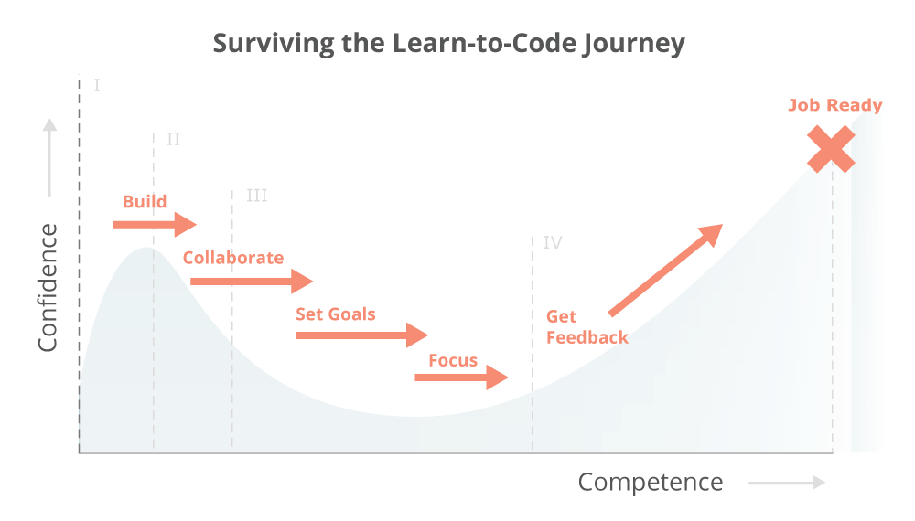
/LEARNING CURVE
JPMC Code Academy
Class 1

