Slide 1
JPMC - EIS
Code Academy
JPMC Code Academy
Class 6
Class 2

Slide 2
GIT
JPMC Code Academy
Why?
Class 2

Slide 3
/TABLE OF CONTENTS
/01
/Development process
/02
/VCSs
/03
/Git and Git culture
/04
/Commands and mistakes
JPMC Code Academy
How code is done every day
What is version control
Where Git helps you
Do and do not do
Class 1

Slide 4
/01
JPMC Code Academy
Class 2

Slide 5
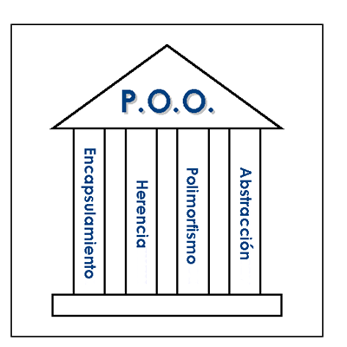
JPMC Code Academy
Class 2

Slide 6
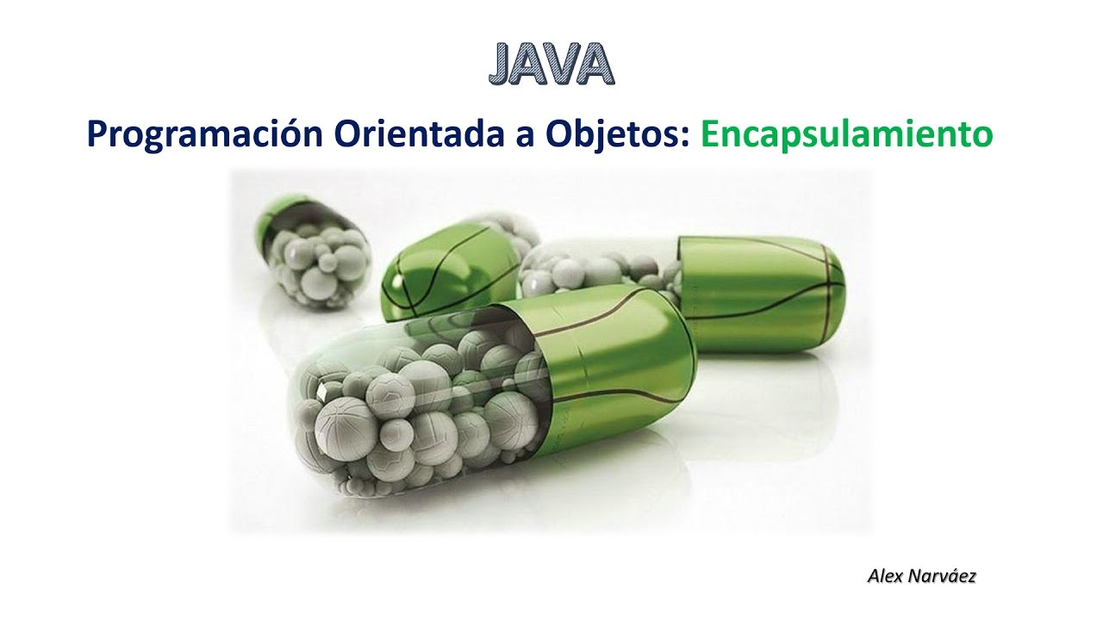
JPMC Code Academy
Class 2

Slide 7
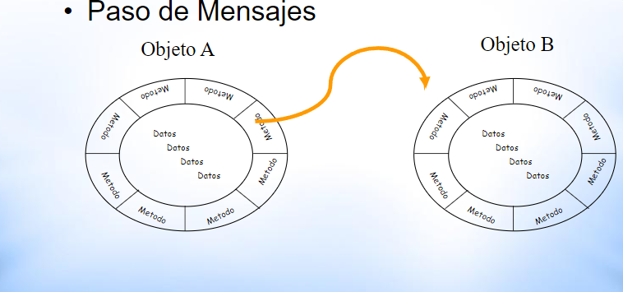
JPMC Code Academy
Class 2

Slide 8
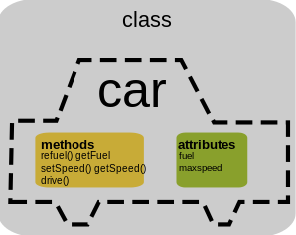
JPMC Code Academy
Class 2

Slide 9
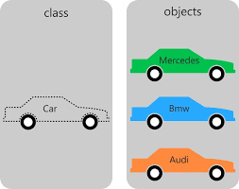
JPMC Code Academy
Class 2

Slide 10
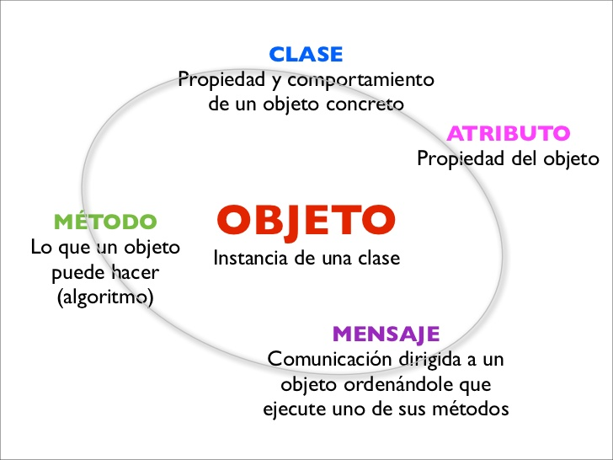
JPMC Code Academy
Class 2

Slide 11

JPMC Code Academy
Class 2

Slide 12
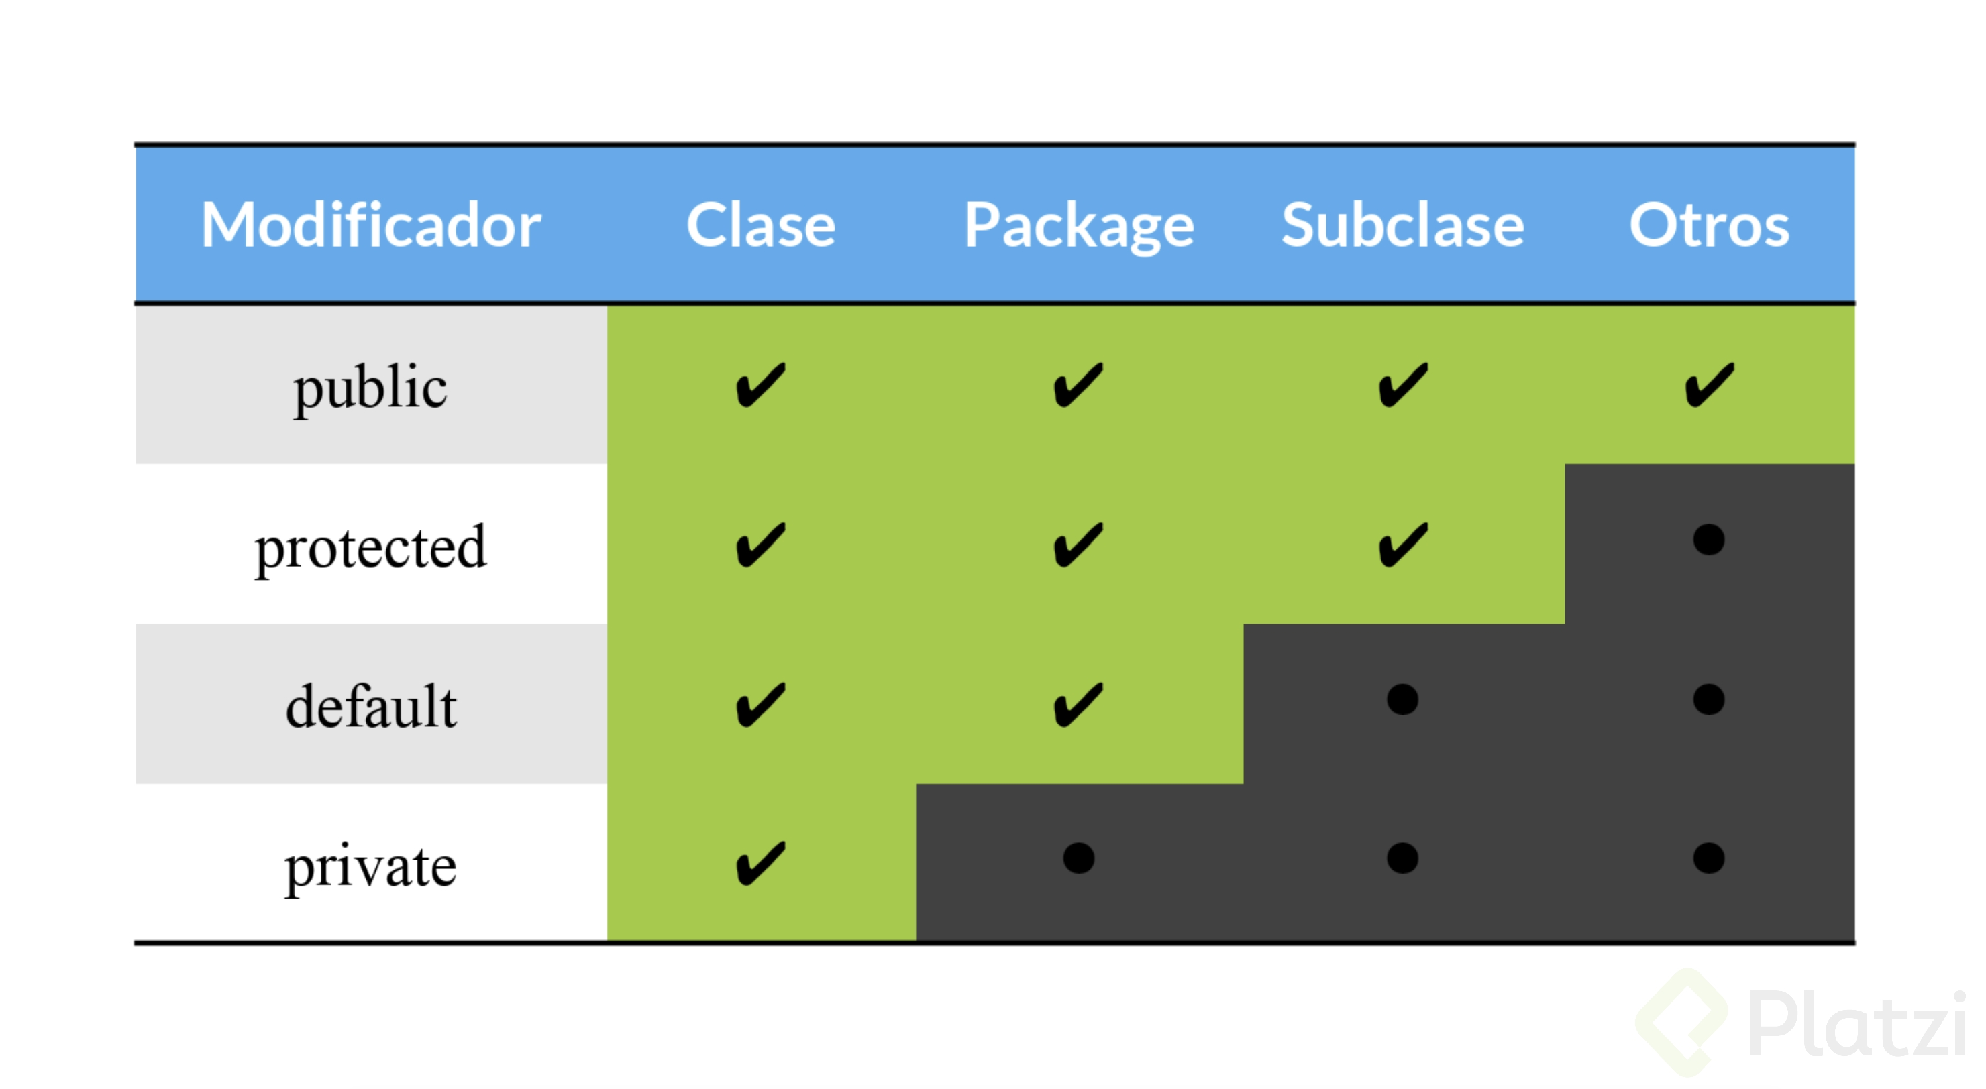
JPMC Code Academy
Class 2

Slide 13
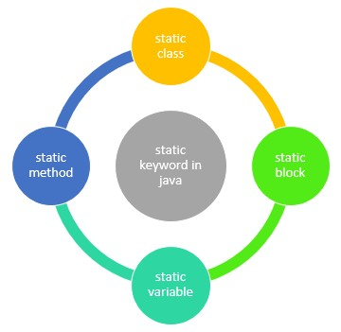
JPMC Code Academy
Class 2

Slide 14
/02
JPMC Code Academy
Class 2

Slide 15
/03
JPMC Code Academy
Class 2

Slide 16
/04
JPMC Code Academy
Class 2

