Slide 1
JPMC - EIS
Code Academy
JPMC Code Academy
Class 3
Class 3

Slide 2
/TABLE OF CONTENTS
/01
/Git Review
/02
/Local vs Remote
/03
/Branches & Commands
/04
/Coding Portfolio
JPMC Code Academy
Brief review of the last class
What is a remote repository?
What is a branch and how do I use it?
Should I have a coding portfolio?
Class 3

Slide 3
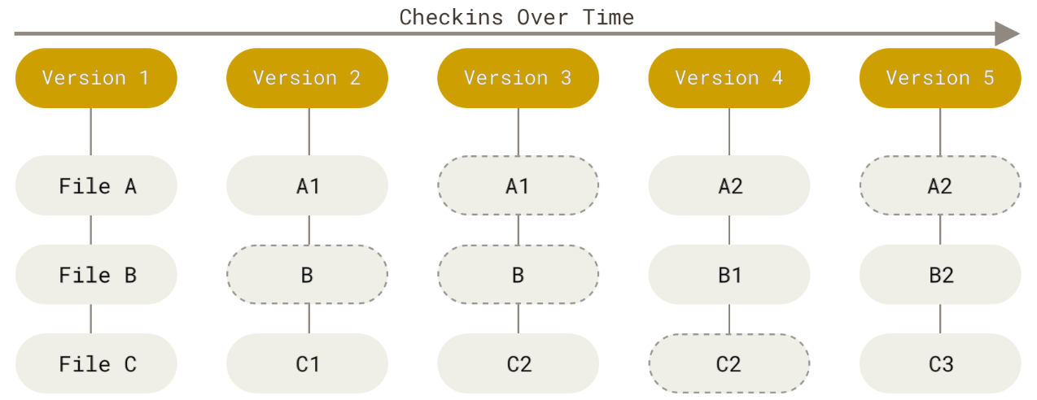
/Git Review
JPMC Code Academy
Class 3

Slide 4
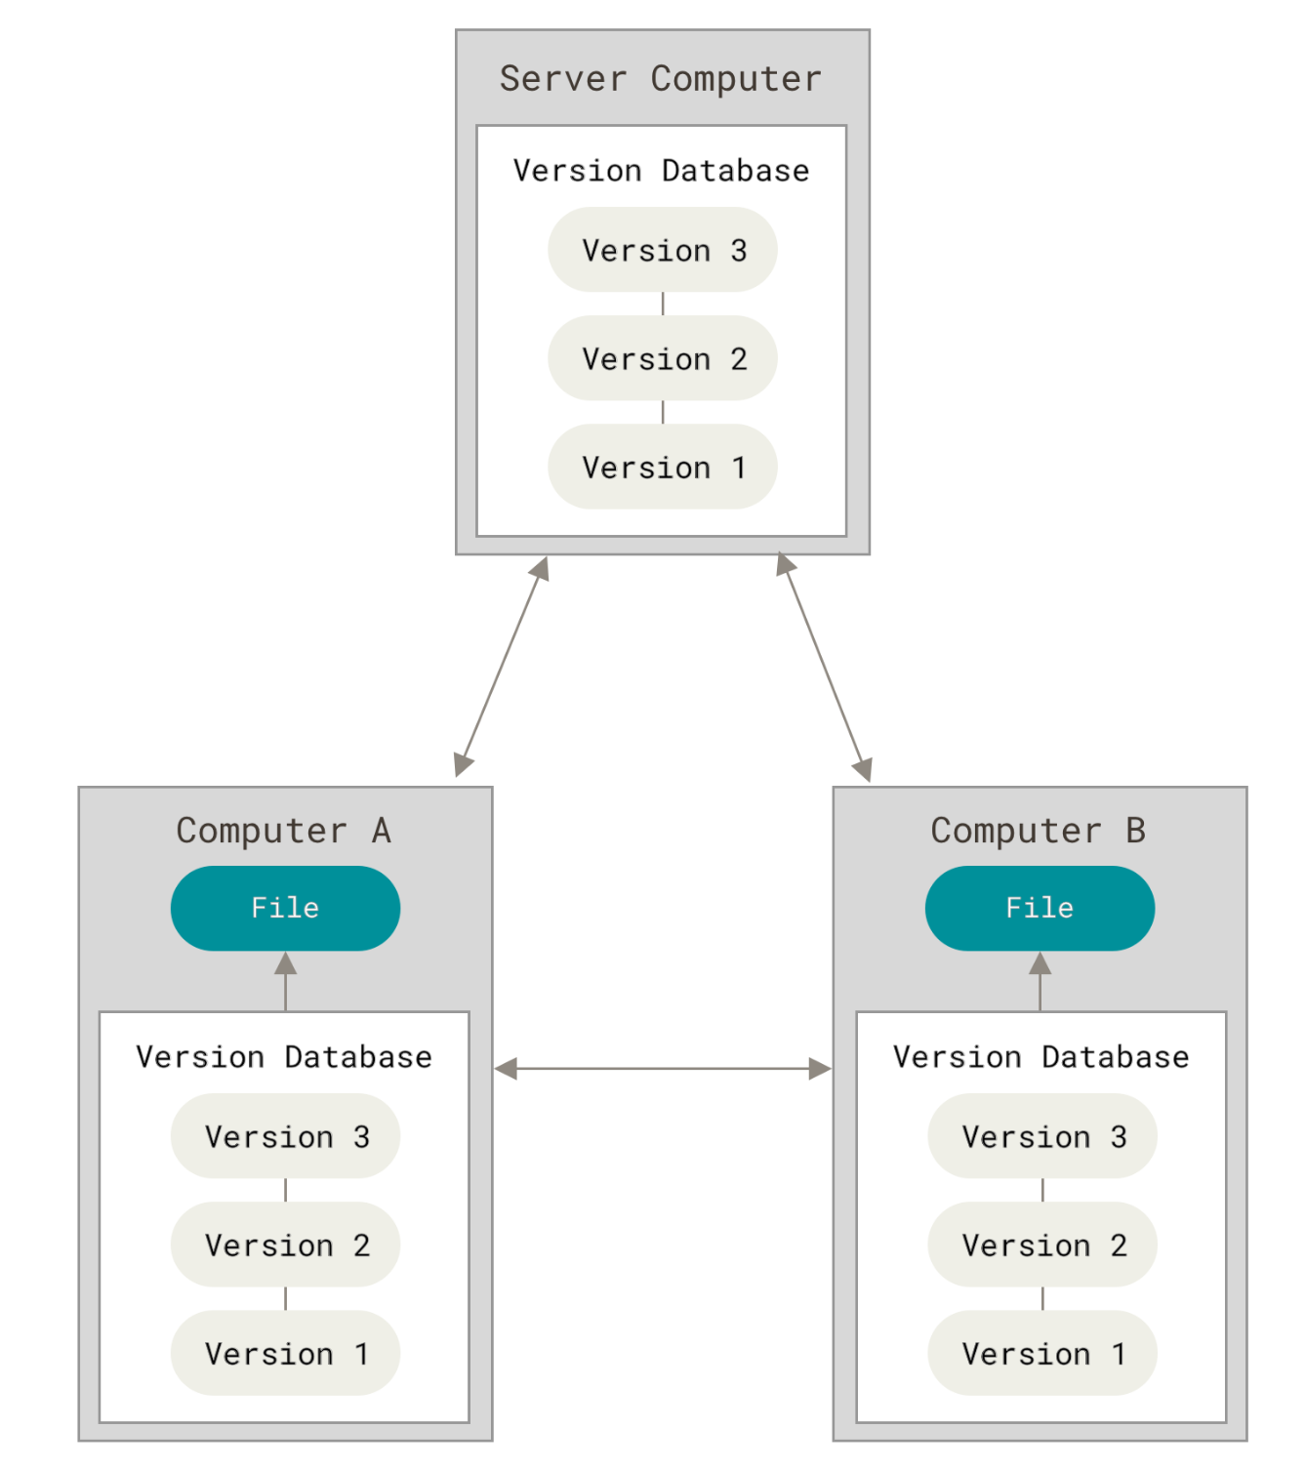
/Local vs Remote
JPMC Code Academy
- In a DVCS (Distributed Version Control System), there are multiple local repositories and a remote repository.
- From your computer’s perspective, you have a local repository and a remote repository located in a server.
- The server hosts the remote repository but there is no one that uses it. All changes happen locally.
Class 3

Slide 5
/Local vs Remote
JPMC Code Academy
Let’s create our own remote repository in GitHub
Class 3

Slide 6
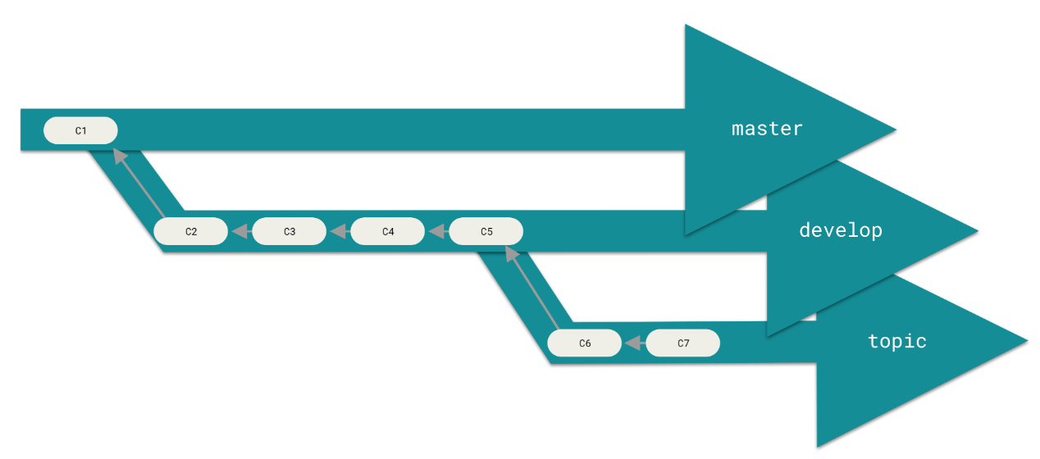
/Branches & Commands
JPMC Code Academy
A branch is a stream of snapshots or commits. Each branch can represent a version of the project where there is a main version or branch.
Class 3

Slide 7
/Branches & Commands
JPMC Code Academy
Let’s create some files and branches in our new GitHub repository
Class 3

Slide 8
/Coding Portfolio
JPMC Code Academy
Set of projects in a public repository that showcases the skills and interests of a software developer.
Works as a resume and depending where it is hosted, it also has some social network features.
Class 3

Slide 9
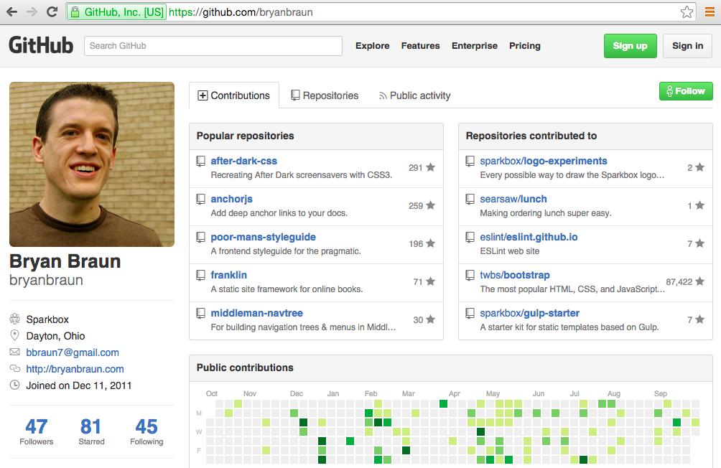
/Coding Portfolio
JPMC Code Academy
- Does my profile need to look like this?
No, and do not look at mine please.
Class 3

Slide 10
/Coding Portfolio
JPMC Code Academy
Taking into account that it is not necessary to have a coding portfolio, let’s build one!
You can upload the exercises you will be doing throught this course, so your mentor can help assess your progress as well as helping you out if you are stuck.
As a start, create an account in HackerRank (you can use your GitHub credentials).
Take on this challenge.
Class 3

