Slide 1
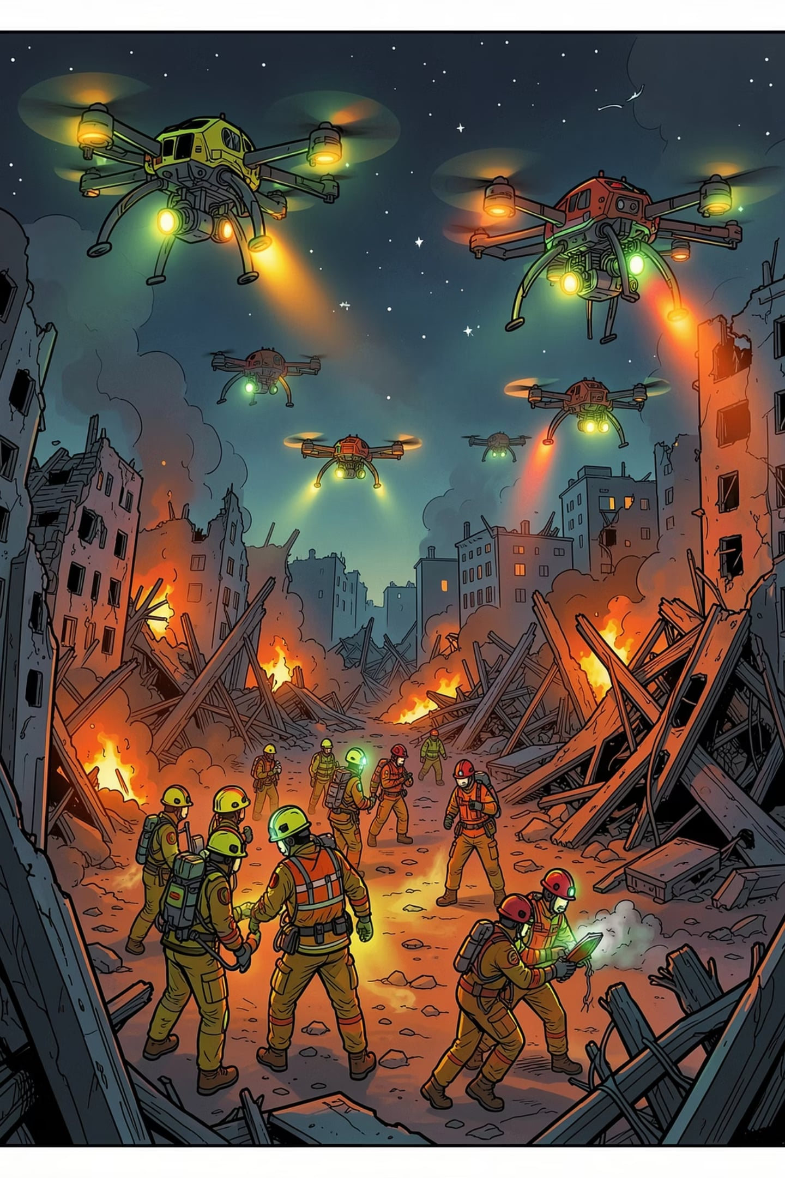
AETHER
AI-Powered Disaster Response & Relief Management
DETECT → VERIFY → EQUIP → EVACUATE
By Team Code Blooded — Rasagna Abothula · Harmanjeet Singh Kalsi · Sanjay S V

Slide 2
The Problem — and the AETHER Solution
What's Broken Today
How AETHER Responds
Delayed survivor localization — manual searches across large debris zones
High false positives — single sensors misfire on hotspots, animals, stray devices
Fragmented awareness — field teams and command centers work off different data
Manual coordination — rescue, logistics, and shelter teams relay updates by hand
DETECT
VERIFY
Multi-sensor UAVs locate probable survivors
Confidence scoring filters false positives
EQUIP
EVACUATE
Relief inventory tracked & dispatched in real time
Evacuees routed to the nearest suitable shelter

Slide 3
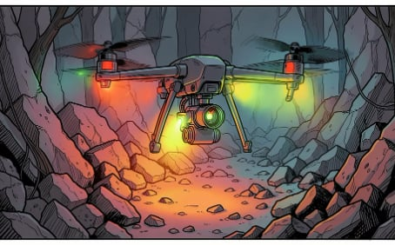
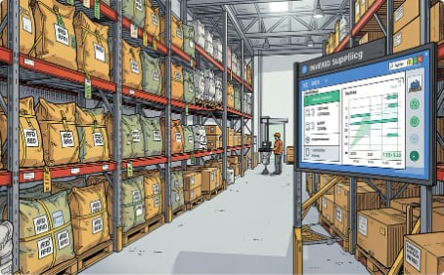


Three Core Modules, One Unified Platform
Multi-Sensor Survivor Detection
Smart Relief Inventory
Intelligent Shelter Management
BLE, thermal imaging & UWB fused through a confidence-scoring engine to prioritize high-probability survivor locations.
RFID/digital tags track supplies in real time, with low-stock alerts and centralized visibility across sites.
Live occupancy and GPS-based recommendations route evacuees to the nearest suitable shelter.
Key Benefits
Stakeholders & Tech Stack
Faster survivor identification through sensor fusion
Real-time inventory & shelter visibility for command teams
Resilient connectivity even when infrastructure fails
Modular design ready for AI routing & predictive allocation
Response Forces · NDRF, SDRF, fire & emergency services, civil defence
Government & EOCs · SDMAs, municipal corporations, Emergency Operations Centers
Humanitarian Orgs · Indian Red Cross Society, NGOs, volunteer groups
Industry & Infrastructure · Smart cities, airports, ports, mining, oil & gas, large campuses
Stack: React.js · FastAPI · PostgreSQL · Firebase · DJI/PX4 UAVs · BLE · UWB · Thermal · RFID · Cisco Meraki · Splunk
GitHub: github.com/Rasagna-05/AETHER

