Slide 1

Decoupling Identity Confounders for Enhanced Facial Expression Recognition: An Information-Theoretic Approach
EE656 - COURSE PROJECT
Abothula Rasagna (230051)
Dhruv V. Shetty (230370)
Prince Yadav (230792)
Vrutika Rao (231177)
How It Works, Where We See It, and Why It Matters

Slide 2

OBJECTIVE
Contents
Summary of the paper
Technical Concepts
Implementation Strategy
Code Modules
Outcomes and Results
Challenges faced
Conclusion

Slide 3

Objective
To understand and implement the core concepts of the DICE-FER framework, which decouples facial expressions from identity features using mutual information estimation—without relying on identity labels or image generation. This project focused on applying the method to a custom-built dataset in a real-world setting.

Slide 4



Solution
Summary of the paper
Facial Expression Recognition is often affected by identity-specific features, making it difficult to isolate the actual emotional expression . Prior methods use GANs or labels for disentanglement, but these are costly or impractical.
Using mutual information to extract shared expression features and remove identity confounders.
Utilizing paired images with the same expression to decouple expression and identity representations.
Avoidinng label dependency or costly image generation

Slide 5

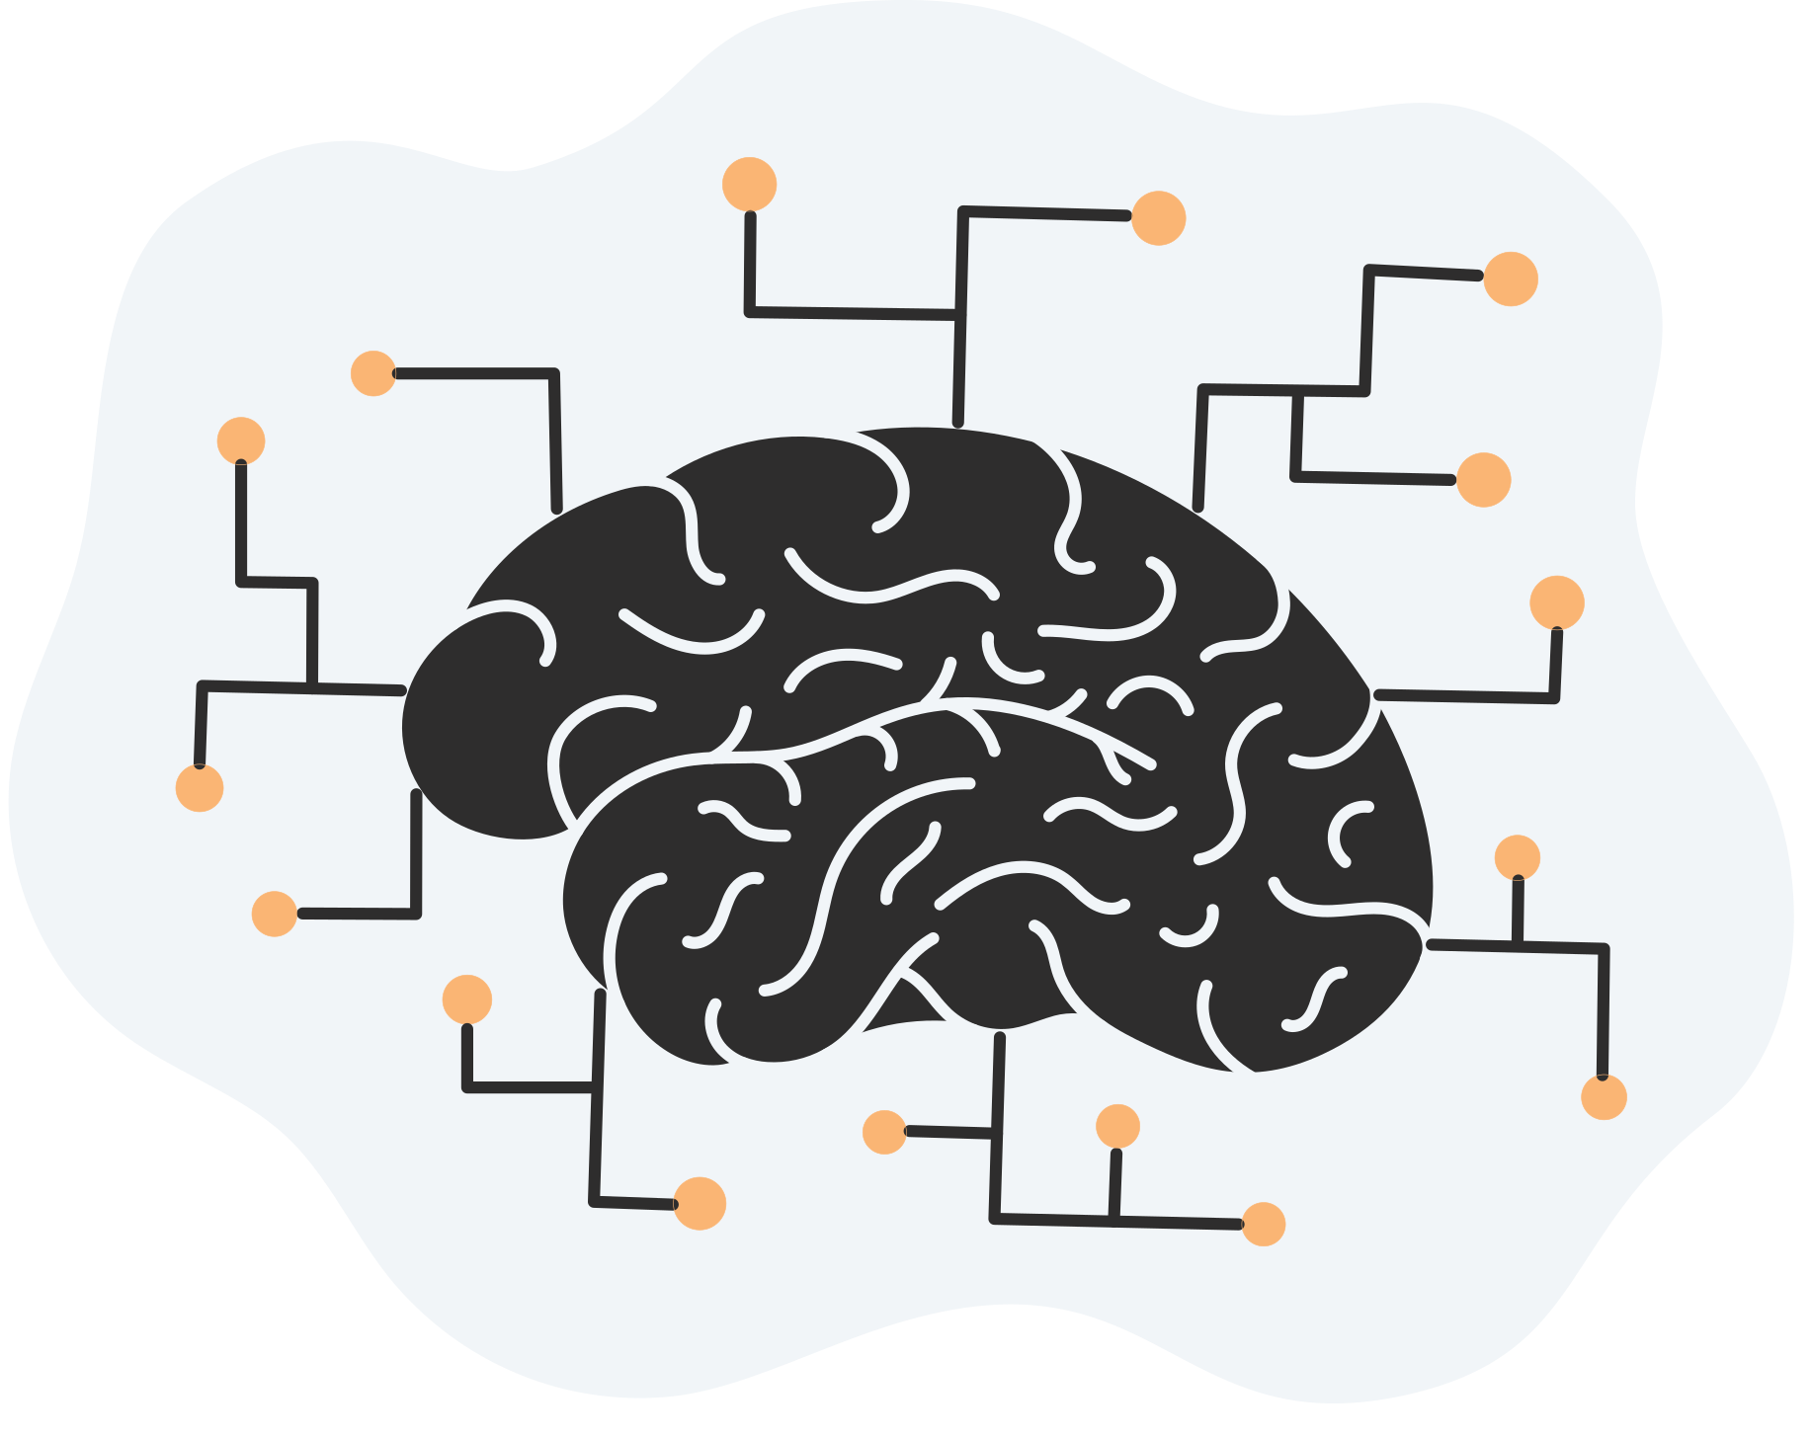

TECHNICAL CONCEPTS
MUTUAL INFORMATION
MI measures the amount of information shared between two variables. It is estimated using the Donsker-Varadhan (DV) representation:
I(M,Z) ≈ Ep[M,Z][ Uθ(m,z)]−log(Ep[M]p[Z][exp(Uθ(m,z))])
CORE COMPONENTS
  Expression Encoder (E_exp)
  Identity Encoder (E_id)
  Statistics Networks
  Discriminator (D)

Slide 6

Implementation Strategy
Expression Representation Learning
Identity Representation Learning
  Concatenate expression and identity features to get total representation.
  MI is maximized between the original image and total representation.
  An adversarial loss minimizes MI between identity and expression features.
  Paired images M and N (with same expressions) are fed through encoders.
  MI is maximized between image M and N’s expression, and vice versa.
  A swapping trick is used to remove identity information.
Final Loss:
Adversial Loss:

Slide 7



Code Modules
Network Architectures
Dataset and Preprocessing
  Encoders: ResNet-18
  Statistics Networks: 2-layer FC networks.
  Discriminator: 3-layer FC network.
  Classifier: FC layers trained on disentangled expression vectors.
  We made our own dataset by clicking pictures of various people, gathering 1800+ photos in the dataset.
  Preprocessing: Face alignment using MTCNN, gray-scaled and resized to 112×112.
Training Pipeline
  Stage 1: Train E_exp, U, using MI maximization and L1 loss.
  Stage 2: Fix E_exp, train E_id, U, D to maximize image-feature MI and minimize expression-identity MI.
  Train classifier on expression features.

Slide 8





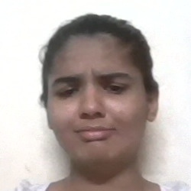








Dataset
Angry
Disgust
Fear
Happy
Neutral
Sad
Surprise
Preprocessingn

Slide 9

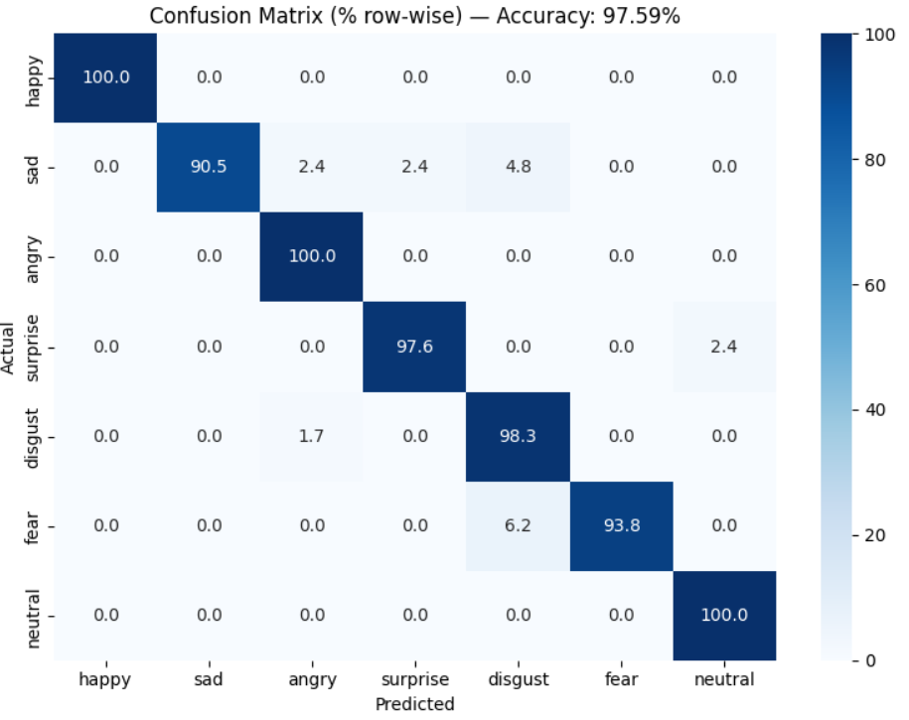
Outcomes and Results
The DICE-based expression recognition model achieved a peak accuracy of ~99.5% of train set and >90% of test set on seven-class facial expression datasets. Through staged training and mutual information minimization, the model effectively disentangled identity from expression features. t-SNE visualizations showed clear expression-wise clustering with minor confusion between similar emotions like fear and surprise. Sample predictions demonstrated accurate and consistent classification across identities, validating the effectiveness of the disentanglement approach.
Confusion matrix

Slide 10


Challenges
  Faced difficulty implementing and stabilizing mutual information minimization using Deep InfoMax-style discriminators.
  Had to manually curate and preprocess a custom facial expression dataset due to limited access to standard datasets.
Learnings
Through this project, we gained hands-on experience with representation learning, encoder-decoder architectures, and the practical value of disentangled features in improving generalization for facial expression recognition.

Slide 11
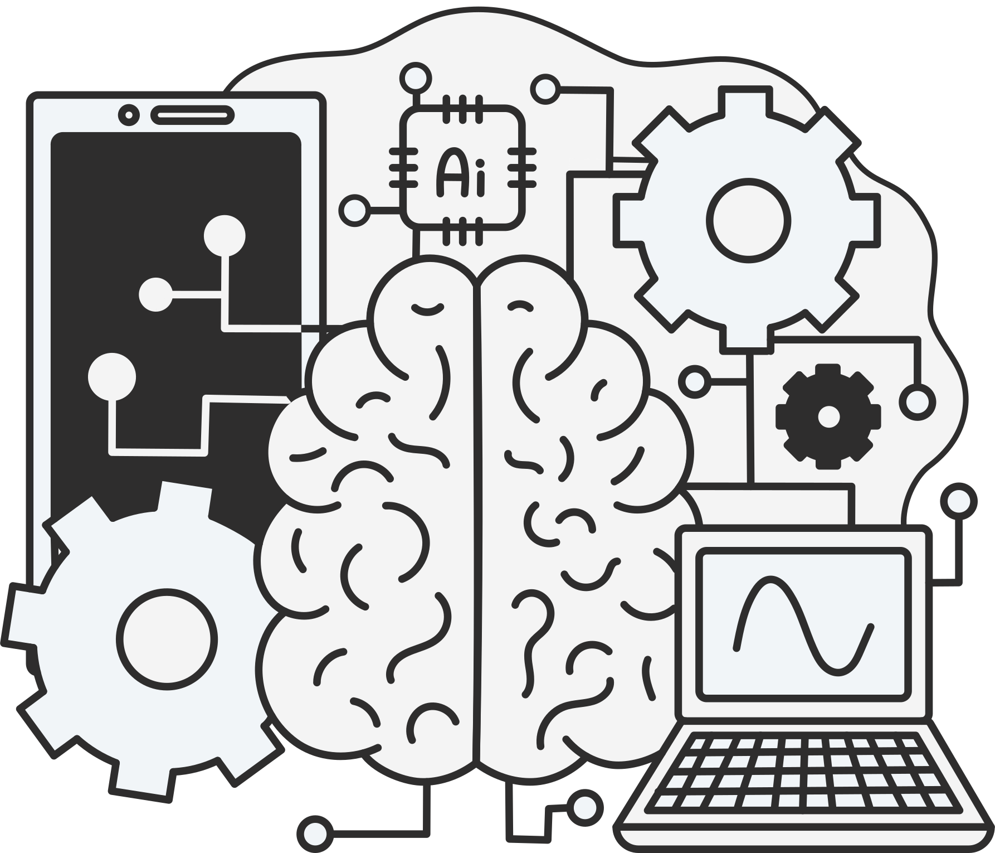
Conclusion
This project successfully implemented the DICE framework to address identity bias in facial expression recognition. By disentangling identity and expression features through staged training and mutual information minimization, the model achieved improved accuracy and generalization. The results highlight the value of representation disentanglement in building more robust and identity-invariant FER systems, especially when working with limited or custom datasets.

Slide 12

Thank You

