Slide 1

MALLA REDDY COLLEGE OF ENGINEERING & TECHNOLOGY (Autonomous Institution – UGC, Govt. of India) DEPARTMENT OF COMPUTER SCIENCE AND ENGINEERING
NeuroGuard : Intelligent Identity Verification System
Team – C14( CSE - IV C) P. Rasagna -22N31A05G4 P. Ramya - 22N31A05H7 P.Vishnuvardhan -22N31A05H2
Under the Guidance of
Ms. T.Ramanama
Assistant Professor

Slide 2
AGENDA
Abstract
Introduction
Existing system
Proposed system
Software and Hardware Requirements
Literature survey
UML Diagrams
Technologies
Modules Explanation
Output screens
Conclusion
Future scope
References

Slide 3
Abstract
This paper presents NeuroGuard, an AI-based biometric authentication system designed to enhance digital security through facial identity verification. The system integrates multi-factor authentication with real-time face recognition and liveness detection to prevent spoofing attacks and unauthorized access. It extracts facial features and compares them with encrypted templates to ensure accurate authentication. Deep learning models improve recognition accuracy and system reliability. NeuroGuard strengthens access control systems and reduces identity fraud in digital environments.

Slide 4
Introduction
Growing need for secure authentication systems
Password-based systems are vulnerable to hacking
Biometric authentication provides higher security
AI and Deep Learning improve recognition accuracy
Real-time verification enhances reliability
Rise in identity fraud enhances reliability

Slide 5
Existing system
Uses only username and password
Easily hackable or shareable
No liveness detection
No biometric validation
Vulnerable to spoofing attacks
Limited monitoring and logging

Slide 6
Proposed system
AI-based facial recognition login
Multi-factor authentication
Liveness detection (prevents photo/video )
Encrypted biometric data storage
Real-time identity verification
Secure access logs and monitoring
User-friendly interface

Slide 7

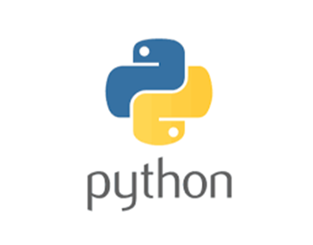

Software Requirements
Backend : Python (Flask/Django) Programming Language : Python 3.9+ Face Recognition : OpenCV, Face Recognition Library Machine Learning : TensorFlow / PyTorch Frontend : HTML, CSS, JavaScript Database : SQLite / MySQL Development Tool : VS Code Operating System : Windows

Slide 8
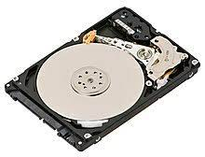
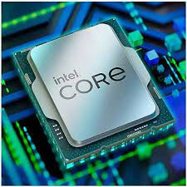
Hardware Requirements
Processor : Intel i5 / Ryzen 5 or higher RAM : Minimum 8GB (16GB recommended) Storage : 20GB free space Webcam : Required for face capture Internet : For model updates

Slide 9
Literature Survey
S.no. | Author(s) & Journal Details
1 | J. Devlin, M.-W. Chang, K. Lee, K. Toutanova — NAACL 2019 | BERT: Pre-training of Deep Bidirectional Transformers for Language Understanding | Introduced contextual embeddings that greatly improve downstream tasks like NER, QA, and text classification—strong base for information extraction.
2 | G. Lample, M. Ballesteros, S. Subramanian, K. Kawakami, C. Dyer — ACL 2016 | Neural Architectures for Named Entity Recognition | Showed BiLSTM-CRF as an effective end-to-end method for extracting entities from text, reducing manual feature engineering.
3 | Y. Xu et al. — KDD 2020 | LayoutLM: Pre-training of Text and Layout for Document Understanding | Combined text with page layout for forms/invoices; boosted key-value extraction accuracy from scanned documents—useful for data extraction from PDFs.
Title of the paper
Outcome

Slide 10
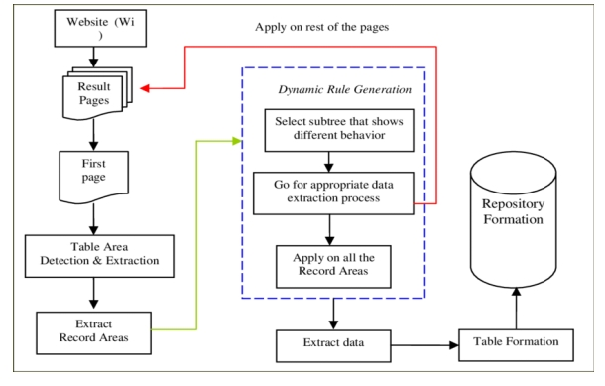
Architecture

Slide 11
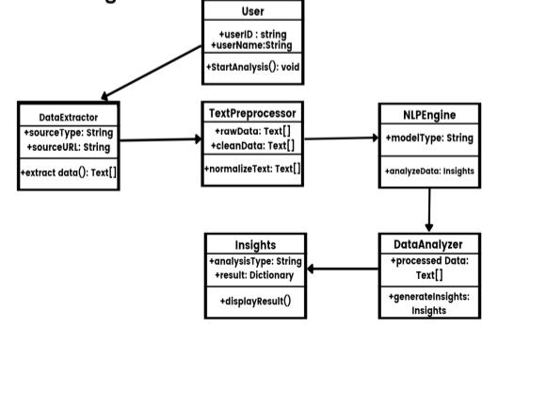
UML Diagrams 1.Class Diagram

Slide 12
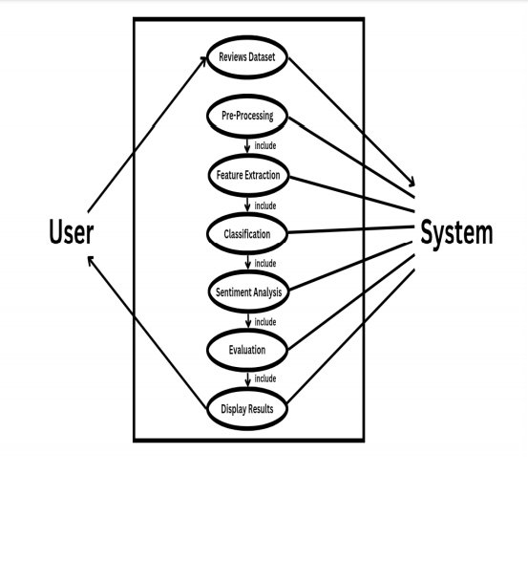
2.Use Case Diagram

Slide 13
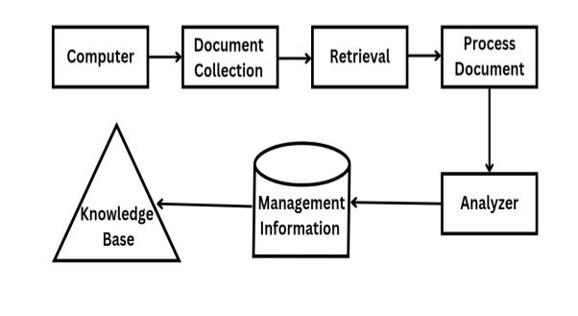
3 Dataflow Diagram

Slide 14
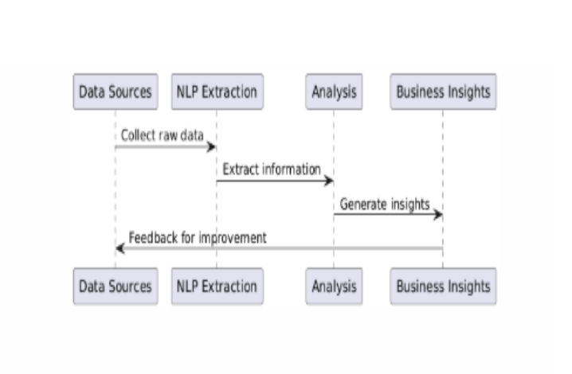
4.Sequence diagram

Slide 15
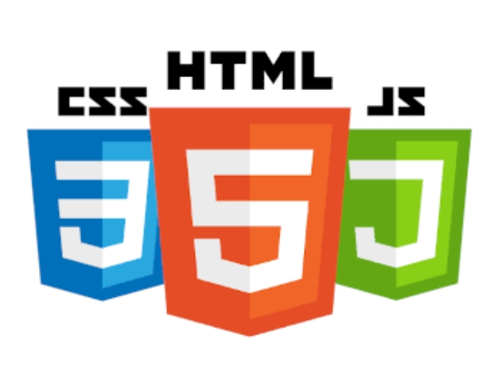
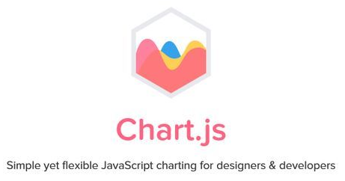
Technologies Used
Frontend Technologies
HTML, CSS, JavaScript • For building user-friendly interface and visualization.
Chart.js / Matplotlib / Seaborn • For displaying interactive graphs and charts of NLP results
Database Technologies :
SQLite / MySQL • To store extracted text data, processed features, and analysis results.

Slide 16



Technologies Used
Backend Technologies :
Python • Core language for implementing NLP and backend logic.
Flask / Django • Web framework for backend API and integration.
NLP & Machine Learning Libraries :
NLTK (Natural Language Toolkit) • Tokenization, stop-word removal, POS tagging, stemming & lemmatization.
spaCy • Named Entity Recognition (NER), dependency parsing, and text processing.
Scikit-learn • Text classification, clustering, sentiment analysis.
Transformers (Hugging Face) • Pre-trained language models like BERT, RoBERTa for advanced NLP tasks

Slide 17
Module Description
1. Data Collection & Preprocessing
Collects text data from files or web.
Cleans unwanted symbols and stop words.
Splits text into tokens (words).
Converts words into their basic form.
2. NLP Processing & Feature Extraction
Finds parts of speech (noun, verb, etc.).
Detects names, places, and dates (NER).
Creates word representations (TF-IDF, embeddings).
Picks out keywords and important phrases.

Slide 18
Module Description
3. Analysis & Visualization
Checks text sentiment (positive/negative/neutral).
Groups text into categories or clusters.
Finds hidden topics in documents.
Shows results using charts and word clouds.
4. User Dashboard & Management
Easy interface for users.
Upload text data for analysis.
View results in dashboard.
Download reports and manage users.

Slide 19
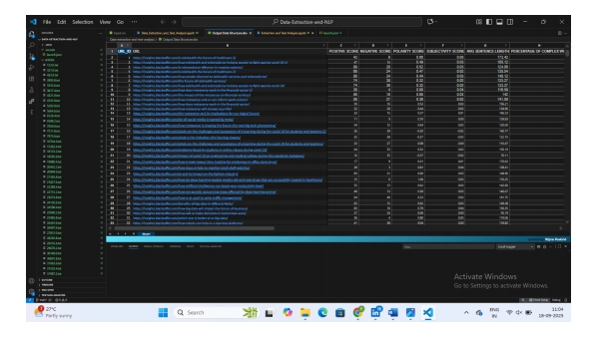
Output Screens

Slide 20
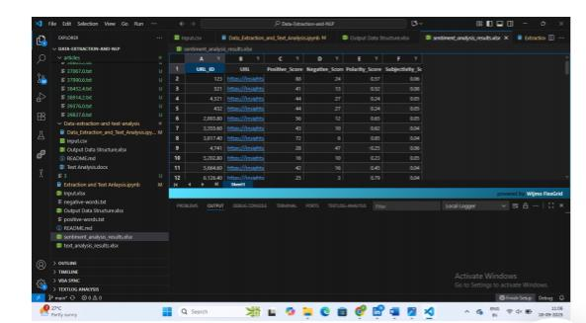
Output Screens

Slide 21
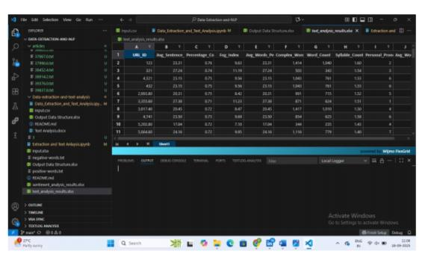
Output Screens

Slide 22
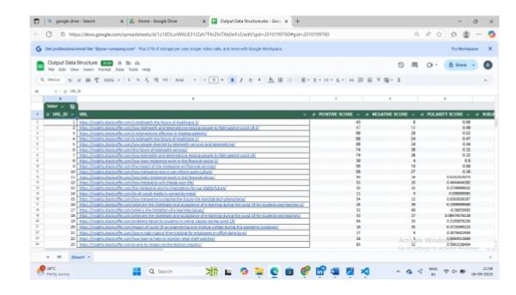
Output Screens

Slide 23
Conclusion
Extracted data from online sources successfully.
Cleaned and preprocessed text using NLP techniques.
Performed sentiment and readability analysis.
Converted unstructured text into structured insights.
Proved usefulness of NLP for data analysis task

Slide 24
Future Scope
Automating extraction from more diverse data sources (PDFs, images, social media).
Applying advanced NLP models (like BERT, GPT) for deeper text understanding.
Integrating topic modeling and text summarization for better insights.
Building a dashboard to visualize extracted data and analysis results.
Expanding to multilingual data extraction and analysis

Slide 25
References
Jurafsky, D. & Martin, J. H. (2023). Speech and Language Processing (3rd Edition Draft). Stanford University.
Bird, S., Klein, E., & Loper, E. (2009). Natural Language Processing with Python. O’Reilly Media.
Manning, C. D., Raghavan, P., & Schütze, H. (2008). Introduction to Information Retrieval. Cambridge University Press.
Vaswani, A., et al. (2017). “Attention Is All You Need.” Advances in Neural Information Processing Systems (NeurIPS).
Pedregosa, F., et al. (2011). “Scikit-learn: Machine Learning in Python.” Journal of Machine Learning Research, 12, 2825–2830.

Slide 26
THANK YOU

