Slide 1

SecureDev: A Cloud-Native Security Reasoning and Automated Remediation Platform
CNAD Project Review-2
23 – 09 - 26
 | Under the Guidance of Dr.Patha Srilatha Associate Professor Department of CSE, KLH CSE Bowrampet Campus
Team Members D. Rasagna - 2420030177 K. Thanusree - 2420030442 G. Swaraja - 2420090085

Slide 2
Outline of Project Work
Focus
Introduction
Literature Survey
Challenges
Research Objectives
Conclusion & Future Work
References
Publications Details

Slide 3
Problem Statement
Cloud-native applications span source-code repositories, CI/CD pipelines, container images, Kubernetes environments, and cloud services – each stage introduces its own opportunities for security failure.
Common risks include exposed API keys, vulnerable Docker configurations, excessive IAM permissions, and insecure deployment workflows.
Existing security tools typically scan one layer at a time and operate in isolation, without correlating findings across the pipeline.
This fragmentation allows multi-step, cross-layer attack paths to go undetected until insecure applications have already reached production.

Slide 4
Objectives
Develop a centralized security evidence collection system
Normalize heterogeneous security findings
Perform cross-layer security correlation
Generate attack paths
Prioritize security risks
Recommend remediation
Validate remediation

Slide 5
Literature Survey
Authors/Source | Title of the Paper | Methodology | Inference | Limitation/Gap
Ou et al. | Automated Attack-Graph Generation | Attack graphs represent possible attack paths through system vulnerabilities | Attack graphs can model multi-step attacks | Traditional approaches can become complex for large environments
Sheyner et al. | Automated Attack-Graph Analysis | Formal attack-graph generation and analysis | Demonstrates systematic attack-path analysis | Focus is primarily on attack modeling rather than modern cloud-native DevSecOps workflows
SecureDev | Cross-layer security reasoning | Scanner evidence + normalization + correlation + remediation + validation | Provides an integrated workflow from detection to validated remediation | Project implementation and evaluation are future work

Slide 6
Problem Gap Identification
Existing situation
Gitleaks → Secrets
Trivy → Vulnerabilities
Checkov → IaC
Prowler → Cloud
IAM → Permissions
Key gaps addressed by SecureDev :
Gap 1 — Fragmented findings
Security information is distributed across multiple tools.
Gap 2 — Lack of cross-layer context
A source-code issue may be related to an IAM or cloud-resource issue.
Gap 3 — Alert overload
Multiple findings may represent one larger security problem.
Gap 4 — Remediation uncertainty
Fixing an individual finding does not necessarily remove the complete attack path.
Gap 5 — Lack of validation
A proposed security fix needs to be verified for both security improvement and application functionality.

Slide 7
Innovation, Creativity, and Novelty
Unified Security Analysis: Combines findings from source code, containers, IaC, CI/CD, IAM, and cloud environments in one platform.
Cross-Layer Correlation: Connects individual security findings to identify relationships and potential attack paths.
Context-Aware Risk: Prioritizes risks based on severity, asset importance, permissions, and attack-path relationships.
Automated Remediation: Provides actionable fixes for identified security issues instead of only reporting vulnerabilities.
Remediation Validation: Re-scans and verifies whether the security risk is reduced while ensuring application functionality is maintained.
Key Novelty
SecureDev moves from “detecting individual vulnerabilities” to “understanding connected security risks and validating their remediation.”

Slide 8
Feasibility and Project Plan
Feasibility
Built on established, freely available open-source tools (Git, Docker, Kubernetes/Minikube, Trivy, Argo CD, GitHub Actions/Jenkins), keeping the project deployable within an academic timeframe.
Modular design lets core layers (Git scanning, Docker scanning, IAM analysis) be built and demoed independently before full integration.
Cloud components can be validated on a free-tier AWS/Azure/GCP account, keeping infrastructure cost low.
Project Plan (Phase-wise)
Phase 1: Requirement analysis and literature survey
Phase 2: Git/GitHub and Docker container security scanning module
Phase 3: Cloud IAM analysis and CI/CD security gates
Phase 4: Attack-path modeling and risk correlation engine
Phase 5: Automated remediation and cloud-native deployment
Phase 6: Testing, validation, and final report

Slide 9
Current WorkFlow
Workflow-
Open the Security overview and show total, critical, high, and open finding counts.
Navigate to Scan findings to review the stored findings.
Search by keyword and combine severity and status filters.
Resolve an open finding, refresh the page, and show the persisted status; reopen it if needed.
Open View remediation to show the rule-based recommended steps.

Slide 10
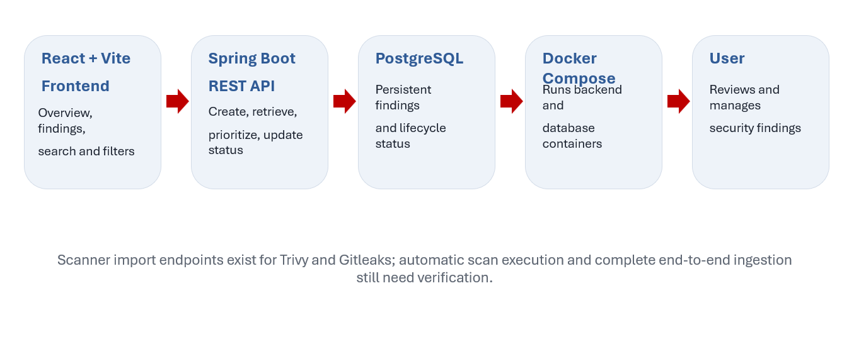
Current Prototype Architecture

Slide 11
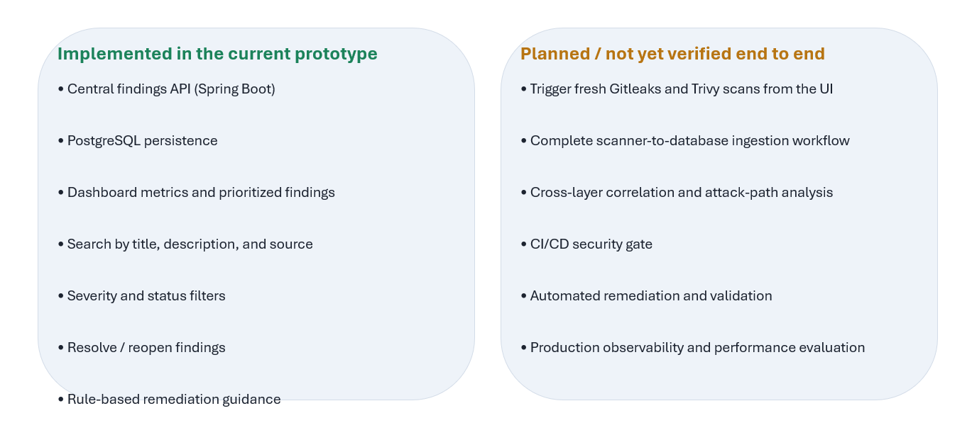
Project Objectives and Current Scope

Slide 12
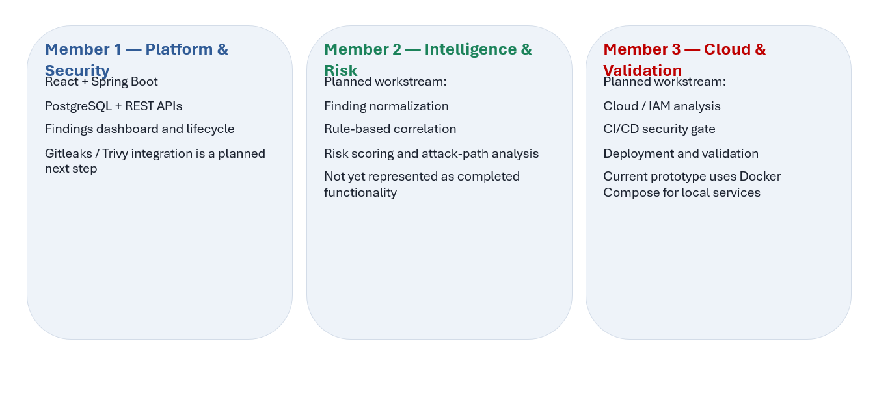
Team Structure and Workstreams

Slide 13
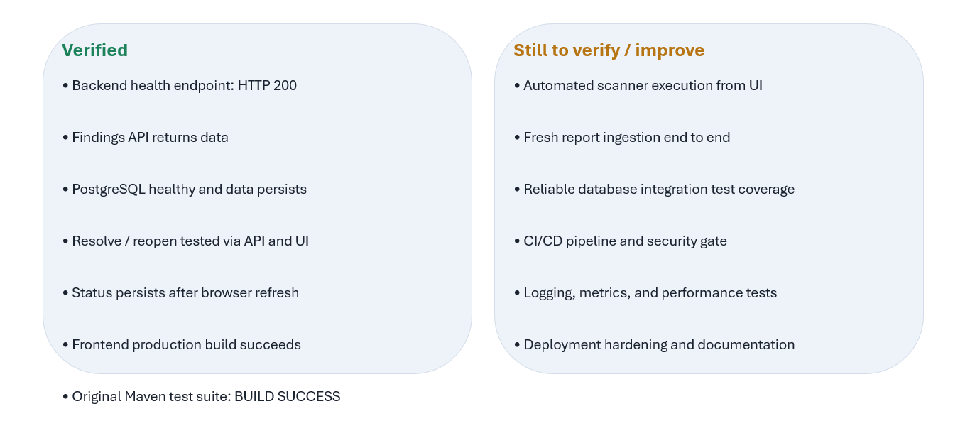
Validation and Current Evidence

