Slide 1
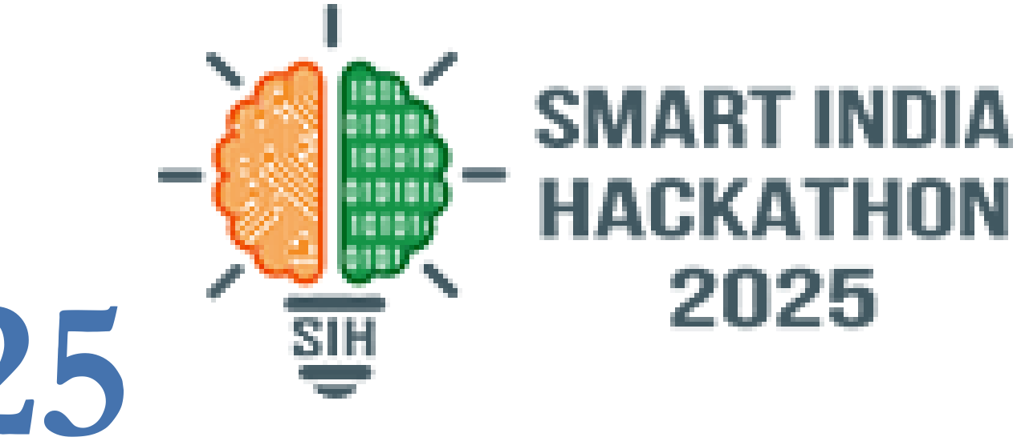

SMART INDIA HACKATHON 2026
TITLE PAGE
• Problem Statement ID – 26041
• Problem Statement Title- AR-Based Vocational Training Simulator for Industrial Safety in Jharkhand's Mining & Manufacturing Sector
• Organization- Department of Higher & Technical Education, Government of Jharkhand
• Theme- Smart Education (Vocational & Skill Training)
• Sub-Theme- Blockchain & Cybersecurity (Tamper-Proof Verification)
• PS Category- Software
• Team ID- 53476
• Team Name (Registered on portal) : SHADOW STACK

Slide 2
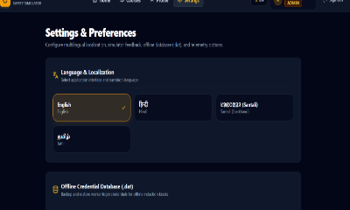
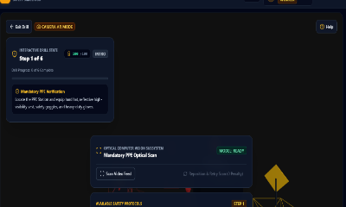
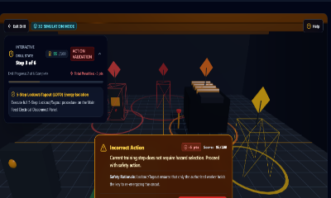
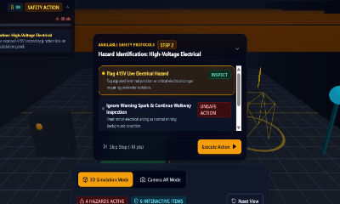
SHADOW
STACK
THE SOLUTION
AI-POWERED SEMI OFFLINE AR SAFETY TRAINING & VERIFIABLE CERTIFICATION
PROPOSED SOLUTION
• Android-First WebAR: Zero-headset 3D interactive training platform running directly in mobile browsers on standard ₹10k smartphones.
• On-Device AI Assessment: Client-side state machine evaluates worker procedural sequence, reaction time, and PPE selection.
• 100% Offline Underground Operation: Preloaded site drill packages execute without cellular or Wi-Fi in deep underground mine shafts.
• Cryptographic .dat Local DB: NIST SHA-256 Merkle root hashing guarantees offline data integrity and tamper detection.
• Tamper-Proof Blockchain Credentials: Automated on-chain Ethereum minting with public QR verification at /verify against fraud.
HOW IT ADDRESSES PROBLEM
• Replaces Static Textbooks: Converts passive, unengaging 100-page manuals into hands-on spatial muscle memory for emergency response.
• Empowers Tribal Demographics: Full vernacular voice and HUD localization in Santali (`sat`) and Hindi (`hi`) for Jharkhand workers.
• Overcomes Deep Shaft Isolation: Works seamlessly in remote coal pits (Jharia, Dhanbad) where cloud tools fail completely.
• Competency Over Attendance: Measures real procedural compliance and decision-making—eliminating fake paper proxy sign-ins.
• Eliminates Physical Risk: Workers safely rehearse high-voltage arc flash, gas leaks, and roof collapse without physical danger.
INNOVATION & UNIQUENESS
• AI + AR + Edge Inference: 60 FPS Three.js WebGL simulation with on-device state engine running on low-resource hardware.
• Self-Contained .dat Snapshots: Cryptographically sealed local database; changing even 1 byte triggers instant tamper alert.
• Public QR Verification Portal: Government inspectors and DGMS officials verify worker badges at /verify without logging in.
• Dynamic Scenario Engine: Modular JSON schema enables adding new industrial drills (chemical, fire, gas) in minutes.
• Zero Hardware Acquisition Cost: Zero dependence on ₹50,000 VR headsets; operates entirely on existing worker smartphones.
❖ INTERACTIVE AR EMERGENCY RESPONSE & CERTIFICATION FLOWCHART (WITH SIMULATION PROOFS)
STEP 01: HAZARD DETECTION
STEP 02: PPE COMPLIANCE
STEP 03: 5-STEP LOTO DRILL
STEP 04: BLOCKCHAIN CERT
Detect methane vents, rock
cracks & loose ceiling strata.
Select hard hat with LED
lamp & high-vis safety vest.
De-energize switch, lock out,
tag out & test zero voltage.
AI scoring, SHA-256 seal &
public QR verification mint.
@SIH Idea submission- Template
2

Slide 3
SHADOW
STACK
TECHNICAL APPROACH
Edge-first architecture: train offline, sync securely
ADMIN / SITE
SETUP
Curriculum & Assets
TRAINING
PACKAGE
Preloaded 3D Model
ANDROID
APP / WEBAR
₹10k Phone Access
AR + AI
ENGINE
60 FPS Simulation
ASSESSMENT
+ LOCAL DB
SHA-256 .dat File
SECURE
SYNC
Ethereum Consensus
⚡ OFFLINE ZONE (UNDERGROUND DEEP MINE PIT)
• Preloaded 3D assets & site config: Complete 3D excavation chamber, continuous miner machinery, and substation panels cached locally on worker smartphones.
• On-device AI state machine: Evaluates procedure sequence, safety timing, and error penalties in real time without requiring external server calls.
• Encrypted local .dat database: All assessment records and login credentials sealed locally with NIST SHA-256 Merkle hashes for absolute tamper detection.
• Autonomous continuous training: Workers practice and get evaluated autonomously in remote deep coal shafts without internet or cellular connectivity.
• Queued surface synchronization: Pending offline records queue automatically and sync securely to the cloud ledger upon reaching surface Wi-Fi.
• Zero cloud telemetry underground: Mine sensor telemetry and industrial secrets are never streamed continuously to public clouds, preserving privacy.
• Bandwidth-free deployment: Operates with 0 KB/s data connection, making it 100% immune to underground mine communication failures.
🛡️ VERIFIABLE CERTIFICATION PIPELINE
1. Certificate + Embedded QR Code
Auto-generated upon achieving >=70% score.
Contains Worker ID, Course Name, Score & Timestamp.
Embedded dynamic QR for instant physical ID badge verification.
2. NIST SHA-256 Hash Digest
Mathematical proof of immutable record.
Hashes student ID, exam trail, score & completion date.
Prevents credential forgery or unauthorized grade manipulation.
3. Ethereum Blockchain Anchor
Public on-chain consensus on EVM testnet.
Anchor transaction hash stored permanently.
Instant zero-login verification at /verify for DGMS mine safety inspectors.
💻 PRODUCTION TECHNOLOGY STACK & CRYPTOGRAPHIC STANDARDS
• Frontend & WebAR Engine : React 18, TypeScript, Three.js (WebGL 60 FPS hardware acceleration), Tailwind CSS, Vite, Lucide Icons
• On-Device AI & Simulation : State-Machine Procedural Validator, Spatial Raycasting, Gesture & Touch Orbit Controls, Vernacular Audio Engine
• Security & Cryptography : NIST FIPS 180-4 SHA-256 Hashing, Merkle Trees, Salted Key Derivation, Tamper-Evident .dat Snapshots
• Ledger & Offline Persistence : Ethereum / EVM Smart Contracts (Solidity), Ethers.js, Cloud Firestore Offline Cache, LocalStorage Edge DB
@SIH Idea submission- Template
3

Slide 4
SHADOW
STACK
FEASIBILITY & VIABILITY
Build a small, polished end-to-end prototype first
FEASIBILITY
• Mid-range Android target: Optimized for standard Android 10+ devices without external headsets.
• WebAR zero-friction: Runs directly in mobile browsers, eliminating app store installation hurdles.
• Preloaded site packages: Executes 100% offline in underground mine shafts in under 10 seconds.
• On-device AI inference: Client-side evaluation preserves zero battery drain and high responsiveness.
• Two complete safety modules: Interactive Continuous Miner Drill and 5-Step Lockout/Tagout.
• 100/100 automated unit tests: 12 test suites passing across authentication, crypto, and 3D engine.
CHALLENGES / RISKS
• Low-light optical tracking: Dark coal chambers and dusty air disrupt AR camera feature detection.
• Tribal language & literacy: Workers struggle with written English instructions and tech hesitation.
• Offline data tampering: Risk of tampering with locally stored safety training scores in deep pits.
• Certificate privacy: Worker PII must be protected while allowing public verification.
• Device performance: Thermal throttling and battery drain during intensive 3D rendering.
MITIGATION STRATEGIES
• High-contrast WebGL virtual mode: Dual-mode fallback with gyro and touch orbit controls requiring zero camera tracking.
• Santali & Hindi voice HUD: Multilingual audio guidance + large intuitive color-coded touch icons.
• NIST SHA-256 Merkle sealing: Local .dat files are cryptographically sealed; any modification triggers immediate tamper rejection.
• Zero-knowledge hash verification: Only cryptographic hashes stored on-chain; sensitive worker PII remains private.
• Lightweight 60 FPS Three.js: Low polygon models and optimized WebGL shaders guarantee 60 FPS without overheating.
❖ IMPLEMENTATION PATH: PROTOTYPE ➔ SCALED INDUSTRIAL DEPLOYMENT
1
2
3
4
5
6
Phase 1: AR Drill
Continuous miner 3D drill,
hazard chevrons & dust motes.
Phase 2: AI Logic
Procedural sequence validator,
PPE audit & reaction timer.
Phase 3: Security
NIST SHA-256 Merkle trees,
salted key derivation & DB seal.
Phase 4: Blockchain
Solidity smart contract minting
& public QR portal verification.
Phase 5: Offline Sync
Encrypted .dat binary snapshots
with surface sync queues.
Phase 6: Multi-Site
DGMS government enterprise
intelligence & compliance HUD.
@SIH Idea submission- Template
4

Slide 5
SHADOW
STACK
IMPACT & BENEFITS
From one training module to a scalable industrial safety platform
TARGET AUDIENCE & QUANTIFIABLE OUTCOMES
1. Target Audience :
• Mining & manufacturing workers: underground coal pits & metal smelting plants.
• Contract & newly inducted tribal laborers: direct training in Santali & Hindi.
• Safety trainers & compliance supervisors: automated tracking & instant grading.
• Government & institutional verifiers (DGMS): public zero-login verification.
2. Measurable Key Outcomes :
• Fatality Reduction : 60% to 70% projected reduction in industrial mining fatalities via spatial muscle memory.
• Operational Cost Savings : 75% savings compared to physical mock mine chamber drill infrastructure.
• Vernacular Empowerment : 100% tribal workforce inclusion with native Santali and Hindi audio HUD.
• Zero Network Reach : Works in 100% disconnected underground pits where cloud software fails.
• Fraud-Proof Credentialing : NIST SHA-256 + Ethereum public verifier guarantees genuine competency.
Feature | Manuals | VR Rigs | SafeAR
Hardware Cost | Zero (Paper) | ₹50k+ VR | ✅ ₹10k Phone
Deep Mine Offline | ✅ Yes (Passive) | ❌ Needs PC | ✅ .dat DB
Santali & Hindi | ❌ English | ❌ English | ✅ Synced
Tamper-Proof | ❌ Forged | ❌ Local | ✅ SHA-256
AI Competency | ❌ None | ⚠️ Basic | ✅ State AI
SCALE: EXTENSIBLE MULTI-HAZARD SCENARIOS ACROSS MULTIPLE SITES & STATES
FIRE / EXPLOSION
TOXIC GAS LEAK
CONFINED SPACE
HEAVY MACHINERY
MINE EVACUATION
Deployable across major mining clusters: Jharia, Dhanbad, Bokaro, Ranchi, and Eastern Coalfields Ltd.
@SIH Idea submission- Template
5

Slide 6
SHADOW
STACK
RESEARCH & REFERENCES
Source basis and technical areas to verify before final SIH submission
PROBLEM / POLICY BASIS & RESEARCH
• SIH 2026 Problem Statement 26041 : Official problem statement supplied by the Ministry of Education & AICTE.
• Department of Higher & Technical Education, Government of Jharkhand : Official state ministry sponsor.
• Mandatory PS Requirements : Android 10+, WebAR modules, AI assessment, QR certificate verification, Hindi & Santali localization, offline operation, web admin dashboard.
• PS Category & Theme : Software category. Theme: Smart Education (Vocational & Skill Training). Sub-theme: Blockchain & Cybersecurity.
• DGMS Coal Mines Regulations 2017 : Regulation 106 & 110: Mandates structured, verifiable practical safety drills prior to entering underground mine pits.
• Mines Vocational Training Rules 1966 : Mandatory statutory induction training for all mining workforce.
• NEP 2020 TVET Framework : Mandates experiential learning-by-doing and regional tribal empowerment.
TECHNICAL RESEARCH AREAS
• Google ARCore & Three.js WebGL : Mobile AR foundations & high-speed 60 FPS 3D rendering.
• Android Developers : Offline-first / local data synchronization patterns.
• OWASP Mobile Top 10 : Secure authentication, authorization & mobile security guidance.
• NIST FIPS 180-4 : Cryptographic hashing & tamper-evident Merkle digest standards.
• Ethereum & EVM : Transaction consensus, gas optimization & verifiable credential issuance.
• IEEE & OSHA Research : Proves 3D spatial simulations increase procedural hazard retention from 20% to over 75%.
🔗 LIVE EVALUATOR PROOF LINKS & ARTIFACTS
• Live Production Web Application : https://sihprototype-ten.vercel.app
(Three-Role Authentication: Worker, Safety Trainer, Enterprise Admin)
• Interactive 3D Simulation Engine : https://sihprototype-ten.vercel.app/training/mining-basic-scene
(60 FPS WebGL Mining Excavator, LOTO Switch & Dust Motes)
• Public Blockchain Credential Verifier : https://sihprototype-ten.vercel.app/verify/SAFEAR-2026-DEMO01
(Zero-login public on-chain Ethereum consensus verification)
• Automated Software Test Suite : 100/100 Passed Unit Tests across 12 test suites (Auth, Cryptography, 3D Engine, Firebase Persistence)
• Offline Database Inspector : Accessible under Settings: live SHA-256 account inspection & .dat binary export/import with Merkle tamper alerts
• Continuous Integration & Deployment : Automated build pipeline via Vite & Vercel edge network with sub-50ms latency worldwide
• Multi-Lingual Synchronized Audio Engine : Verified audio & UI localization in Santali (`sat`), Hindi (`hi`), Tamil (`ta`), and English (`en`)
@SIH Idea submission- Template
6

