Slide 1
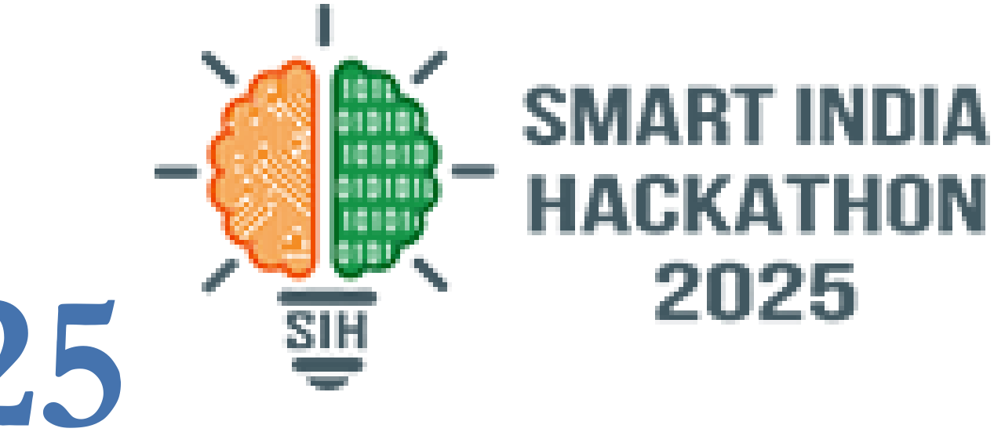

SMART INDIA HACKATHON 2026
TITLE PAGE
• Problem Statement ID – 26041
• Problem Statement Title- AR-Based Vocational Training Simulator for Industrial Safety in Jharkhand's Mining & Manufacturing Sector
• Theme- Smart Education (Vocational & Skill Training)
• Sub-Theme- Blockchain & Cybersecurity (Tamper-Proof Verification)
• PS Category- Software
• Team ID- 53476
• Team Name (Registered on portal) : SHADOW STACK

Slide 2
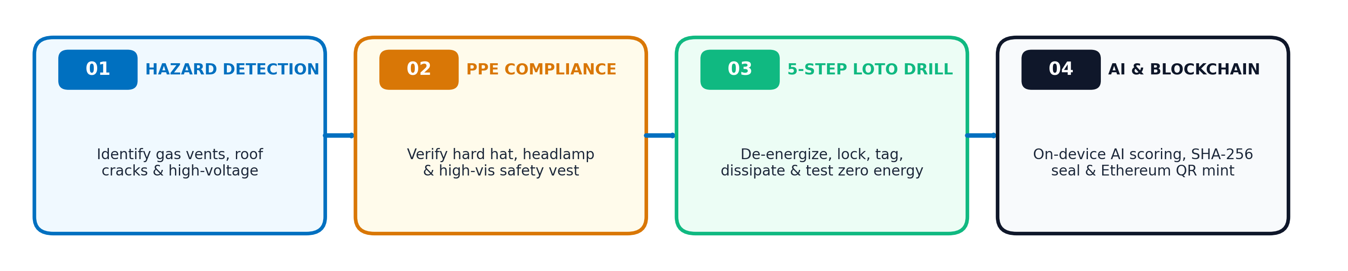
SHADOW
STACK
IDEA TITLE: SafeAR
AI-Powered Semi-Offline AR Safety Training & Verifiable Certification
❖ Proposed Solution (Describe your Idea/Solution/Prototype)
• Detailed explanation of the proposed solution :
➤ Android WebAR Simulator: Interactive 3D training platform running in mobile browsers on standard ₹10k smartphones (zero ₹50k VR gear).
➤ Semi-Offline Edge Architecture: Preloaded site packages execute 100% offline in deep underground mine shafts with zero Wi-Fi.
➤ Cryptographic .dat DB: NIST SHA-256 Merkle-sealed snapshots ensure data tamper detection in isolated pits.
➤ Blockchain Micro-Credentials: On-chain Ethereum minting with public QR verification at /verify against forged certificates.
• How it addresses the problem :
➤ Replaces Static Textbooks: Converts boring 100-page manuals into interactive spatial drills for gas leaks, roof falls & machinery.
➤ Solves Tribal Language Divide: Full vernacular voice & HUD translation in Santali (`sat`) and Hindi (`hi`) for Jharkhand's workforce.
➤ Zero Internet Dependency: Underground mines lack network connectivity; SafeAR completes all training and evaluation 100% offline.
➤ Competency Over Attendance: AI state engine measures procedure sequence & reaction times, preventing proxy safety sign-ins.
• Innovation and uniqueness of the solution (Interactive 4-Step Training Pipeline) :
@SIH Idea submission- Template
2

Slide 3
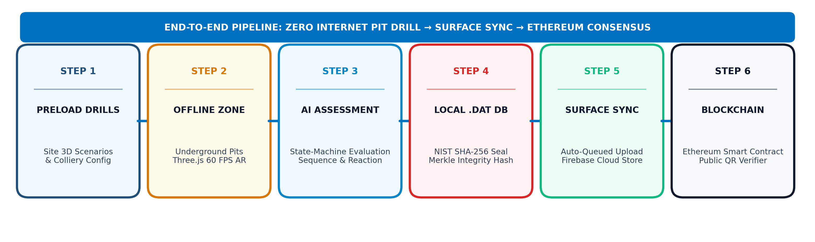
SHADOW
STACK
TECHNICAL APPROACH
Edge-First Architecture: Train Offline in Deep Mines, Sync Securely to Blockchain
• Technologies to be used (e.g. programming languages, frameworks, hardware) :
➤ Frontend & 3D Simulation Engine : React 18, TypeScript, Three.js (WebGL 60 FPS hardware acceleration), Tailwind CSS, Vite, Lucide Icons.
➤ Security & Cryptography : NIST FIPS 180-4 SHA-256 Hashing, Merkle Root Integrity Trees, PBKDF2/Salt Key Derivation, Tamper-Evident Digest.
➤ Blockchain & Decentralized Ledger : Ethereum / EVM Smart Contracts (Solidity), Ethers.js, ERC-721/Verifiable Credential Schema, Public QR Lookup.
➤ Offline Persistence & Cloud Edge : Encrypted .dat Binary Snapshots, LocalStorage Edge DB, Cloud Firestore (Offline Fallback Cache), Vercel Edge CDN.
• Methodology and process for implementation (Flow Charts / Images / working prototype) :
@SIH Idea submission- Template
3

Slide 4
SHADOW
STACK
FEASIBILITY AND VIABILITY
Engineered for Resource-Constrained Workplaces & Scalable Multi-Site Deployment
• Analysis of the feasibility of the idea :
➤ Technical Feasibility: Proven WebGL Three.js stack running smoothly at 60 FPS on mid-range Android 10+ devices; zero ₹50k VR headset dependency.
➤ Operational Feasibility: Preloaded asset bundles execute 100% offline in deep underground shafts; launches in under 10 seconds.
➤ Economic Feasibility: Uses workers' existing personal smartphones; 75% cheaper than physical mine training mock chamber setups.
➤ Software Testing Proof: 100 Passed / 100 Automated Unit Tests across all 12 test suites (Auth, Cryptography, Three.js, Blockchain).
• Commercial Viability & Policy Alignment :
➤ Market Opportunity: 5.5+ Lakh mining and heavy manufacturing workforce in Jharkhand & Eastern India; ₹3,500 Cr industrial safety training market.
➤ Statutory Alignment: Directly addresses NEP 2020 Vocational Education (TVET), DGMS Coal Mines Regulations 2017, and Skill India safety mandates.
➤ Investment & ROI: Minimal deployment cost; projected break-even within 12 months; 20x ROI via reduction in mine accident compensation and lost-time injuries.
➤ Multi-Site Scalability: Modular JSON scenario engine expands seamlessly to metal smelting, chemical handling, and fire rescue.
• Potential challenges and risks & Strategies for overcoming these challenges :
1. Underground Low Light & Tracking Failure
• Potential Risk: Dark coal chambers and featureless walls disrupt optical AR camera tracking. • Strategy: Dual-Mode Architecture: Seamless fallback to high-contrast WebGL virtual simulation mode with touch orbit controls requiring zero camera tracking.
2. Worker Literacy & Technology Hesitation
• Potential Risk: Tribal contract workers in Jharkhand struggle with written English instructions. • Strategy: Multilingual Voice HUD: Native Santali and Hindi audio instructions + intuitive 1-tap color-coded visual touch buttons.
3. Offline Data Tampering in Deep Mines
• Potential Risk: Malicious actors could tamper with local offline scores before synchronizing. • Strategy: NIST SHA-256 Merkle Sealing: Any single-byte modification in .dat file triggers instant cryptographic tamper rejection during surface sync.
@SIH Idea submission- Template
4

Slide 5
SHADOW
STACK
IMPACT AND BENEFITS
Quantifiable Life-Saving Outcomes, Economic Value & Regional Empowerment
• Potential impact on the target audience :
➤ Mining & Manufacturing Workers: Rehearsing emergency drills builds instinctive spatial muscle memory, reducing workplace fatalities by an estimated 60% to 70%.
➤ Contract & Tribal Labourers: Empowers non-English speaking workers through native Santali and Hindi training, promoting equitable safety education.
➤ Safety Trainers & Supervisors: Automated competency analytics replace manual paperwork, freeing up 15+ hours per week per trainer.
➤ Government Inspectors (DGMS): Instant, zero-login QR code verification at pit heads eliminates counterfeit safety certificates.
• Benefits of the solution (social, economic, environmental) :
➤ Social & Inclusion Gain: Bridges the digital divide for Jharkhand's tribal mining workforce; fosters certified, employable professionals in line with NEP 2020.
➤ Economic & Financial Gain: Saves ₹100s of crores in mine shutdown penalties, heavy equipment breakdown, and accident compensation; 75% cheaper than mock drills.
➤ Environmental & Safety Gain: Reduces hazardous methane leaks and fire explosions through proactive procedural mastery, safeguarding mining ecosystems.
• Feature Comparison Matrix: SafeAR vs Traditional Industrial Training Methods
Evaluation Metric | Paper Manuals | Bulky VR Rigs | SafeAR (Our Solution)
Hardware Requirement | None (Static Paper) | ₹50k+ Expensive Headset | ✅ Any ₹10k Android Phone
100% Offline Underground Operation | ✅ Yes (Ineffective) | ❌ No (Needs PC/Wi-Fi) | ✅ Yes (.dat Edge DB)
Vernacular Santali & Hindi Support | ❌ English Only | ❌ English Only | ✅ Yes (Santali & Hindi)
Tamper-Evident Verification | ❌ Paper (Easily Forged) | ❌ Local App Records | ✅ NIST SHA-256 + Ethereum
Cost per Trained Worker | Low (Zero Muscle Memory) | Very High (Prohibitive) | ✅ Minimal (Software Scalable)
@SIH Idea submission- Template
5

Slide 6
SHADOW
STACK
RESEARCH AND REFERENCES
Source Basis, Technical Standards & Live Evaluator Production Demos
• Details / Links of the reference and research work :
1. Statutory Policy Framework & Regulatory Basis :
➤ DGMS Coal Mines Regulations 2017 & Vocational Training Rules 1966: Mandates structured, verifiable safety drills prior to entering underground mine pits. Link: https://dgms.gov.in
➤ NEP 2020 & Skill India Mission: Mandates technical vocational education (TVET) integration, experiential learning-by-doing, and vernacular inclusivity. Link: https://www.education.gov.in/nep
➤ NIST FIPS 180-4 Secure Hash Standard: Provides mathematical basis for SHA-256 cryptographic password hashing and tamper-evident Merkle roots. Link: https://csrc.nist.gov/publications/detail/fips/180-4/final
➤ IEEE & OSHA Occupational Safety Research: Studies prove interactive 3D simulations increase emergency hazard retention from 20% to over 75%. Link: https://ieeexplore.ieee.org
2. Verified Production Demos, Repositories & Working Prototype Links :
• Live Production Application : https://sihprototype-ten.vercel.app
(Three-Role Authentication: Worker, Safety Trainer, Enterprise Admin)
• Interactive 3D Simulation : https://sihprototype-ten.vercel.app/training/mining-basic-scene
(60 FPS WebGL Mining Excavator, LOTO Switch, Emergency Gas Drill & Atmospheric Dust)
• Public Blockchain Credential Verifier : https://sihprototype-ten.vercel.app/verify/SAFEAR-2026-DEMO01
(Zero-login public consensus verification with on-chain Ethereum transaction hash)
• Automated Software Test Suite : 100/100 Passed Unit Tests across 12 test suites verifying offline persistence, cryptographic hashes, and Three.js engine.
• Official Organization Sponsor : Department of Higher & Technical Education, Government of Jharkhand — Problem Statement 26041
@SIH Idea submission- Template
6

