Slide 1

National Conference on Computer, Electrical, Electronics and Communication Engineering (Khwopa CEEL 2026)
KU Smart Meter Monitoring and Analytics System
24th February 2026
Bijan B. Thapa, Manish Bhattarai, Sadit Rasaili, Sameep K. Shrestha, Slok Pradhan,
Suman Shrestha
Department of Computer Science and Engineering,
Kathmandu University
Samundra Gurung
Department of Electrical and Electronics Engineering
Kathmandu University

Slide 2
Presentation Outlines
Introduction
Problem Statement
Methodology
Results and Discussions
Conclusion and Future Works
References
KHWOPA CEEL 2026

Slide 3
1. Introduction
Modern energy systems require real-time monitoring for efficiency and reliability.
Traditional analog meters only provide cumulative readings.
Smart meters provide high-resolution data including
    i. Energy consumption
    ii. Voltage levels
    iii. Load variations
    iv. Outage events
This project develops a real-time smart meter analytics platform for Kathmandu University.
KHWOPA CEEL 2026

Slide 4
1. Introduction
Objectives:
i. Develop a scalable web-based smart meter monitoring platform.
ii. Integrate secure API-based real-time data acquisition.
iii. Provide interactive dashboards for visualization and analysis.
iv. Implement AI-based forecasting for energy prediction.
v. Design a modular and scalable system architecture.
KHWOPA CEEL 2026

Slide 5
2. Problem Statement
Kathmandu University operates multiple facilities with significant energy demand.
Challenges:
  i. No centralized real-time monitoring
  ii. Limited visibility into voltage instability and outages
  iii. No predictive insights for peak load management
  iv. Difficulty in data-driven energy planning
Research Gap:
  Existing IoT platforms are generic and not tailored for smart meter analytics in academic environments.
Need:
  A domain-specific, customizable, and scalable smart meter monitoring and analytics system
KHWOPA CEEL 2026

Slide 6
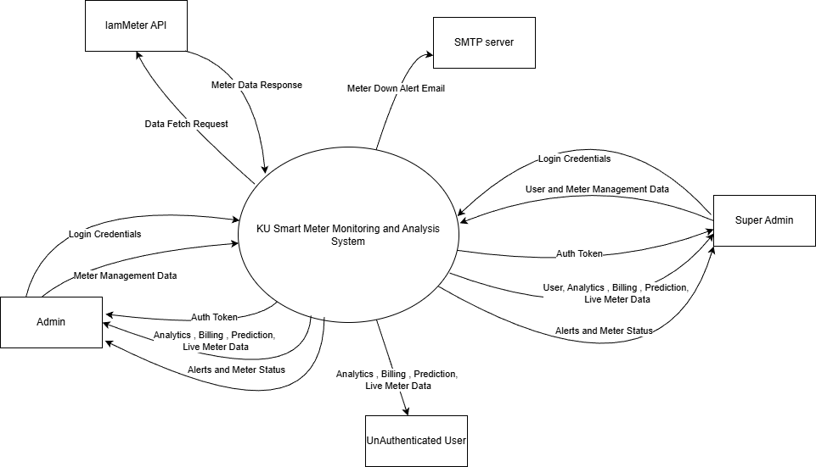
3. Methodology
System Architecture
Figure 1- Context Diagram
KHWOPA CEEL 2026

Slide 7
3. Methodology
Development Approach
  Agile development methodology adopted.
  Phases:
  i. Planning and requirement analysis
  ii. Research on smart meter APIs and forecasting models
  iii. Frontend development using React
  iv. Backend development using FastAPI
  v. Database design using PostgreSQL
  vi. Model training using Random Forest regression
  vii. System testing and validation
KHWOPA CEEL 2026

Slide 8
3. Methodology
Machine Learning Model
  Model Used: Random Forest Regression
  Features:
  i. Hour of day
  ii. Day of week
  iii. Month
  iv. Historical lag values
  Dataset & Split:
  i. Total Dataset Size: 8,355 samples
  ii. Training Samples: 6,684 (80%)
  iii. Testing Samples: 1,671 (20%)
KHWOPA CEEL 2026

Slide 9
4. Results and Discussions
System Features and Implementation
i. Real-time smart meter data acquisition
ii. Interactive dashboard with graphs and trends
iii. Voltage and current analysis
iv. Billing and cost analysis
v. Geographical meter mapping
vi. Role-based access control
vii. ML-based 24-hour forecasting
https://kusm-fend.vercel.app/, https://github.com/Rasaili-rain/KUSM
KHWOPA CEEL 2026

Slide 10
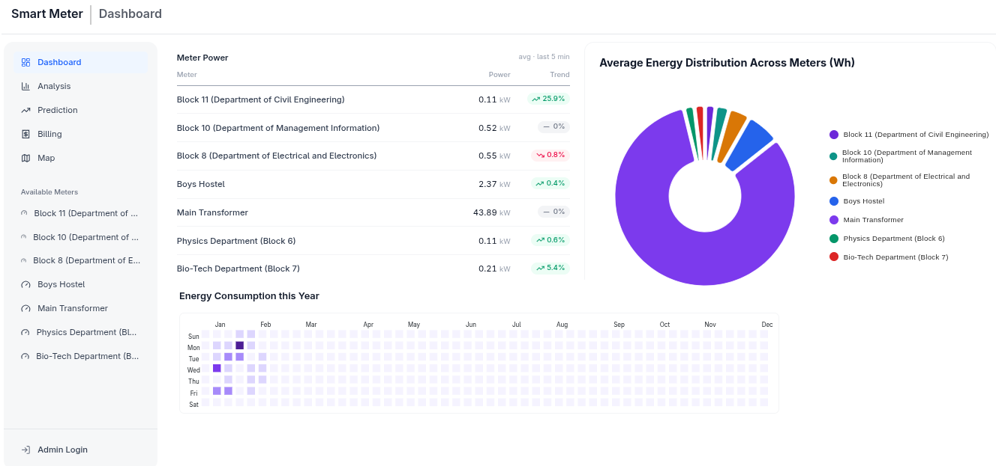
4. Results and Discussions
.
Figure 2- Main Dashboard
KHWOPA CEEL 2026

Slide 11
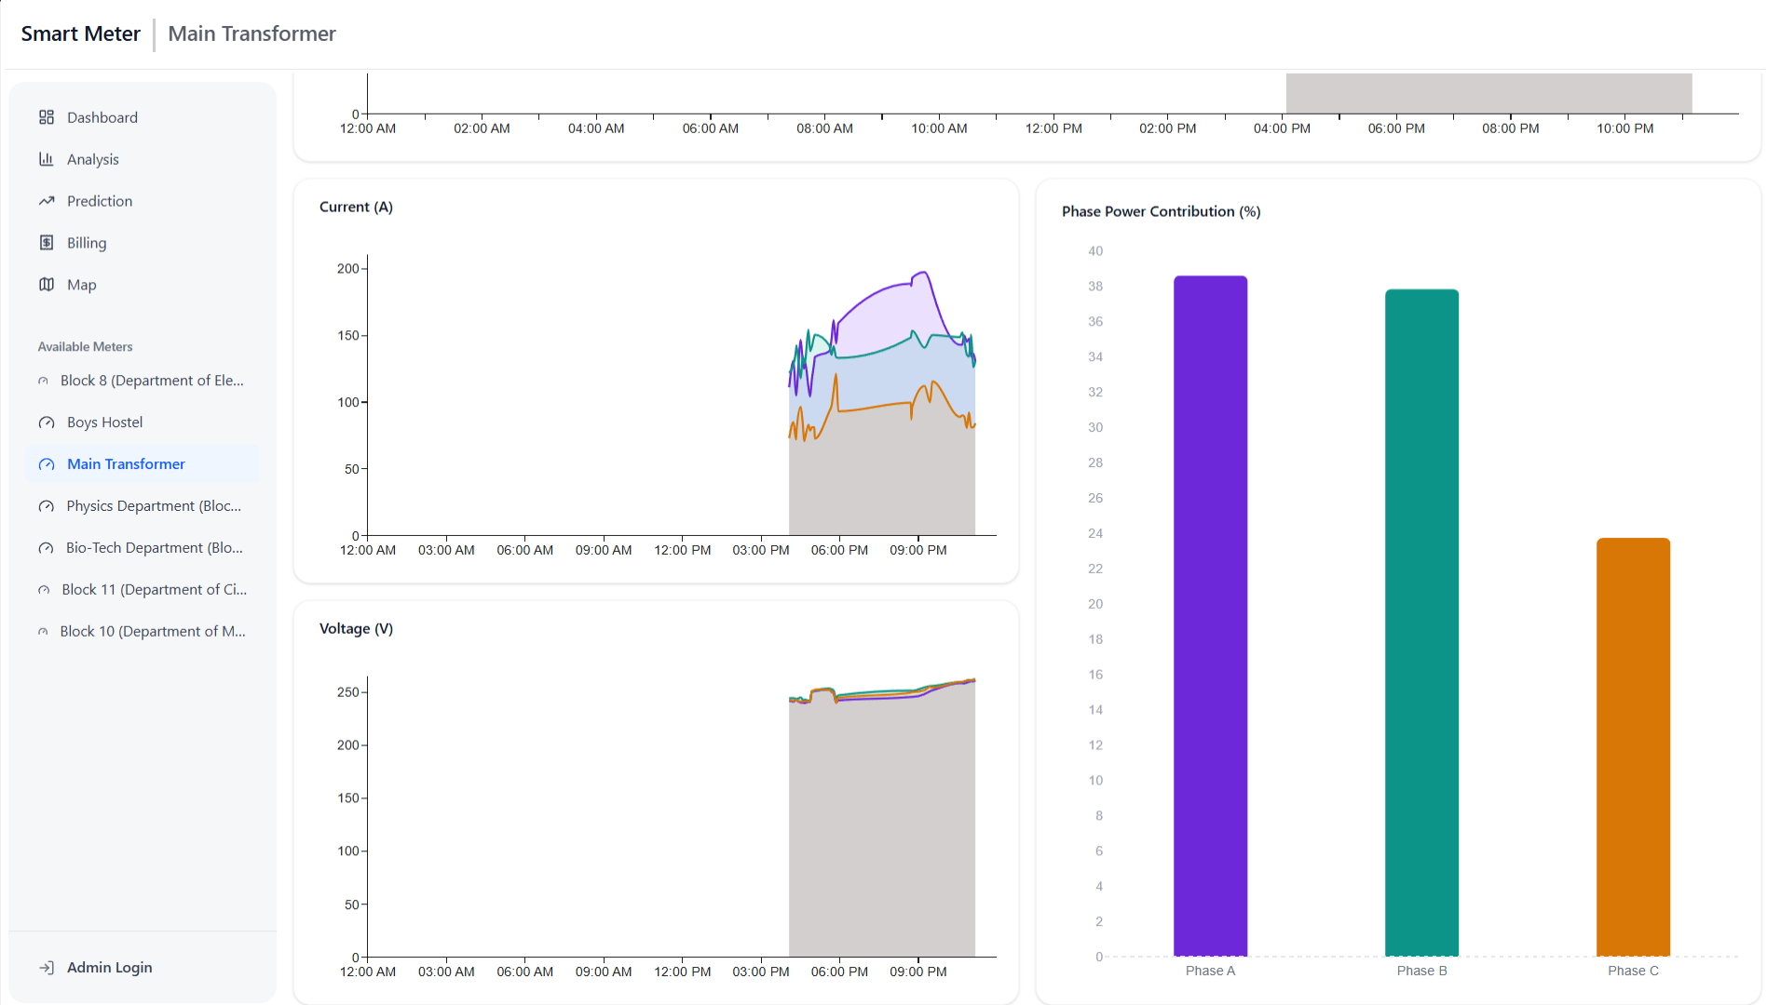
4. Results and Discussions
.
Figure 3.1.- Individual Meter Page
KHWOPA CEEL 2026

Slide 12
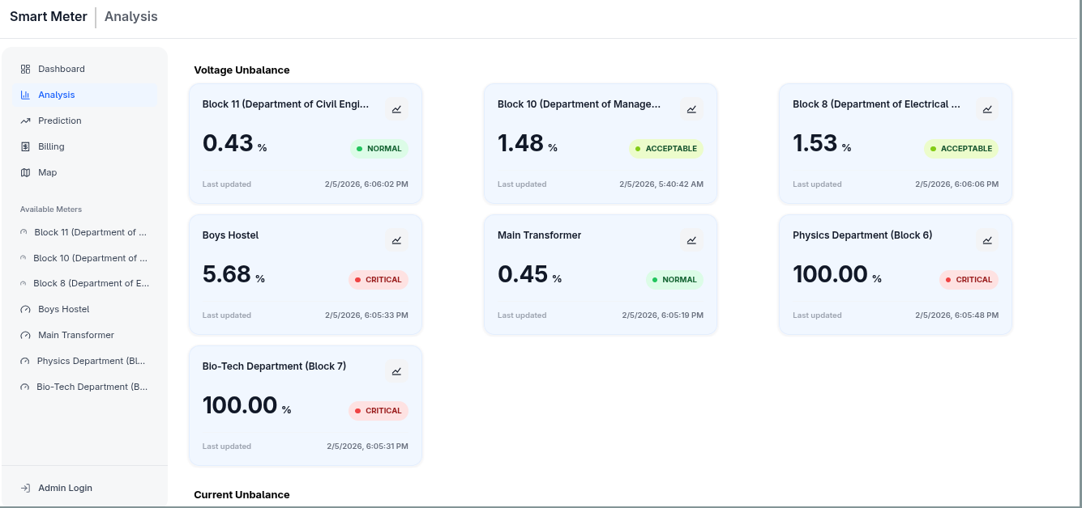
4. Results and Discussions
.
Figure 4- Analysis Page
KHWOPA CEEL 2026

Slide 13
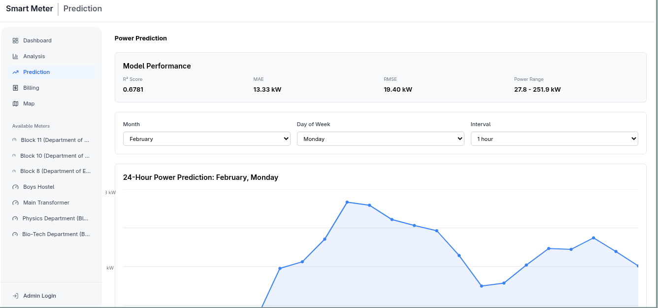
4. Results and Discussions
.
Figure 5- Prediction Page
KHWOPA CEEL 2026

Slide 14
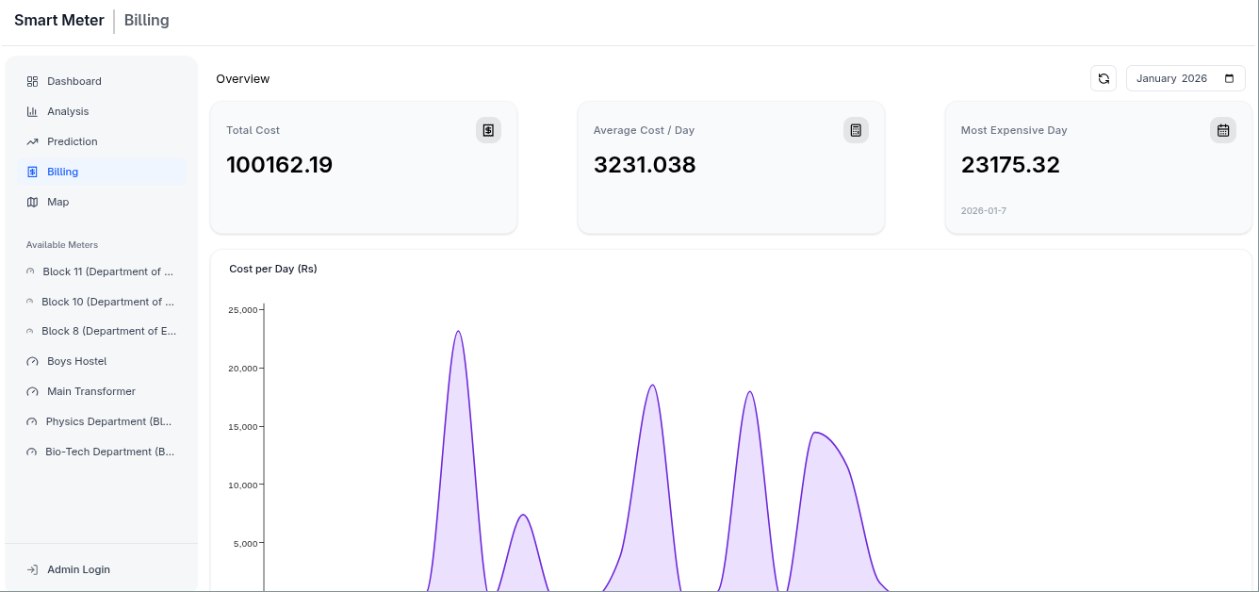
4. Results and Discussions
.
Figure 6 – Billing Page
KHWOPA CEEL 2026

Slide 15
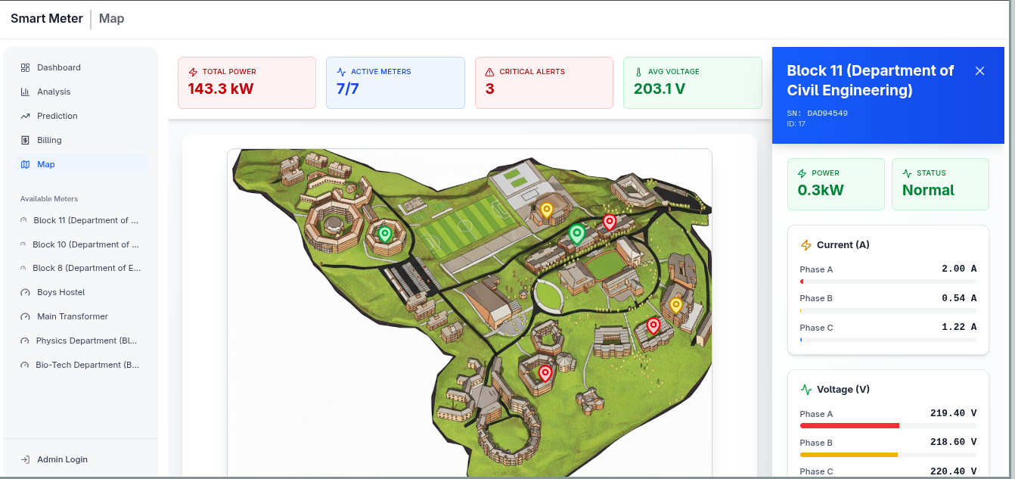
4. Results and Discussions
.
Figure 7- Maps Page
KHWOPA CEEL 2026

Slide 16
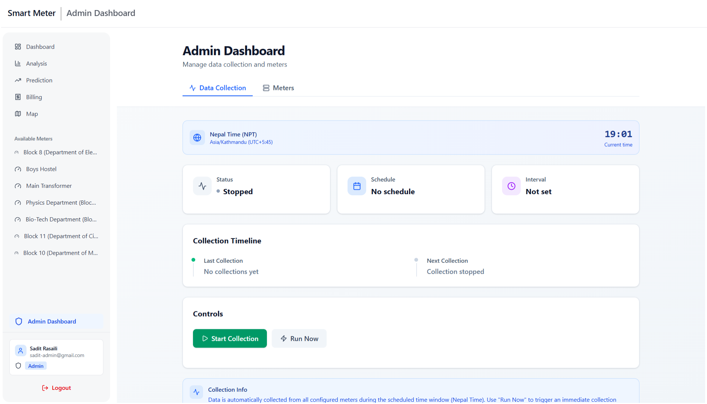
4. Results and Discussions
.
Figure 8. - Admin Dashboard
KHWOPA CEEL 2026

Slide 17
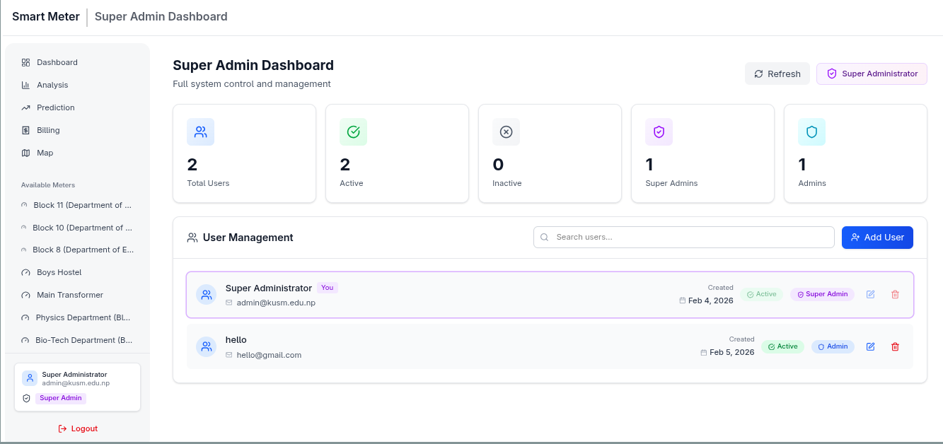
4. Results and Discussions
.
Figure 9. – Super Admin Dashboard
KHWOPA CEEL 2026

Slide 18
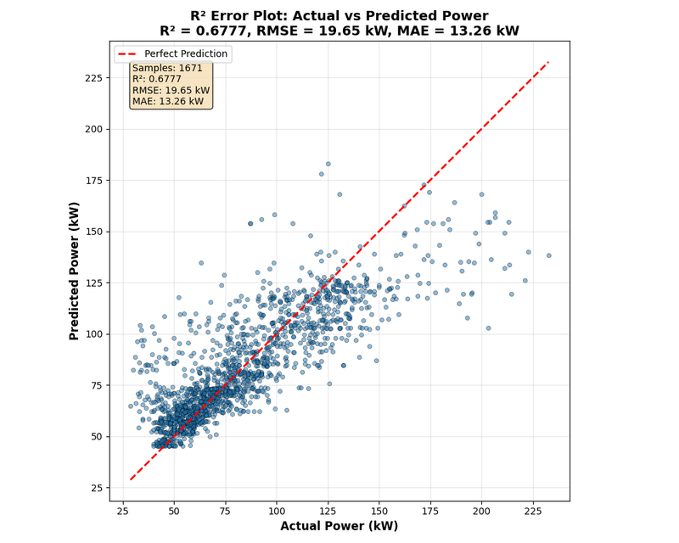
4. Results and Discussions
Visualization Results :
  i. Clear visualization of consumption trends
  ii. Voltage stability monitoring
  iii. Peak load identification
  iv. Monthly and daily billing summaries
  v. Improved transparency in energy usage
Prediction Results :
  i. Predictions closely follow actual values
  ii. Model captures non-linear consumption iii. Useful for anticipating peak demand
  iv. Supports proactive energy management.
Figure 10 - R^2 Error Plot : Actual vs Predicted Power
KHWOPA CEEL 2026

Slide 19
5. Conclusion and Future Works
Developed a scalable real-time smart meter monitoring system.
Integrated IoT APIs with a web-based analytics dashboard.
Implemented AI-based forecasting for predictive insights.
Enabled role-based secure access control.
Provides a foundation for smart grid research and campus-wide energy optimization.
KHWOPA CEEL 2026

Slide 20
5. Conclusion and Future Works
Limitations:
  i. Dependence on external API availability
  ii. Forecast accuracy depends on historical data quality
  iii. Web-based access only
Future Enhancements
i. Real-time anomaly detection and automated alerts
ii. Mobile application support
iii. Advanced deep learning forecasting models
iv. Energy optimization and sustainability recommendations
KHWOPA CEEL 2026

Slide 21
Acknowledgment
The authors would like to thank project IGrid funded by RDI, Kathmandu University for providing access to the smart meter data.
KHWOPA CEEL 2026

Slide 22
6. References
[1] ThingsBoard. Open-source IoT platform. https://thingsboard.io/
[2] Kaa IoT. Smart metering solutions. https://www.kaaiot.com/
[3] Oakter. OakMeter energy monitoring system. https://oakter.com/
[4] IAMMETER API Documentation. https://www.iammeter.com/docs/system-api
KHWOPA CEEL 2026

Slide 23
THANK YOU!

