Slide 1

DATA ANALYTICS · OPEN SOURCE INTELLIGENCE
GitHub Repository
Ecosystem Analysis
An exploratory data analysis of 1,000 trending repositories ,uncovering what drives stars, forks, and engagement.
Prepared from GitHub REST API data | 1,000 repositories | 29 languages

Slide 2




Executive Summary
The dataset spans 1,000 GitHub repositories collected across 13 popularity-driven topics, revealing clear patterns in language dominance, engagement, and growth.
1,000
29
32,054
0.77
Repositories analyzed
Programming languages
Average stars per repo
Correlation: stars ↔ forks
Key Takeaway
Star counts are heavily right-skewed (mean 32,054 vs. median 22,256) — a small set of flagship repositories pull the average far above the typical repo. Python leads in volume, while niche languages like MDX and Ruby post the highest per-repo engagement.
GitHub Repository Ecosystem Analysis
2

Slide 3




Project Methodology
A five-stage analytical pipeline, from raw API collection to actionable business recommendations.
1
2
3
4
5
Data Collection
Data Cleaning
Exploratory Analysis
Statistical Testing
Insights & Recommendations
Queried the GitHub Search API across 8 Data Science and 5 Web Development topics, sorted by stars.
Filled missing languages, fixed date types, verified duplicates, and validated ranges.
Univariate, bivariate, and multivariate visualization across stars, forks, watchers, and issues.
T-tests, ANOVA, chi-square, and confidence intervals to validate observed patterns.
Feature-engineered an Engagement Score to rank repositories and languages.
GitHub Repository Ecosystem Analysis
3

Slide 4
Dataset Snapshot
Repositories were pulled from two broad domains, spanning 13 search topics.
Category Split
1,000
12
Total repositories
Data fields per repo
13
29
Search topics queried
Distinct languages
637
6.5 yrs
800 Data Science · 200 Web Development
Unique repo owners
Average repository age
GitHub Repository Ecosystem Analysis
4

Slide 5

Data Cleaning & Validation
Raw API data was systematically audited before analysis began.
Missing Values
115 missing “Language” entries
Filled with “Unknown” category
Data Types
Dates stored as text
Converted to proper datetime (UTC)
Duplicate Records
Checked full dataset
0 exact duplicates found
Invalid Values
Negative star counts checked
None found — all values valid
Outlier Review
IQR method on Stars
High-star repos retained as genuine signal
GitHub Repository Ecosystem Analysis
5

Slide 6
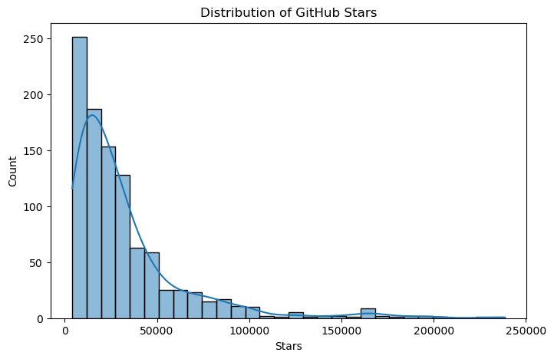
Distribution of GitHub Stars
Univariate analysis reveals a strongly right-skewed distribution.
MEAN
32,054 stars
MEDIAN
22,256 stars
STD. DEV.
32,265
MAX
238,490 stars
GitHub Repository Ecosystem Analysis
6

Slide 7
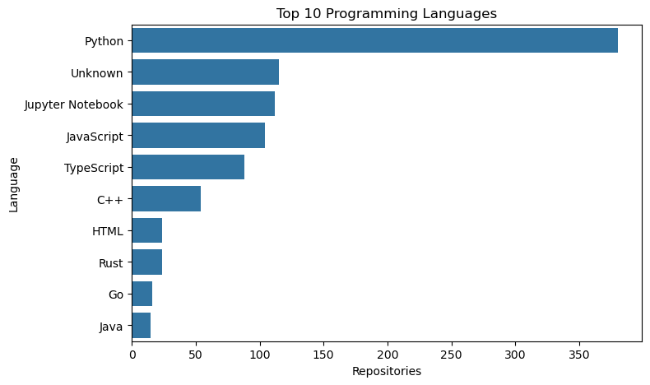
Top Programming Languages
Python dominates repository volume by a wide margin across both categories.
Why It Matters
Python appears in 380 of 1,000 repositories (38%), driven heavily by the Data Science category (ML, NLP, and GenAI topics). JavaScript, TypeScript, and Jupyter Notebook round out the top tier — reflecting the tooling stack of modern AI and web projects.
GitHub Repository Ecosystem Analysis
7

Slide 8
Data Science vs. Web Development
Despite 4x more repositories, Data Science trails Web Development slightly in average star count.
Average Stars by Category
Average Watchers & Forks by Category
GitHub Repository Ecosystem Analysis
8

Slide 9
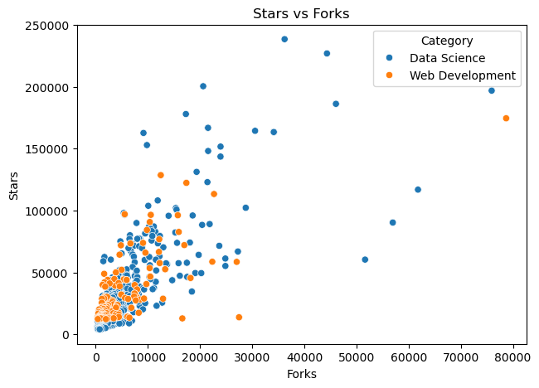
Relationships Between Metrics
Forks track closely with stars; open issues behave more independently.
Correlation Matrix
 | Stars | Forks | Watchers | Open Issues
Stars | 1.00 | 0.77 | 1.00 | 0.29
Forks | 0.77 | 1.00 | 0.77 | 0.30
Watchers | 1.00 | 0.77 | 1.00 | 0.29
Open Issues | 0.29 | 0.30 | 0.29 | 1.00
Stars and Watchers are perfectly correlated (r = 1.00) in this dataset, while Forks track stars closely (r = 0.77). Open Issues shows the weakest relationship (r ≈ 0.29–0.30) — popularity doesn’t necessarily mean more open issues.
GitHub Repository Ecosystem Analysis
9

Slide 10
Statistical Significance Testing
Four hypothesis tests validate (and challenge) the visual patterns observed in EDA.
Independent T-Test
Chi-Square Test
One-Way ANOVA
95% Confidence Interval
Python vs. Java — Stars
Category × Language association
Stars across categories
True mean Stars estimate
t = 5.50
χ² = 442.95
F = 0.75
[30,054 – 34,054]
p < 0.001
p < 0.001
p = 0.388
n = 1,000
Significant difference
Strong association
No significant difference
Precise population estimate
GitHub Repository Ecosystem Analysis
10

Slide 11
Feature Engineering: Engagement Score
A composite metric was built to rank repositories beyond raw star count.
The Formula
Avg. Engagement Score by Popularity Tier
Engagement Score
=
Stars + Forks × 2 + Watchers
Weighting forks by 2x rewards repositories that inspire active derivative work — not just passive stargazing — giving a fuller picture of real developer engagement.
Repository Age = years since creation · Active Repo = updated in last 180 days
GitHub Repository Ecosystem Analysis
11

Slide 12
Top Performing Repositories
Ranked by Engagement Score — the composite of stars, forks, and watchers.
# | Repository | Primary Language | Engagement Score
1 | ECC | JavaScript | 549,410
2 | tensorflow | C++ | 545,614
3 | hermes-agent | Python | 542,558
4 | bootstrap | MDX | 506,494
5 | AutoGPT | Python | 464,564
6 | andrej-karpathy-skills | Unknown | 442,152
7 | transformers | Python | 395,154
TensorFlow and Transformers confirm the ML ecosystem’s continued dominance in developer engagement.
GitHub Repository Ecosystem Analysis
12

Slide 13
Language Performance Leaders
Average Engagement Score by language — niche languages punch above their weight.
GitHub Repository Ecosystem Analysis
13

Slide 14


Key Insights & Recommendations
Popularity is concentrated
Python is the center of gravity
Forks signal real adoption
A small number of flagship repos (TensorFlow, Transformers, AutoGPT) drive most engagement — target partnerships with these ecosystem leaders.
With 38% share, Python-based tooling should be a first-class integration priority for any developer-facing product.
The strong stars–forks correlation (r = 0.77) suggests forks are a reliable proxy for genuine usage, not just visibility.
Niche languages over-perform
Category size ≠ category quality
Use Engagement Score to rank
MDX and Ruby repos post the highest average engagement — smaller, focused communities can be highly efficient to engage.
Web Development repos (20% of dataset) match Data Science in average stars — don’t equate volume with impact.
Raw star count over-rewards visibility; the composite score better reflects sustained community investment.
GitHub Repository Ecosystem Analysis
14

Slide 15
Thank You

