Slide 1
Unsupervised Semantic Image Synthesis in autonomous driving datasets
Diandian Guo

Slide 2
Introduction
Unsupervised Semantic Image Synthesis in autonomous driving datasets is a project provided by Bosch company to George, a PHD student in the Uni Stuttgart. I am working with him to do this project.
Our GAN network works on cityscape datasets and GTA5 datasets.

Slide 3
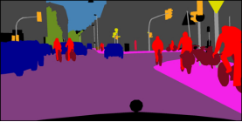
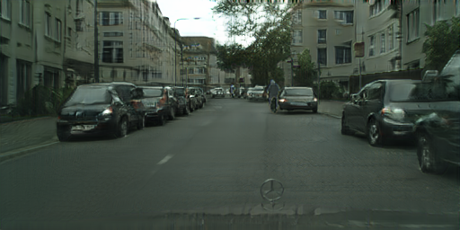
What we are doing on cityscape datasets:
domain A:semantic map
domain B:cityscape images
We have: 1.semantic maps 2.cityscape images. No correspondings.
Unpaired, unsupervised.
What we want: realistic images corresponding to the semantic maps.
Two tasks:
1.Generate realistic images→ The fake images look real and undistinguishable from real images.
2.Semantic alignment: The fake images must correspond to the semantic maps. We shouldn’t draw a human at the position of a car.

Slide 4
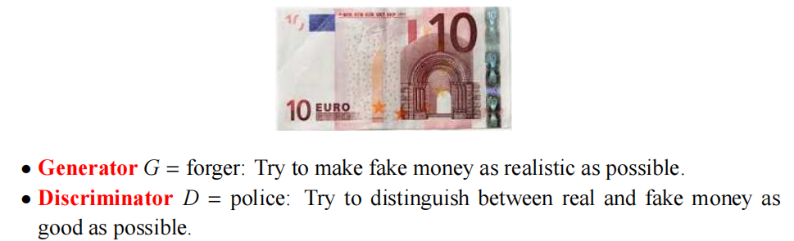
First Task: How to generate realistic images
As usual, we use a discriminator[2] to judge whether it’s a real image or fake image, and backpropagate.

Slide 5
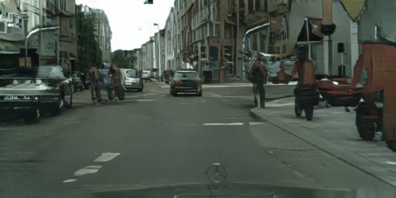
Second Task: Semantic alignment
How could we make sure that the content structure in domain A is preserved when we go to domain B?
In CycleGAN[3], they suggested that we could use another network to go again from domain B to domain A, if we succeed, then it means that the information of domain A is not lost when we go to domain B.
domain A: x
domain B: y
domain A: x’
cycle consistency loss(L1 loss/L2 loss...)

Slide 6
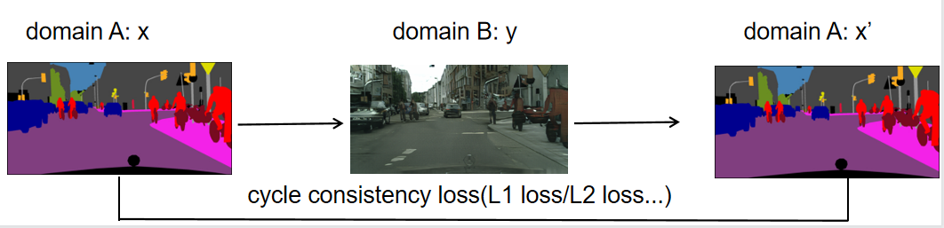
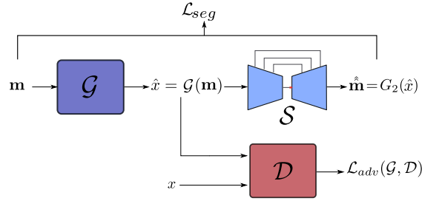
So in our case, we compare the difference between reconstructed label maps and the original label maps.
We go from x→y→x’. So it is a self-supervised model.[4]
Our structure is shown below.
S is responsible for the semantic alignment of fake images.(Task 2)
D is the discriminator,responsible for the real/fake judgement.(to make the image realistic,Task 1)

Slide 7
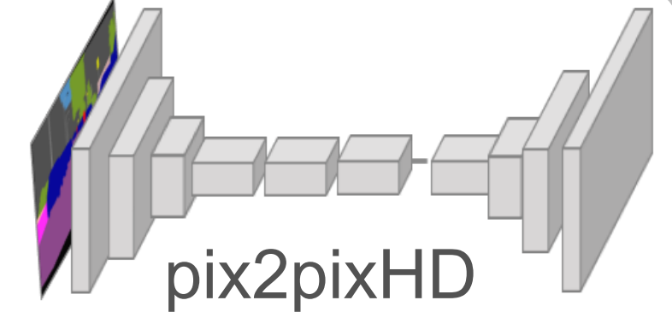
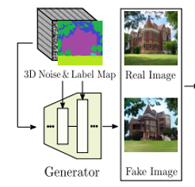
Traditional structure
U-Net/
Encoder+Decoder
Input: label map.
Where to add the noise: Bottleneck!
Our structure
We cut off the structure before the bottleneck
Input: Concatenation of label map and noise.

Slide 8
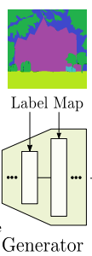
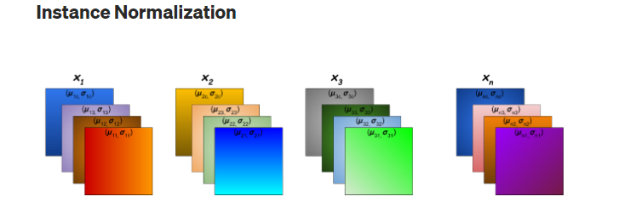
In our task, the semantic map has 34 colours, corresponding to 34 classes:humans, cars,trees......
One hot coding:(B,34,H,W)
A popular method is to use AdaIN(adaptive Instance normalization)[5][6][7]. In StyleGan, they use the semantic map to modulate the two affine parameters in the Instance normalization layer[8].

Slide 9
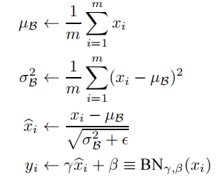
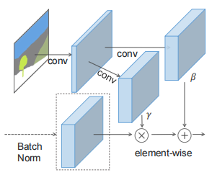
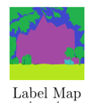
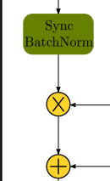
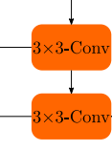

How is AdaIN modulated?
γ and β are the two learnable affine parameters!
Input

Slide 10
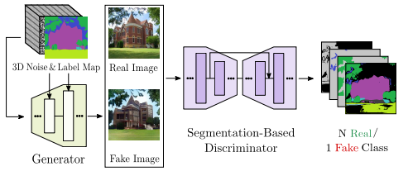
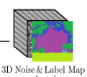
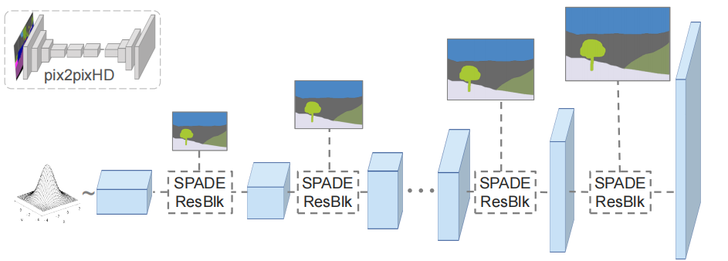
Input: Concatenation of the 3D noise and the Label map. (This idea is from OASIS[9])
We also use it to modulate the Instance normalization layers.
Res
Res
Res
Res

Slide 11
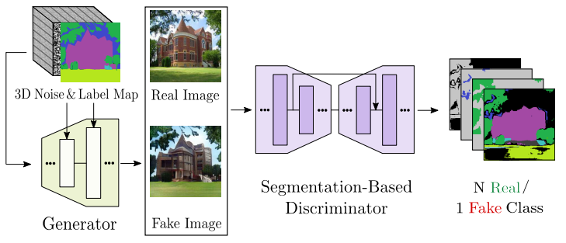
Generator Output : fake images
Segmentation Discriminator output: Semantic maps again!
What’s happening in the Segmentation Discriminator?
In the Segmentation based discriminator we use a U-net to do the image segmentation to the fake images. We use U-net because it helps preserve the low level features(corners, edges...).
Output shape:34 classes→(B,35,H,W) Why?
classification problem→crossentropy loss
In this way , we do the Semantic alignment.

Slide 12
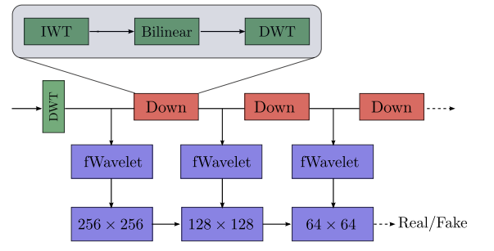
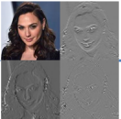
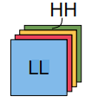
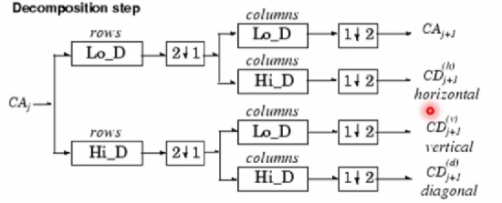
Discriminator D→Wavelet discriminator.
We do the wavelet decomposition to the rows and columns respectively and downsample. So we get 4 combinations:HL,LH,HH,LL.[10][11](the first H/L indicates the rows, the second indicates the columns). Then we concatenate these four parts, and get a 12(4*3) channel wavelet tensor.(the DWT step)
Shape After DWT: (B,12,H/2,W/2)
LL
LH
HL
HH

Slide 13
After the DWT step, we get wavelet tensor (B,12,H/2,W/2).
Feed it into discriminator?
Bad results: learning capacity not enough
Add the fWavelet parts: to transfer from the wavelet domain to the feature domain.
features
fWavelet(from wavelet) layers: stacks of convolutional layers.
12 channel wavelet tensor:Wavelet domain
After fWavelet: feature domain
downsample: get 6 features of different scales in the feature domain.
We do the downsample with our Down block, which is made of a IWT, a bilinear downsampling and a DWT. We do this because we think it maybe not good to downsample the wavelet bands directly in the wavelet domain, so we use IWT to go to pixel domain and then downsample and then use another DWT to go back to wavelet domain.

Slide 14
Why do we use wavelet decomposition?
In the GAN networks, we suffer from poor quality of details.
Because it’s much easier for the discriminator to learn to focus on the low frequency parts only, and ignore the high frequency.
We got the idea of wavelet decomposition from SWAGAN. By doing the wavelet decomposition manually, it may be easier for the discriminator to learn the high ferquency details, and the generated images may have higher qualities.

Slide 15
We have achieved good results with our wavelet discriminator, but we still want to further improve it. We have been trying some new methods:
1.Projective Gan Discriminator
2.styleGan2 method
3.additional decoder method
4.....

Slide 16
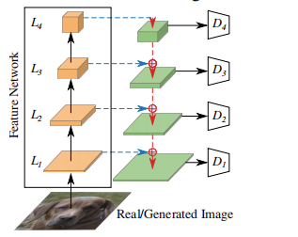
Projective Gan Discriminator[12]
pretrained feature extractor
+ 4 small discriminators
feature extractor is freezed!
Why is it useful?
traditional feature extractor: learn to focus on the low frequency parts only, and ignore the high frequency
So we freezed it:force the discriminator to pay attention to all features including the high frequency parts.
result:we got good results. But it’s not as good as the wavelet discriminator.

Slide 17
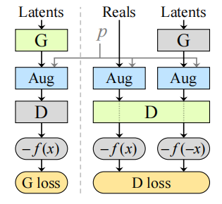

StyleGan2 method
StyleGan2 method aims to reduce overfitting by data augmentation.
Model learns to: from rotated label map→generate unrotated images?
According to the styleGAN2[13] paper, it is feasible if we control the probability p of the data augmentation.
rt > 0.6: overfitting happens ,increase the p
rt < 0.6: overfitting not happens ,decrease the p
Result: It is not that good for our task, it’s too hard for the model to learn. Maybe that’s the reason why the proposed augmentations have not yet become a standard part of the GAN pipeline.

Slide 18
Our new hope:Additional decoder!
We go from wavelet tensor to features in feature domain, and feed them into the discriminator.
Are those features good features? →Use another decoder to use features to reconstruct the image→L1 loss.
We use L1 loss instead of L2 loss because Euclidean distance is minimized by averaging all plausible outputs, which causes blurring. And L1 loss has sparse solutions instead.
wavelet domain
feature
feature domain

Slide 19
How do we reconstruct the image?
fake/real image
original wavelet tensor
reconstructed image
Conv
Conv
Conv
Conv consists of transposeConv,BN,Relu
We use 6 features to reconstruct the image, those features have different sizes,so U-net is our first choice. Amazingly, we get better results with this structure.
best FID = 56.8(-1.5) and corresponding MIOU:42.5(+0.8)
(FID the lower the better, mIoU the higher the better)

Slide 20
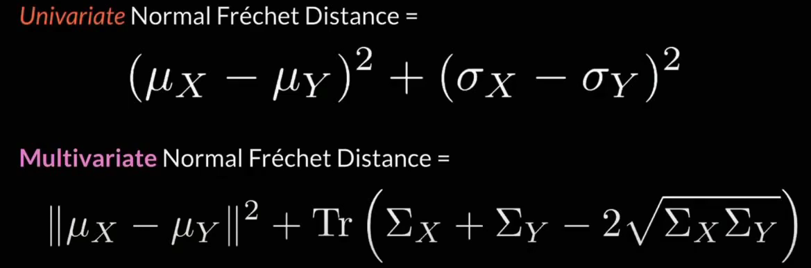
What is FID(Frechet Inception Distance)?
It’s not an easy task to evaluate a GAN network. One popular idea is to use the feature extracting layers of a pretrained Inception v3 net(trained on ImageNet), we cut the classifier off so the output are features. [14]
Then we compare the features of the real and fake images through the mean and standard deviation: If the FID is small, it means that they share a similar distribution in the feature domain.

Slide 21
Are there better ways to design the decoder?
How about reconstructing the 12 channel wavelet tensor instead of the whole image?
fake/real image
original wavelet tensor
reconstructed wavelet tensor
Conv
Conv
Conv
( )
or even further? first reconstruct in the wavelet domain, then go to pixel domain?
reconstructed image

Slide 22
fake/real image
original wavelet tensor
reconstructed wavelet tensor
Conv
Conv
Conv
We use nearest-neighbour upsampling because it preserves the sharpness of the wavelet coefficients (otherwise high value coefficients could be attenuated by linear interpolation techniques).

Slide 23
Or even more complicated structure? We get this idea from SWAGAN, they use a tWavelet(to Wavelet) block to transfer from the feature domain to the wavelet domain. So we don’t reconstruct the wavelet channels in the feature domain directly, we use tWavelet to go back to the wavelet domain first, and then reconstruct the wavelet channels. tWavelet is a stack of convolutional layers.
We are still training these models.
fake/real image
original wavelet tensor
Conv
Conv
Conv
tWavelet
tWavelet
tWavelet
reconstructed wavelet tensor
Conv
Conv
( )
reconstructed image

Slide 24
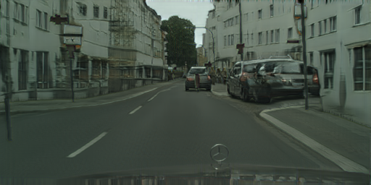
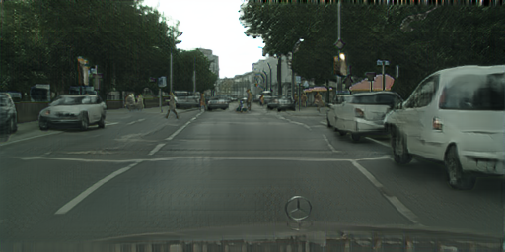
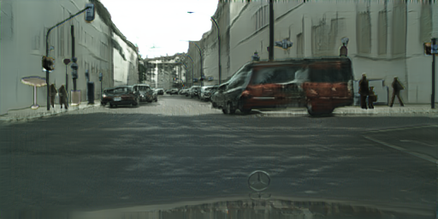




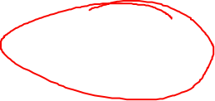



Generated images
The images look good, although we suffer from ill-posed problems. When two cars are very close, the model may see them as a long car or vice versa.

Slide 25
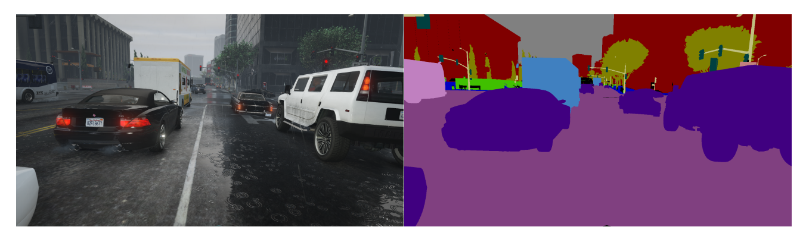
What we are doing on GTA5 datasets:
We have: 1.paired GTA5 semantic maps and game images 2.unpaired cityscape images
We can use: 1.paired GTA5 semantic maps and game images
2.GTA5 semantic maps and unpaired cityscape images
domain gap between GTA5 domain/cityscape domain
No GTA5 style!
want to generate realistic fake images

Slide 26

fake images from gta5 labels
real cityscape images
What does the Discriminator learn in this process?

Slide 27
through texture? ×
through Benz marks!→The discriminator only scans the bottom of the image
result: very low mIoU! The problem is in the semantic alignment

Slide 28






Patch method(from the paper “Enhancing Photorealism”.[15]
Cut the images and semantic maps into patches. 5000 images → 60000 patches
We do this outside our python script → change the dataset
Make the discriminator focus on the content

Slide 29
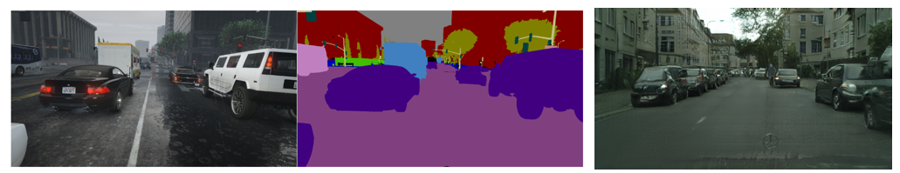
LPIPS(Learned Perceptual Image Patch Similarity) method
LPIPS loss measures the distance in VGG feature space as a “perceptual loss” for images.
Input: fake images from GTA5 label maps + corresponding game images
add a loss to measure the distance of them in the feature space
ensure the content similarity b,3x3x30

Slide 30
References
1.Isola, P., Zhu, J. Y., Zhou, T., & Efros, A. A. (2017). Image-to-image translation with conditional adversarial networks. In Proceedings of the IEEE conference on computer vision and pattern recognition (pp. 1125-1134).
2.Goodfellow, Ian, et al. "Generative adversarial nets." Advances in neural information processing systems 27 (2014).
3.Jun-Yan Zhu, Taesung Park, Phillip Isola, Alexei A. Efros; Proceedings of the IEEE International Conference on Computer Vision (ICCV), 2017, pp. 2223-2232
4.Eskandar, George, et al. "USIS: Unsupervised Semantic Image Synthesis." arXiv preprint arXiv:2109.14715 (2021).
5.Kim, Kunhee, et al. "A Style-aware Discriminator for Controllable Image Translation." Proceedings of the IEEE/CVF Conference on Computer Vision and Pattern Recognition. 2022.
6.Karras, Tero, Samuli Laine, and Timo Aila. "A style-based generator architecture for generative adversarial networks." Proceedings of the IEEE/CVF conference on computer vision and pattern recognition. 2019.
7.Park, Taesung, et al. "Semantic image synthesis with spatially-adaptive normalization." Proceedings of the IEEE/CVF conference on computer vision and pattern recognition. 2019.
8.Ulyanov, Dmitry, Andrea Vedaldi, and Victor Lempitsky. "Instance normalization: The missing ingredient for fast stylization." arXiv preprint arXiv:1607.08022 (2016).
9.Sushko, Vadim, et al. "You only need adversarial supervision for semantic image synthesis." arXiv preprint arXiv:2012.04781 (2020).
10.Zhang, Linfeng, et al. "Wavelet knowledge distillation: Towards efficient image-to-image translation." Proceedings of the IEEE/CVF Conference on Computer Vision and Pattern Recognition. 2022.
11.Gal, Rinon, et al. "SWAGAN: A style-based wavelet-driven generative model." ACM Transactions on Graphics (TOG) 40.4 (2021): 1-11.
12.Sauer, Axel, et al. "Projected gans converge faster." Advances in Neural Information Processing Systems 34 (2021): 17480-17492.
13.Karras, Tero, et al. "Training generative adversarial networks with limited data." Advances in Neural Information Processing Systems 33 (2020): 12104-12114.
14.Heusel, Martin, et al. "Gans trained by a two time-scale update rule converge to a local nash equilibrium." Advances in neural information processing systems 30 (2017).
15.Richter, Stephan R., Hassan Abu Al Haija, and Vladlen Koltun. "Enhancing photorealism enhancement." IEEE Transactions on Pattern Analysis and Machine Intelligence (2022).

