Slide 1




Rascal: Rendezvous and Proximity Operations
Team Bravo
Jennifer Babb
Bryant Gaume
Tom Moline
Tyler Olson
Nate Richard
First Semester Presentation
December 3, 2013

Slide 2
Group Organization
Project Overview
Mission Success Criteria
Design Constraints
Mission Architecture
CONOPS
Risk Assessment
Schedule

Slide 3
Group Organization
Group Member | Position
Jennifer Babb | Structures Engineer, Propulsion Engineer
Bryant Gaume | Structures Engineer, Propulsion Engineer
Tom Moline | Program Manager, Attitude Determination and Control Engineer
Tyler Olson | Power Engineer
Nate Richard | Communications Engineer

Slide 4
Group Organization
Project Overview
Design Constraints
Mission Architecture
CONOPS
Risk Assessment
Schedule

Slide 5
Rascal Mission Definitions
As proposed, the Rascal mission consists of a spacecraft capable of demonstrating key proximity operations.
Spacecraft proximity operations consist of orbital maneuvers made relative to a resident space object. Examples or key proximity operation terms are listed below.
Proximity operations such as these haven been tagged by NASA enabling technologies for future NASA missions.
Proximity Operation Term | Definition
Stationkeeping | Maintaining a set relative displacement between two space objects for a period of several orbits
“Escape” Maneuver | Performing an orbital maneuver that increases the relative displacement between two space objects
Rendezvous | Performing an orbital maneuver that decreases the relative displacement between two space objects within a set distance for a period of several orbits
Resident Space Object | Any satellite or space debris residing in an orbit around Earth

Slide 6
Rascal Mission Success Criteria
In order for the Rascal mission to be considered successful, it must meet the success criteria listed below.
The Rascal mission shall demonstrate:
Stationkeeping: performing correction maneuvers to remain within a 10-75 meter sphere of a resident space object for at least 5 orbits.
“Escape” Maneuver: performing an orbital maneuver that intentionally increases the final displacement of the spacecraft relative to a resident space object to at least 100 meters within 1 orbit.
Rendezvous: performing an orbital maneuver that intentionally decreases the displacement of the spacecraft relative to a resident space object to within 50 meters for at least 5 orbits.

Slide 7
Group Organization
Project Overview
Design Constraints
Mission Architecture
CONOPS
Risk Assessment
Schedule

Slide 8

Quick Note:
CubeSats are a class of satellites defined by California Polytechnic State University (CalPoly), typically weighing less than 8 kg and coming in several sizes. A CubeSat “U” is a 10x10x10 cm cube, massing no more than 1.33 kg.
MicroSats are a more loosely defined category of spacecraft under 500 kg in mass, with no standard external interface.
MicroSat
< 500 kg
6U
8.00 kg
3U
4.00 kg
2U
2.66 kg
1U
1.33 kg

Slide 9
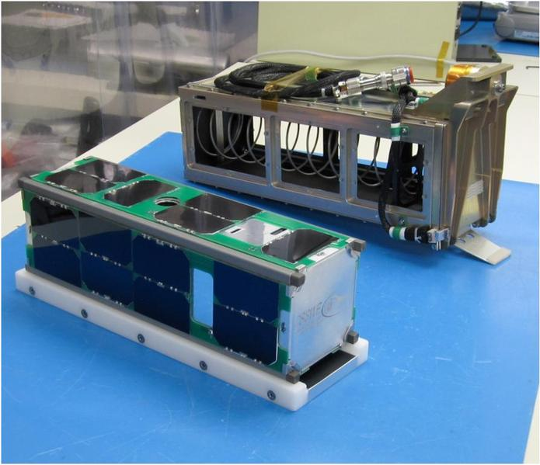
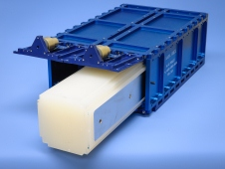
Common Spacecraft Design Constraints
Usually, the key driver of any aerospace system design is its cost and its weight.
In the case of small spacecraft design, the former plays a large role in terms of the cost associated with getting said design to orbit, while the latter place a much less significant role.
Thus, in place of weight, volume becomes a much more important constraint on any small satellite design.
This fact is directly related to the CubeSat standard described in the previous section, which has allowed for the development of deployers for spacecraft that follow it, such as the P-POD and NLAS Deployers.
Other important design constraints include mission operation time and mission success verification.
Each of these design constraints will be discussed in detail on the following slides.

Slide 10
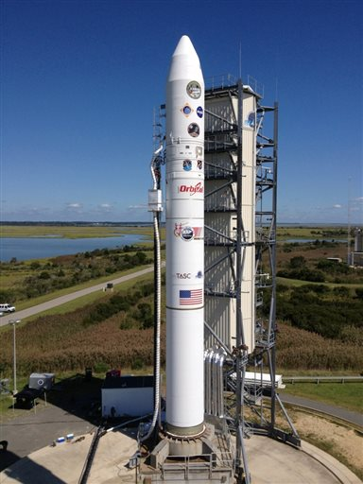
Key Design Parameters: Cost
One of the greatest limits on the scope and success of any spacecraft mission is cost, specifically, the cost of getting a spacecraft to orbit.
Launch costs alone can range from $6 million for microsatellites to $500,000 for CubeSats
However, for satellites that fall under the CubeSat category, a NASA program exists that finds and subsequently pays for launch spots for said satellites. No such program exists for microsatellites.
Beyond launch cost, the cost associated with designing, building, and testing a CubeSat (or microsatellite, for that matter) is on the order of thousands of dollars, as opposed to the millions associated with larger, more complicated spacecraft systems.

Slide 11
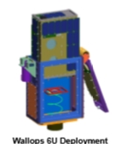
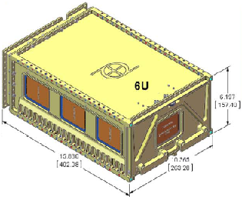
Key Design Parameters: Volume
As discussed previously, another one of the largest constraints on small spacecraft design is volume.
In the case of CubeSats, only a limited number of deployers exist.
For each of these deployers, there exists a specific volume that a spacecraft must possess in order to be properly integrated into them.
These volumes range from 0.0125 m³ for the Wallops 6U deployer to 0.00934 m³ for the Planetary Resources deployer.
Thus, any design, associated with meeting the Rascal mission success criteria must have the volume associated with one of these available deployers.

Slide 12
Key Design Parameters: Mission Lifetime
Another parameter that drives small spacecraft design is the amount of time associated with executing each of the mission success criteria.
In terms of mission operations, the longer a mission takes to run, the more likely that it is to fail before full mission success can be attained.
Thus, it is necessary to impose a limit on the time allotted for executing any given mission, as to minimize the risk associated with prolonging the mission window, as well as to reduce the amount of resources associated with operating a given mission.
In the case of the Rascal mission, a six month mission lifetime will be imposed in order to concentrate design efforts and alleviate these risks.

Slide 13
Key Design Parameters: Mission Success Verification
The final major parameter that drives small spacecraft design is the ability to verify that mission success has been achieved.
Without successful mission verification, there would be no reason to conduct the mission in the first place.
Thus, any design associated with the Rascal mission must have the ability to relay the success of meeting its mission criteria to operators on the ground.
In the case of Rascal, the data being relayed to the ground would consist of the relative distance between it and its target resident space object over the course of each orbital maneuver.

Slide 14
Group Organization
Project Overview
Design Constraints
Mission Architecture
CONOPS
Risk Assessment
Schedule

Slide 15
Relating Design Constraints to Mission Design
Each of the design constraints listed in the previous section relate directly to design decisions made to

Slide 16



Configuration Options
Full 6U satellite
Active – Passive
Active - Active

Slide 17
Configuration Option: 6U
Pros
More power available
No separation required
Cons
SSRL does not have the capabilities to identify and track resident space objects
LSP may not allow rendezvous with resident space object
More delta-v required for operations

Slide 18
Configuration Option: Active - Passive
Pros
Less Complex
Target vehicle accompanies chase vehicle to orbit
Cons
No control over vehicle
Harder to maintain relative velocities
Less redundancy

Slide 19
Configuration Option: Active - Active
Pros
Redundancy
Target vehicle accompanies chase vehicle to orbit
Replicable
Active control over target vehicle
Cons
Increased mission complexity
More expensive

Slide 20
Tom Slide

Slide 21
Subsystem: Power
The Power Subsystem (PWR) generates, stores and distributes power for the other spacecraft subsystems, and consists of three major components:
Electrical Power System (EPS): a component that regulates and distributes power to the rest of the spacecraft through the spacecraft bus.
Rechargeable Battery: usually attached to the EPS, the battery stores the excess power generated by the solar arrays for use during the eclipse section of the orbit and serves as the primary power source for the spacecraft.
Solar Arrays: fixed to the spacecraft’s exterior, the solar arrays recharge the battery during the sunlit section of the orbit. Some configurations can deploy panels to increase the exposed area, allowing for significantly greater power generation. Fixed-body arrays are mounted directly to the spacecraft structure and do not move, saving complexity, cost, and weight in exchange for less power generation.
Future work will include the construction of a power budget incorporating the consumption of all subsystems and generation during every phase of flight to ensure a net-positive power margin.

Slide 22
Subsystem: Attitude Determination & Control
The attitude determination and control provides a means of commanding the propulsion system to perform orbital maneuvers associated with the RFP requirements.
It provides a method to maintain the stability of the spacecraft
Methods of Attitude Determination and Control
Magnetorquer
Star/sun tracker
Accelerometers
Gyroscopes
GPS Receiver
Reaction Wheels

Slide 23
Propulsion System
The propulsion subsystem will be capable of executing orbital maneuvers issued to it from the ADC subsystem.
Potential Fuels:
R-134a
Butane
Electric
Water
Hydrazine
Solid Propellant

Slide 24
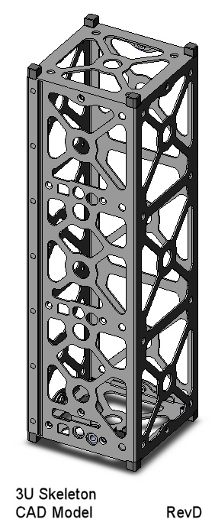
Subsystem: Structures
The structure system is the backbone and is used to ensure the survival of the spacecraft and to hold and contain the satellite.
The structure of the satellite must conform to design specifications of the deployer and the CubeSat standard architecture.
The structure will consist of two 3U CubeSats that will be attached initially but have the capability to separate during orbit.

Slide 25
Subsystem: Communication
The communication system is used to provide verification of mission objective completion to the ground.
Data that would be sent down:
Relative Distances
Relative Velocities
Spacecraft Health
There are several frequencies available for use, ranging from VHF to S-band.
The major design considerations for selecting a radio are the output power and baud rate.

Slide 26
Group Organization
Project Overview
Design Constraints
Mission Architecture
CONOPS
Risk Assessment
Schedule

Slide 27
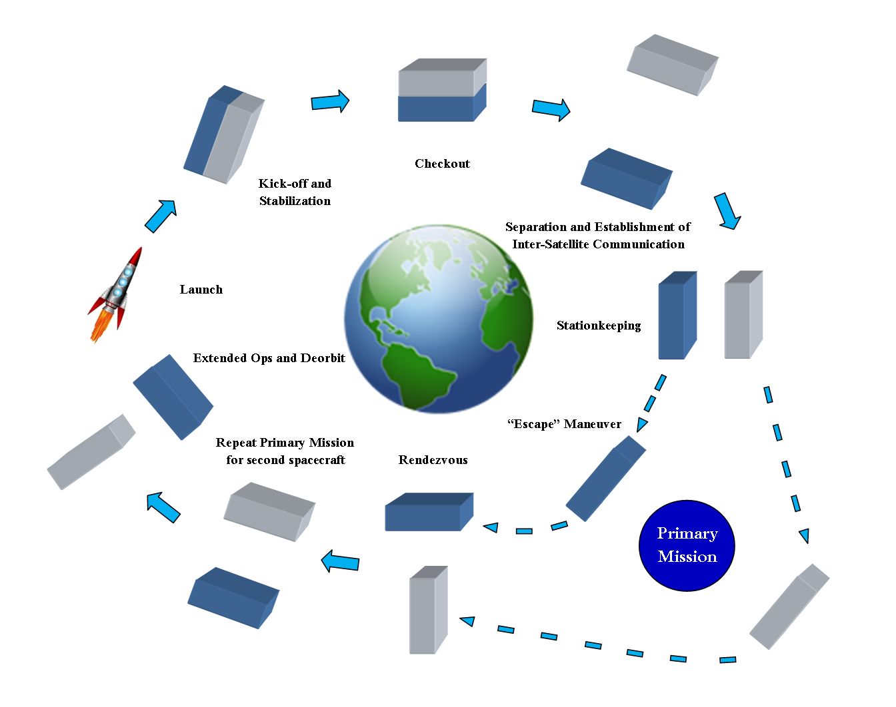
Preliminary Concept of Operations

Slide 28
Group Organization
Project Overview
Design Constraints
Mission Architecture
CONOPS
Risk Assessment
Schedule

Slide 29
Risk Assessment Diagram
5
4
3
2
1
 | 1 | 2 | 3 | 4 | 5
Likelihood
Level | Definition Levels:
1 | Not Likely
2 | Low Likelihood
3 | Likely
4 | Highly Likely
5 | Near Certainty
Likelihood
Consequence
Consequences
Level | Technical | Schedule | Cost
1 | Minimal or no impact | Minimal or no impact | Minimal or no impact
2 | Minor performance Shortfall, Same approach retained | Additional activities required; able to meet key dates? | Budget increase or unit production cost<1%
3 | Moderate performance shortfall, but workarounds available | Minor schedule slip; will miss need date | Budget increase or unit production cost increase <5%
4 | Unacceptable, but workarounds available | Program critical path affected | Budget increase or unit production cost increase <10%
5 | Unacceptable, no alternatives exist | Cannot achieve key program milestone | Budget increase or unit production cost increase >10%

Slide 30
Risks
Risks
 | Risk | Likelihood | Consequences
1 | Loss of Communication | 2 | 5
2 | Collision between spacecraft | 3 | 3
3 | The spacecraft did not separate properly | 3 | 2
4 | Spacecraft unable to locate each other | 3 | 4
5 | Unable to generate enough power | 2 | 3
6 | Spacecraft separate too fast from each other | 3 | 3
7 | The spacecraft end up too far apart from each other | 3 | 4
8 | Run out of propellant before end of mission | 1 | 5
5
4
3 |  | 3 | 2 5 6 | 4 7
2 |  |  |  |  | 1
1 |  |  |  |  | 8
 | 1 | 2 | 3 | 4 | 5
Likelihood
Consequence

Slide 31
Risks
 | Risk | Likelihood | Consequences
9 | An error occurs during the integration of spacecraft components | 2 | 4
10 | Deorbits before six months | 1 | 5
11 | A spacecraft component fails on orbit | 1 | 3
12 | A leak develops on the propulsion unit | 1 | 3
13 | A failure occurs on the satellite during launch | 1 | 3
14 | Solar panels malfunction | 2 | 3
15 | Spacecraft components operate out of operational temperature range | 1 | 2
16 | Radiation damage | 1 | 2
5
4
3
2 |  |  | 14 | 9
1 |  | 15 16 | 11 12 13 |  | 10
 | 1 | 2 | 3 | 4 | 5
Likelihood
Consequence

Slide 32
Group Organization
Project Overview
Design Constraints
Mission Architecture
CONOPS
Risk Assessment
Schedule

Slide 33
Here be Schedule

Slide 34
Questions?
Jennifer Babb
Bryant Gaume
Tom Moline
Tyler Olson
Nate Richard
First Semester Presentation
December 3, 2013

