Slide 1
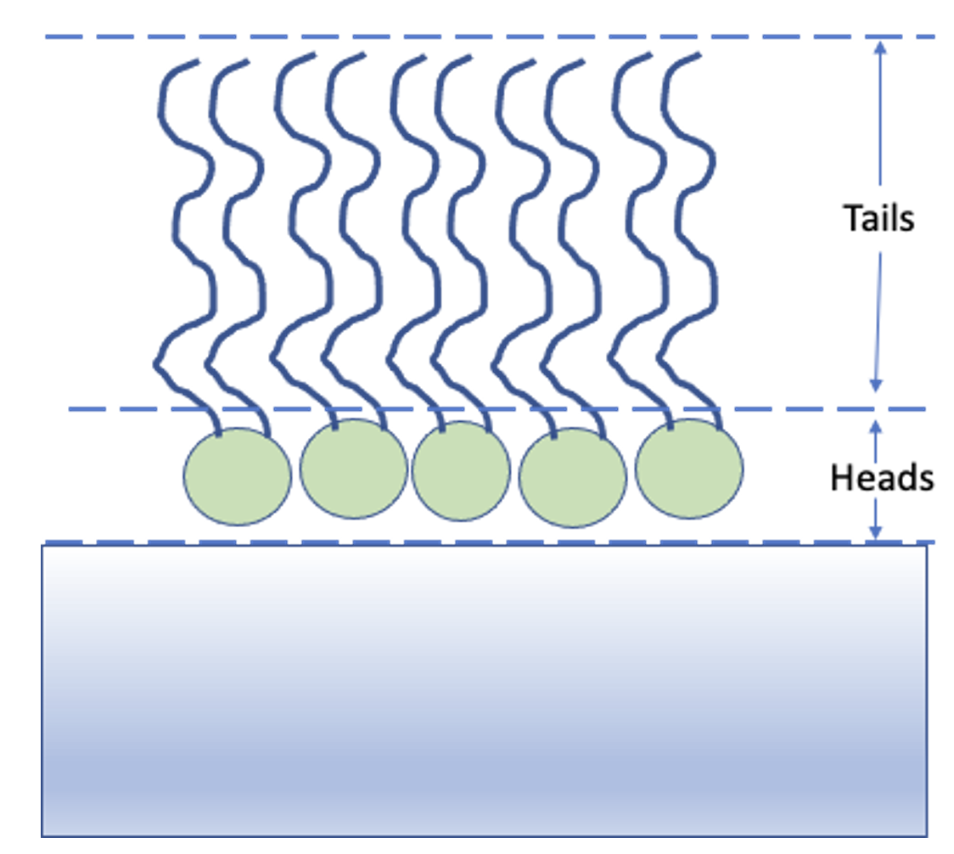
Properties
Layers
Thickness = 0
Bulk-in (Layer 0)
SLD-In: 0
Roughness:0-1
Thickness:1
Layer 1
SLD:1
hydration:1
Contrast
Roughness:1-2
Layer 2
Thickness:2
SLD:2
Roughness:2-3
(Substrate roughness)
SLD-Out:3
Bulk-Out (Layer 3 )
hydration:3
Thickness = 0

