Slide 1

Group : Name : Homayun Kabir Rasel , Munna Dhar Id : 1703310201508, 1703310201504 Semester: 5th Section : C1
PREMIER UNIVERSITY, CHITTAGONG
Department of Computer Science & Engineering
Course Title :Software Engineering & Information System design Laboratory.
Course Code : CSE 306
Presentation on : University Project
Presented to:
Drubajyoti Das
Lecturer at Premier University,
Department of Computer Science and Engineering.

Slide 2
Introduction
The name of our project is “Premier University” where user can see all of the information about Premier University. To find out the Admission information, Academics information, Facuilties Information, Notice and also user can apply for online admission.

Slide 3
Motivation
We choose this types of project for our future work. A University website is very imporatant and useful for Students ,Teachers and other publics. In future we can implements new features in this project.

Slide 4
Features
1.User/ Admin Registration form.
2.User/ Admin login form.
3.Clean Navigation menu with categories.
Details university activity.
4.Academic and Teacher Information.
5.Online application form.
6.Admission test schedule and Tution fees.
7.Contact.
8.Notice.
9.Location.(Map)
10.Logout

Slide 5
Tecnologies Used
1.Php
2.Css
3.Html
4.Bootstrap4
5.Server Used (xampp)
6.Editor(Sublime text)

Slide 6
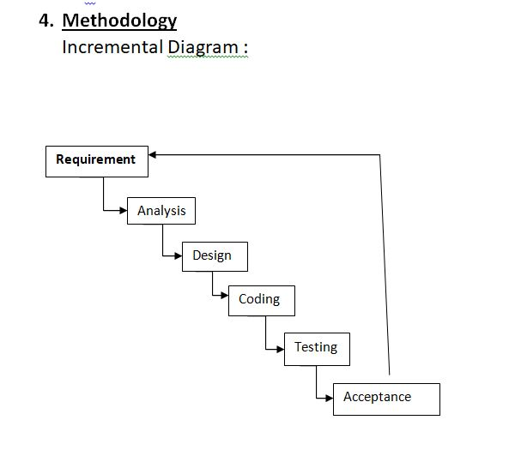

Slide 7
ER Diagram
User
Name
Address
Location
Contact No.
Email
Password
Admin
Address
Location
Phone no
Email
Password
Admin code(
Manage
Yes
Yes
Online form
Name
Date of Birth
Father Name
Mother name
Adress
Email
SSC-gpa
HSC-gpa
Department
Session
Techers
Name
Image
descripton

Slide 8
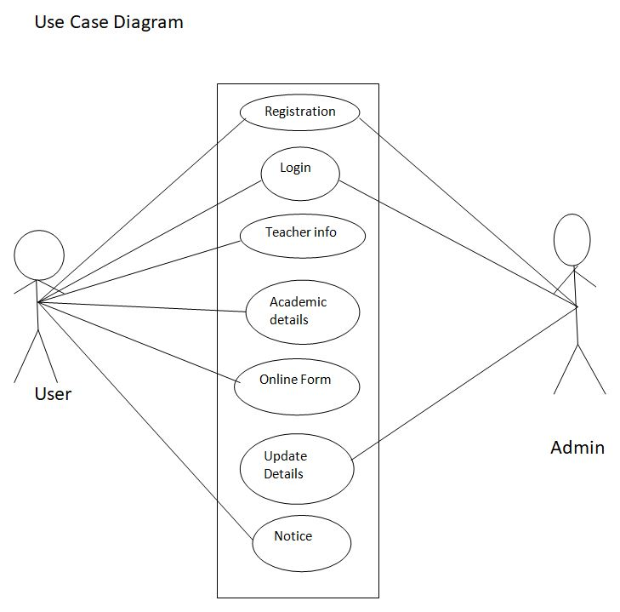

Slide 9
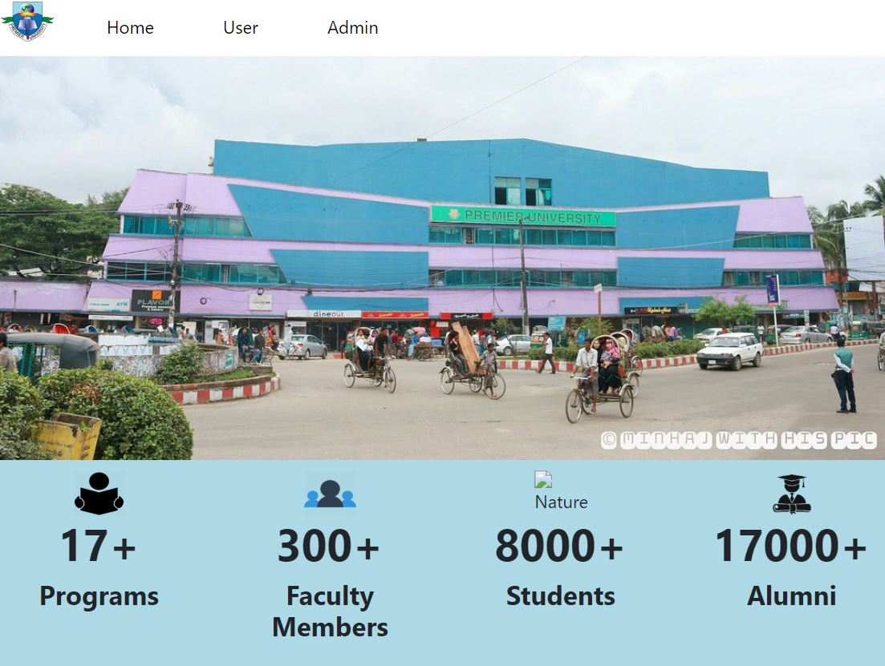
Project Main page

Slide 10
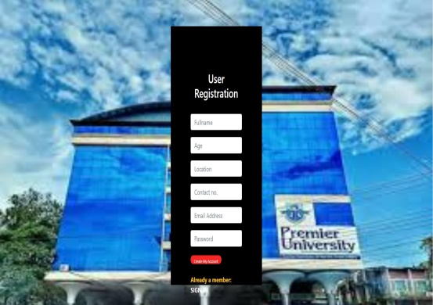
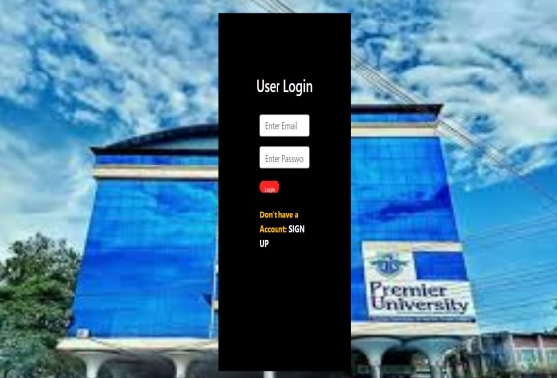
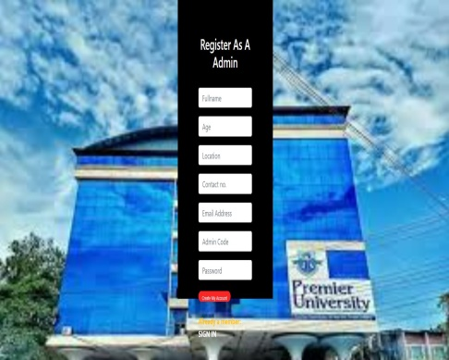
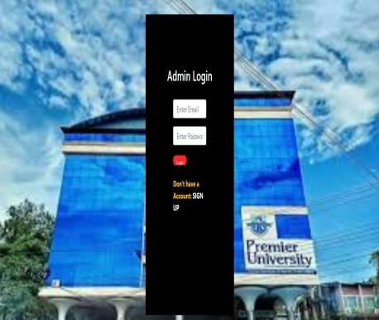
USER
Admin

Slide 11
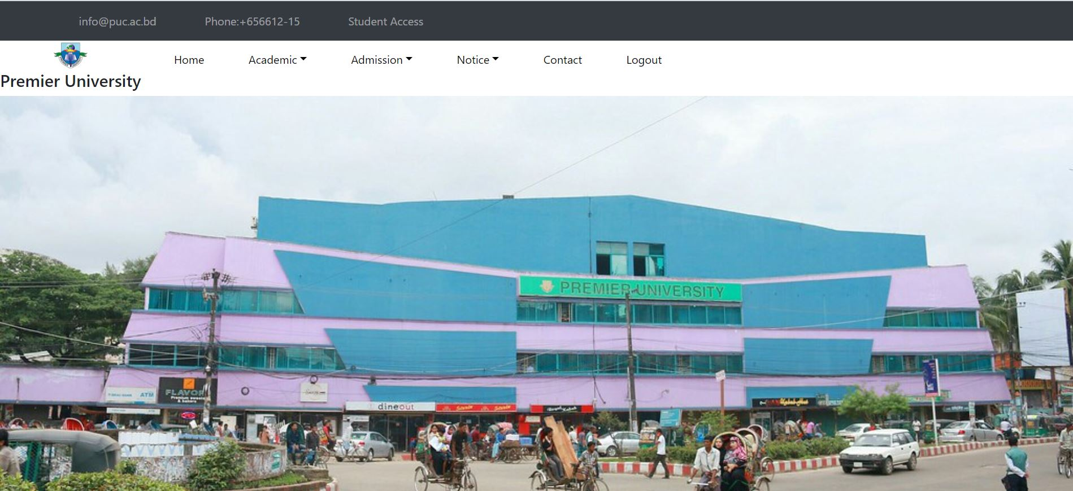
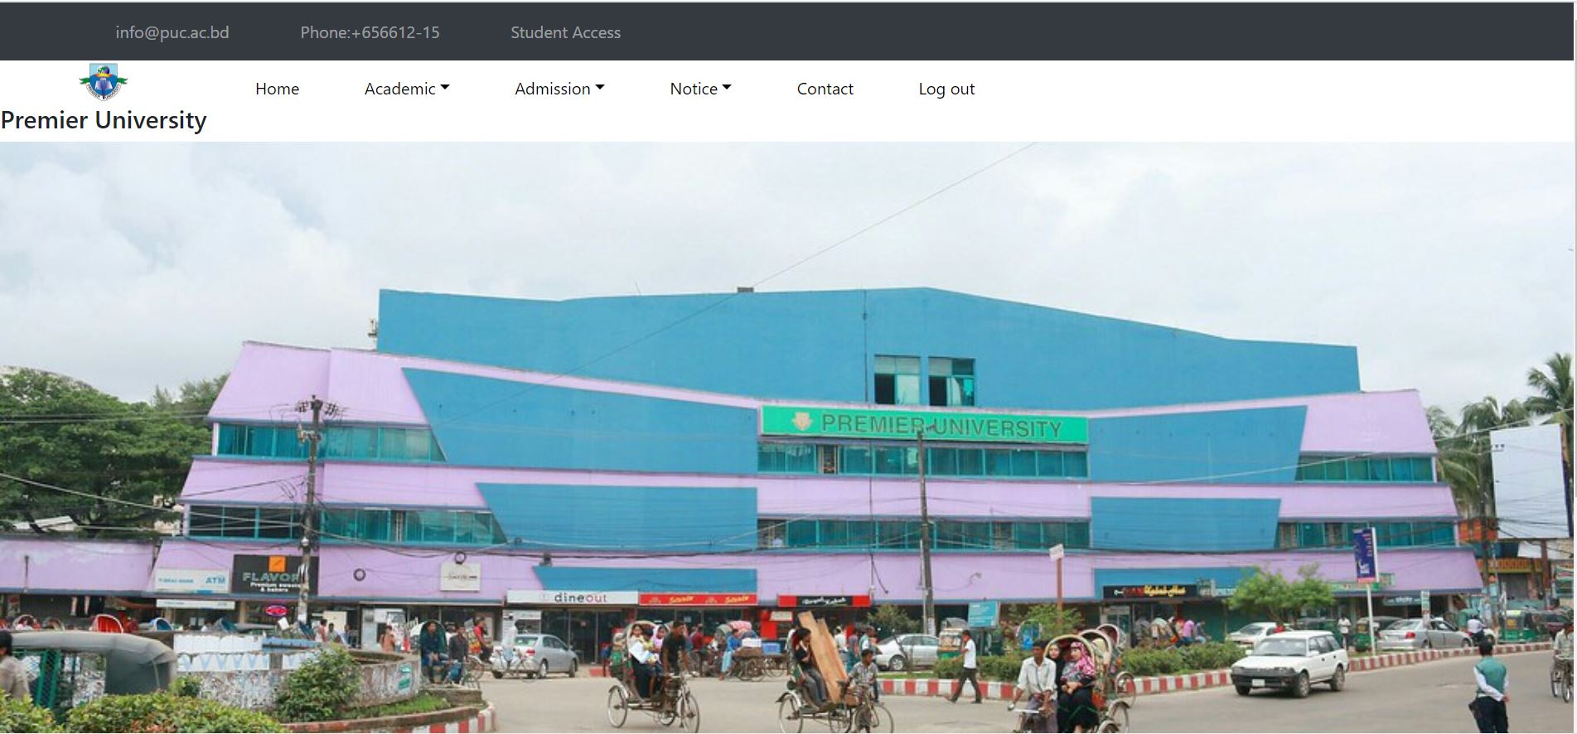
Admin Home page
User Home page

Slide 12
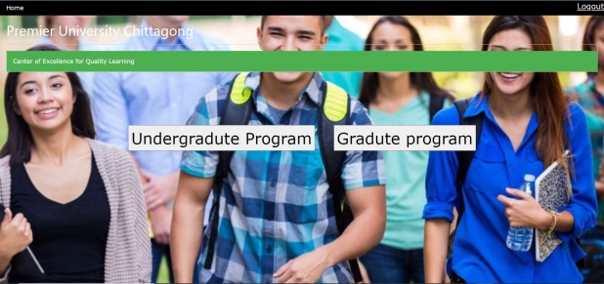
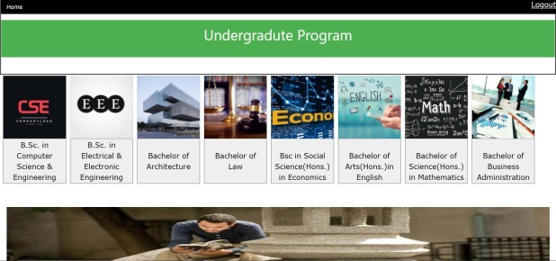

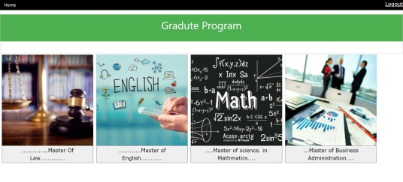
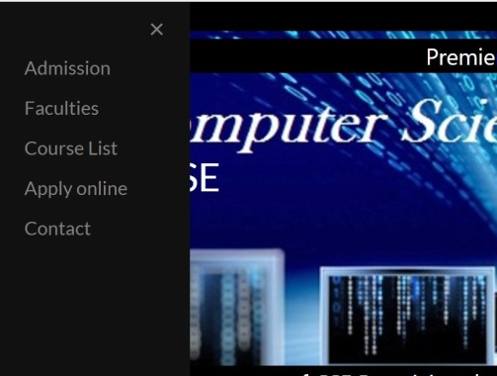
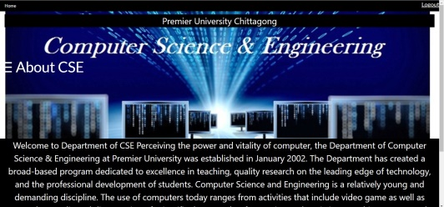

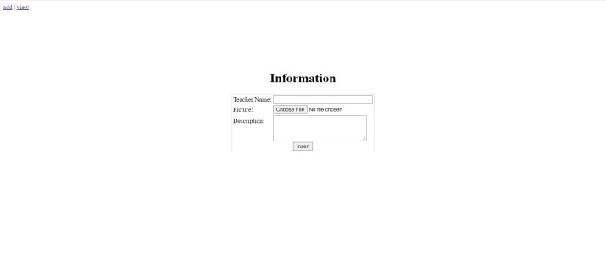
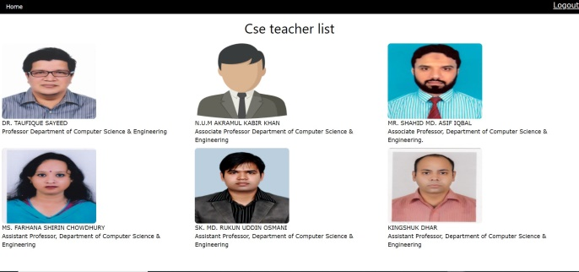
Admin
USER

Slide 13
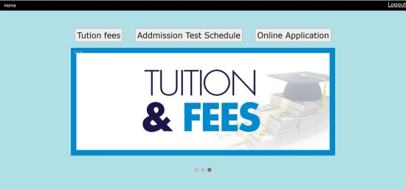
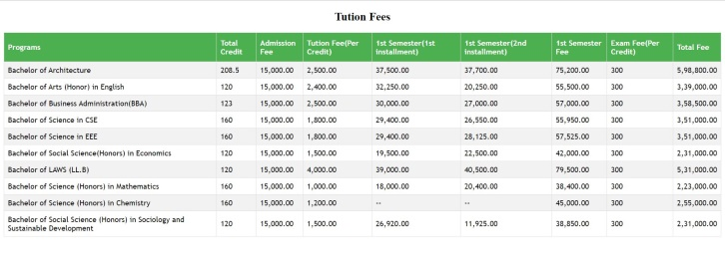
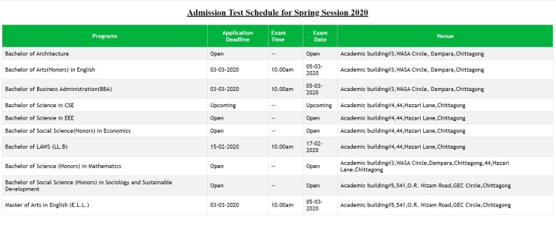
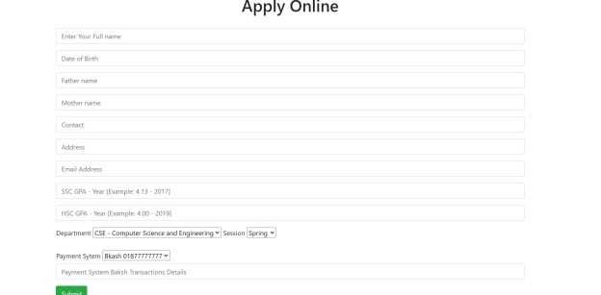
Admin
USER
Applicant Data
Applicant Data

Slide 14
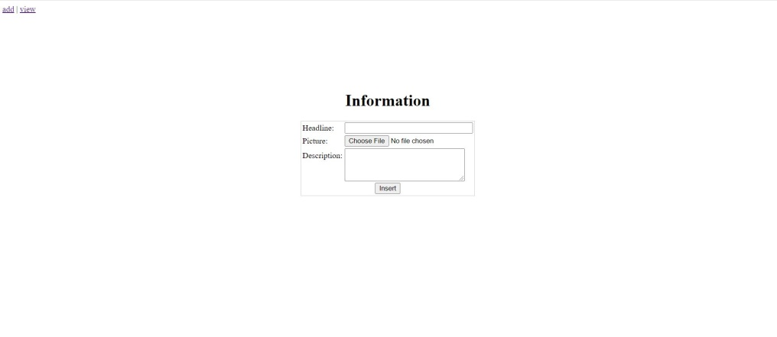
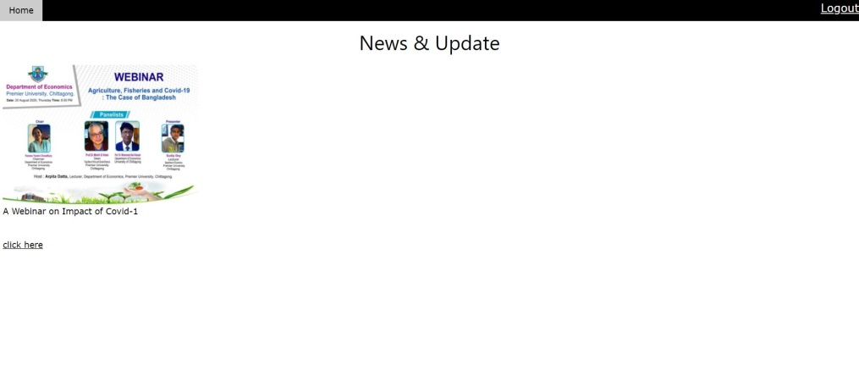
Admin
USER

Slide 15
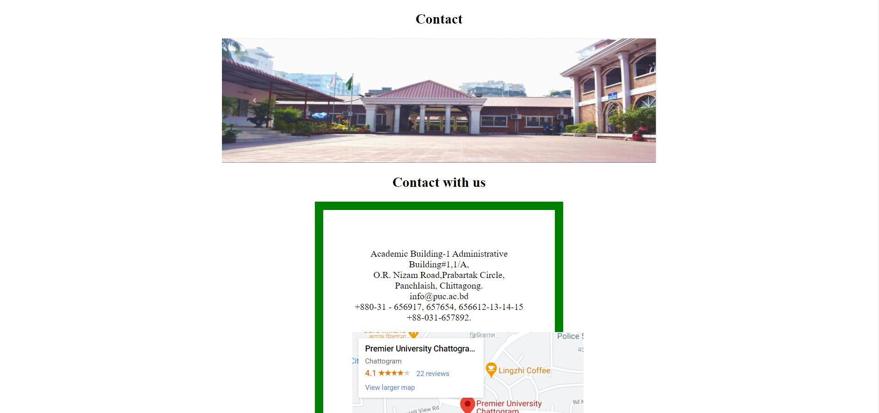
Admin
USER

Slide 16
Admin
USER
Project Home Page
Project Home Page

Slide 17
Limitation:
Apllication form cannot take any input.
2. All Department is not include .
(Without CSE)
Future Work:
1.An applicant can see their admission test result.
2.Every student can access their profile .
3.University Student can enroll their course.
4.University student can find out their result.
4. Library facilities.

Slide 18
Conclusion:
Our website allows us to view all the facilities Premier University is providing.
It allows us to register sitting at home.
It provides all online university services.
It saves a lot of our time and hassle.
Reference:
1. Premier University, Chattogram.
2. www.w3school.com
3. www.getbootstrap.com .

Slide 19
Thank You

