Slide 1

AI POWERED CARRER MENTOR

Slide 2
PROBLEM STATEMENT
In today's competitive job market, individuals often struggle to identify the right career path, improve their skills, or find relevant job opportunities that match their expertise. Traditional career counseling methods are time-consuming, expensive, and lack personalization.This project aims to address these challenges by building a career mentoring tool that leverages generative AI to:
Analyze user-provided skill sets or resumes.
Identify suitable career paths and job roles.
Recommend top skills to learn for career growth.
Provide real-time insights and actionable recommendations to enhance employability.

Slide 3

OBJECTIVE
To develop an AI-powered application that analyzes a user's resume or skill set, recommends relevant career paths, suggests job opportunities, and provides personalized skill improvement advice using state-of-the-art AI models like Cohere.

Slide 4
FEATURES
Resume Analysis: Extract insights from user resumes or descriptions using AI embeddings.
01
Career Recommendations: Match user profiles with suitable job descriptions and recommend relevant career paths.
02
Skill Improvement Suggestions: Generate a list of skills that the user should acquire to enhance their career prospects.
03
Interactive and User-Friendly Interface: Enable users to input their profiles easily through prompts and receive actionable feedback instantly.
04

Slide 5
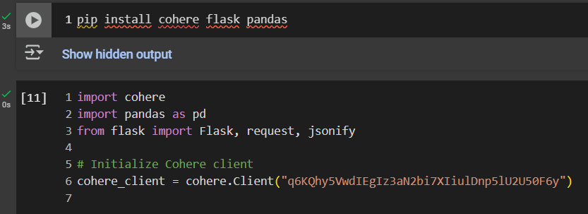
METHODOLOGY
Installing python libraries like flask and pandas and api coehere and importing them in the system

Slide 6
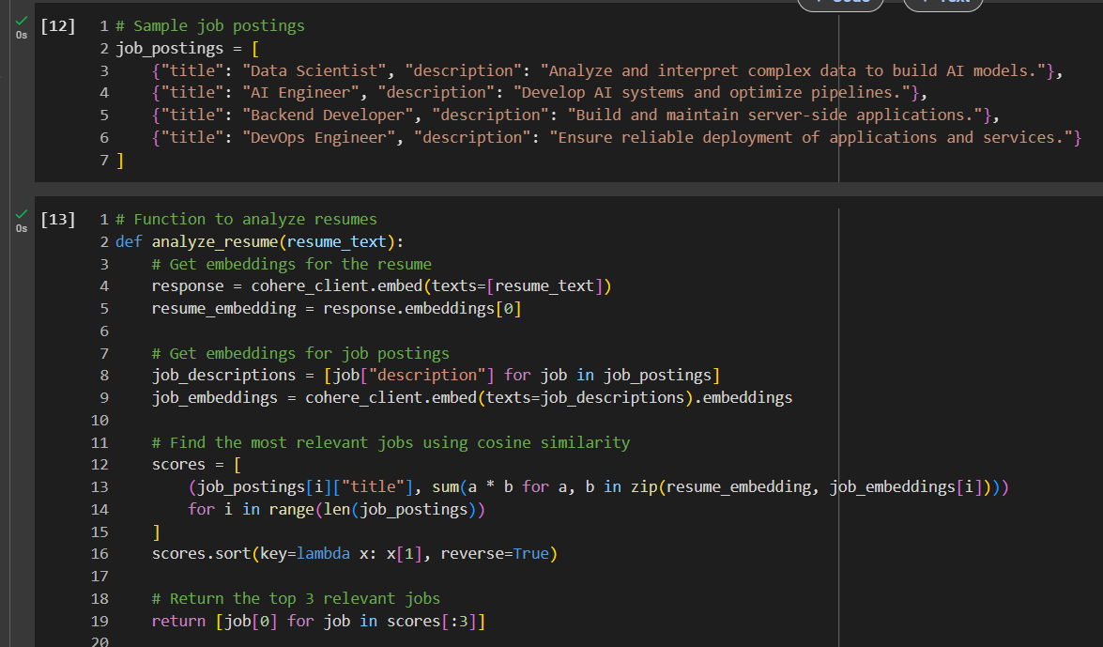
METHODOLOGY
2) Inputting sample job postings and using embedding function to analyzing the resume skill set

Slide 7
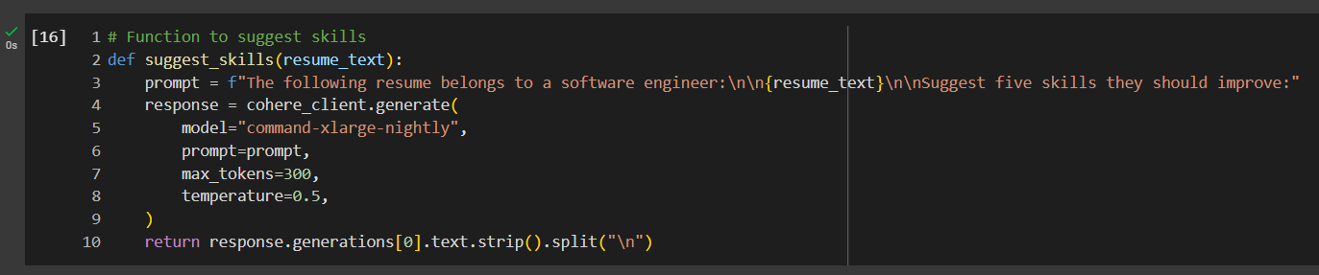
METHODOLOGY
Using functions to suggest skills using api model "x-large nightly"

Slide 8
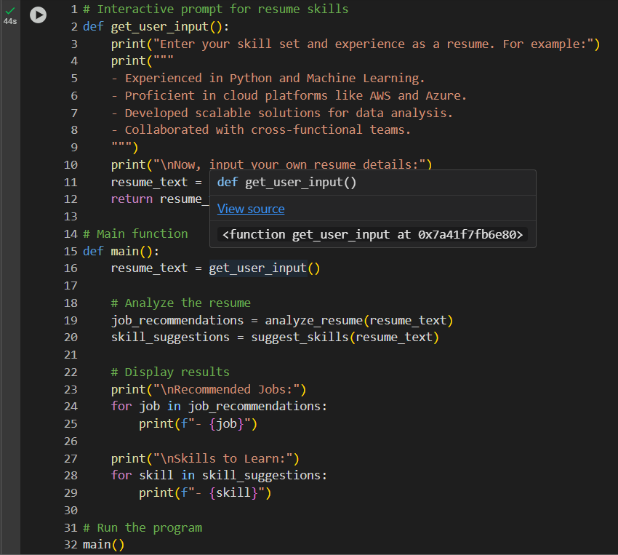
METHODOLOGY
Using basics of prompt engineering to allow user to input their resume skill set and get recommended job options and further skills they can learn

Slide 9
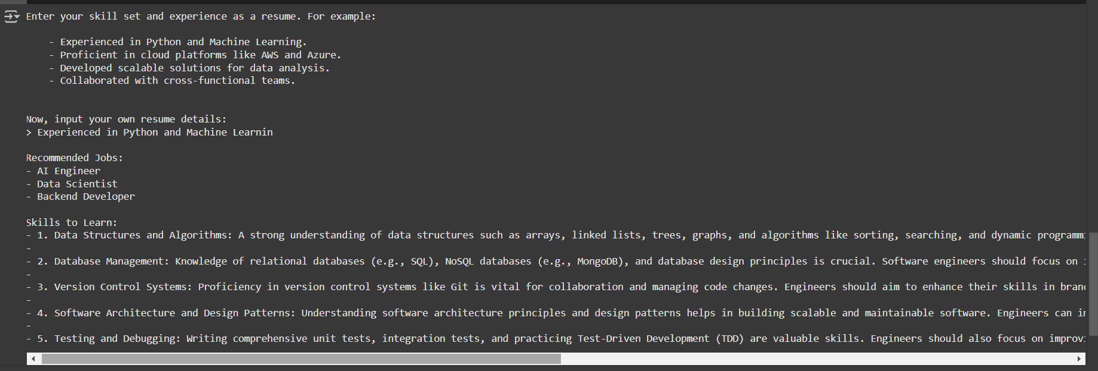
RESULT

Slide 10

THANK YOU

