Slide 1
DA321M Machine Learning Course Project (Group-8)
Group Members: Anant Bansal, Rasesh Srivastava, Vidya Sagar G, Naveen Kumar A G, Karan Garg, Aditya Gupta
Topic: EEG signal classification using PCA, ICA, LDA and support vector machines. (Expert Systems with Applications -2010)
Link to the Research Paper

Slide 2
Introduction
Overview and Seizure Prediction Methods
Electroencephalogram (EEG) signals are vital for studying brain activity and predicting events like seizures. Traditional methods like Power Spectral Analysis emphasize frequency but miss temporal details. Time-Frequency Signal Processing, particularly Discrete Wavelet Transform (DWT), addresses this by breaking EEG signals into frequency bands, preserving both time and frequency information.
Various Seizure prediction approaches include preictal feature analysis, fast detection, classification-based prediction, and probability estimation.
Training processes used RBF kernel with PCA + SVM, ICA + SVM, and LDA + SVM, reducing the number of support vectors (SVs) through feature extraction.
Advantages of DWT Analysis
Preserves time and frequency information for a comprehensive view of EEG signal variations.
Suitable for analysing non-stationary EEG signals.
Effective in detecting transient events, important for identifying features like spikes in epileptic seizures.

Slide 3
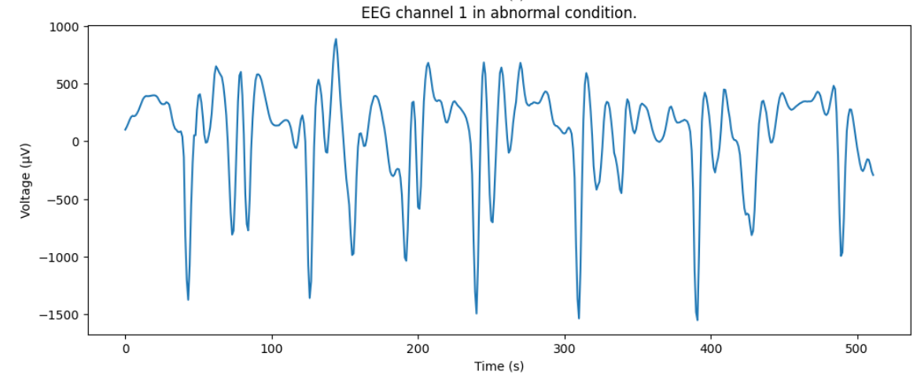
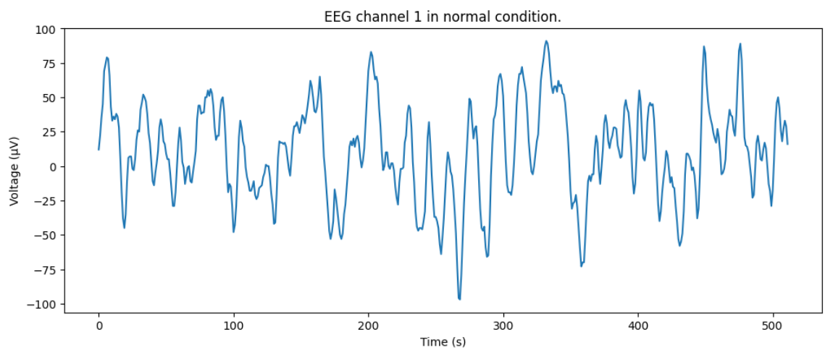
Dataset and Methodology
The dataset comprises EEG segments from five healthy volunteers in two states: eyes open (Set A) and eyes closed (Set B), as well as segments from five patients with post-resection seizure control. Set C features activity from the opposite hemisphere (seizure-free), Set D includes activity within the epileptogenic zone (seizure-free), and Set E contains seizure activity. Our study primarily focuses on datasets A (awake) and E (seizure).
Data preprocessing
1. Signal Transformation:
Addressed non-stationarity using wavelet transforms: Continuous Wavelet Transform (CWT) and Discrete Wavelet Transform (DWT)
2. Features Extracted to represent time-frequency distribution:
Mean and average power of coefficients in sub-bands
Standard deviation of coefficients
Ratio of absolute mean values between adjacent sub-bands
3. DWT Decomposition:
Chose 5 decomposition levels based on dominant frequency components
Retained signal parts relevant for classification
4. Decomposition Components:
Decomposed EEG signals into detail components (D1–D5)
Final approximation component (A5) based on dominant frequency components.

Slide 4
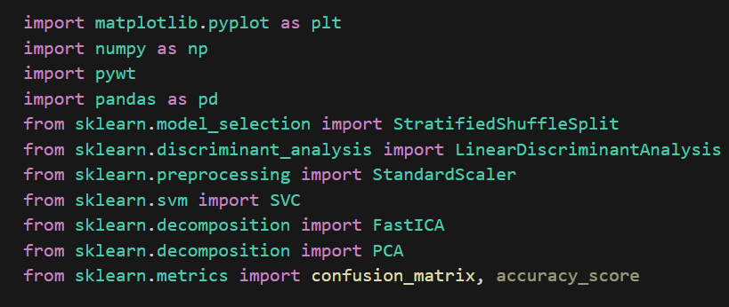
Libraries Used:
SVM and how does it work
Utilizes hyperplane separation, mapping to a higher-dimensional space for nonlinear data.
EEG signal classification using SVMs shows that nonlinear feature extraction can improve the performance of classifier with respect to reduce the number of support vectors.
Optimizes using a kernel function for nonlinear transformations. In our case, we have used the radial basis function
Maximal Margin Separation: Aims for maximal margin, ensuring better generalization ability.

Slide 5

Process Pipeline Followed For PCA
Principal Component Analysis (PCA) aims to condense high-dimensional data into a lower-dimensional space by capturing its variability. It identifies key patterns by computing the mean and covariance of the data, then extracting the most influential components through eigenvectors and eigenvalues.
By selecting the most significant eigenvectors (representing signal) and disregarding others (representing noise), PCA constructs a transformed representation that minimizes error, making it effective for dimensionality reduction and separating signals from various sources in datasets.
We used StandardScaler to preprocess the data initially and then applied PCA. After that, we used SVM and used the radial basis function for the kernel, to avoid and overcome the problems of under-fitting and over-fitting so the best classification process is yielded.
The choice of setting `n_components` to 0.95 was done to retain a substantial portion of variance within the data. This ensured that, in our specific case 5 components were retained and a minimum of 95% variance was preserved.

Slide 6
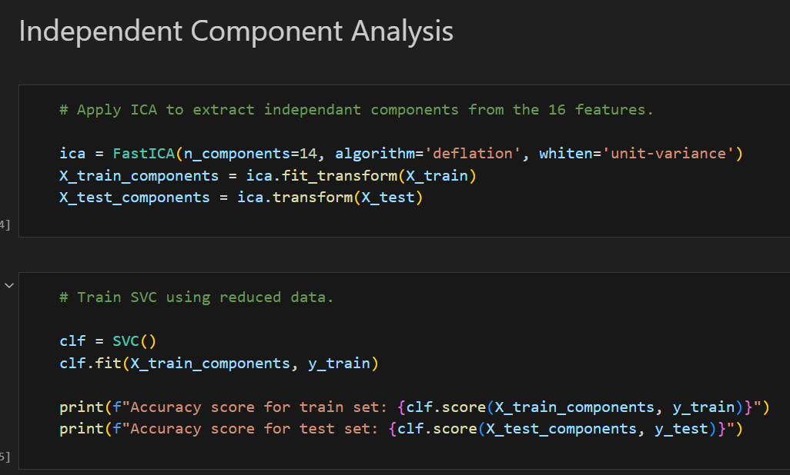
Process Pipeline Followed For ICA
Independent Component Analysis (ICA) is a feature extraction method that transforms multivariate random signals into mutually independent components. The independence of these components implies that the information carried by one component is not predictable from the others
The key characteristic of ICA is that the information carried by one component is statistically independent of the others, reflected in the joint probability being the product of the probabilities of each individual component. The task of independent component analysis is to recover the source signals from the sensed signals.
Before applying the ICA algorithm, we must first “whiten” our signal. To “whiten” a given signal means that we transform it in such a way that potential correlations between its components are removed (covariance equal to 0) and the variance of each component is equal to 1 and then using ICA we were able to deduce 14 independent components which gave the best performance.
The following SVC classifier model was trained using these 14 features. ICA achieved 99% accuracy, 100% sensitivity and 98% specificity.

Slide 7
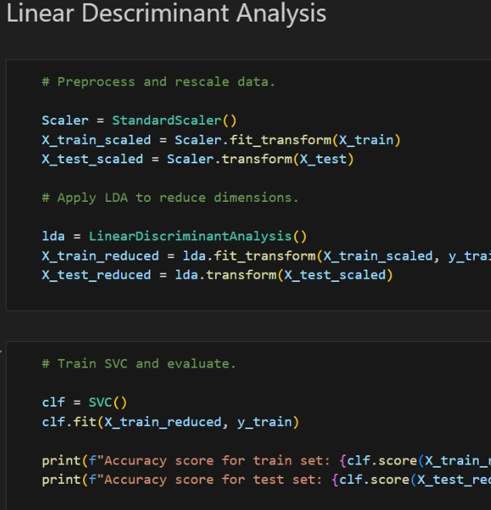
Process Pipeline Followed for LDA
Linear Discriminant Analysis (LDA) aims to create a single composite variable by maximizing the differences between predefined groups based on the original predictors. It compresses multiple predictors into a one-dimensional line to form discriminant scores that highlight variations between classes. Hence targeting maximum separability and is particularly relevant in EEG for distinguishing between different states.
This technique transforms predictor scores into a weighted sum, creating a discriminant score that emphasizes differences in class means. The weights assigned to predictors reflect dissimilarities between class means, with larger weights for predictors that show greater differences and smaller weights for similar class means. The degree of overlap in discriminant score distributions serves as a measure of the method's success.
We used StandardScaler to preprocess the data initially and then applied LDA. After that, we used SVM and used the radial basis function for the kernel, to avoid and overcome the problems of under-fitting and over-fitting so the best classification process is yielded.
LDA achieved 99% accuracy, 100% sensitivity and 98% specificity, this can be attributed to the following, the number of SVs which is reduced and smaller than PCA and ICA. In these circumstances, classification process using ICA feature extraction needs fewer numbers of SVs than PCA feature extraction.

Slide 8
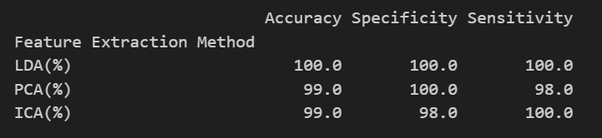
Results Obtained
Performance Evaluation: Simulation results indicate that Support Vector Machine (SVM) with feature extraction using Principal Component Analysis (PCA), Independent Component Analysis (ICA), or Linear Discriminant Analysis (LDA) consistently outperforms SVM without feature extraction. Notably, LDA feature extraction demonstrates the best performance among the three methods.
Conclusion: EEG signal analysis using DWT provides a powerful tool for seizure prediction, offering a holistic perspective by preserving both time and frequency information. Using statistical features extracted from the DWT sub-bands of EEG signals, three feature extraction method; namely PCA, ICA, and LDA, were used with SVM and cross-compared in terms of their accuracy relative to the observed epileptic/normal patterns. The comparisons were based on two scalar performance measures derived from the confusion matrices; namely specificity and sensitivity. The result of EEG signal classification using SVMs shows that nonlinear feature extraction can improve the performance of classifier with respect to reduce the number of support vector. Also, it is demonstrated that dimension reduction by PCA, ICA and LDA can improve the generalization performance of SVM.

