Slide 1

Engine Reliability and Maintenance
Rashmi

Slide 2
Question: How do annual members and casual riders use Cyclist bikes differently?
Business Task:
By identifying how annual members and casual riders use Cyclist bikes differently, we can determine the best marketing strategy to convert casual riders into annual members.
Data Sources Used:
07/2021 – 06/2022 Cyclist Trip Data
Note: Divvy_Stations_Trips and Divvy_Trips_YYYY files were not used since they were before July 2021.

Slide 3

Data Analysis Problems & Workarounds
PROBLEMS:
🞅 R Studio Cloud: Unable to upload all datasets into R Studio Cloud to combine into one file → R Studio crashed
Why? Memory space availability on the free trial
🞅 Excel/CSV Format: Unable to combine all files into a singular Excel or CSV → Excel crashed
Why? Exceeded max # of rows Excel can handle
🞅 PowerBI: Tried uploading files directly into PowerBI instead → PowerBI also crashed
🞅 Tableau: Because of this, did not attempt Tableau
WORKAROUNDS:
🞅 Divided files in Excel format – members vs. casual users
🞅 Analyzed data per file, creating pivot tables and either bar or pie charts (‘Analyze Data’ button in Excel)
🞅 Visually compared same-month casual vs member data (October to October)
🞅 Created summary document with all pivot chart summaries, ran new analysis on summary data, and compared for trends

Slide 4
FINDINGS

Slide 5


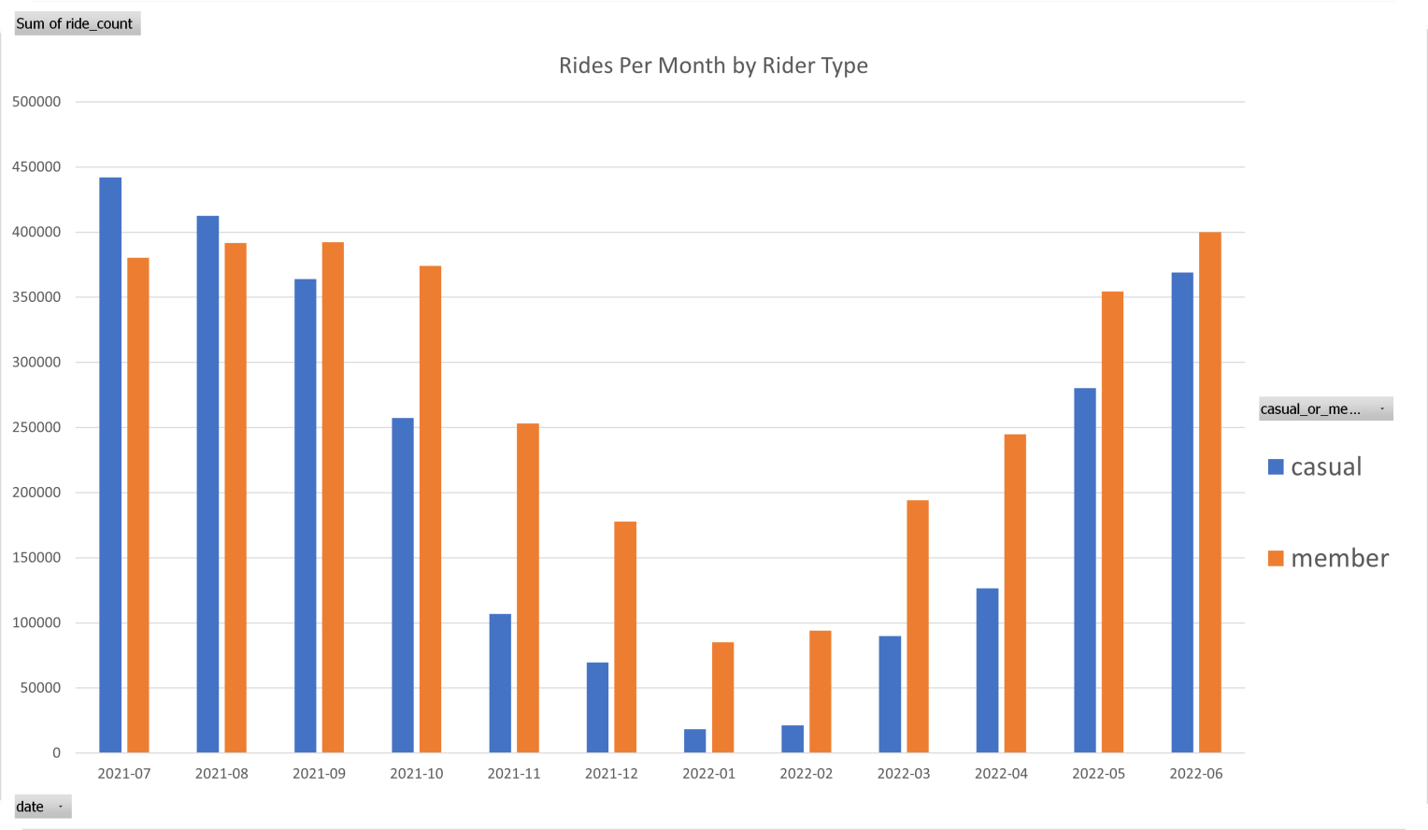
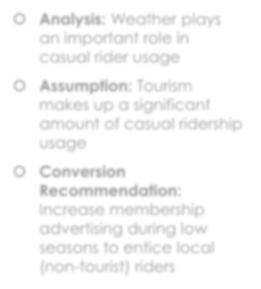
RIDES BY MONTH
Casual ridership most popular in summer
🞅 Analysis: Weather plays an important role in casual rider usage
🞅 Assumption: Tourism makes up a significant amount of casual ridership usage
🞅 Conversion Recommendation: Increase membership advertising during low seasons to entice local (non-tourist) riders

Slide 6
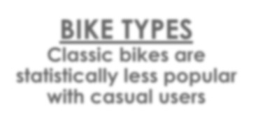
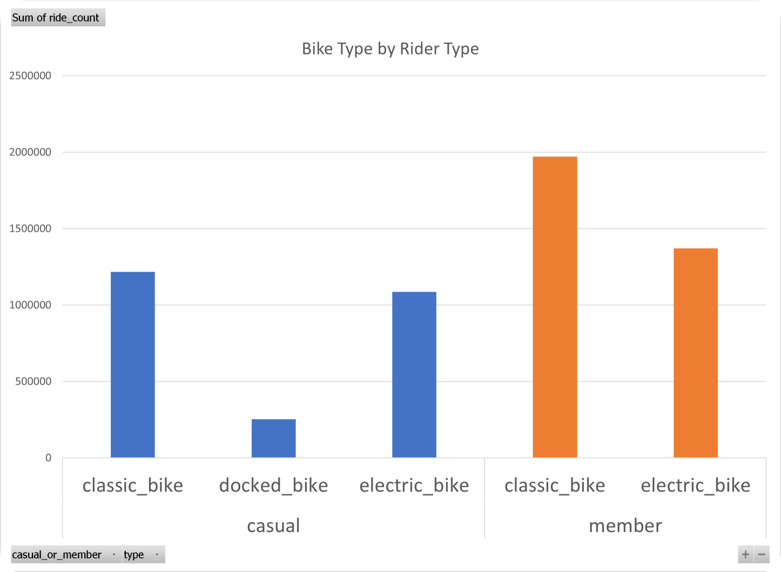
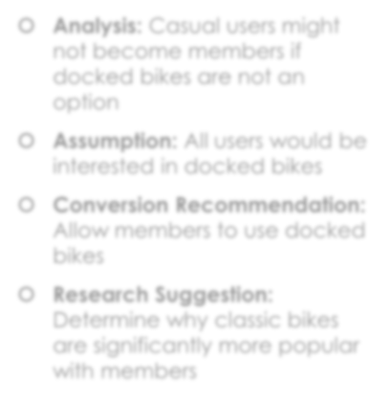
BIKE TYPES
Classic bikes are statistically less popular with casual users
🞅 Analysis: Casual users might not become members if docked bikes are not an option
🞅 Assumption: All users would be interested in docked bikes
🞅 Conversion Recommendation: Allow members to use docked bikes
🞅 Research Suggestion: Determine why classic bikes are significantly more popular with members

Slide 7



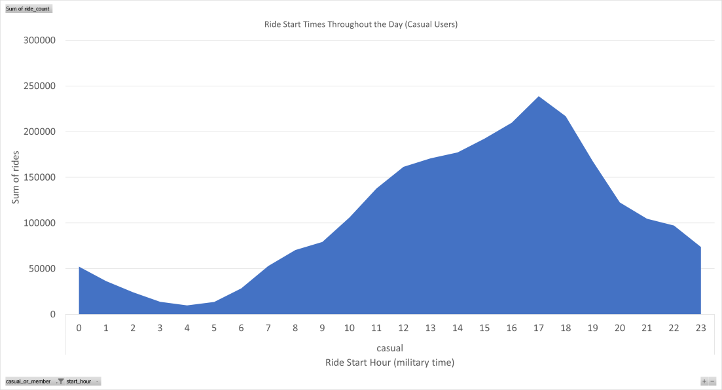
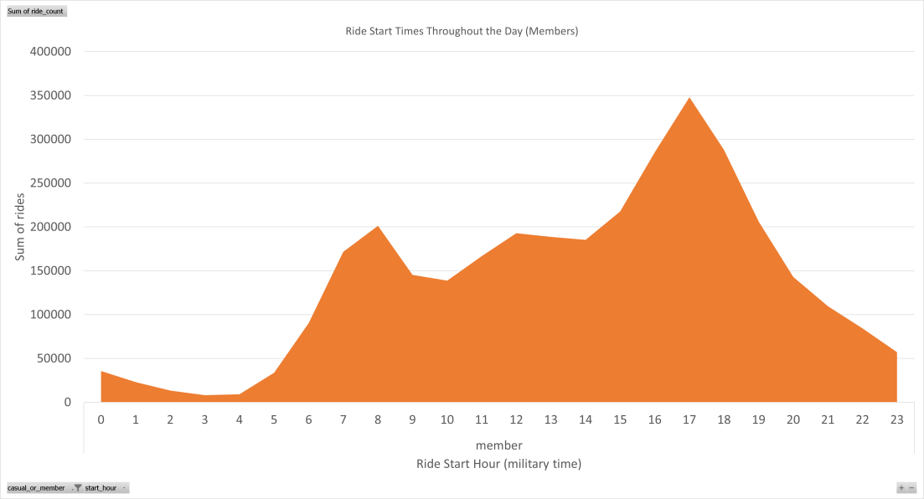
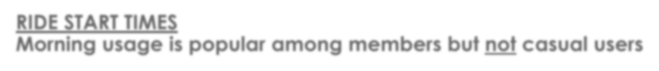


Casual Riders
Members
RIDE START TIMES
Morning usage is popular among members but not casual users
🞅 Analysis: Members use the bikes for commuting
🞅 Assumption: Casual users aren’t interested in morning rides
🞅 Conversion Recommendation: Provide a discounted rate to members who only use bikes after 11 AM (opposite of an early-bird
discount)

Slide 8
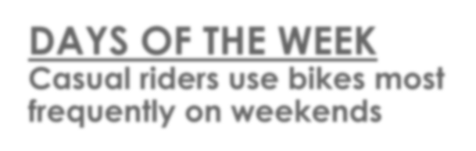
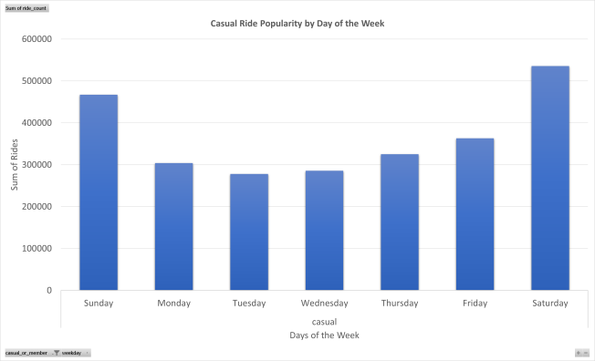

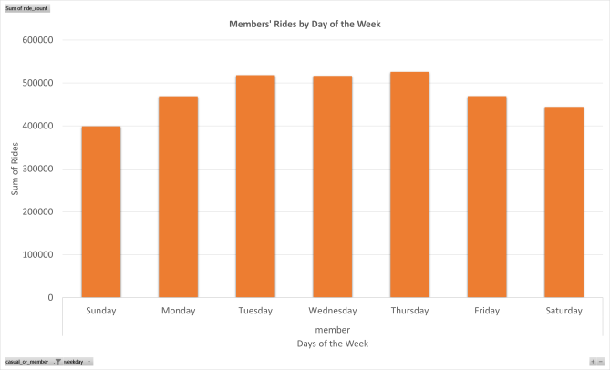
DAYS OF THE WEEK
Casual riders use bikes most frequently on weekends
Casual Ride Days
Member Ride Days
Analysis: Members use the bikes for commuting
Assumption: Tourists (the casual ridership majority) are not interested in commuting with the bikes
Conversion Recommendation: Offer weekend discounts to new members

Slide 9


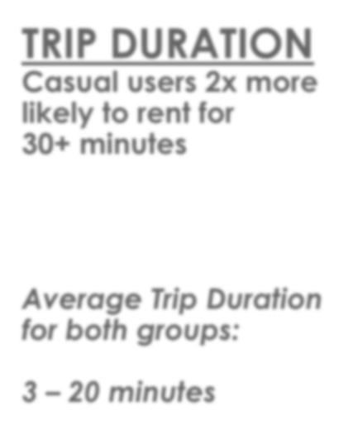

TRIP DURATION
Casual users 2x more likely to rent for
30+ minutes
Average Trip Duration for both groups:
3 – 20 minutes
Analysis: Casual users like the leisure of long bike
rides
Assumption: Current rates are based on usage by the minute, which might deter some casual users from
becoming members
Conversion Recommendation: Provide a day- based membership package
(2 days/month, 5 days/month) instead of a minute- based rate

Slide 10
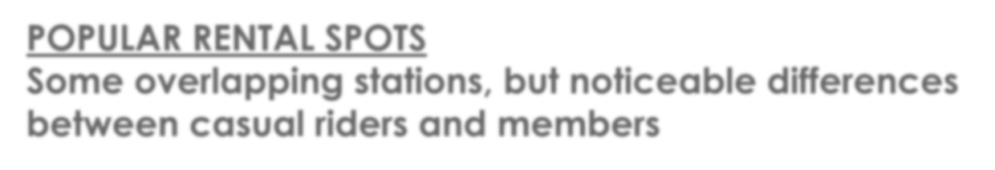
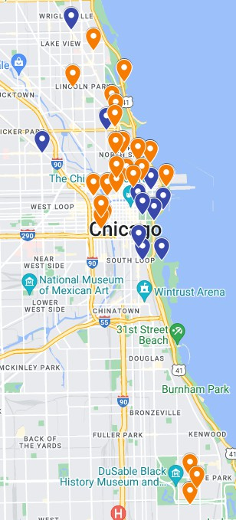
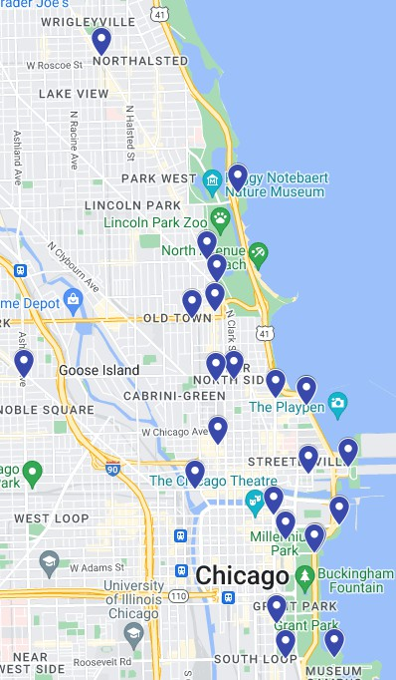
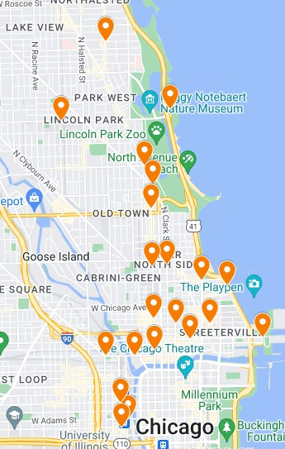
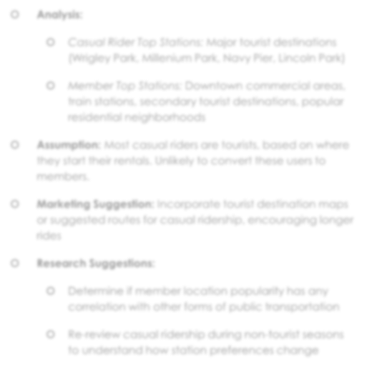
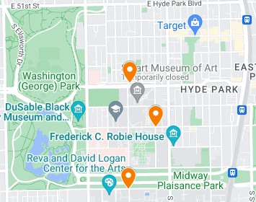
POPULAR RENTAL SPOTS
Some overlapping stations, but noticeable differences between casual riders and members
🞅 Analysis:
🞅 Casual Rider Top Stations: Major tourist destinations (Wrigley Park, Millenium Park, Navy Pier, Lincoln Park)
🞅 Member Top Stations: Downtown commercial areas, train stations, secondary tourist destinations, popular residential neighborhoods
🞅 Assumption: Most casual riders are tourists, based on where they start their rentals. Unlikely to convert these users to members.
🞅 Marketing Suggestion: Incorporate tourist destination maps or suggested routes for casual ridership, encouraging longer rides
🞅 Research Suggestions:
🞅 Determine if member location popularity has any
correlation with other forms of public transportation
ORANGE = Members BLUE = Casual Riders
https://www.google.com/maps/d/edit?mid=1HdDD6B_Rx7vgKdTrFh-NENchpyIu1_0&usp=sharing
🞅 Re-review casual ridership during non-tourist seasons to understand how station preferences change

Slide 11


APPENDIX
Assumptions and Observations
Questions from reviewing the data
Data Cleaning Notes Additional Improvement
Recommendations

Slide 12
Assumptions and Observations
🞅 If the trip duration is under 45 seconds, an error occurred.
🞅 User error - booked on accident, cancelled immediately, etc.
🞅 Bike error – malfunctioning and user needed to return bike
🞅 System error - not logging time in/out correctly, bug while booking
🞅 If the bike was returned to the same place it was taken from, that could be caused by two things:
🞅 Trip didn’t occur
🞅 User made a round-trip with the bike
🞅 Multi-day rentals caused by two things:
🞅 Users actually rented the bike long-term (need billing data to confirm)
🞅 Bike tracking malfunctioning – didn’t log return of the bike by user

Slide 13

Questions from reviewing the data
🞅 Are electric bikes faster than classic bikes? Do they self- propel?
🞅 What are docked bikes?
🞅 Why are members not allowed to used docked bikes?
🞅 Why are there duplicate station names for the same geographical location?
🞅 Why are start stations sometimes not logged in the data?
🞅 How is latitude/longitude data used differently than the station start/end data?

Slide 14
Data Cleaning Notes
1.
2.
3.
Added the Trip Duration and Weekday Columns as instructed
Formatted Lat/Long to consistent (8) decimal places Sorted Trip Duration Smallest to Largest
1. All Negative Trip Duration Hours: Assumption – technical errors caused start TIME and end TIME to be reversed. When negative trip duration occurred – swapped the started_at and ended_at date/timestamps
Added Column “start_end_same_location”. Compared start and end latitudes and longitudes for distance traveled.
Added Column “trip_or_error” to determine if an actual trip was made or if it was a booking error. Assumption: If the user used the bike for less than 45 seconds and dropped it off at the same place they picked it up, the bike was probably not used, and the data should not be included in the overall calculations. Another analysis should be made about why so many errors occur.
4.
5.
1.
2.
This does not diminish the DEMAND for bikes at a given date/time.
How many of these errors occurred for casual riders? Maybe that influences conversion rates – user experience.
6.
7.
8.
9.
Made copies – 1 set of files with just errors, 1 set of files with just trips, and kept 1 set of original data with both
Unable to combine original data set files into a single file – attempted and crashed Excel multiple times.
Attempted to combine original files. Combined file wouldn’t save data changes. See Problems and Workarounds (Slide 3)
Divided data into two datasets – casual riders and members
1. Kept files individual, separated
Used Excel’s Analyze Data to create pivot tables within each file, for individual data points (Columns)
Copied the pivot table summaries into a smaller Summary file
Created pivot tables and charts in Summary file based on combined data from all months
For Station Locations, created a Google Map with pins for top 10 stations from each month, for visual

Slide 15
Additional Improvement Recommendations
🞅 Do not allow casual riders to rent the bikes more than the maximum time allotted for members – screws up the data metrics
Example: Casual riders sometimes rented for multiple days, whereas members
🞅 Always track start and end locations
🞅 Log short trips (under 45 seconds) with same departure/return location as errors
🞅
🞅
🞅
🞅
🞅
maxed out just under 24 hours.
Create member logins for all user types to track how many times casual riders rent bikes Determine if there are popular routes
Determine if there’s ever been rental demand that exceeded bike supply
Add monetary stats to the data – is usage influenced by rates?
Track distance of trip, not just lat/long of start.
Example: Two people starting and ending at the same place with wildly different ride times suggests additional stops/reasons for rental
🞅 Add weather to data information: does weather influence both member and casual ridership rentals?
🞅 Add a poll when renting bikes: Do you live within the Chicago Metropolitan area? Track that data.

