Slide 1

Exploratory Data Analysis
G2M Insight for Cab investment Firm
27th June 2021

Slide 2

Background
XYZ is a private firm in US. Due to remarkable growth in the Cab Industry in last few years and multiple key players in the market, it is planning for an investment in Cab industry.
Objective: Perform an EDA on given cabs data and provide some recommendation for investment.
This analysis is divided into below given steps:
Data Preprocessing
Analysis
Recommendation

Slide 3
Data Preprocessing
Data is provided into CSV format. Given Data is from 2016-01-31 to 2018-12-31.
Cab_Data.csv – this file includes details of transaction for 2 cab companies.
Customer_ID.csv – this is a mapping table that contains a unique identifier which links the customer’s demographic details
Transaction_ID.csv – this is a mapping table that contains transaction to customer mapping and payment mode.
City.csv – this file contains list of US cities, their population and number of cab users.
These 4 files are combined to make final workable file with 359392 rows and 12 feature.
After this we have derived feature like:
Profit
Profit per KM

Slide 4
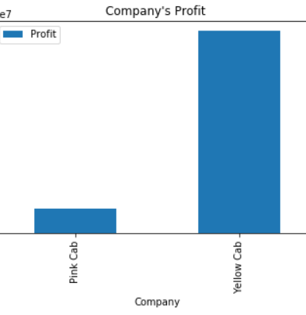
Total Profit by Cabs based on city and their Population
Company | Profit
Pink Cab | 5307328
Yellow Cab | 44020373
Comparison of overall profit by both the companies
Yellow cab is more profitable.
Yellow cab is making almost 8 time more profit than pink cab

Slide 5
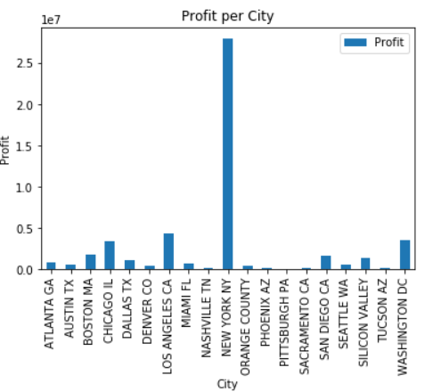
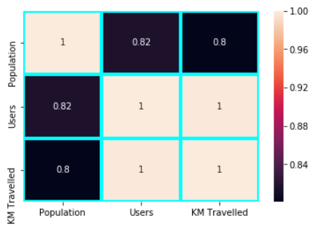
Total Profit by Cities
Plot of profit based on city.
New York has highest cab user as well as highest profit.
Cities with more population have more cab users in turn more distance travelled.

Slide 6
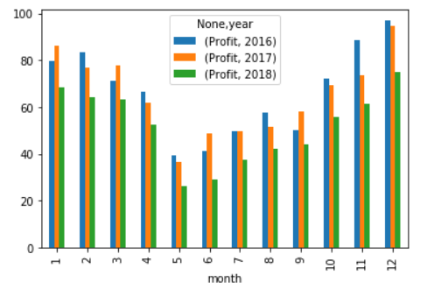
Pink Cab Profit
Plot of average monthly profit made by pink cab in 3 years.
There is seasonality in the profit may, June and July is the low performing months.
Profit in most recent year is (2018) is comparatively lower that 2016 and 2017.
Pink cabs profit in recent year is reduced.

Slide 7
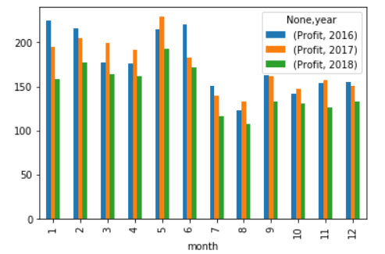
Yellow Cab Profit
Plot of average monthly profit made by yellow cab in 3 years.
There is no seasonality in the profit in 2nd half of the years are is slightly less than 1st Half of the year.
Profit in most recent year is (2018) is comparatively lower than 2016 and 2017.
Yellow cabs profit in recent year is reduced.

Slide 8
Recommendation
Yellow Cab is more profitable.
Yellow Cabs profit is almost constant through out the year.
Investment in yellow cab will be recommended.

Slide 9
Thank You

