Slide 1
SNYK- Introduction
Snyk Open Source Security Management automatically finds, prioritizes and fixes vulnerabilities in your open source dependencies throughout your development process.
Snyk can detect vulnerable dependencies during coding to avoid fixing efforts and save development time.
Using Synk, A developer can scan pull request before merging by enabling them to test project directly from the repository.
Synk allows monitoring applications on a regular basis by giving email updates if any new vulnerability is found in the dependencies.
Important Features:-
Dependency tree view - To understand dependency path through which vulnerabilities were introduced.
Priority Score - Uses an advanced built in system to measure priority of found bugs.
Reachable Vulnerabilities – Find out whether vulnerable function in reachable by application or not.
Runtime Monitoring – To prioritize fixes based on whether vulnerabilities are called during runtime.
Exploit Maturity – Use exploitability indicators to identify the vulnerabilities that can be weaponized easily.
6. Accuracy control for minimizing false positives - Receive high-accuracy alerts that are verified and qualified by Snyk’s dedicated security research team.

Slide 2
DEVOPS INTEGRATION
Snyk provides a range of integrations and capabilities so it can fit seamlessly into your existing software development process. Synk can help you find and fix existing vulnerabilities, as well as monitor and prevent new ones from being introduced at all stages of your SDLC:
Integrated IDE check & CLI: Detects vulnerable dependencies locally, while coding, to avoid future fixing efforts and save development time.
Language support: Snyk supports a wide range of languages such as Java, .NET, Node.js, Python, and more.
Containers & Kubernetes: Detects and monitors vulnerabilities in your containers and Kubernetes configurations.
Git scanning: Checks pull requests before merging. Tests your projects directly from the repository and monitors them daily for new vulnerabilities. Snyk supports cloud and self-hosted SCMs.
CI/CD gate: Prevents new vulnerabilities from passing through your build process by adding an automated Snyk test to your CI/CD.
Production environment: Tests your running environments to verify that there is no exposure to existing vulnerabilities, and continuously monitors for newly disclosed vulnerabilities.

Slide 3
SNYK CLI
The Snyk CLI, connects to snyk.io over https, authenticates your machine with your account, and then helps you find and fix known vulnerabilities in your dependencies, both manually and as part of your continuous integration.
Installation of the Snyk CLI can be done using one of these options:
Install the Snyk CLI with npm
Install the Snyk CLI tool with a container
Install the Snyk CLI with Homebrew
Install the Snyk CLI with the Windows Scoop package manager
Snyk CLI tool command structure:
snyk [options] [command] [package]The package argument is optional.
If no package is indicated, Snyk runs the command against the current working directory, allowing you test your non-public applications.
Important Commands-
Test - Test for any known vulnerabilities.
Wizard - Configure your policy file to update, auto patch and ignore vulnerabilities.
Protect - Protect your code from vulnerabilities and optionally suppress specific vulnerabilities.
Monitor - Record the state of dependencies and any vulnerabilities on snyk.io.

Slide 4
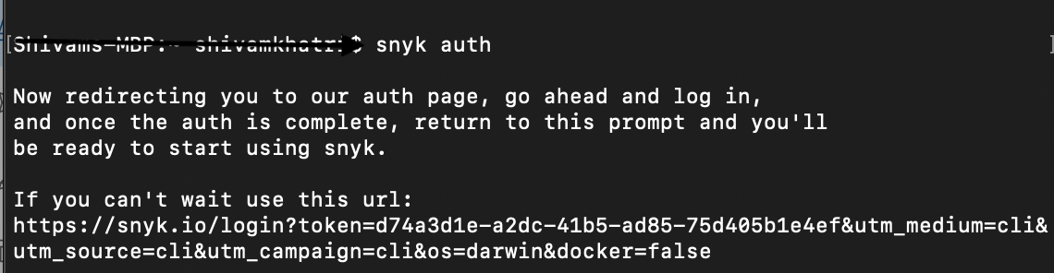
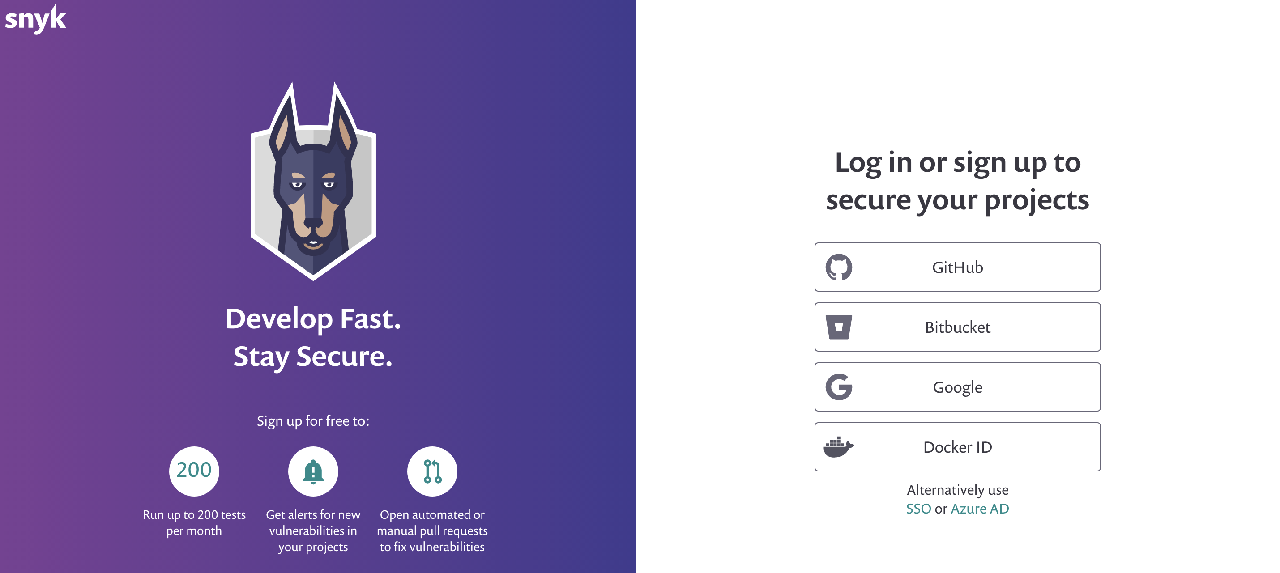
Screenshots
Snyk Auth Command-
It Redirects to the snyk web page for authentication-

Slide 5
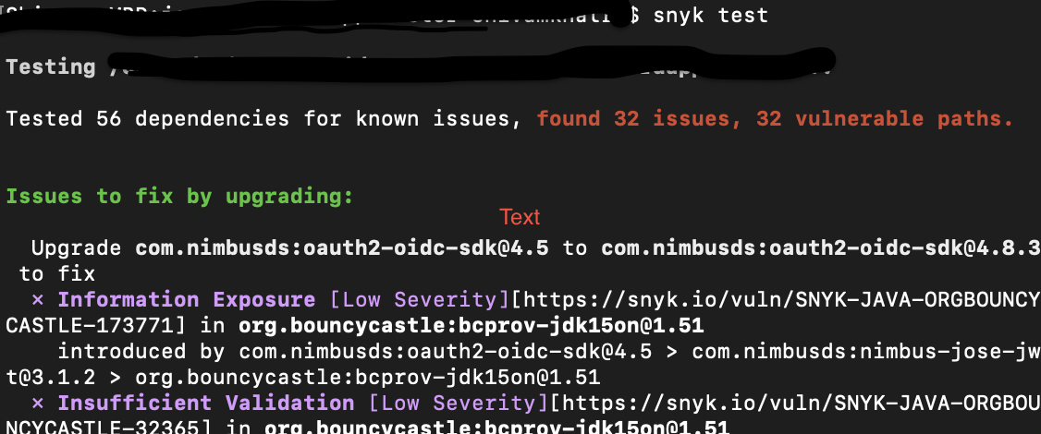
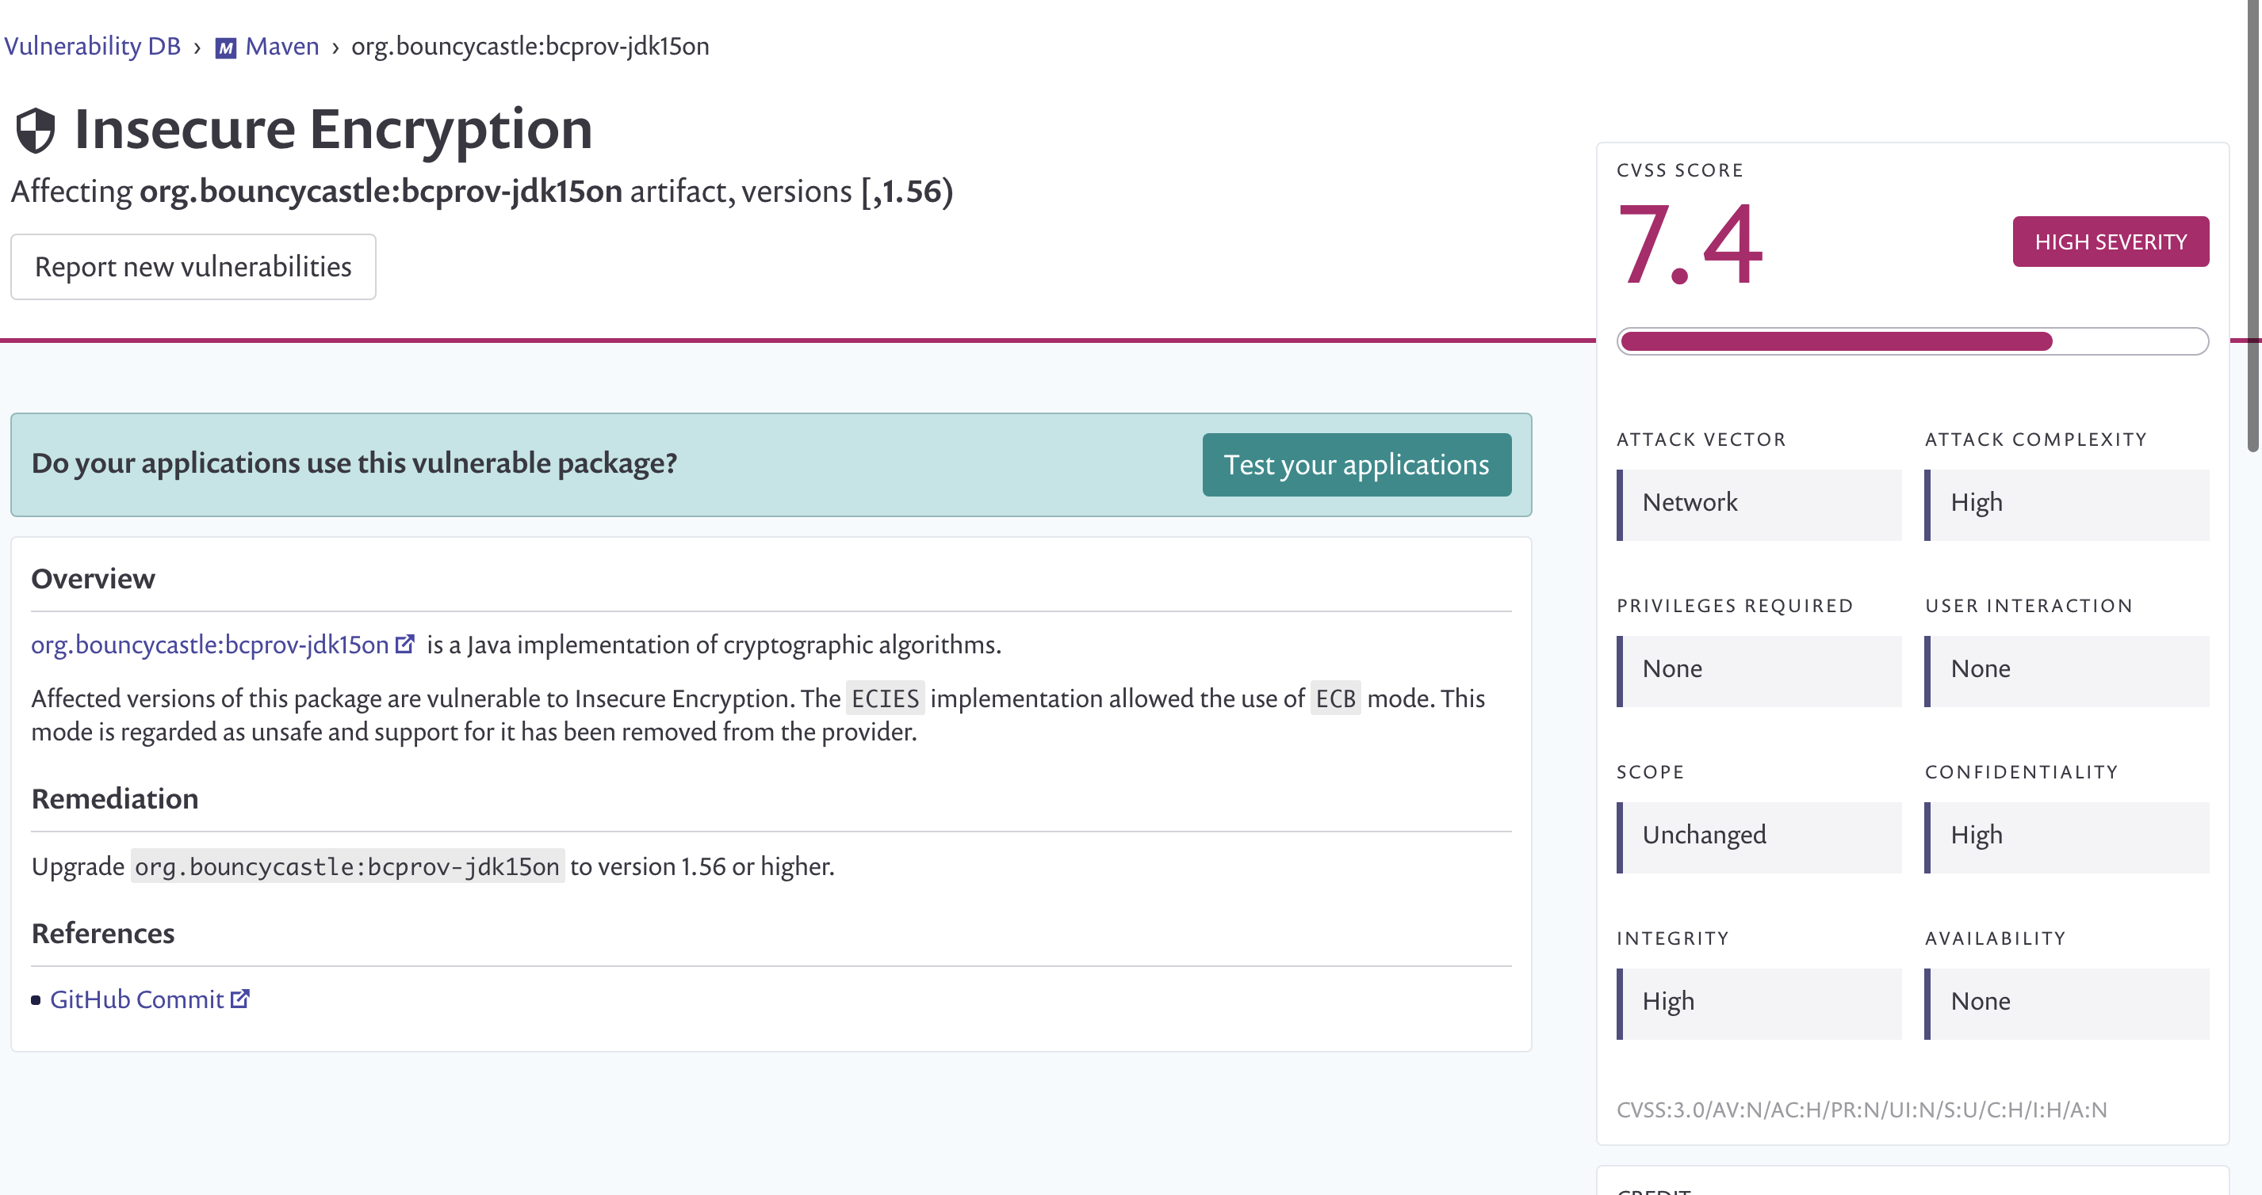
Screenshots
Open CL on the project and run Snyk Test Command-
Navigate to web page of any vulnerability to explore about it -

